Slide 1
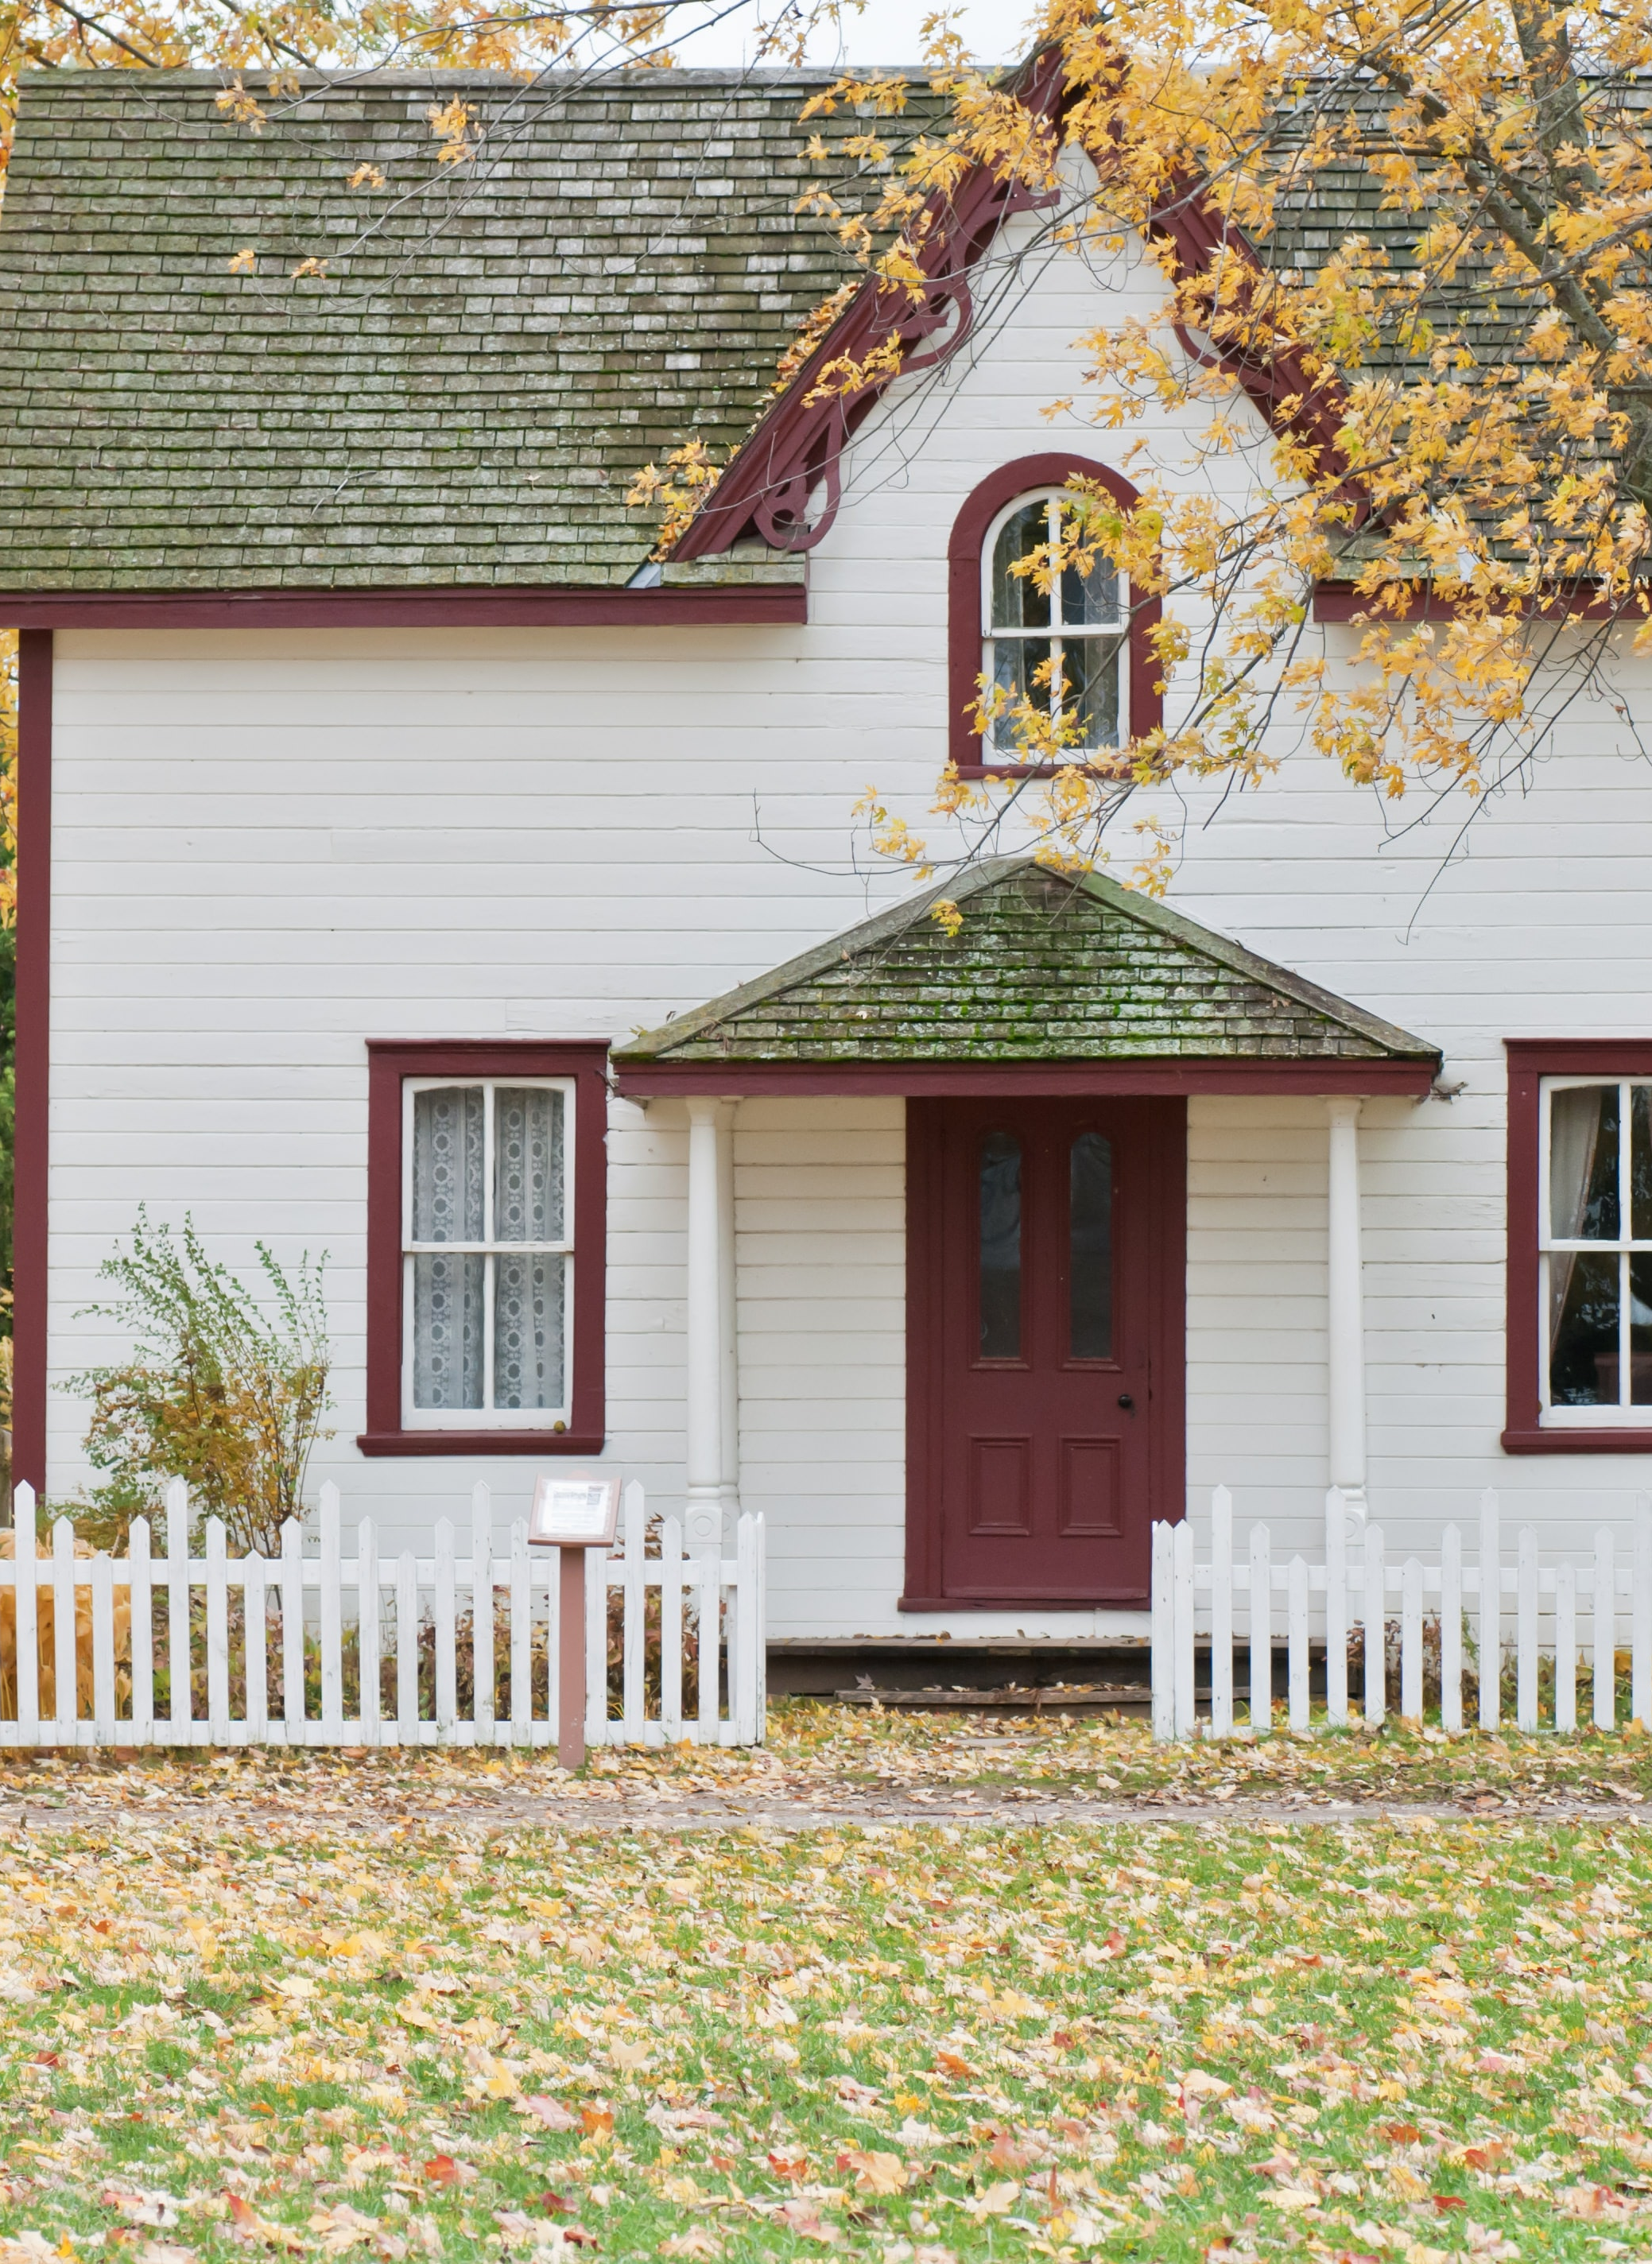
GA Data Science 1116
Dec. 14, 2020
Ames, Iowa
Home Pricing Analysis
Photo by:
https://unsplash.com/photos/1ddol8rgUH8?utm_source=unsplash&utm_medium=referral&utm_content=creditShareLink

Slide 2

Problem Statement
Ames, IA
Home to Iowa State University (33,000 students)
Congratulations on your new job!
Null hypothesis H₀:
There is a 5% or more premium to home prices in the seven neighborhoods closest to the Iowa State campus

Slide 3
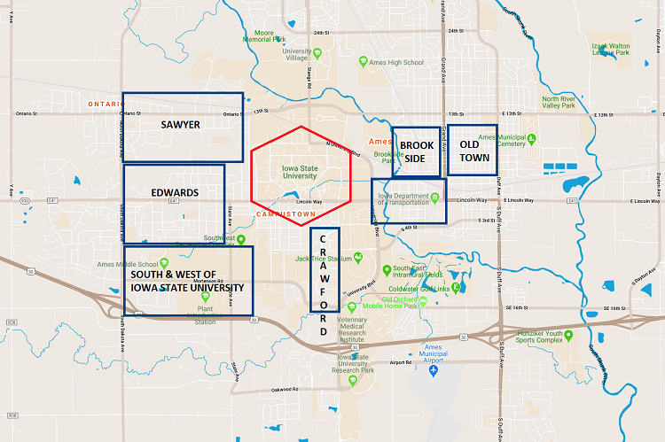
The three most important factors in real estate

Slide 4
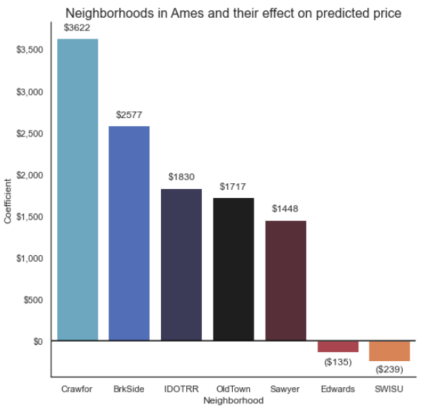
Modeling Results
Combined coefficient
value for all seven neighborhoods:
$3,122

Slide 5
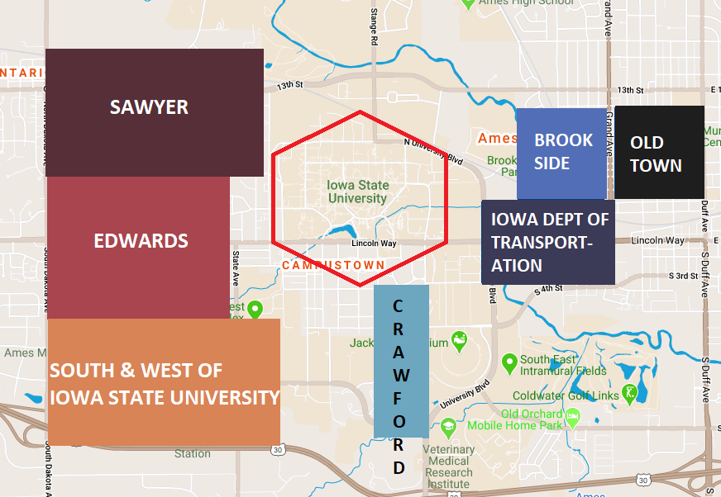
Coefficients:
Crawford - $3,622
Brook Side - $2,577
Iowa DOT - $1,830
Old Town – $1,717
Sawyer - $1,448
Edwards – ($135)
South & West – ($239)
Combined: $3,122

Slide 6
Conclusion
Null hypothesis H₀: There is a 5% or more premium to home prices in the six neighborhoods closest to the Iowa State campus
Average Sale Price (All houses in training set) : $180,995.11 5% = $9,049.76
Seven closest neighborhoods premium: $3,122
Reject the null hypothesis

Slide 7
Thank You! Questions or comments?
Paul Miller
Email pdmill@gmail.com
Phone 919-672-3099

