Slide 2
L
R

Slide 3
 |  | E | L | E | P | H | A | N | T
 | 0 | 1 | 2 | 3 | 4 | 5 | 6 | 7 | 8
R | 1 | 1 | 2 | 3 | 4 | 5 | 6 | 7 | 8
E | 2 | 1 | 2 | 2 | 3 | 4 | 5 | 6 | 7
L | 3 | 2 | 1 | 2 | 3 | 4 | 5 | 6 | 7
E | 4 | 3 | 2 | 1 | 2 | 3 | 4 | 5 | 6
V | 5 | 4 | 3 | 2 | 2 | 3 | 4 | 5 | 6
A | 6 | 5 | 4 | 3 | 3 | 3 | 3 | 4 | 5
N | 7 | 6 | 5 | 4 | 4 | 4 | 4 | 3 | 4
T | 8 | 7 | 6 | 5 | 5 | 5 | 5 | 4 | 3
E L E P H A N T
replace
R E L E V A N T
delete
insert
P

Slide 4


$$x$$
1 | 0 | 1 | 1 | 0 | 0 | 1 | 0 | 0 | 1
$$y$$
1 | 0 | 0 | 1 | 0 | 0 | 0 | 0 | 1 | 1

Slide 5
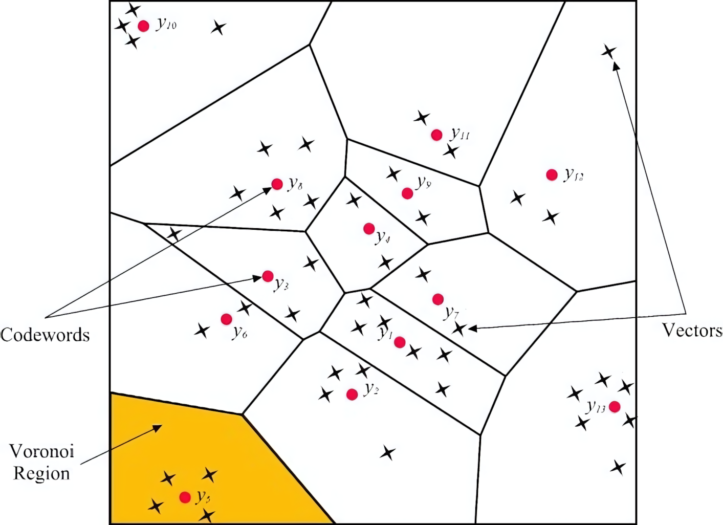


$$i\left(x\right)=argmin_{i}{\left|\left|x−c_{i}\right|\right|}^{2}$$
$$C=\{c_{1}, c_{2},…, c_{k}\}$$

Slide 6
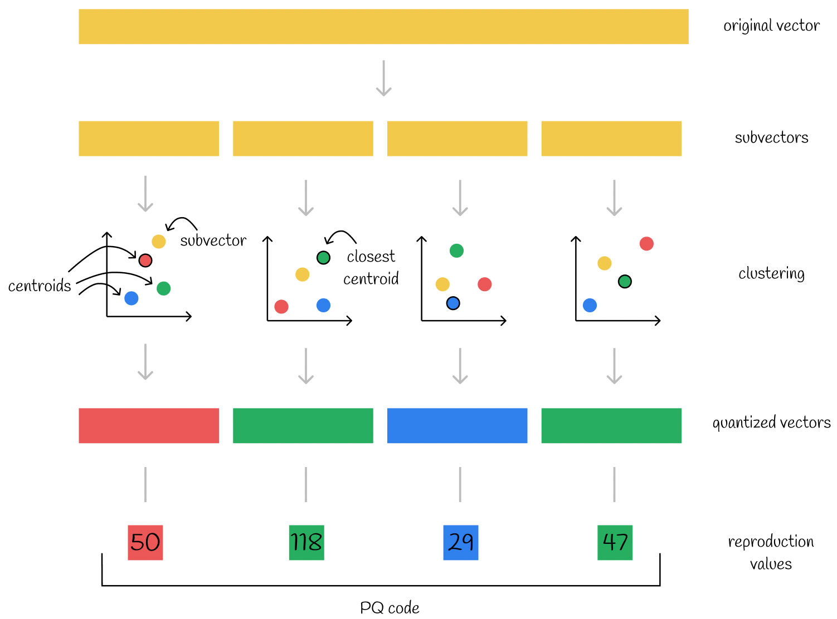











$$x ∈ℝ^{D}$$
$$x_{1}$$
$$x_{2}$$
$$…$$
$$x_{m}$$
$$\text{subvectors}{ x}_{j}∈ℝ^{d}$$
$$C_{j}={\{c}_{j,1},c_{j,2},…,c_{j,k}\}$$
$$q_{1}x_{1}$$
$$q_{2}x_{2}$$
$$…$$
$$q_{m}x_{m}$$

Slide 7


$$C_{right}$$
$$C$$
$$C$$
$$C_{left}$$

Slide 8




$$d$$
$$r$$
$$q$$
$$C$$

