Slide 1
Programming Contest

Slide 2
Programming contest
Many similar contests at MIT
  6.370
  6.270
  MASLAB
  Student-organized and student-run
  One of the major ways MIT students learn
Our contest is based on 1-day contest run by Trilogy as a recruiting event

Slide 3
6.370
Teams of students write programs that act as AIs in a videogame
AIs compete against each other
Videogame varies from year to year
1 month

Slide 4
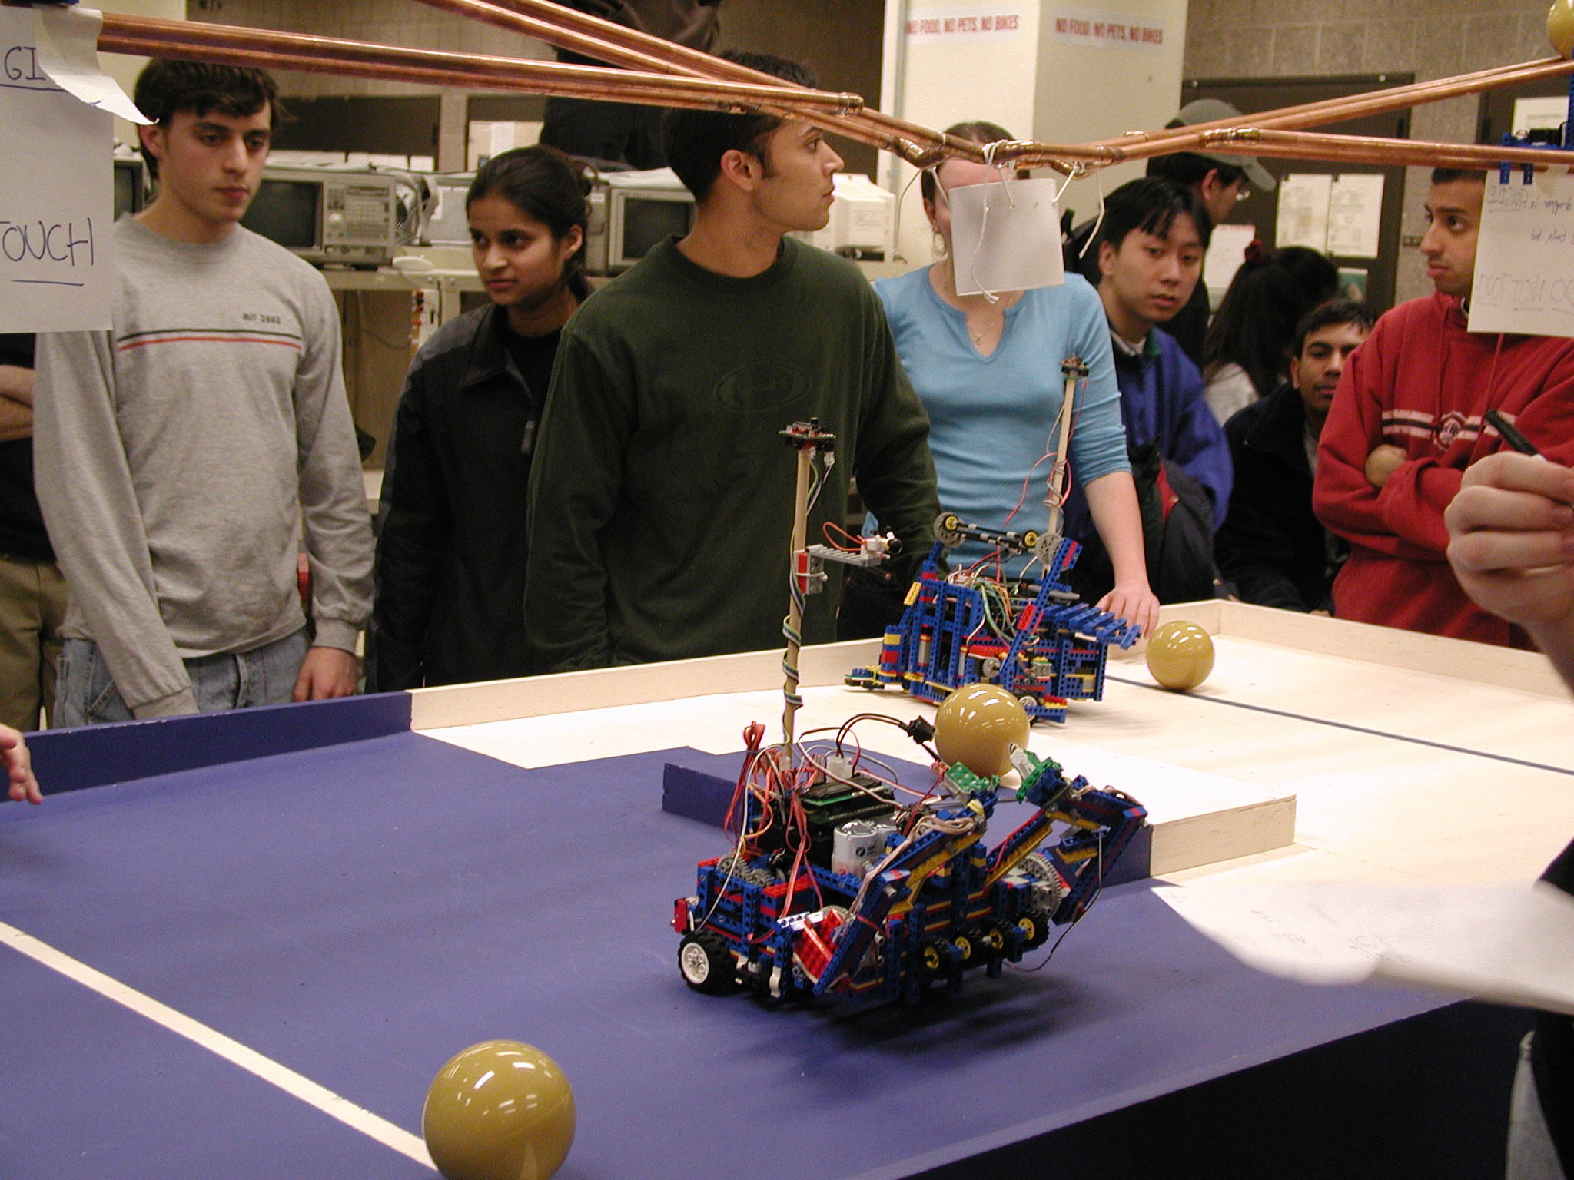
6.270
1 month
2-3 person teams
Lego robots (easy to build)
Autonomous (no remote control)
  Primarily programming competition
Robots compete head-to-head

Slide 5
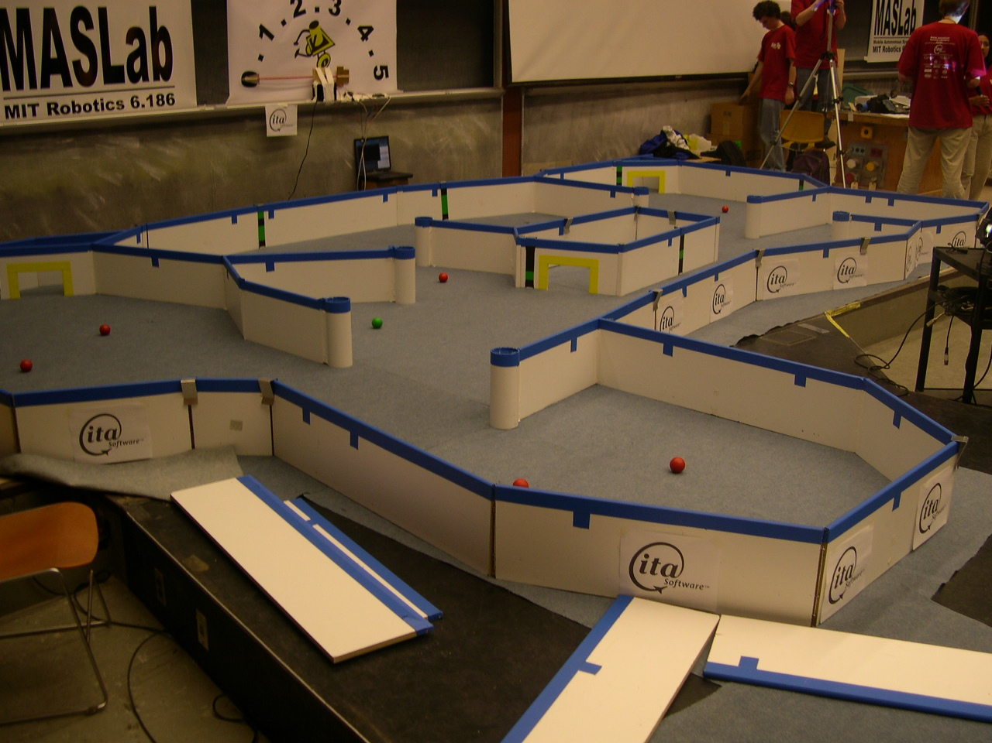
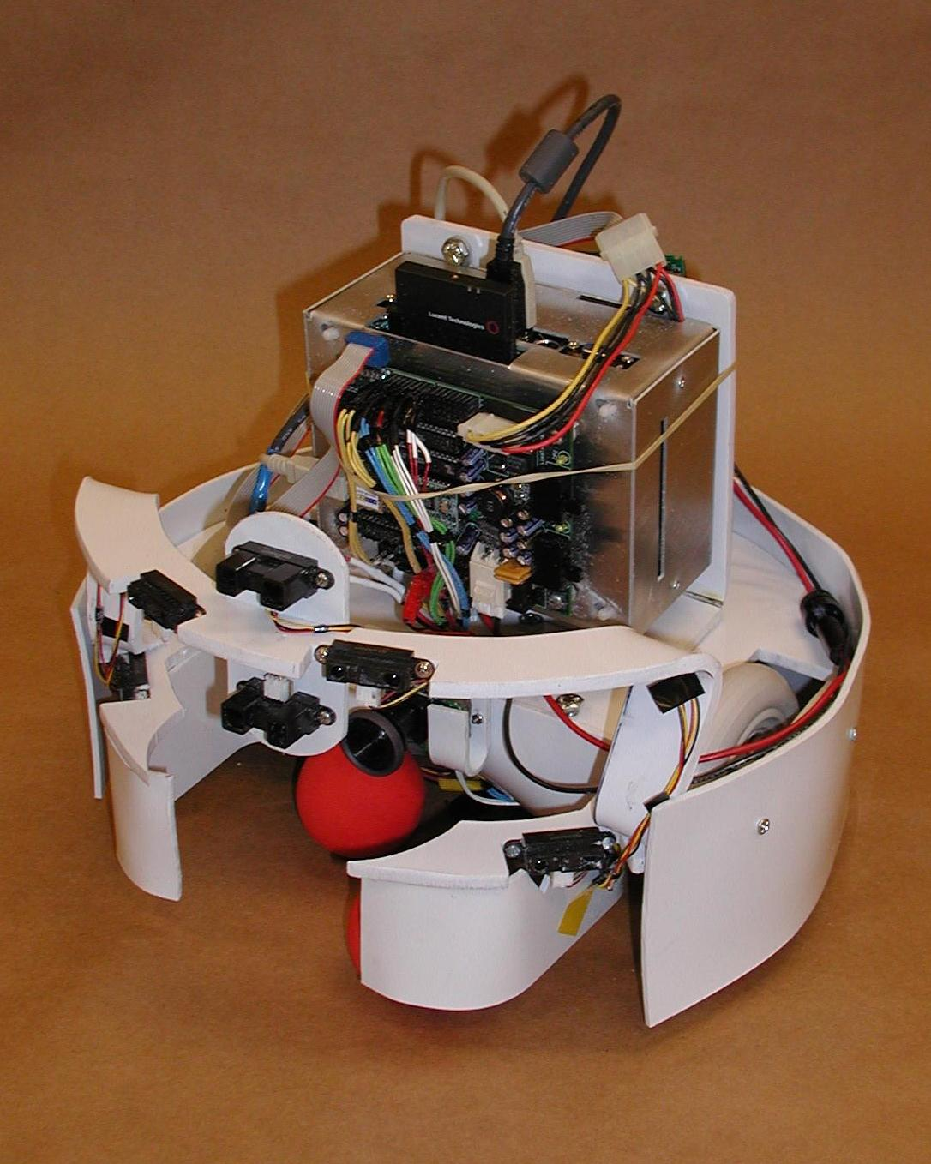
6.186: MASLab
1 month
4 person teams
Autonomous (no remote control)
  Primarily programming competition
Playing field unknown in advance
Single robot on the field

Slide 6
Programming contest
Many similar contests at MIT
  6.370
  6.270
  MASLAB
  Student-organized and student-run
  One of the major ways MIT students learn
Based on 1-day contest run by Trilogy as a recruiting event

Slide 7
Our contest
Similar to Pacman
Robots wander a maze, picking up points
Robots can also shoot each other
Hacked together quickly – fairly crude

Slide 8
Game Overview
4 robots in a maze – each player controls 2 of them.
Field starts full of points
Robots moving over points collect points
Robots may also shooy each other
AIs may be disqualified if they take more than 1 sec.

Slide 9
Sample game
[0 0] [0 0]
XXXXXXXXXXXXXXXXXXXX
XX....XXX...XXX...XX
XX....XXX...XXX...XX
XX.>........XXX...XX
XX....XXX.......<.XX
XX....XXX...XXX...XX
XXX.XXXXXXXXXXXX.XXX
XXX.XXXXXXXXXXXX.XXX
XX...XXXXXXXXXXX.XXX
XX...XXXXXXXXXXX.XXX
XX...XXXXXXXXXXX.XXX
XXX.XXXXXXXXXXXX.XXX
XXX.XXXXXXXXXXXX.XXX
X.....XXX...XXX....X
X.....XXX...XXX....X
X..>........XXX....X
X.....XXX.......<..X
X.....XXX...XXX....X
XXXXXXXXXXXXXXXXXXXX

Slide 10
Sample game
[1 1] [1 1]
XXXXXXXXXXXXXXXXXXXX
XX....XXX...XXX...XX
XX....XXX...XXX...XX
XX. >.......XXX...XX
XX....XXX......< .XX
XX....XXX...XXX...XX
XXX.XXXXXXXXXXXX.XXX
XXX.XXXXXXXXXXXX.XXX
XX...XXXXXXXXXXX.XXX
XX...XXXXXXXXXXX.XXX
XX...XXXXXXXXXXX.XXX
XXX.XXXXXXXXXXXX.XXX
XXX.XXXXXXXXXXXX.XXX
X.....XXX...XXX....X
X.....XXX...XXX....X
X..^........XXX....X
X.....XXX......< ..X
X.....XXX...XXX....X
XXXXXXXXXXXXXXXXXXXX

Slide 11
Sample game
[2 2] [1 2]
XXXXXXXXXXXXXXXXXXXX
XX....XXX...XXX...XX
XX....XXX...XXX...XX
XX. v.......XXX...XX
XX....XXX.....< .XX
XX....XXX...XXX...XX
XXX.XXXXXXXXXXXX.XXX
XXX.XXXXXXXXXXXX.XXX
XX...XXXXXXXXXXX.XXX
XX...XXXXXXXXXXX.XXX
XX...XXXXXXXXXXX.XXX
XXX.XXXXXXXXXXXX.XXX
XXX.XXXXXXXXXXXX.XXX
X.....XXX...XXX....X
X..^..XXX...XXX....X
X.. ........XXX....X
X.....XXX.....< ..X
X.....XXX...XXX....X
XXXXXXXXXXXXXXXXXXXX

Slide 12
Sample game
[2 3] [2 3]
XXXXXXXXXXXXXXXXXXXX
XX....XXX...XXX...XX
XX....XXX...XXX...XX
XX. .......XXX...XX
XX..V..XXX....< .XX
XX....XXX...XXX...XX
XXX.XXXXXXXXXXXX.XXX
XXX.XXXXXXXXXXXX.XXX
XX...XXXXXXXXXXX.XXX
XX...XXXXXXXXXXX.XXX
XX...XXXXXXXXXXX.XXX
XXX.XXXXXXXXXXXX.XXX
XXX.XXXXXXXXXXXX.XXX
X..^..XXX...XXX....X
X.. ..XXX...XXX....X
X.. ........XXX....X
X.....XXX....< ..X
X.....XXX...XXX....X
XXXXXXXXXXXXXXXXXXXX

Slide 13
Sample game
[3 4] [3 4]
XXXXXXXXXXXXXXXXXXXX
XX....XXX...XXX...XX
XX....XXX...XXX...XX
XX. .......XXX...XX
XX..<.XXX...< .XX
XX....XXX...XXX...XX
XXX.XXXXXXXXXXXX.XXX
XXX.XXXXXXXXXXXX.XXX
XX...XXXXXXXXXXX.XXX
XX...XXXXXXXXXXX.XXX
XX...XXXXXXXXXXX.XXX
XXX.XXXXXXXXXXXX.XXX
XXX^XXXXXXXXXXXX.XXX
X.. ..XXX...XXX....X
X.. ..XXX...XXX....X
X.. ........XXX....X
X.....XXX...< ..X
X.....XXX...XXX....X
XXXXXXXXXXXXXXXXXXXX

Slide 14
Sample game
[3 5] [4 5]
XXXXXXXXXXXXXXXXXXXX
XX....XXX...XXX...XX
XX....XXX...XXX...XX
XX. .......XXX...XX
XX.< .XXX..< .XX
XX....XXX...XXX...XX
XXX.XXXXXXXXXXXX.XXX
XXX.XXXXXXXXXXXX.XXX
XX...XXXXXXXXXXX.XXX
XX...XXXXXXXXXXX.XXX
XX...XXXXXXXXXXX.XXX
XXX^XXXXXXXXXXXX.XXX
XXX XXXXXXXXXXXX.XXX
X.. ..XXX...XXX....X
X.. ..XXX...XXX....X
X.. ........XXX....X
X.....XXX..< ..X
X.....XXX...XXX....X
XXXXXXXXXXXXXXXXXXXX

Slide 15
Sample game
[4 6] [5 6]
XXXXXXXXXXXXXXXXXXXX
XX....XXX...XXX...XX
XX....XXX...XXX...XX
XX. .......XXX...XX
XX. .XXX.< .XX
XX....XXX...XXX...XX
XXX.XXXXXXXXXXXX.XXX
XXX.XXXXXXXXXXXX.XXX
XX...XXXXXXXXXXX.XXX
XX...XXXXXXXXXXX.XXX
XX...XXXXXXXXXXX.XXX
XXX^XXXXXXXXXXXX.XXX
XXX XXXXXXXXXXXX.XXX
X.. ..XXX...XXX....X
X.. ..XXX...XXX....X
X.. ........XXX....X
X.....XXX.< ..X
X.....XXX...XXX....X
XXXXXXXXXXXXXXXXXXXX

Slide 16
Order of play
Robots over points get points
Robots rotate and move
Lasers fire

Slide 17
API
  (define mouser-sys (mouser-init))
  (get-input mouser-sys)
  ==> State of system
  (update-system commands)
  ==> State of system
  (deinit mouser-sys)

Slide 18
Suggestions
Start simple
Add strategy incremently
Cooperate with other teams
  Test your robots against each other
  Avoid secrecy

