Slide 1

PMIx: Process Management for Exascale Environments
Ralph H. Castain, David Solt, Joshua Hursey, Aurelien Bouteiller
EuroMPI/USA 2017, Chicago, IL

Slide 2
What is PMIx?
2015
2016
2017
RM
RM
SLURM
RM
SLURM
JSM
others
SLURM
JSM
ALPS
PMI-1
PMI-2
PMIx v1.2
PMIx v2.x
MPICH
years go by…
wireup support
dynamic spawn
keyval publish/lookup
Exascale systems
on horizon
Launch times long
New paradigms
OMPI
Spectrum
OSHMEM
OMPI
Spectrum
OSHMEM
SOS
PGAS
others
PGAS
others
Exascale launch
in < 30s
Exascale launch
in < 10s
Orchestration

Slide 3
Three Distinct Entities
PMIx Standard
  Defined set of APIs, attribute strings
  Nothing about implementation
PMIx Reference Library
  A full-featured implementation of the Standard
  Intended to ease adoption
PMIx Reference Server
  Full-featured “shim” to a non-PMIx RM

Slide 4










The Community
https://pmix.github.io/pmix
https://github.com/pmix

Slide 5

Traditional Launch Sequence
GO
Wait for files
& libs
FS
Global
Xchg
Barrier
Job
Script
WLM
WLM
RM
Spawn
Procs
Proc
Proc
Proc
Launch
Cmd
Fabric
Fabric
Fabric
NIC
NIC
NIC
Topo
Topo
Topo

Slide 6
Newer Launch Sequence
GO
Wait for files
& libs
FS
Proxy
Proxy
Proxy
Global
Xchg
Barrier
Spawn
Procs
Proc
Proc
Proc
Job
Script
WLM
WLM
RM
Proc
Proc
Proc
Launch
Cmd
Fabric
Fabric
Fabric
NIC
NIC
NIC
Topo
Topo
Topo

Slide 7
PMIx-SMS Interactions
System
Management Stack
OpenMP
FS
RM
Fabric
Mgr
Orchestration
Requests
PMIx
Client
PMIx
Server
Fabric
APP
NIC
Responses
MPI
RAS
Job
Script
Tool Support

Slide 8
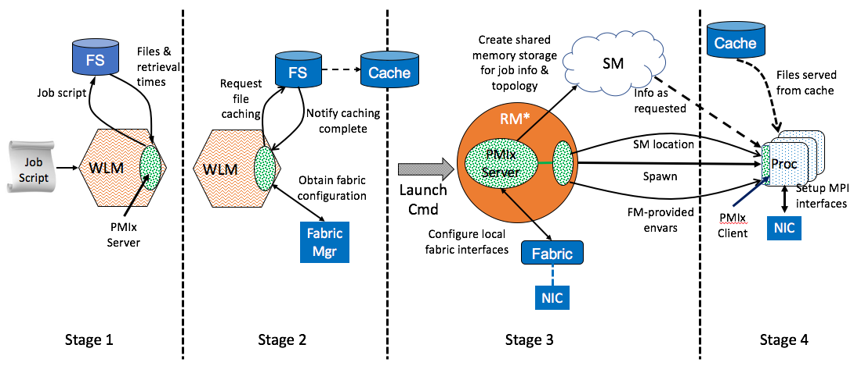
PMIx Launch Sequence
*RM daemon, mpirun-daemon, etc.

Slide 9
PMIx/SLURM*
Performance papers coming in 2018!
MPI_Init (sec)
PRS**
srun/PMI2
#nodes
*LANL/Buffy cluster, 1ppn
**PMIx Reference Server v2.0, direct-fetch/async

Slide 10
Similar Requirements
Notifications/response
  Errors, resource changes
  Negotiated response
Request allocation changes
  shrink/expand
Workflow management
  Steered/conditional execution
QoS requests
  Power, file system, fabric
Multiple, use-specific libs?
(difficult for RM community to support)
Single, multi-purpose lib?

Slide 11
PMIx “Standards” Process
Modifications/additions
  Proposed as RFC
  Include prototype implementation
    Pull request to reference library
  Notification sent to mailing list
Reviews conducted
  RFC and implementation
  Continues until consensus emerges
Approval given
  Developer telecon (weekly)
Standards Doc under development!

Slide 12
Philosophy
Generalized APIs
  Few hard parameters
  “Info” arrays to pass information, specify directives
Easily extended
  Add “keys” instead of modifying API
Async operations
Thread safe
SMS always has right to say “not supported”
  Allow each backend to evaluate what and when to support something

Slide 13

Messenger not Doer
Generalized APIs
  Few hard parameters
  “Info” arrays to pass information, specify directives
Easily extended
  Add “keys” instead of modifying API
Async operations
Thread safe
SMS always has right to say “not supported”
  Allow each backend to evaluate what and when to support something
SMS
APP
Tool

Slide 14
Current Support
Typical startup operations
  Put, get, commit, barrier, spawn, [dis]connect, publish/lookup
Tool connections
  Debugger, job submission, query
Generalized query support
  Job status, layout, system data, resource availability
Event notification
  App, system generated
  Subscribe, chained
  Pre-emption, failures, timeout warning, …
Logging (job record)
  Status reports, error output
Flexible allocations
  Release resources, request resources

Slide 15
Event Notification Use Case
Fault detection and reporting w/ULFM MPI
  ULFM MPI is a fault tolerant flavor of Open MPI
Failures may be detected from the SMS, RAS, or directly by MPI communications
Components produce a PMIx event when detecting an error
Fault Tolerant components register for the fault event
Components propagate fault events which are then delivered to registered clients
MPI
MPI
PMIx
Server
PMIx
Server
PMIx
RAS

Slide 16
In Pipeline
Network support
  Security keys, pre-spawn local driver setup, fabric topology and status, traffic reports, fabric manager interaction
Obsolescence protection
  Automatic cross-version compatibility
  Container support
Job control
  Pause, kill, signal, heartbeat, resilience support
Generalized data store
File system support
  Dependency detection
  Tiered storage caching strategies
Debugger/tool support⁺⁺
  Automatic rendezvous
  Single interface to all launchers
  Co-launch daemons
  Access fabric info, etc.
Cross-library interoperation

Slide 17
Summary
We now have an interface library RMs will support for application-directed requests
Need to collaboratively define what we want to do with it
Project: https://pmix.github.io/pmix
Reference Implementation: https://github.com/pmix/pmix
Reference Server: https://github.com/pmix/pmix-reference-server

