Slide 1

Process Management
Interface – Exascale

Slide 2
Agenda
Overview
  Introductions
  Vision/objectives
Performance status
Integration status
Roadmap
Malleable application support
Wrap-Up/Open Forum

Slide 3





PMIx – PMI exascale
Collaborative open source effort led by Intel, Mellanox Technologies, IBM, Adaptive Computing, and SchedMD.
New collaborators are most welcome!

Slide 4
Contributors
Intel
  Ralph Castain
  Annapurna Dasari
Mellanox
  Joshua Ladd
  Artem Polyakov
  Elena Shipunova
  Nadezhda Kogteva
  Igor Ivanov
HP
  David Linden
  Andy Riebs
IBM
  Dave Solt
Adaptive Computing
  Gary Brown
RIST
  Gilles Gouaillardet
SchedMD
  David Bigagli
LANL
  Nathan Hjelmn

Slide 5
Motivation
Exascale launch times are a hot topic
  Desire: reduce from many minutes to few seconds
  Target: O(10⁶) MPI processes on O(10⁵) nodes thru MPI_Init in < 30 seconds
New programming models are exploding
  Driven by need to efficiently exploit scale vs. resource constraints
  Characterized by increased app-RM integration

Slide 6
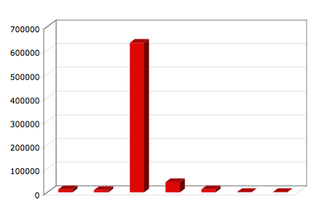
MPI_Init
MPI_Finalize
Time (μsec)
Exchange MPI contact info
Setup MPI structures
mpi_init completion
Initialization
Launch
barrier
barrier
RRZ, 16-nodes, 8ppn, rank=0

Slide 7
What Is Being Shared?
Job Info (~90%)
  Names of participating nodes
  Location and ID of procs
  Relative ranks of procs (node, job)
  Sizes (#procs in job, #procs on each node)
Endpoint info (~10%)
  Contact info for each supported fabric
Known to local RM daemon
Can be computed for many fabrics

Slide 8
Stage I
MPI_Init
MPI_Finalize
Provide method for RM to share job info
Work with fabric and library implementers to compute endpt from RM info
Time (μsec)
Exchange MPI contact info
Setup MPI structures
mpi_init completion
Initialization
Launch
barrier
barrier
RRZ, 16-nodes, 8ppn, rank=0

Slide 9
Stage II
MPI_Init
MPI_Finalize
Add on 1st communication
(non-PMIx)
Time (μsec)
Exchange MPI contact info
Setup MPI structures
mpi_init completion
Initialization
Launch
barrier
barrier
RRZ, 16-nodes, 8ppn, rank=0

Slide 10
Stage III
MPI_Init
MPI_Finalize
Use HSN+Coll
Time (μsec)
Exchange MPI contact info
Setup MPI structures
mpi_init completion
Initialization
Launch
barrier
barrier
RRZ, 16-nodes, 8ppn, rank=0

Slide 11
Changing Needs
Notifications/response
  Errors, resource changes
  Negotiated response
Request allocation changes
  shrink/expand
Workflow management
  Steered/conditional execution
QoS requests
  Power, file system, fabric
Multiple, use-specific libs?
(difficult for RM community to support)
Single, multi-purpose lib?

Slide 12
Objectives
Establish an independent, open community
  Industry, academia, lab
Standalone client/server libraries
  Ease adoption, enable broad/consistent support
  Open source, non-copy-left
  Transparent backward compatibility
Support evolving programming requirements
Enable “Instant On” support
  Eliminate time-devouring steps
  Provide faster, more scalable operations

Slide 13

Today’s Goal
Inform the community
Solicit your input on the roadmap
Get you a little excited
Encourage participation

Slide 14
Agenda
Overview
  Introductions
  Vision/objectives
Performance status
Integration/development status
Roadmap
Malleable/Evolving application support
Wrap-Up/Open Forum

Slide 15
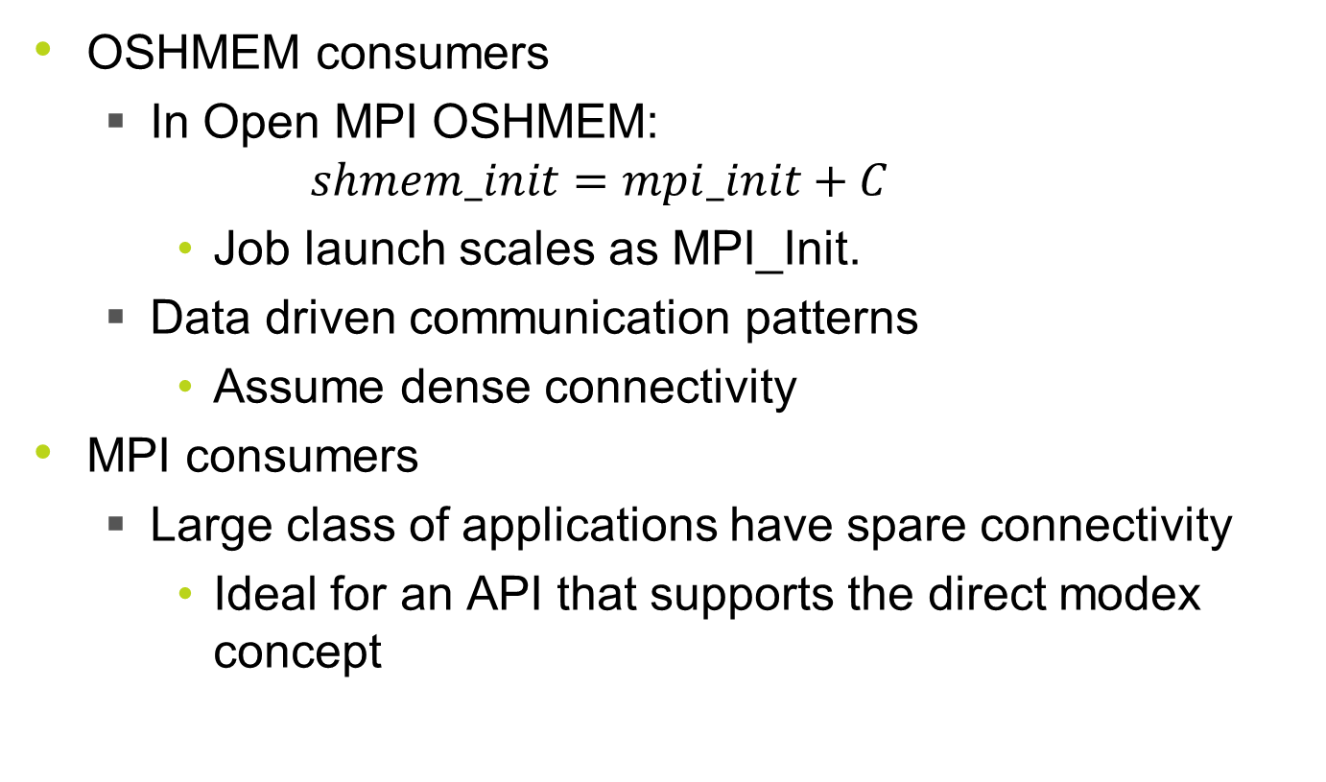
PMIx End Users
OSHMEM consumers
  In Open MPI OSHMEM:
    $$shmem_init=mpi_init+C$$
    Job launch scales as MPI_Init.
  Data driven communication patterns
    Assume dense connectivity
MPI consumers
  Large class of applications have spare connectivity
    Ideal for an API that supports the direct modex concept

Slide 16
What’s been done
Worked closely with customers, OEMs, and open source community to design a scalable API that addresses measured limitations of PMI2
  Data driven design.
Led to the PMIx v1.0 API
Implementation and imminent release of PMIx v1.1
  November 2015 release scheduled.
Significant architectural changes in Open MPI to support direct modex
  “Add procs” in bulk MPI_Init → “Add proc” on-demand on first use outside MPI_init.
  Available in the OMPI v2.x release Q1 2016.
Integrated PMIx into Open MPI v2.x
  For native launching as well as direct launching under supported RMs.
  For mpirun launched jobs, ORTE implements PMIx callbacks.
  For srun launched jobs, SLURM implements PMIx callbacks in the PMIx plugin.
  Client side framework added to OPAL with components for
    Cray PMI
    PMI1
    PMI2
    PMIx
    backwards compatibility with PMI1 and PMI2.
Implemented and submitted upstream SLURM PMIx plugin
  Currently available in SLURM Head
  To be released in SLURM 16.05
  Client side PMIx Framework and S1, S2, PMIxxx components in OPAL
PMIx unit tests integrated into Jenkins test harness

Slide 17
srun --mpi=xxx hello_world
Stage I-II

Slide 18
srun --mpi=pmix ./hello_world
Stage I-II

Slide 19
mpirun/oshrun ./hello_world

Slide 20
Conclusions
API is implemented and performing well in a variety of settings
  Server integrated in OMPI for native launching and in SLURM as PMIx plugin for direct launching.
PMIx shows improvement over other state-of-the-art PMI2 implementations when doing a full modex
  Data blobs versus encoded metakeys
  Data scoping to reduce the modex size
PMIx supported direct modex significantly outperforms full modex operations for BTL/MTLs that can support this feature
Direct modex still scales as O(N)
Efforts and energy should be focused on daemon bootstrap problem
Instant-on capabilities could be used to further reduce deamon bootstrap time

Slide 21
Next Steps
Leverage PMIx features
Reduce modex size with data scoping
Change MTL/PMLs to support direct modex
Investigate the impact of direct modex on densely connected applications
Continue to improve collective performance
  Still need to have a scalable solution
Focus more efforts on the daemon bootstrap problem – this becomes the limiting factor moving to exascale
  Leverage instant-on here as well

Slide 22
Agenda
Overview
  Introductions
  Vision/objectives
Performance status
Integration/development status
Roadmap
Malleable application support
Wrap-Up/Open Forum

Slide 23
Client Implementation Status
PMIx 1.1.1 released
  Complete API definition
    Future-proof API’s with Info array/length parameter for most calls
    Blocking/non-blocking versions of most calls
    Picked up by Fedora, others to come
PMIx MPI clients launched/tested with
  ORTE (indirect) / ORCM (direct launch)
  SLURM servers (direct launch)
  IBM PMIx server (direct launch)

Slide 24
Server Implementation Status
Server implementation time is greatly reduced through the PMIx convenience library
  Handles all server/client interactions
  Handles many PMIx requests that can be handled locally
  Bundles many off-host requests
Optional
  RMs free to implement their own

Slide 25
Server Implementation Status
Moab
  Integrated PMIx server in scheduler/launcher
  Currently integrating PMIx effort with Moab
  Scheduled for general availability: no time set
ORTE/ORCM
  Full embedded PMIx reference server implementation
  Scheduled for release with v2.0

Slide 26
Server Implementation Status
SLURM
  PMIx support for initial job launch/wireup currently developed & tested
  Scheduled for GA: 16.05 release
IBM/LSF
  CORAL
    PMIx support for initial job launch/wireup currently developed & tested w/PM
    Full PMIx support planned for CORAL
  Integration to LSF to follow (TBD)

Slide 27
Agenda
Overview
  Introductions
  Vision/objectives
Performance status
Integration/development status
Roadmap
Malleable/Evolving application support
Wrap-Up/Open Forum

Slide 28
Scalability
Memory footprint
  Distributed database for storing Key-Values
    Memory cache, DHT, other models?
  One instance of database per node
    "zero-message" data access using shared-memory
Launch scaling
  Enhanced support for collective operations
    Provide pattern to host, host-provided send/recv functions, embedded inter-node comm?
  Rely on HSN for launch, wireup support
    While app is quiescent, then return to OOB

Slide 29
Flexible Allocation Support
Request additional resources
  Compute, memory, network, NVM, burst buffer
  Immediate, forecast
  Expand existing allocation, separate allocation
Return extra resources
  No longer required
  Will not be used for some specified time, reclaim (handshake) when ready to use
Notification of preemption
  Provide opportunity to cleanly pause

Slide 30
I/O Support
Asynchronous operations
  Anticipatory data fetch, staging
  Advise time to complete
  Notify upon available
Storage policy requests
  Hot/warm/cold data movement
  Desired locations and striping/replication patterns
  Persistence of files, shared memory regions across jobs, sessions
  ACL to generated data across jobs, sessions

Slide 31
Spawn Support
Staging support
  Files, libraries required by new apps
  Allow RM to consider in scheduler
    Current location of data
    Time to retrieve and position
    Schedule scalable preload
Provisioning requests
  Allow RM to consider in selecting resources, minimize startup time due to provisioning
  Desired image, packages

Slide 32
Network Integration
Quality of service requests
  Bandwidth, traffic priority, power constraints
  Multi-fabric failover, striping prioritization
  Security requirements
    Network domain definitions, ACLs
Notification requests
  State-of-health
  Update process endpoint upon fault recovery
Topology information
  Torus, dragonfly, …

Slide 33
Power Control/Management
Application requests
  Advise of changing workload requirements
  Request changes in policy
  Specify desired policy for spawned applications
  Transfer allocated power to specifed job
RM notifications
  Need to change power policy
    Allow application to accept, request pause
  Preemption notification
Provide backward compatibility with PowerAPI

Slide 34
PMIx: Fault Tolerance
Notification
  App can register for error notifications, incipient faults
    RM will notify when app would be impacted
    App responds with desired action
      Terminate/restart job, wait for checkpoint, etc.
    RM/app negotiate final response
  App can notify RM of errors
    RM will notify specified, registered procs
Restart support
  Specify source (remote NVM checkpoint, global filesystem, etc)
  Location hints/requests
  Entire job, specific processes

Slide 35
Agenda
Overview
  Introductions
  Vision/objectives
Performance status
Integration/development status
Roadmap
Malleable/Evolving application support
Wrap-Up/Open Forum

Slide 36
Job Types
Rigid
Moldable
Malleable
Evolving
Adaptive (Malleable + Evolving)

Slide 37
Job Type Characteristics
Resource Allocation Type
  Static
  Dynamic
Who Decides | When it is decided
 | At job submission (static allocation) | During job execution (dynamic allocation)
User | Rigid | Evolving
Scheduler | Moldable | Malleable

Slide 38
Rigid Job
Job Resources
  4 nodes
  60 minutes
8
7
6
5
4
3
2
1
0 15 30 45 60 75 90 105 120 135 150 165 180 195 210 225 240

Slide 39
Moldable Job
Job Resources
  4 nodes/60 min
  2 nodes/120 min
  1 node/240 min
8
7
6
5
4
3
2
1
0 15 30 45 60 75 90 105 120 135 150 165 180 195 210 225 240

Slide 40
Malleable Job
Job Resources
  1-8 nodes
  1000 node-min
8
7
6
5
4
3
2
1
0 15 30 45 60 75 90 105 120 135 150 165 180 195 210 225 240

Slide 41
Evolving Job
Job Resources
  1-8 nodes
  1000 node-min
8
Phases A, B, C and D (each phase 2x nodes of previous phase)
D
7
6
5
4
C
3
2
B
1
A
0 15 30 45 60 75 90 105 120 135 150 165 180 195 210 225 240

Slide 42
Adaptive Job
Job Resources
  1-8 nodes
  1000 node-min
8
Phases A, B, C and D (each phase 2x nodes of previous phase)
D₁
7
6
Scheduler takes 4 nodes halfway through Phase D and phase D₂ takes 2x as long as phase D₁
5
4
C
D₂
3
2
B
1
A
0 15 30 45 60 75 90 105 120 135 150 165 180 195 210 225 240

Slide 43
Motivations
New Programming Models
New Algorithmic Techniques
Unconventional Cluster Architectures

Slide 44
Adaptive Mesh Refinement
  Granularity
  Node Allocation
Coarse
➔
Medium
➔
Fine
Few (1)
➔
Some (4)
➔
Many (64)

Slide 45
Master/Slaves
Master
Slave
Slave
Slave
Slave
Slave
Slave
Slave
Slave
Slave
Slave
Slave
Slave
Slave
Slave
Slave
Slave
Slave
Slave

Slide 46
Secondary Simulations
8
7
Sim₂
Sim₂
6
5
Sim₂
Sim₂
4
3
2
1
Primary Simulation
0 15 30 45 60 75 90 105 120 135 150 165 180 195 210 225 240

Slide 47
Unconventional Architectures
Cluster Booster
  Many-core “Booster”
  Multi-core “Cluster”
Multi-core jobs dynamically
burst out to parallel “booster”
nodes with accelerators
Same Network Domain

Slide 48
Apps, RTEs and Archs
Applications
RTEs
Astrophysics
Brain simulation
Climate simulation
Flow solvers (QuadFlow)
Hydrodynamics (Lulesh)
Molecular Dynamics (NAMD)
Water reservoir storage/flow
Wave propagation (Wave2D)
Charm++
OmpSs
Uintah
Radical-Pilot
Architectures
EU DEEP/DEEP-ER

Slide 49
Scheduler/Malleable Job Dialog
Expand resource allocation
Contract resource allocation
Scheduler
Expand (more)
Application
Application
Response
Scheduler
Contract (less)
Application
Application
Response

Slide 50
Scheduler/Evolving Job Dialog
Grow resource allocation
Shrink resource allocation
Scheduler
Grow (more)
Application
Application
Response
Scheduler
Shrink (less)
Application
Application
Response

Slide 51
Adaptive Job Race Condition
Reason for naming convention
  Prevent ambiguity and confusion
?
Scheduler
Grow (more)
Application
Application
Grow (more)
Expand (more)

Slide 52
Need for Standard API
MPI: standard API for parallel communication
Need standard API for application / scheduler resource management dialogs
  Same API for applications
  Scheduler-specific API implementations
Scheduler and Malleable/Evolvable Application Dialog (SMEAD) API
  Make part of PMIx
  Need application use cases

Slide 53
Interested Parties
Adaptive Computing (Moab scheduler, TORQUE RM, Nitro)
Altair (PBS Pro scheduler/RM)
Argonne National Laboratory (Cobalt scheduler)
HLRS at University of Stuttgart
Jülich Supercomputing Centre (DEEP-ER)
Lawrence Livermore National Laboratory (Flux scheduler)
Partec (ParaStation)
SchedMD (Slurm scheduler/RM)
TU Darmstadt Laboratory for Parallel Programming
UK Atomic Weapons Establishment (AWE)
University of Cambridge COSMOS
University of Illinois at Urbana-Champaign Parallel Programming Laboratory (Charm++ RTE)
University of Utah SCI Institute (Uintah RTE)

Slide 54
URLs
Need your help to design a standard API!
  Malleable/Evolving Application Use Case Survey
  http://goo.gl/forms/lq85y3SkV3 (Google Form)
Info on adaptive job types and scheduling
  4-part blog about malleable / evolving / adaptive jobs and schedulers
  http://www.adaptivecomputing.com/series/
  malleable-and-evolving-jobs/

Slide 55
Agenda
Overview
  Introductions
  Vision/objectives
Performance status
Integration/development status
Roadmap
Malleable/Evolving application support
Wrap-Up/Open Forum

Slide 56
Bottom Line
We now have an interface library the RMs will support for application-directed requests
Need to collaboratively define what we want to do with it
For any programming model
MPI, OSHMEM, PGAS,…

Slide 57
Contribute or Follow Along!
Project: https://pmix.github.io/master
Code: https://github.com/pmix
Contributors/collaborators
are welcomed!

