Slide 1

PMIx: Process Management for Exascale Environments

Slide 2
Agenda
State of the Community
  Ralph H. Castain (Intel)
Scaled Performance
  Aurelien Bouteiller (UTK)
PMIx Standards Document
  Josh Hursey (IBM)
Q&A

Slide 3
Three Distinct Entities
PMIx Standard
  Defined set of APIs, attribute strings
  Nothing about implementation
PMIx Reference Library
  A full-featured implementation of the Standard
  Intended to ease adoption
PMIx Reference Server
  Full-featured “shim” to a non-PMIx RM
  Provides development environment
Standards Doc under development!

Slide 4
Where Are We?
Launch scaling
  Wireup enhancements complete
  Fabric “instant on” enablement underway
Results
  Tracks spawn propagation time
  Exascale in < 5 seconds
  3rd party confirmation
EuroMPI 2017 Overview Article*
*extended version to be published

Slide 5
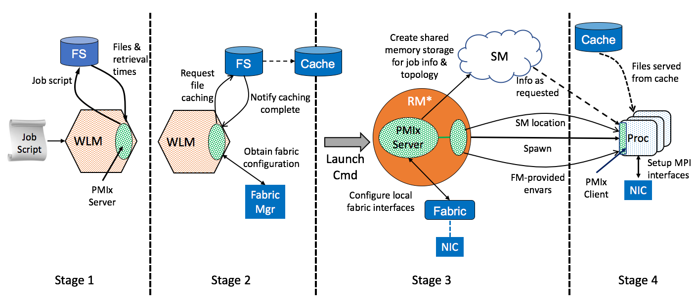
PMIx Launch Sequence
*RM daemon, mpirun-daemon, etc.

Slide 6
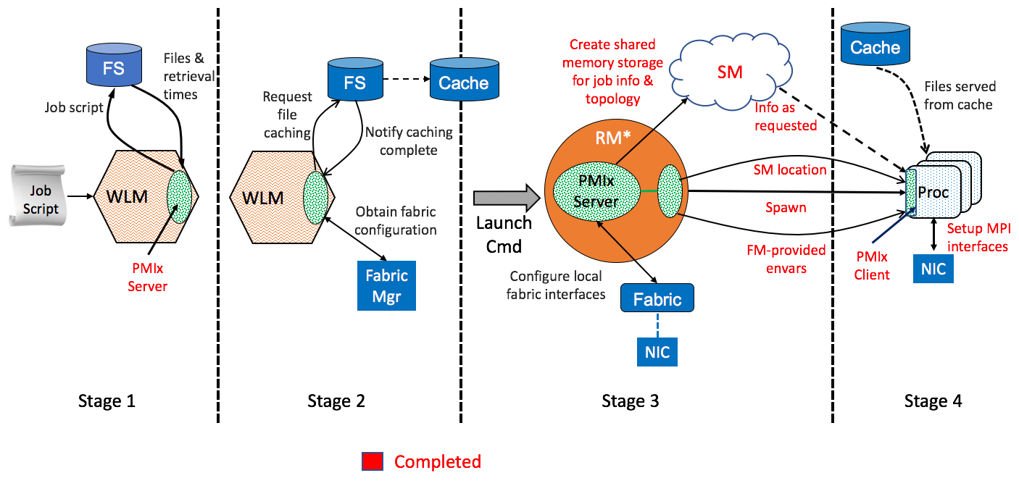
PMIx Launch Sequence
*RM daemon, mpirun-daemon, etc.

Slide 7
Current Support (I)
Typical startup operations
  Put, get, commit, barrier, spawn, [dis]connect, publish/lookup
Tool connections
  Debugger, job submission, query
Generalized query support
  Job status, layout, system data, resource availability
Event notification
  App, system generated
  Subscribe, chained
  Preemption, failures, timeout warning, …
Logging
  Status reports, error output
Flexible allocations
  Release resources, request resources

Slide 8
Current Support (II)
Network support
  Security keys, pre-spawn local driver setup
Obsolescence protection
  Automatic cross-version compatibility
  Container support
Job control
  Pause, kill, signal, heartbeat, resilience support (C/R coordination)
Async definition of process groups
  Rolling startup/teardown

Slide 9
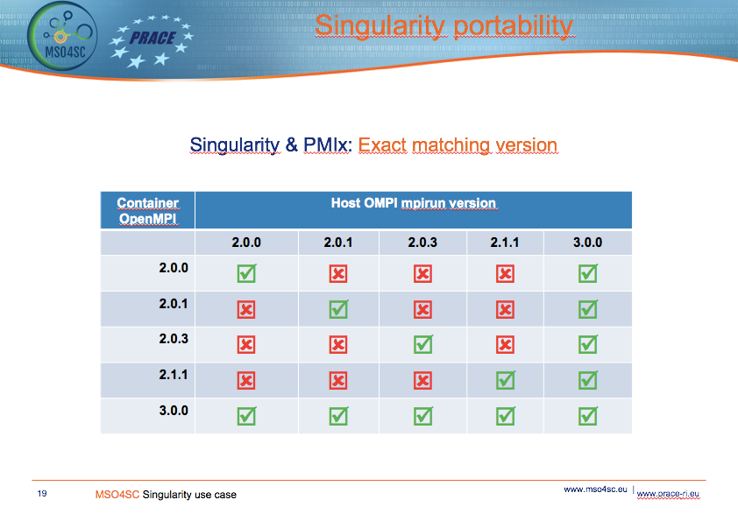
1.2.5
1.2.5
1.2.5
1.2.5
2.1
PMIX version
Should be all ☑
going forward
Courtesy of:
Víctor Sande Veiga
Supercomputing Center of Galicia

Slide 10
Cross-Version Interoperability
PMIx v1.1.5
PMIx v1.2.5⁺
PMIx v2.0.3⁺
PMIx v2.1.x
PMIx v3.0.x
Server >= Client
Any client/server
combination

Slide 11
In Pipeline
Network support
  Fabric topology and status, traffic reports, fabric manager interaction
MPI Sessions support
  Rolling startup/teardown
Generalized data store
  Distributed key-value storage
Security
  Obtain and validate credentials for application/SMS
Power directives
File system support
  Dependency detection
  Tiered storage caching strategies
Debugger/tool support⁺⁺
  Automatic rendezvous
  Single interface to all launchers
  Co-launch daemons
  Access fabric info, etc.
Cross-library interoperation
  OpenMP/MPI coordination
Nearing completion
Ramping up
Idling

Slide 12
Adoption
RMs
  SLURM, IBM’s Job Step Manager (JSM) complete
  Fujitsu underway, Altair ramping up
Libraries
  Open MPI, OSHMEM, SOS complete
  GASNet, ORNLshmem – in PR
  MPICH to come (1H2018?)
Tools
  Debugger integration under development

Slide 13
Scalable Performance
Aurelien Bouteiller

Slide 14
PMIx Launch Early Results
Comparing launch sequence of Open MPI with pmix vs aprun
ORNL Titan (Cray XK)
16 procs/node (8k ranks max)
4x speedup vs aprun

Slide 15
PMIx Launch Early Results
MPI processes startup sequence:
  Modex Exchange (business card and NIC info)
  Fence
PMIx MPI processes startup sequence
  No Modex (PMIx provides business cards info from local RM)
  Fence unnecessary
In this experiment,
  MPI_Init fence is still present
  uGNI driver startup adds a significant latency (not present with e.g. EDR IB)
prun --npernode 16 -mca pmix_base_async_modex 1 –mca pmix_base_collect_data 0 -n 512*16 ./mpi_no_op

Slide 16
PMIx Launch Early Results
Try this at home! (and report back)
  Run Open MPI contrib/scaling/scaling.pl
  Will produce startup scalability data for
    Native launcher (e.g. Slurm, PBS, Alps)
    Open MPI `mpirun`
      With and without MPI_Init/Finalize fence
    PMIx `prun` with persistent daemons
      With and without MPI_Init/Finalize fence
In this experiment,
  MPI_Init fence is still present
  uGNI driver startup adds a significant latency (not present with e.g. EDR IB)

Slide 17
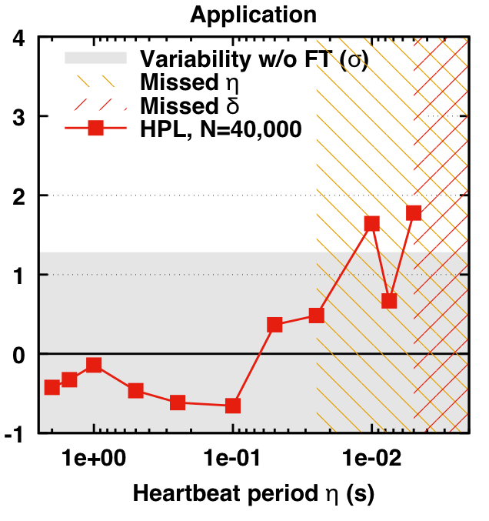
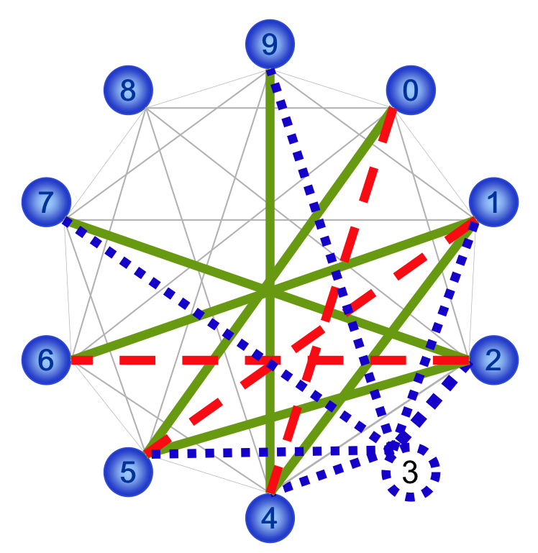
Side topic: Scalable Communication
External projects: not part of the PMIx specification
Mellanox: Hardware Accelerated Overlay
Intel/UTK: SCON: Scalable Communication Overlay Network
  Goals: scalable, generic, fault tolerant communication infrastructure for RTE systems
  New partners welcome ☺
PMIx Server
PMIx SCON
Ressource Manager
xcast
Resilient xcast
Vendor
Accelerated
REF
RM SCON
SCON operations
17
Network fabrics/drivers
Failure Detector (core function)
Reliable Broadcast (notifications)
Agreement (allgather/modex/fence)
MPI Agreement on Darter (Cray XC30)
SCON supply for communication features not provided from a supplier
  PMIx uses RM communication features, if available
  Similarly, RM uses internal communication features, if available
SCON will use vendor accelerated modules, when available
  Fallback to reference SCON operations when no vendor specific
Algorithms proven at the MPI level

Slide 18

PMIx Standard Document
Josh Hursey

Slide 19
PMIx Standard
Goal:
  Create a document that details the PMIx project goals, architecture, interfaces and semantics, and language bindings.
    Separate from the PMIx Reference Implementation.
  Ratify that document with the PMIx community.
    Open process to encourage broad participation.
Start with the interface from the PMIx Reference Implementation v2.0.
https://github.com/pmix/pmix-standard
Notes:
Motivated by:
* an increasing number of venders providing PMIx – need a reference version to state compliance.
* an increasing number of RFC looking for a version to request minimal compliance for new systems.

Slide 20
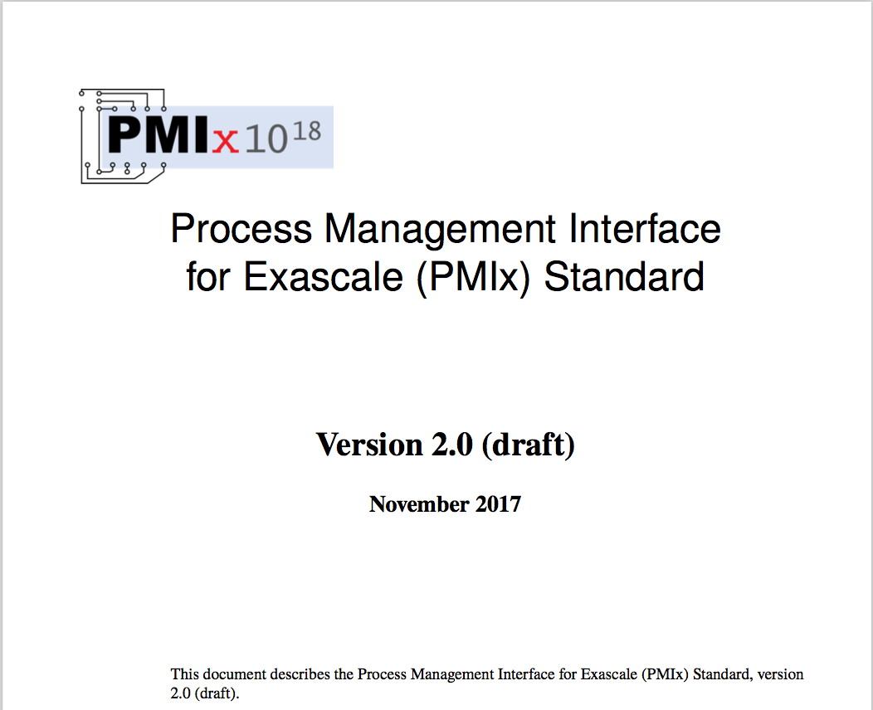
PMIx Standard
Lots of work to do!
Requesting:
Assistance in crafting standard language,
Vigorous debate on semantics, and
Participation in the ratification process.
https://github.com/pmix/pmix-standard

Slide 21
PMIx Standard - Organization
Introduction to PMIx
  Overview, Goals, Architecture
PMIx Terms and Conventions
Data Structures, Types, Constants
  Includes: Reserved attributes, Keys
Initialization & Finalization
  Client, Server, Tool interfaces
Key/Value Management
  put, get, commit, fence
  (un)publish, lookup
Process Management
  spawn, (dis)connect, resolve_peers
Job Allocation Management
  Allocation request, process monitor
Event Handling
  (de)register_event, notify_event
Data Packing & Unpacking
  (un)pack, copy
PMIx Server Specific Interfaces
  setup_fork, (de)register_nspace
  pmix_server_module_t
Revisions, Acknowledgements
Bibliography
Index
https://github.com/pmix/pmix-standard

Slide 22
PMIx Standard
Participation:
  File PRs against the GitHub repo
    https://github.com/pmix/pmix-standard
  Start a discussion on the PMIx community mailing list
    https://groups.google.com/forum/#!forum/pmix
  Join the weekly PMIx teleconference
    Thursday’s 3 pm (Eastern)
  The approval process is still being determined, but will likely match that of other HPC standardization bodies (e.g., MPI, OpenMP)
https://github.com/pmix/pmix-standard

Slide 23
PMIx Standard
Questions for the community
  Is it important to have a v1.0 version of the standard to match the interface from the PMIx Reference implementation v1.x?
  The standard focuses on the C interface, how important are language bindings? Which additional languages should we focus on?
  What examples would you like to see in the standard to help illustrate how PMIx should be used?
  How should the standardization ratification process be structured? What determines a voting member of the community?
https://github.com/pmix/pmix-standard

Slide 24
PMIx Standard
New interfaces & Semantic changes for discussion
  A PMIx server can return PMIX_ERR_NOT_SUPPORTED if a given attribute to, for example, PMIx_Get() is not supported.
  We do not have an interface for the PMIx client to query this information so they know in advance what attribute is supported.
    Is this functionality that would be useful to PMIx clients/applications?
    In what form should we provide that query mechanism?
      PMIx_Query_supported_attributes(…)
      Special PMIx attribute PMIX_PROBE_SUPPORT passed with the attribute?
      ???
https://github.com/pmix/pmix-standard

Slide 25
PMIx Standard
New interfaces & Semantic changes for discussion
  Attributes can be required or not. What should be the default?
    Currently we default to not required
  Other suggestions?
https://github.com/pmix/pmix-standard

Slide 26
Agenda
State of the Community
  Ralph H. Castain (Intel)
Scaled Performance
  Aurelien Bouteiller (UTK)
PMIx Standards Document
  Josh Hursey (IBM)
Q&A
Reminder:
Enhanced launch scaling talk
SLURM booth @ 2pm

