Slide 1

OpenMP – MPI
Coordination

Slide 2
Issue
Hybrid applications gaining popularity
  Especially with many-core architectures
Multiple programming libraries
  Operate independently
  No knowledge of presence of other libs or what those libs are doing
Conflicts occur
  Binding, resource utilization, …
OpenMP/MPI WG
  Prototype use of PMIx for coordination

Slide 3
What is PMIx?
2015
2016
2017
RM
RM
SLURM
RM
SLURM
JSM
others
SLURM
JSM
ALPS
PMI-1
PMI-2
PMIx v1.2
PMIx v2.0
MPICH
years go by…
wireup support
dynamic spawn
keyval publish/lookup
Exascale systems
on horizon
Launch times long
New paradigms
OMPI
Spectrum
OSHMEM
OMPI
Spectrum
OSHMEM
others
PGAS
others
Exascale launch
in < 30s
Exascale launch
in < 10s
Orchestration

Slide 4










The Community
https://pmix.github.io/pmix
https://github.com/pmix

Slide 5
v1.2 Features
Typical startup operations
  Put, get, commit, barrier, spawn, [dis]connect, publish/lookup
System/job data returned upon PMIx_Init
  Topology, proc locations, bindings, …
  Provided by host resource manager via PMIx
  Full list: https://github.com/pmix/pmix/wiki/2.8-Pmix-Server-Data-Requirements

Slide 6
v2.0 Features
Tool connections
  Debugger, job submission, query
Generalized query support
  Job status, layout, system data, resource availability
Logging
  Status reports, error output
Event notification
  App, system generated
  Subscribe, chained
  Pre-emption, failures, timeout warning, …
Flexible allocations
  Release resources, request resources
Job control
  Pause, kill, signal, heartbeat, resilience support
2Q2017

Slide 7
v3.0 Planned Features
Network support
  Security keys, pre-spawn local driver setup, fabric topology and status, traffic reports
File system support
  Dependency detection
  Tiered storage caching strategies
Inter-library coordination
4Q2017

Slide 8

PMIx Integration Architecture
System
Management Stack
OpenMP
FS
Orchestration
Requests
RM
Fabric
Mgr
PMIx
Client
PMIx
Server
Fabric
APP
NIC
Responses
MPI
RAS
Job
Script
Tool Support

Slide 9

Messenger not Doer
Standardized APIs
  Four header files (client, server, common, tool)
  Enable portability across environments
  Support interactions between applications and system management stack
Convenience library
  Facilitate adoption
  Serves as validation platform for standard
Community
SMS
APP
Tool

Slide 10
Scheme
Each library
  Declares itself upon initialization
    Model, implementation, version, …
  Registers event handler
    Receive async notice of other declarations
    Async updates as published by other libs
  Order is irrelevant
    Events cached and delivered upon registration
Coordinate during execution via events
Opportunity
  Utilize PMIx features for OpenMP itself

Slide 11
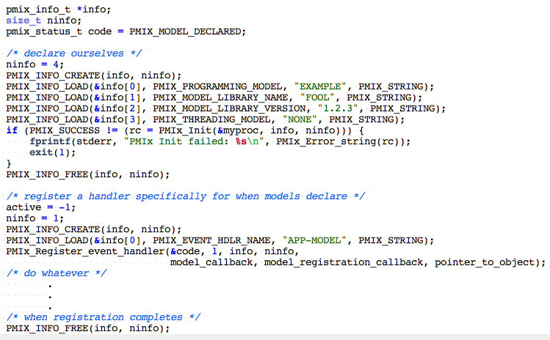
Initialization
Callback when declarations received
object returned on
registration callback
Called back when
registration completes

Slide 12
Callback
Receives
  Copy of all info provided by declarer
  size_t identifier of the event handler
  Name of the event handler, if assigned
  Provided object, if given
Multiple handlers registered for same code(s)
  Called in order (defined in registration)
  Results of each handler aggregated and provided to later handlers

Slide 13
Summary
Working group:
Wiki: https://github.com/pmix/pmix/wiki/7.1-openmp
Minutes: https://github.com/pmix/pmix/wiki/4.3-openmp
Prototype code:
OpenMPI master: https://github.com/open-mpi/ompi
Example app:
https://github.com/open-mpi/ompi/blob/master/orte/test/mpi/xlib.c
We now have an interface library the RMs will support for application-directed requests
Need to collaboratively define what we want to do with it

