Slide 1
HPC Resource Management: View to the Future
Ralph H. Castain
Jan 27, 2016

Slide 2
Definition: RM
Scheduler/Workload Manager (WLM)
  Allocates resources to session
  Interactive and batch
Run-Time Environment
  Launch and monitor applications
  Support inter-process communication wireup
  Serve as intermediary between applications and WLM
    Dynamic resource requests
    Error notification
  Implement failure policies

Slide 3
Current State
Provided as complete package (WLM+RTE)
  Sometimes offer hook to replace one
  Mostly proprietary
  Open source often GPL (integration difficult)
Programming model specific, static
Independent island
  Not integrated with monitoring, file systems, or networks
Limited fault tolerance support
  Restart failed job

Slide 4



RM => Orchestrator
File
System
Network
Resource
Manager
Pub-Sub
RM
APP
Prov. Agent
Monitoring
Overlay
Network
Console
SCON
DB

Slide 5
Resource Management Emerging Needs
Emerging Application Needs
  Dynamic resource management
  Application involvement in decisions, including fault notification
  Workflow orchestration
Emerging System Needs
  Scalable operations
  Cross-subsystem integration (RM, RAS, site utilities, …)
  Data staging, Burst Buffers, persistent memory management
  System notification requests, topology, QoS
  Power management

Slide 6
Multi-Tiered Strategy
Existing HPC RMs
Enable
SLURM
LSF
MOAB
PBSPro
RAS
Integration
Overlay
Network
Hadoop
Support
PMIx
Open Resilient Cluster Mgr
Reference
Implementation
Containers
(S&S)
Provisioning
(WW)
Data
Analytics
ULFM &
Fault Pred.
Technology

Slide 7
Reference Implementation: ORCM
Scalable to exascale levels & beyond
  Better-than-linear scaling
  Constrained memory footprint
Dynamically configurable
  Sense and adapt, user-directable
  On-the-fly updates
  Fully utilize underlying hw
Open source (non-GPL)
  Support proprietary add-ons
Maintainable, flexible
  Plugin architecture
  Easy extension for R&D
Resilient
  Self-heal around failures
  Reintegrate recovered resources

Slide 8
Launch Scaling: Core Capability

Slide 9

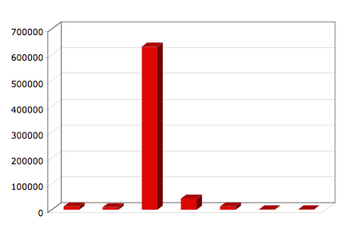
MPI_Init
MPI_Finalize
Time (μsec)
Exchange MPI contact info
Setup MPI structures
mpi_init completion
Initialization
Launch
barrier
barrier
RRZ, 16-nodes, 8ppn, rank=0

Slide 10
Stage I
MPI_Finalize
MPI_Init
Provide method for RM to share job info
Work with fabric and library implementers to compute endpt from RM info
Time (μsec)
Exchange MPI contact info
Setup MPI structures
mpi_init completion
Initialization
Launch
barrier
barrier
RRZ, 16-nodes, 8ppn, rank=0

Slide 11
Stage II
MPI_Init
MPI_Finalize
Add on 1st communication
(non-PMIx)
Time (μsec)
Exchange MPI contact info
Setup MPI structures
mpi_init completion
Initialization
Launch
barrier
barrier
RRZ, 16-nodes, 8ppn, rank=0

Slide 12
Stage III
MPI_Init
MPI_Finalize
Use HSN, Daemon
“instant on”, Coll
Time (μsec)
Exchange MPI contact info
Setup MPI structures
mpi_init completion
Initialization
Launch
barrier
barrier
RRZ, 16-nodes, 8ppn, rank=0

Slide 13
Current Status
Adoption:
SLURM
LSF
Moab
PBSPro
Stage I-II
Stage III (projected)

Slide 14
Flexible Allocation Support
Request additional resources
  Compute, memory, network, NVM, burst buffer
  Immediate, forecast
  Expand existing allocation, separate allocation
Return extra resources
  No longer required
  Will not be used for some specified time, reclaim (handshake) when ready to use
Notification of preemption
  Provide opportunity to cleanly pause

Slide 15
I/O Support
Asynchronous operations
  Anticipatory data fetch, staging
  Advise time to complete
  Notify upon available
Storage policy requests
  Hot/warm/cold data movement
  Desired locations and striping/replication patterns
  Persistence of files, shared memory regions across jobs, sessions
  ACL to generated data across jobs, sessions

Slide 16
Spawn Support
Staging support
  Files, libraries required by new apps
  Allow RM to consider in scheduler
    Current location of data
    Time to retrieve and position
    Schedule scalable preload
    Specified topology, min/max procs, …
Provisioning requests
  Allow RM to consider in selecting resources, minimize startup time due to provisioning
  Desired image, packages

Slide 17
Network Integration
Quality of service requests
  Bandwidth, traffic priority, power constraints
  Multi-fabric failover, striping prioritization
  Security requirements
    Network domain definitions, ACLs
Notification requests
  State-of-health
  Update process endpoint upon fault recovery
Topology information
  Torus, dragonfly, …

Slide 18
Power Control/Management
Scheduler analytics
  Predict power usage, advise updates
Application requests
  Advise of changing workload requirements
  Request changes in policy
  Specify desired policy for spawned applications
RM notifications
  Need to change power policy
  Preemption notification
    Allow application to accept, request pause

Slide 19
Fault Tolerance
Notification
  App can register for error notifications, incipient faults
    RM-app negotiate to determine response
  App can notify RM of errors
    RM will notify specified, registered procs
Rapid application-driven checkpoint
  Local on-node NVRAM, auto-stripe checkpoints
  Policy-driven “bleed” to remote burst buffers and/or global file system
Restart support
  Specify source (remote NVM checkpoint, global filesystem, etc)
  Location hints/requests
  Entire job, specific processes

Slide 20
Workflow Orchestration
Growing range of workflow patterns
  Traditional HPC: bulk synchronous, single application
  Analytics: asynchronous, staged
  Parametric: large number of simultaneous independent jobs
Ability to dynamically spawn a job
  Need flexibility – min/max size, rolling allocation, …
  Events between jobs and cross-linking of I/O
  Queuing of spawn requests
Tool interfaces that work in these environments

Slide 21

Workload Manager: Job Description Language
Complexity of describing job is growing
  Power, file/lib positioning
  Performance vs capacity, programming model
  System, project, application-level defaults
Provide templates?
  System defaults, with modifiers
    --hadoop:mapper=foo,reducer=bar
  User-defined
    Application templates
    Shared, group templates
  Markup language definition of behaviors, priorities
30 yrs

Slide 22
Flexible Architecture
Each tool built on top of same plugin system
  Different combinations of frameworks
  Different plugins activated to play different roles
  Example: orcmd on compute node vs on rack/row controllers
Designed for distributed, centralized, hybrid operations
  Centralized for small clusters
  Hybrid for larger clusters
  Example: centralized scheduler, distributed “worker-bees”
Accessible to users for interacting with RM
  Add shim libraries (abstract, public APIs) to access framework APIs
  Examples: SCON, pub-sub, in-flight analytics

Slide 23
Breaking it Down
Workload Manager
  Dedicated framework
  Plugins for two-way integration to external WM (Moab, Cobalt)
  Plugins for implementing internal WM (FIFO)
Run-Time Environment
  Broken down into functional blocks, each with own framework
    Loosely divided into three general categories
    Messaging, launch, error handling
    One or more frameworks for each category
  Knitted together via “state machine”
    Event-driven, async
    Each functional block can be separate thread
    Each plugin within each block can be separate thread(s)

Slide 24
Analytics Workflow Concept
Pub-Sub
Input Module
Sensors
RAS
Event
Generalized
Format
Database
Other
Workflow
Other
Workflows
Available in SCON as well

Slide 25
Workflow Elements
Average (window, running, etc.)
Rate (convert incoming data to events/sec)
Threshold (high, low)
Filter
  Selects input values based on provided params
RAS event
  Generates a RAS event corresponding to input description
Publish data

Slide 26
Analytics
Execute on aggregator nodes for in-flight reduction
  Sys admin defines, user can define (if permitted)
Event-based state machine
  Each workflow in own thread, own instance of each plugin
  Branch and merge of workflow
  Tap stream between workflow steps
  Tap data streams (sensors, others)
Event generation
  Generate events/alarms
  Specify data to be included (window)

Slide 27
Distributed Architecture
Hierarchical, distributed approach for unlimited scalability
  Utilize daemons on rack/row controllers
Analysis done at each level of the hierarchy
  Support rapid response to critical events
  Distribute processing load
  Minimize data movement
RM’s error manager framework controls response
  Based on specified policies

Slide 28
Fault Diagnosis
Identify root cause and location
  Sometimes obvious – e.g., when direct measurement
  Other times non-obvious
    Multiple cascading impacts
    Cause identified by multi-sensor correlations (indirect measurement)
    Direct measurement yields early report of non-root cause
    Example: power supply fails due to borderline cooling + high load
Estimate severity
  Safety issue, long-term damage, imminent failure
Requires in-depth understanding of hardware

Slide 29
Fault Prediction: Methodology
Exploit access to internals
  Investigate optimal location, number of sensors
  Embed intelligence, communications capability
Integrate data from all available sources
  Engineering design tests
  Reliability life tests
  Production qualification tests
Utilize learning algorithms to improve performance
  Both embedded, post process
  Seed with expert knowledge

Slide 30
Fault Prediction: Outcomes
Continuous update of mean-time-to-preventative-maintenance
  Feed into projected downtime planning
  Incorporate into scheduling algo
Alarm reports for imminent failures
  Notify impacted sessions/applications
  Plan/execute preemptive actions
Store predictions
  Algorithm improvement

Slide 31
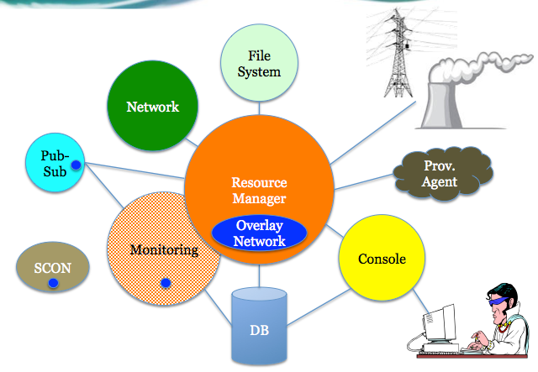
HPC Controls
Thank You!

