Slide 1
Eksploracja danych kredytowych FICO
Joanna Gajewska
Olaf Werner
Bogdan Jastrzębski

Slide 2
Wprowadzenie
Dane Kredytowe
Pochodzą z FICO
Zadanie klasyfikacyjne

Slide 3
Dostępne dane

Slide 4
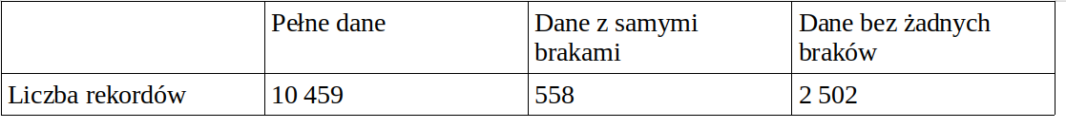
Braki danych i flagi
-9 No Bureau Record or No Investigation
-8 No Usable/Valid Trades or Inquiries
-7 Condition not Met (e.g. No Inquiries, No Delinquencies)
-9 Posiadają klasyfikację
Wiersze z -9 w prawie wszystkich kolumnach zostały usunięte.

Slide 5
Braki danych i flagi c.d.
ColName | -9 | -8 | -7
ExternalRiskEstimate | 10 | 0 | 0
MSinceOldestTradeOpen | 0 | 239 | 0
MSinceMostRecentDelq | 0 | 176 | 4664
MSinceMostRecentInqexcl7days | 0 | 476 | 1855
NetFractionRevolvingBurden | 0 | 186 | 0
NetFractionInstallBurden | 0 | 3419 | 0
NumRevolvingTradesWBalance | 0 | 156 | 0
NumInstallTradesWBalance | 0 | 861 | 0
NumBank2NatlTradesWHighUtilization | 0 | 583 | 0
PercentTradesWBalance | 0 | 18 | 0

Slide 6
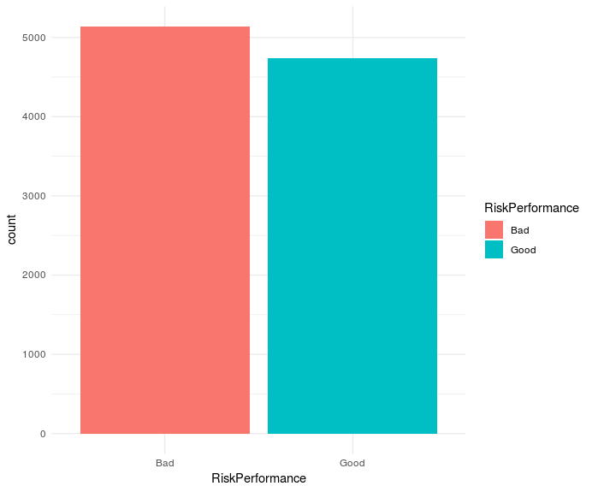
Risk Performance
Values: {Good, Bad}
-9 : 0
-8 : 0
-7 : 0
Paid as negotiated flag (12-36 Months). String of Good and Bad

Slide 7
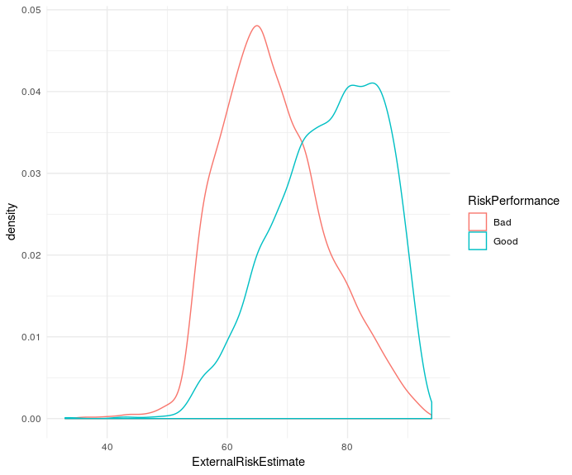
External Risk Estimate
Values: 0-100%
-9 : 0
-8 : 239
-7 : 0
Consolidated version of risk markers

Slide 8
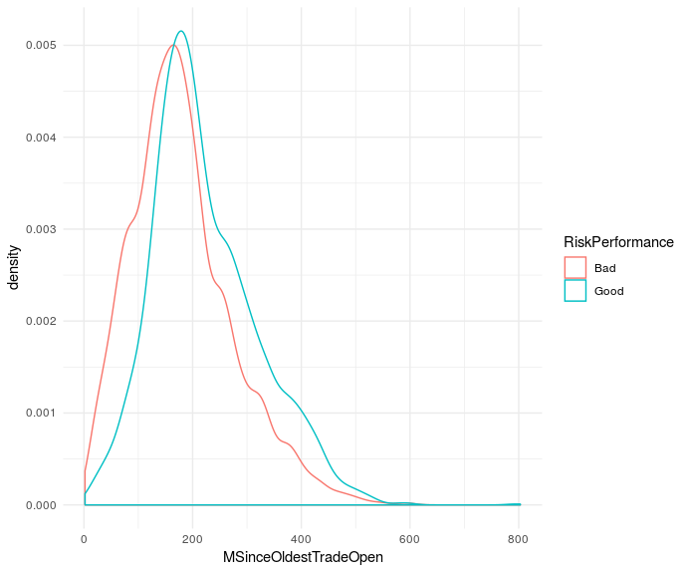
Months Since Oldest Trade Open
Values: 0, 1, 2, 3…
-9 : 0
-8 : 239
-7 : 0

Slide 9
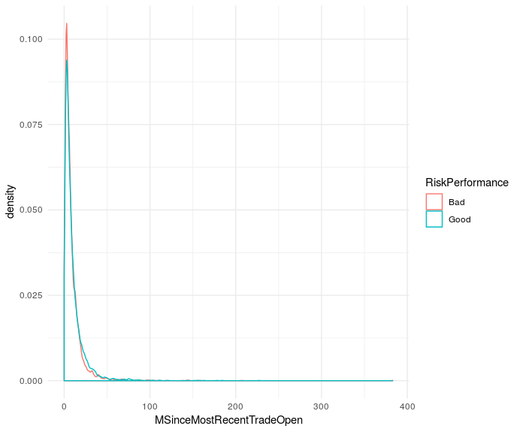
Months Since Most Recent Trade Open
Values: 0, 1, 2, 3…
-9 : 0
-8 : 0
-7 : 0

Slide 10
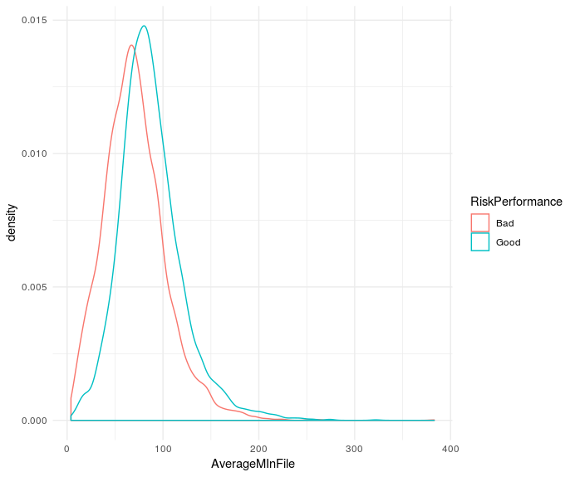
Average Months in File
Values: R+
-9 : 0
-8 : 0
-7 : 0

Slide 11
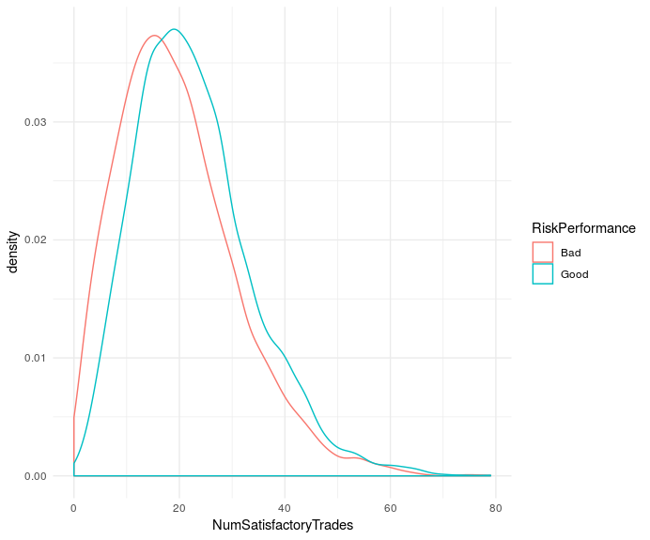
Number Satisfactory Trades
Values: 0, 1, 2, 3…
-9 : 0
-8 : 0
-7 : 0

Slide 12
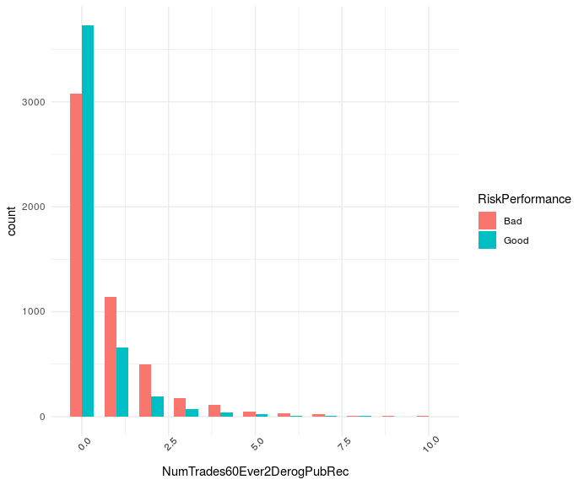
Number Trades 60+ Ever
Values: 0, 1, 2, 3…
-9 : 0
-8 : 0
-7 : 0

Slide 13
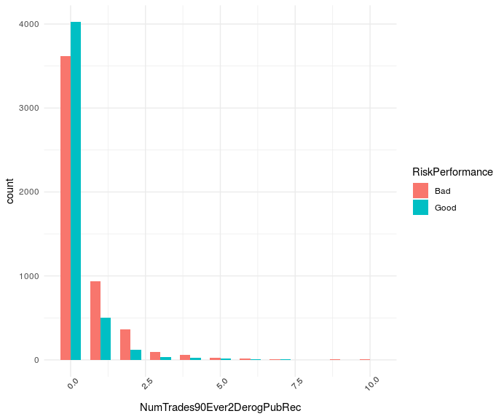
Number Trades 90+ Ever
Values: 0, 1, 2, 3…
-9 : 0
-8 : 0
-7 : 0

Slide 14
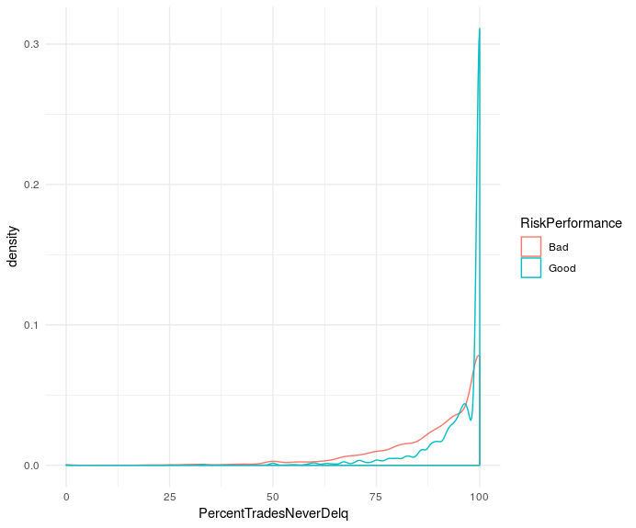
Percent Trades Never Delinquent
Values: 0-100%
-9 : 0
-8 : 0
-7 : 0

Slide 15
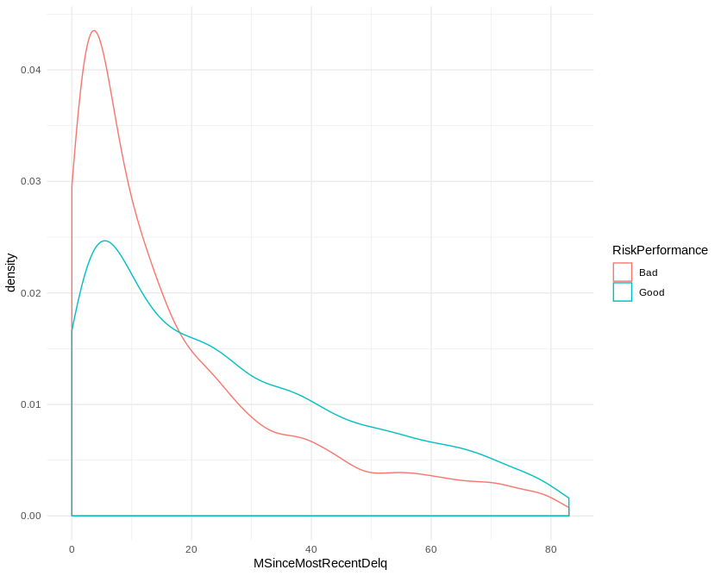
Months Since Most Recent Delinquency
Values: 0, 1, 2, 3…
-9 : 0
-8 : 176
-7 : 4664

Slide 16
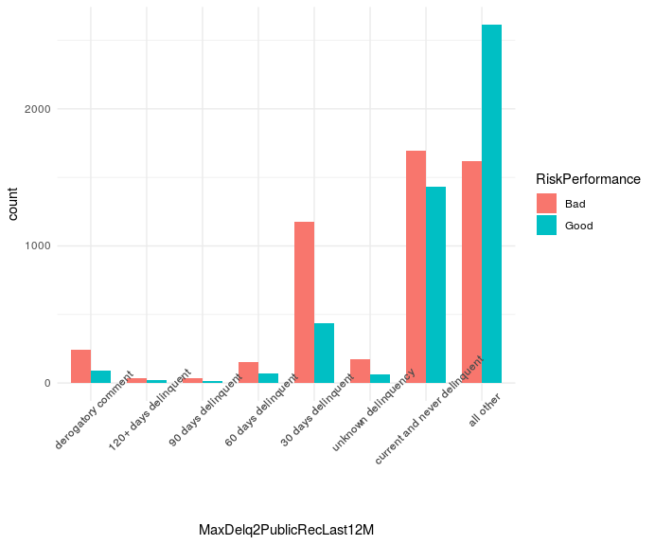
Max Delq/Public Records Last 12 Months
Values: {derogatory comment,
120+ days delinquent,
90 days delinquent,
60 days delinquent,
30 days delinquent,
unknown delinquency,
current and never delinquent,
all other}
-9 : 0
-8 : 0
-7 : 0

Slide 17
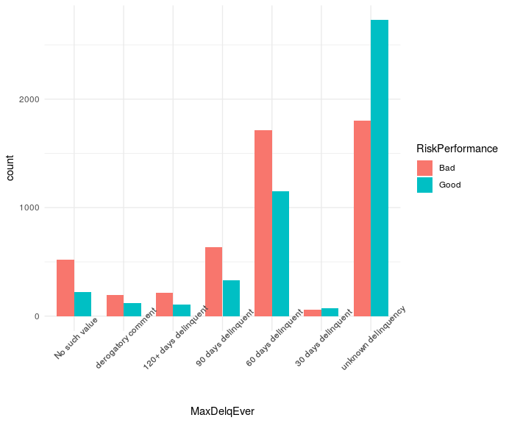
Maximum Delinquency Ever
Values: {No such value,
derogatory comment,
120+ days delinquent,
90 days delinquent,
60 days delinquent,
30 days delinquent,
unknown delinquency,
current and never delinquent,
all other}
-9 : 0
-8 : 0
-7 : 0

Slide 18
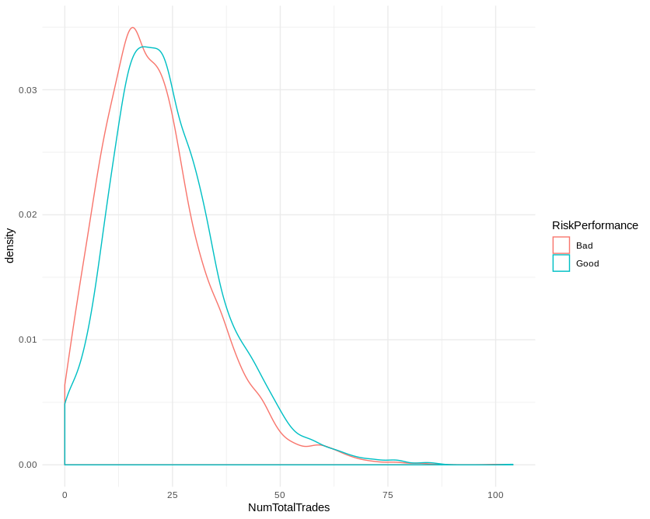
Number Total Trades
Values: 0, 1, 2, 3…
-9 : 0
-8 : 0
-7 : 0

Slide 19
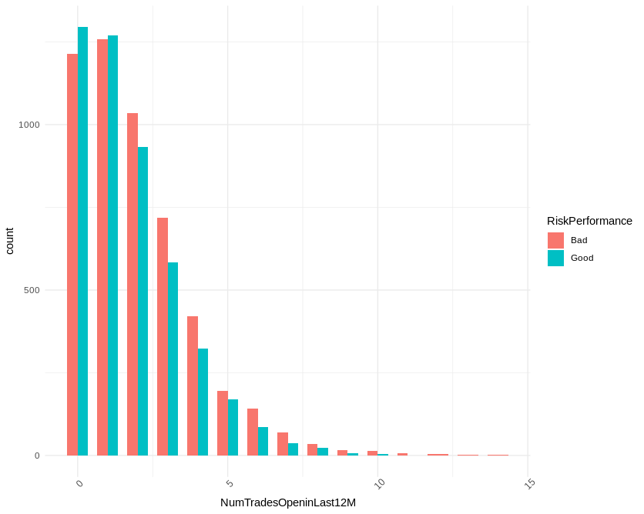
Number Trades Open in Last 12 Months
Values: 0, 1, 2, 3…
-9 : 0
-8 : 0
-7 : 0

Slide 20
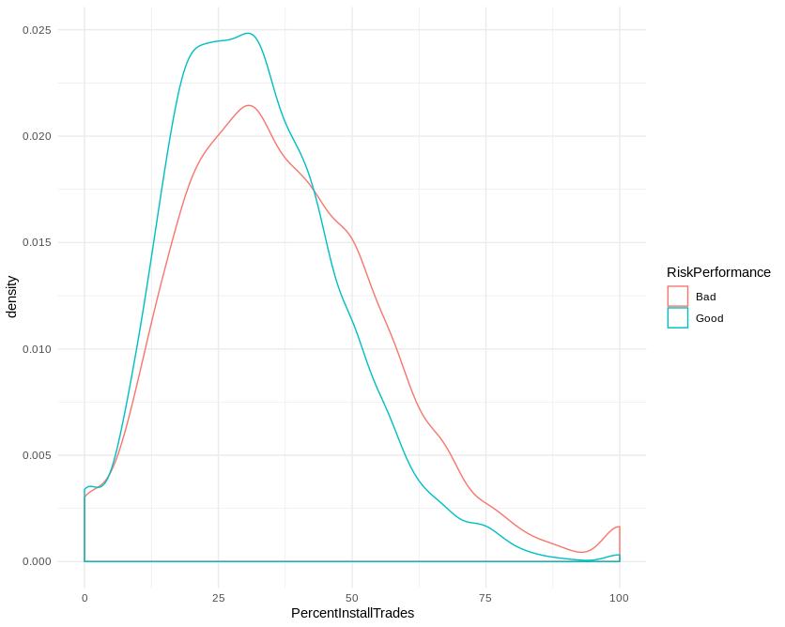
Percent Installment Trades
Values: 0-100%
-9 : 0
-8 : 0
-7 : 0

Slide 21
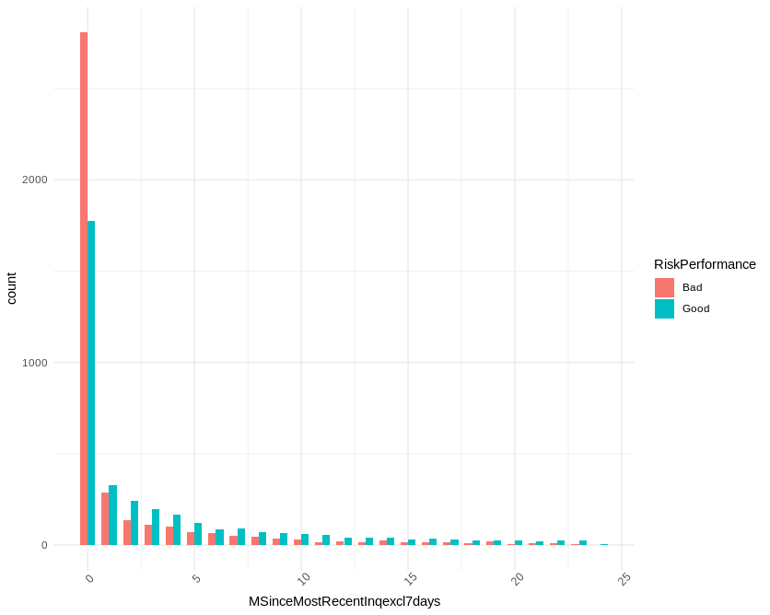
Months Since Most Recent Inq. Excl. 7 days
Values: 0, 1, 2, 3…
-9 : 0
-8 : 476
-7 : 1855

Slide 22
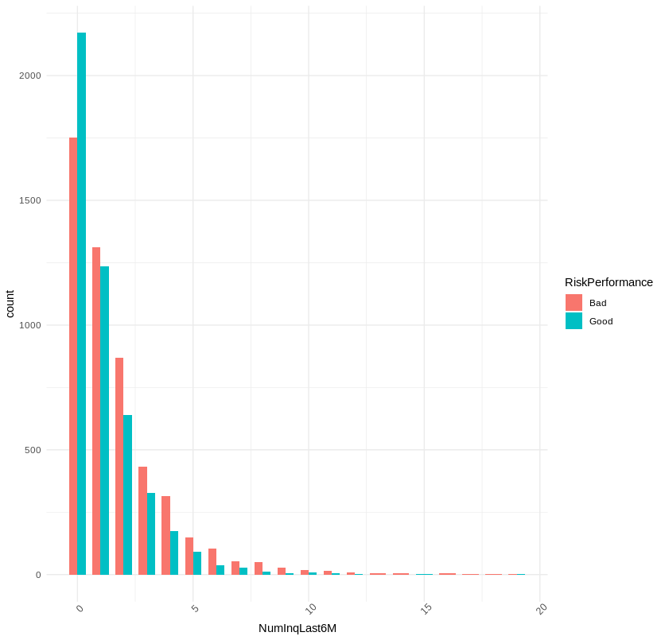
Number Inq. Last 6 Months
Values: 0, 1, 2, 3…
-9 : 0
-8 : 0
-7 : 0

Slide 23
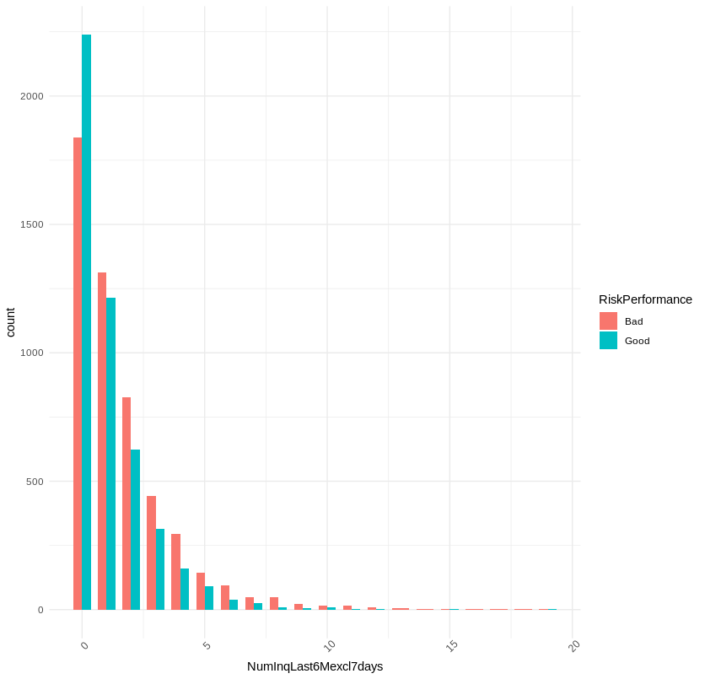
Number Inq. Last 6 Months excl. 7 days
Values: 0, 1, 2, 3…
-9 : 0
-8 : 0
-7 : 0

Slide 24
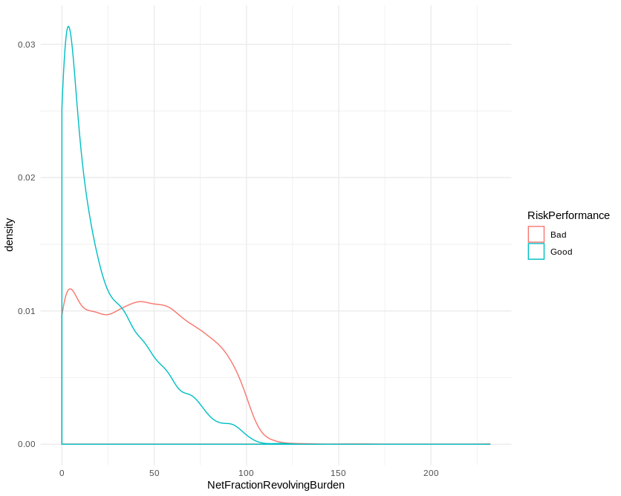
Net Fraction Revolving Burden
Values: 0, 1, 2, 3…
-9 : 0
-8 : 186
-7 : 0

Slide 25
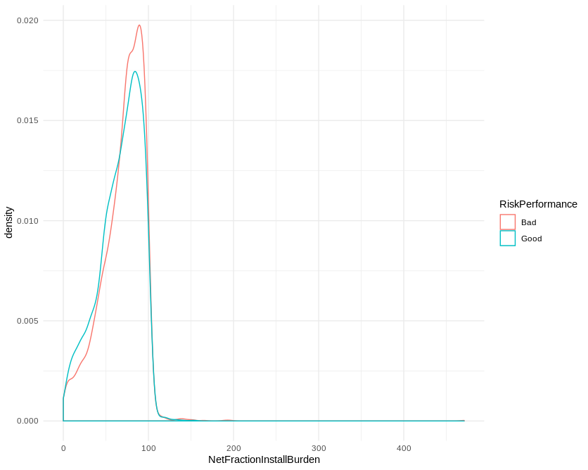
Net Fraction Installment Burden
Values: 0, 1, 2, 3…
-9 : 0
-8 : 3419
-7 : 0

Slide 26
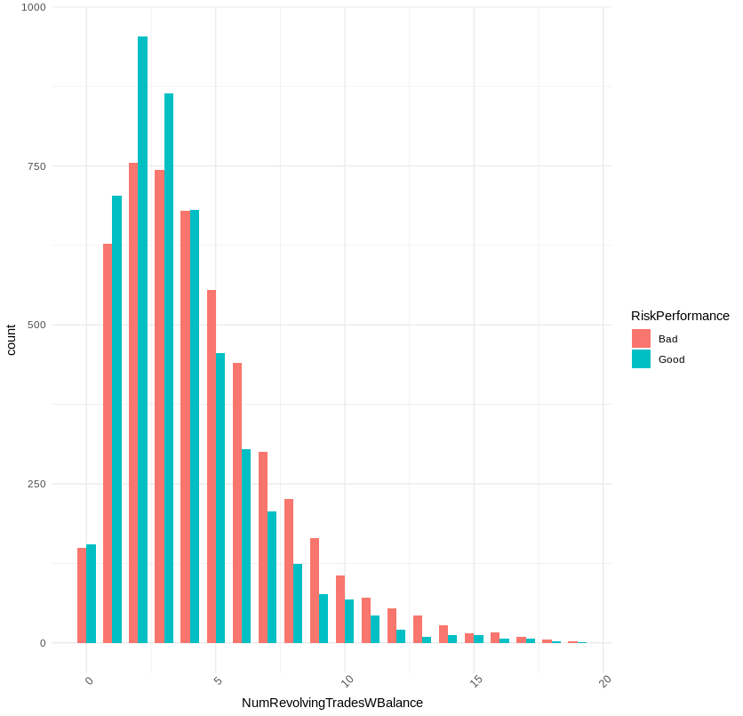
Number of Revolving Trades With Balance
Values: 0, 1, 2, 3…
-9 : 0
-8 : 156
-7 : 0

Slide 27
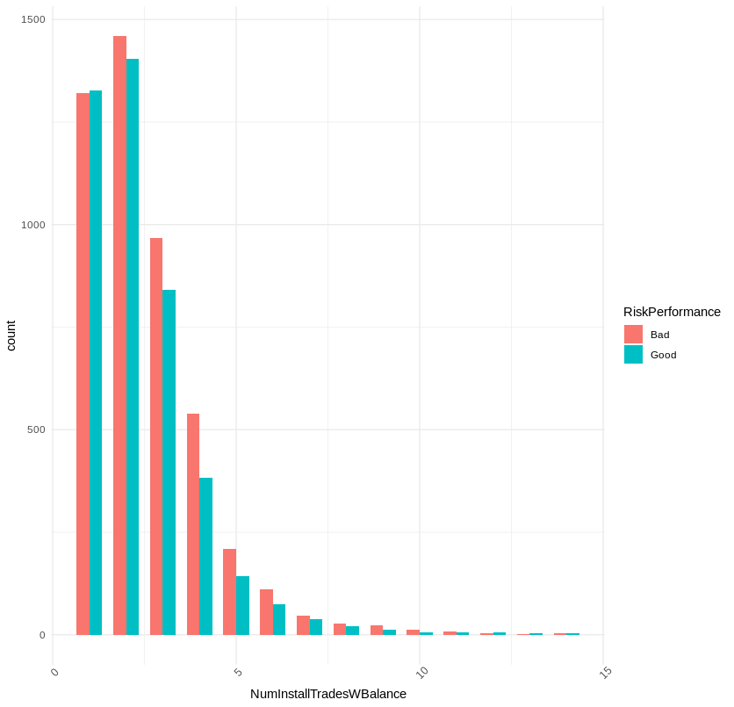
Number of Installment Trades With Balance
Values: 0, 1, 2, 3…
-9 : 0
-8 : 861
-7 : 0

Slide 28
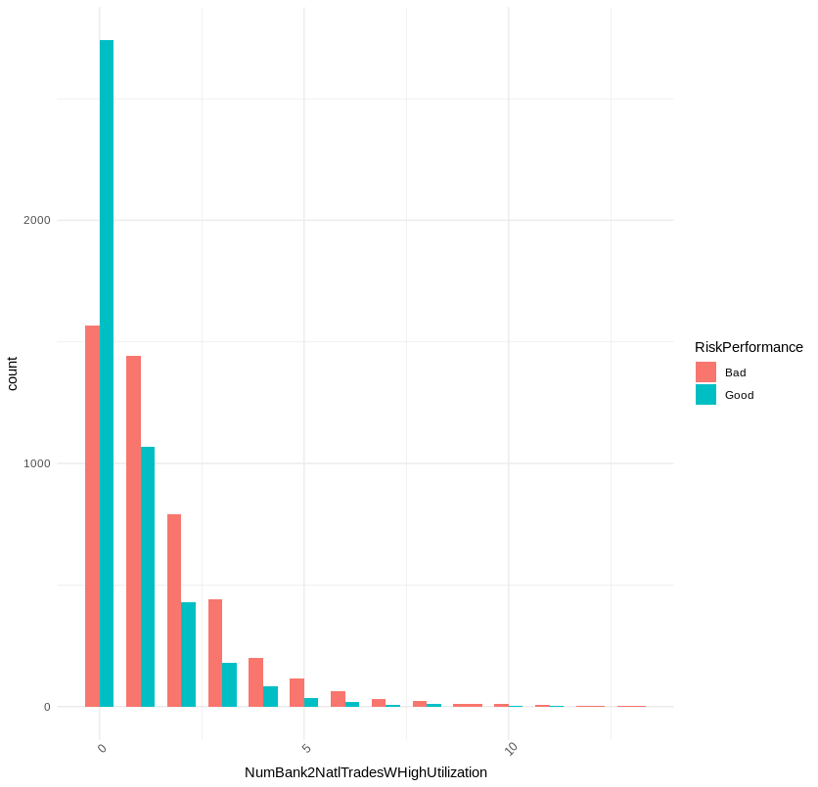
NumBank2NatlTradesWHighUtilization
Values: 0, 1, 2, 3…
-9 : 0
-8 : 583
-7 : 0

Slide 29
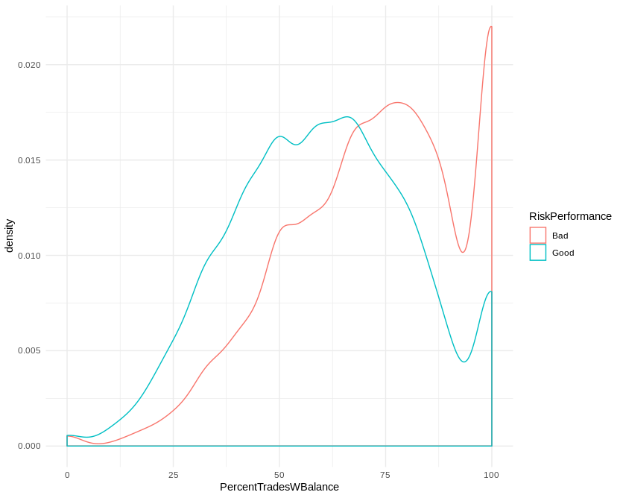
Percent of Trades With Balance
Values: 0-100%
-9 : 0
-8 : 18
-7 : 0

Slide 30
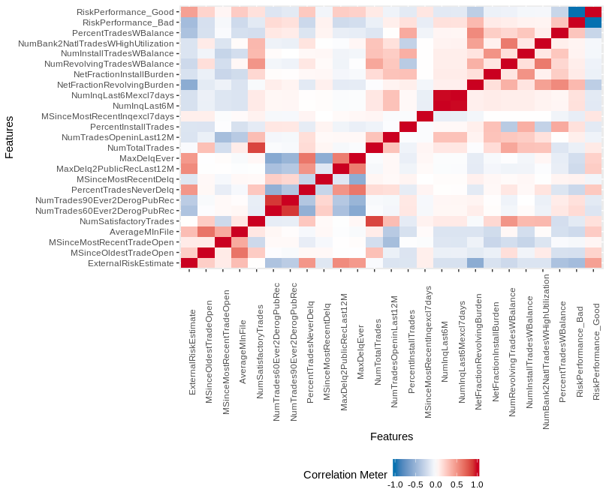
Correlation

