Slide 1
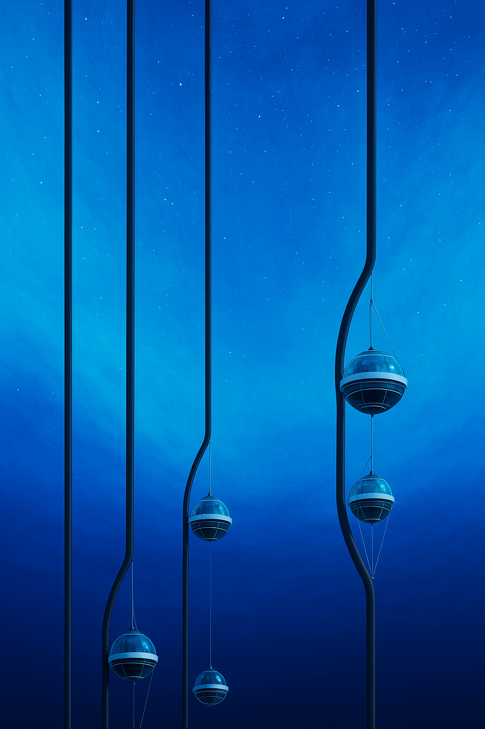
Generative AI for Neutrino Event in IceCube
Event Generation Using Optimal Transport Flow Matching
104th KPS Spring Meeting
Sungkyunkwan University| Department of Physics
Minje Park, Teayun Kim, Chang Dong Rho

Slide 2
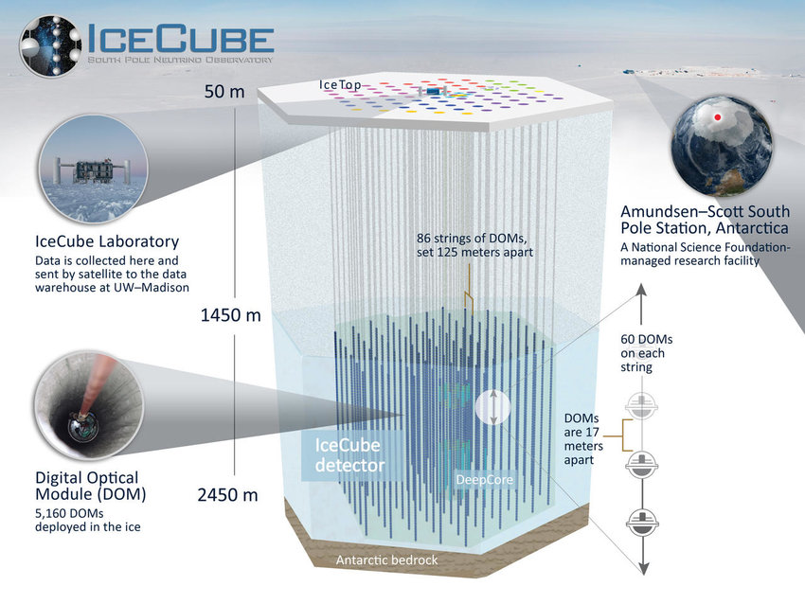
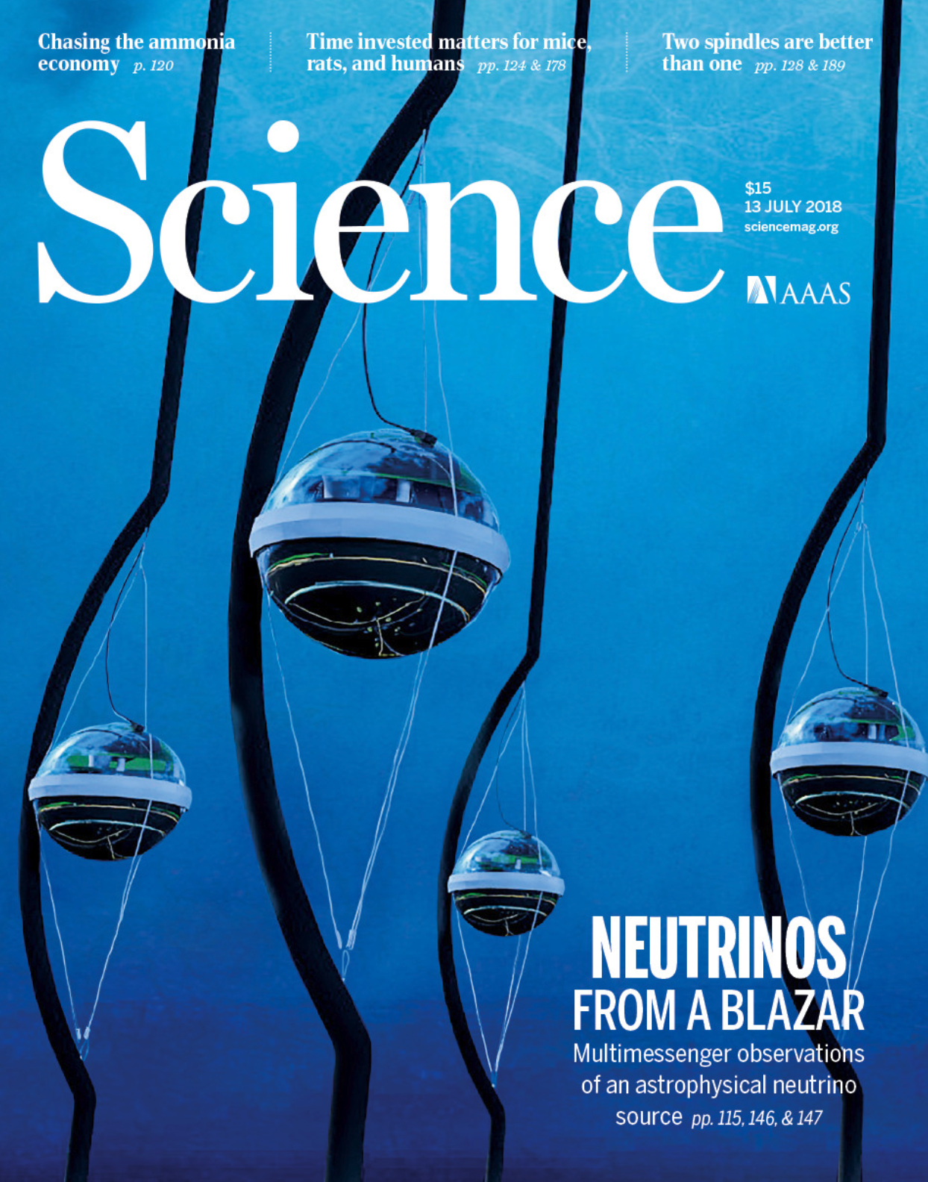
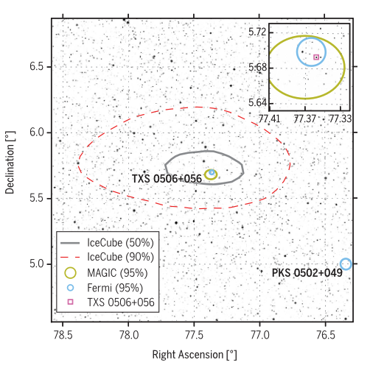
01
IceCube Neutrino Observatory
About IceCube
A cubic-kilometer neutrino detector at the South Pole
Configured with 5,160 Digital Optical Modules (DOM)
Detects neutrino via Cherenkov radiation from particles produced by neutrino interaction
Major Achievements
2013: Discovery of astrophysical neutrinos
2018: First identified source — TXS 0506+056
2023: First neutrino map of the Milky Way
Notes:
NGC 1068
eCube는 남극에 설치된 1세제곱킬로미터 규모의 중성미자 검출기입니다.
5,160개의 DOM이 얼음 속에서 중성미자 상호작용으로 생기는 체렌코프 빛을 검출합니다.
IceCube는 몇 년에 뭐를 하고 몇 년에 뭐를 하는 등 중성미자 천문학을 대표하는 핵심 관측 장비로 평가됩니다.

Slide 3
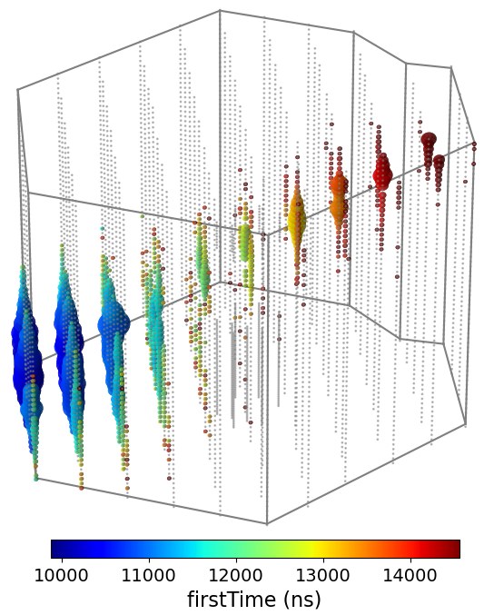
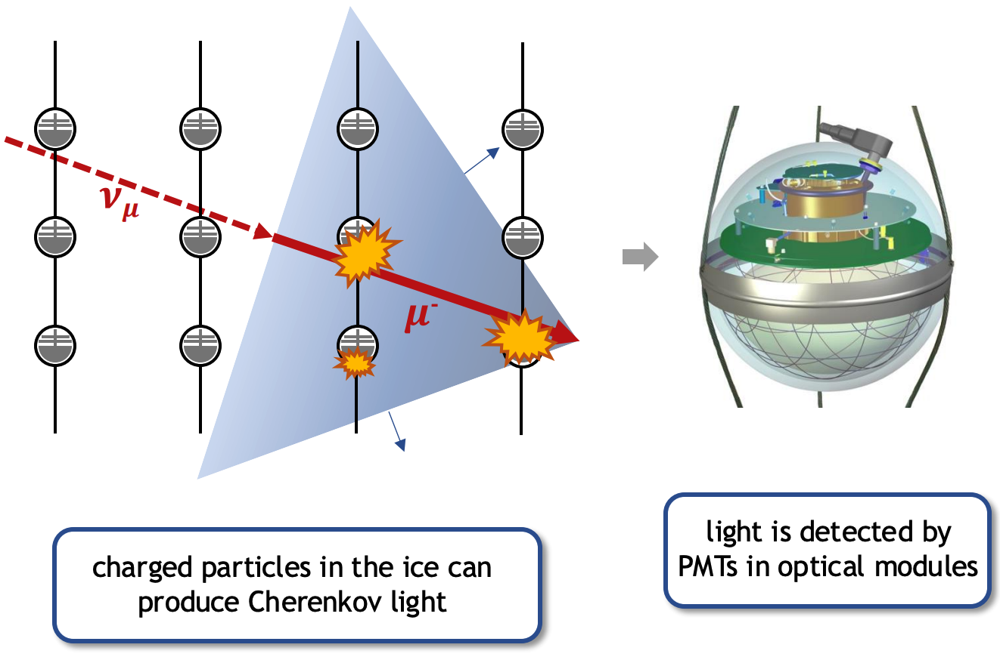
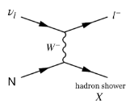
02
Muon Neutrino Event in IceCube
Track Signature
When $ν_{μ}$undergoes CC interaction near Icecube,
the resulting $μ$passes though the detector, leaving a track signatured event
Each DOM records
NPE : Tot
Time :
NPE : number of detected photoelectrons
Hit Time : arrival time of earliest photon
The size of each DOM indicate the number of detected photons
Notes:
Npe랑 charge 이야기 하기
J. Ahrens et al. Muon track reconstruction and data selection techniques in AMANDA. Nucl.Instrum.Meth., A524:169–194, 2004. 15, 36, 41 (이건 그대로)

Slide 4
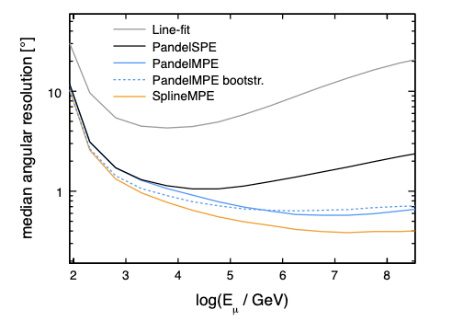
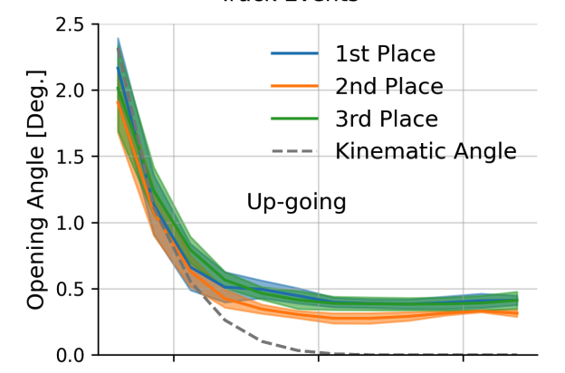
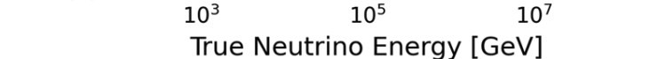
03
Motivation for JANUS
Reconstruction Methods & Limitation
Track events have an angular resolution of < 1$°$ $→$ Main channel for neutrino’s source studies
There are two main approaches to track event reconstruction in IceCube
1. Spline Reconstruction [Left]
Maximum likelihood method using photon arrival time PDFs derived from simulations
2. Neural Network [Right]
Regression models that map observed events to track parameters
However, both methods show a gap to the theoretical lower bound, with performance degradation around 1 TeV.
We believe this gap is related to the difficulty of capturing the stochastic nature of high-energy events.
Generative AI is known to learn the underlying structure of data more fundamentally.
Generative AI based-framework that can both:
Generate track events
Reconstruct neutrino parameters
Notes:
How Ever 뉴트리노를 reocontrution하는 것은 힘들다. 그래서 완전히 새로운 접근 방법을 제안한다. 그것은 생성형 인공지능을 만들고 그 인공지능을 이용해서 컨디셔널 generation을 하는 모델을 만들고 그걸 이용해서 reconstiuction하는 것이다.

Slide 5
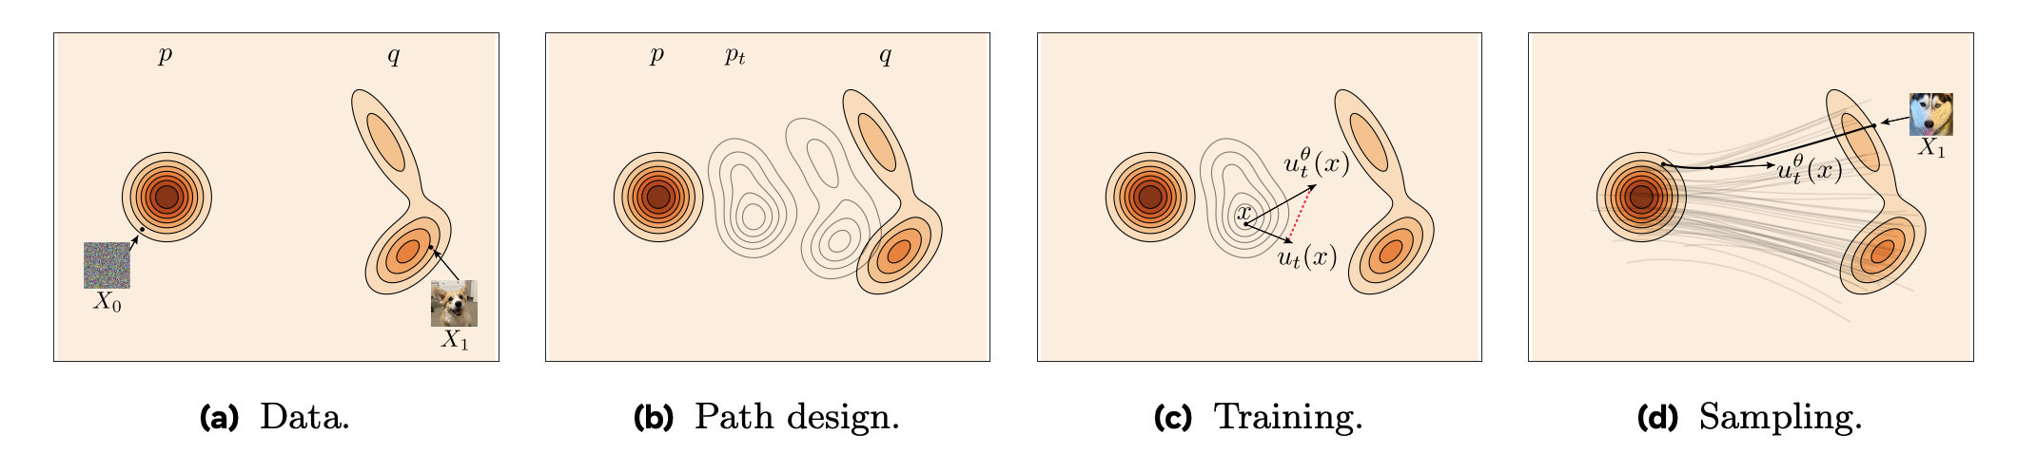

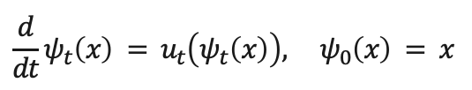
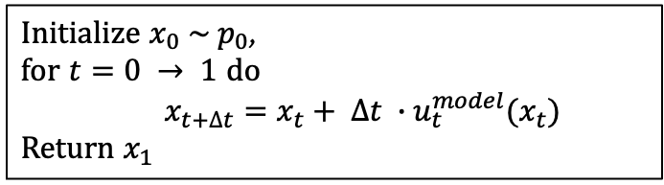


04
JANUS Design & Architecture
Flow Matching & Generative AI
In general, Generative AI refers to models that can generate data such as images or videos
The objective of Generative AI is to transport known distribution $p_{0}$ to data distribution ($q$)
Flow Matching is a subset of Generative AI
learns a flow, $ψ_{t}$, that transport $p_{0}→q$
$$\frac{d}{dt}ψ_{t}\left(x\right) = u_{t}\left(ψ_{t}\left(x\right)\right), ψ_{0}\left(x\right) = x$$
Optimal transport
$$x_{t}=tx_{1}+\left(1−t\right)x_{0}$$
$$ℒ_{fm}=𝔼_{x_{t}, t}\left[u_{t}^{model}(x_{t})−u_{t}^{traget}(x_{t})\right]$$
$${∇ ℒ}_{fm}={∇ ℒ}_{OT−fm}$$
Figure of source distribution $p_{0}$ and data distribution $q$
$$ℒ_{OT−fm}=𝔼_{x_{1}, x_{0},t}\left[u_{t}^{model}\left(tx_{1}+\left(1−t\right)x_{0}\right)−(x_{1}−x_{0})\right]$$
After training, we can generate data by follows:
Initialize $x_{0} \sim p_{0}$,
for $t=0 → 1$ do
$x_{t+∆t}=x_{t}+ ∆t ∙u_{t}^{model}(x_{t})$
Return $x_{1}$
Optimal transport between $p_{0}$to $q$

Slide 6


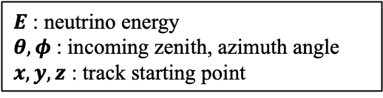
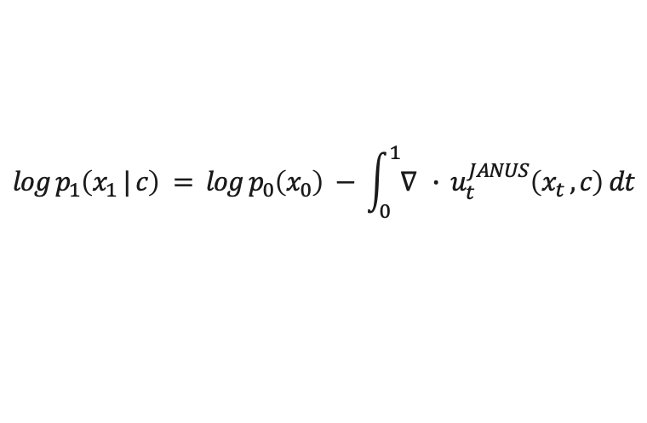
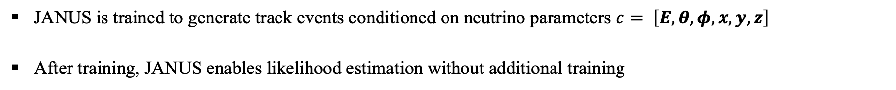

03
JANUS Design & Architecture
JANUS
JANUS : Joint generative AI for Neutrino reconstrUction and Simulation
JANUS is trained to generate track events conditioned on neutrino parameters $c= \left[E, θ, φ, x, y, z\right]$
After training, JANUS enables likelihood estimation without additional training
$E$ : neutrino energy
$θ,φ$ : incoming zenith, azimuth angle
$x,y, z$ : track starting point
JANUS
(generator)
JANUS
(reconstructor)
$$\left[E, θ, φ, x, y, z\right]$$
$$\left[E, θ, φ, x, y, z\right]$$
By applying the charge of variable formula
$$log p_{1}\left(x_{1} | c\right) = log p_{0}\left(x_{0}\right) − \int_{0}^{1}{∇ ∙ u_{t}^{JANUS}\left(x_{t} , c\right) dt}$$
At this presentation, we focus on the generator component of JANUS
$$\arg{\max{ \{ log p_{1}\left(x_{1} | c\right)} \}}$$
Notes:
So by using flow matching we have developed JANUS ().
JANUS can work is trained to generate sames by condition on . As we used flow mathing objective model is trained to model vector field U_t_theta
After traing model can be used as a reconstrucot by using the network to calculate the likelihood of x
As mention by
모델이 그래서 simulation emulator로 기능할 수 있다.
이번 발표에서는 시뮬레이터의 성능까지 볼거다
-------
결국 해야하는건 이 path를 design
가장 많이 그리고 높은 성능을 보여주는 것은 Flow와 Diffusion이
이벤트 디스플레이(이거 이야기 ) 해놔야
설명을 해놔야 (결과를 보여주는 것) 앞쪽에서 테크니컬 한 이야기들
데이터 적인 측면

Slide 7

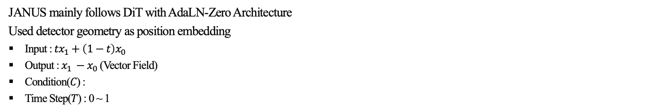




04
JANUS Design & Architecture
JANUS Architecture & Dataset
JANUS mainly follows DiT with AdaLN-Zero Architecture
Used detector geometry as position embedding
Input : $tx_{1}+\left(1−t\right)x_{0}$
Output : $x_{1} −x_{0}$ (Vector Field)
Condition($C$) :
Time Step($T$) : 0 ~ 1
Vector Field
2$×$ 5160
Scale, Shift
Scale
$$\left[E, θ, φ, x, y, z\right]$$
Layer Norm
Feedforward
Network
MLP
Scale, Shift
Icecube simulation dataset
Number of training data (events) : 178,056
Energy range : 1~100PeV
Up going track only
DiT Block
(N = 8)
Layer Norm
Scale
Multi-Head
Self-Attention
Scale, Shift
MLP
MLP
Layer Norm
$$C$$
$$T$$
Geometry Position Embedding
Input Tokens
2$×$ 5160
C +T Imbedding
Input Tokens
Trained on NVIDIA-A100 : 10hours

Slide 8
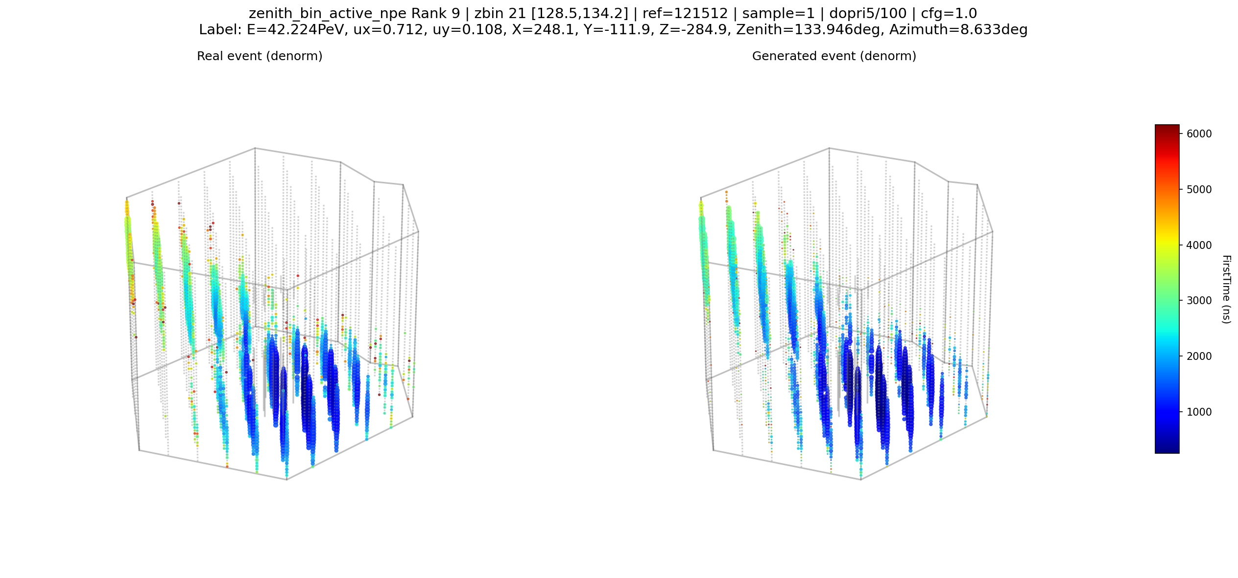
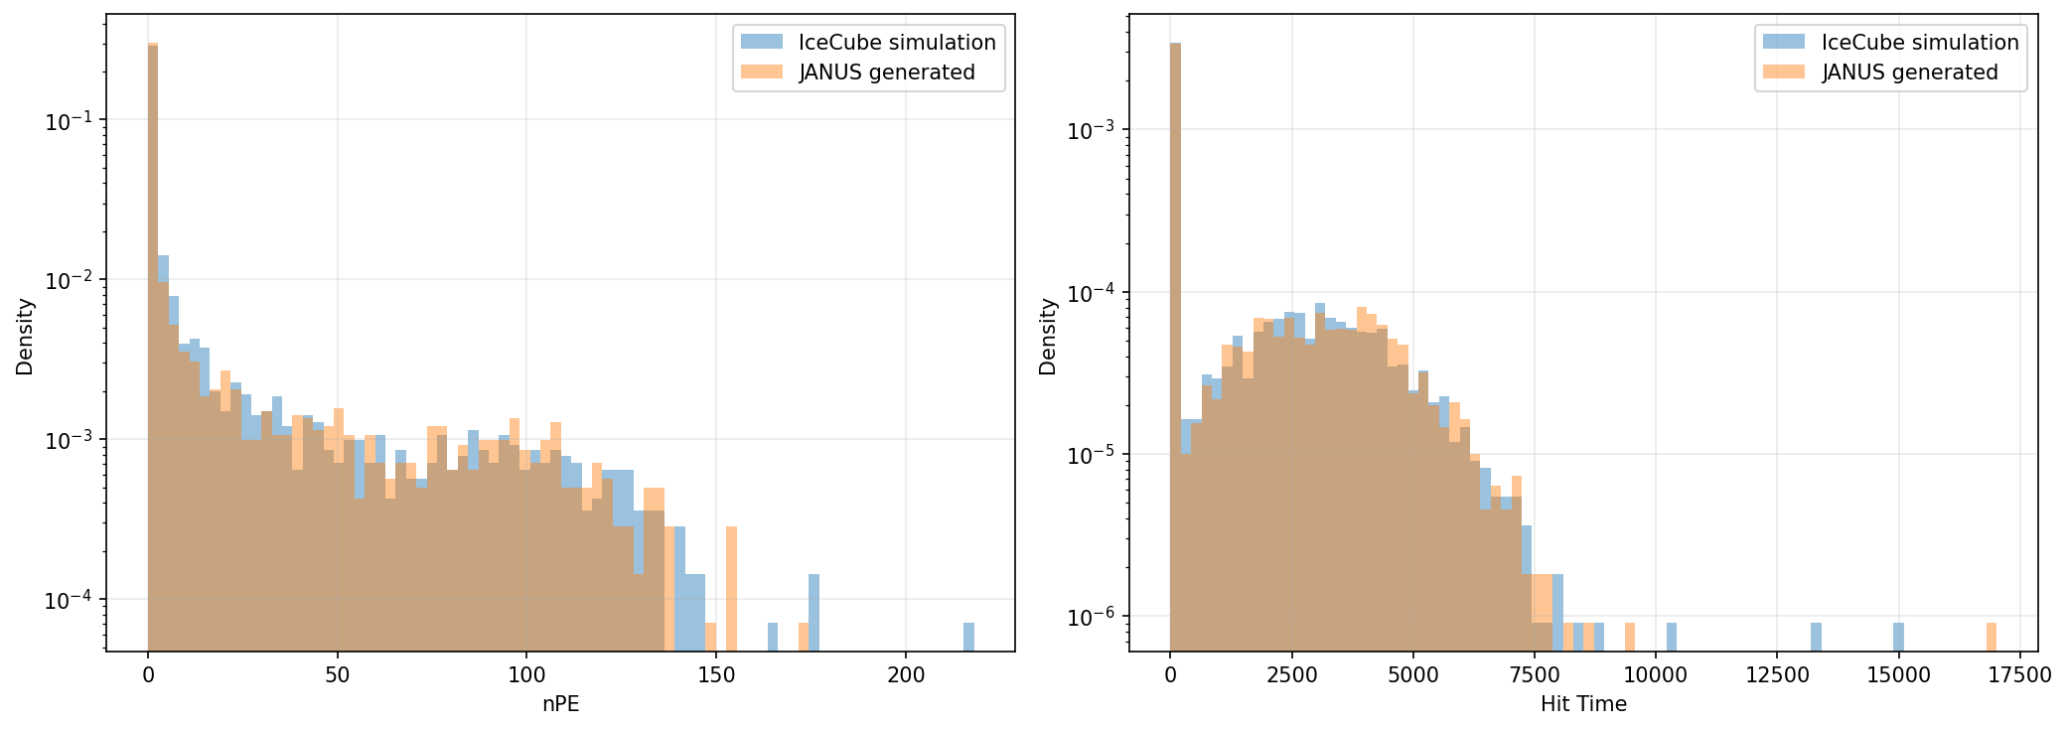
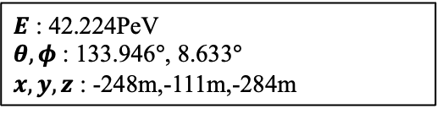
05
JANUS Performance
Generated Event 1
$E$ : 42.224PeV
$θ,φ$ : 133.946$°$, 8.633$°$
$x,y, z$ : -248m,-111m,-284m
IceCube Simulation
JANUS Generated
Notes:
여기 이야기 아니면 마지막에 이야기 보여주면서 이야기 하던가 (여기서 이야기) 시뮬레이션 이벤트 true 라는 말이 맞는 거 같다 true event JANUS 시뮬레이티드 이벤트
Icecube simulation janus generated

Slide 9
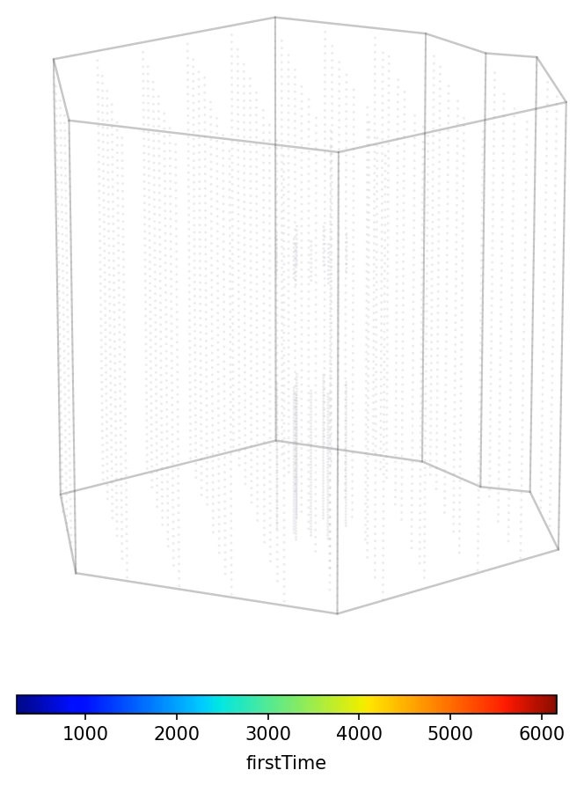

05
JANUS Performance
Generated Event 1 - Video
$E$ : 42.224PeV
$θ,φ$ : 133.946$°$, 8.633$°$
$x,y, z$ : -248m,-111m,-284m
Notes:
여기 이야기 아니면 마지막에 이야기 보여주면서 이야기 하던가 (여기서 이야기) 시뮬레이션 이벤트 true 라는 말이 맞는 거 같다 true event JANUS 시뮬레이티드 이벤트
/home/work/icecube_janus/JANUS/tasks/rectified_flow_0413_jointzero_transformer/ztesting_color/method_dopri5/rank_06_ref_90320/sample_003_ref_90320_denorm.npy
/home/work/icecube_janus/JANUS/tasks/rectified_flow_0413_jointzero_transformer/ztesting_color/method_dopri5/rank_09_ref_121512/sample_001_ref_121512_denorm.npy

Slide 10
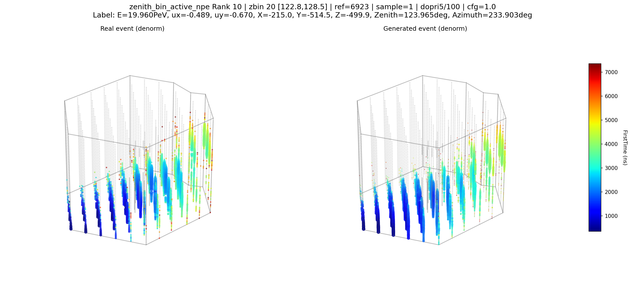
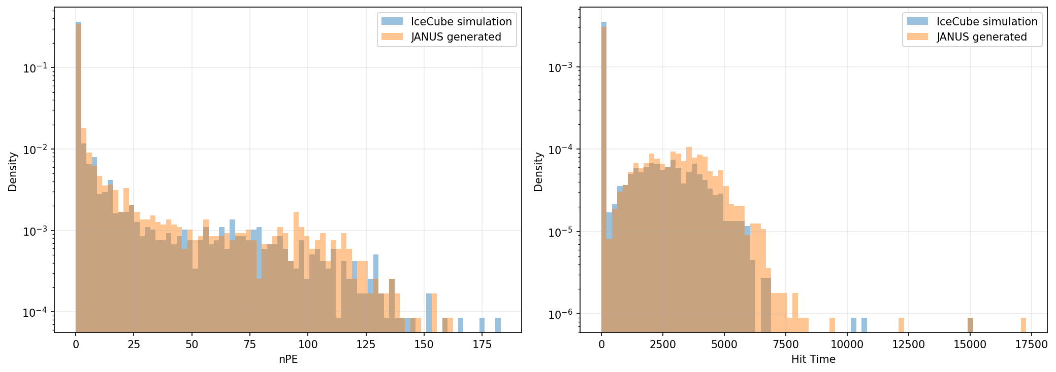
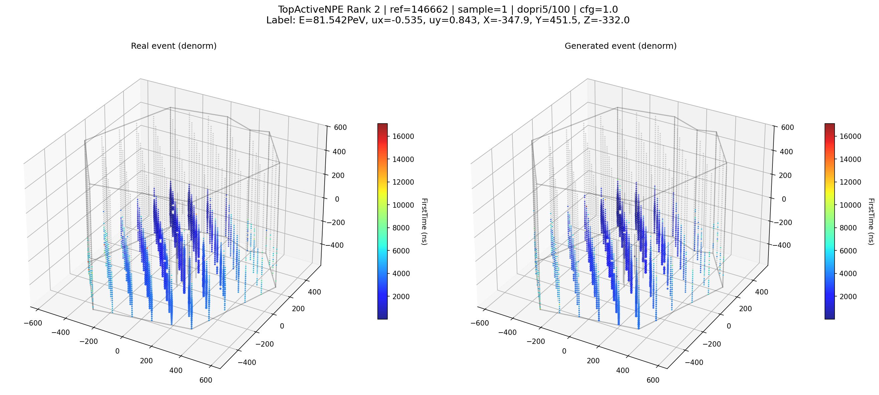
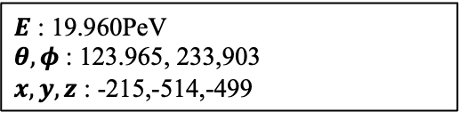
05
JANUS Performance
Generated Event 2
$E$ : 19.960PeV
$θ,φ$ : 123.965, 233,903
$x,y, z$ : -215,-514,-499
IceCube Simulation
JANUS Generated
Notes:
여기 이야기 아니면 마지막에 이야기 보여주면서 이야기 하던가 (여기서 이야기) 시뮬레이션 이벤트 true 라는 말이 맞는 거 같다 true event JANUS 시뮬레이티드 이벤트
Icecube simulation janus generated

Slide 11
05
Summary
Summary & Future Work
Summary
We trained JANUS using a optimal transport flow matching.
To the best of our knowledge, this is the first application of generative AI to Icecube neutrino event
JANUS captures the overall trends of track events
Future Work
Design a summary statistic for the JANUS generated events
Likelihood evaluation and parameter inference with JANUS

Slide 12
Thank you for your Attention
Fell free to contact me at :
pmj0324@g.skku.edu
pmj032400@naver.com
Any questions or discussion is welcome
“What I cannot create, I do not understand.” – Richard Feynman
A model understands if it can generate.

Slide 13
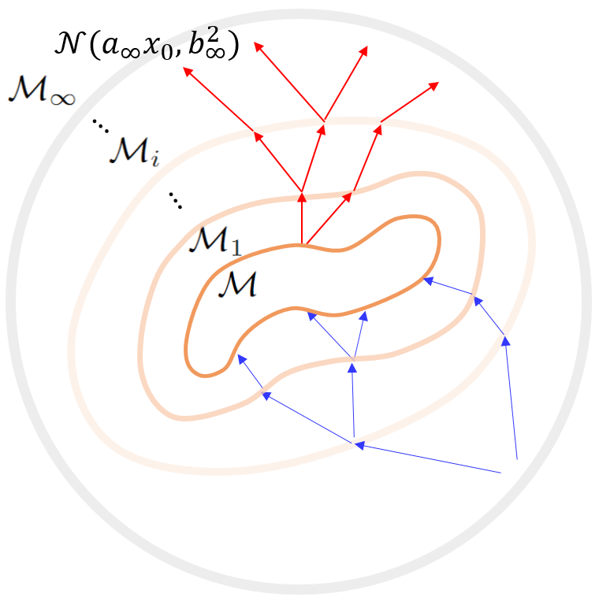
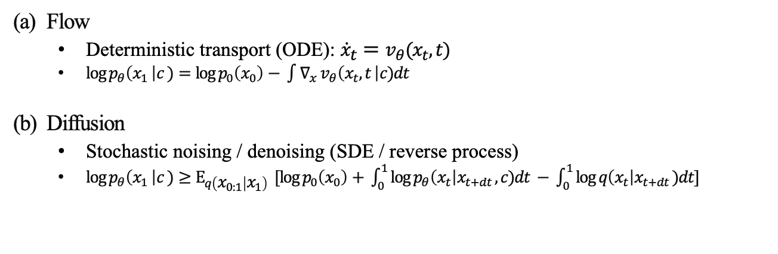
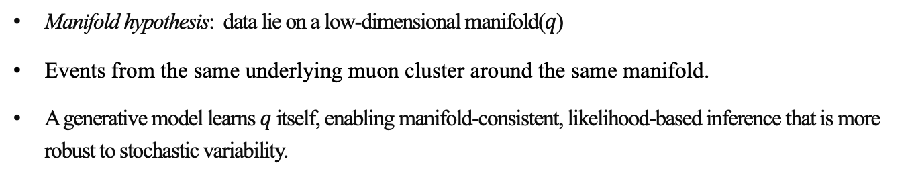
A
Motivation for JANUS
Why Generative AI
How can we infer from just training to sample the event
Flow
Deterministic transport (ODE): ${\dot{x}}_{t}=v_{θ}(x_{t}, t)$
$\log{p_{θ}\left(x_{1} \right|c )=\log{p_{0}\left(x_{0}\right)− \int{∇_{x} v_{θ}\left(x_{t}, t \right|c)dt }}}$
Diffusion
Stochastic noising / denoising (SDE / reverse process)
${\log{p_{θ}\left(x_{1} \right|c )≥Ε}}_{q\left(x_{0:1} | x_{1}\right)} [\log{p_{0}\left(x_{0}\right)+ \int_{0}^{1}{\log{p_{θ}\left(x_{t}\right|x_{t+dt }, c)dt − \int_{0}^{1}{\log{q\left(x_{t}\right|x_{t+dt })dt}]}}}}$
Why should we use it rather than basic regression model
Manifold hypothesis: data lie on a low-dimensional manifold($q$)
Events from the same underlying muon cluster around the same manifold.
A generative model learns $q$ itself, enabling manifold-consistent, likelihood-based inference that is more robust to stochastic variability.

Slide 14
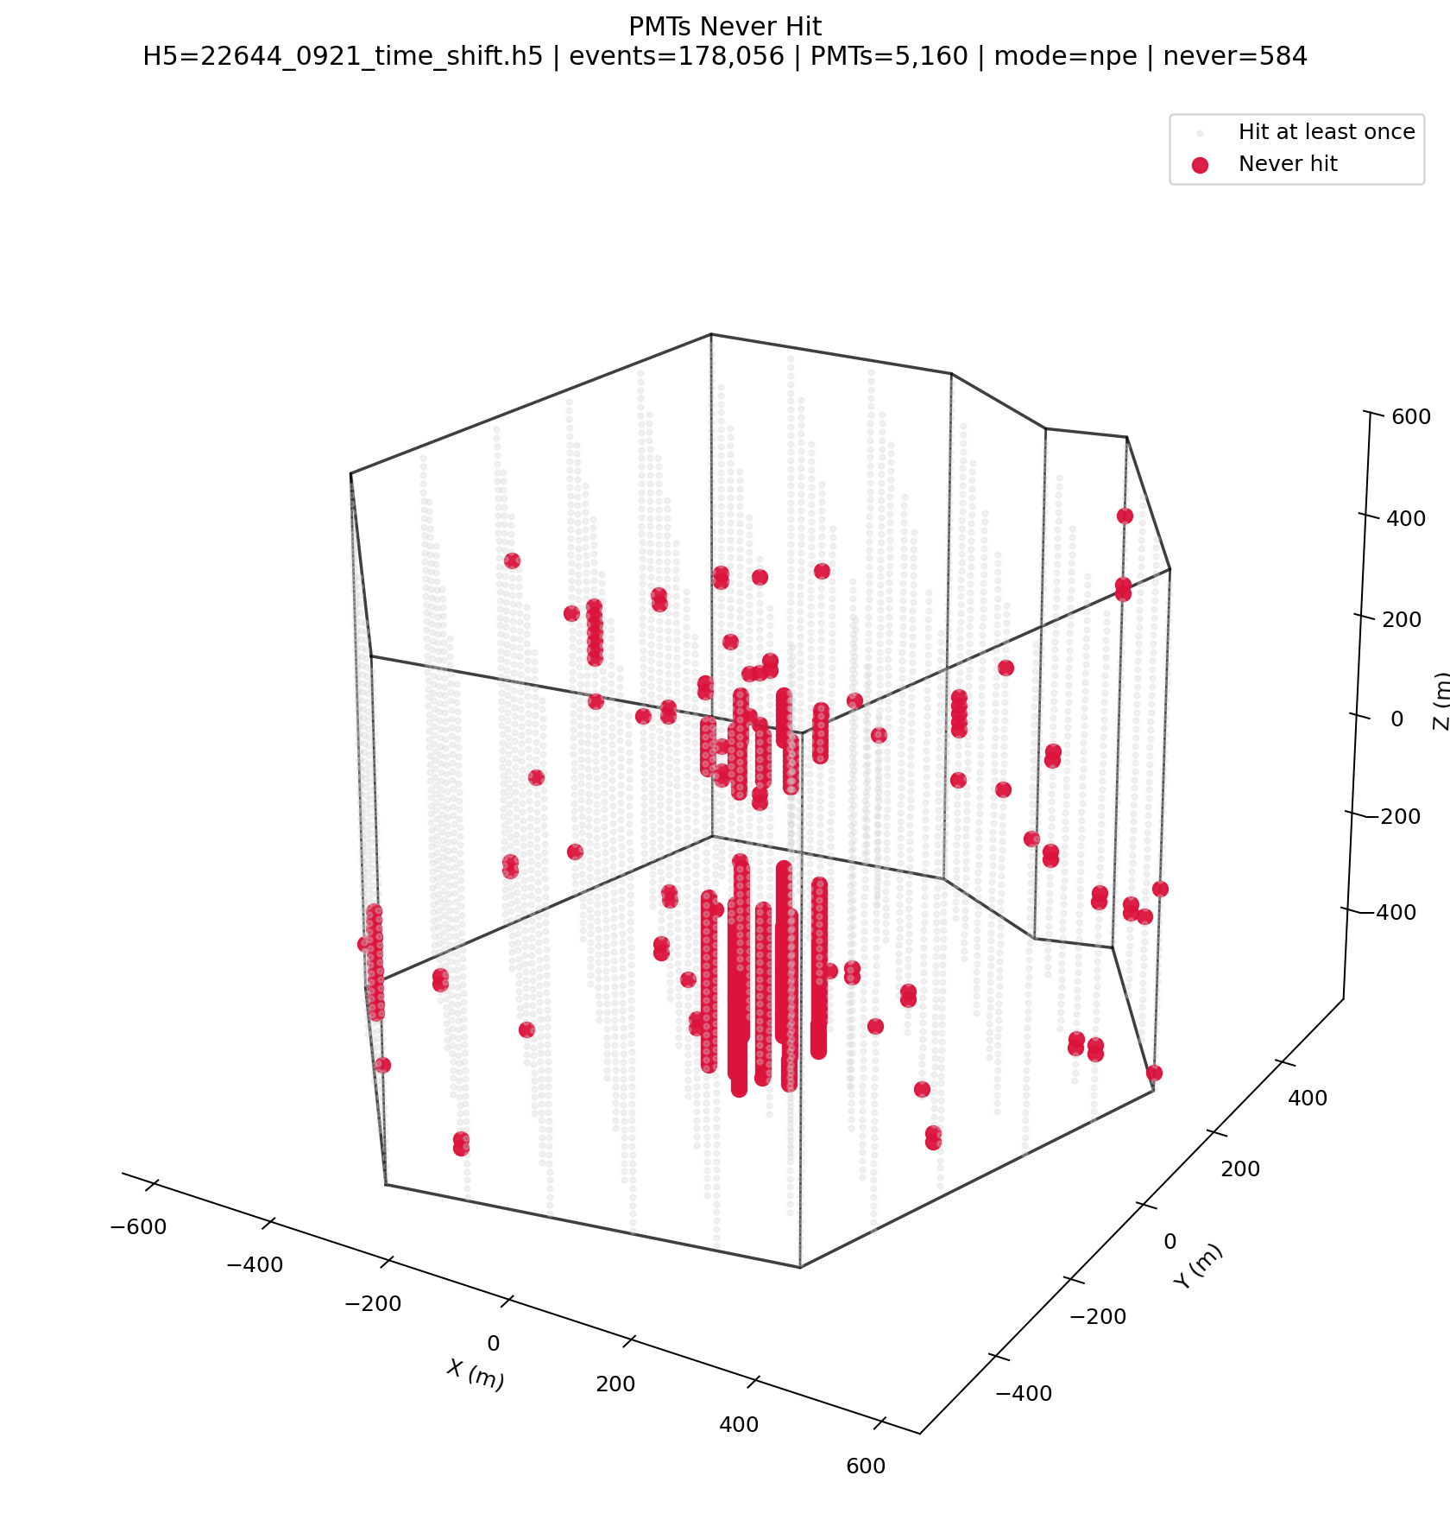
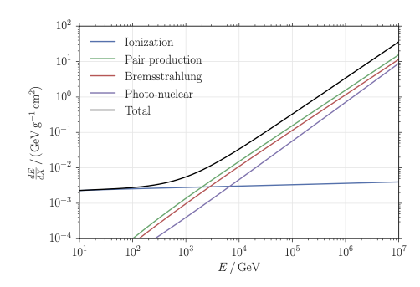
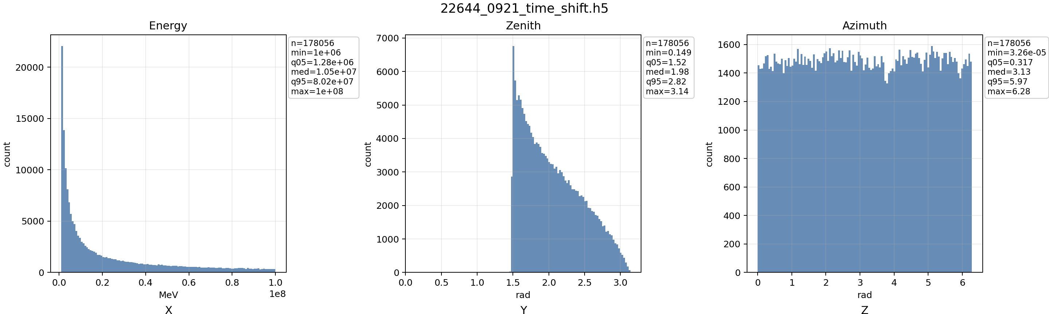
01
Diffusion & Flow Models
Reference
[1]

Slide 15
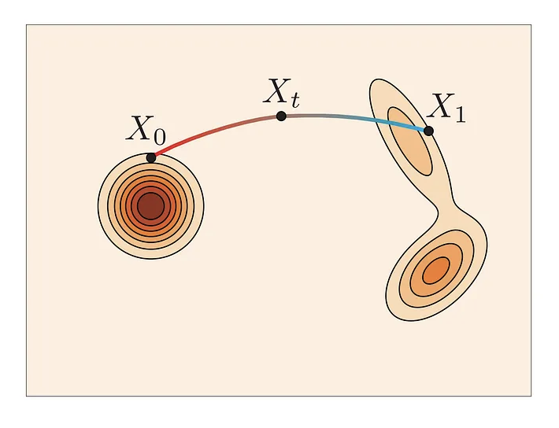
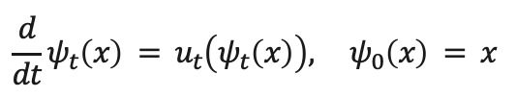







Model ;earns to transport simple distribution $p$ to $q$
Flow Mathing is to using flow defined by vector field
04
JANUS Design & Architecture
Flow Matching & Generative AI
In general, Generative AI is model that can generate data ; such as image or video
Objective of Generative AI is to model the data distribution ($q$)
Flow Matching is subset of Generative AI
learns a flow, $ψ_{t}$, that the pushforward $p_{0}→ q$
$$\frac{d}{dt}ψ_{t}\left(x\right) = u_{t}\left(ψ_{t}\left(x\right)\right), ψ_{0}\left(x\right) = x$$
$$ℒ_{fm}=𝔼_{x_{t}, t}\left[u_{t}^{model}(x_{t})−u_{t}^{traget}(x_{t})\right]$$
$${\left(ψ_{1}\right)}_{\#} p_{0} = q$$
$$ℒ_{cfm}=𝔼_{x_{1}, x_{0},t}\left[u_{t}^{model}\left(x_{t}\right)−(x_{1}−x_{0})\right]$$
$$\dot{x_{t}}=x_{1}−x_{0}=u_{t}\left(x_{t}\right|x_{1})$$
$${∇ ℒ}_{fm}={∇ ℒ}_{cfm}$$
$$x_{t}=tx_{1}+\left(1−t\right)x_{0} \sim tx_{1}+\left(1−t\right)N(0, I)$$
$$p_{t}\left( x_{t} \right|x_{1} )=N( tx_{1} , {\left(1−t\right)}^{2}I )$$
$$E\left[{\left\|u_{θ}\left(x_{t}, t\right) − u_{t}\left(x_{t}\right)\right\|}^{2}\right]$$
the velocity field uₜ drives the flow ψₜ:
Training objective becomes find the vector field that satisfy
Start from a simple source distribution $p$ and learn a transformation $p$ → $q$ : defined as a time-dependent path $p_{t}$
pushforward gives exact log-likelihood:
Notes:
Flow matching is the tryes to learn the flow that transport the source distribution p0 to data distrubtion q
Flow here is a solution to the vectrior field with means the point of the source distribution move aloung the vector fild
If we larning the flow propaly

Slide 16
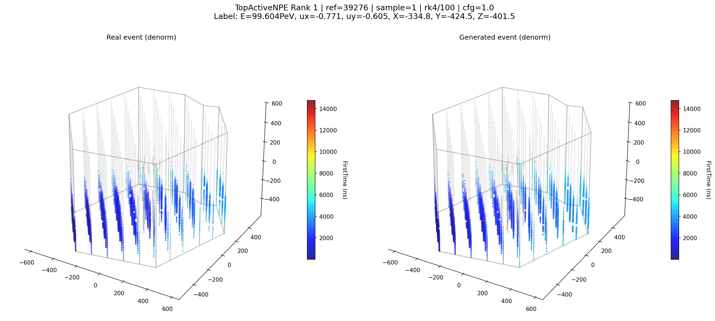
A
Diffusion & Flow Models
Never Hit PMT in 22644
[1]

Slide 17


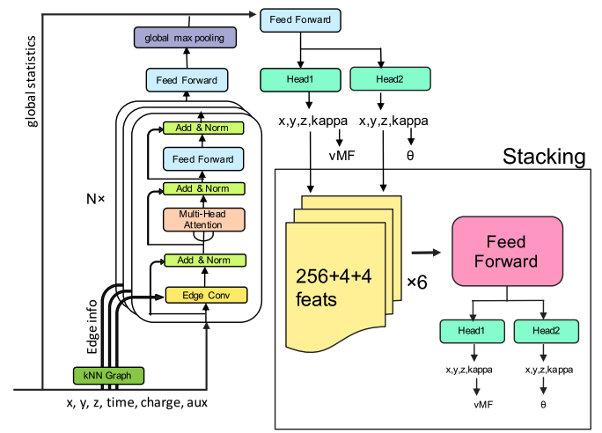
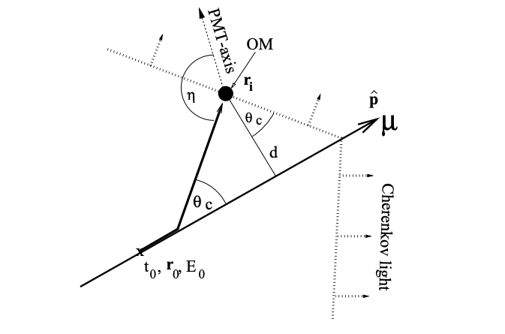
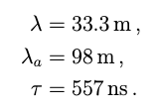
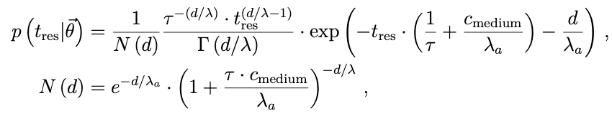
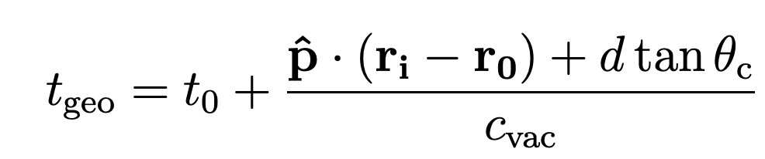


02
Muon Neutrino Event in IceCube
Track Reconstruction in IceCube
Track events has a angular resolution of < 1$°$ $→$Main channel for neutrino’s source study
IceCube has mainly two reconstruction methodology for muon reconstruction
Pandel Function
Likelihood Reconstruction based on Photon Arrival time Modeling
Photon arrival time depends on the ice property and relative position between DOM and muon track.
Studies have motivated the use of the Pandel function to model the photon arrival time
2. Regression Model using Neural Network
Event
Line-fit
Scattering length , Absorption length, is fixed to the values following
Neural Network
Arrival Time Based
Likelihood
Pandel SPE
Pandel MPE
Only free parameter is d, distance between the track and DOM.
Spline MPE
Example
Example
Many other Network exists
Track Parameter
Detail in Appendix
$$ψ=0.7°∙(E_{ν}/TeV)$$
Similar limitations appear in some other ML-based reconstruction
We hypothesize that this is because most ML-based reconstructions are primarily feature-extraction (i.e., regression) models
map detector observations to a track parameters.
To address this, we adopted a Generative AI instead of a regression-based model.
(Right) show the track-like event reconstruction pipeline Result of previous method is used as a seed
Notes:
앞에 설명한 것처럼 CC muon만이 track like signature를 만든다. 이런 track signature덕분에 angulare resolution이 상대적으로 좋다 1도 정도 그래서 뉴트리노 소스 서치의 주요한 channel이다

Slide 18
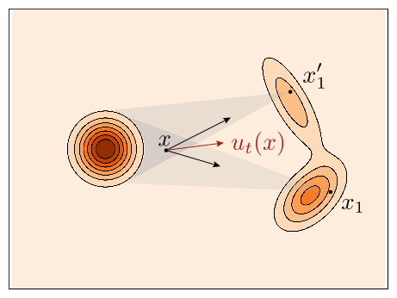
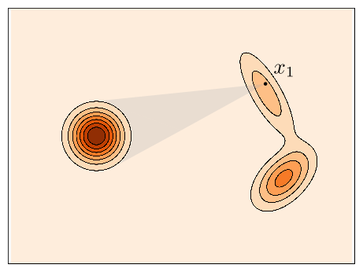
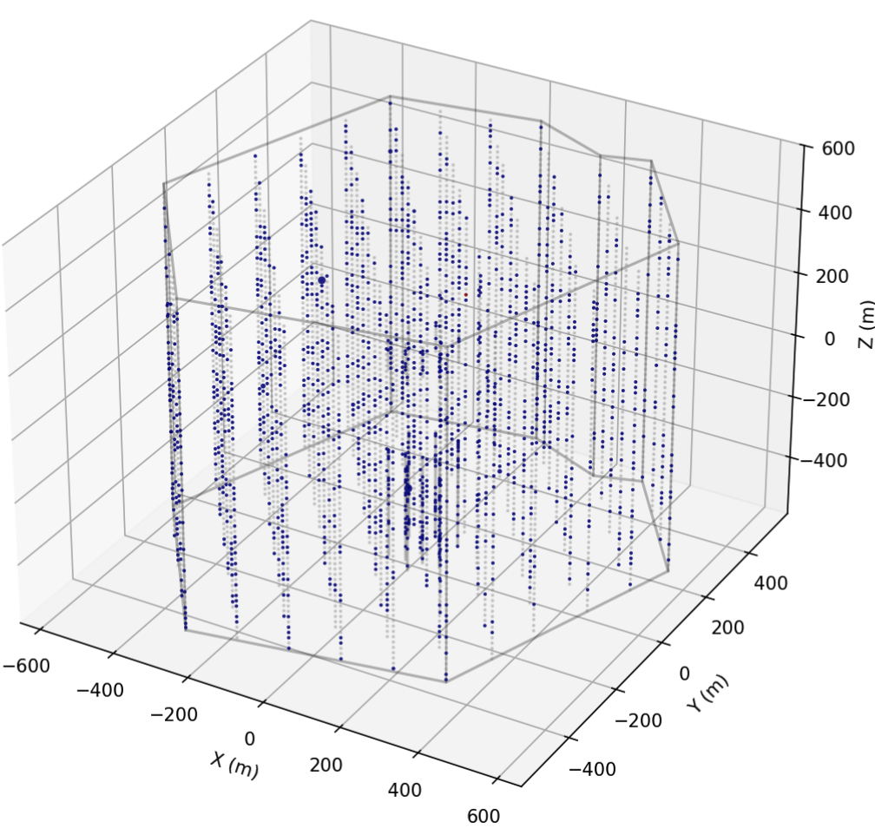
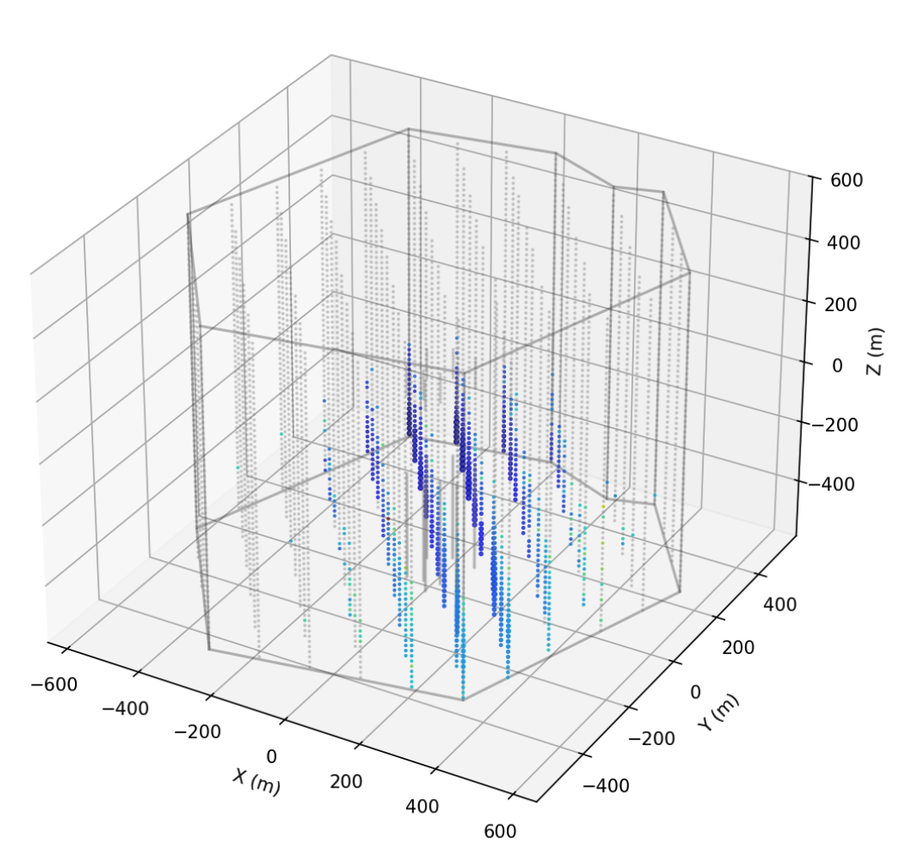










04
JANUS Design & Architecture
Training Objective
Original objective of FM is
$$L_{FM}=E_{\left\{t, x_{0}\right\}} {\left\|u_{θ}\left(x_{t}, t\right)−u_{t}(x_{t}) \right\|}^{2}$$
however, where
$$x_{1} \sim q_{data}$$
define
$$L_{CFM}=E_{\left\{t, x_{0},x_{1}\right\}} {\left\|u_{θ}\left(x_{t}, t\right)−u_{t}\left(x_{t} \right|x_{1}) \right\|}^{2}$$
then
$${∇_{θ} L}_{FM}={∇_{θ} L}_{CFM}$$
Let
$$p_{t}\left( x_{t} \right|x_{1} )=N( tx_{1} , {\left(1−t\right)}^{2}I )$$
$$x_{t}=tx_{1}+\left(1−t\right)x_{0} \sim tx_{1}+\left(1−t\right)N(0, I)$$
$$\dot{x_{t}}=x_{1}−x_{0}=u_{t}\left(x_{t}\right|x_{1})$$
In conclusion our loss function is in this form
$$L_{CFM}=E_{\left\{t, x_{0},x_{1}\right\}} {\left\|u_{θ}\left(x_{t}, t\right)−(x_{1} −x_{0}) \right\|}^{2}$$
$$x_{0}$$
$$x_{1}$$
Notes:
조금 길었다 이거는 간략하게 인 컨클루션 하지 말고 다른 말로 바꾸지 말고

Slide 19
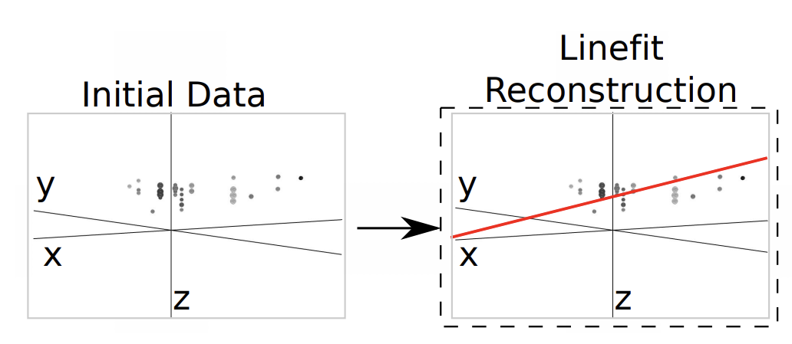
2. Current Muon Track Reconstruction
Line-fit
19
Very first step is called line-fit
Simply finding the track that minimizes the squared distance errors between the triggered DOMs
Obviously optical ice properties are not taken into account
Notes:
first step, called “line-fit.” It simply finds the track that minimizes the squared distance errors between
the triggered DOMs and the track.

Slide 20
2. Current Muon Track Reconstruction
PandelSPE
20
SPE : Single Photo Electron
PandelSPE uses the arrival time information of only first Cherenkov photon.
Pandel Function
Photon arrival time depends on the ice property and relative position between DOM and muon track.
Studies have motivated the use of the Pandel function to model the photon arrival time
Scattering length , Absorption length, is fixed to the values following
Only free parameter is d, distance between the track and DOM.
Notes:
The next step is called likelihood based reconstruction PandelSPE.
SPE stands for Single Photo Electron, which means it uses only the first photon information for the likelihood
And Pandel is the name of the pdf we are going to use in this likelihood.

Slide 21
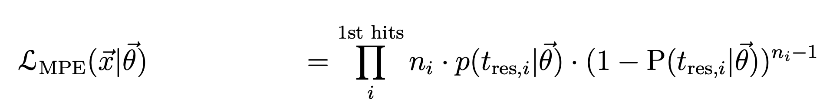
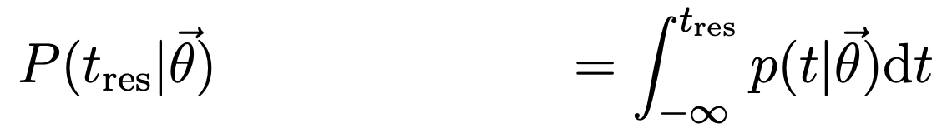
2. Current Muon Track Reconstruction
PandelMPE
21
MPE : Single Photo Electron
PandelMPE uses the first arrival time information and number of measured photon
Pandel Function
Photon arrival time depends on the ice property and relative position between DOM and muon track.
Studies have motivated the use of the Pandel function to model the photon arrival time
Scattering length , Absorption length, is fixed to the values following
Only free parameter is d, distance between the track and DOM.
Notes:
The next step is called likelihood based reconstruction PandelSPE.
SPE stands for Single Photo Electron, which means it uses only the first photon information for the likelihood
And Pandel is the name of the pdf we are going to use in this likelihood.

Slide 22
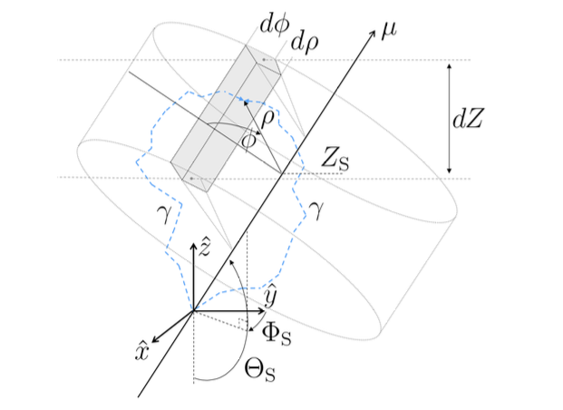
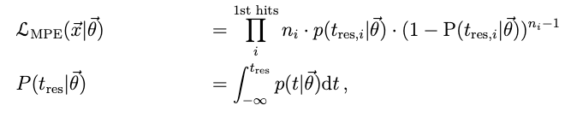
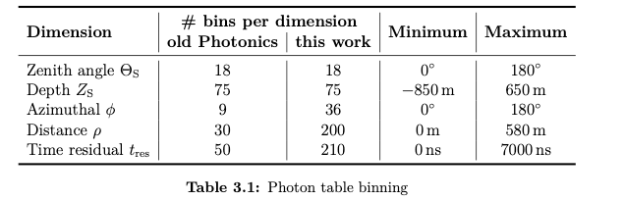
2. Current Muon Track Reconstruction
SPlineMPE
22
But we know that scattering & absorption length varies over depth.
So setting absorption & scattering length fixed , which is done in Pandel MPE, is not great option
In this context SplineMPE accrued
SplineMPE uses likelihood formula same as PandelMPE
But Instead of using Pandel function it creates
PDF based on photon distribution table binned as Table 3.1,
Also it uses splines (B-spline) technique for the interpolations
Notes:
But we know that scattering & absorption length varies over depth.
So setting absorption & scattering length fixed , which is done in Pandel MPE, is not great option
SplineMPE ,which is next reconstruction method after the result of PandelMPE,addresses the fact that scattering and absorption lengths vary with depth,
So instead of using the Pandel function,
it builds the PDF from binned light distribution tables, which is generated by the simulation with the IceModel, with employing B-splines for interpolation.

