Slide 1


SMART INDIA HACKATHON 2025
TITLE PAGE
Problem Statement ID – 25040
Problem Statement Title- FloatChat
Theme- Miscellaneous
PS Category- Software
Team ID-T76
Team Name – Team OG

Slide 2
FloatChat
Team OG
Why? (Problem)
Oceanographic data (satellites, CTD, ARGO floats, BGC sensors) is huge, complex & stored in difficult formats like NetCDF.
Non-technical users (policy makers, students, early researchers) struggle to access, query & visualize this data.
Current tools require domain knowledge + coding skills → limits accessibility.
With AI + LLMs + modern databases, we can now make ocean data more democratic, intuitive, and interactive.
Problem Resolution:
Data Inaccessibility: Argo’s vast NetCDF data (via GDACs) is complex, limiting use by policymakers, educators, and managers .
Technical Barrier: Current tools require expertise, delaying real-time insights for climate, weather, and ecosystem needs .
Solution Delivery: Chatbot and dashboard interpret natural language, use PostGIS for geospatial searches, and deliver results in <3 seconds . Regional Impact: Address underutilization in data-rich Indian Ocean for timely decision-making.
Unique Value Proposition (UVP):
Unmatched Accessibility: First platform combining NLP with Argo data for non-experts, powered by FAISS semantic search and PremSQL .
Real-Time Insights: Streamlit dashboard offers interactive maps and BGC comparisons tailored to user queries .
Global Impact: Democratizes ocean data for climate strategies and local ecosystem management.
Light weight self hostable text to data package.
What? (Solution Idea)
Build an AI-powered conversational system for ARGO float data and Allow natural language queries
Output: clear tables, plots (temp/salinity.. vs depth), float trajectories on maps, and easy-to-read explanations.

Slide 3
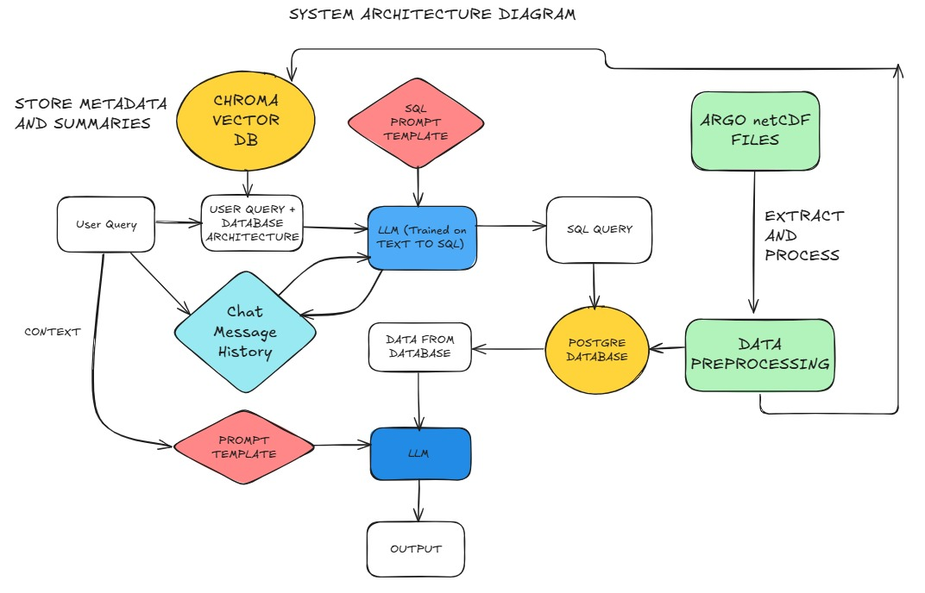



TECHNICAL APPROACH
Team OG
Data Ingestion: Parse Argo NetCDF files (~100,000 Indian Ocean profiles) using xarray to extract metadata and profiles .
Database Storage: Store metadata in PostgreSQL with PostGIS for geospatial queries, full profiles in Parquet, and embeddings in FAISS for semantic search .
Query Processing: Use RAG pipeline—encode queries with sentence-transformers, search FAISS, and generate SQL with PremSQL for PostgreSQL/Parquet retrieval .
Visualization & Interface: Build interactive dashboard and chatbot with Streamlit, leveraging Plotly for maps and depth-time plots .
ChatHistory: We maintain conversation by assigning each chat a session ID linked to a ChatMessageHistory, where we store user queries and their generated SQL within a fixed context window. When a follow-up query comes, the LLM uses past queries + SQL to generate the new SQL with proper context.
Twin LLM Architecture: Incorporate an additional LLM to (i) extract context from user queries before passing them to PremSQL for more accurate SQL generation, and (ii) interpret tabular outputs from the database into natural language explanations, ensuring clarity for non-technical users.
Tech Stack :
Database - Postgre SQL , Chroma Vector DB
Frontend - Streamlit , Tailwind CSS
Backend - Python, Langchain , open source llm models , Langchain API
Data Preprocessing - Numpy , Pandas , xarray

Slide 4
FEASIBILITY AND VIABILITY
Team OG
Technical Feasibility The solution leverages existing AI/ML(PremSQL,Gemine) models and proven components, including vector databases (FAISS/Chroma), and visualization frameworks (Plotly, Streamlit). With validated technologies and low integration risk, the system is reliable, scalable and straightforward to implement.
Potential Challenges and risks:
Performance Bottlenecks: Large datasets (~100,000 profiles) could slow queries or visualizations .
PremSQL Accuracy: Generated SQL may contain errors, even with correct sql structure. PremSQL struggles with deep joins and nested queries
Team Expertise: Handling relatively new file formats such as .nc and parquet files is difficult in the beginning.
Market Feasibility With ~34,000 researchers and ~9,400 institutions working in marine/ocean sciences worldwide, the system has a large potential user base especially in academia, government, and research bodies.
Operational Feasibility Deployment is simple via cloud or local servers, and the system requires minimal user training due to its natural language interface. Updating embeddings and databases with new ARGO data is straightforward, and the modular design ensures easy maintenance and future expansion.
Strategies for overcoming these challenges:
Data Quality: Validate downloads with GDAC checksums; use argopy for reliable access and fallback to local backups.
Performance: Optimize FAISS indexing, use Dask for Parquet, and scale to cloud if needed .
PremSQL Accuracy: Test SQL against known data, provide detailed schema context, and implement query validation. Also, can change the model to granite 20B for more accuracy (but hardware constraints remain) Scalability: Start with PoC subset, design modular code, and plan cloud migration for global deployment.
Financial Feasibility Freely accessible Argo data (GDACs) and open-source libraries reduce costs and open-source tools for storage and visualization. We only require basic cloud deployment. The main cost is running LLMs, but this can be reduced by using smaller open-source or fine-tuned models, keeping the solution sustainable and scalable.

Slide 5
IMPACT AND BENEFITS
Team OG
Potential Impact on Target Audience:
Policymakers: Gain real-time ocean insights (e.g., salinity trends) for informed climate policies and disaster preparedness.
Educators: Access interactive visualizations (e.g., depth-time plots) to enhance oceanography teaching and student engagement.
General Public: Foster awareness of ocean health through an intuitive chatbot, bridging science and community.
Researchers: Accelerate data exploration with natural language queries, reducing analysis time for global studies.
Benefits of the Solution:
Social: Empowers non-technical users with knowledge, promoting ocean literacy and community-driven conservation efforts.
Economic: Reduces costs for data analysis by automating queries, benefiting industries like fisheries and shipping.
Environmental: Supports climate modeling and ecosystem protection by making Argo data actionable for mitigation strategies.
Technological: Advances AI applications in oceanography, setting a scalable model for global data platforms.
Global Reach: Extends benefits to developing regions (e.g., Indian Ocean nations) with free, accessible insights.

Slide 6
RESEARCH AND REFERENCES
Team OG
Sources we’ve referred to:
https://yale-lily.github.io/spider
https://github.com/premAI-io/premsql
https://developer.ibm.com/tutorials/awb-text-to-sql-using-llms/
https://arxiv.org/abs/2208.13629
https://nrlgodae1.nrlmry.navy.mil/ftp/outgoing/argo/
https://oneargo-user-manual-a1e33f.gitlab-pages.ifremer.fr/chapter2.html
https://www.notion.so/27ae2b03125c80698efad070c8b1f584?source=copy_link

