Slide 1
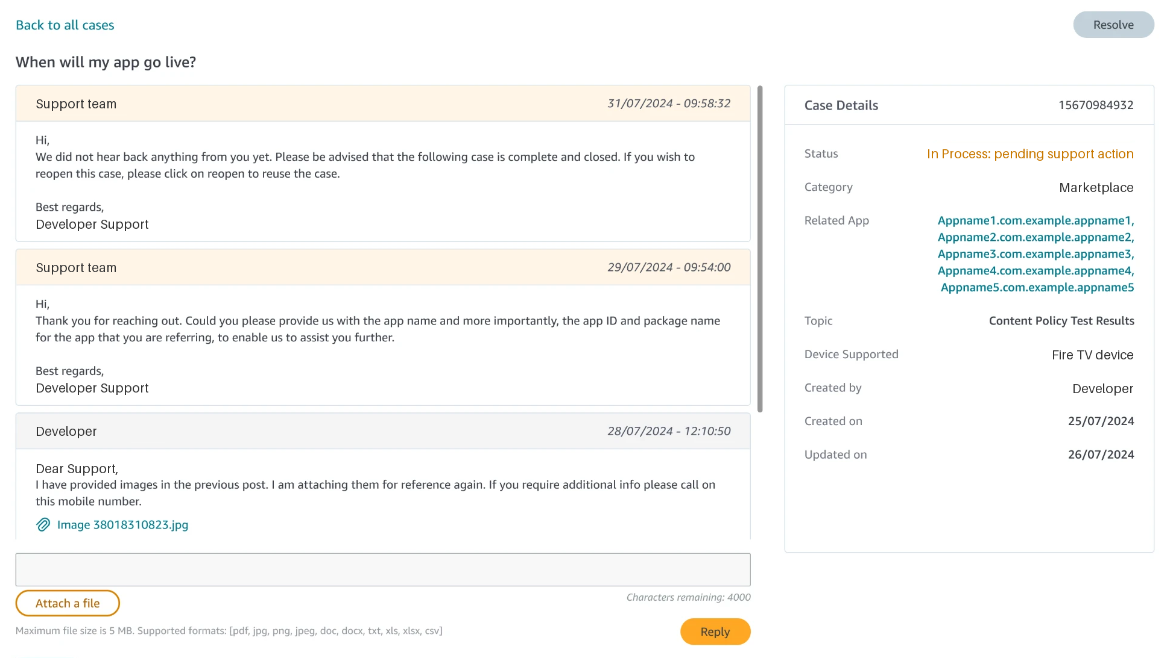
CASE STUDY · PRODUCT DESIGN · DEVELOPER TOOLS
Helping Amazon developers follow their support cases
What began as a request for two-way communication became a rethink of the support case itself.
After · The case page. Example data.
ROLE
TEAM
Lead designer
PM, TPM, engineering, research
PLATFORM
COMPANY
Web · Developer console
Amazon Developer Experience

Slide 2
01 · SUMMARY
Developers could open a support case, but not follow it.
Email carried the whole conversation. I turned the case into a page they can open, follow and return to.
~47%
~87%
Halved
3 weeks
fewer cases after Phase 1
after the Phase 2 widget (shared with the platform team)
turnaround time, roughly
of design, plus a week of review
02

Slide 3
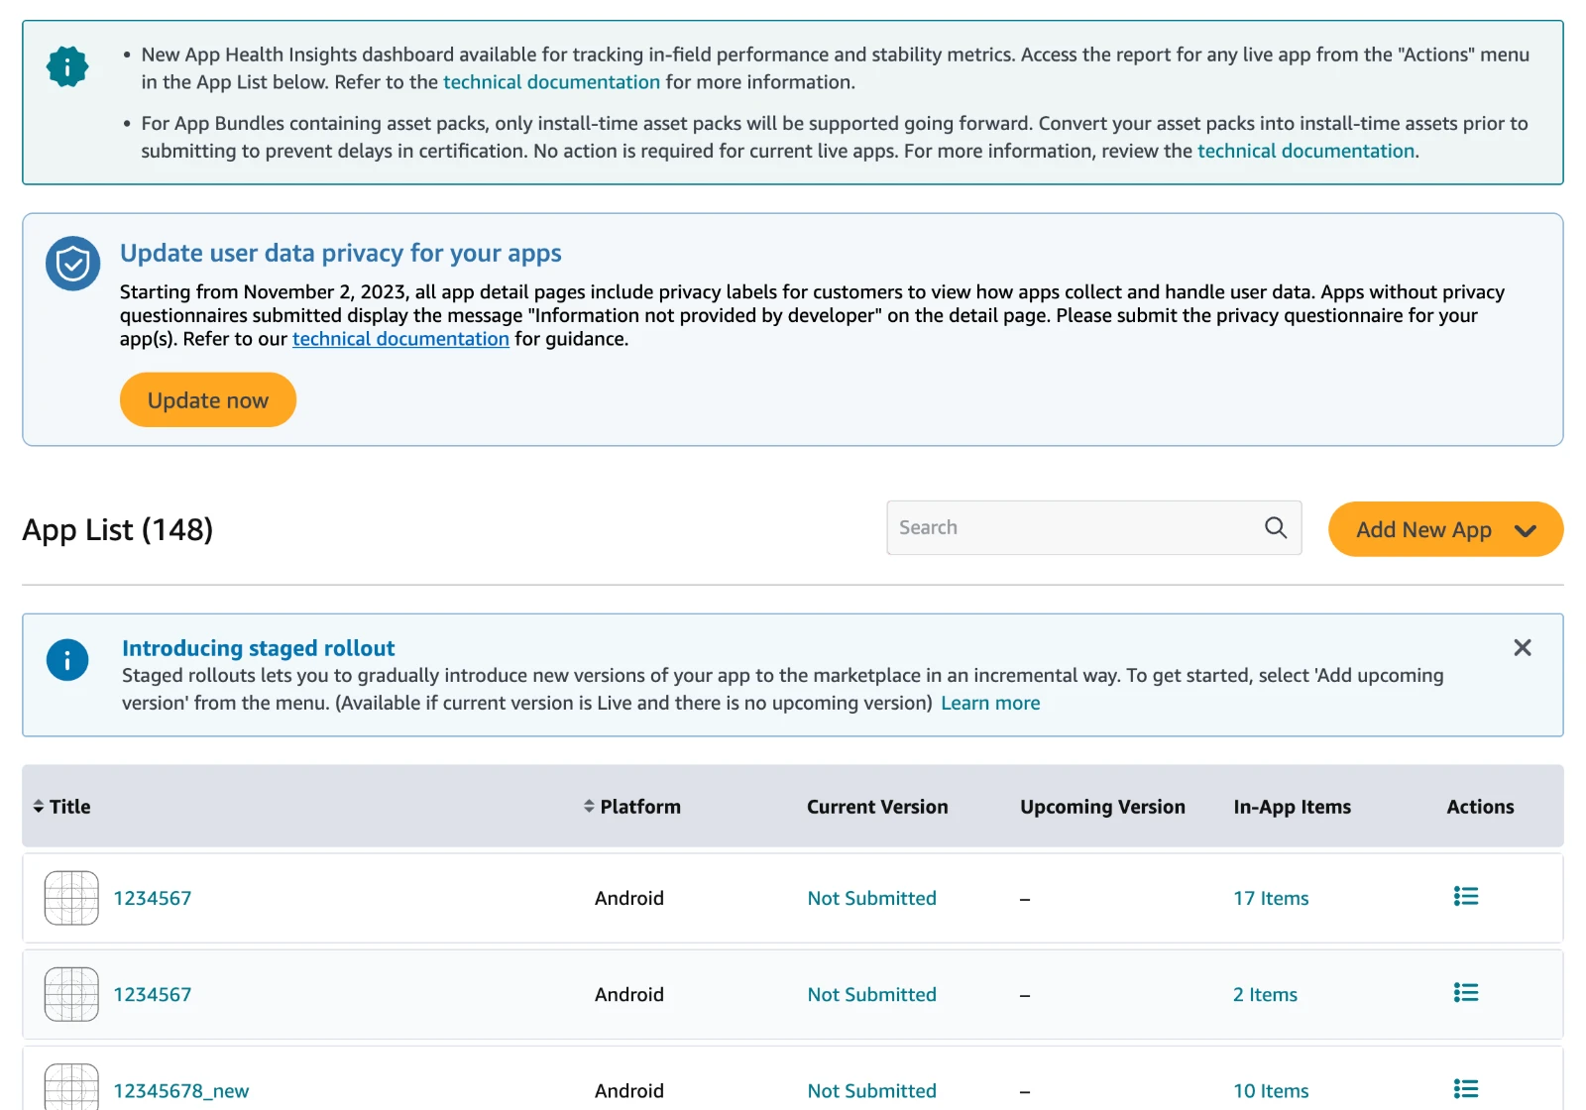
02 · PROBLEM
A case was never a thing a developer could hold.
Follow-ups became new cases
One problem, several tickets.
History lived in inboxes
Reviewing a case meant searching mail.
Silence
No sign anyone was working on it.
Before · A support reply has nowhere to live.
No single record
5 teams, 7 tools, no patterns.
03

Slide 4
02 · PROBLEM · THE DATA
Real demand, slow answers, scattered voices.
13.9k
~9 in 10
10–14 days
cases in eight months of 2023, only 2% spam
resolved within 14 days
wait for managed partners via a shared mailbox
Forums named “responsiveness” and “support” as the main negative drivers.
04

Slide 5
03 · ROLE & APPROACH
Three weeks, one designer, a plan a year old.
ROLE
APPROACH
Lead designer
Joined Q3 2024. Strategy and research predated me.
Launch and learn
Random share of unmanaged developers first.
Scope
Creation, status, conversation, history.
Protect partners
Same email habit, new address.
Phase 2
I proposed the widget; the platform team built it.
Keep the forum
Out of scope.
Constraint
A retail design system I did not own.
Phase 1 → 2
Case tool first, help widget second.
05

Slide 6
04 · CHOICES
What I rejected, and what we held back.
Rejected
A read-only viewer on email, which would not stop follow-ups becoming new tickets.
Rejected
A chat-first model: a much larger change, not on the roadmap.
Held back
A promised resolution date. A missed date costs more trust than silence.
Held back
Trend analysis. It needs the single record to exist first.
06

Slide 7
05 · FIVE DECISIONS · 1 OF 5
The console holds the conversation, and email mirrors it
One thread, newest first. Replies from console and email land together. Resolved cases re-open for 30 days.
Phase 1 · The case page. Example data.
07

Slide 8
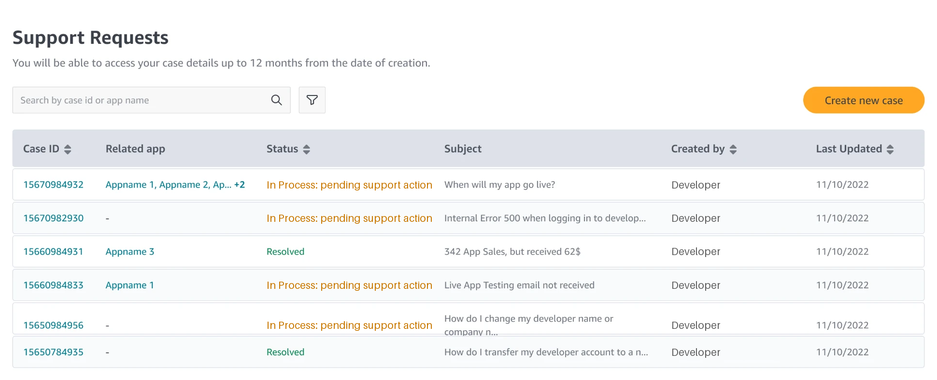
05 · FIVE DECISIONS · 2 OF 5
Status is the headline, from the developer’s side
Pending your action. Pending support action. Resolved. Whose move it is, on every row.
Phase 1 · The case list. Example data.
08

Slide 9
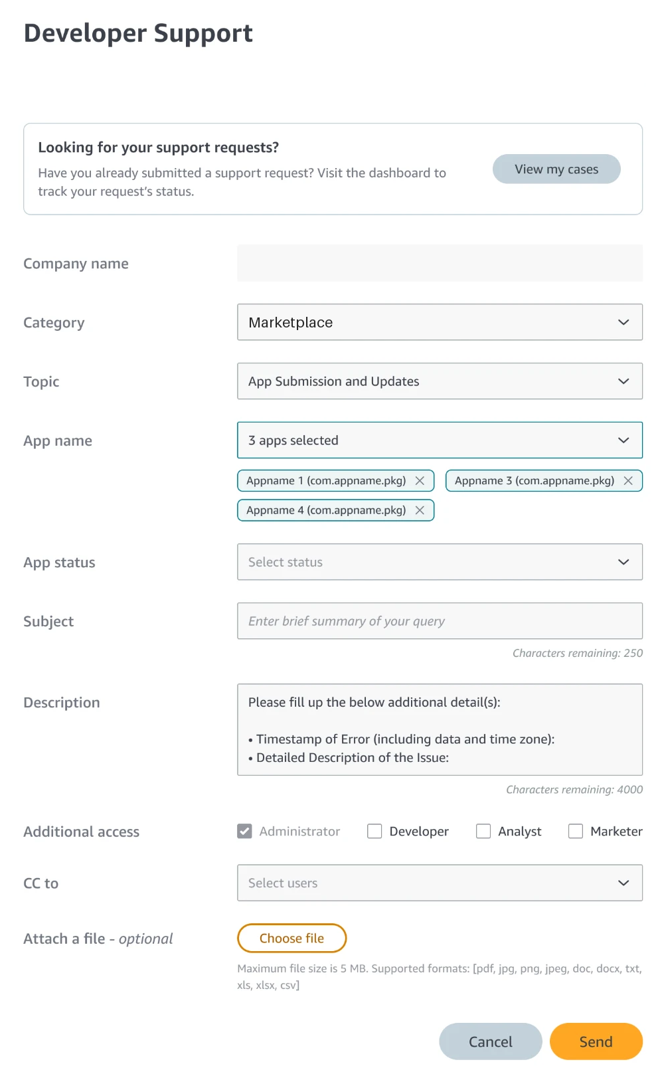
05 · FIVE DECISIONS · 3 OF 5
Collect context up front, accept a longer form
Support’s first reply was a question. Now the form asks it, so the first reply is an answer.
Phase 1 · The form. Example data.
09

Slide 10
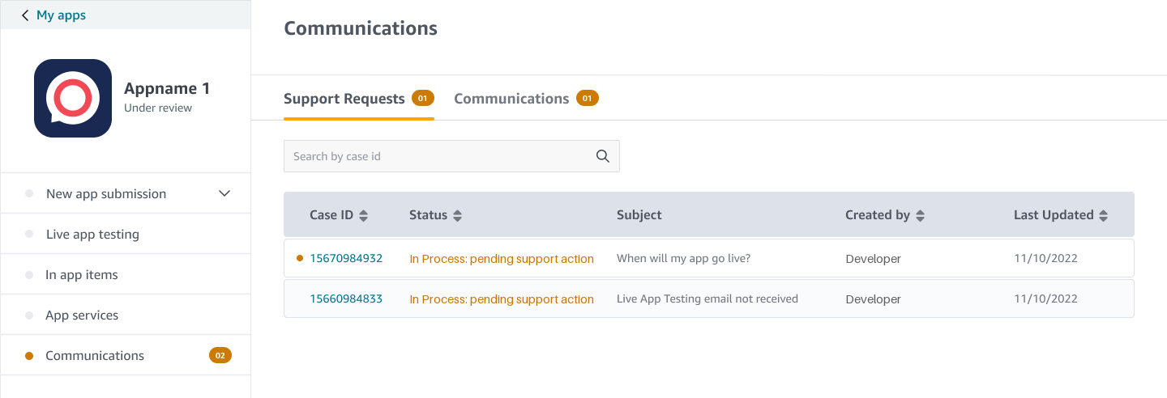
05 · FIVE DECISIONS · 4 OF 5
Put cases where developers already are
My Cases leads the Help menu. Every app has Communications, with unread counts.
Phase 1 · The inbox. Example data.
10

Slide 11
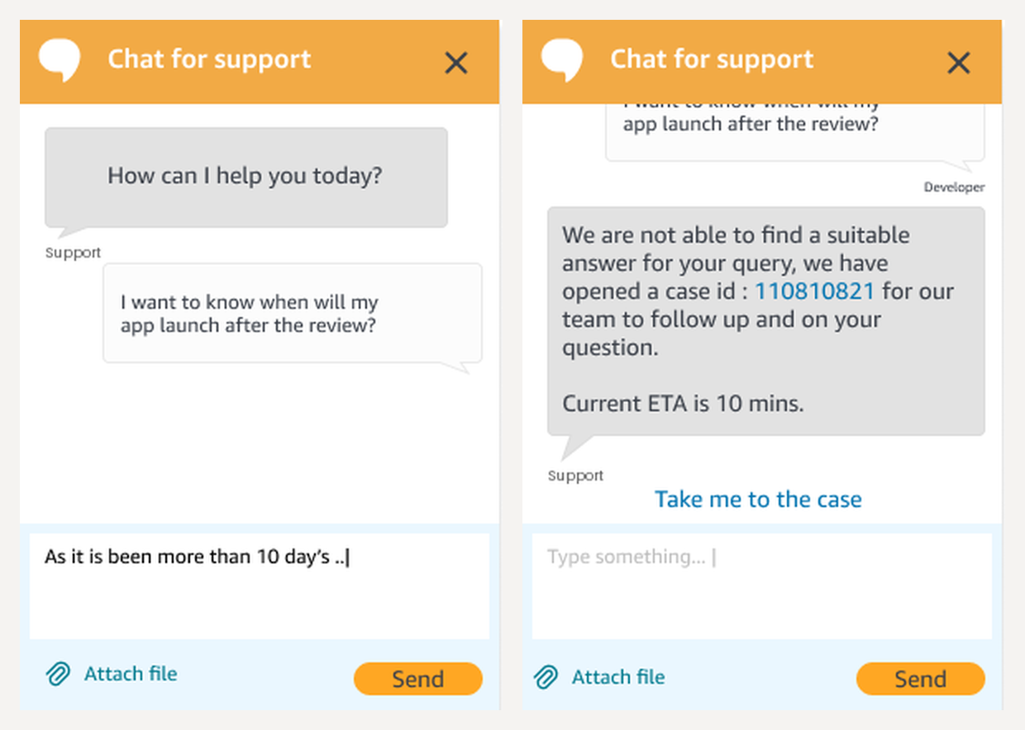
05 · FIVE DECISIONS · 5 OF 5
Adopt the ecosystem, plan the exit, end help in a case
A chat widget answers first. With no answer, it opens a case and links to it.
Phase 2 · Chat. Built by the platform team.
11

Slide 12
06 · RESULTS
Fewer cases, because follow-ups stopped creating duplicates.
~47%
Halved
~87%
fewer cases after Phase 1
turnaround time, roughly
fewer cases after the Phase 2 widget, built by another team
Fewer cases is good only if developers were helped. I have no satisfaction data to show that.
12

Slide 13
07 · REFLECTION
The most useful change was a model change: from “submit and wait” to “open a thread”.
Measure helped
Satisfaction, form drop-off, re-open rate.
Bring back an estimate
Resolution time, once targets hold.
Grow Communications
One role-aware home. A direction, not shipped.
13

