Slide 1
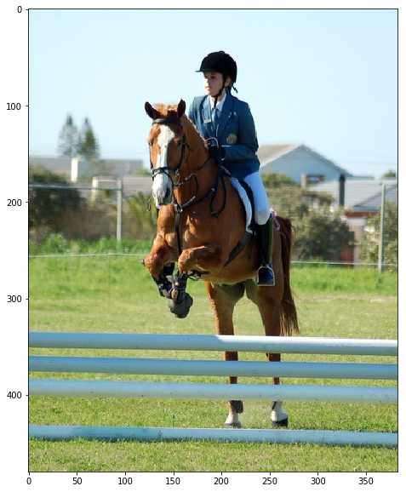
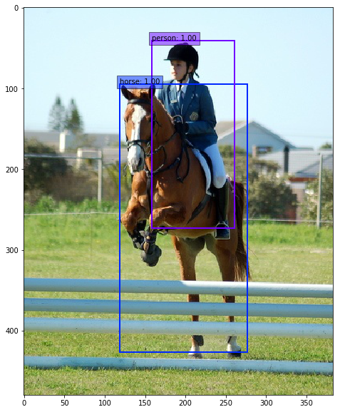
Object Detection

Slide 2

Dataset
PASCAL VOC
  10k annotated images
  20 object classes
  25k object annotations (xml)
  Images from flickr
  Competition runs every year

Slide 3
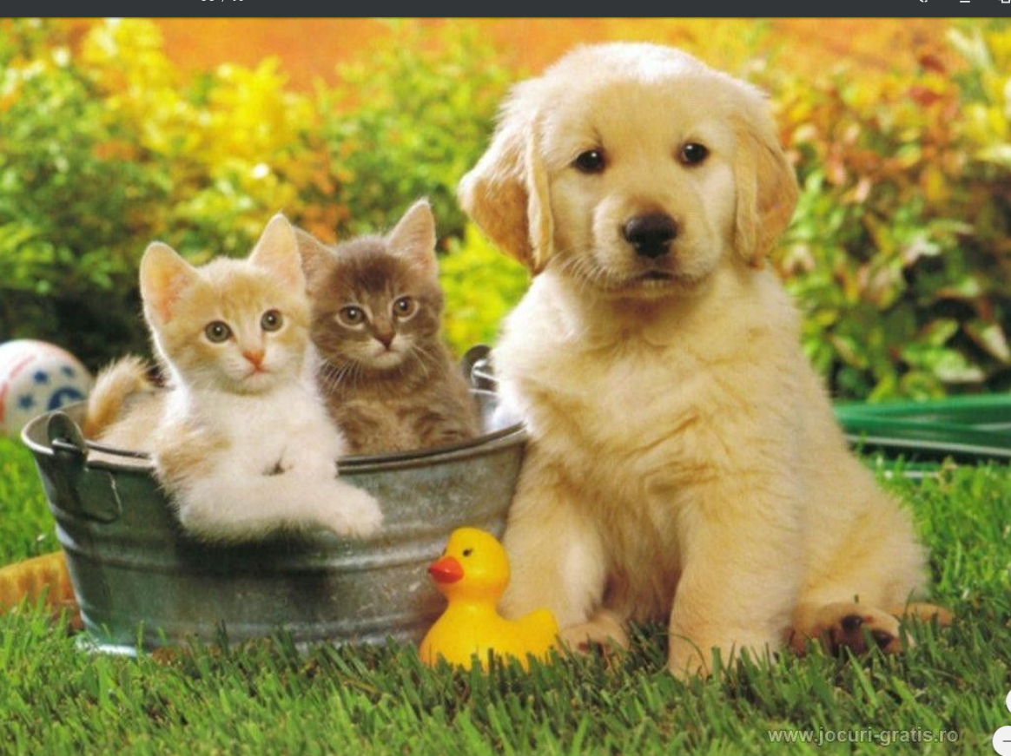
Challenge
[
[DOG, (x1, y1, w1, h1)],
[CAT, (x2, y2, w2, h2)],
[CAT, (x3, y3, w3, h3)],
[DUCK, (x4, y4, w4, h4)]
]
= 20 values

Slide 4
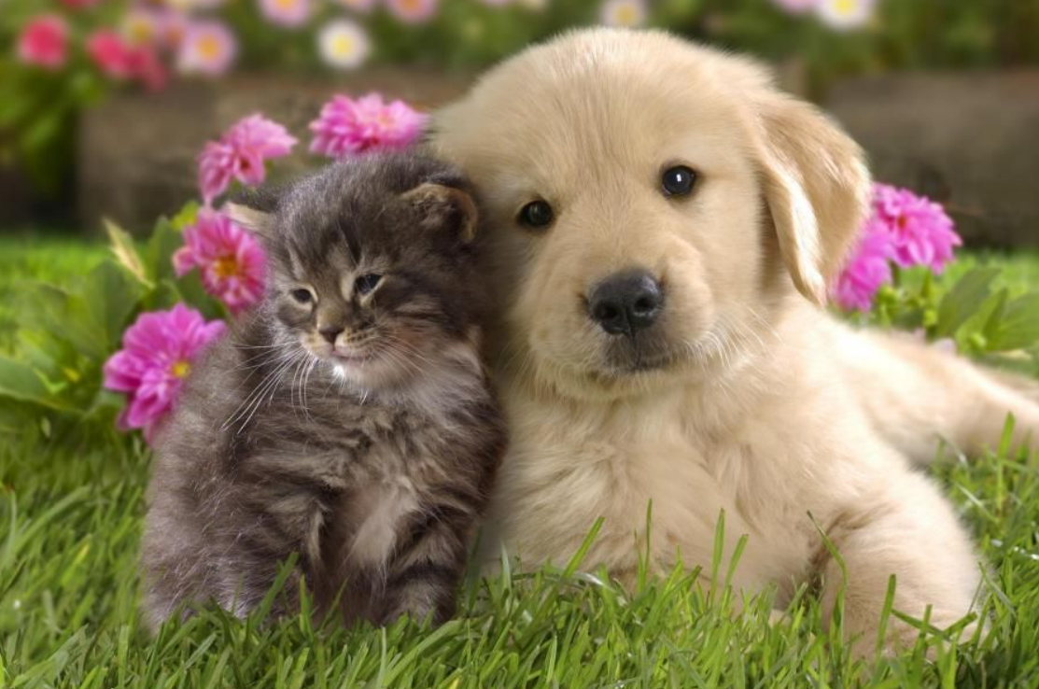
Challenge
[
[DOG, (x1, y1, w1, h1)],
[CAT, (x2, y2, w2, h2)]
]
= 10 values

Slide 5
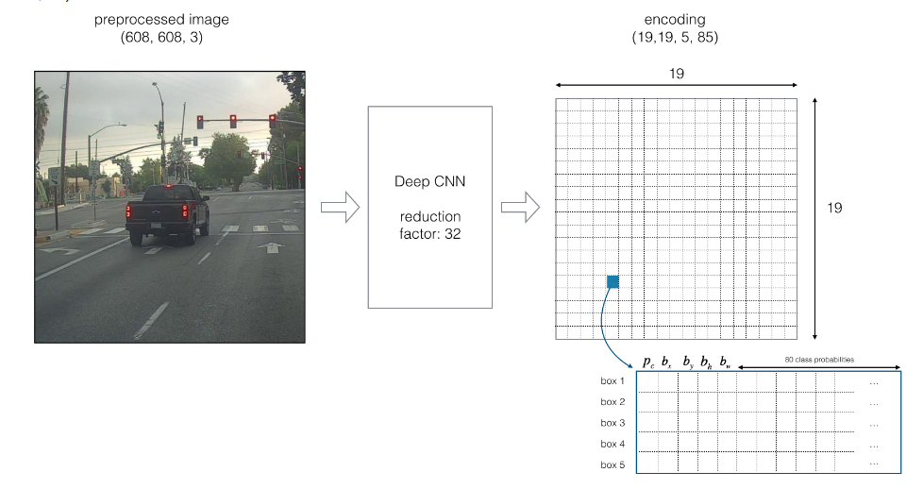
Preprocessing
Handle Variable Output Size

