Slide 1
CUSTOMER SEGMENTATON

Slide 2
Abstract
In today’s fast moving world of marketing from product-orientation to customer-orientation, the management of customer treatment can be seen as a key to achieve revenue growth and profitability. The business marketers usually prefer to cooperate with fewer but larger buyers than the final consumer marketer. Most customer segmentation approaches based on customer value fail to account for the factor of time and the trend of value changes in their analysis. In this article, we classify customers based on their value using the RFM model and K-means clustering method. Then, an assessment of changes over several periods of time is carried out.

Slide 3
Table of Contents
Title | Page No.
1.Introduction | 1
2.Existing Method | 2
3. Proposed Method and Architecture | 4
4.Methodology | 6
5.Implementation | 7
6.Environment and Tools | 8
7.Conclusion | 13
8.Advantages | 16

Slide 4
Introduction
With the evolution of new technologies and increasing growth of e-commerce it is important for every business to adapt new strategies which help them to win the competitive environment. The most valuable asset of any business is customer. In this emerging market it is very difficult to maintain its customer base. To overcome this difficulty every business has to focus on customer segmentation.
Customer Segmentation is the subdivision of a market into discrete customer groups that share similar characteristics. Customer Segmentation can be a powerful means to identify unsatisfied customer needs. Using the above data companies can then outperform the competition by developing uniquely appealing products and services.

Slide 5
Existing Method
Customer segmentation divides your email lists into groups based on common features that tend to predict buying habits, such as demographics or interests, in order to better serve the customer. This is called a priori segmentation and basically means that you’ve deducted these segments based on anecdotal knowledge or observed trends in your marketing efforts.
Here are some a priori segments you can use:
Demographics
Decision-making status
Customer history w/ company
Personal interactions with customers

Slide 6
There are three main approaches to market segmentation:
A priori segmentation, the simplest approach, uses a classification scheme based on publicly available characteristics — such as industry and company size — to create distinct groups of customers within a market. However, a priori market segmentation may not always be valid, since companies in the same industry and of the same size may have very different needs.
Needs-based segmentation is based on differentiated, validated drivers (needs) that customers express for a specific product or service being offered. The needs are discovered and verified through primary market research, and segments are demarcated based on those different needs rather than characteristics such as industry or company size.
Value-based segmentation differentiates customers by their economic value, grouping customers with the same value level into individual segments that can be distinctly targeted.

Slide 7
Proposed Method and Architecture
Identifying right customer and providing right service at right time and treating different types of customers differently is the key to success in business.
So, a predictive model will be used to segregate customers into different groups based on their transactional data. Once the customers are segregated then their associative buying pattern are identified to enhance the profit for the organization future coming customer.

Slide 8
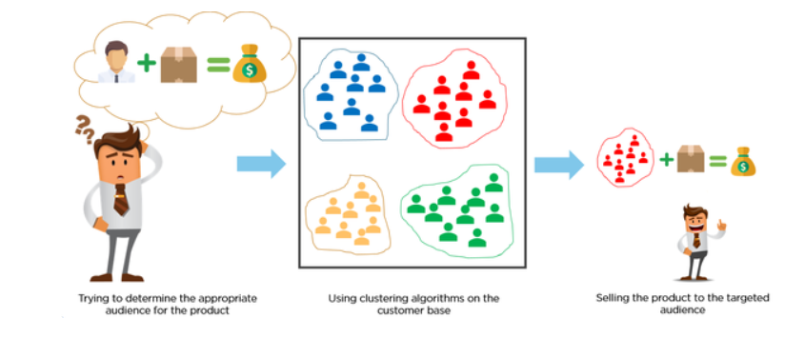

Slide 9
Methodology
In order to identify the target customers Clustering technique can be used for cluster analysis. Clustering is defined as to group data in clusters/segments so that data within segment are similar while data across the segments are dissimilar. Various techniques can be used for clustering like k means, hierarchical, grid based model based technique. In this paper we proposed to use K-means technique for customer segmentation due its following advantages: This technique suits for the data with numeric features and often terminates at local optimum. It is highly scalable and efficient for large data sets. It is fast in modelling and its result is more understandable

Slide 10
Implementation
K Means Clustering is an unsupervised machine learning algorithm. The output is not predicted in unsupervised learning algorithm. It finds similar patterns. The clustering of data is based on the similarity that occurs in the dataset. The k means algorithm finds number of clusters the dataset may be grouped into. For each row, the cluster number will be assigned randomly by the algorithm. The centroid of each cluster is determined. The following two steps are performed repeatedly until the within cluster sum of squares is minimized.
Reassign data points to the cluster whose centroid point is very nearer.
Determine new centroid for each cluster obtained.

Slide 11
Environment and Tools
scikit-learn
seaborn
NumPy
pandas
Matplotlib
plotly

Slide 12
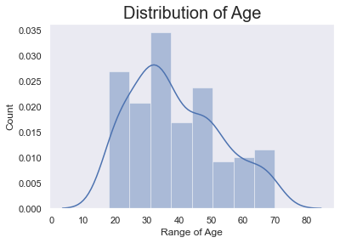
The within cluster variation is calculated by between_SS / total_SS. X1,X2,…..Xj is a set of observations. The cluster variance is defined as the sum of the squared variations of mean of the cluster of all the rows in the dataset. The goal of clustering algorithm is minimizing the within cluster variance. Minimum value of cluster variance is more preferable.

Slide 13
Algorithm 1 : K-Means
1. Select K clusters for the dataset
2. Assign the centroids randomly
3. For each data point, calculate the closest centroid.
4. Assign the point to the cluster
5. Set each cluster position to the mean of all data points assigned to the cluster
6. Step 4 and 5 is repeated until no more changes

Slide 14
Algorithm 2 : The Elbow Method
Calculate the Within Cluster Sum of Squared Errors (WSS) for different values of k, and choose the k for which WSS first starts to diminish. In the plot of WSS-versus k, this is visible as an elbow.
The steps can be summarized in the below steps:
Compute K-Means clustering for different values of K by varying K from 1 to 10 clusters.
For each K, calculate the total within-cluster sum of square (WCSS).
Plot the curve of WCSS vs the number of clusters K.
The location of a bend (knee) in the plot is generally considered as an indicator of the appropriate number of clusters.

Slide 15
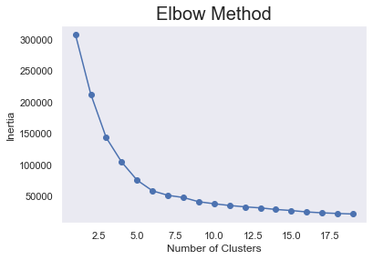

Slide 16
Conclusion
K means Clustering implies grouping is one of the most famous bunching calculations and as a rule the principal thing specialists apply when tackling grouping assignments to get a thought of the structure of the dataset. The objective of K means Clustering implies is to bunch information focuses into particular non-covering subgroups. One of the significant utilization of K means clustering implies grouping is division of clients to improve comprehension of them which thus could be utilized to build the income of the organization.

Slide 17
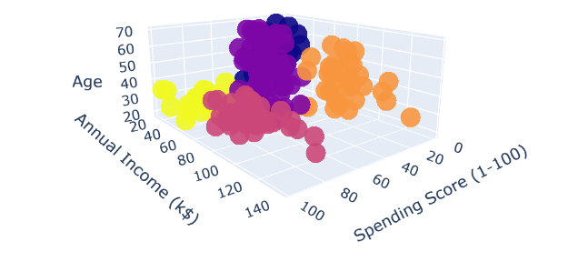
After plotting the results obtained by K-means on this 3D graph, it's time to identify and describe the five clusters that have been created:

Slide 18
Yellow Cluster - The yellow cluster groups young people with moderate to low annual income who actually spend a lot.
Purple Cluster - The purple cluster groups reasonably young people with --pretty decent salaries who spend a lot.
Pink Cluster - The pink cluster basically groups people of all ages whose salary isn't pretty high and their spending score is moderate.
Orange Cluster - The orange cluster groups people who actually have pretty good salaries and barely spend money, their age usually lays between thirty and sixty years.
Blue Cluster - The blue cluster groups whose salary is pretty low and don't spend much money in stores, they are people of all ages.

Slide 19
Advantages of Customer Segmentation
Determine appropriate product pricing.
Develop customized marketing campaigns.
Design an optimal distribution strategy.
Choose specific product features for deployment.
Prioritize new product development efforts.

Slide 20
THANK YOU

