Slide 1
ANZ Virtual Internship Predictive Analysis
Prepared by Pranay Kuthe
University of Nagpur

Slide 2
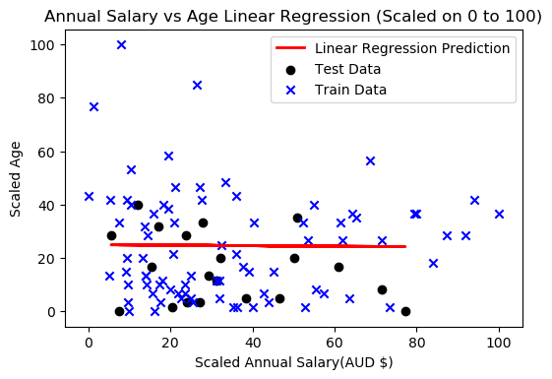
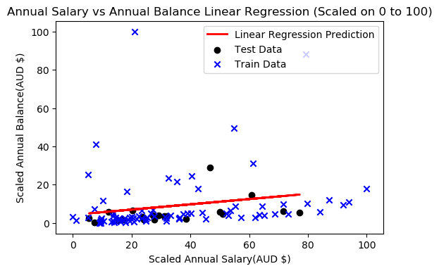
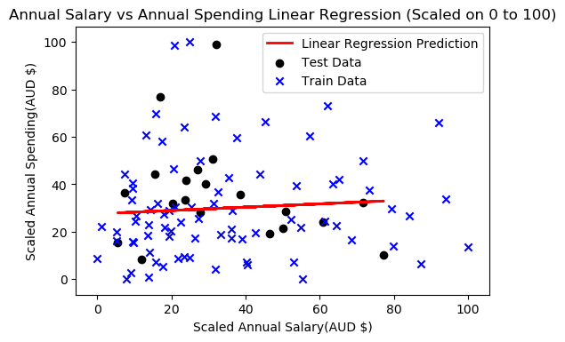
Linear Regression Models
Mean Absolute Error: 13.39
Mean Squared Error: 231.82
Root Mean Squared Error: 15.23 Correlation Coefficient r: -0.04
Mean Absolute Error: 5.46
Mean Squared Error: 43.29
Root Mean Squared Error: 6.58
Correlation Coefficient r: 0.22
Mean Absolute Error: 15.2
Mean Squared Error: 489.82
Root Mean Squared Error: 22.13
Correlation Coefficient r: 0.03

Slide 3
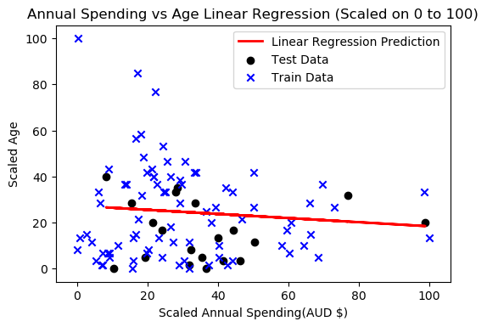
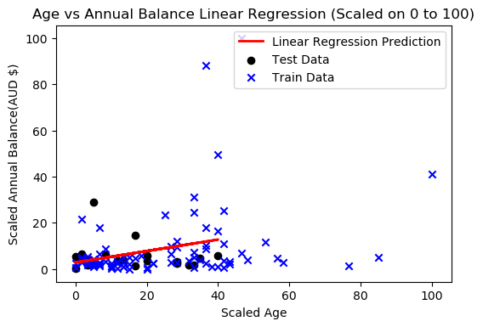
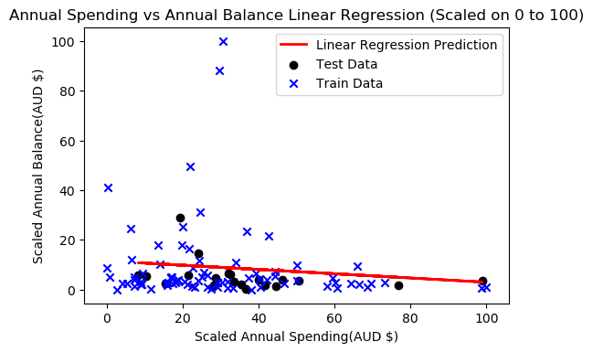
Linear Regression Models
Mean Absolute Error: 13.14
Mean Squared Error: 227.14
Root Mean Squared Error: 15.07
Correlation Coefficient r: -0.1
Mean Absolute Error: 5.4
Mean Squared Error: 56.24
Root Mean Squared Error: 7.5
Correlation Coefficient r: 0.29
Mean Absolute Error: 5.5
Mean Squared Error: 43.2
Root Mean Squared Error: 6.57
Correlation Coefficient r: -0.13

Slide 4
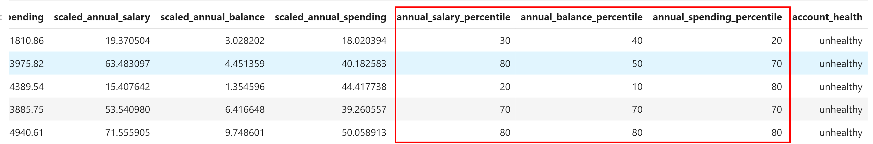
Decision Tree Model

Slide 5
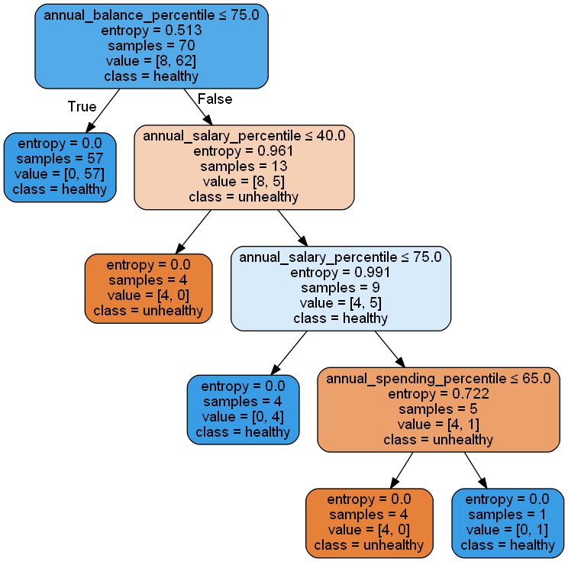
Decision Tree Model

