Slide 1
Teaching LLMs Expert Judgment: A Chess RL Case Study
Ibrahim El-Fayoumi · Perth Machine Learning Group · Microsoft, 100 St Georges Terrace, Perth
Notes:
[0:00-1:30] Welcome. One sentence up front: expert judgment is tacit, so it has to be trained into a model, not prompted into it. Tonight: chess with Qwen3-1.7B as the controlled testbed, then the Bridgewater result that shows the same recipe works at production scale.

Slide 2
The hook: prompting can't transfer judgment
Frontier LLMs, six routine investor tasks, prompt that just states the task: ~50% accuracy
Experts rewrite the prompts, automatic prompt optimisation on top: mid-70s - still below the 80% trust threshold
"An explicit prompt can only convey the intuition an expert is able to put into words"
The judgments that matter most are the hardest to articulate
  Source: Thinking Machines Lab x Bridgewater AIA Labs, 'Learning to Replicate Expert Judgment in Financial Tasks', 30 Jun 2026
Notes:
[1:30-4:00] Start with the strongest evidence, not ours. Frontier models averaged ~50% (Opus 4.6: 47.2, Gemini 3.1 Pro: 50.1, GPT 5.4: 47.2...). Expert prompts lifted to mid-70s (77.2, 74.3, 75.8, 78.2, 78.0) - coin flip to C+ student. Prompt optimisation hit a wall. Quote is from the TML/Bridgewater post.

Slide 3
The thesis
Notes:
[4:00-4:30] Transition.

Slide 4
Thesis: tacit judgment is trained in, not prompted
Expert judgment is tacit - it lives in thousands of small decisions, not in a written rubric
Fine-tuning on expert signal lets the model develop its own judgment
A small model trained on expert signal can beat a much larger frontier model
We need a testbed where 'expert judgment' is objective, cheap, and measurable
That testbed is chess: Qwen3-1.7B trained against Stockfish
Notes:
[4:30-6:30] Chess gives us a perfect expert (Stockfish ~3200 Elo), an exact reward, and infinite labelled positions. Financial judgment at Bridgewater is the noisy real-world version of the same problem. Everything we learn about reward design and credit assignment transfers.

Slide 5
Setup: chess as the controlled testbed
Notes:
[6:30-7:00] Transition to setup.

Slide 6
Setup: Qwen3-1.7B + Stockfish reward
Policy: Qwen3-1.7B - small enough to train on modest compute, large enough to produce legal play
Teacher/reward: Stockfish 17 - an expert ~1000+ Elo above anything the policy can reach
Pipeline: SFT on game transcripts -> GRPO with engine reward -> off-policy extension (LUFFY)
Evaluated on held-out positions (n=1000) + full games vs Stockfish and vs random
Notes:
[7:00-9:00] Deliberately the smallest credible model. Question we're really asking: how small can a model be and still reason? Three training stages mirror the talk structure.

Slide 7
How we measure
Legal-move rate: can the model play the game at all? (formats, state tracking)
Median centipawn loss (CPL): quality of each move vs Stockfish's best
Use the MEDIAN, not the mean - the mean is dominated by rare blunders (std ~2900 cp)
Game outcomes vs Stockfish (20 games) and vs random (10 games); avg game length
Estimated Elo
Notes:
[9:00-10:30] Explain CPL briefly: 0 = engine's move, 100 cp = roughly a pawn of lost value. Legal-move rate is the floor: an LLM that emits 'e4 e5 Nf3' as one token or hallucinates squares fails here. Our headline floor stat: 100% legal moves on 1000 held-out positions.

Slide 8
Stage 1 - SFT on game transcripts
Notes:
[10:30-11:00] Transition.

Slide 9
Stage 1 - SFT: what the model learns
Data: game transcripts (FEN state -> move in SAN), generated with Stockfish
Learns: move format, board syntax, opening patterns, 'what a reasonable move looks like'
Does NOT learn: why a move is good - no signal beyond imitation
Result: 100% legal-move rate on the test set - the model can play
But: median CPL 81 cp, loses 0-20 vs Stockfish (20/20), 0 wins vs random (9 draws, 1 loss)
Notes:
[11:00-13:00] SFT buys competence, not judgment. The odd result to flag honestly: 9/10 draws vs random. Likely draw-adjudication / move-limit artifacts - we show the numbers as they are. Data format note: transcripts teach the token patterns of chess; the model still has no internal critic.

Slide 10
Stage 2 - GRPO with Stockfish as the reward
Notes:
[13:00-13:30] Transition.

Slide 11
Stage 2 - GRPO: reward from the engine
GRPO: critic-free policy gradient - sample G moves per state, reward each, normalise within the group
Reward: Stockfish evaluation of the chosen move (centipawn signal), plus game outcome
Advantage is relative: 'better than the group's average move', not 'objectively good'
No value network to train - fits our compute budget
Reward shaping: legality penalty, engine eval, game result
Notes:
[13:30-15:30] Keep GRPO math light here (the notebook does the step-by-step). Key intuition: within a group of sampled moves, the model learns which of ITS OWN candidate moves the engine prefers. That is expert signal, per decision.

Slide 12
Failure modes: sparse reward, brutal credit assignment
One terminal reward spread over ~30 decisions per game - credit assignment is the core difficulty
Long-horizon strategy: a good move's value may only appear 20 plies later
Strategy has no token signature - nothing in the trace says 'this was the strategic move'
Reward hacking pressure: engine-eval shaping can be gamed locally (shallow tactics)
Off-policy drift: by the time a game finishes, the policy that played it is stale
Notes:
[15:30-18:00] This is the honest heart of the talk. Compare: a chat model gets per-token feedback; our policy gets one scalar after ~30 decisions. That is why RL from game outcomes alone stalls - and it motivates both per-move engine shaping and the distillation stage.

Slide 13
Strategic vs tactical: why chess is hard for a 1.7B model
Tactics (forks, pins): local, 2-4 plies, pattern-shaped - SFT handles these
Strategy (piece activity, pawn structure, plans): global, 20+ plies, no local pattern
Branching: ~35 legal moves/ply - the horizon problem explodes combinatorially
A frontier model 'knows' chess commentary; a 1.7B must learn search-free evaluation
Humans also can't articulate strategic judgment - exactly the tacit-knowledge problem
Notes:
[18:00-20:00] Tie back to the thesis: strategic judgment in chess is tacit even for humans - club players can't write down why a move 'feels' right. That's the same structure as Bridgewater investors filtering documents.

Slide 14
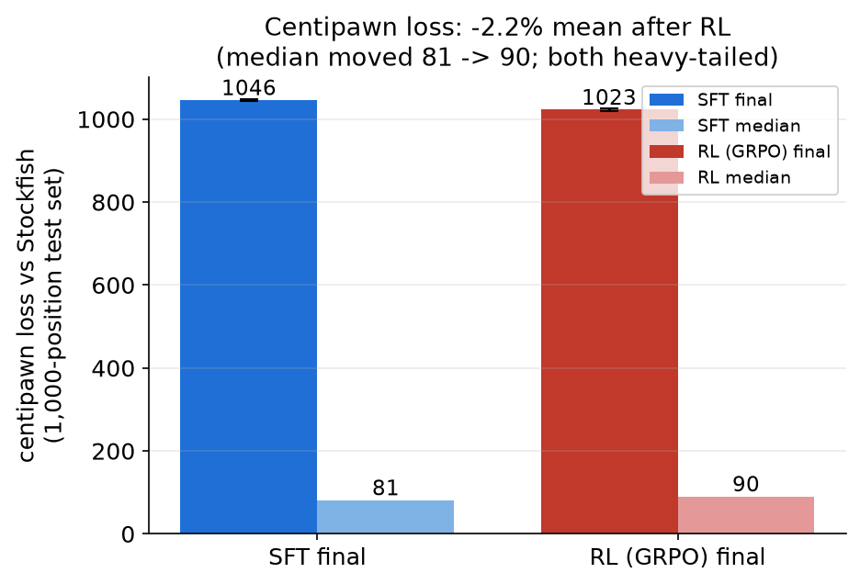
GRPO results - the honest read
Metric (1000 held-out positions) | SFT | GRPO (RL)
Legal-move rate | 100% | 100%
Median centipawn loss | 81.0 | 90.0
Mean centipawn loss (blunder-dominated) | 1045.7 | 1022.7
vs Stockfish (20 games) | 0-20 | 0-20
Avg game length (plies) | 24.3 | 27.7
vs random (10 games) | 0W / 9D / 1L | 0W / 9D / 1L
Mean CPL 1045.7 -> 1022.7 (-2.2%); median 81 -> 90. Both heavy-tailed (std ~2,900): a few blunders dominate the mean. Source: comparison.json, 1,000 positions.
Notes:
[20:00-22:30] Numbers are real, from the repo. Say it straight: RL did NOT move the headline evals - median CPL slightly up (81->90), still 0-20 vs Stockfish. What changed: longer games (24.3 -> 27.7 plies) - the policy survives longer, plays differently. Source of truth: comparison.json (canonical, frozen 2026-10-19); benchmark_results.json is a stale duplicate run and is never quoted.

Slide 15
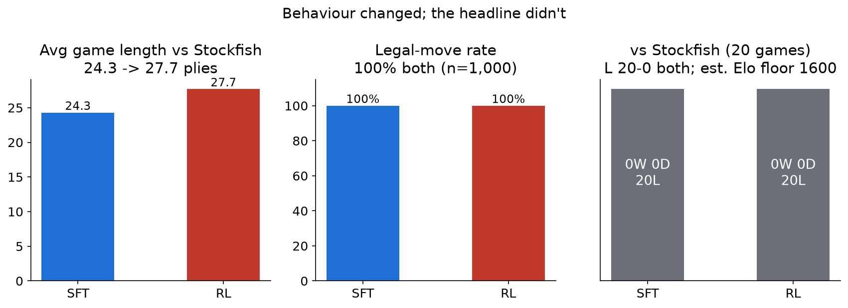
So did RL teach anything new?
Games got longer (24.3 -> 27.7 plies) and the move distribution changed, but headline strength did not: 0W-0D-20L vs Stockfish for both checkpoints.
Notes:
[22:30-24:30] This is the 'RL: new capabilities or sharpened SFT?' key question answered for OUR case: sharpening. Bridge to LUFFY/on-policy distillation: the problem isn't the model, it's the reward density.

Slide 16
Stage 3 - off-policy learning: LUFFY and distillation
Notes:
[24:30-25:00] Transition.

Slide 17
LUFFY: off-policy guidance from a stronger teacher
LUFFY: mix a strong teacher's traces into GRPO rollouts, with policy-aware down-weighting
Learns from the expert even where the policy's own samples are all bad
Regularisation keeps the mixture on-policy (importance-based advantage adjustment)
Extra learning from limited compute - we don't need more engines, we need better use of the one we have
Notes:
[25:00-27:00] Be explicit about repo status: our LUFFY eval is not yet run - the comparison-table cell is empty (audit 2026-10-18). Present LUFFY as the designed next stage, with the TML/Bridgewater ablation as external evidence the recipe class works.

Slide 18
Why on-policy distillation helps
Exposure bias: off-policy training never fixes the states the policy actually reaches
Dense per-token signal vs one terminal reward - credit assignment becomes trivial
The student's own rollouts stay on-policy; only the TARGET comes from the teacher
Cheaper than sampling from a frontier teacher at every state
Notes:
[27:00-29:00] The key mental model: RL asks 'which of my moves was good?' (sparse, noisy). Distillation asks 'match the teacher's distribution HERE' (dense, per-token, on the states I actually visit). Examples: SFT model sees only Stockfish games, not its own blunders; OPD trains on the model's own states with teacher targets.

Slide 19
Evidence at scale: Thinking Machines x Bridgewater
Notes:
[29:00-29:30] Transition to the payoff.

Slide 20
The same recipe, at production scale
Bridgewater AIA Labs + Thinking Machines Lab, published 30 Jun 2026
Task: six document-triage tasks from real investor workflows (relevancy, labelling, truncation)
Base: Qwen3-235B fine-tuned on Tinker - GRPO start, then interleaved batching + CISPO + on-policy distillation
Expert labels only where needed: contested examples routed to investors for re-review
Result: fine-tuned open model beats every frontier model tested - at 13.8x lower inference cost per task
Notes:
[29:30-31:30] This is our thesis proven outside chess. Walk the pipeline: contractor labels failed (models trained on them performed poorly) - the fix was routing contested examples to real investors. Note the overlap with our recipe: GRPO + on-policy distillation, same component names.

Slide 21
Bridgewater numbers
  84.7% vs 78.2% = 29.8% fewer errors; 13.8x lower inference cost per task. Source: TML/Bridgewater post, 30 Jun 2026 (thinkingmachines.ai)
Notes:
[31:30-33:00] Read the bars: 44.8 base -> 73.5 after GRPO alone (the biggest single jump, same as our SFT->RL story) -> 84.7 after the full recipe. Their ablations: removing interleaved batching drops to 72.2%; removing OPD drops to 72.4%; CISPO+asymmetric clips 74.6%. A 13.8x cost cut with better accuracy is the production argument.

Slide 22
Caveats (say them before the audience does)
Company-run internal evaluation - not an independent public benchmark
Six tasks, private test set cleared for release; generalisation beyond them unproven
Cost figure covers inference only - expert labelling and training cost not included
Frontier models not improving fast on this axis: GPT 5.4 cost 43% more than 5.2 for marginal accuracy gain
Same discipline applies to OUR numbers: small n, one seed, self-reported
Notes:
[33:00-34:30] Credibility slide. Both the Bridgewater result and our chess numbers are self-reported on internal evals. State limits, then move to takeaways. This honesty is itself part of the talk's argument about expert judgment.

Slide 23
Key questions this testbed answers
How small can a model be and still reason?
  1.7B reaches 100% legal play and club-level tactics after SFT; strategic play needs better signal, not more parameters
Does RL teach new capabilities or sharpen SFT?
  In our run: sharpening (longer games, stable behaviour), evals flat - consistent with TML/Bridgewater where the recipe, not scale, moved the number
Reward from an engine ~1000 Elo stronger - what goes wrong?
  Reward signal too sparse in game outcome; per-move engine shaping helps but invites local (tactical) reward hacking; the stronger the teacher, the more its best moves are unreachable-by-imitation
Notes:
[34:30-37:00] The three questions from the abstract, answered with our data plus the external evidence. Keep each to ~45 seconds.

Slide 24
Takeaways
Expert judgment is tacit - prompting plateaus (~50-78%), fine-tuning on expert signal crosses the trust threshold (84.7%)
Chess is a clean rehearsal space: real reward design, real credit-assignment pain, honest metrics
Small models + expert signal beat large models + prompts, at a fraction of the cost
On-policy distillation turns a sparse terminal reward into dense per-token learning
The bottleneck is signal quality, not model size
Notes:
[37:00-38:30] Five lines, each proven earlier in the deck. Slow down here.

Slide 25
Demo & materials
Talk material — the NOTEBOOK (runs live, offline, no GPU/checkpoint):
notebooks/grpo_and_onpolicy_distillation.ipynb
GRPO loss on real Stockfish scores -> group-relative advantage -> OPD, step by step (Qwen3-0.6B, CPU)
Repo: github.com/deep-science-ai/qwen-chess-rl
Notes:
[38:30-39:30] The notebook IS the talk material — it runs live, offline, on CPU (Qwen3-0.6B, no checkpoint needed): real Stockfish scores drive the GRPO group, then group-relative advantage, then on-policy distillation, step by step. If the trained checkpoint is available on the venue machine, optionally show the web app game; otherwise skip - the notebook carries the demonstration. Repo + QR for materials.

Slide 26

Thank you - questions?
Repo: github.com/deep-science-ai/qwen-chess-rl
References:
  Thinking Machines Lab x Bridgewater AIA Labs - 'Learning to Replicate Expert Judgment in Financial Tasks' (30 Jun 2026), thinkingmachines.ai/news/learning-to-replicate-expert-judgment-in-financial-tasks
  LUFFY: off-policy RL with mixing guidance (arXiv 2504.14945)
  On-policy distillation - Thinking Machines Lab blog
Ibrahim El-Fayoumi - Perth Machine Learning Group
Scan for slides, code & the
step-by-step notebook:
github.com/deep-science-ai/
qwen-chess-rl
Notes:
[39:30-40:00+] Q&A. Likely questions: why chess (objective reward), why not Leela (we study LLM training, not chess engines), will the recipe transfer (Bridgewater evidence), what's next (LUFFY eval on our repo).

