Slide 1
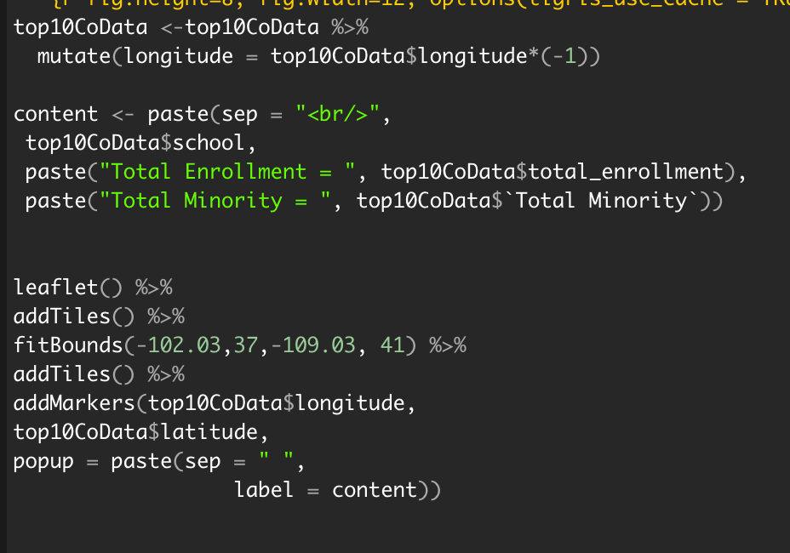
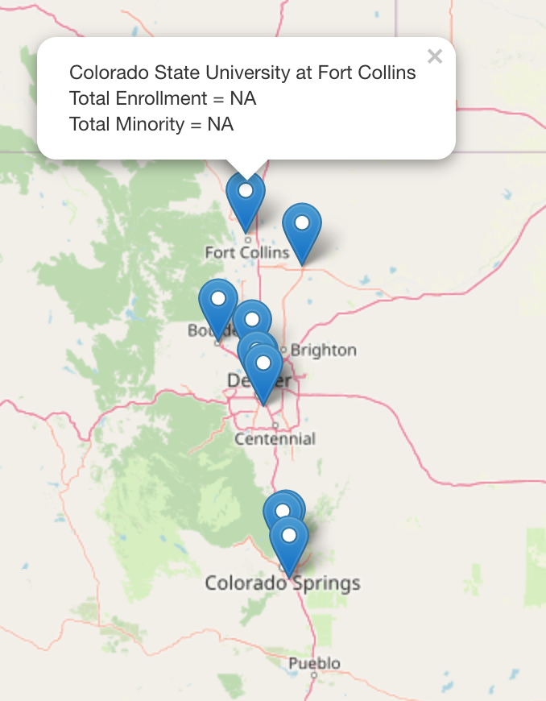
Most Enrolled Universities in Colorado: A glance at minority enrollment & salary outlook
Kiara Hodo, Pablo Maldonado & Naly Torres, ERHS 535 , Colorado State University, December 14, 2021
Minority Enrollment Numbers: Interactive Map

Slide 2
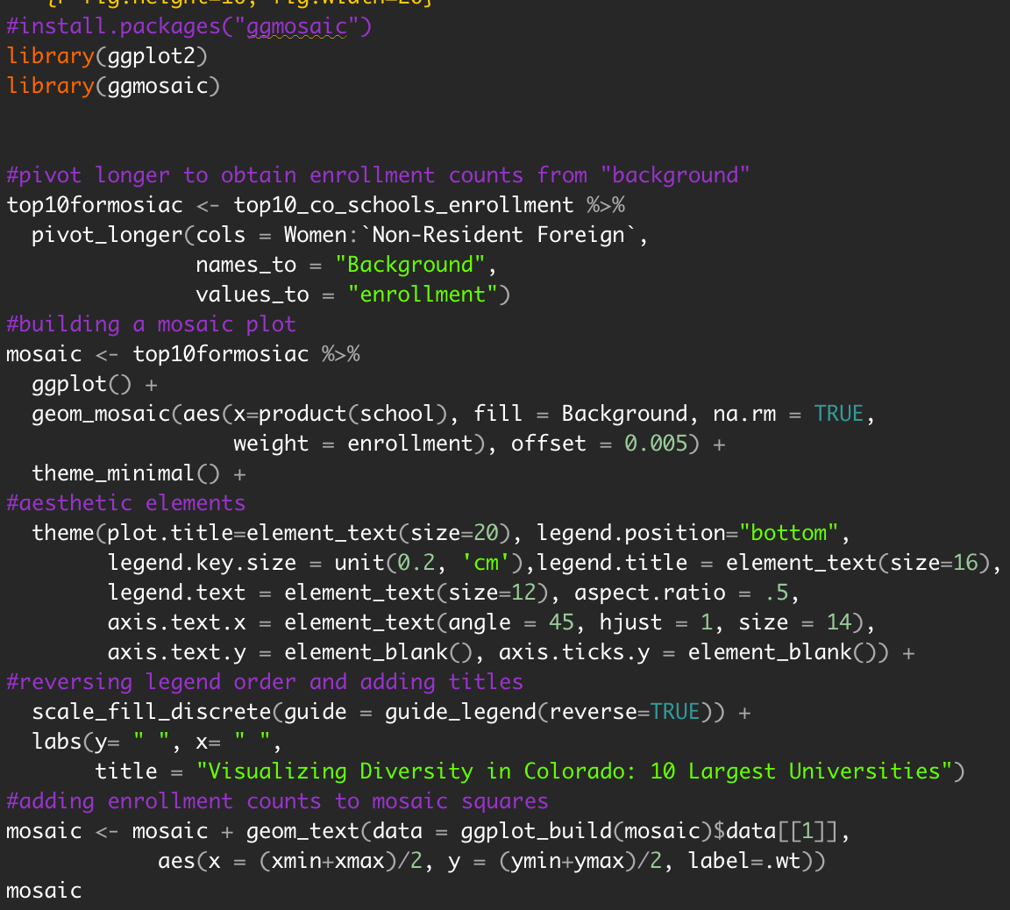
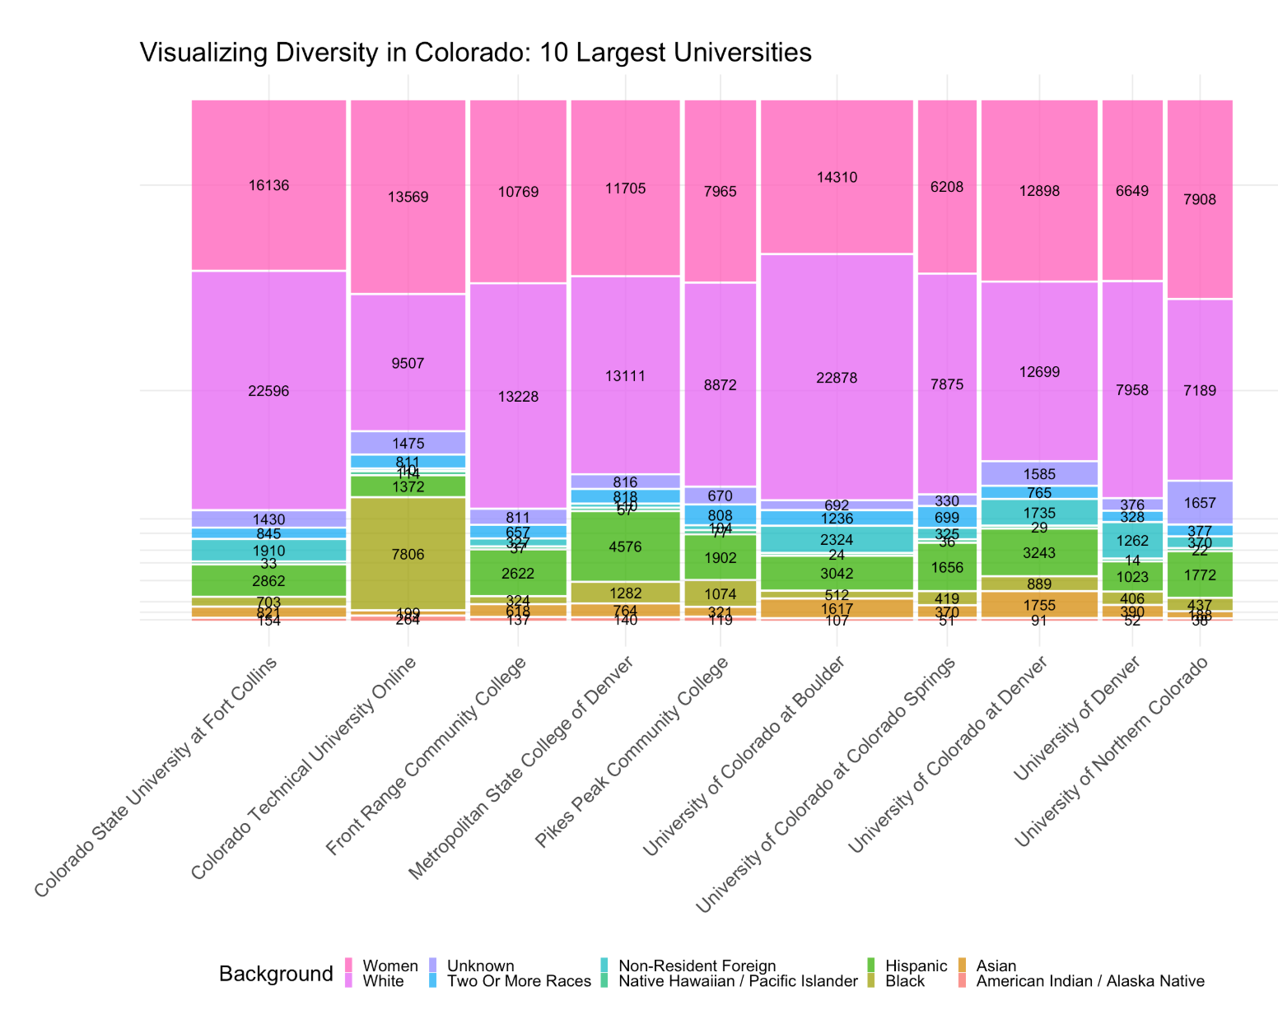
Most Enrolled Universities in Colorado: A glance at minority enrollment & salary outlook
Minority Enrollment Numbers: Mosaic Plot

Slide 3
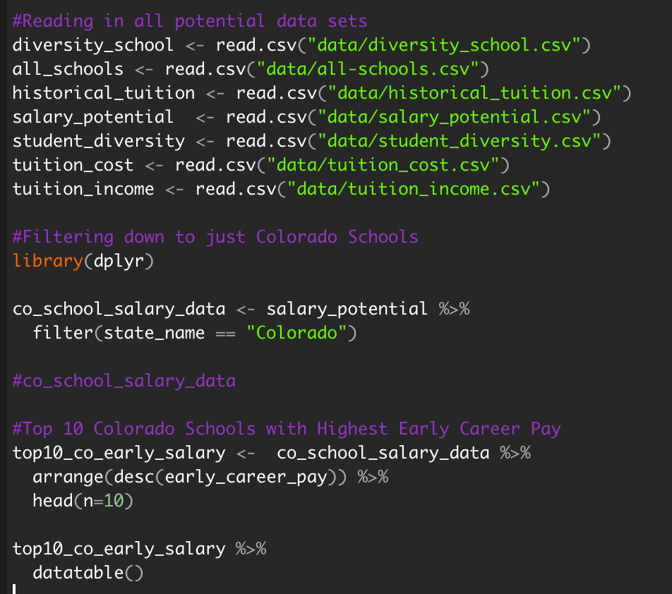
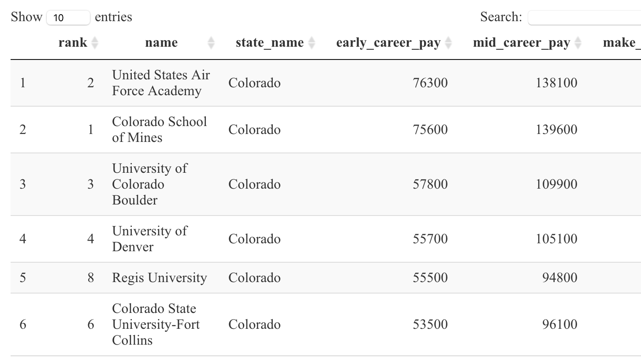
Most Enrolled Universities in Colorado: A glance at minority enrollment & salary outlook
Minority Enrollment Numbers: Interactive Table

Slide 4
Most Enrolled Universities in Colorado: A glance at minority enrollment & salary outlook
Lessons Learned
BUGS
Repository Issues
Teamwork
Burn it down
Dataset Used
School Diversity - tidytuesdays
Key Tools Used
flexdashboard
leaflet
ggmosaic
ggplot2
datatable

