Slide 1
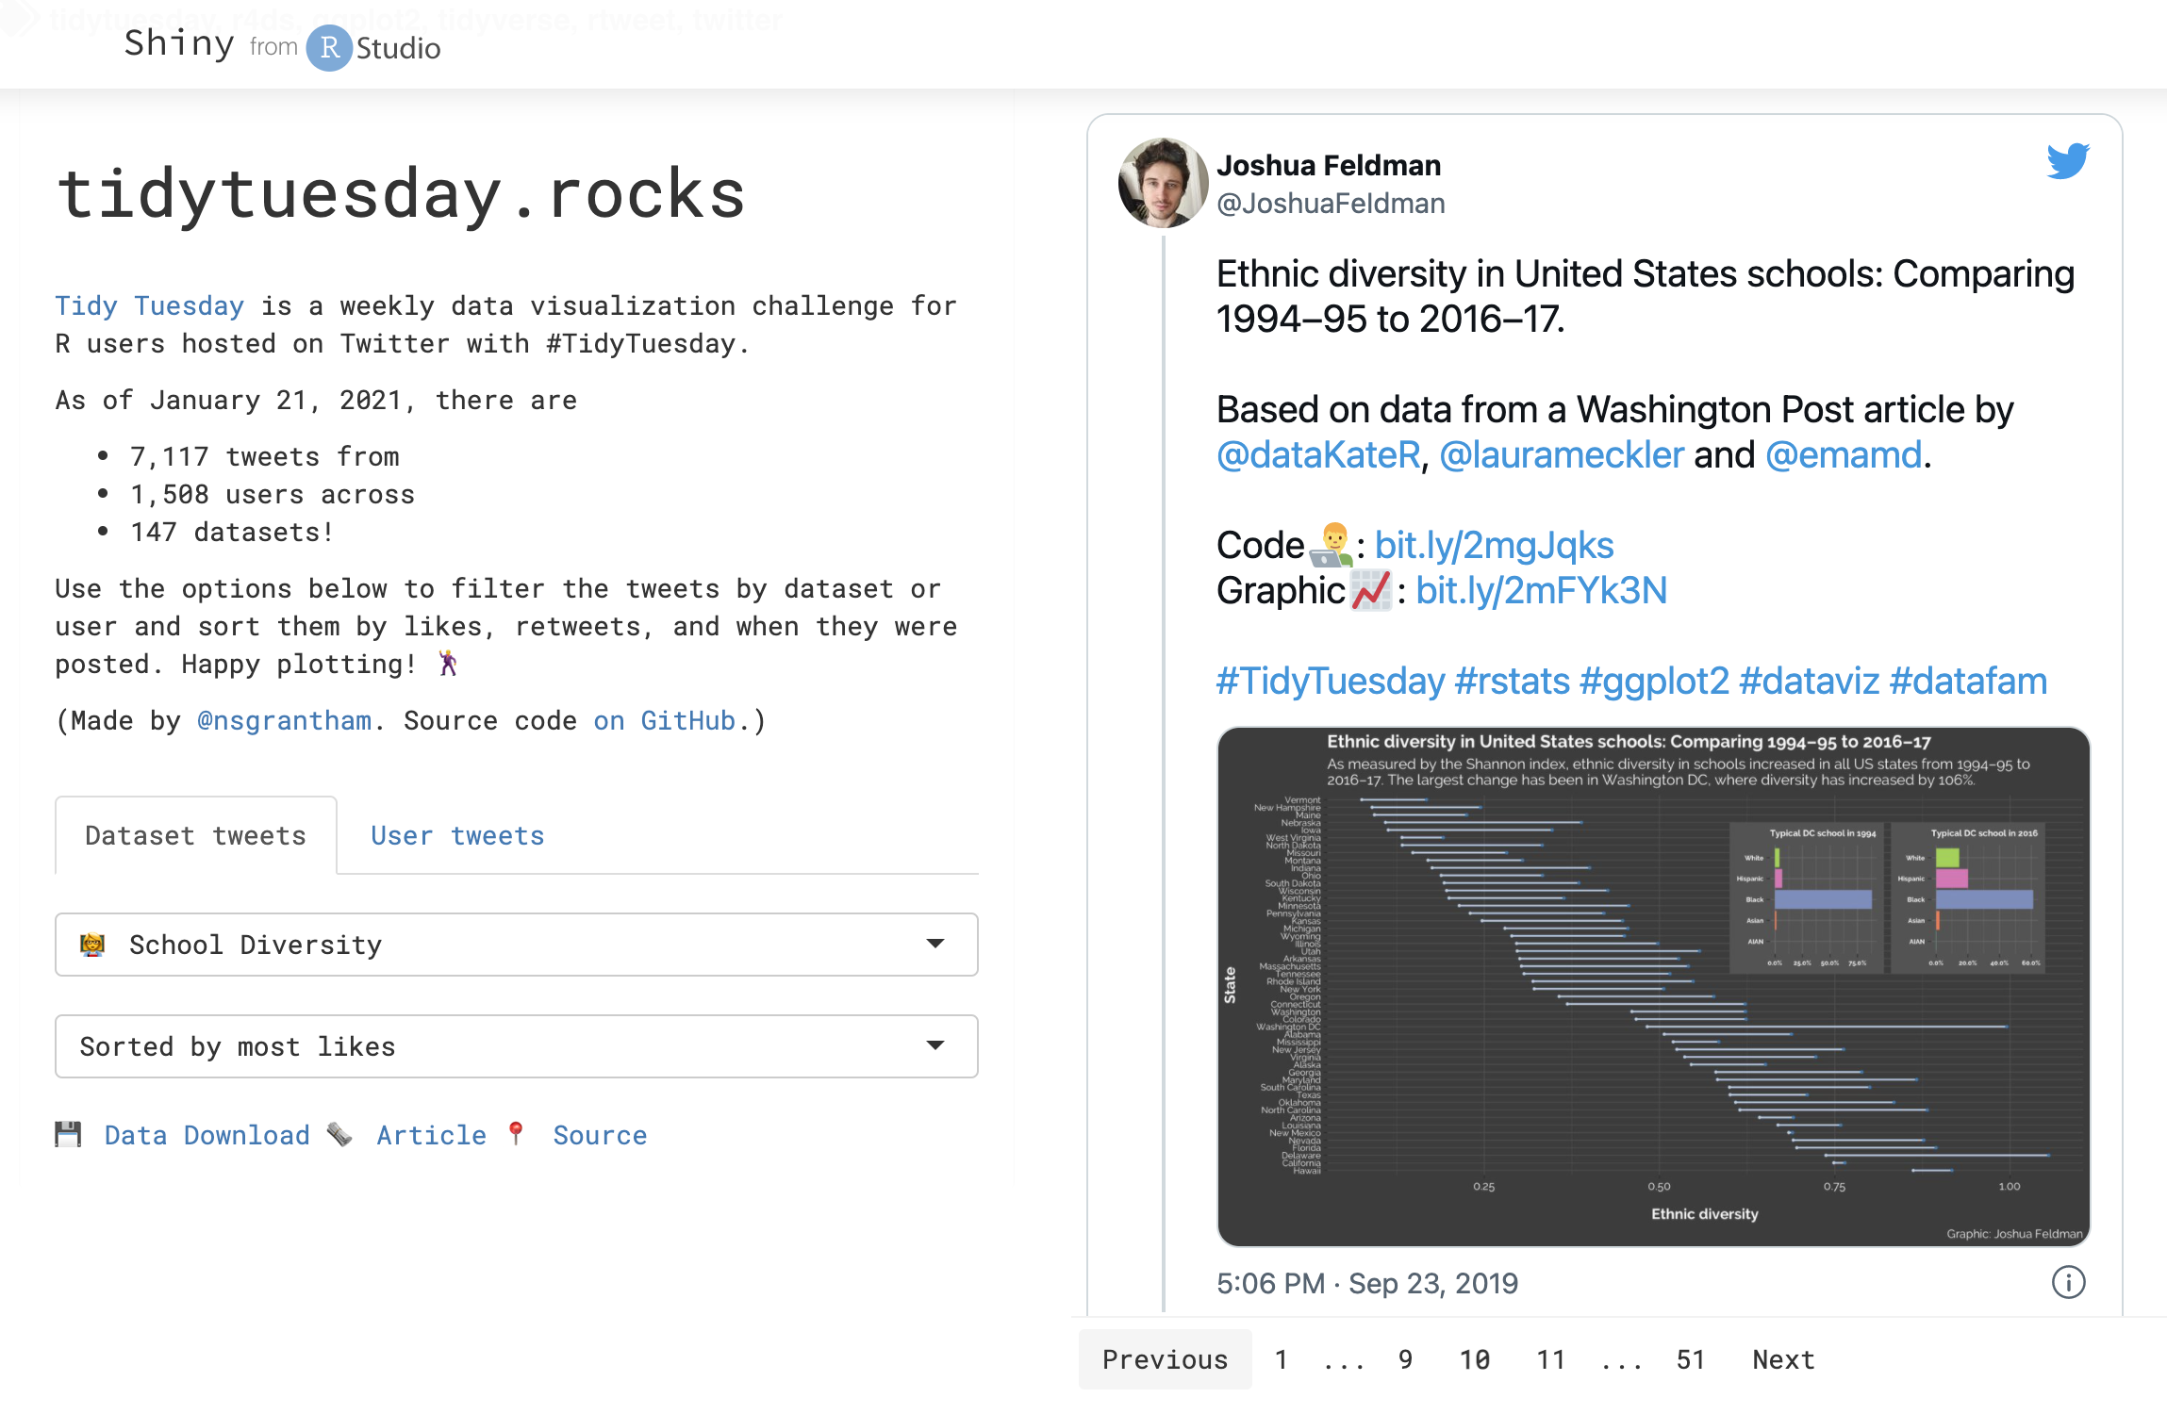

Most Enrolled Universities in Colorado:
A glance at minority enrollment & salary outlook
Kiara Hodo, Pablo Maldonado & Naly Torres
Colorado State University - ERHS 535
December 14, 2021

Slide 2
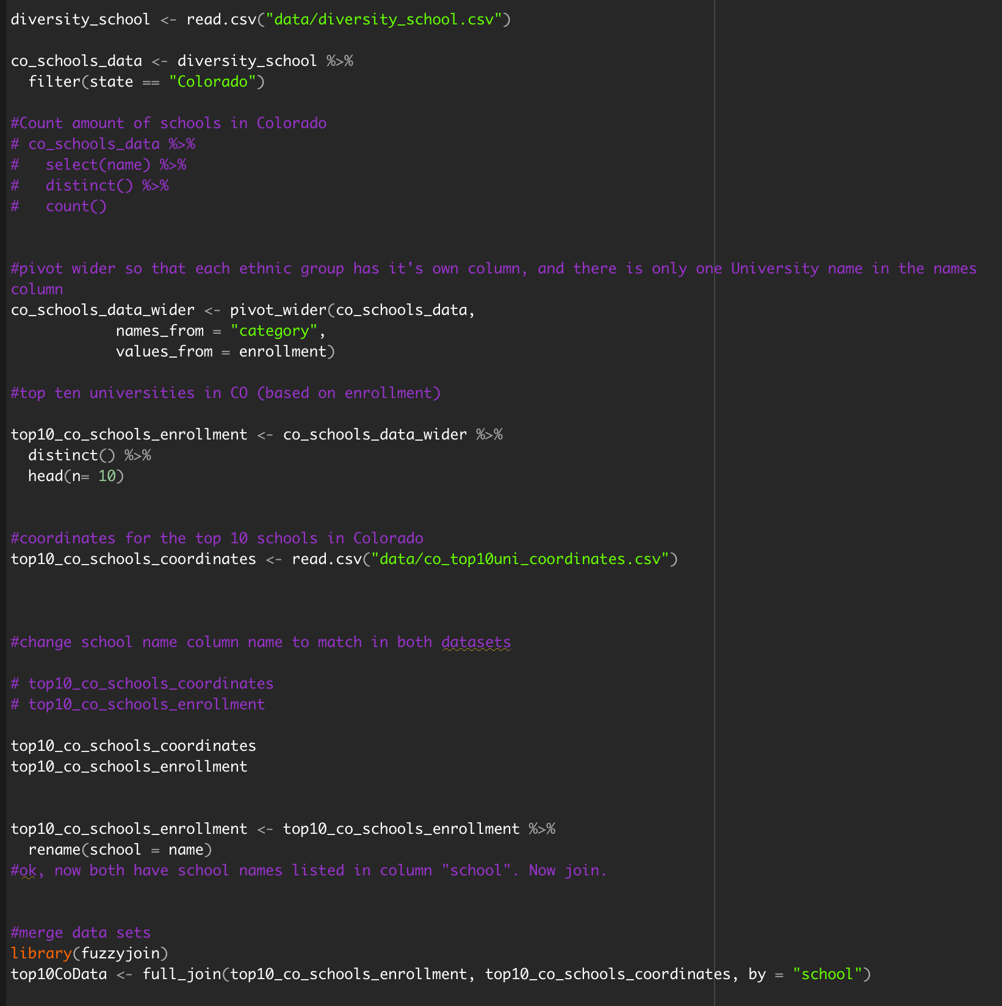
Most Enrolled Universities in Colorado: A glance at minority enrollment & salary outlook
Cleaning the data

Slide 3
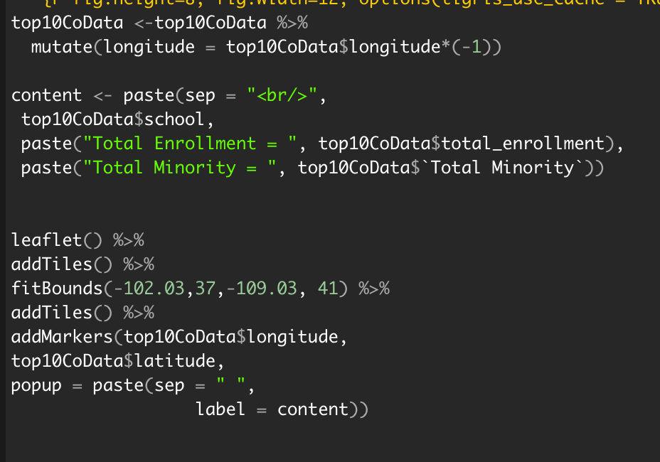
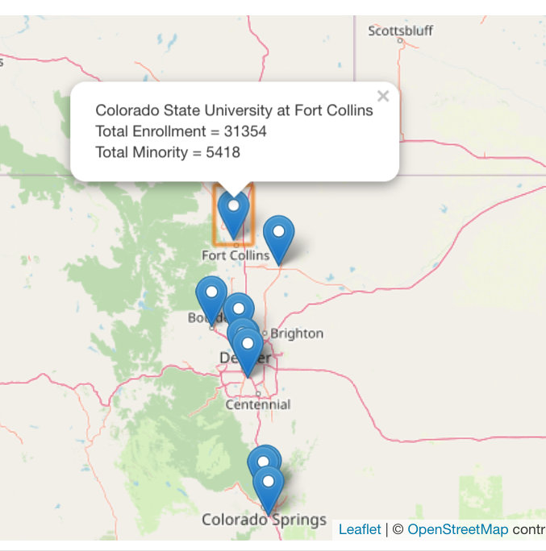
Most Enrolled Universities in Colorado: A glance at minority enrollment & salary outlook
Minority Enrollment Numbers: Interactive Map

Slide 4
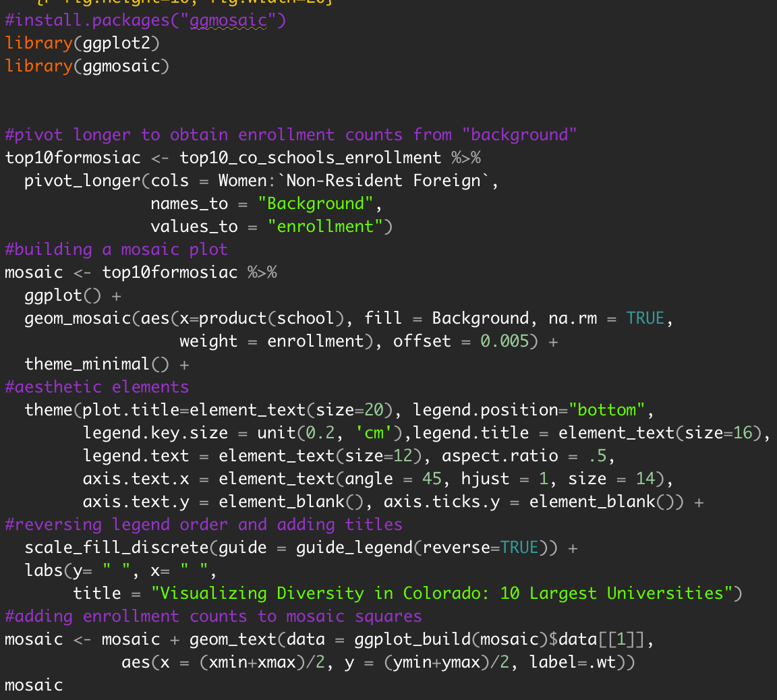
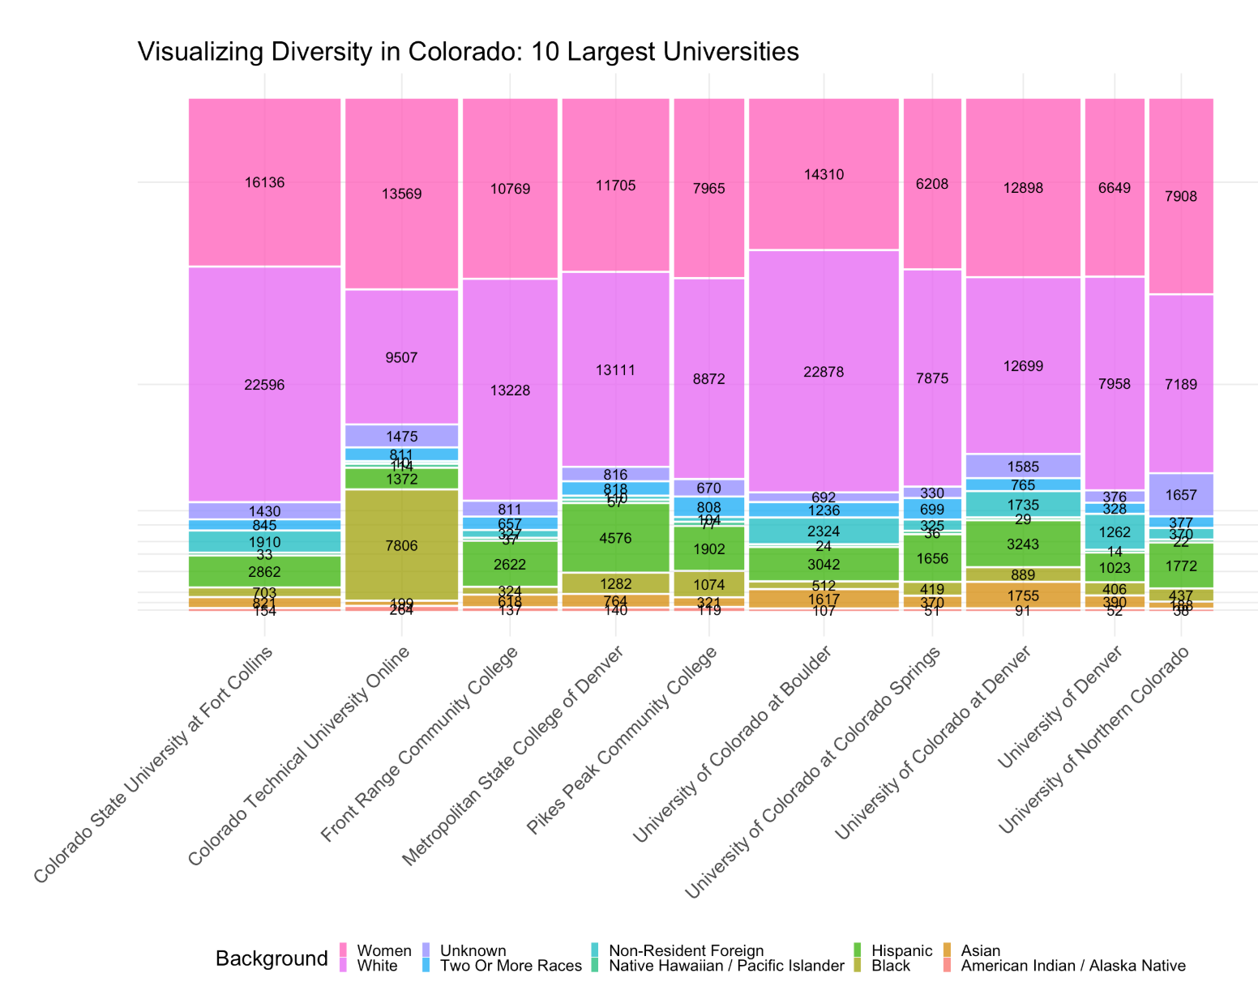
Most Enrolled Universities in Colorado: A glance at minority enrollment & salary outlook
Minority Enrollment Numbers: Mosaic Plot

Slide 5
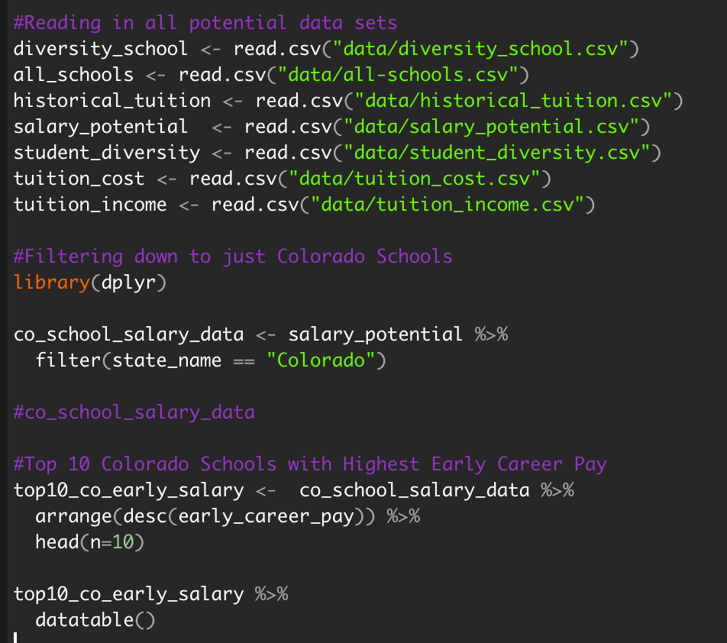
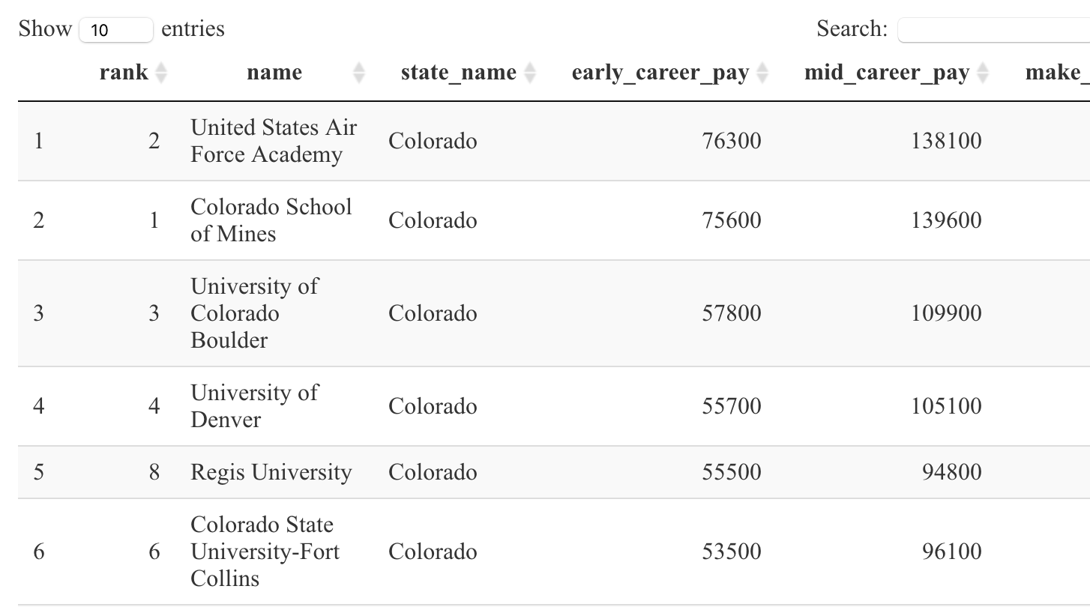
Most Enrolled Universities in Colorado: A glance at minority enrollment & salary outlook
Minority Enrollment Numbers: Interactive Table

Slide 6
Most Enrolled Universities in Colorado: A glance at minority enrollment & salary outlook
Lessons Learned
BUGS
Repository Issues
Teamwork
Burn it down
Dataset Used
School Diversity - tidytuesdays
Key Tools Used
flexdashboard
leaflet
ggmosaic
ggplot2
datatable

Slide 7
Challenges
Interactive map
- Plotting markers
- knitting leaflet
- CSU coordinates
Joining the data

