Slide 1
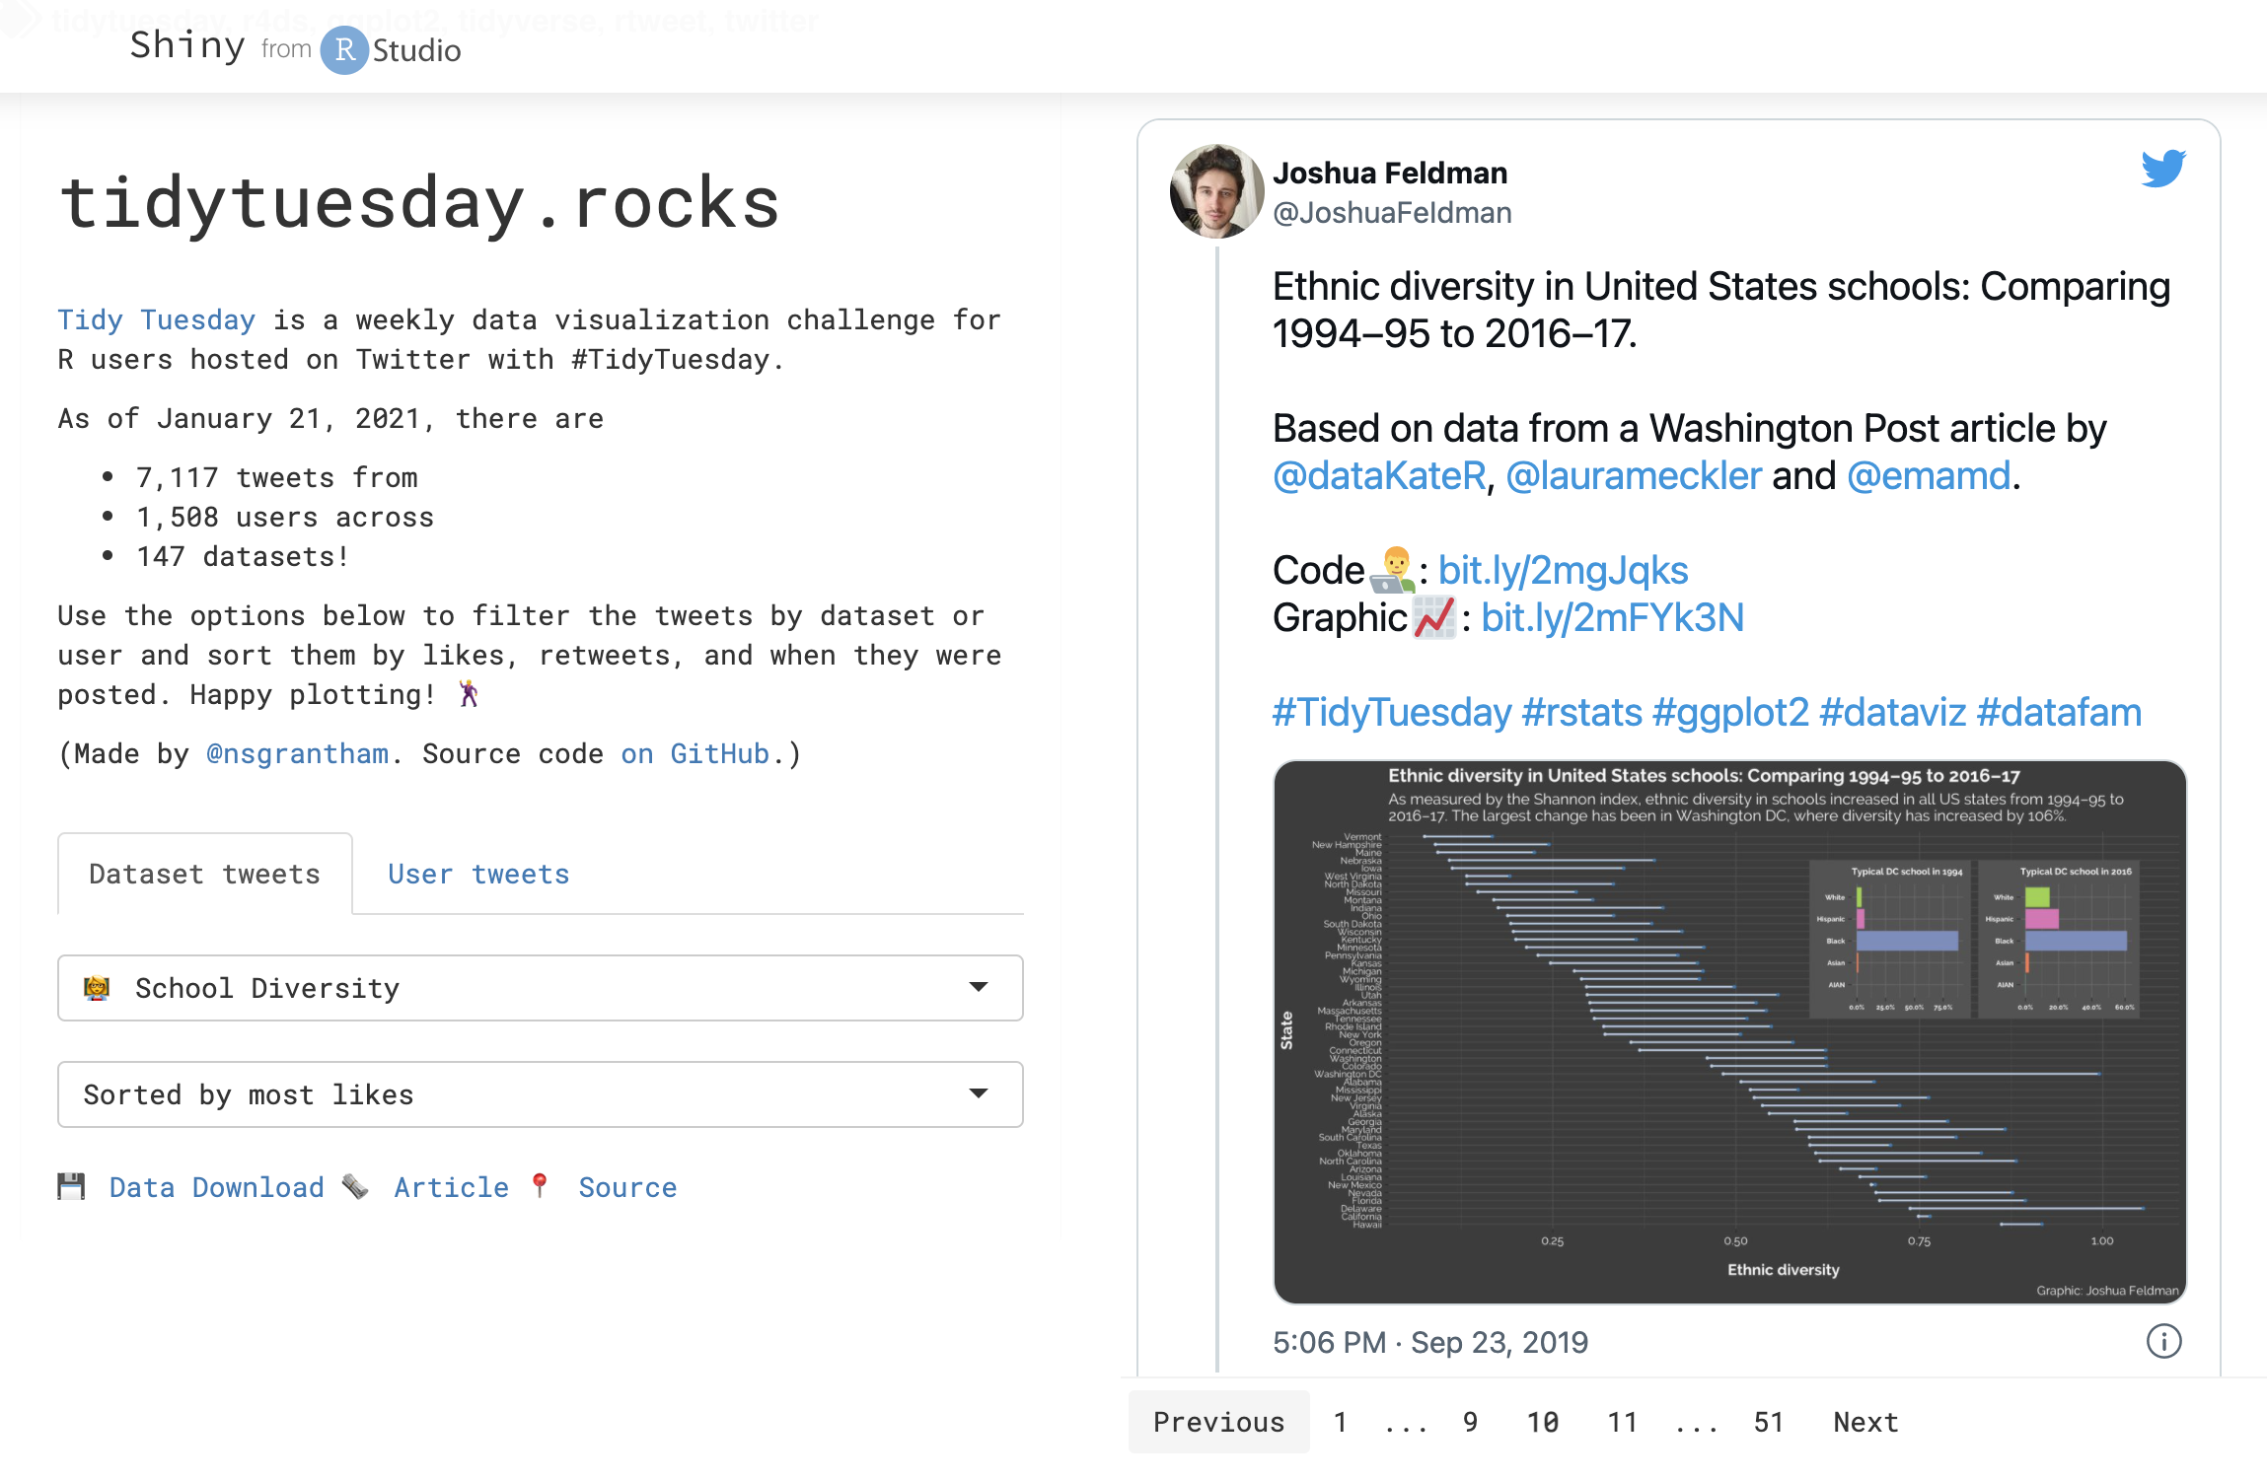

Most Enrolled Universities in Colorado:
A glance at minority enrollment & salary outlook
Kiara Hodo, Pablo Maldonado & Naly Torres
Colorado State University - ERHS 535
December 14, 2021

Slide 2
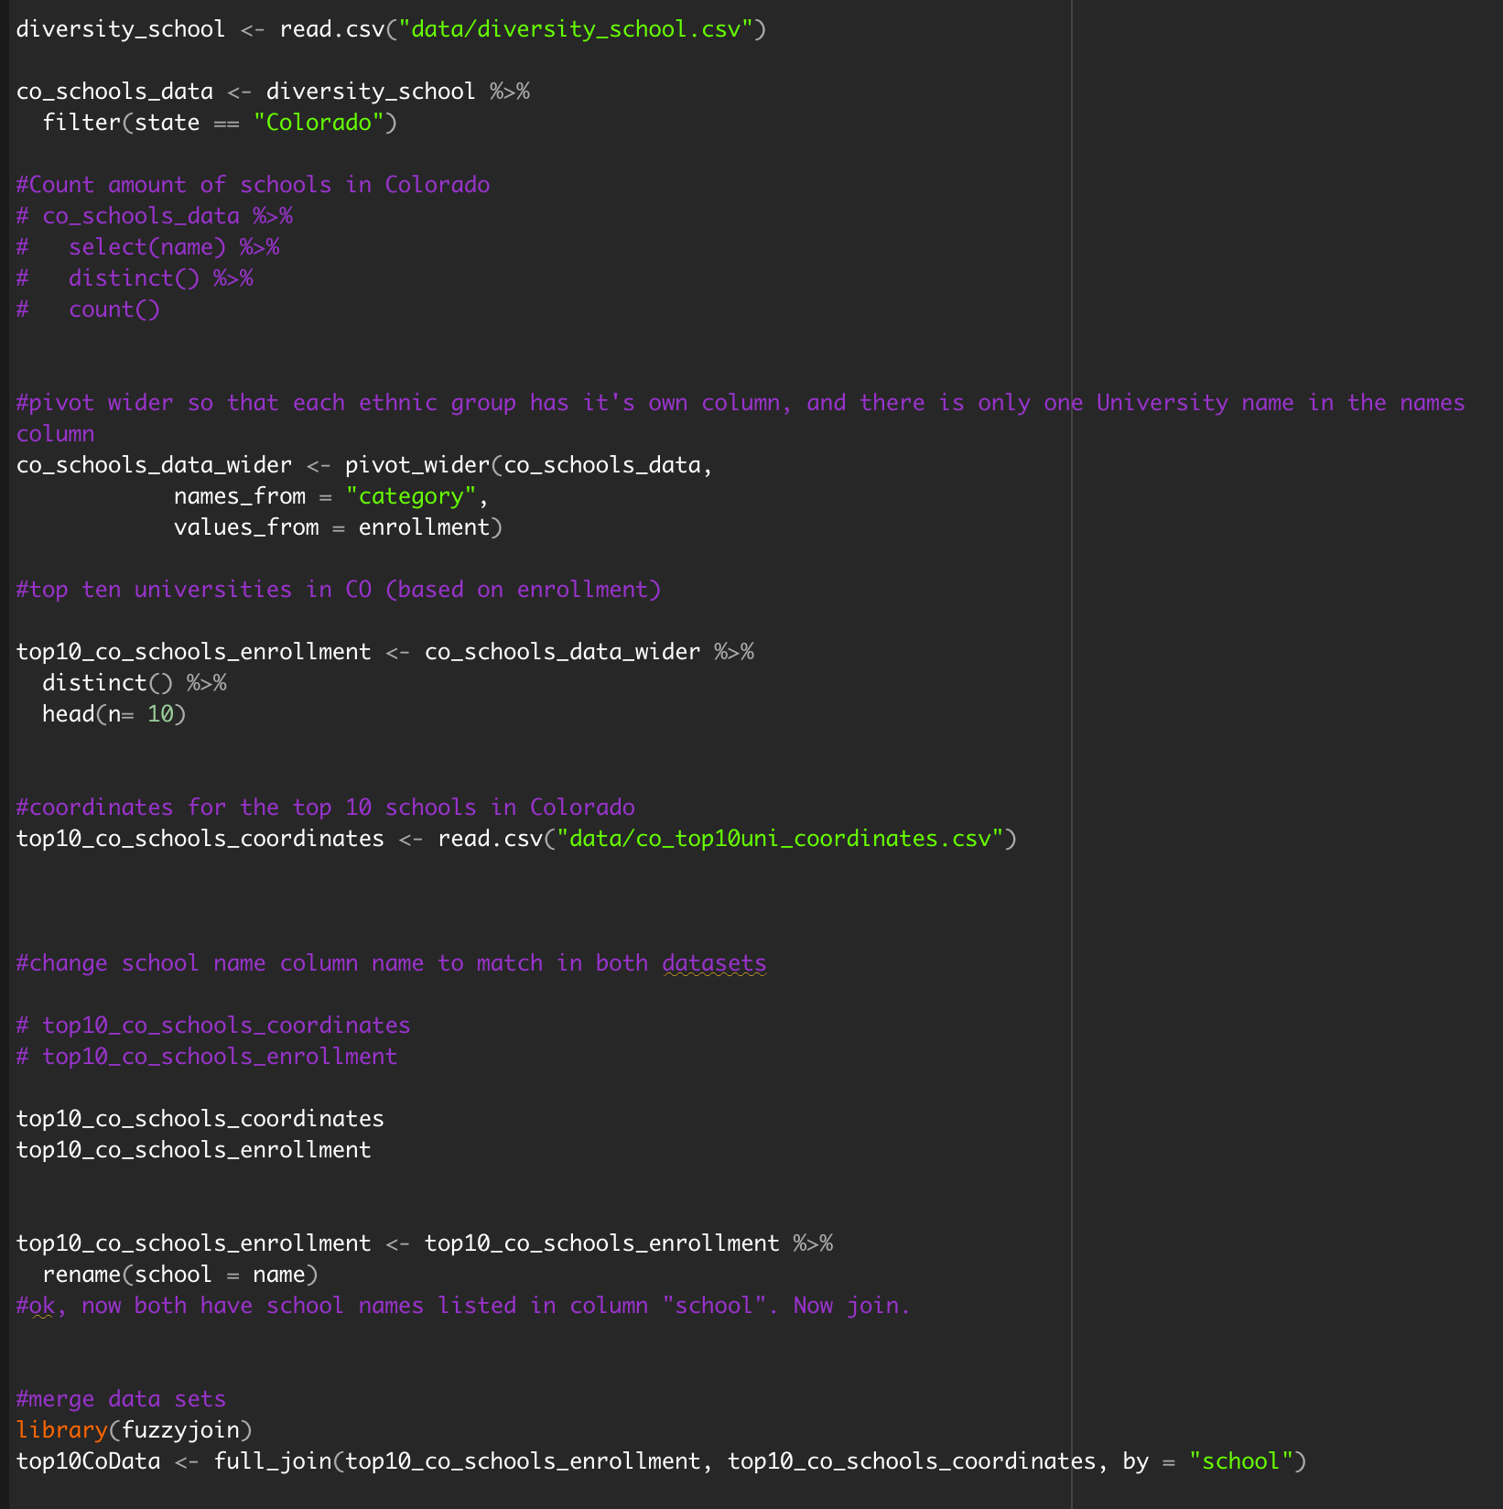
Most Enrolled Universities in Colorado: A glance at minority enrollment & salary outlook : Cleaning the data

Slide 3
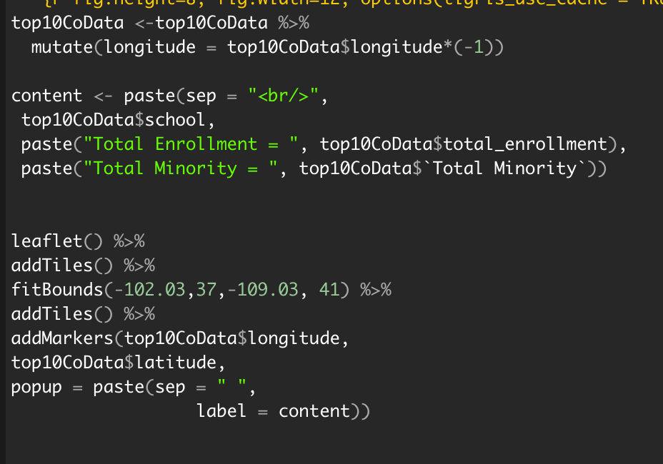
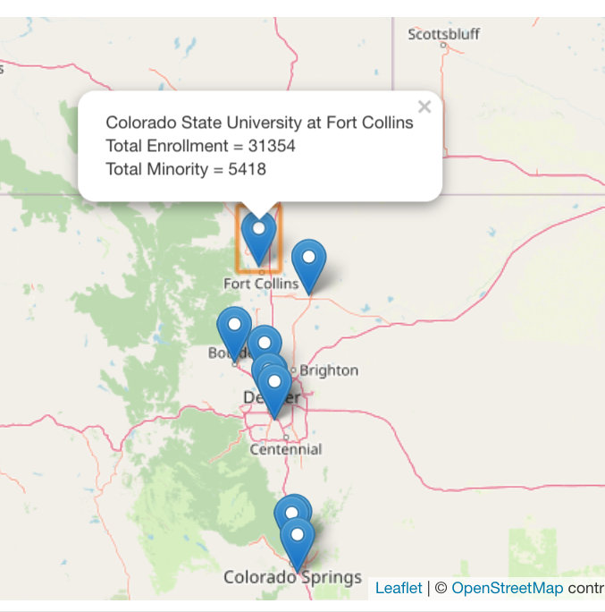
Most Enrolled Universities in Colorado: A glance at minority enrollment & salary outlook
Minority Enrollment Numbers: Interactive Map

Slide 4
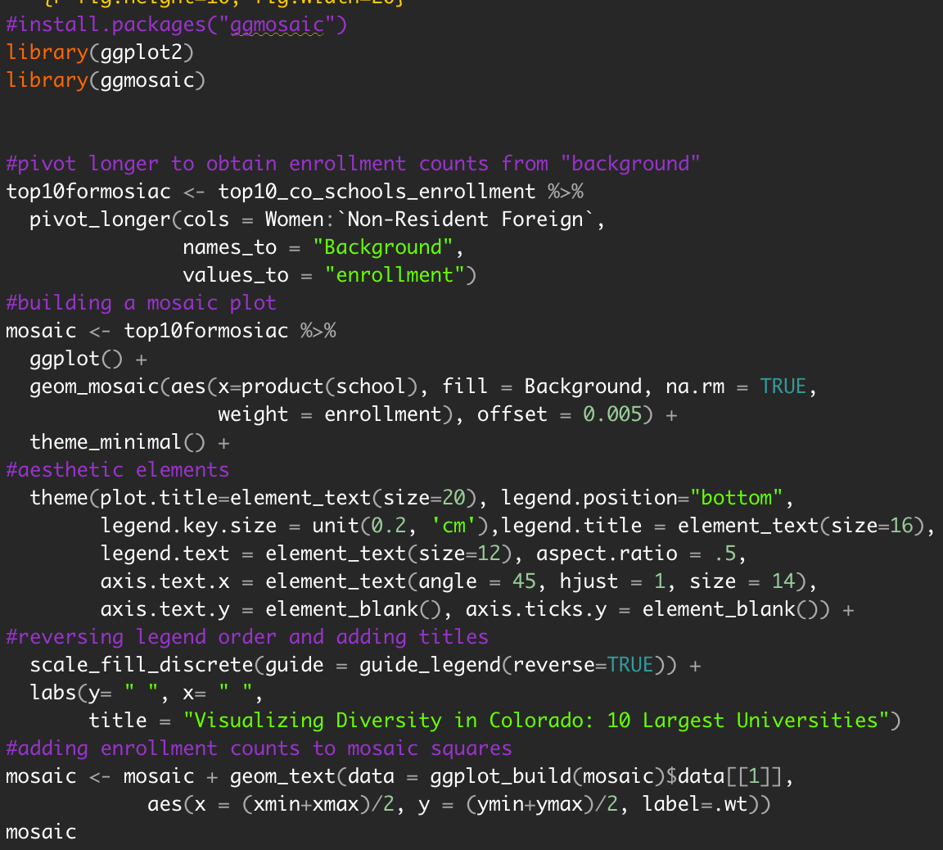
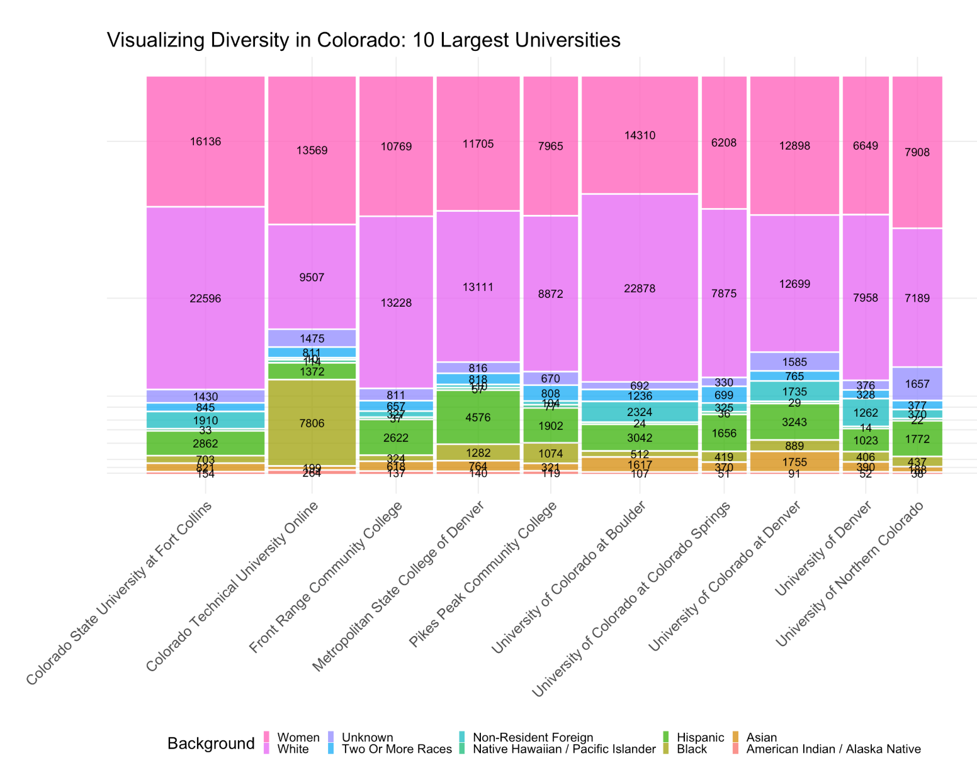
Most Enrolled Universities in Colorado: A glance at minority enrollment & salary outlook
Minority Enrollment Numbers: Mosaic Plot

Slide 5
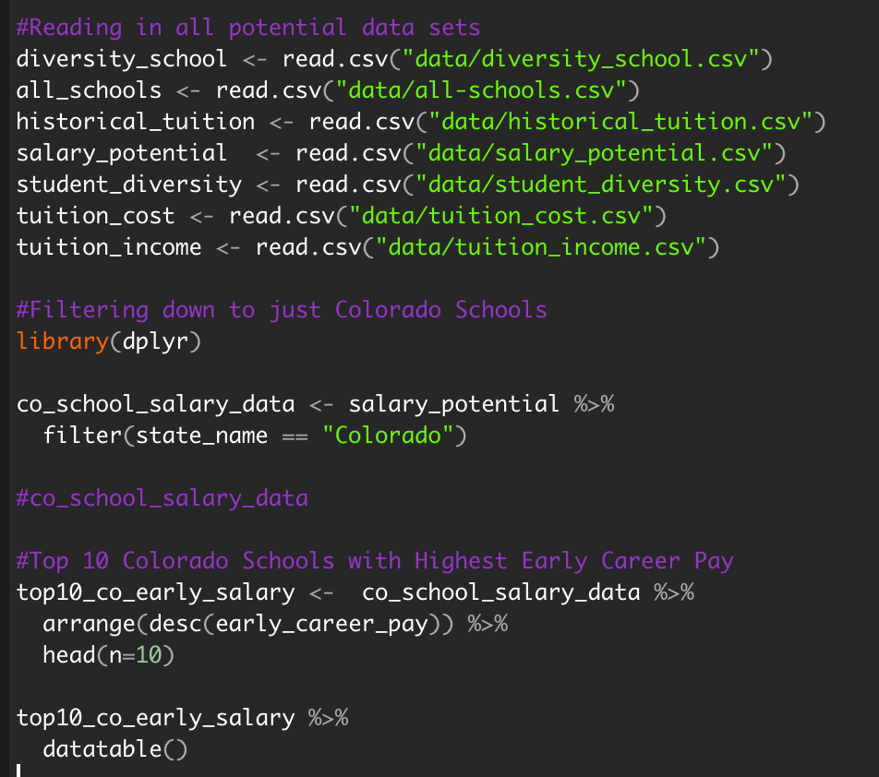
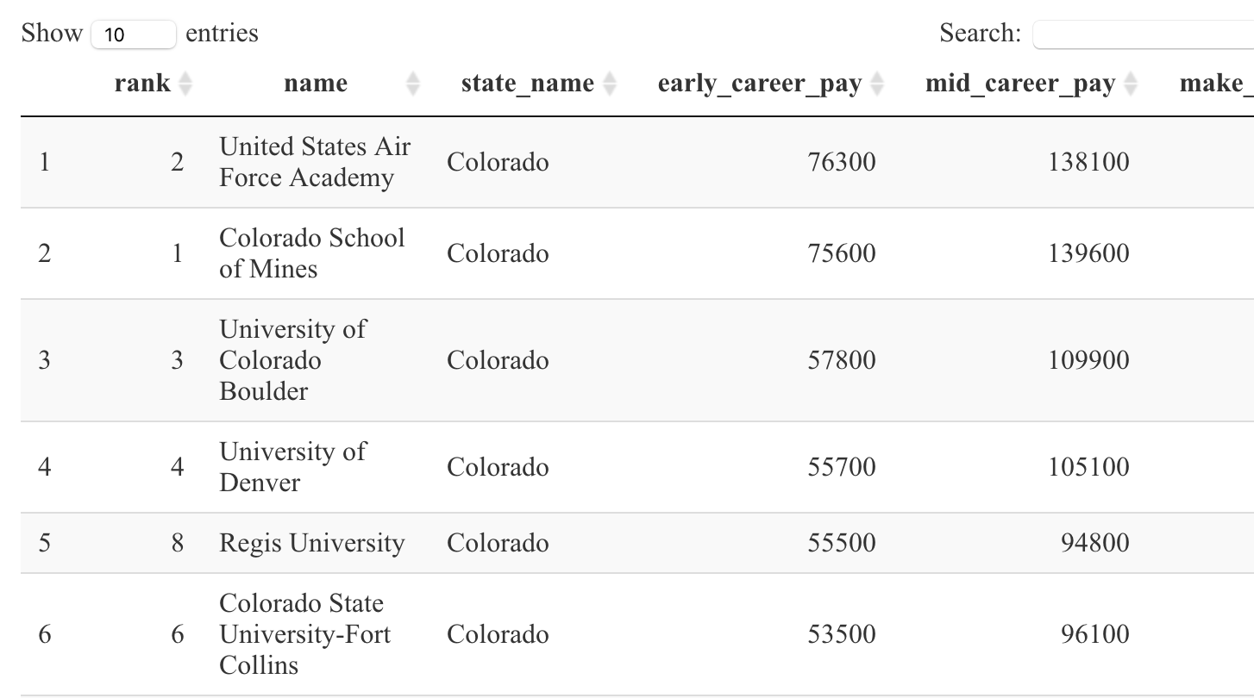
Most Enrolled Universities in Colorado: A glance at minority enrollment & salary outlook
Minority Enrollment Numbers: Interactive Table

Slide 6
Most Enrolled Universities in Colorado: A glance at minority enrollment & salary outlook
Lessons Learned
BUGS
Repository Issues
Teamwork
Burn it down
Joining data
Dataset Used
School Diversity - tidytuesdays
Key Tools Used
flexdashboard
leaflet
ggmosaic
ggplot2
datatable
Interactive map
Plotting markers
Knitting leaflet
CSU coordinates

