Slide 1

Algorithm for Redundant Data Placement in a Distributed Relational Database Management System
Peter the Great St.Petersburg Polytechnic University
Institute of computer science and cybersecurity
Higher school of artificial intelligence technologies
Student: Lobanov Pavel
2026

Slide 2
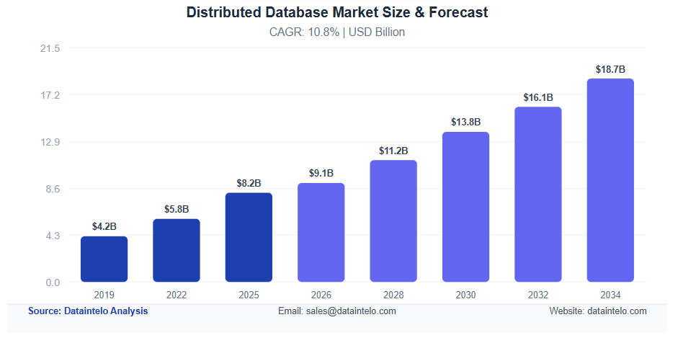
Introduction
Subject area state
Growth in users and internet traffic.
Increased use of distributed systems.
Different data is required in different regions.
53% of users leave web pages if loading takes longer than 3 seconds – Google AdSense.

Slide 3
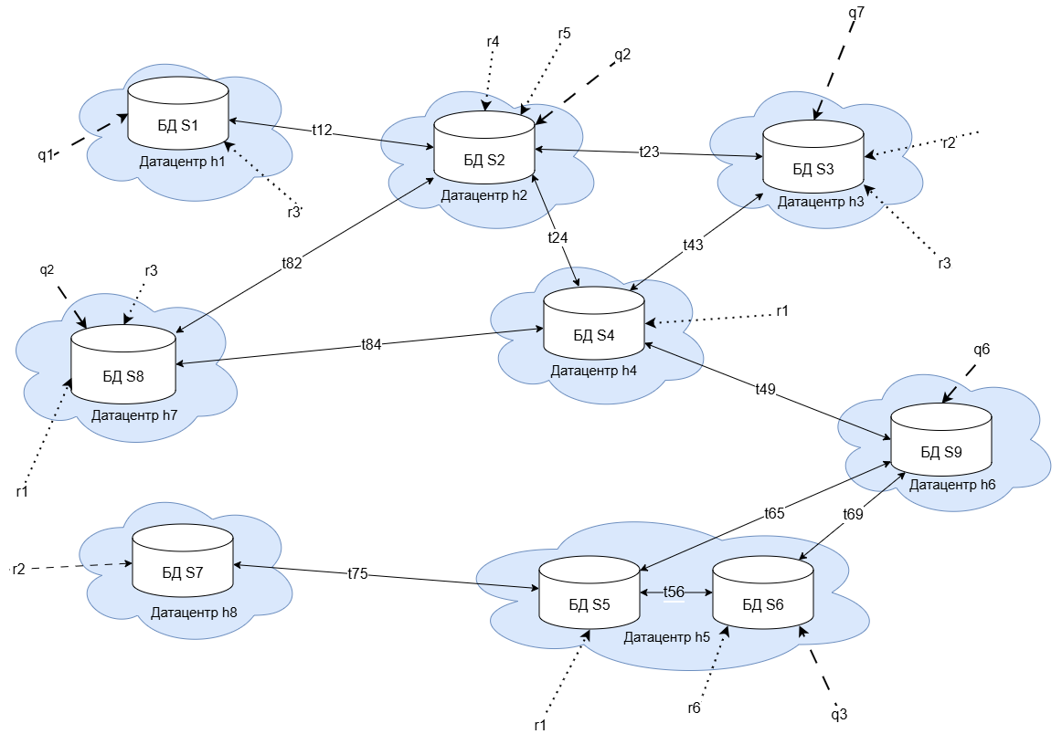
Introduction
Suggested Solution
Main goal: to develop an algorithm for placing data fragments and their replicas in a geographically distributed RDBMS to reduce query processing time, taking into account network latency, local load, and storage constraints.

Slide 4

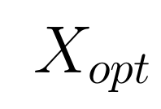








Problem Statement
Results of algorithms:
— fragment distribution matrix.
— copy distribution matrix
Formal model
— set of servers
— a set of read requests.
— set of requests requiring attention.
— a multitude of tables
forming the database.
— a large number of read requests.
— the set of attributes
of all relations.
— matrices of read and update request frequencies.
— matrix of time delays between nodes.
— node capacity vector
4
4

Slide 5
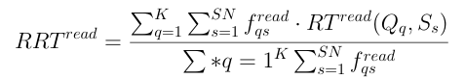



Problem Statement
Metric:
Restrictions:
5
5

Slide 6
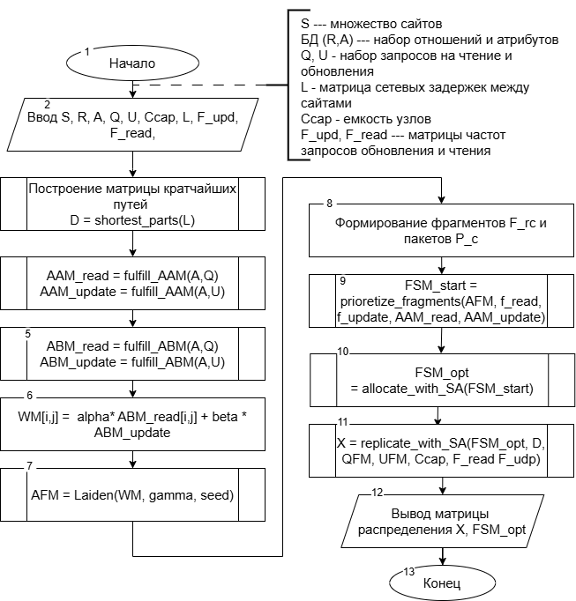
Method
Main steps
System analysis: construction of shortest-path, connectivity, and attribute access matrices
Data fragmentation based on the popularity of joint queriesInitial data distribution;
Improving initial distribution using SA
Data replication where needed, using SA
6

Slide 7
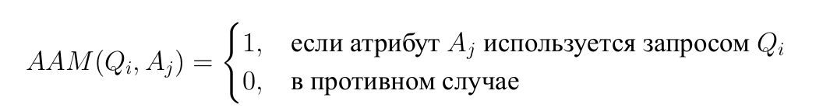

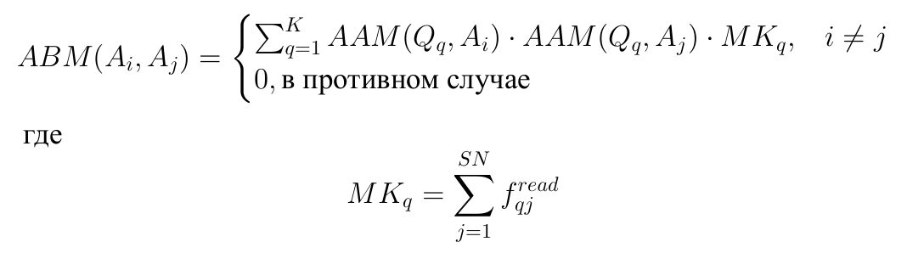
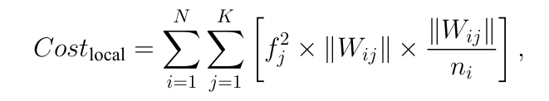
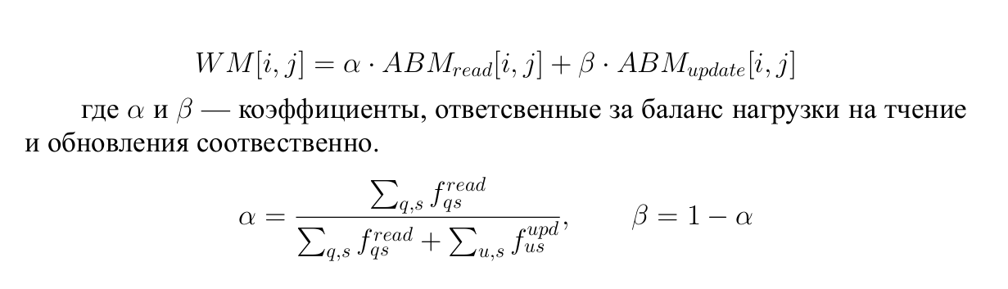
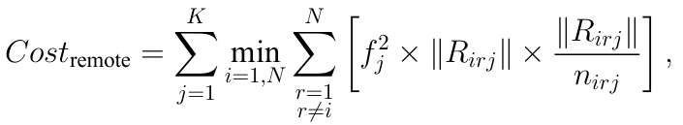

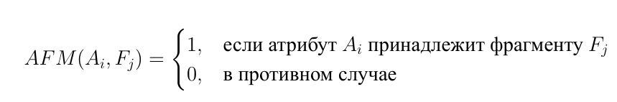
Algorithm. Implementation of data fragmentation.
Attribute access matrix
Fragmentation metric
Матрица связей атрибутов
Attribute read/update relationship matrix
Результат работы алгоритма фрагментации:
Query frequencies are taken into account immediately when constructing attribute relationships.The Leiden algorithm groups attributes that are frequently used together.

Slide 8



Placement algorithm
— global data fragment priority
— local node's
demand for a fragment.
Fragments of various relations are co-located in packets.
AR is required for the initial placement of the system's most frequently requested packets.
LR places a packet on the node where it is most often needed. If the selected node interferes with the placement of other packets, the decision is rolled back.
SA is used to improve RRT.
Results:
Initial Placement Matrix:

Slide 9
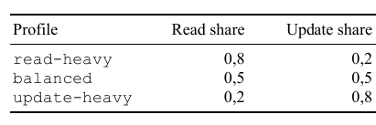
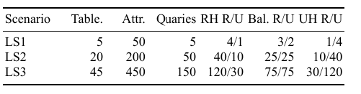
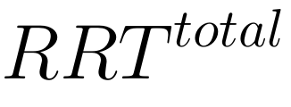

Experiments. Experiment scenarios.
Research metrics:
— round-trip response time
— cost of accessing a distributed fragment
For each scenario, three load profiles were tested: read-intensive, update-intensive, and balanced.

Slide 10
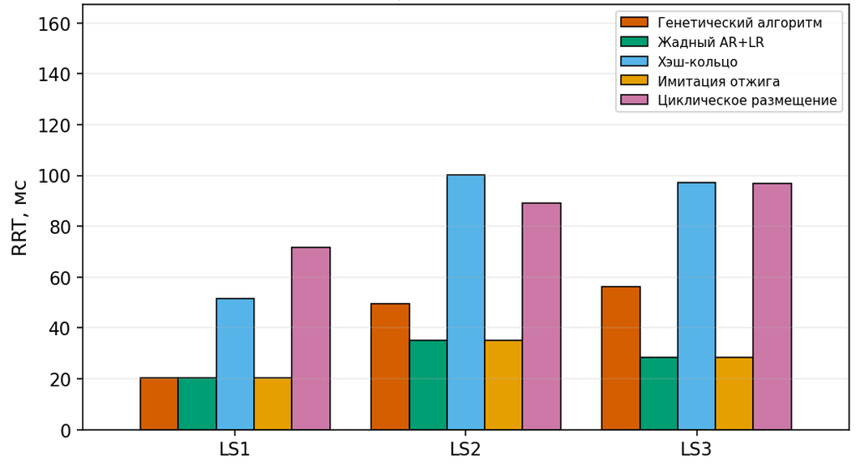
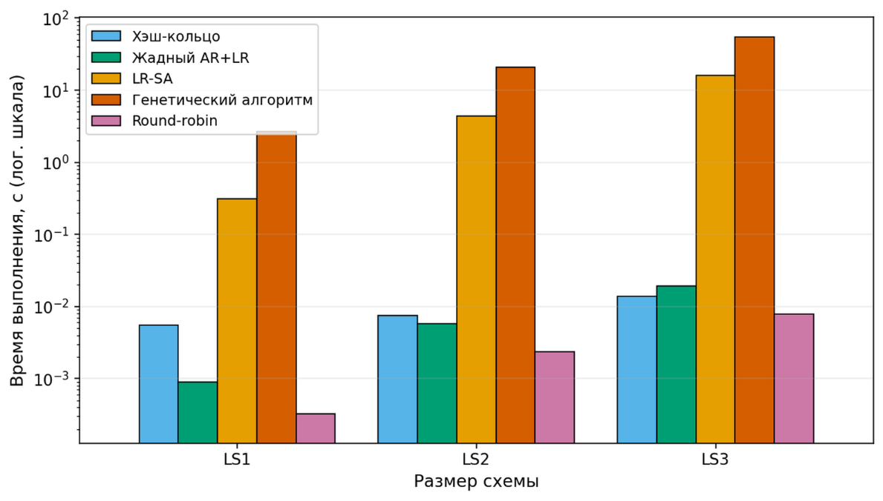
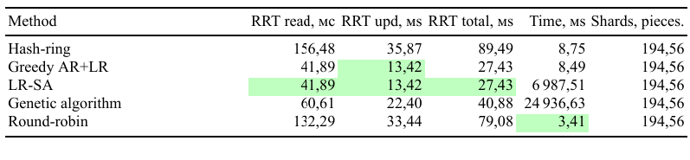
Experiments. Placement Algorithm.
RRT
Genetic algorithm
Greedy AR+LR
Hash-ring
LR-SA
Round-robin
Experimental Setup
The goal of the experiment is to evaluate how the placement method for master copies affects RRT, given the same Leiden fragmentation and without considering replicas.
RRT, ms
Time.
Hash-ring
Greedy AR+LR
LR-SA
Genetic algorithm
Round-robin
Time, ms
10

Slide 11
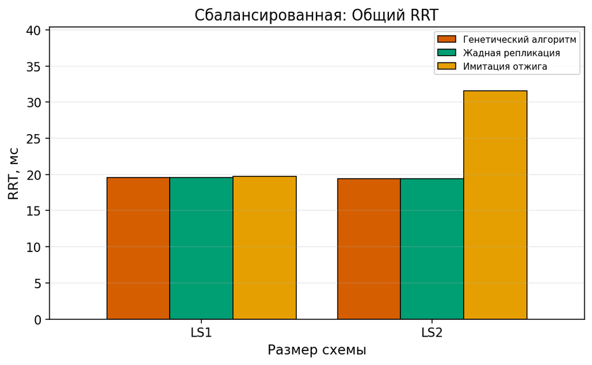
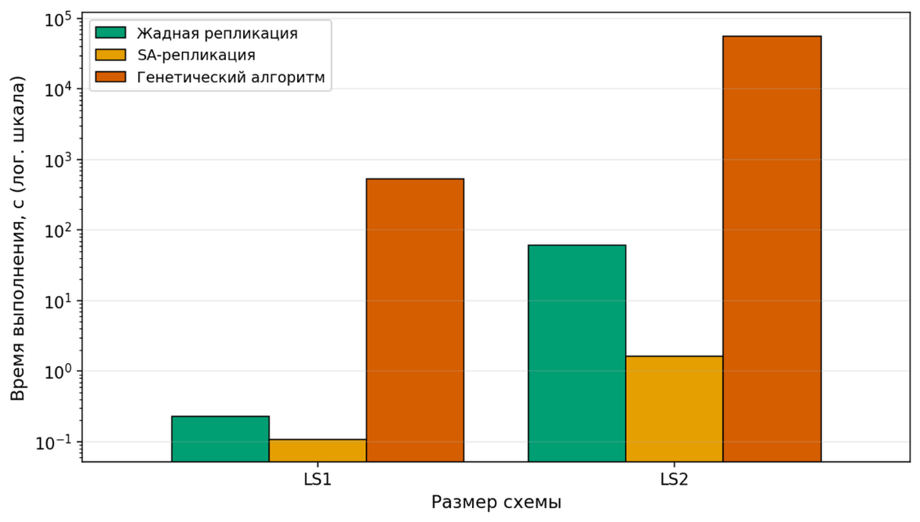
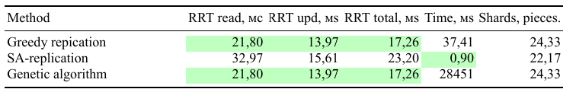
Experiments. Replication algorithm.
RRT
GA
Greedy replication
SA
Experimental Setup
Experimental SetupThe goal of the experiment is to compare methods for selecting replicas following the fixed placement of master copies.
RRT, ms
Time
GA
Greedy replication
SA
Time, ms

Slide 12
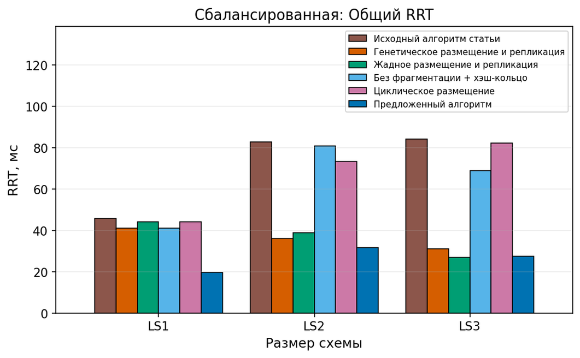
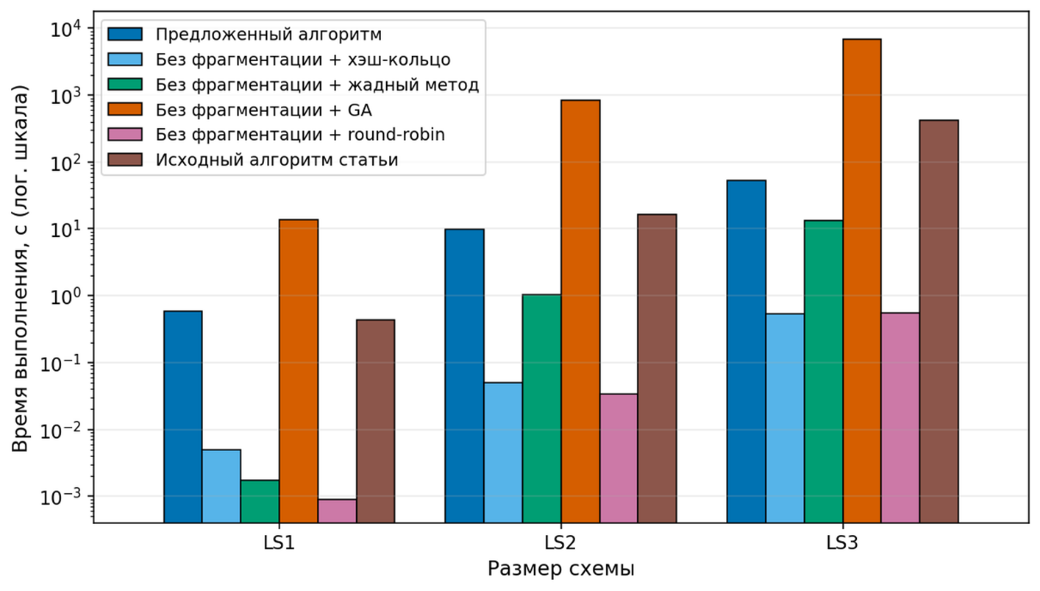
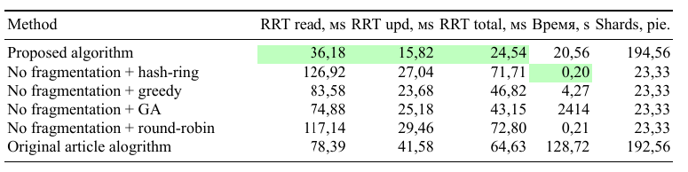
Experiments. General pipelines.
RRT
Original article algorithm
No frag + GA
No frag + greedy
No frag + hash-ring
No frag + round-robin
Proposed algorithm
Experimental Setup
The goal of the experiment is to compare the final data distribution strategies, including fragmentation, master copy placement, and replication.
RRT, ms
Time
Proposed algorithm
No frag + hash-ring
No frag + greedy
No frag + GA
No frag + round-robin
Original article algorithm
Time, ms

Slide 13
Conclusion
A redundancy-based data placement algorithm for a geographically distributed relational database has been developed and implemented.
The developed data fragmentation algorithm, utilizing the Leiden algorithm, enables the grouping of frequently queried attributes.
The data placement algorithm establishes an effective initial distribution by considering both global and local priorities, thereby improving RRT by 32.91%, 65.32%, and 69.35% compared to other methods.
The data replication algorithm enables the relocation of necessary fragments, demonstrating a time advantage of 760 units compared to the Genetic Algorithm (GA).When comparing the complete pipelines—none_ga_ga, none_greedy_greedy, article_original, none_hash_none, and none_round_robin_none—the improvements in total RRT were 43.13%, 47.59%, 62.03%, 65.78%, and 66.29%, respectively.

Slide 14
Thank you for your attention!
Lobanov P.M.
lobanov.pm@edu.spbstu.ru

