Slide 1
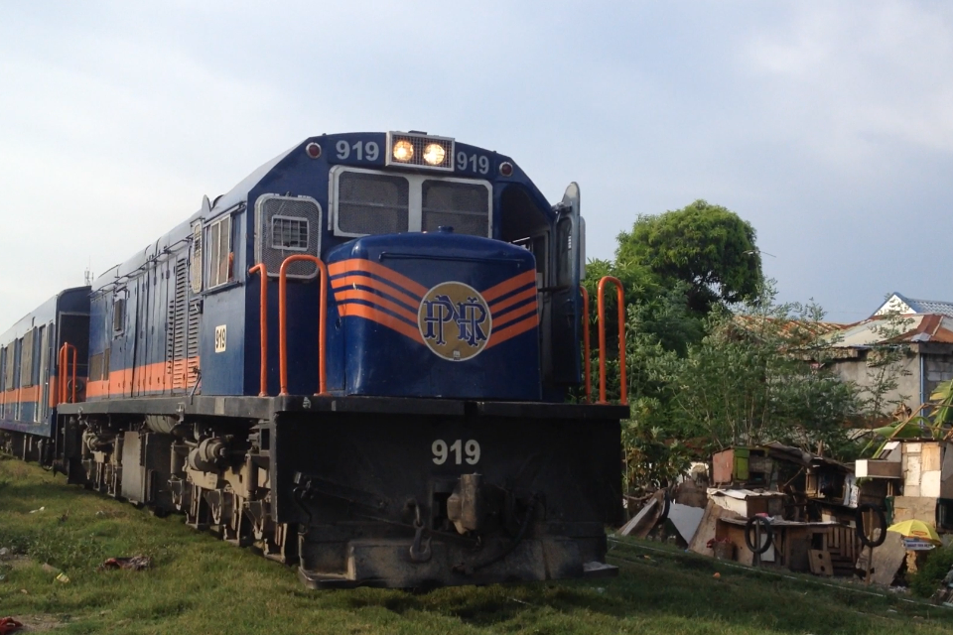
PNR Commuters Manalang || Timo
Notes:
Commuting has been a part of the daily life of every Filipino – from students to teachers, workers, etc. Rest assure that most Filipinos have experienced commuting at least a few times in their life, and some of those experience may be something they don’t want to experience anymore – it could from any public transportation that is available in the country.
There are various ways to commute but for this specific activity, the observers will focus with the Philippine National Railway (PNR) commuters as their subject.

Slide 2
1.
Need Finding
Questions
Interviewees’ Insights
User need breakdown
Point of view

Slide 3
How often do you ride the train?
Why ride it other than the other public transportation available in our disposal?
Give us any suggestions that you think can help PNR improve and make it a more effective public transportation in the future.
Questions

Slide 4

Angelica Mendoza || 28 years old || Programmer
Once a month
Efficient, less traffic – can reach many destinations, and fare is cost-effective than the others
Airconditioning units, impose stricter rules when it comes to the loading and unloading process.
Interviewee Insights

Slide 5

Zenaida Chavez || 20 years old || Student
Occasionally
Trains are much faster and less hassle
More train trams for more people to enjoy
Interviewee Insights

Slide 6

Rommel Ormita || 20 years old || Student
Every other day
I consider riding jeepneys and buses, but PNR is more convenient for me.
Have more trains to have more timeslots. Integrate beep system, innovate the trains because most of it are already old.
Interviewee Insights

Slide 7

Inspire Manalang || 17 years old || Student
Everyday, when I go to school
I find it cheaper and efficient than the others.
Proper maintenance of the railways, shorter interval of train arrivals.
Interviewee Insights

Slide 8
Commuters need a way to ride the train comfortably.
Commuters need to be able to avoid long waiting lines.
Commuters need a way to avoid the huge crowd in train stations.
Commuters need a way to not worry about the train interval schedule.
Commuters need to be able to have their tickets in advance.
User needs

Slide 9
Proper organization and developing more effective and efficient ways that can greatly impact everyday travel of train commuters.
Point of view

Slide 10
2.
Story board

Slide 11
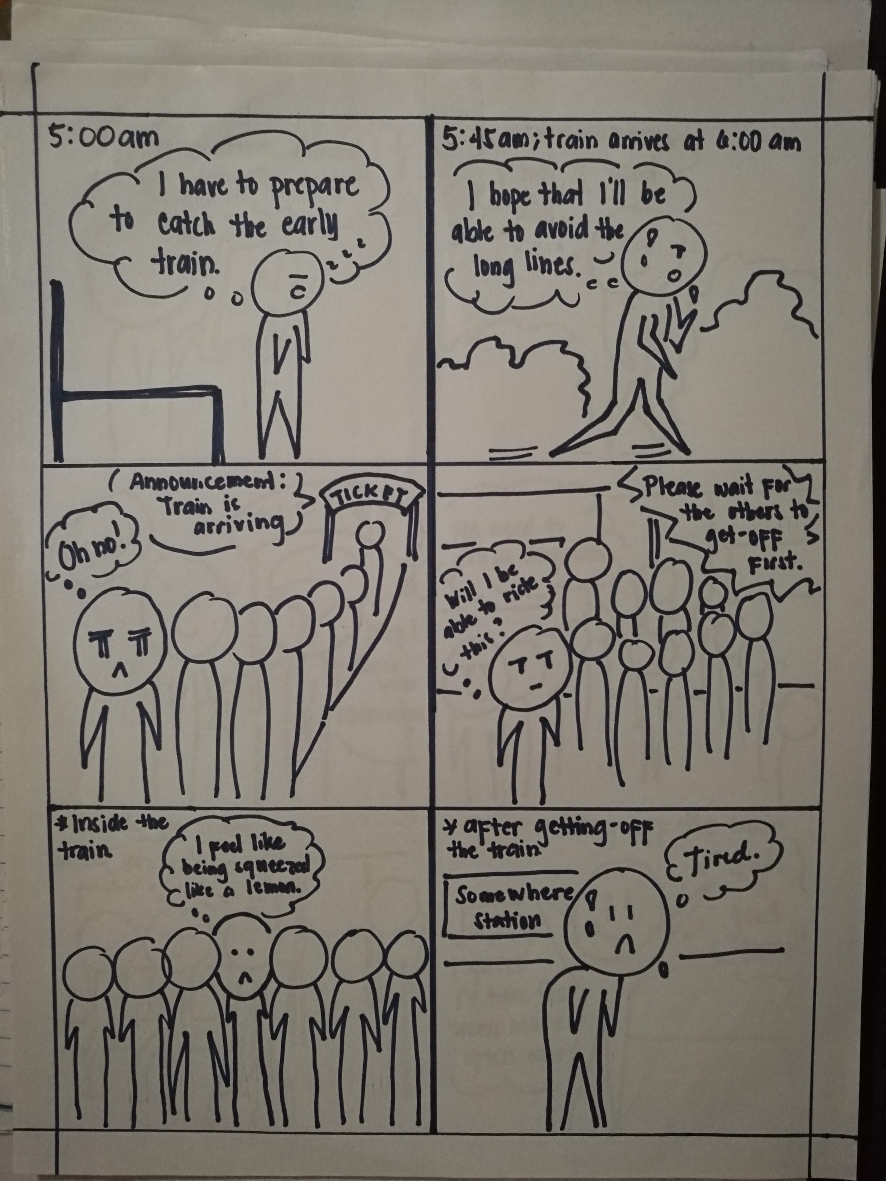
Storyboard 1

Slide 12
Storyboard 1

Slide 13
Storyboard 1

Slide 14
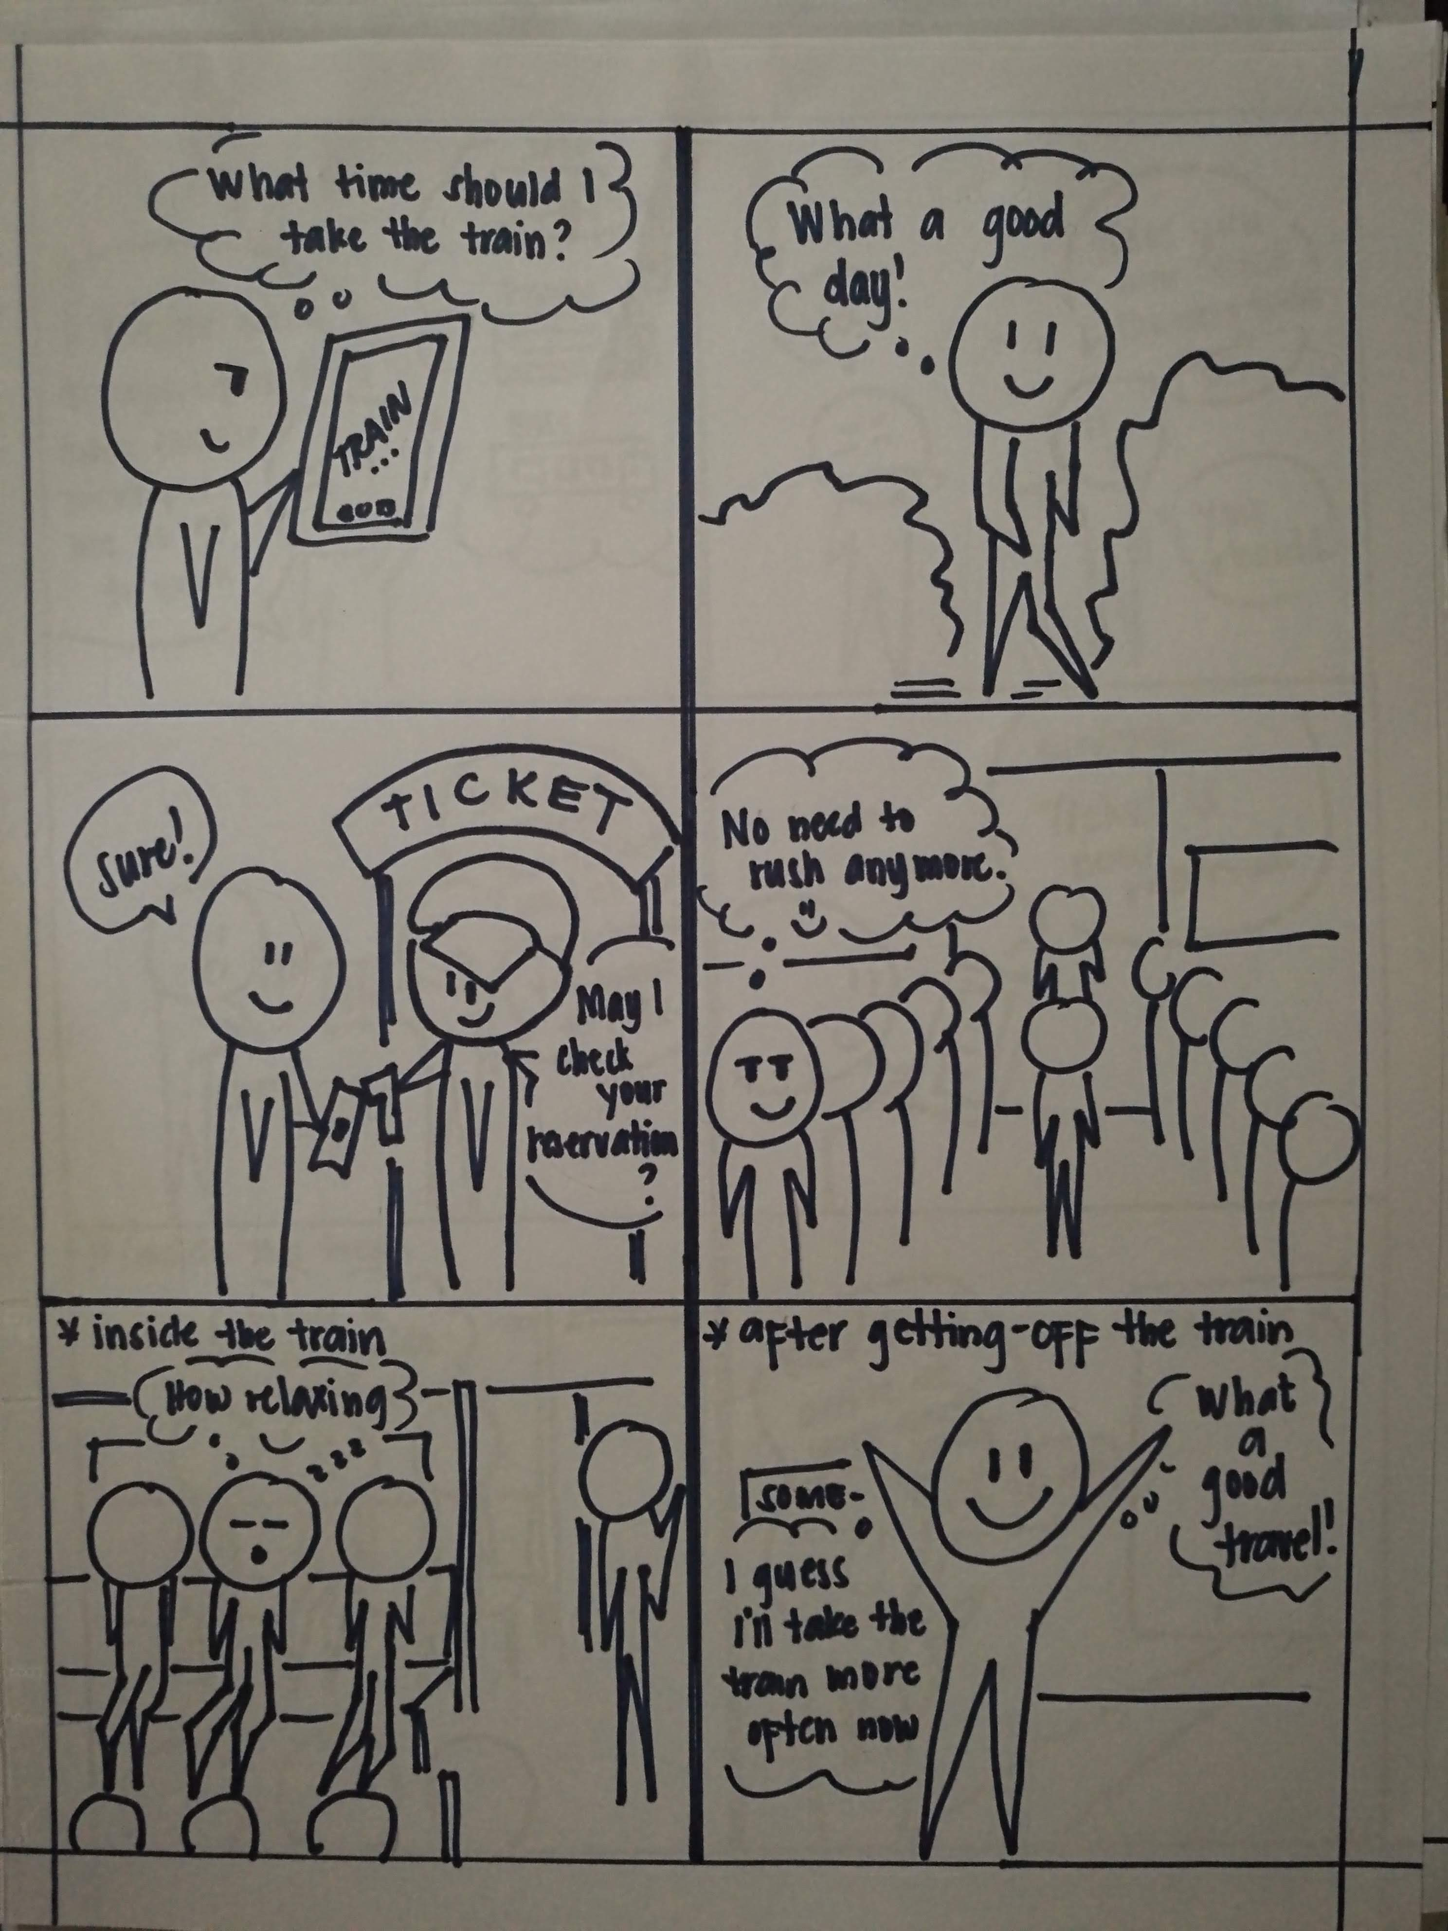
Storyboard 2

Slide 15
Storyboard 2

Slide 16
Storyboard 2

Slide 17
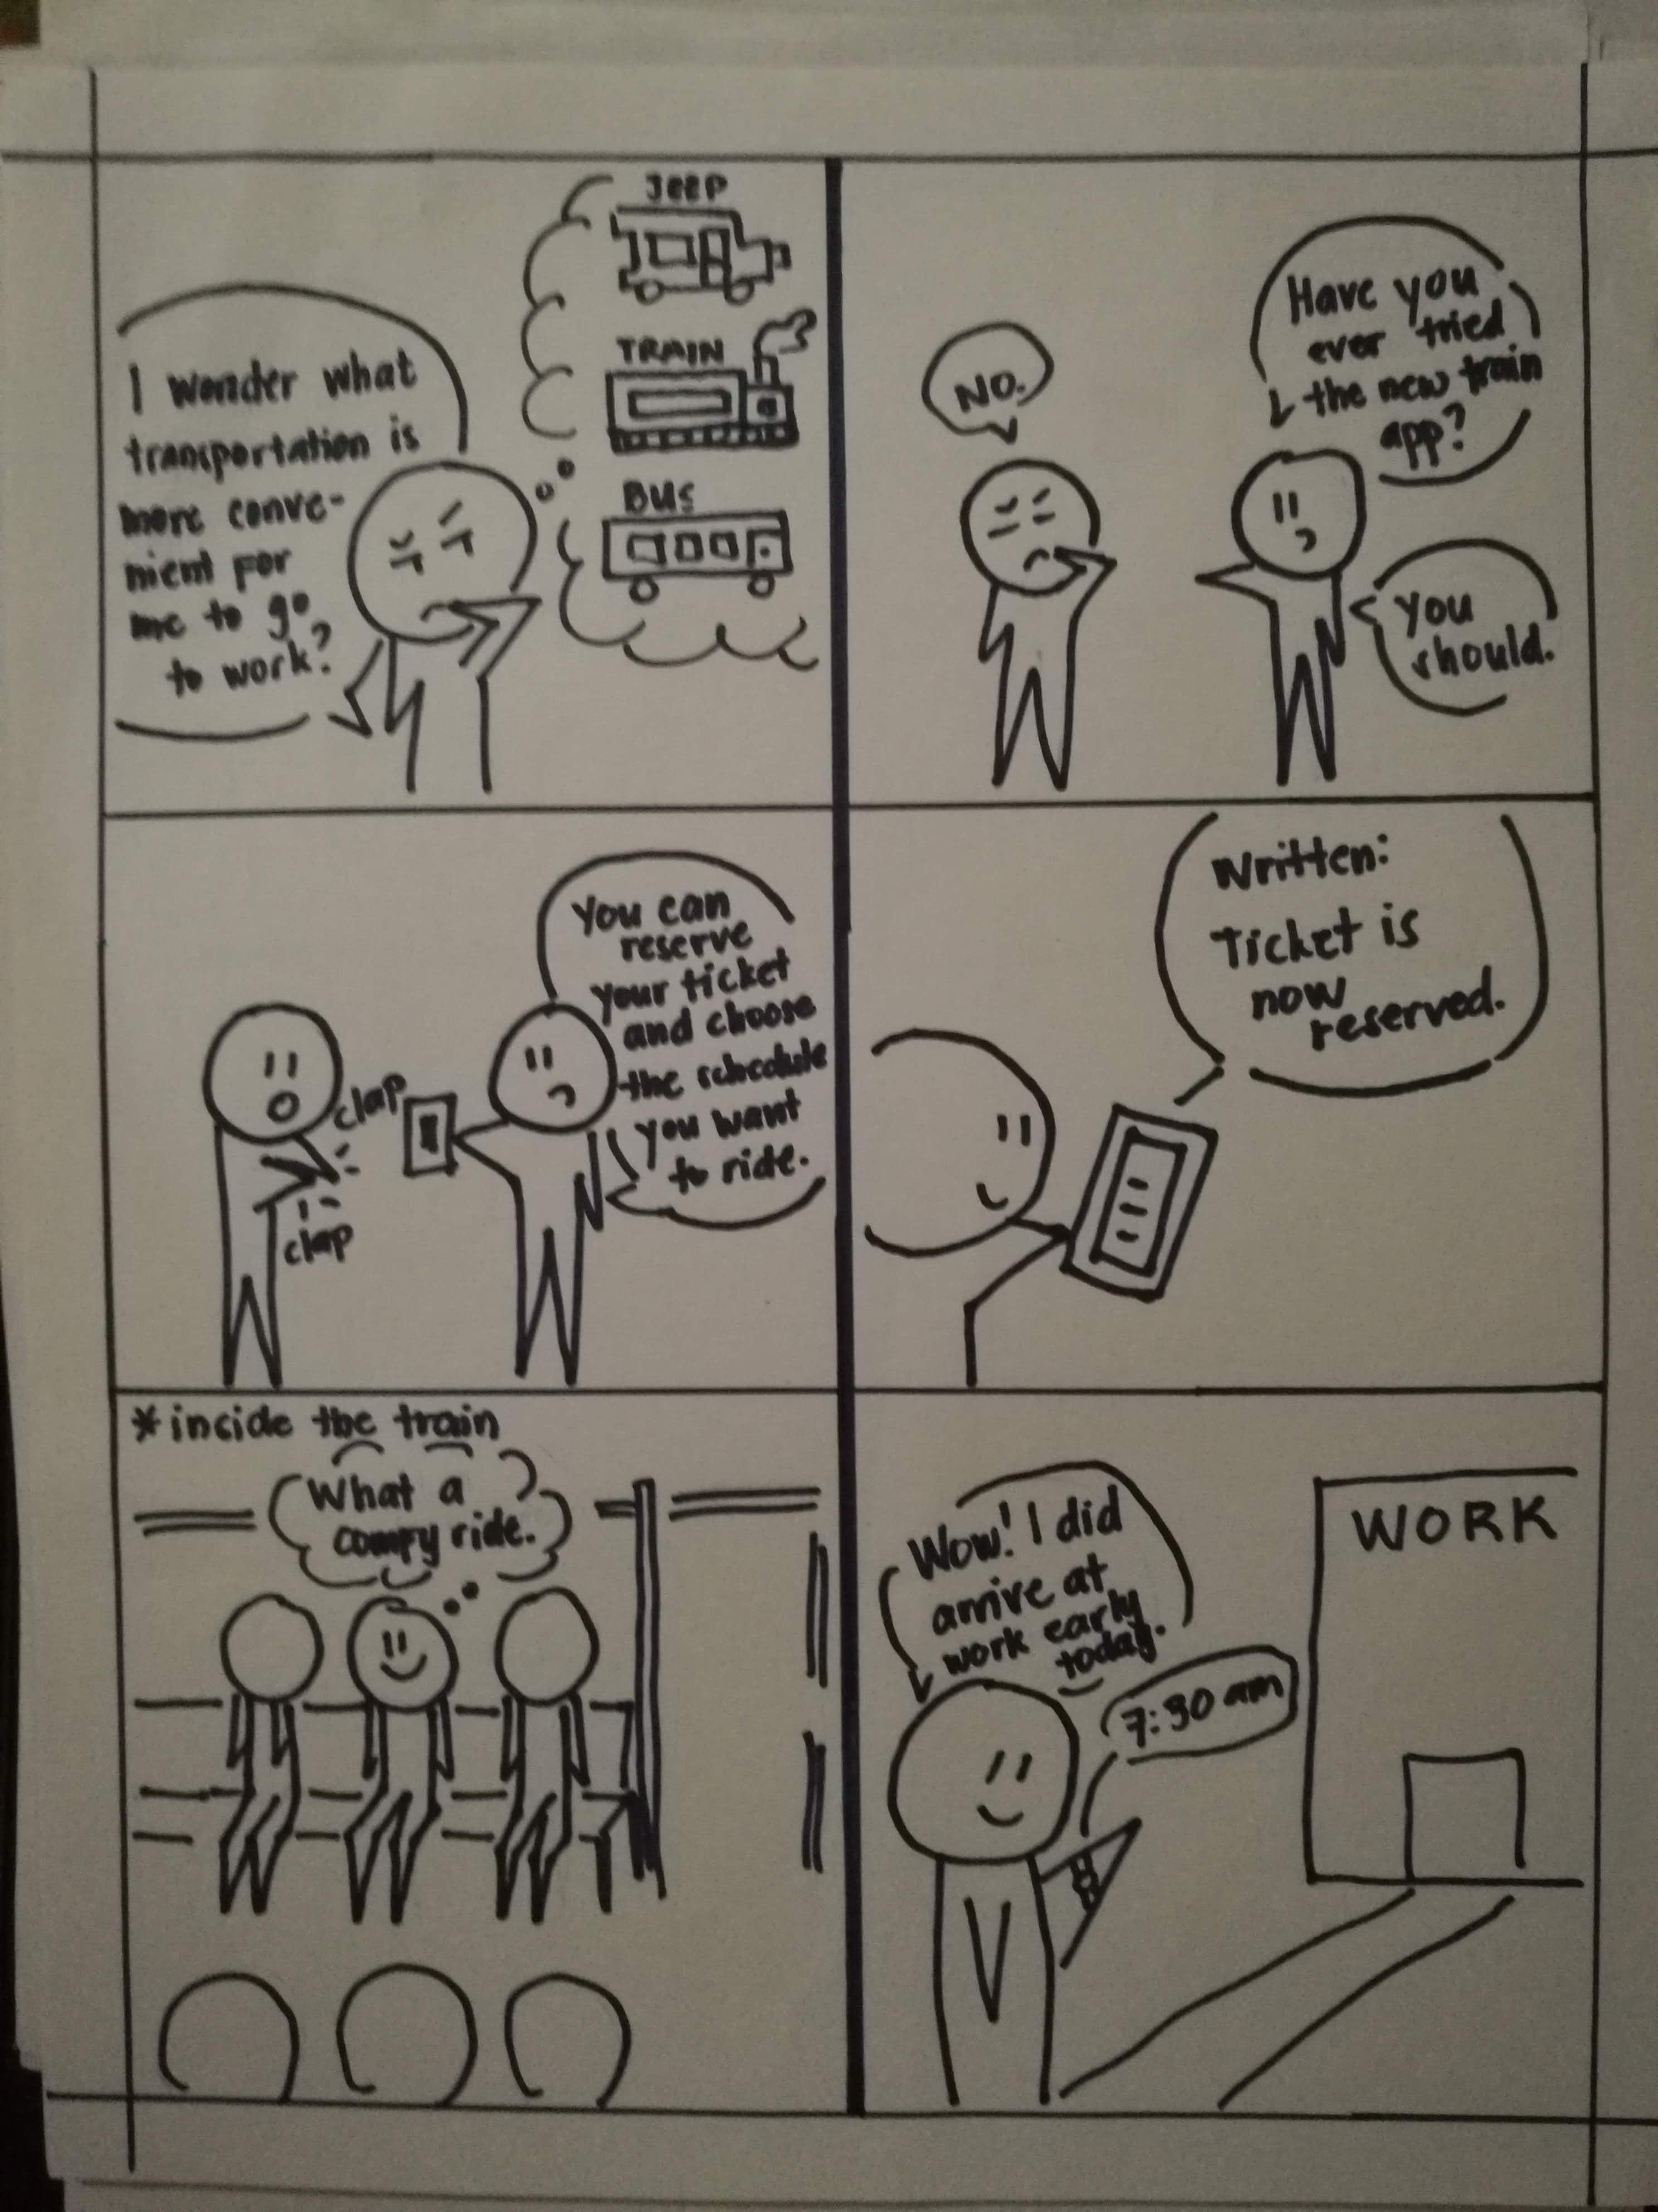
Storyboard 3

Slide 18
Storyboard 3

Slide 19
Storyboard 3

Slide 20
3.
Prototype
Notes:
Demo with the interviewees (prototype 1 and 2)

Slide 21
Video Link: Prototype
https://youtu.be/1TZmB0xLpGU
Notes:
Demo with the interviewees (prototype 1 and 2)

Slide 22
Prototype 1
There’s a sign-up button but no actual window for it.
There’s a login button but no actual window input for email and password to login.
Improve interface – make it more user friendly

Slide 23
Prototype 2
It’s more efficient and user friendly than the first one.
I think it’s better if there are accounts for users so that they can track their transactions online. (Facebook or Google account bindings)
Add e-payment options
Incorporate GPS to track the nearest train station

