Slide 1

Need Finding Presentation
Manalang || Timo

Slide 2
Commuters needs a way to ride the train worry free
Commuters need a way to not think about train intervals
User needs
Commuters needs a way to avoid long lines
Commuters needs a way to have their tickets in advance

Slide 3
Point of view

Slide 4
“Proper organization and developing more effective and efficient ways that can greatly impact everyday travel of
train commuters. “
Point of view

Slide 5
PNR Ticketing App

Slide 6
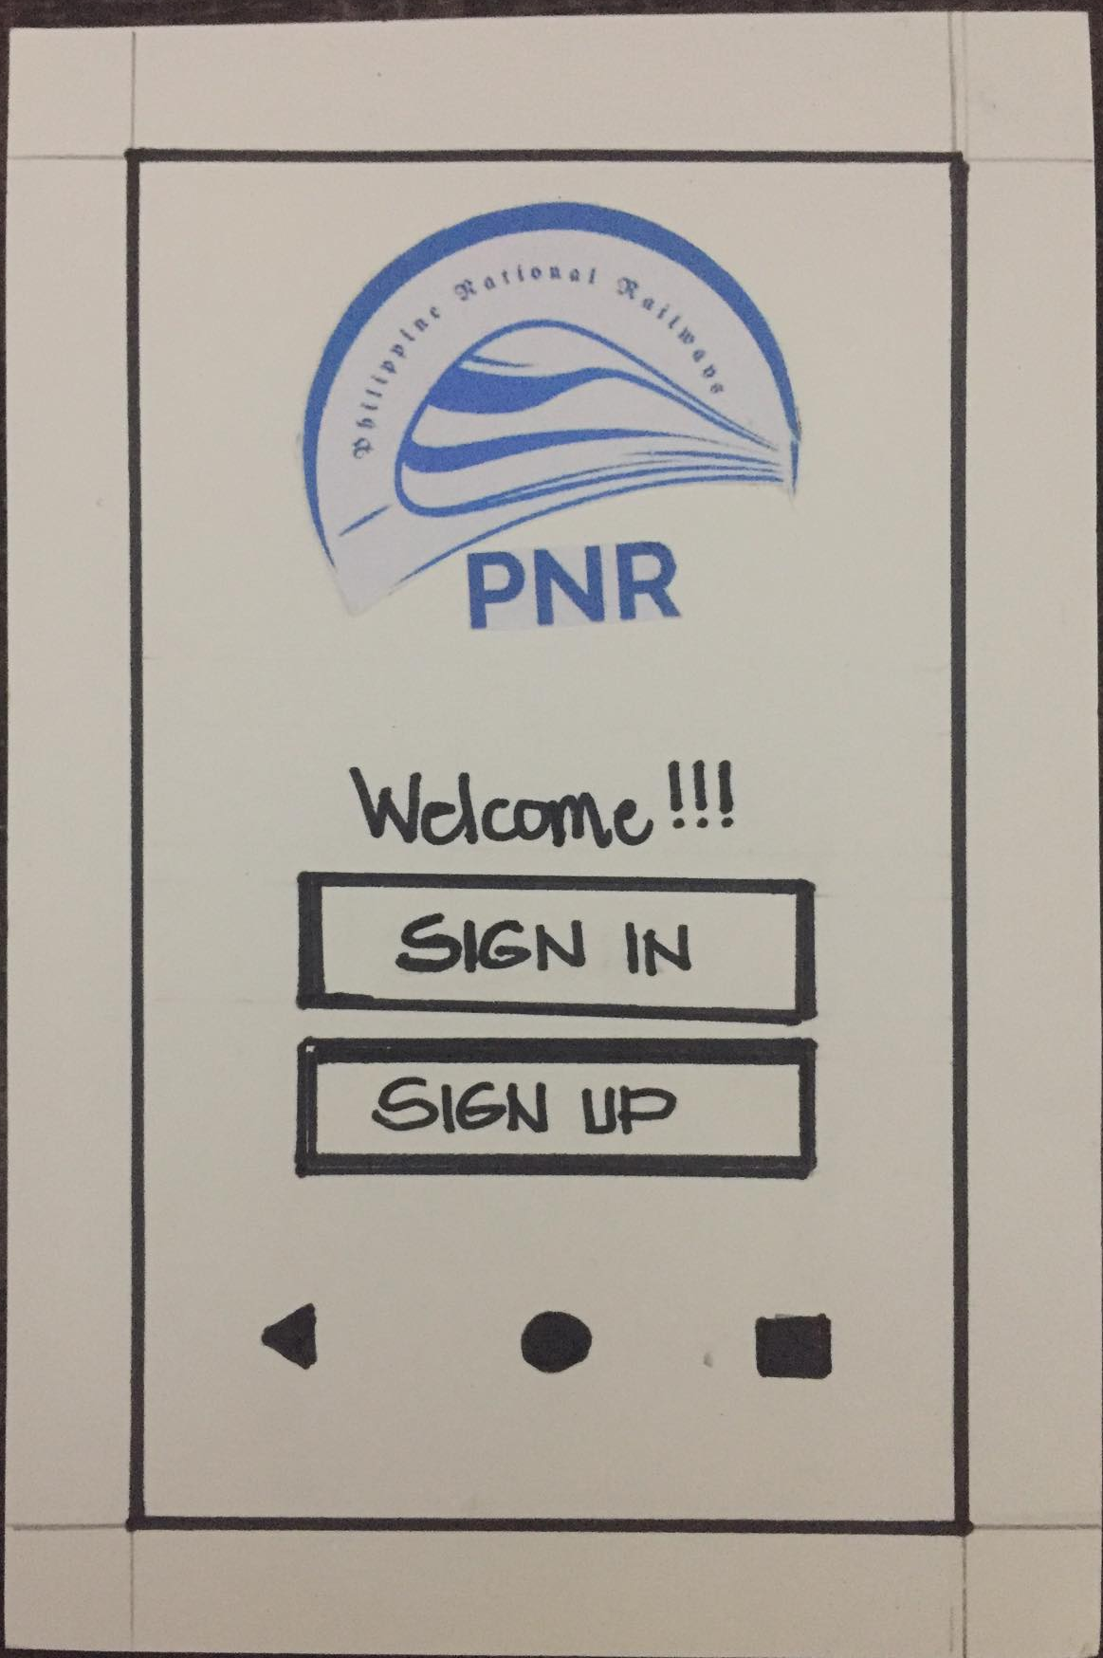
Digital Mockup
Paper Prototype
Welcome!!!
PNR Ticketing App
Sign in
https://youtu.be/S0CxBlK46js
Sign up

Slide 7
Nakakatuwa kasi same na same siya sa kung paano usually ginagawa yung mga apps
Paper Prototype
Almost every option that an app needs is already there
The ticketing choice, VIP or REGULAR. It’s a good choice to avoid hassle
Straightforward app, and user friendly
Madali ma-access and may tracker ng past transactions

Slide 8
Digital Mockup
Improve the UI Design of the application, it’s kind of plain.
Nakakatuwa kasi ang simple talaga niya, hindi siya mahirap intindihin
Welcome!!!
I like how the app automatically knows what station you are near at
Sign in
It’s really simple, not complicated at all. Siguro, ang downfall na lang is kapag walang internet access yung customer mo.
Sign up

Slide 9
Demo of Digital Mockup

