Slide 1
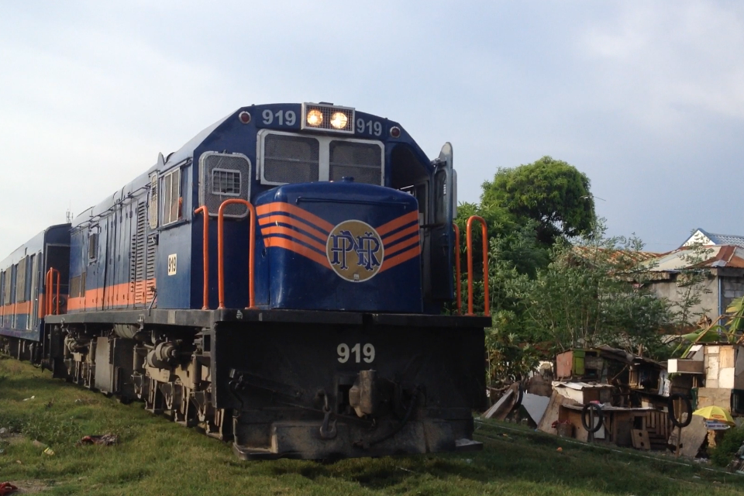
PNR Commuters Manalang || Timo
Notes:
Commuting has been a part of the daily life of every Filipino – from students to teachers, workers, etc. Rest assure that most Filipinos have experienced commuting at least a few times in their life, and some of those experience may be something they don’t want to experience anymore – it could from any public transportation that is available in the country.
There are various ways to commute but for this specific activity, the observers will focus with the Philippine National Railway (PNR) commuters as their subject.

Slide 2
1.
Need Finding
Questions
Interviewees’ Insights
User need breakdown
Point of view

Slide 3
2.
Story board

Slide 4
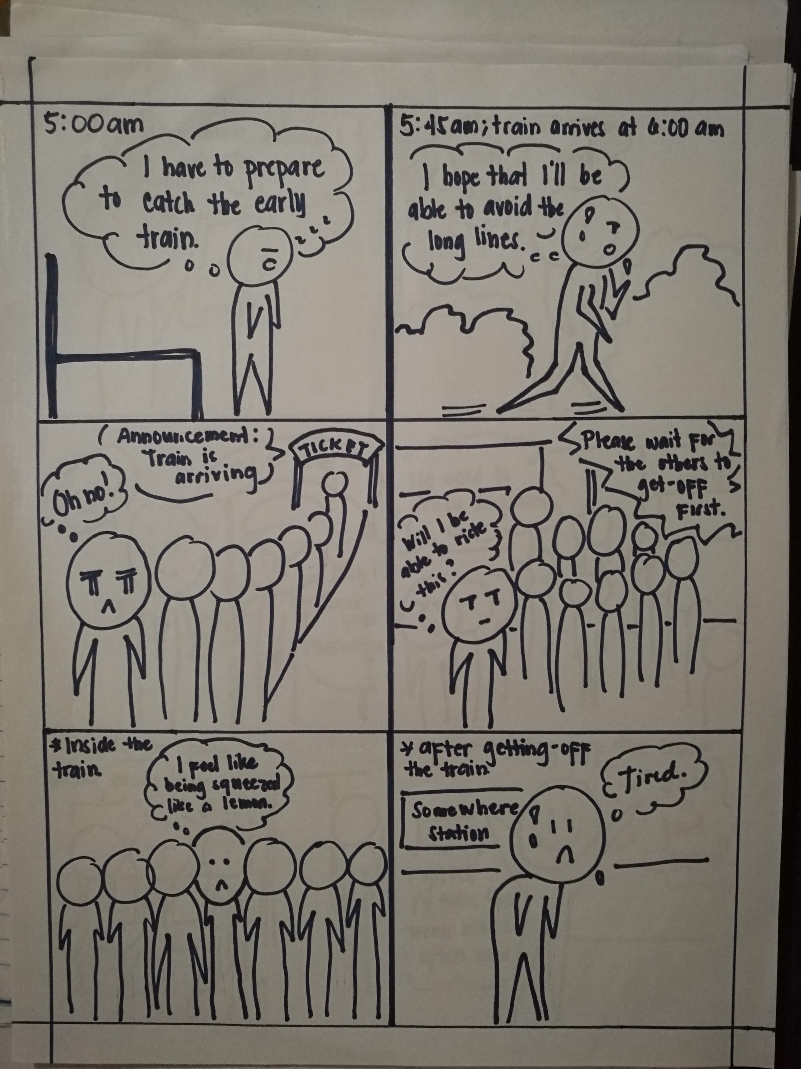
Storyboard 1

Slide 5
Storyboard 1

Slide 6
Storyboard 1

Slide 7
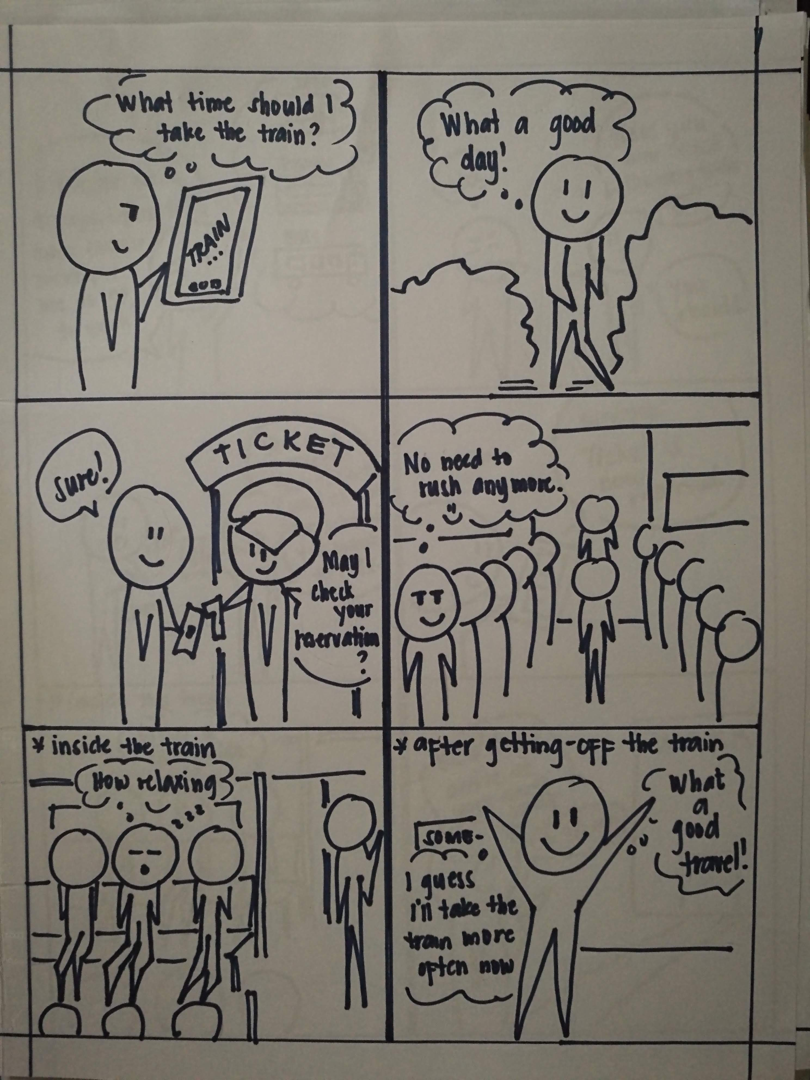
Storyboard 2

Slide 8
Storyboard 2

Slide 9
Storyboard 2

Slide 10
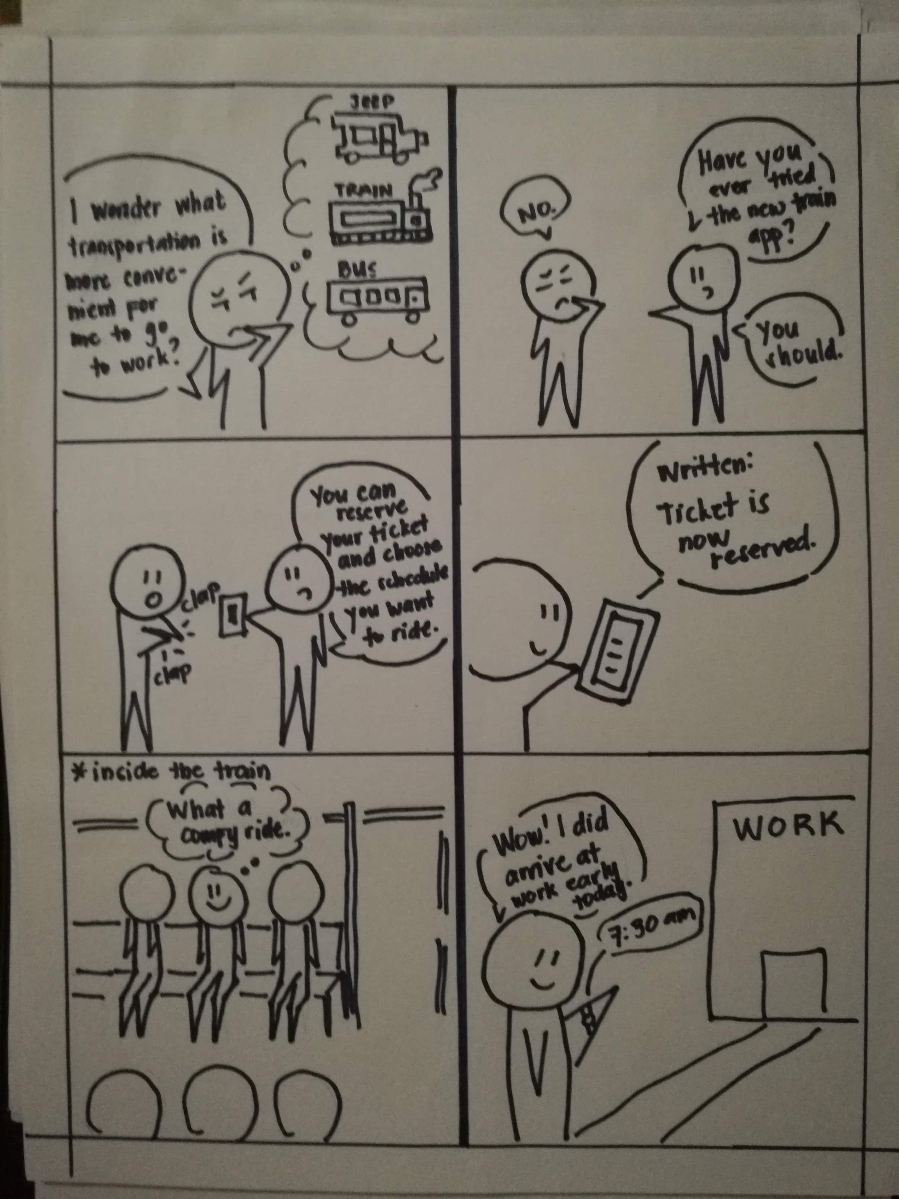
Storyboard 3

Slide 11
Storyboard 3

Slide 12
Storyboard 3

Slide 13
3.
Prototype
Notes:
Demo with the interviewees (prototype 1 and 2)

Slide 14
Prototype 1

Slide 15
INSTRUCTIONS FOR USE
EDIT IN GOOGLE SLIDES
Click on the button under the presentation preview that says "Use as Google Slides Theme".
You will get a copy of this document on your Google Drive and will be able to edit, add or delete slides.
You have to be signed in to your Google account.
EDIT IN POWERPOINT®
Click on the button under the presentation preview that says "Download as PowerPoint template". You will get a .pptx file that you can edit in PowerPoint.
Remember to download and install the fonts used in this presentation (you’ll find the links to the font files needed in the Presentation design slide)
More info on how to use this template at www.slidescarnival.com/help-use-presentation-template
This template is free to use under Creative Commons Attribution license. You can keep the Credits slide or mention SlidesCarnival and other resources used in a slide footer.

Slide 16
HELLO!
I am Jayden Smith
I am here because I love to give presentations. You can find me at @username

Slide 17
Quotations are commonly printed as a means of inspiration and to invoke philosophical thoughts from the reader.

Slide 18
THIS IS A SLIDE TITLE
Here you have a list of items
And some text
But remember not to overload your slides with content
Your audience will listen to you or read the content, but won’t do both.

Slide 19
BIG CONCEPT
Bring the attention of your audience over a key concept using icons or illustrations

Slide 20
YOU CAN ALSO SPLIT YOUR CONTENT
White
Is the color of milk and fresh snow, the color produced by the combination of all the colors of the visible spectrum.
Black
Is the color of coal, ebony, and of outer space. It is the darkest color, the result of the absence of or complete absorption of light.

Slide 21
IN TWO OR THREE COLUMNS
Yellow
Is the color of gold, butter and ripe lemons. In the spectrum of visible light, yellow is found between green and orange.
Blue
Is the colour of the clear sky and the deep sea. It is located between violet and green on the optical spectrum.
Red
Is the color of blood, and because of this it has historically been associated with sacrifice, danger and courage.

Slide 22
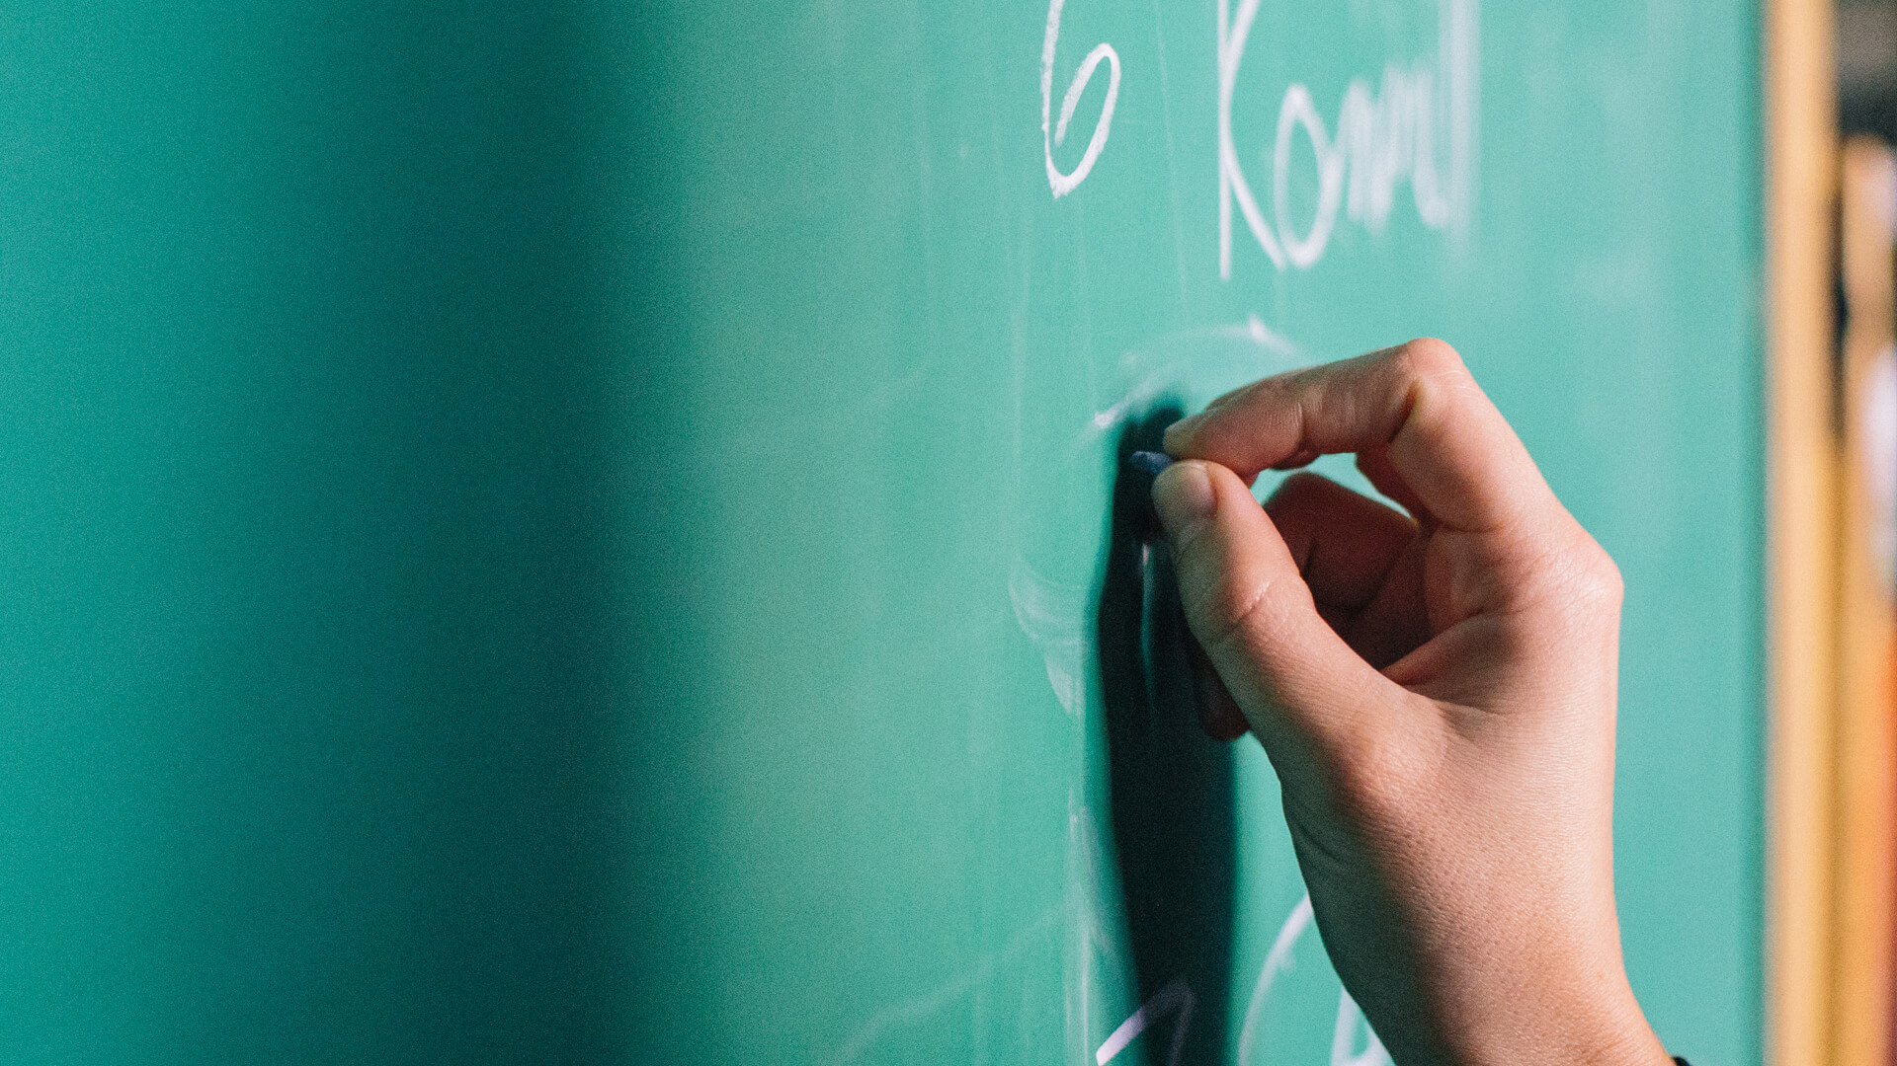
A PICTURE IS WORTH A THOUSAND WORDS
A complex idea can be conveyed with just a single still image, namely making it possible to absorb large amounts of data quickly.

Slide 23

WANT BIG IMPACT?
Use big image.

Slide 24
USE CHARTS TO EXPLAIN YOUR IDEAS
WHITE
GRAY
BLACK

Slide 25
OR USE DIAGRAMS TO EXPLAIN COMPLEX IDEAS
01
Vestibulum nec congue tempus
Vestibulum nec congue tempus
Vestibulum nec congue tempus
03
02
Vestibulum nec congue tempus

Slide 26
AND TABLES TO COMPARE DATA
 | A | B | C
Yellow | 10 | 20 | 7
Blue | 30 | 15 | 10
Orange | 5 | 24 | 16

Slide 27

MAPS
our office

Slide 28
89,526,124
Whoa! That’s a big number, aren’t you proud?

Slide 29
89,526,124$
185,244 users
100%
That’s a lot of money
And a lot of users
Total success!

Slide 30
OUR PROCESS IS EASY
First
Second
Last

Slide 31
LET’S REVIEW SOME CONCEPTS
Yellow
Is the color of gold, butter and ripe lemons. In the spectrum of visible light, yellow is found between green and orange.
Blue
Is the colour of the clear sky and the deep sea. It is located between violet and green on the optical spectrum.
Red
Is the color of blood, and because of this it has historically been associated with sacrifice, danger and courage.
Yellow
Is the color of gold, butter and ripe lemons. In the spectrum of visible light, yellow is found between green and orange.
Blue
Is the colour of the clear sky and the deep sea. It is located between violet and green on the optical spectrum.
Red
Is the color of blood, and because of this it has historically been associated with sacrifice, danger and courage.

Slide 32
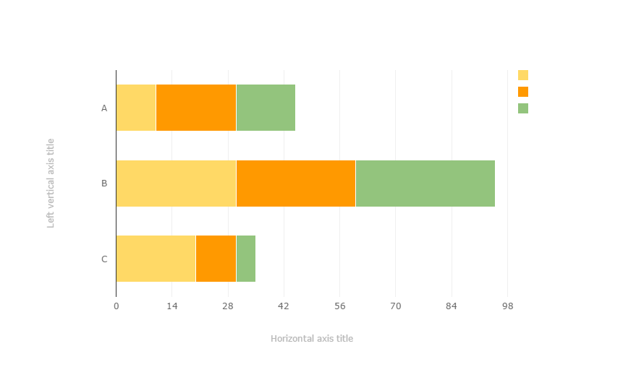
You can copy&paste graphs from Google Sheets

Slide 33
ANDROID PROJECT
Place your screenshot here
Show and explain your web, app or software projects using these gadget templates.

Slide 34
IPHONE PROJECT
Place your screenshot here
Show and explain your web, app or software projects using these gadget templates.

Slide 35
TABLET PROJECT
Place your screenshot here
Show and explain your web, app or software projects using these gadget templates.

Slide 36
DESKTOP PROJECT
Place your screenshot here
Show and explain your web, app or software projects using these gadget templates.

Slide 37
THANKS!
Any questions?
You can find me at @username & user@mail.me

Slide 38
CREDITS
Special thanks to all the people who made and released these awesome resources for free:
Presentation template by SlidesCarnival
Photographs by Death to the Stock Photo (license)

Slide 39
PRESENTATION DESIGN
You don’t need to keep this slide in your presentation. It’s only here to serve you as a design guide if you need to create new slides or download the fonts to edit the presentation in PowerPoint®
This presentations uses the following typographies and colors:
Titles: Montserrat
Body copy: Karla
You can download the fonts on these pages:
https://www.fontsquirrel.com/fonts/montserrat
https://www.fontsquirrel.com/fonts/karla
Red #F44336 Deep orange #FF5722 Orange #FF9800 Amber #FFC107
Yellow #FFEB3B Lime #CDDC39 Green #8BC34A Dark green #4CAF50
Teal #009688 Cyan #00BCD4 Blue #03A9F4 Dark blue #2196F3
Indigo #3F51B5 Deep Purple #673AB7 Purple #9C27B0 Magenta #E91E63
Blue gray #607D8B

Slide 40
SlidesCarnival icons are editable shapes.
This means that you can:
Resize them without losing quality.
Change line color, width and style.
Isn’t that nice? :)
Examples:

Slide 41
😉
Now you can use any emoji as an icon!
And of course it resizes without losing quality and you can change the color.
How? Follow Google instructions https://twitter.com/googledocs/status/730087240156643328
✋👆👉👍👤👦👧👨👩👪💃🏃💑❤😂😉😋😒😭👶😸🐟🍒🍔💣📌📖🔨🎃🎈🎨🏈🏰🌏🔌🔑 and many more...

