Slide 1

Project Title: Technology Trends in the Developer Job Market By: Pierre Marie Ntang Date: 2025/11/12
You can find all of the presentation and more materials at https://github.com/pmntang/Project-for-Data-Science

Slide 2


OUTLINE
Executive Summary
Introduction
Methodology
Results
Visualization – Charts
Dashboard
Discussion
Findings & Implications
Conclusion
Appendix

Slide 3

EXECUTIVE SUMMARY
Python and JavaScript dominate current job market demand and future developer interest.
SQL and PostgreSQL are critical database skills, showing high current usage and strong future demand.
Cloud platforms, especially AWS, are the most desired technology for future projects.
The developer demographic is predominantly 25-34 years old, holding a Bachelor's degree.
High salaries for Swift and C++ indicate premium value for niche and performance-critical skills.

Slide 4

INTRODUCTION
Purpose: To analyze current and emerging trends in programming languages and databases to guide career and learning paths for aspiring data analysts and developers.
Target Audience: Job seekers, career switchers, educational institutions, and corporate L&D departments.
Value: Provides data-driven insights into which technologies are in high demand and offer the best financial returns, enabling informed decision-making.

Slide 5

METHODOLOGY
Data Sources:
Stack Overflow Developer Survey (for current usage and future desire).
Job Postings API (job_postings.xlsx).
Web Scraping of salary data (popular-languages.xlsx).
Collection Methods: Automated API calls, web scraping, and survey data aggregation.
Key Wrangling Steps: Data cleaning, handling missing values, aggregating counts, and calculating percentages for comparative analysis.

Slide 6
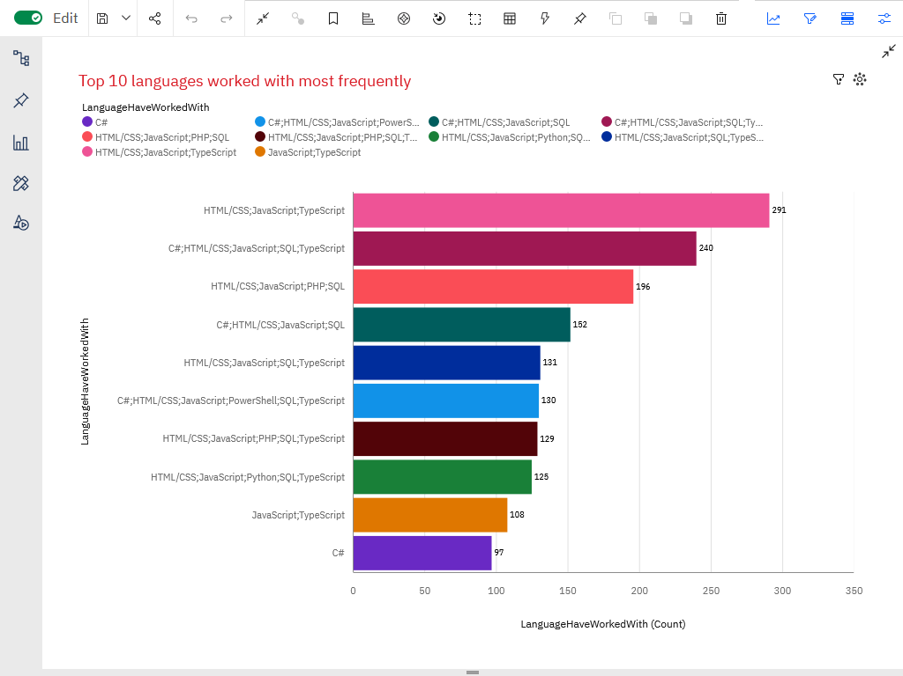
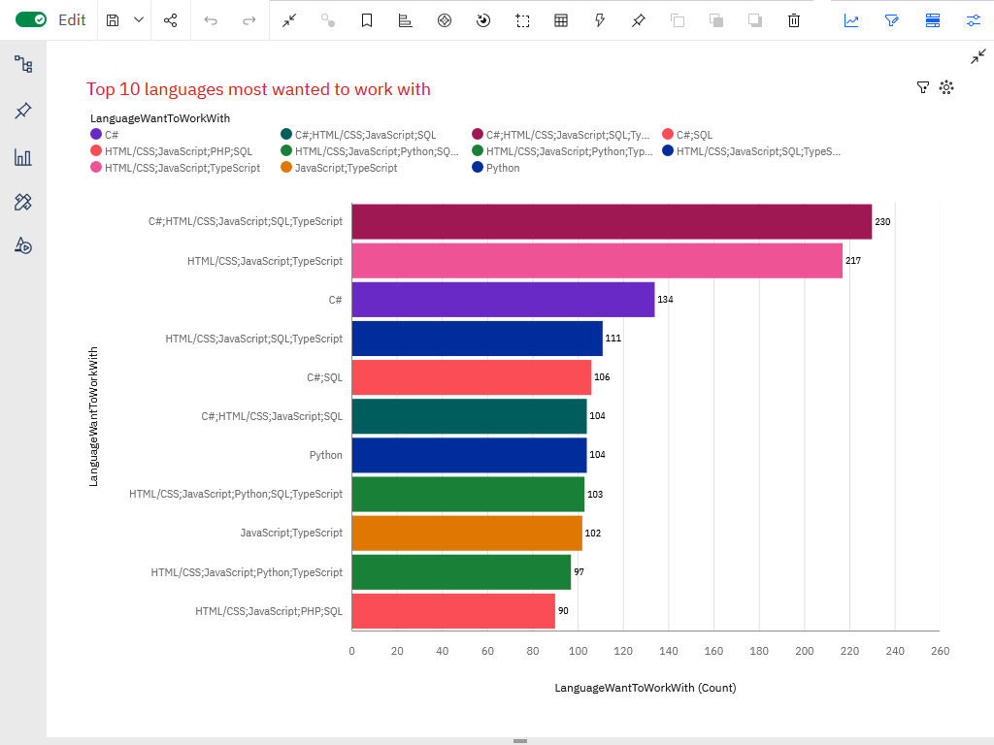
PROGRAMMING LANGUAGE TRENDS
Current Year
Next Years

Slide 7
PROGRAMMING LANGUAGE TRENDS - FINDINGS & IMPLICATIONS
Beyond the C# language itself, which is a worthwhile investment to learn and master, one should consider specializing in cloud computing to ensure employability.
Findings
The web stack, HTML, CSS, JavaScript (TypeScript), and PHP (to a lesser extent) continue to dominate in terms of the most widely used languages or combinations of languages. It is worth noting the presence of SQL and Python among the most sought-after language combinations
C# stands alone as the most widely used traditional language at present; no doubt this has something to do with the dominance of Microsoft hard/software and its cloud infrastructure.
Implications
Training should emphasize the web stack HTML, CSS, JavaScript (TypeScript), PHP (to a lesser extent) and Python, SQL for employability.
Beyond the C# language itself, which is a worthwhile investment to learn and master, one should consider specializing in cloud computing to ensure employability.

Slide 8
PROGRAMMING LANGUAGE TRENDS - FINDINGS & IMPLICATIONS
Findings
The trend looks set to continue in the future, but with one nuance: Python will become more popular, while C# and SQL will be increasingly in demand. The PowerShell scripting language is expected to disappear from the top 10 most in-demand languages; is this a result of the widespread adoption of the cloud?
Implications
The cloud is no longer just an option, but a major trend, as evidenced by the decline in non-mandatory languages in cloud usage. On the other hand, languages considered essential for the cloud will be increasingly in demand. It is therefore crucial to invest in these languages.

Slide 9
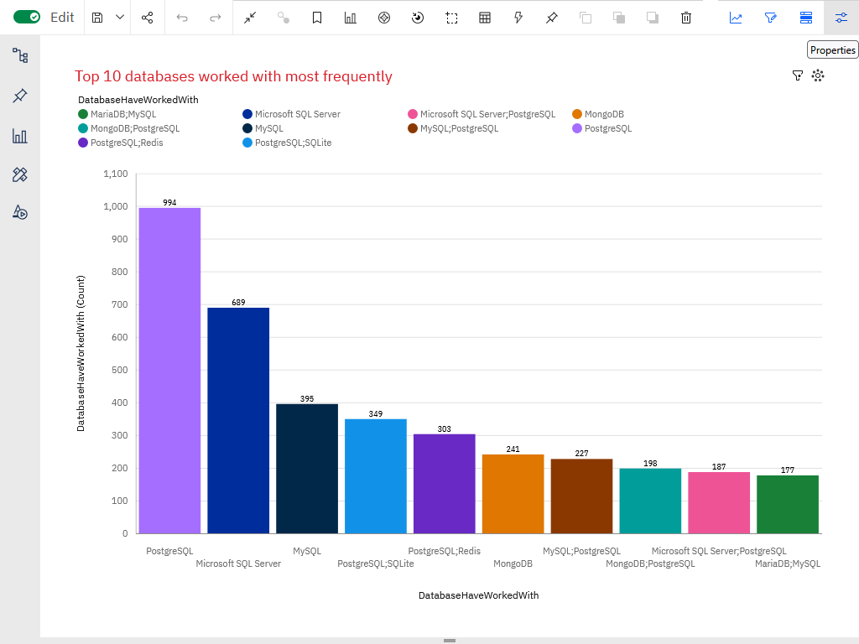
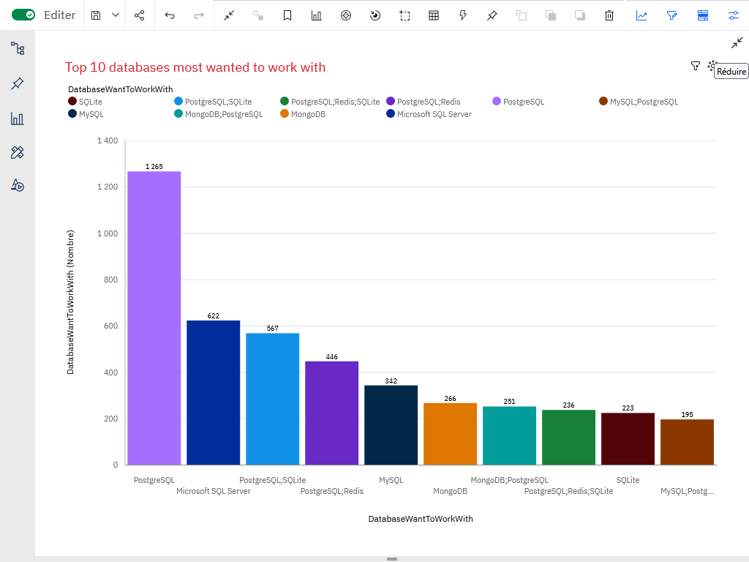
DATABASE TRENDS
Current Year
Next Years

Slide 10
DATABASE TRENDS - FINDINGS & IMPLICATIONS
Using dashboard insights, relational databases remain dominant.
Cloud-hosted and NoSQL options continue to grow with application scale.
Future demand points to managed, scalable database services.

Slide 11
DATABASE TRENDS - FINDINGS & IMPLICATIONS
Findings
Traditional SQL databases are still widely used.
Future-facing roles expect familiarity with cloud DBs.
We see SQLite's role growing stronger in the future, which is both an indicator of diversification and a shift toward the cloud, since it is more of a cross-functional SQL tool in a cloud environment than in a traditional relational database management environment.
Implications
Include SQL in all core training tracks.
Add modules on cloud-native databases.
Skill diversification improves job readiness. It is therefore advisable to rely on traditional SQL technologies to seek expertise in emerging but already essential technologies such as the Cloud.

Slide 12

DASHBOARD
The following dashboards were created in Cognos Analytics:
Current Technology Usage
Future Technology Trends
Demographics

Slide 13
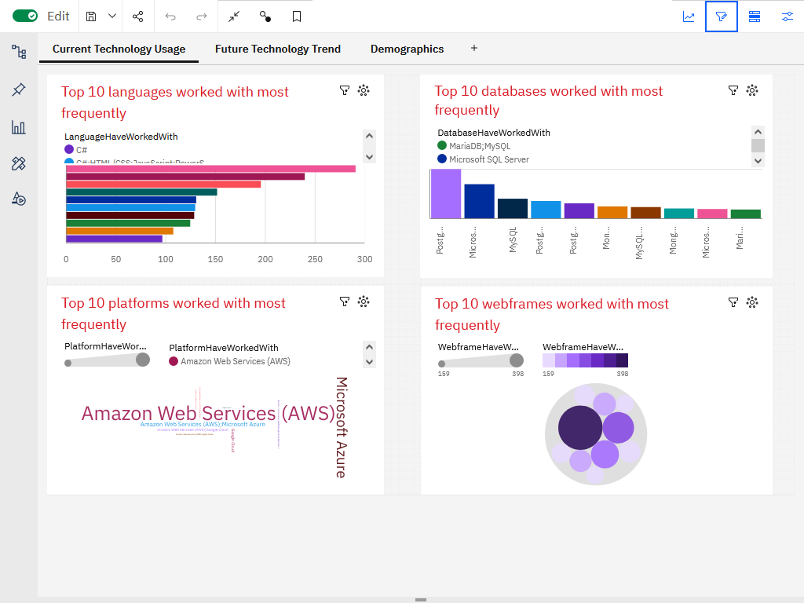
Current Technology Usage

Slide 14
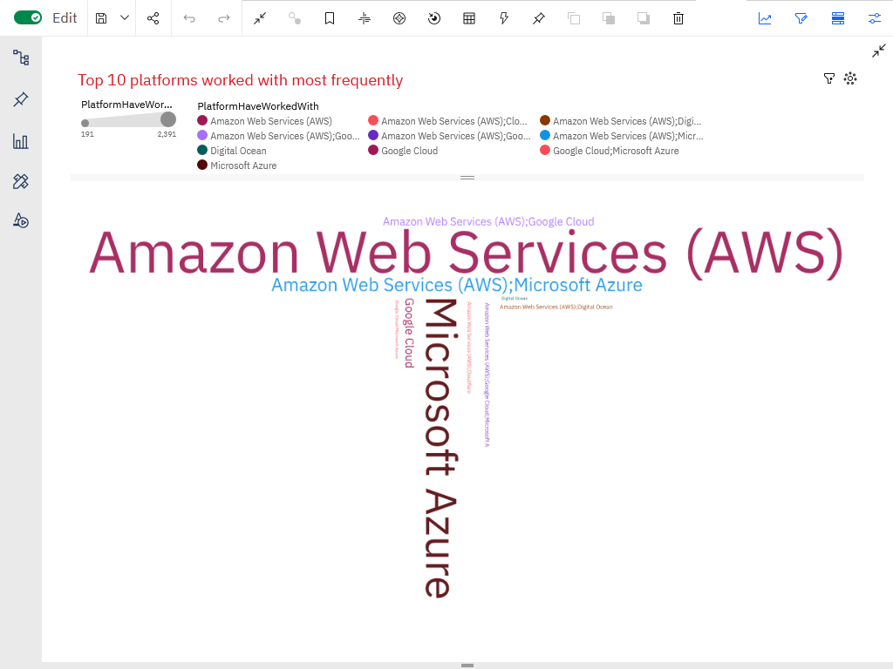
Current Technology Usage -Top 10 platforms worked with most frequently

Slide 15
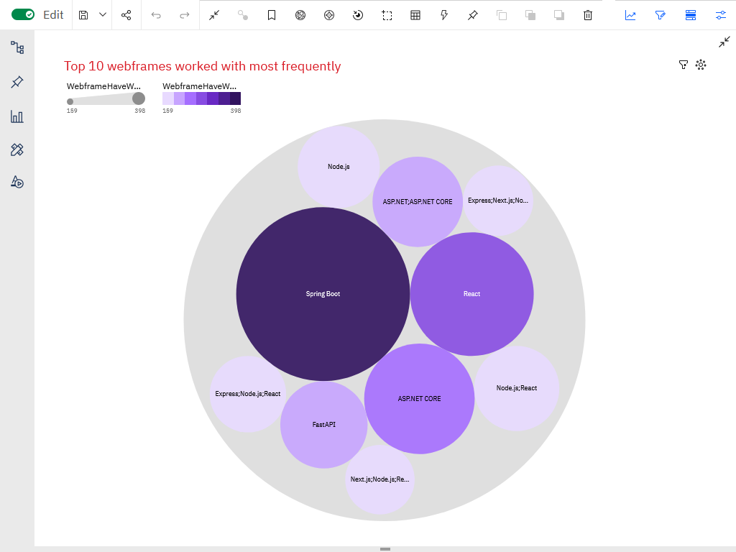
Current Technology Usage - Top 10 webframes worked with most frequently

Slide 16
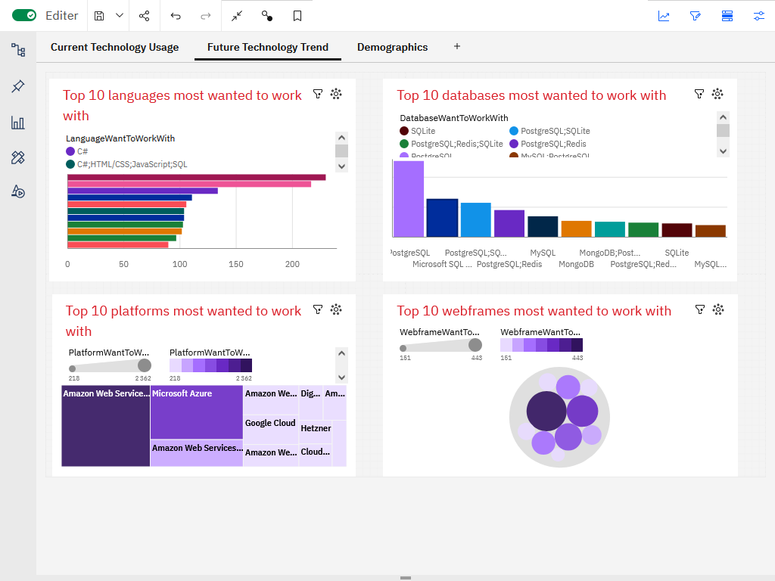
Future Technology Trend

Slide 17
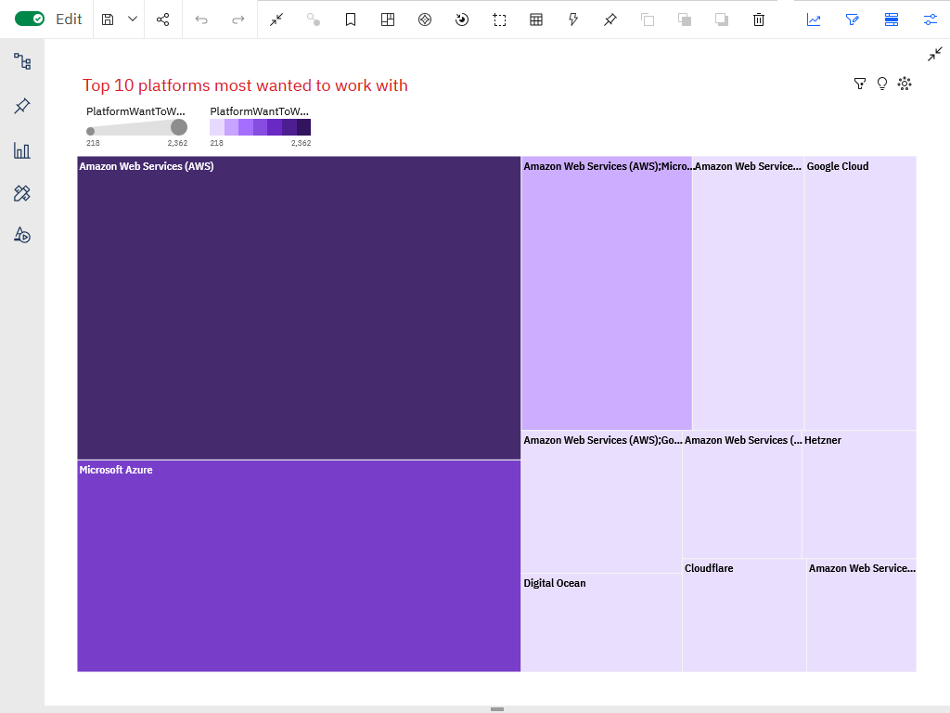
Future Technology Trend-Top 10 platforms most wanted to work with

Slide 18
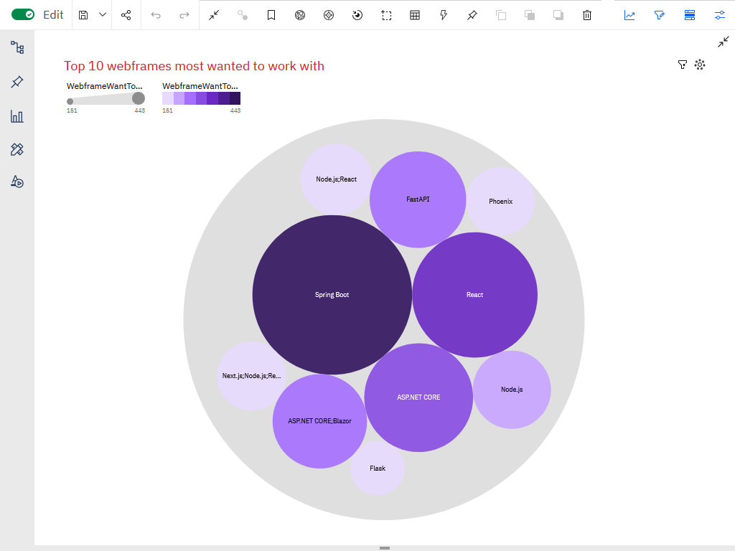
Future Technology Trend-Top 10 webframes most wanted to work with

Slide 19
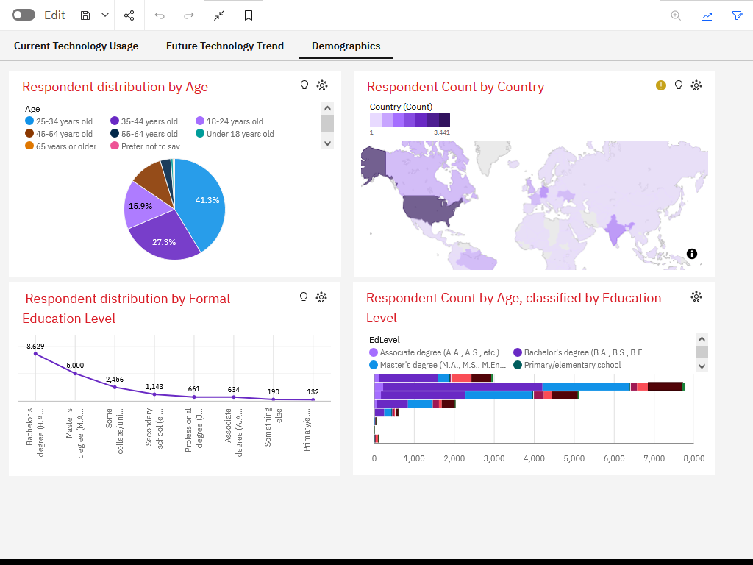
Demographics

Slide 20
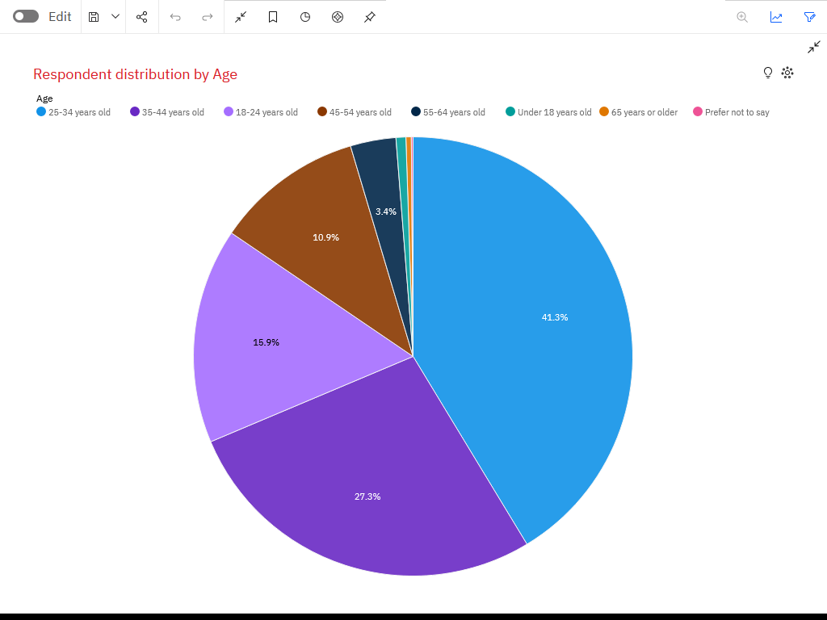
Demographics –Respondent distribution by Age

Slide 21
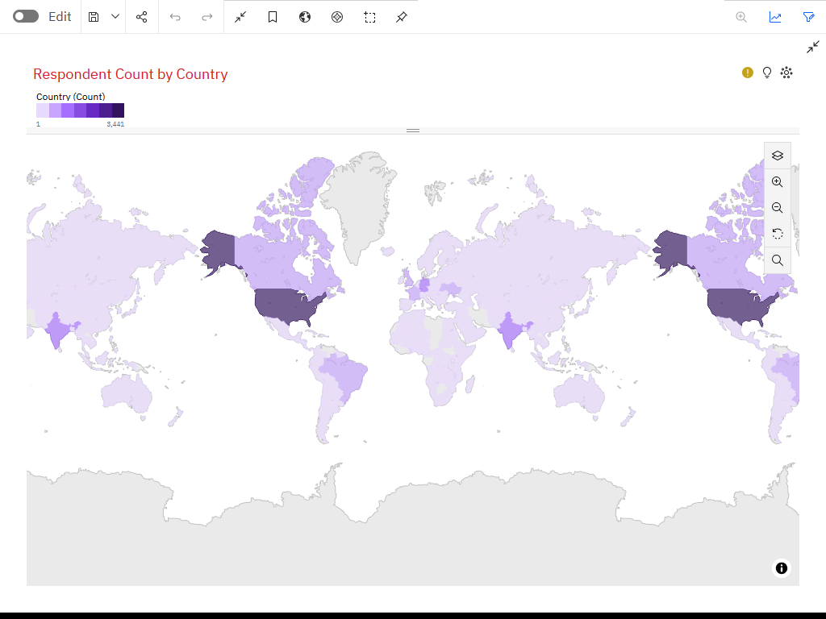
Demographics – Respondent count by Country

Slide 22
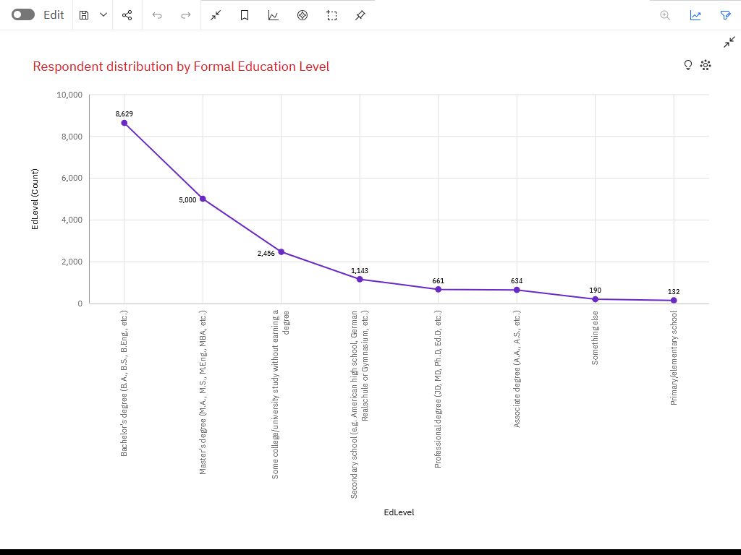
Demographics-Respondent distribution by Formal Education Level

Slide 23
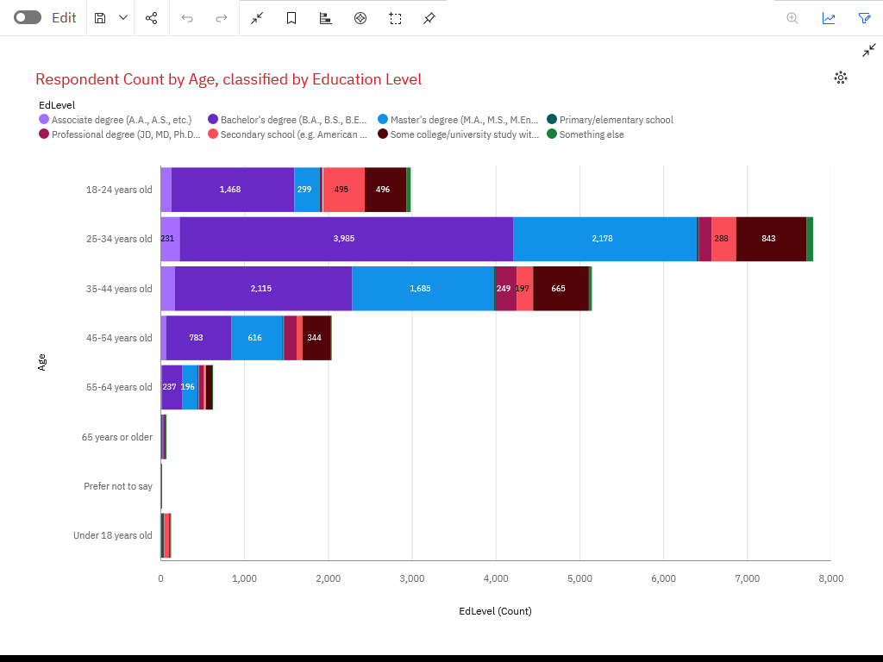
Demographics-Respondent count by Age, classified by Education Level

Slide 24
DISCUSSION – DATA USED AND CHOICES MADE
It is certain that if, instead of looking at a combination of languages, we had looked at each language separately, the result would have been quite different. In fact, it would have been interesting to ask respondents about their (single) most used language.
Note: We could have extracted the languages individually and seen which one was the most popular. But this can be misleading and biased because a developer who says they use a combination of languages does not necessarily use a language from that combination more often; their most frequently used language on its own may be another language. For example, a full-stack developer may spend a lot of time on the front end (in which case they will use the HTML/CSS and JavaScript web stack) and a little less time on the back end with Java, for example. In this case, their most used language is actually the combination of the HTML/CSS and JavaScript web stack, whereas if they had to choose a single most used language, it would be Java.

Slide 25
DISCUSSION - RESULTS
Current vs. Future: While JavaScript and Python lead today, the strong desire to work with AWS and Python points to a consolidation of cloud and data-centric skills.
Demographic Insight: The primary workforce (25-34 years) is highly educated, suggesting a competitive job market where certifications and specialized skills (like cloud expertise) are key differentiators.
High-Value Skills: Niche languages (Swift, Go) and cloud platforms (AWS) command premium salaries and high future demand.

Slide 26
OVERALL FINDINGS & IMPLICATIONS
Findings
The tech landscape is bifurcating between widespread web technologies (JS, Python) and high-value specialized skills (Cloud, Swift, C++).
Cloud proficiency is transitioning from a "nice-to-have" to a "must-have" skill.
Real-world job postings sometimes contrast with developer surveys, highlighting the importance of analyzing multiple data sources.
Implications
For Job Seekers: Build a core foundation in Python and JavaScript, then specialize in a high-demand area like cloud computing or a niche language.
For Educators: Curricula must integrate cloud technologies and data management principles.
For Companies: To attract top talent, focus on projects involving trending technologies like AWS, Azure, Python, and Go.

Slide 27

CONCLUSION
Python and JavaScript remain the cornerstone languages for the present and immediate future.
Cloud Adoption is the single most significant trend, with AWS leading the pack.
Data Skills—specifically SQL and cloud databases—are critically important across roles.
Strategic Specialization in high-salary, high-demand technologies (e.g., Swift, Go, AWS) offers a strong career advantage.

Slide 28

APPENDIX
Language | Number of times the language is requested | Average Annual Salary ($) |  | Language | Number of times the language is requested per percentage | Average Annual Salary ($) per percentage
C# | 526 | $ 88 726 |  | C# | 0,07 | 0,17
C++ | 506 | $ 113 865 |  | C++ | 0,06 | 0,22
Java | 3428 | $ 101 013 |  | Java | 0,43 | 0,19
JavaScript | 2248 | $ 110 981 |  | JavaScript | 0,29 | 0,21
Python | 1173 | $ 114 383 |  | Python | 0,15 | 0,22
Total | 7881 | 528968 |  |  | 1,00 | 1,00
We only considered languages that appeared in both job_postings.xlsx and popular-languages.xlsx. We used relative frequencies to enable comparison.

Slide 29
JOB POSTINGS
Language | Number of times the language is requested | Percentage of requests for the language in the sample
C | 25114 | 72%
Java | 3428 | 10%
JavaScript | 2248 | 6%
Python | 1173 | 3%
Oracle | 899 | 3%
C# | 526 | 2%
C++ | 506 | 1%
SQL Server | 423 | 1%
MongoDB | 208 | 1%
Scala | 138 | 0%
PostgreSQL | 86 | 0%
MySQL Server | 0 | 0%
Total | 34749 | 100%

Slide 30
POPULAR LANGUAGES
Language | Average Annual Salary
Swift | $ 130 801
Python | $ 114 383
C++ | $ 113 865
Javascript | $ 110 981
Java | $ 101 013
Go | $ 94 082
R | $ 92 037
C# | $ 88 726
SQL | $ 84 793
PHP | $ 84 727

