Slide 1
Improving the spatial resolution of the SoLid antineutrino detector using deep learning
Background
Method
Data Analysis
Results
Conclusions
Priyanka Mocherla
Notes:
Hi! So today I will be presenting my results from a proof of concept project which was aimed at finding out whether we could improve the spatial resolution of the SoLid antineutrino detector.

Slide 2
Background
Method
Data Analysis
Results
Conclusions
The “sterile” neutrino and SoLid
Recent recalculations of antineutrino flux suggests existence of “sterile’” neutrino
SoLid antineutrino scintillator set up to measure spectrum from BR2 MTR reactor in Mol, Belgium.
The background discrimination of the detector is currently limited by resolution.
Notes:
Now the SoLid project itself is related to discrepancies between measurements of antineutrino flux and their theoretical values, in particular from the sun and other reactors. One way to reconcile this difference has been to introduce a intermediate form of neutrino dubbed the “sterile” neutrino, as it doesn’t interact with the weak force as traditional neutrinos do. SoLid aims to prove the existence of this sterile state by setting up an antineutrino scintillator to measure the antineutrino spectrum of a Uranium 235 reactor located in Belgium. The detector itself has a novel segmented design, made up from thousands of 5x5 scintillating cubes, and it will be able to gather evidence of electron neutrinos oscillating between their original and sterile state.

Slide 3
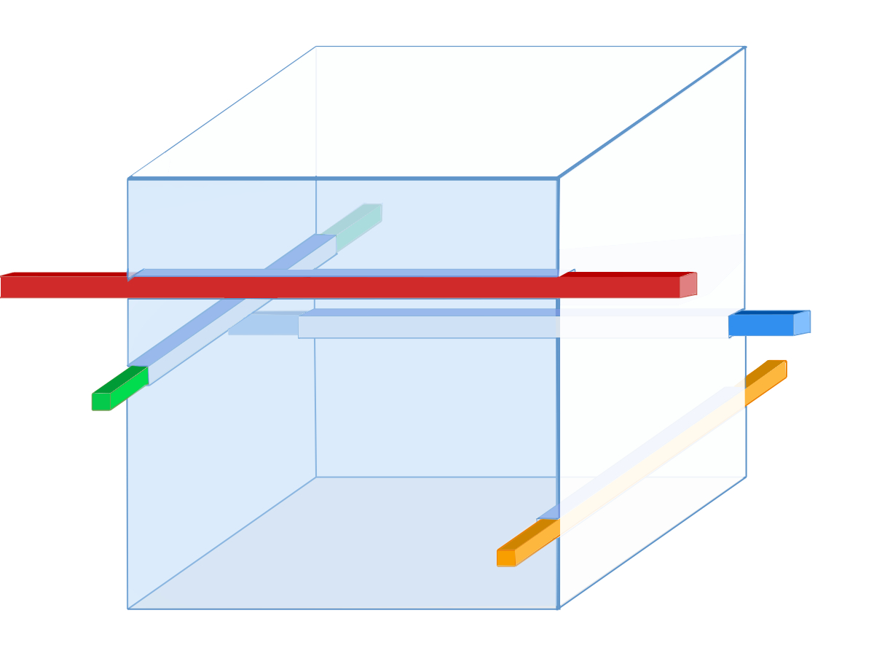
Experimental Setup
Background
Method
Data Analysis
Results
Conclusions
ZnS layers
Single detector cube
Channel 8
Channel 5
Channel 7
Channel 6
PVT
Notes:
So, to see if improving the resolution is possible, we set up a small scale experiment using a single detector cube and four light readout channels. In the SoLid experiment, the cube detects antineutrinos via the products of inverse beta decay, which are neutrons and positrons. Neutrons are captured in the layers of ZnS, here we have two, which produces a fairly directed light output which is then dispersed into the cube and towards the read out channels. The cube itself is made from PVT which scintillates with positron, which disperse light more isotropically in the cube. As you can see, the geometry of the channels does suggest that we may be able to reconstruct the position of a particle based on the light output of each channel. To see if this was true, we conducted an experiment, simulating neutrons and positrons using alpha and beta sources. We placed each source individually in nine positions on the top and side layers of the cube. We recorded the fibre readout amplitudes for roughly ten thousand events, per position per source. Due to limitations in the set up, we were only able to record beta data for the top side of the cube.

Slide 4
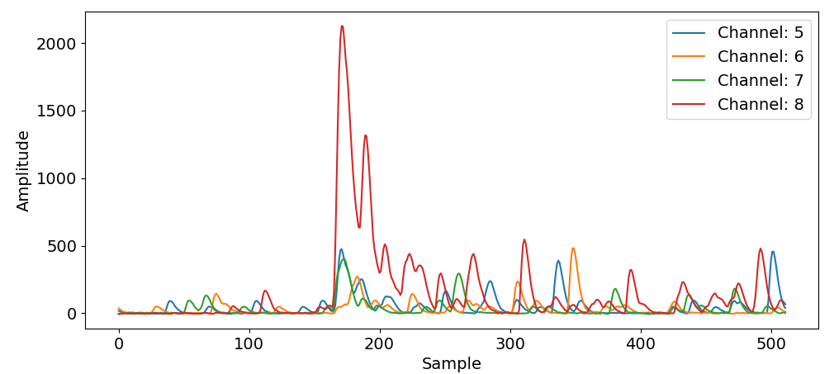
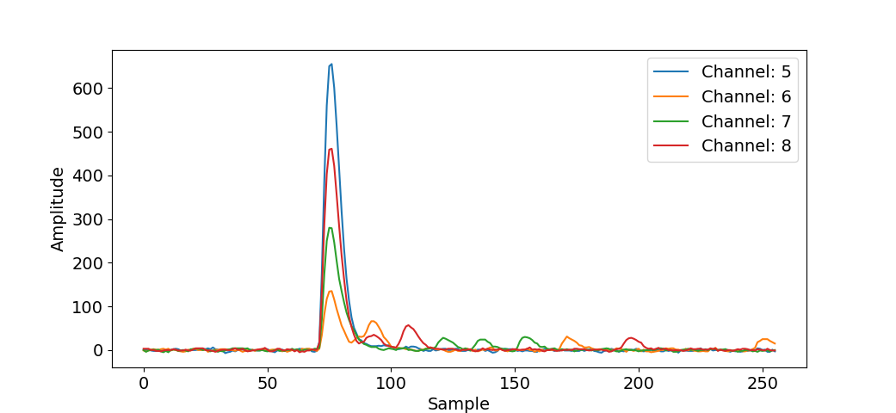
Data
Background
Method
Data Analysis
Results
Conclusions
²⁴¹Am
Two sources
⁹⁰Sr
Notes:
Here are some examples of typical trigger event for each source , which largely correspond to the signals you expect from neutrons and positrons. Using the americium alpha source we see that the decay time of the alpha particle is long and the peak is not localised. The strontium beta source on the other hand is much more localised and has a better defined amplitude and integral. The peak can also occur at any point within this sample frame. We converted these waveforms to a pixel map depending on amplitude value for further analysis. For example, here.
The fluctuations are features, they arent random
The time resolution of each pulse, so these are very real pulses. Why would these extra pulses happen? They arent included in the light for a single event

Slide 5
Experimental Setup
Background
Method
Data Analysis
Results
Conclusions
Single detector cube
Channel 8
Channel 5
Channel 7
Channel 6
Notes:
So, to see if improving the resolution is possible, we set up a small scale experiment using a single detector cube and four light readout channels. In the SoLid experiment, the cube detects antineutrinos via the products of inverse beta decay, which are neutrons and positrons. Neutrons are captured in the layers of ZnS, here we have two, which produces a fairly directed light output which is then dispersed into the cube and towards the read out channels. The cube itself is made from PVT which scintillates with positron, which disperse light more isotropically in the cube. As you can see, the geometry of the channels does suggest that we may be able to reconstruct the position of a particle based on the light output of each channel. To see if this was true, we conducted an experiment, simulating neutrons and positrons using alpha and beta sources. We placed each source individually in nine positions on the top and side layers of the cube. We recorded the fibre readout amplitudes for roughly ten thousand events, per position per source. Due to limitations in the set up, we were only able to record beta data for the top side of the cube.

Slide 6
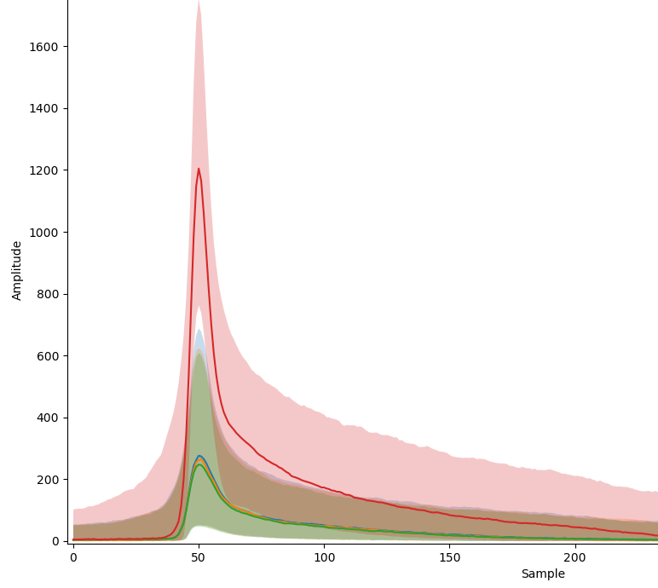
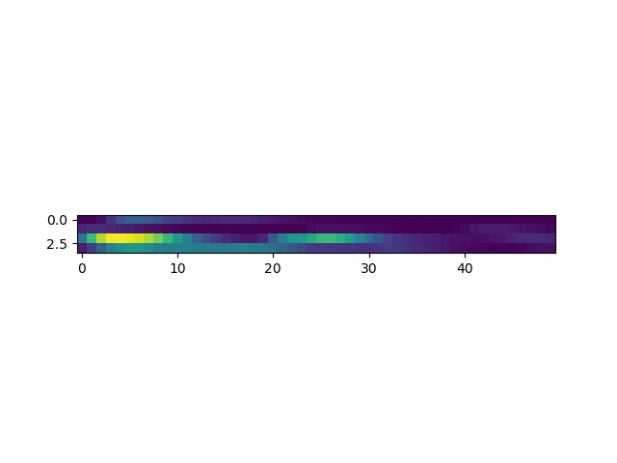
Preliminary Analysis
Background
Method
Data Analysis
Results
Conclusions
Average waveforms
y
0.5
2.5
x
Notes:
To simplify the experiment we reduced the problem to a 2D plane, and here is a diagram of a 2D experimental set up with americium alpha source in position [2.5 0.5] cm on the top of the cube and each coloured line corresponding to a channel. To quantify some of the correlations in the channels depending on position I centred each event around the same point and calculated the average and the spread of the the event waveform amplitudes at each position. For example for this position I obtained this average. If we look at the diagram we can see that this makes sense: The source is closest to channel 8 thus it peaks more strongly than the other channels – so on average there are definitely some correlations emerging depending on particle position.

Slide 7
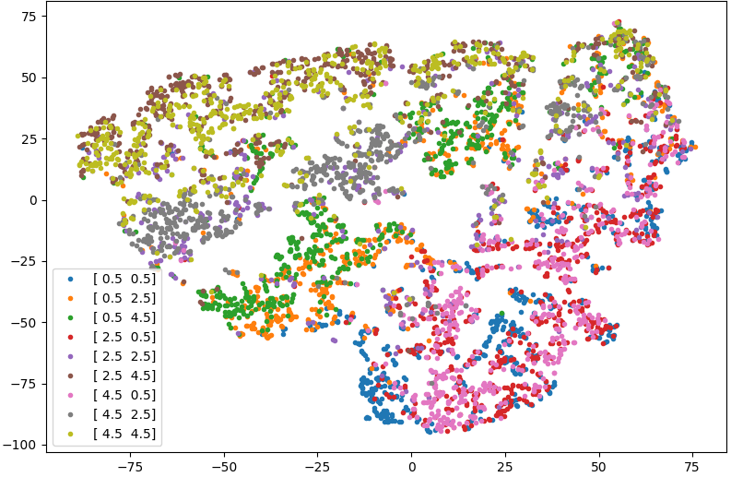
Preliminary Analysis
Background
Method
Data Analysis
Results
Conclusions
Raw data t-SNE – Am Top
Notes:
Already the features begin to show clustering behaviour so a simple cut based analysis might do

Slide 8
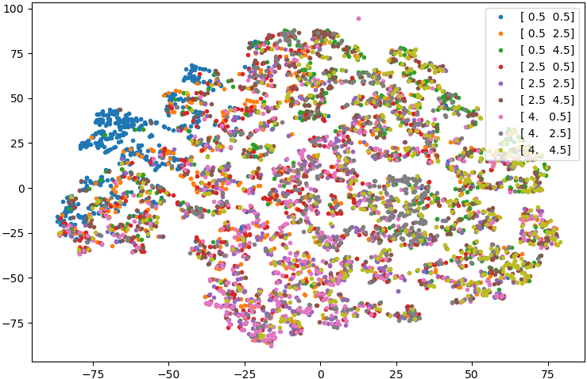
Preliminary Analysis
Background
Method
Data Analysis
Results
Conclusions
Raw data t-SNE – Am Side
Notes:
Blue is separate and might do better on a cut based analysis.
Since this is only using 4. instead of 4.5, depending on the resolution of the data this may not be enough to differentiate the middle

Slide 9
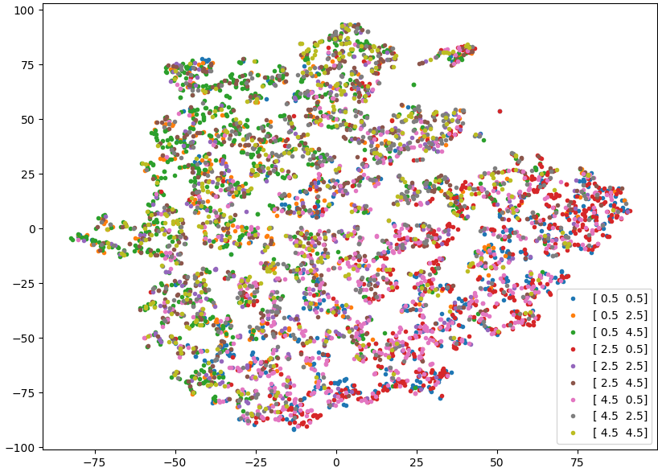
Preliminary Analysis
Background
Method
Data Analysis
Results
Conclusions
Raw data t-SNE – Sr Top
Notes:
Closest to the red fibre fits better – cut based analysis would probably end grouping these points together and then the others together.

Slide 10
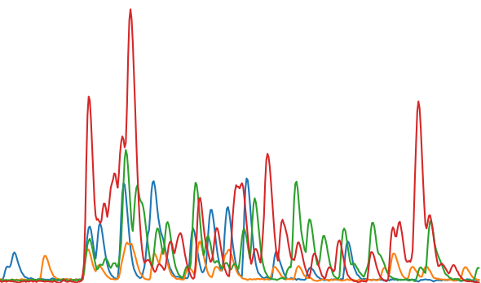
Data Processing
Background
Method
Data Analysis
Results
Conclusions
Convolutional Neural Network
Fully connected layer
128 neurons
[x, y]
Output layer
Input image
2 x 8 window
Convolution and pooling layer 1
8 filters
Convolution and pooling layer 2
16 filters
Notes:
To look at things at an event by event level, I used supervised learning, to train some machine learning models, to see if they could learn the correlations between the fibre amplitude and the position of the source, and predict the position of an unseen waveform. The first model I used was a convolutional neural network, which took sections of the image and applied two layers of filters on it to produce a set of features that should be similar for similar inputs, allowing the prediction of the position of the waveform. The fully connected layer gathers all the feature information and combines it to predict an output.

Slide 11
Data Processing
[11]
Background
Method
Data Analysis
Results
Conclusions
[11]
Averaged
Decision Forest
Decision node
Leaf node
Notes:
The second method I looked at was the Decision forest. For this I had to condense the waveform into feature space – so I converted each waveform into 8 features corresponding to the amplitude and integral of each channel. The model performs a simple cut based analysis of the data to try and optimise a fit function. When test data is then input into each tree a value is produced at the end and by taking the average of many trees you can get the final output. Some of the limitations of this model is that you have to calculate each position coordinate separately and the model cannot extrapolate predictions.

Slide 12
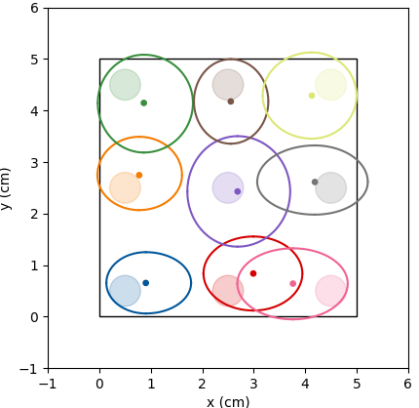
Convolutional Neural Network
Background
Method
Data Analysis
Results
Conclusions
Am Top
Average | Value/cm
Error in mean (σ_{μ}) | 0.44
1σ uncertainty | 0.44
2σ uncertainty | 0.85
Notes:
Looking at the convolutional neural network first, these are the results for the top screen using the alpha source, plotting the 2σ uncertainty for each point. On average the error in the mean was less than half a centimetre and 95% of the data was predicted to be within 1cm of the predicted pointThis could be because channel 6, do to how low down it is in the cube, is less sensitive to changes in the position, which is esp.ecially apparent for the red and pink positions, who are closest to channel 8 and 6. 6 may be a weak channel for position indication because of its depth.

Slide 13
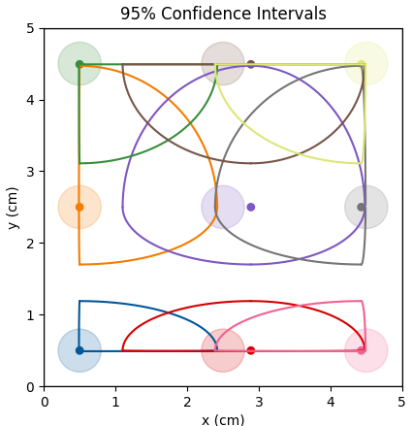
Decision Forest
Background
Method
Data Analysis
Results
Conclusions
Am Top
Average | Value/cm
Error in mean (σ_{μ}) | 0.27
1σ uncertainty | 0.26
2σ uncertainty | 1.02
Notes:
For the top of the cube using the alpha source I used a DF to predict the coordinates of the data. On average, the error in the mean was around 0.5cm however we can see that the average spread was towards 1cm, although the 1 sigma spread was actually less than 0.3 cm. If we look at what features were most important when predicting each coordinate, we find that the integrals of channel 7 and 6 were the most important for predicting x, and 5 and 8 for predicting y, which makes physical sense. In general the amplitudes were a poor indicator of location.

Slide 14
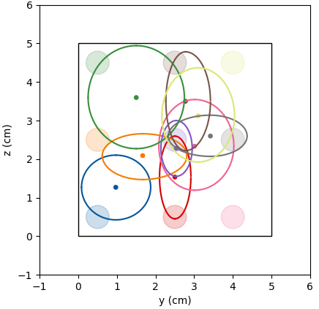
Convolutional Neural Network
Background
Method
Data Analysis
Results
Conclusions
Am Side
Average | Value/cm
Error in mean (σ_{μ}) | 1.12
1σ uncertainty | 0.46
2σ uncertainty | 0.91
Notes:
If we look at the side we see a large increase in the error in the mean at 1.12cm. A note on this data - due to obstables in data collection here instead of collecting data foy y = 4.5 we had to collect it on y = 4.0. Here we see the CNN finds it hard to discriminate greater y values. . The difficulty in prediction could be accounted for by the fact that the light is more directed for alpha sources and therefore the system relies a lot more on reflected light reaching the fibres, thus vastly reducing the effectiveness of preditions usign channel correlations.

Slide 15
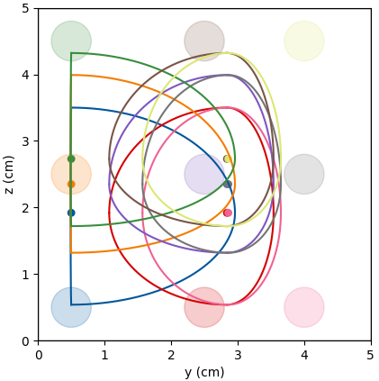
Decision Forest
Background
Method
Data Analysis
Results
Conclusions
Am Side
Average | Value/cm
Error in mean (σ_{μ}) | 1.62
1σ uncertainty | 0.66
2σ uncertainty | 1.27
Notes:
For the alpha source at the side, the uncertainty in the mean was larger at 1.62cm and 95% of the data was contained within the bands plotted. Here we see that we can split the cube into 2 and it was harder to predict the position for increasing y, with all predictions converging to the centre. When predicting the y coordinate the most important factor was channel 8,and to predict the z, Channel 6 was more important. Overall these results look similar to the predictions made by the CNN

Slide 16
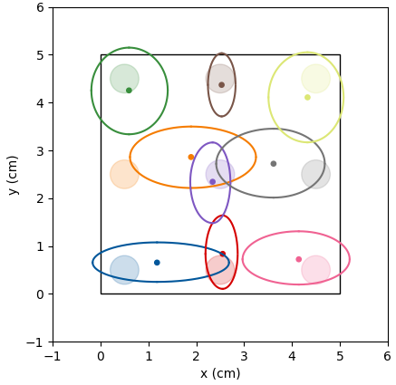
Background
Method
Data Analysis
Results
Conclusions
Convolutional Neural Network
Sr Top
Average | Value/cm
Error in mean (σ_{μ}) | 0.54
1σ uncertainty | 0.40
2σ uncertainty | 0.78
Notes:
Using a convolutional neural network for the Strontium top data, we achieved an error in the mean of 0.54cm, and 95% of the data was contained within 0.8cm of the mean. The slightly worse performance compared to the Sr top could be accounted for the fact that beta particles actually penetrate the cube and can travel in anydirection for a short time before being captured. This results in the position of the particle not wholly corresponding to the position of the source. We also see the y = 2.5 was difficult to predict. This could could be because these points depend more on channels 7 and 6 to locate and 6 may be the weaker channel due to its depth in the system.

Slide 17
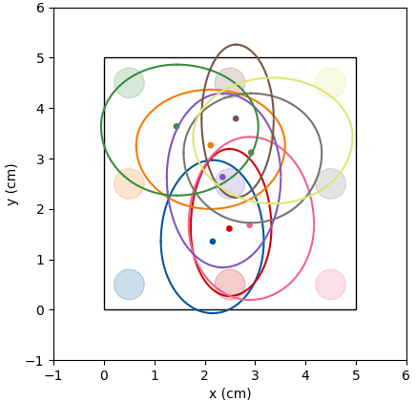
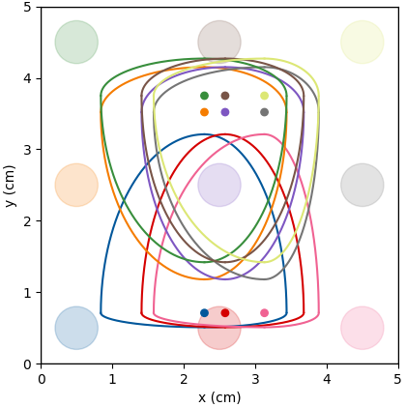
Decision Forest
Background
Method
Data Analysis
Results
Conclusions
Convolutional Network
Sr Top
Replicating DF input for CNN
σ_{μ} | 1σ | 2σ
1.49 cm | 0.69 cm | 1.31 cm
σ_{μ} | 1σ | 2σ
1.36 cm | 0.68 cm | 1.32 cm
Notes:
Although Sr signals have a better defined integral and amplitude, a cut based analysis is not sufficient to distinguish between the points. However it seems that the cube can be split into two sections, although the uncertainty bounds of the points suggest that all the predicted data converges into the middle. One of the things hypothesized was the fact that the CNN may be picking up the small fluctuations in the waveforms, the are an artificial product of this setup and are not replicated in the actual detector, which was why the DF was performing much worse. As you can see, the average uncertainties are similar for both, showing that the cNN was learning these features to predict positions, and it is harder to split the cube into two sections.

Slide 18
Analysis
Background
Method
Data Analysis
Results
Conclusions
Comparing DF and CNN performance
(Reduced mean square)
Source/Area | CNN RMS | DF RMS
Am/Top | 0.46 | X | 0.75
 |  | Y | 0.30
Am/Side | 0.51 | Y | 1.58
 |  | Z | 1.94
Sr/Top (Cropped) | 0.51 (1.28) | X | 2.12
 |  | Y | 1.75
Notes:
Since the accuracy of each model is calculated in different ways, we can use the reduced mean square between predictions and true position values to observe which model performed better. The prediction performance of Am Top for the cnn and df are comparable. For the side the CNN out performed the DF and for the Sr/Top even when the fluctuations and position dependece of the data was removed the rms was still better than the DF although around twice as high as just using the raw data. I am currently trying to apply the same analysis to the Am data to see what effect that has, if any.

Slide 19
Conclusions
Background
Method
Data Analysis
Results
Conclusions
For a single cube system can achieve resolution of ~ 2.0 cm for both sources
CNN performs better than the DF
Removing artefacts of the setup from the data reduces the accuracy of the CNN (Sr/ Top)
Need to see if this also applies to Am data
Notes:
To conclude, our results show that for a single cube system, our models can achieve a resolution of around 1cm for both of our sources. In general the CNN performed better than the decision forest in terms of robustness of predictions but more work needs to be done to see how well this applies to real data from the SoLid detector, by perhaps analysing multiple cube systems. We saw a dramatic loss in accuracy for Sr after removing the artefacts of our setup, and I am currently investigating how this affects the alpha sources. However training the CNN until there was total convergence is required to see if results can be improved.

Slide 20
Background
Method
Data Analysis
Results
Conclusions
Thank you!

