Slide 1
“BATTLE ROOMS” Progress presentation
Chris Di Fulvio
Katrina Anderson
Matthew Tam
Patrick Modafferi

Slide 2

Agenda
Progress report
Framework
1st Mini Game
Future Plans
Goals
Areas of Improvement
Logo / Box Art

Slide 3
Progress Report - Framework
Goal was to make as minimal as possible to allow more work to be done on the actual mini games themselves
Very simple design using heavy OOP practices and Factory pattern
Focus on making each mini game as if they were individual games

Slide 4
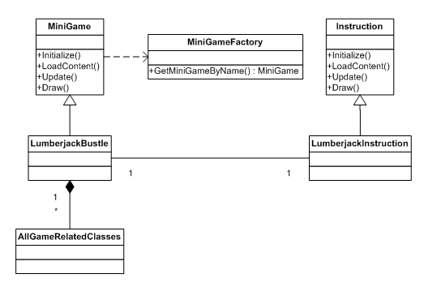
Progress Report - Framework

Slide 5
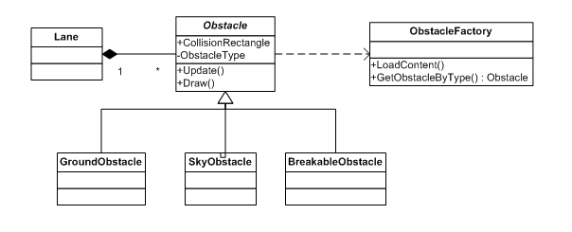
Progress Report - Framework

Slide 6
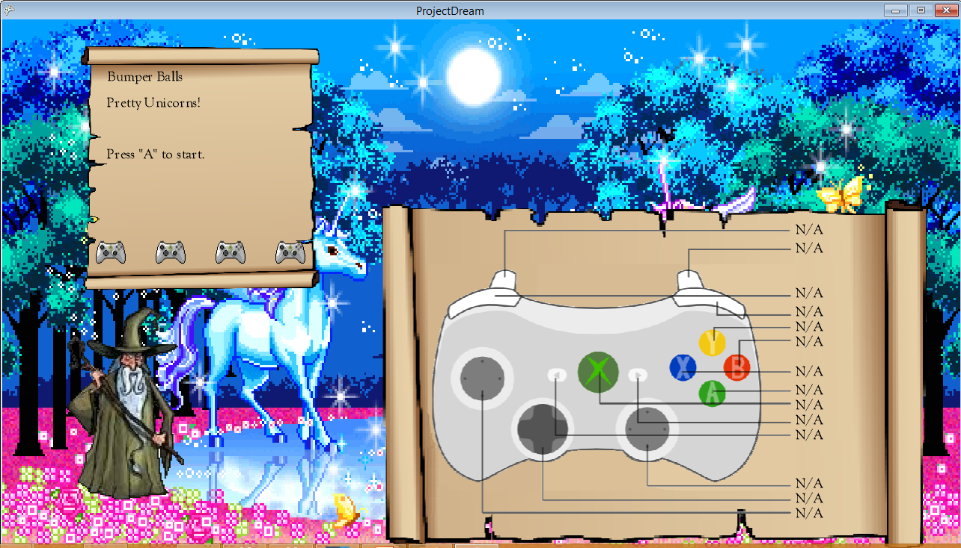
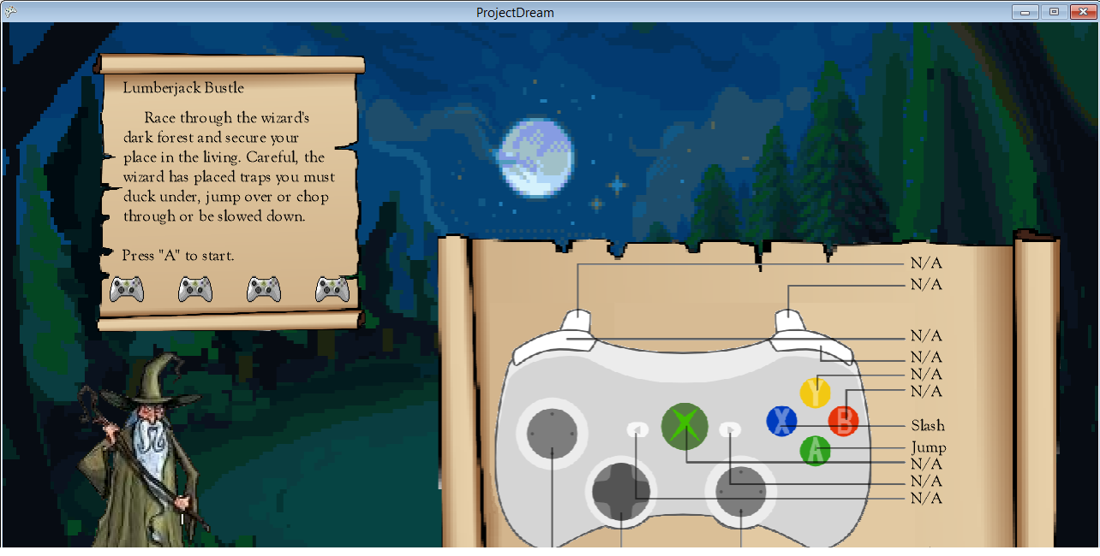
Progress Report – Mini Game
Instruction screens before each Mini Game

Slide 7
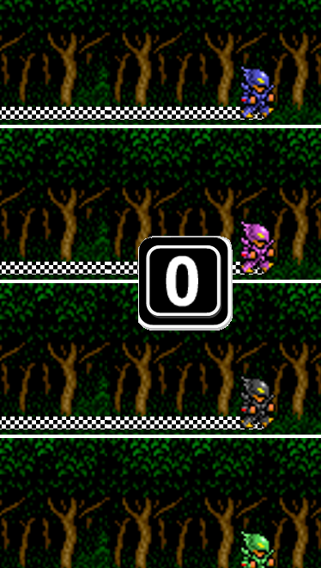
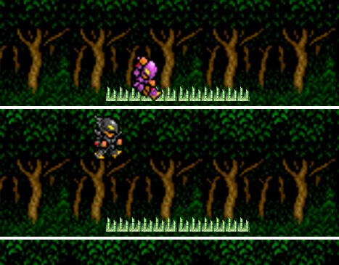
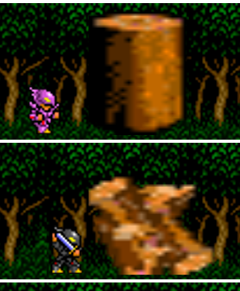

Progress Report – Mini Game
Race through the dark forest
Duck, Jump, Chop the obstacles

Slide 8
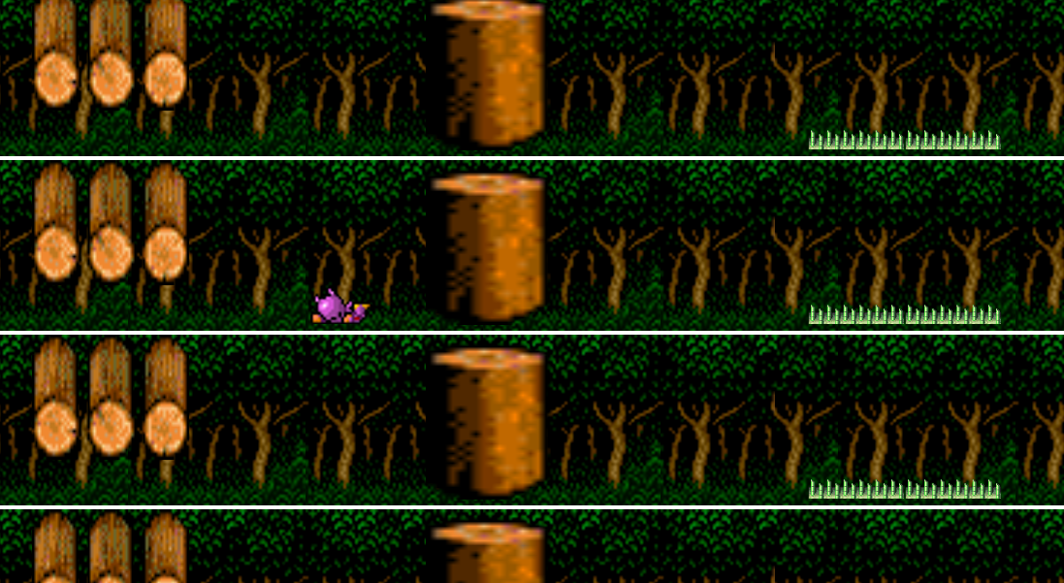
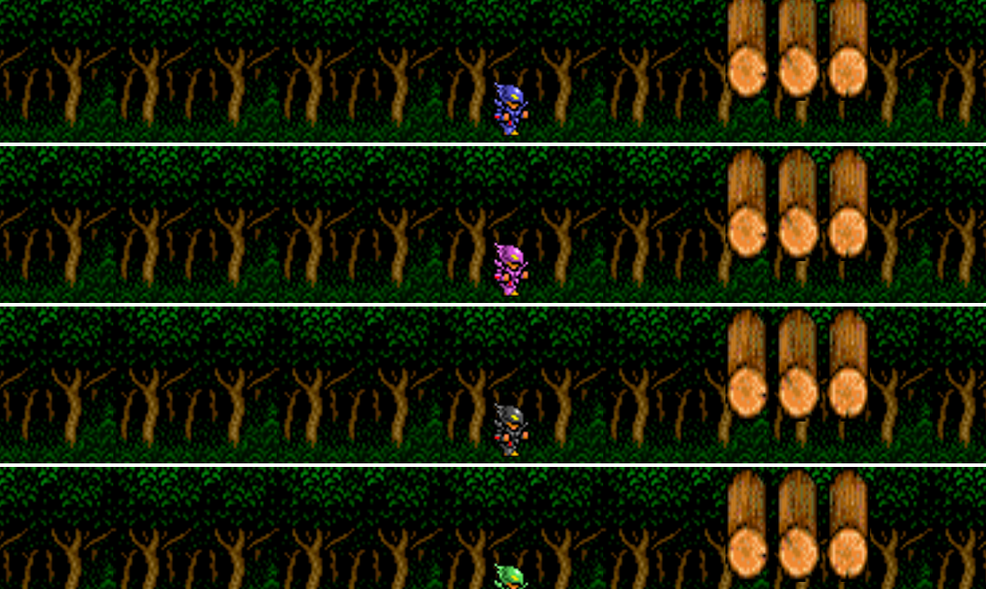
Progress Report – Mini Game
Every race is unique
Every player encounters the same obstacles
Difficulty increase as players progress through the forest
Takes completion into account
Add a random factor for distance

Slide 9

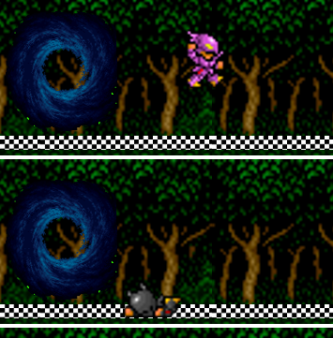
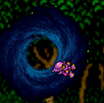

Progress Report – Mini Game
In the end, the leader is victorious
The others must suffer the consequences

Slide 10
Future Plans
Complete at least 2 more mini games (3 if time permits)
Continue testing iteratively on Xbox
Improve aesthetics
Improve storyline (From Feedback)
Cut scenes & narrative
Make sure our game is playable and fun!

Slide 11
References
Character sprites:
Stephen Galano: http://www.dawezy.com/spritesdb.htm
Controllers - http://www.clker.com/clipart-26653.html / http://www.pixeljoint.com/pixelart/55875.htm
Scrolls - http://www.turbosquid.com/3d-models/scroll-paper-books-3ds/353673
Wizard - http://graphicleftovers.com/graphic/cartoon-wizard-staff/
Forest Background - http://www.wayofthepixel.net/index.php?action=profile;area=showposts;u=6993
Sound Effects:
Jump -http://www.mobilefish.com/services/sound_effects/sound_effects.php?cat=25&page=2&file=&accesscode=#sounds
Slash and Collide - http://www.freesound.org/people/qubodup/sounds/60009/
Slide - http://www.flashkit.com/soundfx/Mechanical/Swishes/Nice_Swi-NEO_Soun-8395/index.php
Music
FFIV Fanfare - http://www.youtube.com/watch?v=mHsdFijn3Bc
Mario Party 1 Instructions - http://www.youtube.com/watch?v=hYeLhWa2Ddk
Benny Hill Theme - http://www.youtube.com/watch?v=MK6TXMsvgQg

Slide 12
Questions?

