Slide 1
“BATTLE ROOMS” Game Proposal
Chris Di Fulvio
Katrina Anderson
Matthew Tam
Patrick Modafferi

Slide 2
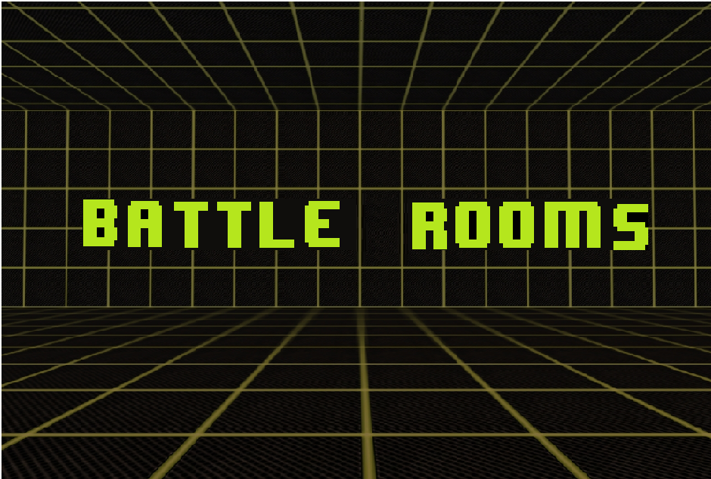
Introduction
Tag line
“Leave your friends behind”
Genre
Party Game – Adventure
Platform
Xbox 360 (2D)
Market
Recreational Gamers, Families
Setting
Series of mini games to escape the evil wizard
Play’s Like Mario Party meets Wario Ware
Logo / Box Art

Slide 3
Summary
Four friends are trapped by an evil wizard in a magical room
The room has the magic ability to transform completely, transporting players to imaginary places
The wizard forces them to compete in a series of cruel yet comical mini games
Players who perform well in these games are rewarded
For those who loose, the consequences are dire

Slide 4
Summary
The competitive aspect will play out like an elimination based tournament
Only one player survives and is crowned champion of the magical wizard games
The mini games will be randomly selected from a list in story mode
Players can replay their favorite games in mini game mode
These games are short survival, timing and reflex based games which can be:
Free for All
2 vs. 2
1 vs. 3

Slide 5
Mechanics
Gladiator
Mini Games
Precision Timing
Team Coordination

Slide 6
Reference Art
Final Fantasy I to IV
Mario Party
Wario Ware
The Holodeck (Star Trek)
Dreamatorium (Community)
Secrets of the Mirage

Slide 7
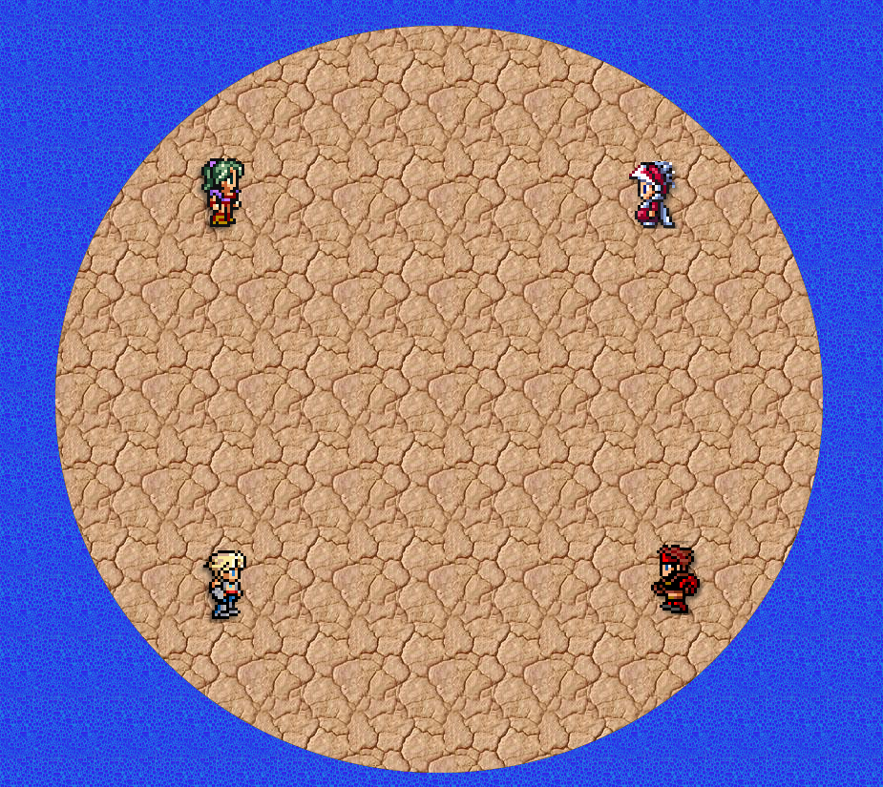
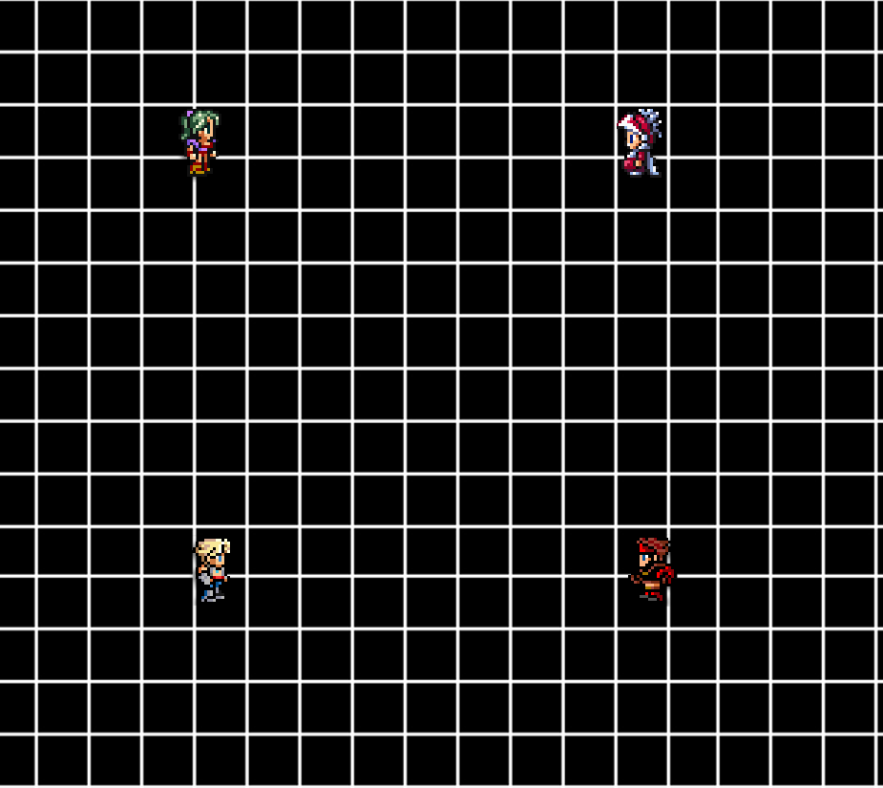
Supporting Screenshot or Mechanic Analysis Diagram

Slide 8
Related Game: Mario Party 1-9
Author: Nintendo, Multiple Dates
Platform(s): Nintendo 64, GameCube, Wii
Party game composed of a series of mini-games, where friends compete
Genre: Party Game – Adventure
Demographic: Everyone
Supports two modes of play:
“Party Mode” – Core game mode with story line
“MiniGame Mode” – Choose which mini-game to play
Mini game types:
Free for All
2 vs. 2
1 vs. 3
Supports 4 human players

Slide 9
Related Game: Fuzion Frenzy
Author: Microsoft Game Studios, 2001
Platform(s): Xbox & Xbox 360
Party game composed of a series of mini-games, where friends compete
Genre: Party Game – Adventure
Demographic: Everyone
Supports two modes of play:
“Tournament” – Core game mode with story line
"Mini-Game Frenzy“ – Choose which mini-game to play
Supports 4 human players

Slide 10
Related Game: Rayman Raving Rabbids
Author: Ubisoft, 2006
Platform: Wii
Party game composed of a series of mini-games, where friends compete
Genre: Party
Demographic: Everyone
Supports two modes of play:
“Story Mode” – Core game mode with story line
“Score Mode “ – Obtain points for winning mini-games and compete for the highest score
Supports 4 human players

Slide 11
References
Sprites: http://calicostonewolf.deviantart.com/art/Final-Fantasy-Sprites-113099860
Black Grid: https://picasaweb.google.com/lh/photo/WxVJ8xmyyj5KVQPwb6BYjw

Slide 12
Questions?

