Slide 1
Improving Cryptanalytic Applications with Stochastic Runtimes on GPUs
Lena Oden and Jörg Keller

Slide 2
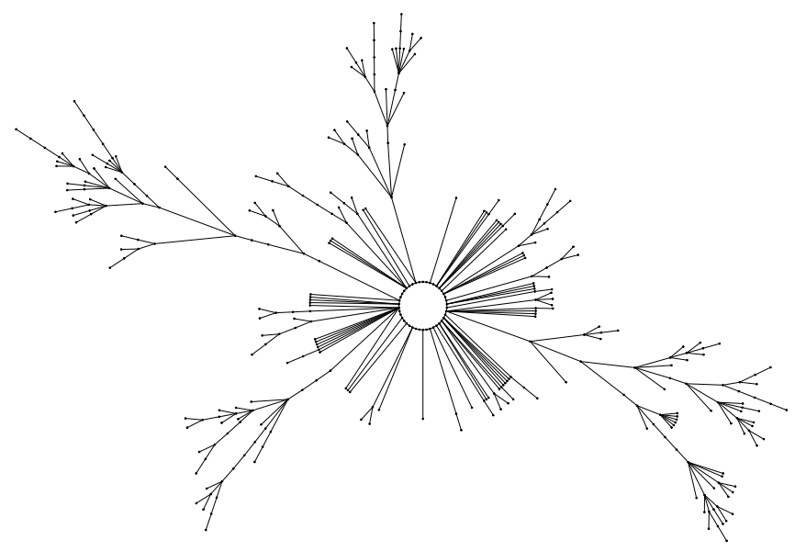
Applications
Stream ciphers and pseudo random number generators
Finite state automata, input only upon seeding
Each call to PRNG: transition to unique follow-up state
State graph: each node=state exactly one outgoing edge
Structure: few components, each with 1 cycle + ragged trees

Slide 3
Applications 2
Explore state graph of medium size (n=2⁶⁴) to find if cycle lengths meet expectations (~sqrt(n))
Construct anchor graph
Anchors = nodes with property, e.g., node index mod 2^²⁰=0, spread all over state graph
From each anchor u: follow path to next anchor v (and store (u,v,dist(u,v))
Analyze anchor graph in post-processing step, not difficult because much smaller (not covered here)

Slide 4
Basic Implementation
u i n t 6 4 d i s t [N ] , a r c [N ] ;
f o r ( u i n t 6 4 i = 0 ; i<N ; i + + )
d o t a s k ( i , d i s t , a r c ) ;
v o i d d o t a s k ( u i n t 6 4 i , u i n t 6 4*d i s t , u i n t 6 4*a r c ){
u i n t 6 4 s t e p s = 0 ;
u i n t 6 4 x = g e n e r a t e a n c h o r ( i ) ;
do{
x = f ( x ) ;
s t e p s + + ;
}w h i l e ( ! i s a n c h o r ( x , steps) ) ;
w( d i s t , a r c , i , s t e p s , x ) ;}
Embarrassing Parallel:
Each Task can be computed independent!
Get start state!
Get next state
Write the number of steps back to memory

Slide 5
Classic way to solve this on the GPU
b
Blocking
Function f(x)
Write-Function w(x)
f
f
f
w
f
w
f
w
f
w
f
f
f
w
f
w
f
f
f
w
f
w
f
w
f
f
f
w
f
w
f
f
f
w
f
w
f
w
f
f
f
w
f
w
f
w
Thread 0
f
f
f
w
Thread 1
f
b
b
w
g l o b a l v o i d k e r n e l ( u i n t 6 4 M, u i n t 6 4 o f f s e t ,u i n t 6 4*d i s t , u i n t 6 4*a r c ){
u i n t 6 4 i = g e t i n d e x ( b l o c k I d x , b l o c k D i m , t h r e a d I d x ) ;
u i n t 6 4 s t e p s = 0 ;
u i n t 6 4 x = g e n e r a t e a n c h o r ( i ) ;
do{
x= f ( x ) ; s t e p s + + ;
}w h i l e ( ! i s a n c h o r ( x ) ) ;
w( d i s t , a r c , i , s t e p s , x ) ;
}
Thread 2
f
b
b
w
Thread 3
f
b
b
w
Thread 4
f
f
f
w
…
Thread 14
f
f
f
w
Thread 15
f
b
b
w

Slide 6
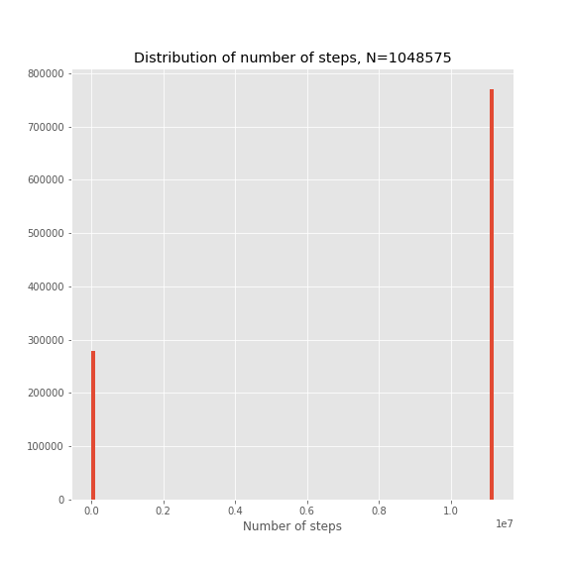
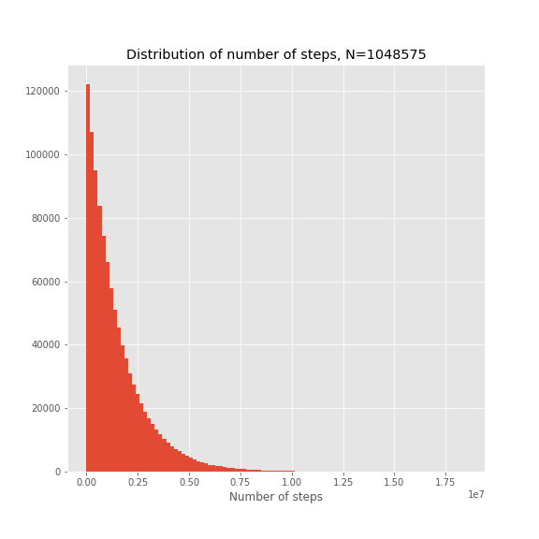
Distribution of Step-Length
stream chiper
Pseudo random number generator

Slide 7
Regular execution
Thread 0
Thread 1
Thread 2
Thread 3
b
Blocking
Function f(x)
Write-Function w(x)
f
f
f
f
w
f
w
f
w
f
w
f
f
f
w
f
w
f
f
f
w
f
w
f
w
f
f
f
w
f
w
f
f
f
w
f
w
f
w
f
f
f
w
f
w
w
Thread 0
f
f
f
w
f
b
b
w
f
b
b
w
f
b
b
w
u i n t 6 4 i = g e t i n d e x ( b l o c k I d x , b l o c k D i m , t h r e a d I d x ) ;
i = i*T;
f o r ( u i n t 6 4 t = 0 ; t<T ; t + + ){
u i n t 6 4 s t e p s = 0 ;
u i n t 6 4 x= g e n e r a t e a n c h o r ( i + t ) ;
do{
x= f ( x ) ;
s t e p s + + ;
} w h i l e ( ! i s a n c h o r ( x ) ) ;
w( d i s t , a r c , i + t , s t e p s , x ) ;
}
Thread 1
f
f
f
w
f
b
b
w
f
f
f
w
f
b
b
w
Thread 2
f
b
b
w
f
f
f
w
f
b
b
w
f
f
f
w
Thread 3
f
b
b
w
f
b
b
w
f
f
f
w
f
b
b
w
Warp Divergence

Slide 8
Irregular Distribution
Thread 0
Thread 1
Thread 2
Thread 3
b
Blocking
Function f(x)
Write-Function w(x)
f
f
f
f
w
f
w
f
w
f
w
f
f
f
w
f
w
f
f
f
w
f
w
f
w
f
f
f
w
f
w
f
f
f
w
f
w
f
w
f
f
f
w
f
w
w
f
f
b
f
w
f
b
w
f
w
f
b
w
b
b
u i n t 6 4 i = g e t i n d e x ( b l o c k I d x , b l o c k D i m , t h r e a d I d x ) ;
i = i*T;
u i n t 6 4 t = 0 ;
u i n t 6 4 s t e p s = 0 ;
u i n t 6 4 x = g e n e r a t e a n c h o r ( i + t ) ;
do{
x = f ( x ) ;
s t e p s + + ;
i f ( i s a n c h o r ( x ) ) {
w( d i s t , a r c , i + t , s t e p s , x ) ;
++ t ;
x = g e n e r a t e a n c h o r ( i + t ) ;
s t e p s = 0 ;
}
}w h i l e ( t<T ) ;
f
f
b
f
w
f
b
w
f
b
f
f
w
f
w
f
b
w
f
b
f
f
w
f
w
f
f
b
f
w
f
b
w
f
w
f
f
b
f
w
f
b
w
b
b
Warp Divergence

Slide 9
Problem: Static distribution of Workload between threads
Thread 0
Thread 1
Thread 2
Thread 3
f
f
f
f
f
f
f
f
f
f
w
f
f
f
f
f
f
f
f
f
f
w
f
w
f
f
f
f
f
f
f
f
f
f
w
f
w
f
w
f
f
f
f
f
f
f
f
f
f
w
f
f
f
f
f
f
f
f
f
f
w
f
w
f
w
f
f
f
f
f
f
f
f
f
f
w
f
f
f
f
f
f
f
f
f
f
w
f
w
f
w
f
w
f
w
Some threads will terminate much earlier
Tasks are statically assigned
This problem is more significant, if the differences between the number of steps is significant
f
f
b
f
f
b
f
f
b
f
f
b
f
f
b
w
f
f
f
f
b
f
f
f
f
f
f
w
f
b
w
f
f
b
f
f
f
f
f
f
f
f
w
f
b
w
f
b
w
f
f
b
f
f
b
f
f
f
b
f
f
f
b
w
f
f
f
f
f
f
b
f
f
b
f
f
w
b
f
b
w
f
b
w
f
f
b
f
f
b
f
f
f
b
f
f
f
b
w
f
f
f
f
f
f
b
f
f
b
f
f
w
b
f
b
w
f
b
w
f
b
w
f
b
w
b

Slide 10
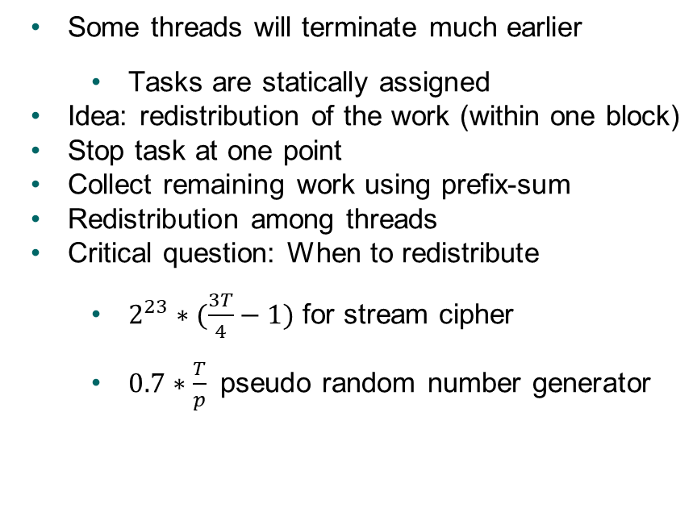
Compact Scheduling
Thread 0
Thread 1
Thread 2
Thread 3
f
f
f
f
f
f
f
f
f
f
w
f
f
f
f
f
f
f
f
f
f
w
f
w
f
f
f
f
f
f
f
f
f
f
w
f
w
f
w
f
f
f
f
f
f
f
f
f
f
w
f
f
f
f
f
f
f
f
f
f
w
f
w
f
w
f
f
f
f
f
f
f
f
f
f
w
f
f
f
f
f
f
f
f
f
f
w
f
w
f
w
f
w
f
w
Thread 0
Thread 1
Thread 2
Thread 3
Some threads will terminate much earlier
Tasks are statically assigned
Idea: redistribution of the work (within one block)
Stop task at one point
Collect remaining work using prefix-sum
Redistribution among threads
Critical question: When to redistribute
$2^{23}∗(\frac{3T}{4}−1)$ for stream cipher
$0.7∗\frac{T}{p}$ pseudo random number generator
f
f
b
f
f
b
f
f
b
f
f
b
f
f
b
w
f
f
f
f
b
f
f
f
f
f
f
w
f
b
w
b
f
b
w
f
b
w
f
f
b
f
f
b
f
f
f
b
f
f
f
b
w
b
f
f
b
f
f
f
f
f
f
f
f
w
f
b
w
f
b
w
f
f
b
f
f
b
f
f
f
b
f
f
f
b
w
b
f
f
b
f
f
f
f
f
f
f
f
w
f
b
w
f
b
w
f
b
w
f
b
w
b
f
f
b
f
f
f
f
f
f
f
f
w
Notes:
For A5/1, where there are only two possibilities for task length, we choose the threshold as $2^{23}\cdot (3T/4-1)$, as this is shortly before the expected workload has been processed in an optimally balanced computation:
75\% of the tasks comprise about $2^{23}$ iterations.
We find that for $T=8$, at this point still around 25\% of the tasks are not processed.
For random numbers, we choose $0.7\cdot T/p$ for the threshold, where $T/p$ is the expected number of iterations for $T$ independent geometrically distributed task runtimes. At this point, about 75\% of the tasks have been processed, and the variance is large: some threads have processed 4 tasks, some only 1.

Slide 11
Dynamic Distribution using atomics
f
f
f
f
f
f
f
f
f
f
w
f
f
f
f
f
f
f
f
f
f
w
f
w
f
f
f
f
f
f
f
f
f
f
w
f
w
f
w
f
f
f
f
f
f
f
f
f
f
w
f
f
f
f
f
f
f
f
f
f
w
f
w
f
w
f
f
f
f
f
f
f
f
f
f
w
f
f
f
f
f
f
f
f
f
f
w
f
w
f
w
f
w
f
w
uint64 t = atomicfetchandadd(&cnt,1);
uint64 x = generateanchor(i+t);
do{
x = f(x);
steps++;
if(isanchor(x)){
w(dist,arc,i,steps,x);
t = atomicfetchandadd(&cnt,1);
if(t<M/NB){
x = generateanchor(i+t);
steps = 0; }
}
}while(t<M/NB);
Thread 0
b
w
f
f
b
f
f
b
f
f
b
f
f
f
f
w
f
f
b
f
f
f
f
f
f
b
f
f
w
f
b
Thread 1
w
f
f
b
f
f
b
f
f
b
f
f
f
f
w
f
b
w
f
f
f
f
b
f
f
b
f
f
b
f
f
Thread 2
f
b
w
f
b
w
f
b
w
f
f
f
f
b
f
f
b
f
f
f
f
w
f
b
w
f
b
w
f
b
w
Thread 3
b
f
f
b
f
f
b
f
f
f
f
w
f
b
w
f
f
f
f
b
f
f
b
f
f
b
f
f
w
f
f

Slide 12
Results: stream cipher

Slide 13
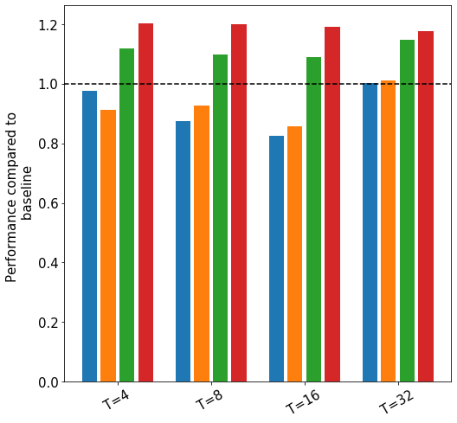
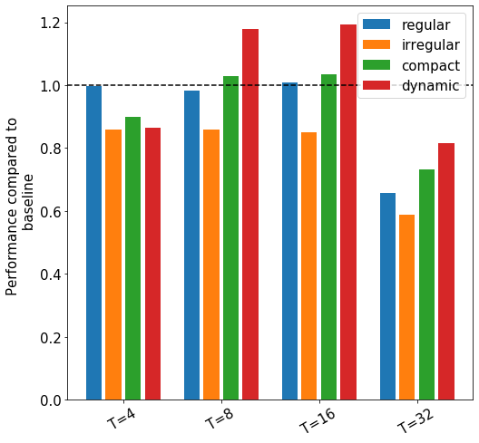
Results: stream cipher
Volta GPU (N=2MB)
Jetson Nano (N=4kB)

Slide 14
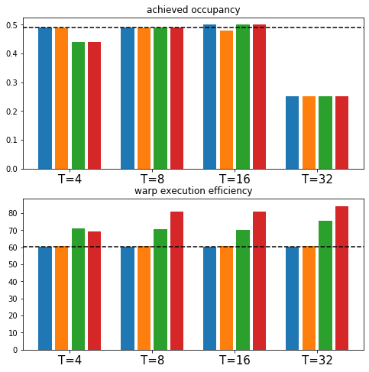
Analysis for Jetson Nano: stream cipher

Slide 15
Results Stochastic Task Sets

Slide 16
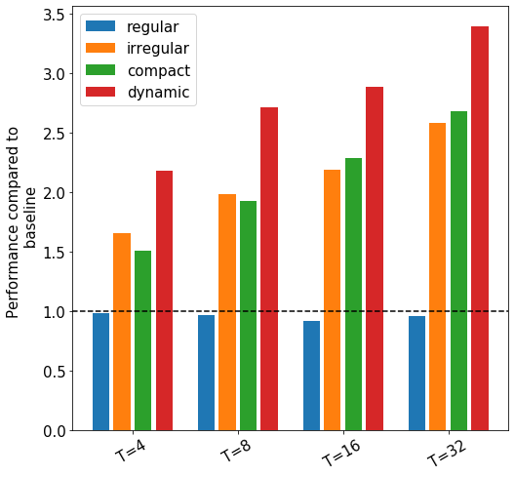
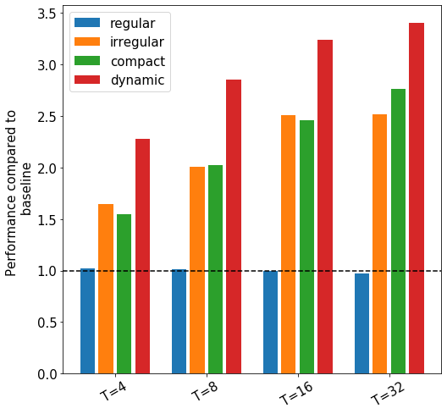
Results random number generator
Volta GPU (N= 2MB)
Jetson Nano (M=4kB)

Slide 17
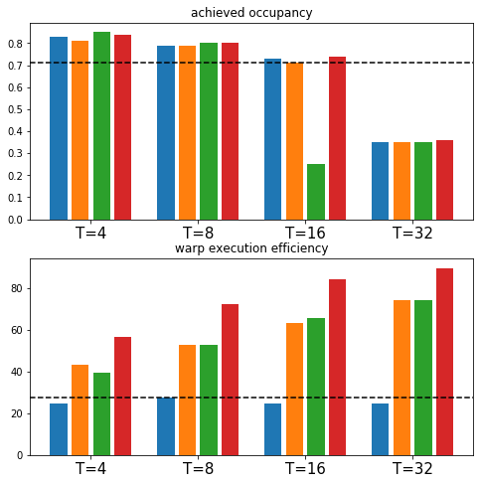
Analysis for Volta GPU, random number generator

Slide 18
Conclusion
Stream cipher and pseudo random number generator are compromised of many independent tasks
Task runtimes are stochastic and follow a common distribution
„one task per thread“ leads to a bad utilization of GPUs
Strategies:
Irregular loops
Compaction and re-assignment
Dynamic work distribution
Dynamic distribution shows good performance and better warp execution efficiency
Next steps:
Normal and exponential distributions
Provide a pattern/library to use these strategies
Compare to openMP scheduling strategies
Thanks! Questions?

Slide 19
Dynamic Distribution using atomics
T0
T1
T2
T3
T1
T2
T3
T0
T2
T0
T1
T2
T3
T1
T3
T0
f
f
f
w
f
w
f
w
f
w
f
f
f
w
f
w
f
f
f
w
f
w
f
w
f
f
f
w
f
w
f
f
f
w
f
w
f
w
f
f
f
w
f
w
Thread 0
f
f
b
f
w
f
b
w
f
f
b
f
w
f
b
w
uint64 t = atomicfetchandadd(&cnt,1);
uint64 x = generateanchor(i+t);
do{
x = f(x);
steps++;
if(isanchor(x)){
w(dist,arc,i,steps,x);
t = atomicfetchandadd(&cnt,1);
if(t<M/NB){
x = generateanchor(i+t);
steps = 0; }
}
}while(t<M/NB);
Thread 1
f
b
w
f
b
f
f
w
f
b
w
f
w
b
b
b
Thread 2
f
b
w
f
w
f
b
w
f
f
b
f
w
b
b
b
Thread 3
f
b
w
f
b
f
f
w
f
b
w
f
b
f
f
w

