Slide 1

Accelerating Radiation Therapy Dose Calculations with Nvidia GPUs
Felix Liu^{1,2}, Niclas Jansson¹, Artur Podobas¹, Albin Fredriksson², Stefano Markidis¹
KTH Royal Institute of Technology
RaySearch Laboratories
Notes:
Notes

Slide 2
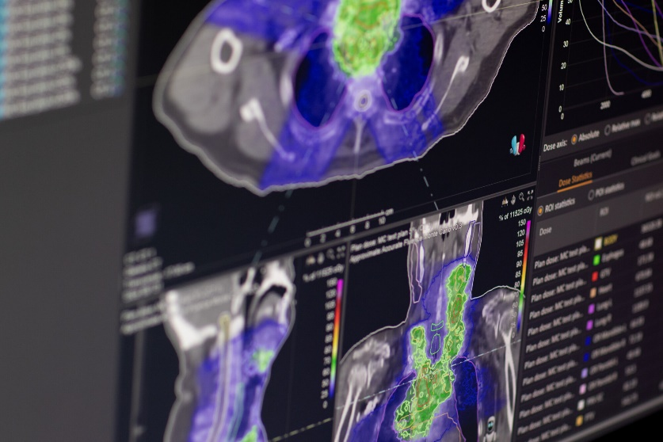
Background - Motivation
Radiation Treatment Planning (RTP) is the process of creating individual, patient-specific, treatment plans for radiation therapy
Time consuming process
Computationally intensive
Iterative trial-and-error when creating treatment plan
More efficient treatment planning
Higher productivity at clinics
Enables more sophisticated optimization methods (Robustness, multi-criteria optimization, online adaptive etc.)
Higher quality treatment plans

Slide 3
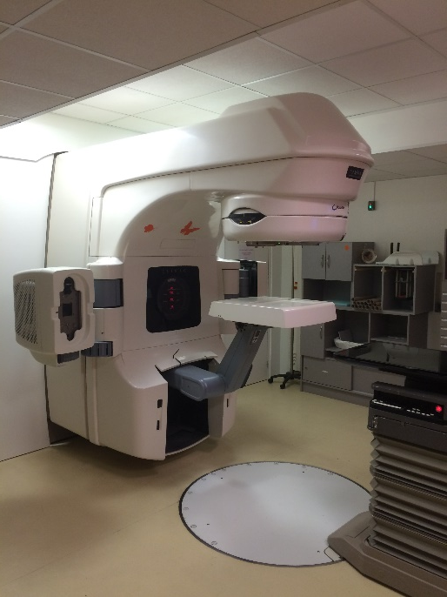
Background – What is RTP?
Treatment machine needs control parameters to deliver treatment
These control parameters are the treatment plan
Determined by formulating a mathematical optimization problem
Promote sufficient dose to tumour, and low dose to surrounding organs
Optimization problem solved iteratively
Need dose computations at each iteration
For some cases a majority of the optimization time is spent on dose computations

Slide 4
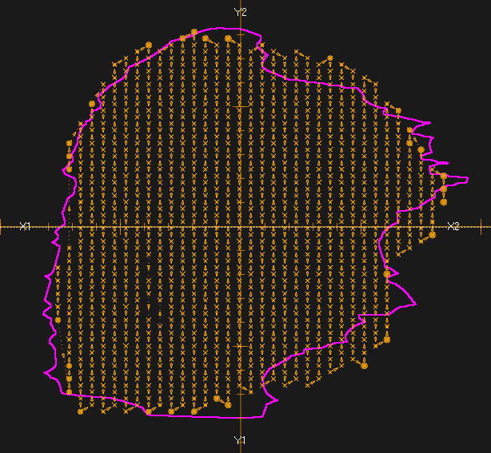
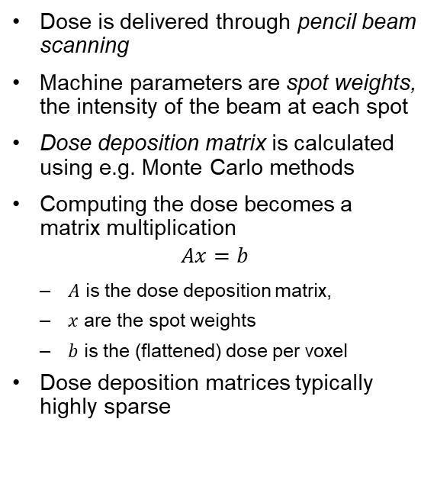

Proton Therapy Dose Calculation
Dose is delivered through pencil beam scanning
Machine parameters are spot weights, the intensity of the beam at each spot
Dose deposition matrix is calculated using e.g. Monte Carlo methods
Computing the dose becomes a matrix multiplication
$$Ax=b$$
$A$ is the dose deposition matrix,
$x$ are the spot weights
$b$ is the (flattened) dose per voxel
Dose deposition matrices typically highly sparse
$$Ax=b$$

Slide 5
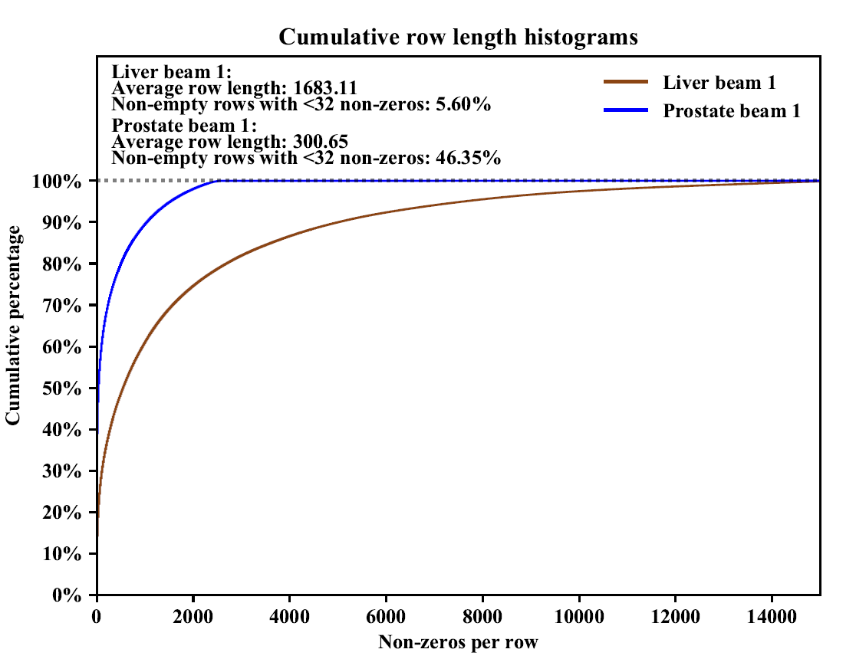
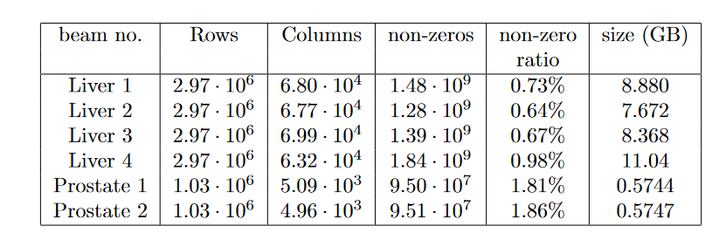
Dose Deposition Matrices
Matrices from two cases used: one liver and one prostate case
Liver case consists of 4 beams with one dose deposition matrix for each beam.
Prostate case has 2 beams
Dose deposition matrices exported from RayStation
RaySearch’s treatment planning system
Large number of rows with no non-zeros, ~70%

Slide 6
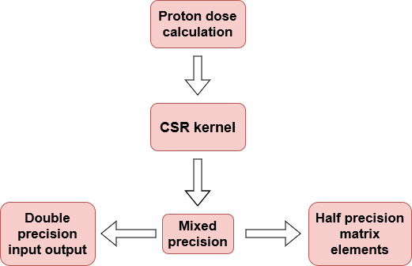
This Work
Port the performance critical proton dose calculation to GPU using CSR
Mixed half/double precision, half precision for matrix entries and double precision for input output.
Similar to RayStation’s current implementation
Double precision for optimization algorithm, half precision to save space.
Comparison with current RayStation CPU implementation and RayStation’s CPU algorithm ported to GPU
Comparison also with state-of-the-art library implementations, in single precision (Half / double mixed precision unsupported)
Ginkgo¹
cuSPARSE
1. https://ginkgo-project.github.io/ginkgo/doc/develop/index.html

Slide 7
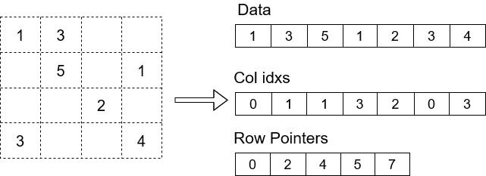
Sparse Matrices - CSR Format
Store matrix using 3 arrays
Non-zero elements -> Data
Column indices of each non-zero element -> Col idxs
Where, in the other 2 arrays, each row starts -> Row Pointers
Row based orderings suited for SpMV
Parallelize over matrix rows
Accumulate local value

Slide 8
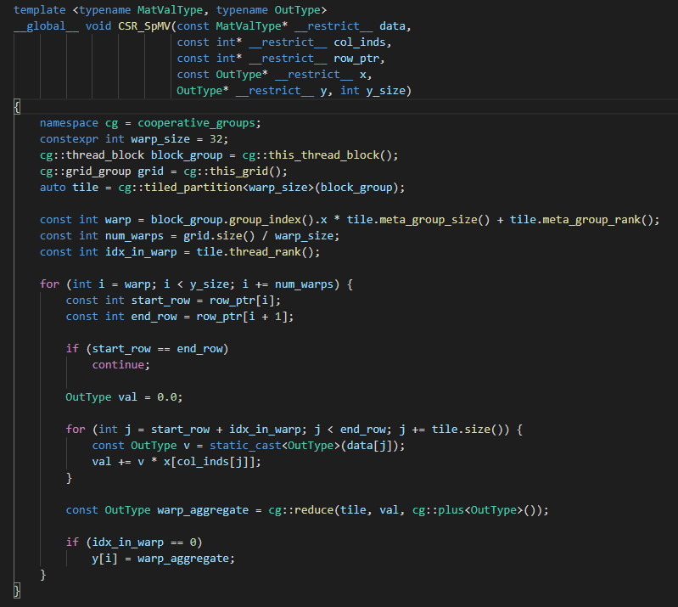
CSR SpMV Kernel
Largely follows the implementation described in [1].
Warp coordination using CUDA cooperative groups
Each row processed by one thread warp
Skip empty rows (up to ~70% of rows empty in our case)
Calculate dot product
Warp-wide reduction using
Coop. groups API
[1] Bell, Nathan, and Michael Garland.
"Implementing Sparse Matrix-Vector Multiplication on Throughput-oriented Processors."
Proceedings of the Conference on High Performance Computing Networking, Storage and Analysis. 2009.

Slide 9
Terminology
We will refer to our kernels by their floating point precision schemes.
Half/double will refer to our kernel in mixed half and double precision, single to our kernel in single precision only.
Our port of the RayStation algorithm to GPU is called GPU baseline.
State-of-the-art library implementations referred to by their names.

Slide 10
Experiments
Measurements done on Nvidia A100, V100 and P100 GPUs, and CPU measurements done on Intel i9 7940X
Half/double, Single, GPU baseline and RayStation’s CPU algorithm on the A100 and i9 CPU
Single with Ginkgo and cuSPARSE on the A100
Half/double on the A100, V100 and P100
Roofline analysis on the A100, using metrics collected by Nvidia Nsight

Slide 11
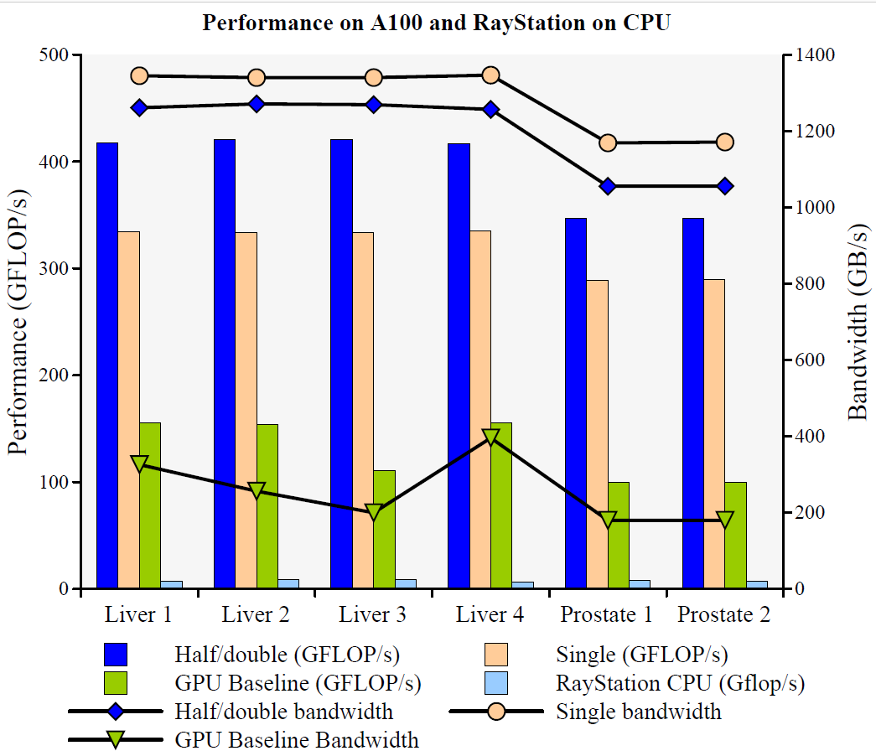
A100 performance

Slide 12
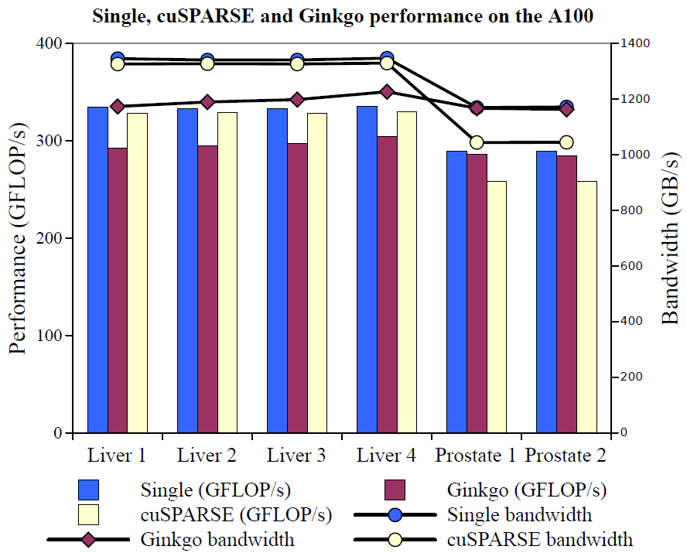
A100 Library comparison

Slide 13
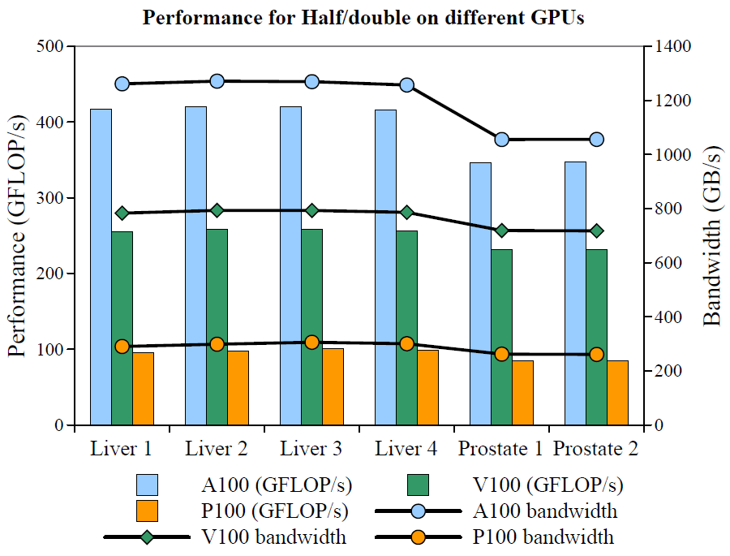
Comparison Between GPUs
For the liver cases, we achieve roughly 80-87% of the peak theoretical bandwidth on the A100 and V100.
The achieved bandwidth for the P100 is around 41% of peak, significantly lower.

Slide 14
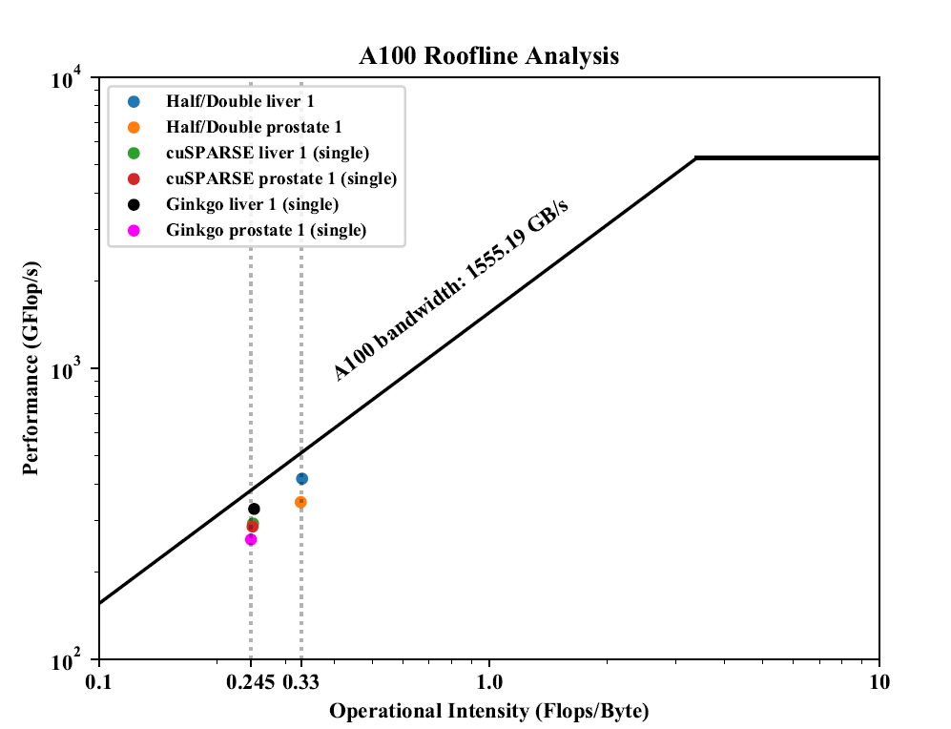
Roofline
Half/double has higher operational intensity, which expains the difference in performance
Single precision versions have lower operational intensity, hence lower performance
Half/double performance ~80% of roofline for liver and ~68% for prostate

Slide 15
Operational Intensity
Memory traffic mainly from reading matrix elements and input vector elements.
Number of columns quite small means input vector fits in cache.
Reading from the input vector does not contribute a lot to memory traffic from main memory.
Non-zero elements dominate memory traffic to main memory!

Slide 16
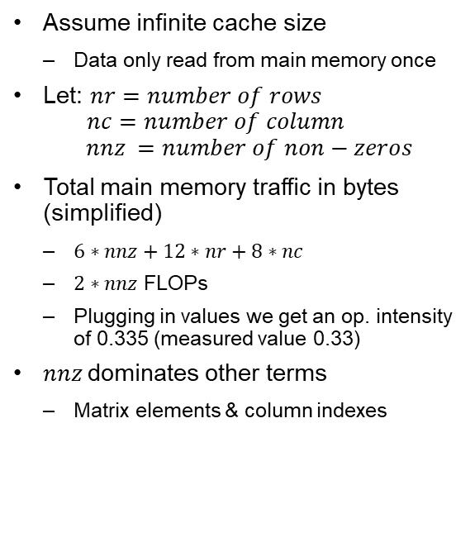
Memory Traffic Model
Assume infinite cache size
Data only read from main memory once
Let: $nr=number of rows$ $nc=number of column$ $nnz =number of non−zeros$
Total main memory traffic in bytes (simplified)
$6∗nnz+12∗nr+8∗nc$
$2∗nnz$ FLOPs
Plugging in values we get an op. intensity of 0.335 (measured value 0.33)
$nnz$dominates other terms
Matrix elements & column indexes

Slide 17
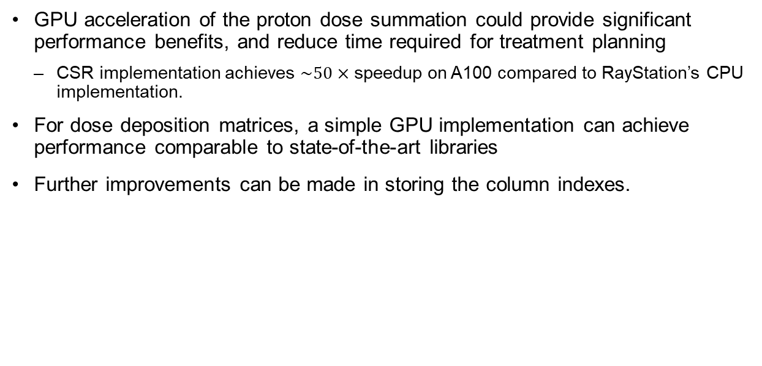
Conclusions
GPU acceleration of the proton dose summation could provide significant performance benefits, and reduce time required for treatment planning
CSR implementation achieves $\sim 50×$ speedup on A100 compared to RayStation’s CPU implementation.
For dose deposition matrices, a simple GPU implementation can achieve performance comparable to state-of-the-art libraries
Further improvements can be made in storing the column indexes.

Slide 18
Thank you for listening!

