Slide 1
Time-Division Multiplexing for FPGA Considering CNN Model Switch Time IEEE IPDPS Workshop - AsHES Tetsuro Nakamura, NTT Network Service Lab.

Slide 2
Agenda
Ⅰ. INTRODUCTION
Edge computing / System requirements
Ⅱ. ANALYSIS FOR ACCELERATOR SHARING
Target usecase / CNN acceleration on FPGA / Time-division multiplex FPGA
Ⅲ. MACHINE PRE-EVLUATION FOR FEASIBILITY
CNN model switch cost on FPGA / Optimization difficulties per CNN models
Ⅳ. PROPOSED METHOD
System architecture / Scheduling algorithm
Ⅴ. EVALUATION
User Performance / Fairness among users / Resource efficiency
Ⅵ. CONCLUSIONS and FUTURE WORK

Slide 3
Ⅰ. INTRODUCTION – Edge Computing
Cloud to Edge Computing
Improvement on Latency, Saving Network Traffic
Any Improvement on Resource Efficiency ?
CPU to Heterogeneous Resources
GPU
High throughput / High Performance on Deep Neural Network
FPGA
Low Latency / Low Power Consumption
Monolithic Design / Fixed Resource in Edge+Cloud
Potential Low Utilization / Over-Provisioning
Can’t we share FPGAs among users in Edge Computing?

Slide 4
Ⅰ. INTRODUCTION – System Requirements
System requirements to share FPGA among multiple users
Resource Efficiency
Maximized Device Utilization
Minimum Cost to Switch Device Users
Fairness between Users
No monopolization of the shared device / No Resource Starvation
Max-min Fairness
Real Time Performance
Minimum Turn Around Time / Minimum Response Time
Hardware Abstraction
Dynamic Resource Scale
Brings Agility to Service

Slide 5
Ⅱ. ANALYSIS FOR ACCELERATOR SHARING
Target Application / Use Case:
Inference for Images / Video Streaming on Edge Server
Convolutional Neural Network (CNN) Algorithm on FPGA
Concurrent Requests from Multiple Users
What is CNN ?
Deep Neural Network for Recognizing / Classifying Images
Various CNN algorithm models with Different Layer Depths and Sizes
Single Shot Detector (SSD): Object Detection
Residual Network (ResNet): Image Classification

Slide 6
Ⅱ. ANALYSIS FOR ACCELERATOR SHARING
Acceleration models of CNN algorithms on FPGA
Fixed-Model Acceleration
Static lay out of a CNN model on internal FPGA chip
Effective Performance
Less Flexibility
Hardware reconfiguration necessary to switch CNN model
Programmable-Model Acceleration
Load CNN model on FPGA off-chip device memory
More Flexibility
Support concurrent requests of various kinds of CNN models
We focus on Programmable-Model Acceleration
to build Time-multiplexed FPGA sharing system

Slide 7
Ⅱ. ANALYSIS FOR ACCELERATOR SHARING
How Programmable-Model CNN Accelerators work
Common processing part by hardware chip
that can support various CNN models
Host Memory
PCIe Bus
FPGA Chip
FPGA Device memory
Load Input
Input Matrix
Output Matrix
32x32x1
1x1x6
Supported calculation
instructions
Parallel Processing
32x32x1
1x1x6
Hierarchical Loop
CNN Algorithm
Model Biases
Input Matrix
Input:32x32x1
Model Information
Conv1:28x28x20
Conv1
Conv
Pooling1
Weights, Biases
Pooling1:14x14x20
Pooling
Conv2:10x10x20
Conv2
Results
Pooling2
Pooling2:5x5x20
Fully
Conv3
Conv3:3x3x20
Fully
Store Output
Fully:1x1x6
Different between CNN algorithms and models

Slide 8
Ⅱ. ANALYSIS FOR ACCELERATOR SHARING
Time-division sharing of FPGA device
Support Context Save in FPGA
Enables to preempt jobs at any time, as well as CPU
Two ways to save FPGA context / state
Inside FPGA : High *spatial* cost
In host memory : High *time* cost
No Context Save in FPGA
Each Job assumed as non-preemptive
Switch users at reasonable job granularity
Switch users only when no state to save is retained internally in FPGA
i.e. per inference execution for an image frame (～milliseconds)
We focus on no context save switch
(because actual inference time is short enough)

Slide 9
Ⅲ. MACHINE PRE-EVLUATION FOR FEASIBILITY
Evaluated programmable-model accelerator with two CNN models
Single Shot Detection (SSD)
model size: 4.5 MB
model switch time: 3.9 ms
inference execution time: 20.62 ms
Residual Network 50 (ResNet50)
model size: 54 MB
model switch time: 48.9 ms
inference execution time: 11.58 ms
(Note: model switch time is the time to transfer the model parameter from host memory to device memory)
Table I. Evaluation Environment
Hardware | Server | Dell R740 PowerEdge
 | CPU | Intel Xeon Gold 5118
 | Host Memory | 96 GB
 | FPGA | Xilinx Alveo U50LV
Software | OS | Ubuntu 18.04.4
 | Driver | XRT 2019.2
The first problem:
Model/User switch cost is not negligible compared to execution time

Slide 10
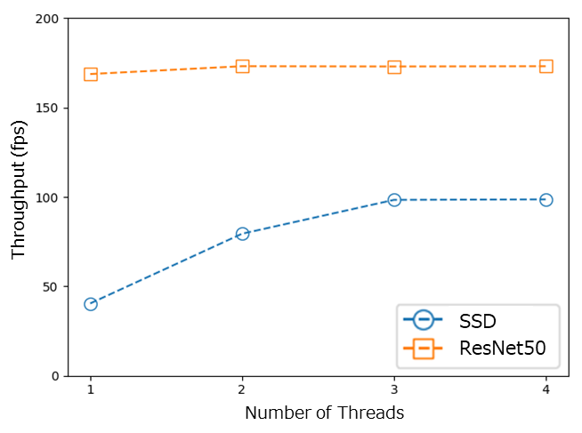
Ⅲ. MACHINE PRE-EVLUATION FOR FEASIBILITY
Throughput Analysis on Different CNN models
SSD needs three threads to maximize the throughput while ResNet50 doesn’t
Each model require detailed hardware tuning while the requirement of resource hardware abstraction prevents it.
The second problem:
Model difference in the optimal number of FPGA execution threads

Slide 11
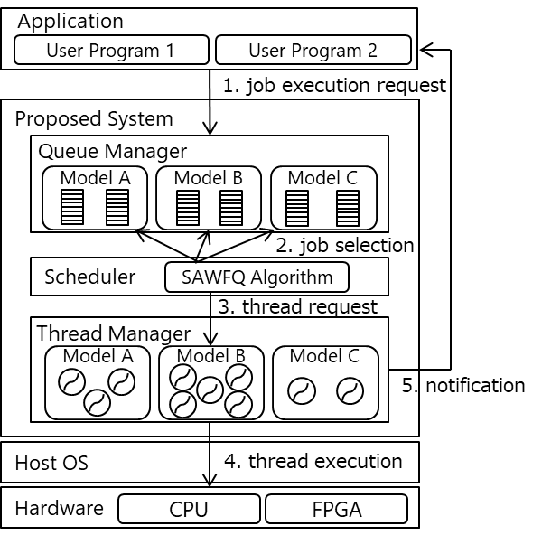
Ⅳ. PROPOSED METHOD – System Architecture
Switch cost is not negligible
→ New Algorithm Proposed:
[Switch Aware WFQ]
Minimizes Switch cost
Ageing Technique with Weighted Fair Queuing
Difference among models
→ Thread Manager Integrated:
Prepares thread groups for each model
Pays out threads on demand to optimal numbers automatically

Slide 12
Ⅳ. PROPOSED METHOD – Scheduling Algorithm
Existing Fair Scheduling Algorithms for CPU
Complete Fair Scheduler, Multi-level Feed Back Queue
Not suitable since they depend on CPU context switch
Weighted Fair Queueing (WFQ) Algorithm
Used in area of network bandwidth control
Select job with earliest virtual finish time
Implicitly use ageing technique
Prevent resource starvation
SAWFQ: switch-aware WFQ proposed
Extension of WFQ to take switch cost into account
Introduces virtual jobs for model switches
“switch penalty”: the burst time of the virtual model switch jobs
Notes:
.

Slide 13
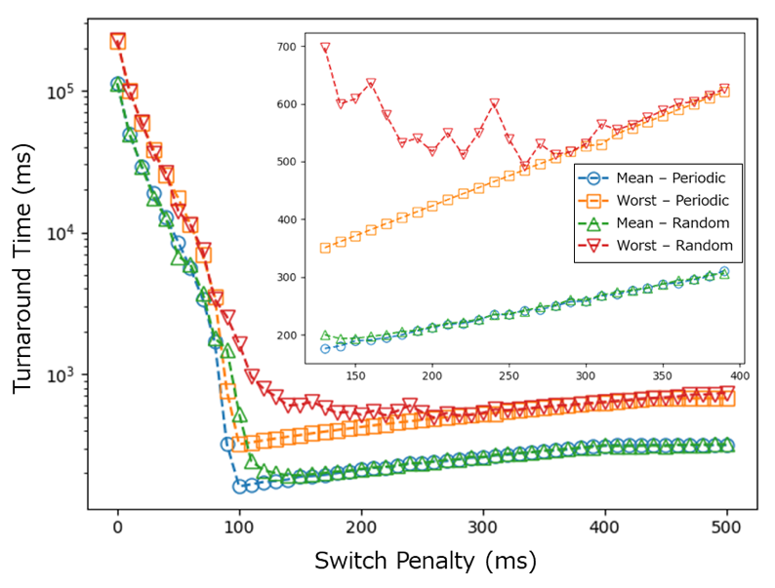
Ⅳ. PROPOSED METHOD – Scheduling Algorithm
How to Optimize the scheduler parameter “Switch Penalty”?
We created SAWFQ simulator, simulated many times
Finally found there is an optimal value for switch penalty
Simulated Two Cases:
Periodic Arrival:
Streaming Request
Random Arrival:
On Demand Request
Smaller switch penalty is faster,
but it bursts at an optimal point
Notes:
.

Slide 14
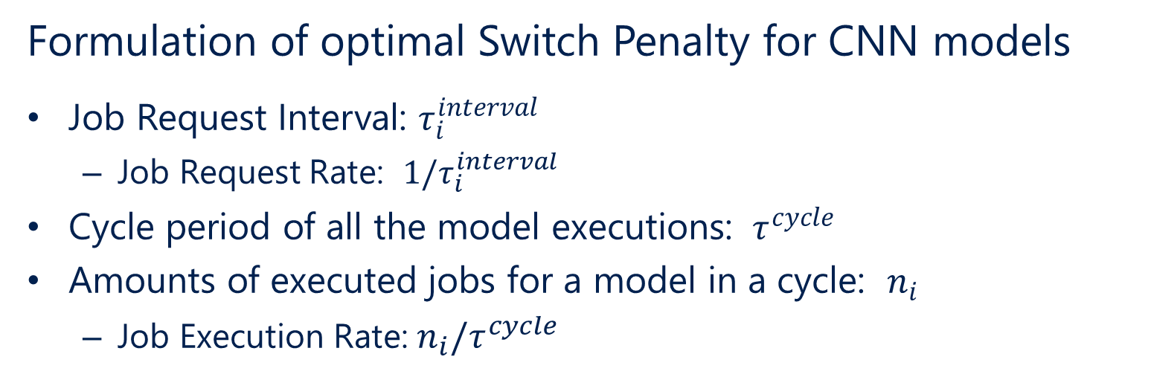
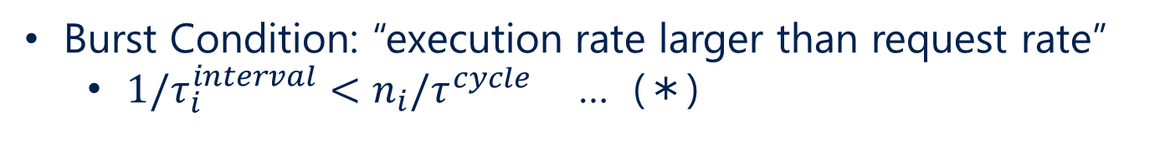


Ⅳ. PROPOSED METHOD – Scheduling Algorithm
Formulation of optimal Switch Penalty for CNN models
Job Request Interval: $τ_{i}^{interval}$
Job Request Rate: ${1/τ}_{i}^{interval}$
Cycle period of all the model executions: ${ τ}^{cycle}$
Amounts of executed jobs for a model in a cycle: $n_{i}$
Job Execution Rate: ${n_{i}/τ}^{cycle}$
Burst Condition: “execution rate larger than request rate”
${1/τ}_{i}^{interval}<{n_{i}/τ}^{cycle}$ … (＊)
E.g. Switch between Two models:
$${ τ}^{cycle}$$
time
Switch Time
$n_{i}$ jobs
Switch Time
Switch Time
Notes:
.

Slide 15




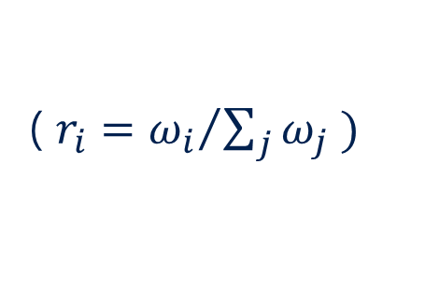
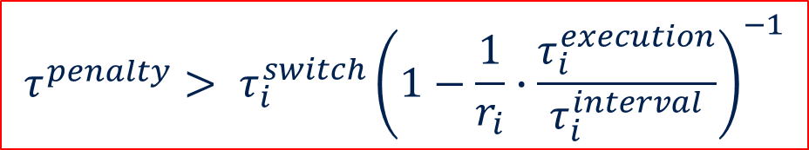
Ⅳ. PROPOSED METHOD – Scheduling Algorithm
Note WFQ calculates virtual time dividing actual time by weight ($ω_{i}$), so switch penalty ($τ_{i}^{penalty}$) and switch time ($τ_{i}^{switch}$) are weighted in actual time
$$n_{i}={ω_{i}\left(τ_{i}^{penalty}−τ_{i}^{switch}\right)}/{τ_{i}^{execution}}, { τ}^{cycle} = \sum_{j}{ω_{j}}τ_{j}^{penalty}$$
Then, the burst condition (＊) becomes
$$τ^{penalty}> τ_{i}^{switch}{\left(1−\frac{1}{r_{i}}∙\frac{τ_{i}^{execution}}{τ_{i}^{interval}}\right)}^{−1}$$
( $r_{i}={ω_{i}}/{\sum_{j}{ω_{j}}} )$
$${ τ}^{cycle}$$
time
$${ω_{i}τ}_{i}^{penalty}$$
$${ω_{i}τ}_{i}^{switch}$$
$n_{i}$ jobs
Notes:
.

Slide 16
Ⅴ. PEFORMANCE EVALUATION
Implemented the System of SAWFQ on FPGA
The System Evaluated with Traditional Algorithms
FCFS (First Come First Served), RR (Round Robin)
Three Evaluation Points:
User Performance
Fairness Among Users
Resource Efficiency
Two CNN Models on Programmable-Model Accelerator:
SSD, ResNet50
Each CNN user issues inference requests periodically
Table I. Evaluation Environment
Hardware | Server | Dell R740 PowerEdge
 | CPU | Intel Xeon Gold 5118
 | Host Memory | 96 GB
 | FPGA | Xilinx Alveo U50LV
Software | OS | Ubuntu 18.04.4
 | Driver | XRT 2019.2

Slide 17
Ⅴ. EVALUATION – User Performance
Requirement (3) Real-Time
Request Interval Time:
SSD: 30ms , ResNet50: 55ms
Load where Jobs have a little waiting time in queues
Metrics1: Scheduling Overhead
130-170 us
Metrics2: Turn Around Time
Model | Turnaround Time (ms)
 | SAWFQ |  | Round Robin |  | FCFS
 | Mean | Worst | Mean | Worst | Mean | Worst
SSD | 278 | 478 | 16,781 | 33,154 | 19,552 | 38,911
Resnet | 196 | 508 | 29,434 | 42,111 | 19,591 | 38,996
Better performance - SAWFQ can minimize the switch costs since it is aware of switch time thanks to the concept of switch penalty

Slide 18
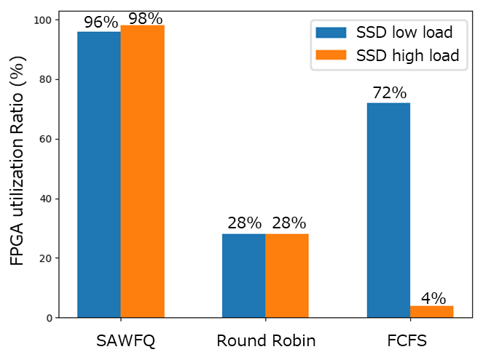
Ⅴ. EVALUATION – Fairness Among Users
Requirement (2) Fairness Among Users
Request Interval Time:
SSD Low Load - SSD: 30ms , ResNet50: 55ms
SSD High Load - SSD: 5ms , ResNet50: 55ms
Metrics3: FPGA Total Utilization Time Ratio Between Users (Models)
Why Not Total Utilization Time? - Waiting Time / Slowdown not suitable
Waiting time orders differs too much between algorithms
Note 100 % is completely fair
FCFS:
Vulnerable to request load
Round Robin:
Robust to request load, but not good
depends on the rate of one inference period of SSD vs. ResNet
SAWFQ:
Min-max Fairness as well as WFQ

Slide 19
Ⅴ. EVALUATION – Resource Efficiency
Requirement (1) Resource Efficiency
Request Interval Time:
SSD: 5ms , ResNet50: 55ms
High load since it doesn’t make much sense to measure efficiency when there are little jobs to execute
Metrics4: FPGA Utilization Rate Against Idle Time
System (not user) Point of view
Considers user (or model) switch time as idle time
 | SAWFQ | RR | FCFS
Device Utilization (%) | 75.72 | 44.93 | 42.80
Better efficiency - SAWFQ can minimize the switch costs since it is aware of switch time thanks to the concept of switch penalty

Slide 20
Ⅵ. CONCLUSIONS and FUTURE WORK
Conclusions
Proposed system…
Enables multiple users to share an FPGA device by switching CNN models on FPGA memory device
Integrates a thread manager to maximize the throughput without reveling hardware resource to users
Integrates new scheduling algorithm, Switch-Aware WFQ, to provide high resource efficiency, real-time performance and user fairness.
Future work
In this work, both FPGA chip and FPGA device memory are time-division multiplexed
We’d like to make FPGA device memory spatial-division multiplexed to minimize the switch cost
Dynamic assign of device memory for CNN models
Extension of FPGA driver to limit memory space for a user process.

