Slide 1
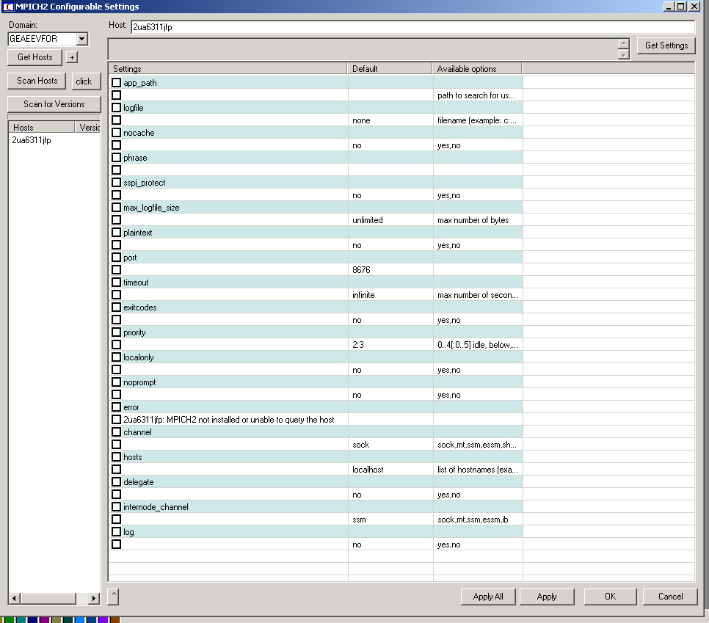
Error that appears when Mpich2 has just been instaled.

Slide 2
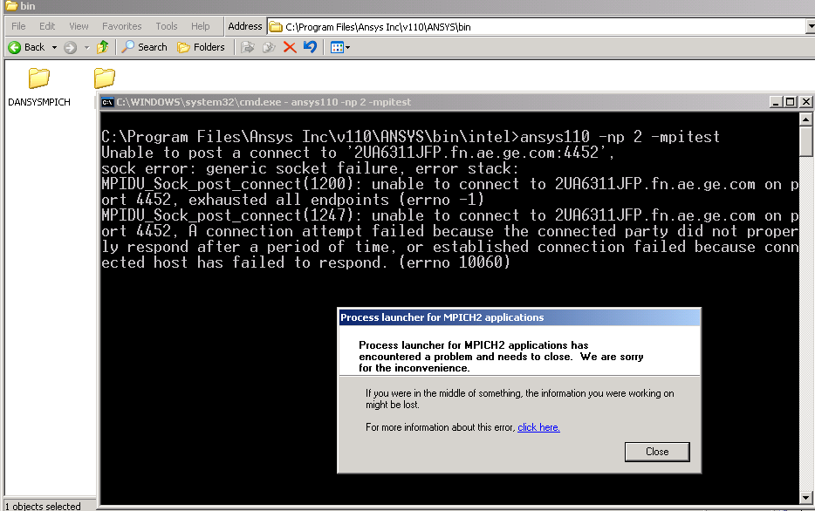
Error that appears in command prommt

