Slide 1



TempestGuard
Predicting Thunderstorms with Virtual Weather Sensors & Machine Learning
IEEE SMC Student Branch Chapter, KGEC • Research Internship Programme 2026
Pranjal Mohata • B.Tech CSE, Final Year

Slide 2

01
Introduction
Background and problem statement
The Problem
Our Idea
How It Works
What You Get
Thunderstorms build up fast — wind, pressure swings, sudden rain — and there's often little warning before they hit.
Instead of buying physical sensors, we turned a live weather API into a network of “virtual” sensor nodes.
Collect readings, label the risk, engineer a few smart features, classify, and put it all on a live dashboard.
A dashboard that flags thunderstorm risk for each node in real time — no hardware required.
IEEE SMC Student Branch Chapter • Kalyani Government Engineering College
2

Slide 3

02
Literature Study
Review of existing research and related work
Physical Sensor Networks
Public Weather APIs
ML for Weather Data
Where the Gap Is
They're accurate, sure, but expensive to install and keep running at a campus or city-block scale.
Services like OpenWeatherMap make software-only “virtual” sensing genuinely realistic — and free to try.
Random Forest keeps coming up as a solid, low-fuss choice for this kind of tabular weather data.
Very few student projects combine live API sensing, ML, and a dashboard people can actually act on — so we did.
IEEE SMC Student Branch Chapter • Kalyani Government Engineering College
3

Slide 4

03
Contribution
What this work adds to the field
Sensors Made of Code
Features That Matter
A Simple, Solid Classifier
Not Just a Warning — A Plan
Five live nodes across Howrah and Kolkata, built entirely from API calls — nothing to wire up.
Pressure-change and humidity-change turned out to be strong signals for a storm building up.
A Random Forest model predicts thunderstorm risk from 8 engineered features per node.
The dashboard points you to the nearest node that's currently safe, not just the one that's risky.
IEEE SMC Student Branch Chapter • Kalyani Government Engineering College
4

Slide 5

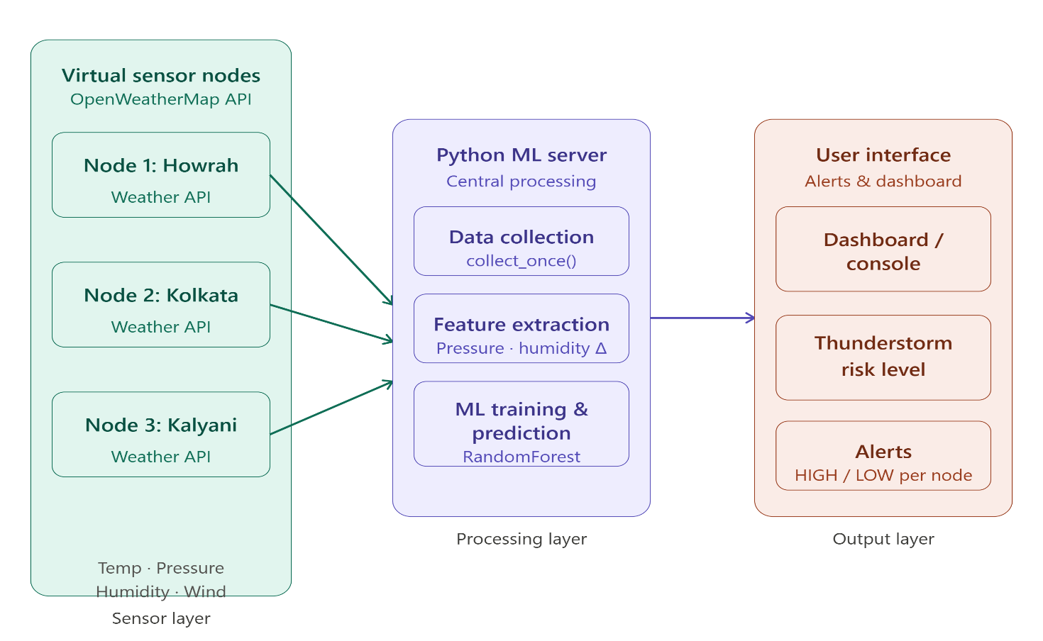
04
Methodology
Approach, design, and implementation
1
Collect — poll OpenWeatherMap per node — temp, pressure, humidity, wind, rain
2
Label — auto-label thunderstorm risk from the weather code
3
Engineer — compute pressure-change & humidity-change per node
4
Train — Random Forest, 100 trees, 8 features, 70/30 split
5
Deploy — Flask dashboard shows live risk + nearest safe node
TempestGuard system architecture — sensor, processing & output layers
IEEE SMC Student Branch Chapter • Kalyani Government Engineering College
5

Slide 6

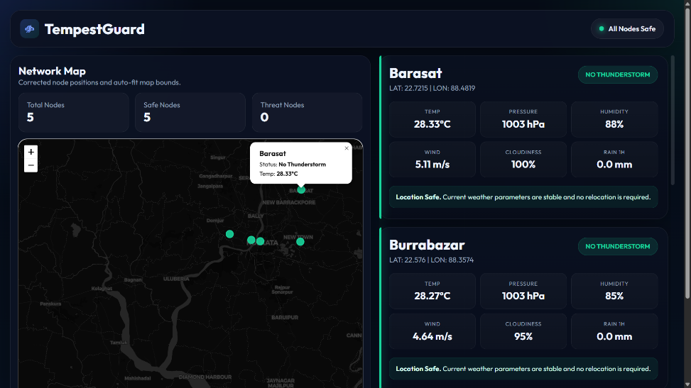
05
Results
Key findings and observations
5
live virtual sensor nodes, running continuously
8
engineered weather features per prediction
100
trees in the Random Forest ensemble
The TempestGuard dashboard — live node-wise weather & risk status
IEEE SMC Student Branch Chapter • Kalyani Government Engineering College
6

Slide 7

06
Comparison Study
Benchmarking against existing methods
TRADITIONAL WEATHER STATIONS
TEMPESTGUARD
✕ Need physical hardware at every location
✓ Nodes are just API calls — fully software-defined
✕ Costly to deploy and to keep maintained
✓ Cheap to run and quick to spin up
✕ Hard to scale past a fixed sensor count
✓ Add a node by adding a coordinate
✕ Tells you the risk, not what to do about it
✓ Points you to the nearest node that's safe
IEEE SMC Student Branch Chapter • Kalyani Government Engineering College
7

Slide 8

07
Conclusion & Future Work
Summary and directions ahead
Conclusion
Future Work
TempestGuard is proof that a lightweight, API-driven pipeline can stand in for a distributed sensor network — turning ordinary weather readings into thunderstorm guidance you can actually act on, without a single physical sensor.
Collect a larger, multi-season dataset to fix the class imbalance
Add rolling / trend-window features for stronger predictions
Bring in real ESP32 sensor nodes alongside the virtual ones
Add alert levels, confidence scores & historical trend charts
IEEE SMC Student Branch Chapter • Kalyani Government Engineering College
8

