Slide 1
G.I. Bill subsidies and vocational training after WWII
Patrick Molligo
Proseminar in ECONOMIC HISTORY | UCLA
MAY 21, 2024

Slide 2
This project
Did tuition subsidies after WWII and Korean War increase enrollment in vocational training?
1944: Servicemen's Readjustment Act (G.I. Bill) + Korean War extension
Widescale draft of most men → source of randomization
Did local access to education shift veterans into vocational training vis-à-vis college?
Black veterans faced segregation
Historically Black Colleges and Universities (HBCUs)

Slide 3
Empirical strategy – big picture
Goal: measure G.I. Bill effect on education/training
Challenges:
Selection into military
Don’t observe benefit utilization
Solution: Birth cohort ≈ benefit eligibility
WWII military service → benefit eligibility → college education
Bound and Turner (2002), Larsen et al. (2015), Thomas (2017)

Slide 4
Difference from previous studies
Strong evidence of increased:
College education (white)
High school attainment
Marital sorting
Home ownership
Bound and Turner (2002), Stanley (2003), Thomas (2017), Larsen et al. (2015)
Today: look at vocational (job) training as alternative use of G.I. benefits
New empirical approaches to setting
Completed training & predicted training (occupation-industry cells)
Interaction with HBCUs
Multinomial logit

Slide 5
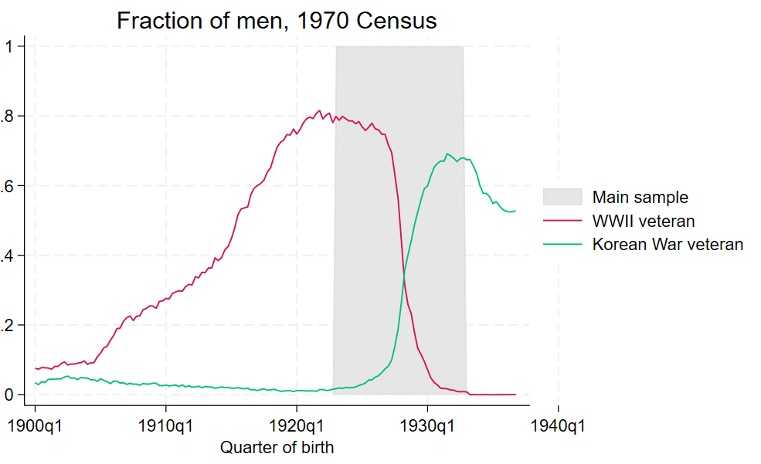
Variation in veteran status

Slide 6
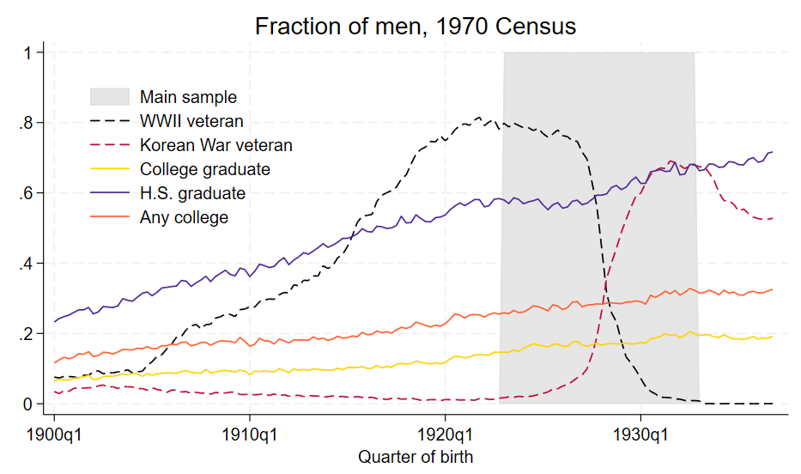
Education + veteran status
Years educ
Years college

Slide 7
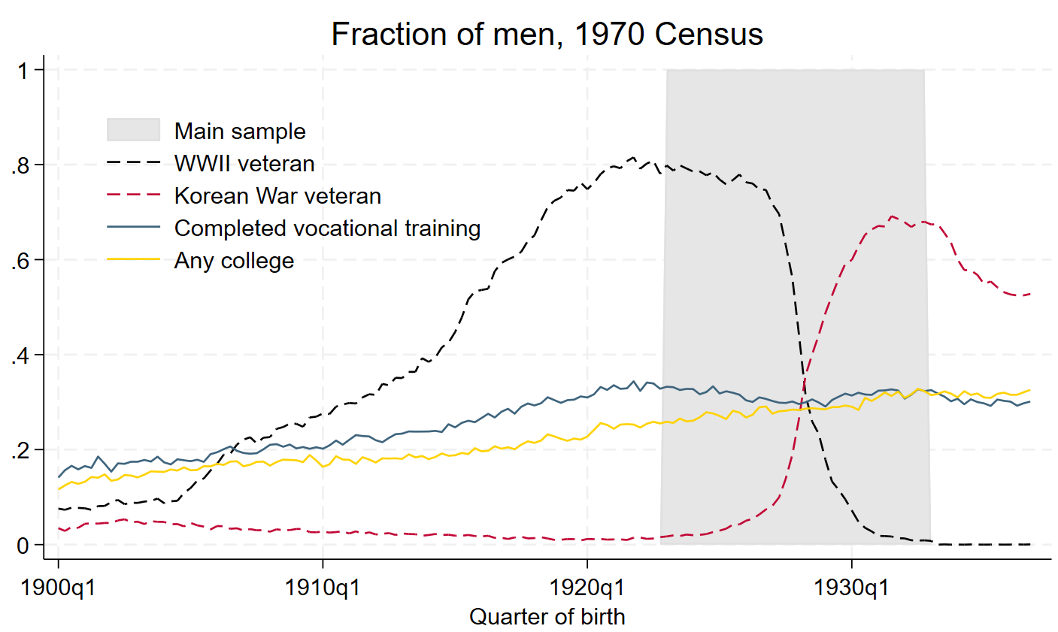
Vocational training + veteran status
Breakdown

Slide 8
G.I. Bill overview
An Act to provide Federal Government aid for the readjustment in civilian life of returning World War II veterans. […] This Act may be cited as the "Servicemen's Readjustment Act of 1944".
– June 22, 1944, Public Law 346
Direct cash benefits to individual veterans
$500 for tuition/books + $50-$120 monthly stipend
Served between Sept. 1940 and July 1947; at least 90 days
Min. 1 year training/eduction → up to 4 years depending on service
Similar Bill for Korean War ( served 1950-1955)

Slide 9
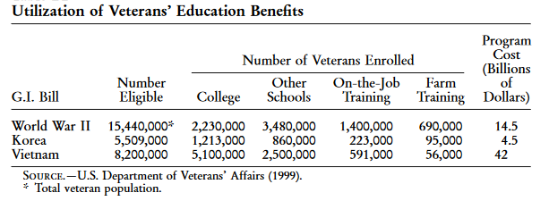
G.I. Bill take up
Source: Bound & Turner (2002), Appendix B2

Slide 10
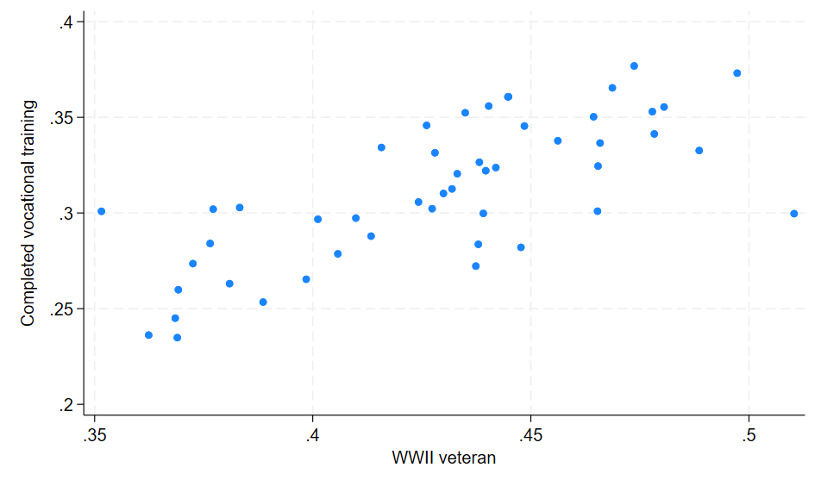
Vocation training vs. vet status by state

Slide 11
Empirical model #1
Y_{ics} = β₀ + β₁*WWII_{cs} + β₂*Korea_{cs} + β₃*State + β₄*Black_{i} + β₅*Trend + β₆*Trend² + e_{ics}
Y_{ics}: Education/training attainment
WWII_{cs} : fraction served in WWII (birth cohort-state)
Korea_{cs} : fraction served in Korean War (birth cohort-state)
State: State of birth dummy
Trend: birth year – 1929 + birth quarter/4

Slide 12
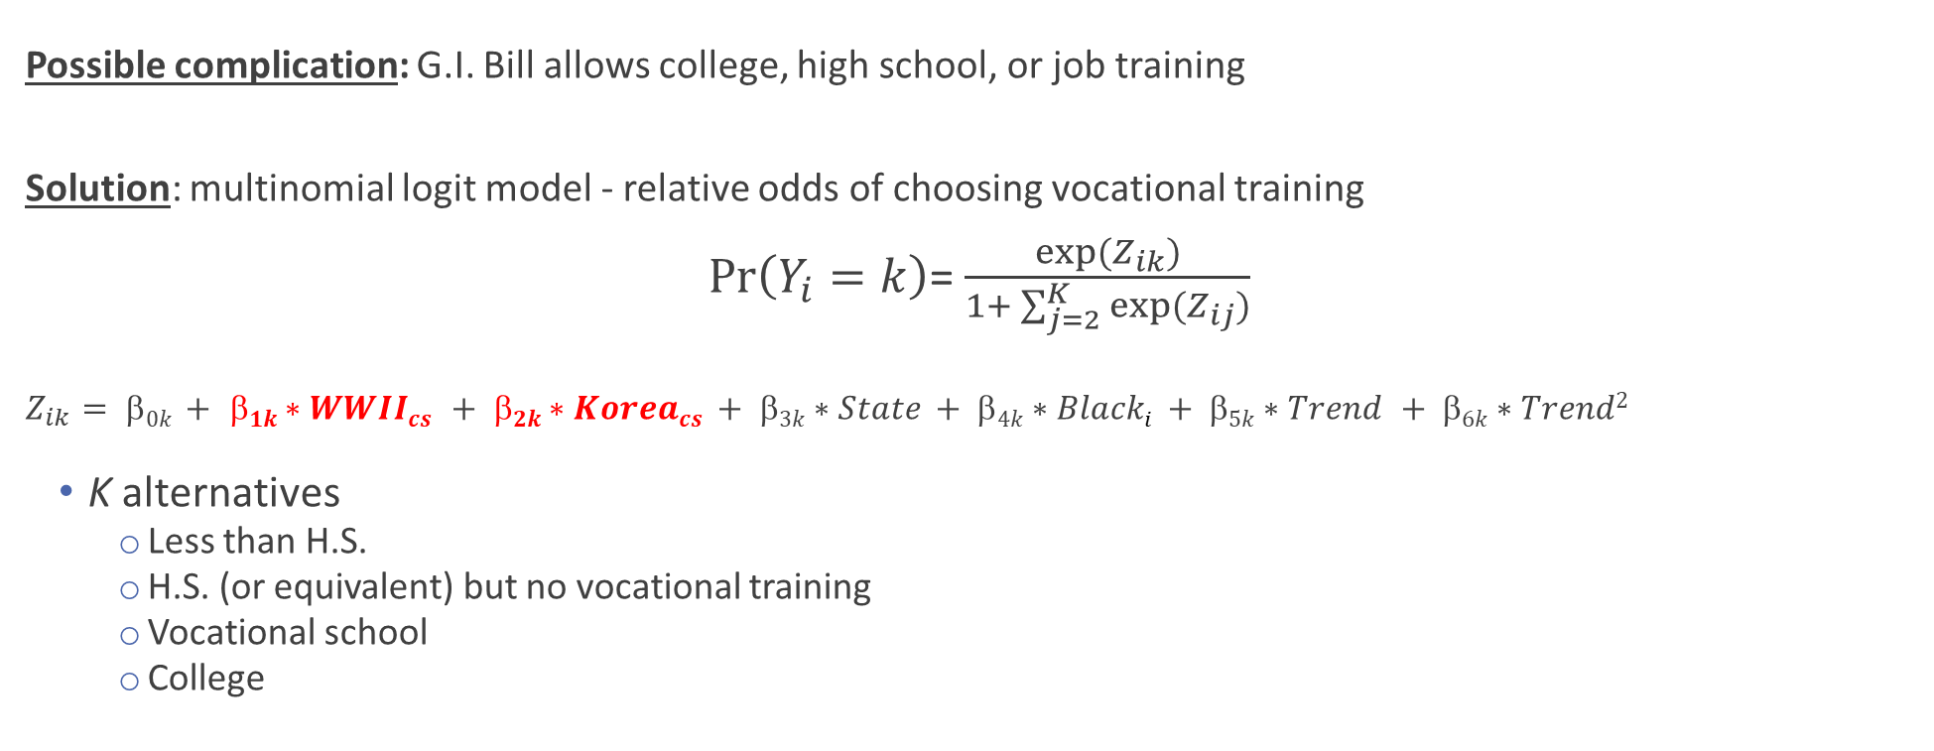
Empirical model #2
Possible complication: G.I. Bill allows college, high school, or job training
Solution: multinomial logit model - relative odds of choosing vocational training
$\operatorname{Pr}\left(Y_{i}=k\right)$= $\frac{exp⁡(Z_{ik})}{1+ \sum_{j=2}^{K}{exp⁡(Z_{ij})}}$
$$Z_{ik}= 0k + 1k∗WWIIcs + 2k∗Koreacs + 3k∗State + 4k∗Blacki + 5k∗Trend + 6k∗Trend2$$
K alternatives
Less than H.S.
H.S. (or equivalent) but no vocational training
Vocational school
College

Slide 13
Public data sources
U.S. Census - 1970 1% samples (IPUMS)
Key variables:
Vocational training (SCHLVOC)
Ever completed a vocational training program + main field of training.
Special high school programs, apprenticeships, business, nursing, and trade schools, technical institutes, and armed forces schools
Military service (VETWWII, VETKOREA)
HBCU data
Number of HBCUs by county, date founded, date closed
Notes:
Census:
SCHLVOC indicates whether the respondent had ever completed a vocational training program and, if so, the main field of training. Examples of vocational training programs are: special high school programs; apprenticeships; business, nursing, and trade schools; technical institutes; and armed forces schools.
No vocational trainingX2Business, office workX3Nursing, health fieldsX4Trades and craftsX5Engineering, drafting, science technicianX6Agriculture, home economicsX7Other vocational fieldX8Field not reported

Slide 14
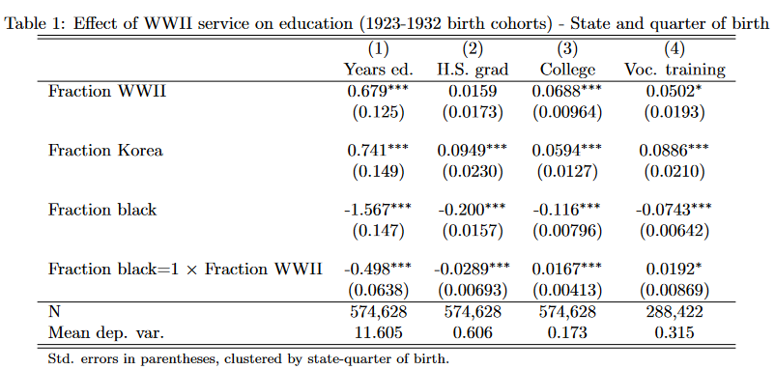
Did the GI Bill increase vocational training?
Quarter only
County
Acemoglu et al.
Notes:
- 41% in range have voc only; 17% coll grad

Slide 15
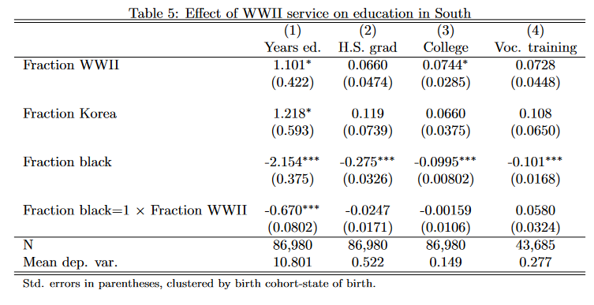
Effects in the South
Non-south
Notes:
- 41% in range have voc only; 17% coll grad

Slide 16
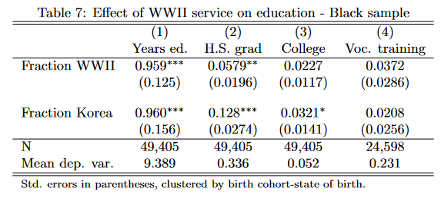
Effects by race
South
Notes:
- 41% in range have voc only; 17% coll grad

Slide 17
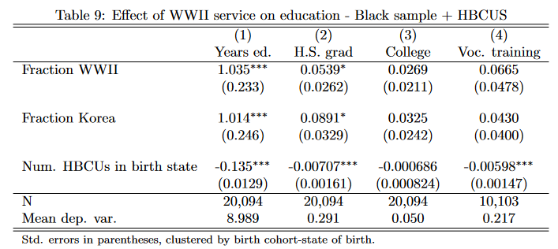
Effect of HBCUs in birth state
Binary
Notes:
- 41% in range have voc only; 17% coll grad

Slide 18
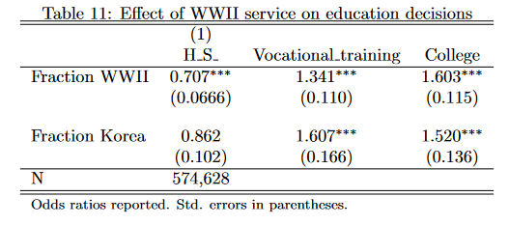
Multinomial logit – base = no training
Alternate ordering
Notes:
Census:
SCHLVOC indicates whether the respondent had ever completed a vocational training program and, if so, the main field of training. Examples of vocational training programs are: special high school programs; apprenticeships; business, nursing, and trade schools; technical institutes; and armed forces schools.
No vocational trainingX2Business, office workX3Nursing, health fieldsX4Trades and craftsX5Engineering, drafting, science technicianX6Agriculture, home economicsX7Other vocational fieldX8Field not reported

Slide 19
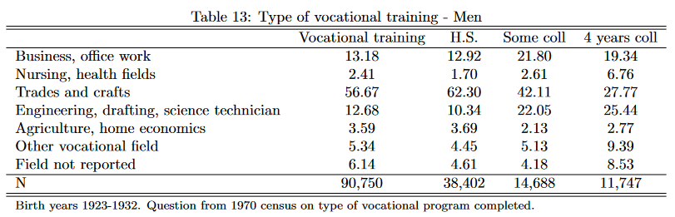
What kind of training?

Slide 20
Alternative measure of vocational school
Data limitation of 1970 vocational school measure
- Few observations; not linked to veteran questionnaire; broad measure; single Census year
Construct a more detailed measure
Group by occupation-industry-education attainment
Compute fraction with vocational training
Classify high/low intensity of voc. school

Slide 21
Variation within occupations
Occupation | Industry | Years of school | Fraction vocational training
Carpenters | Fabricated steel products | 12 | 0.51
Carpenters | Fabricated steel products | 13 | 0.76
Carpenters | Fabricated steel products | 14 | 0.82

Slide 22
Variation across industries
Occupation | Industry | Years of school | Fraction vocational training
Carpenters | Misc retail stores | 12 | 0.26
Carpenters | Misc retail stores | 13 | 0.50
Carpenters | Misc retail stores | 14 | 0.20

Slide 23
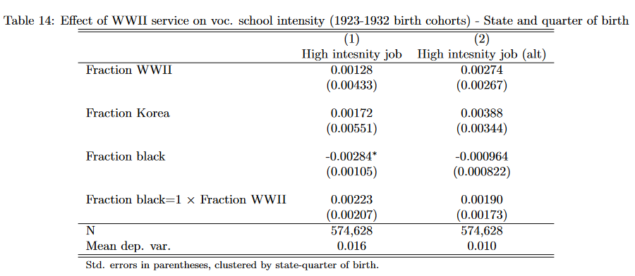
New outcome variable

Slide 24
Appendix

Slide 25
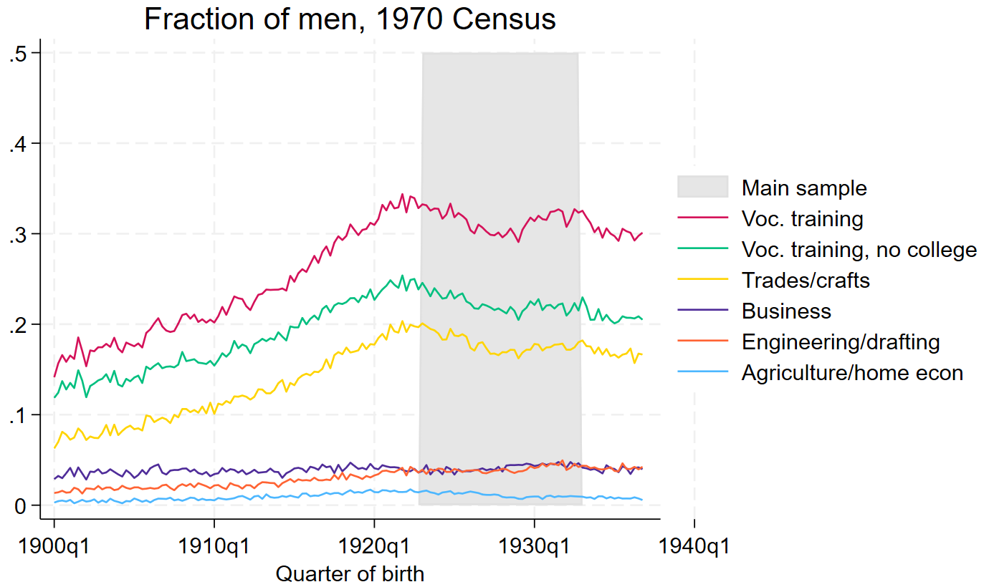
Vocational training - detailed
Back

Slide 26
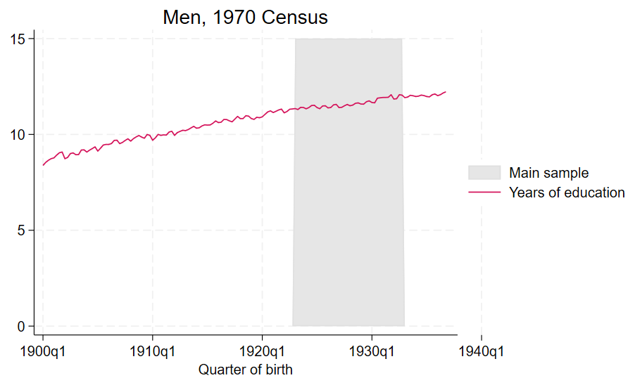
Years of education
Back

Slide 27
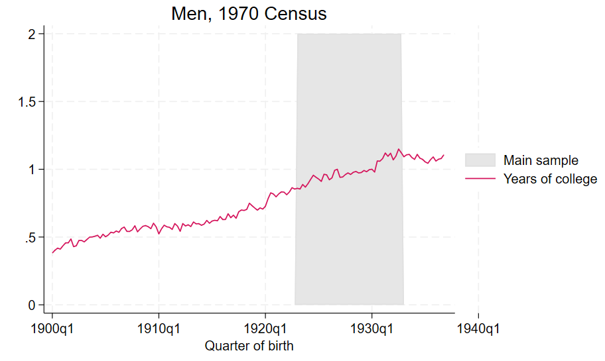
Years of college
Back

Slide 28
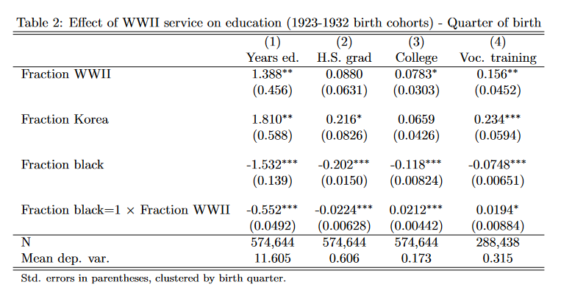
Birth quarter mobilization
Back
Notes:
- 41% in range have voc only; 17% coll grad

Slide 29
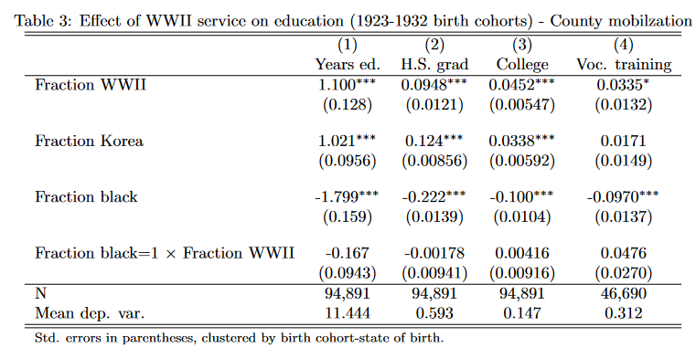
County mobilization (non-movers)
Back
Notes:
- 41% in range have voc only; 17% coll grad

Slide 30
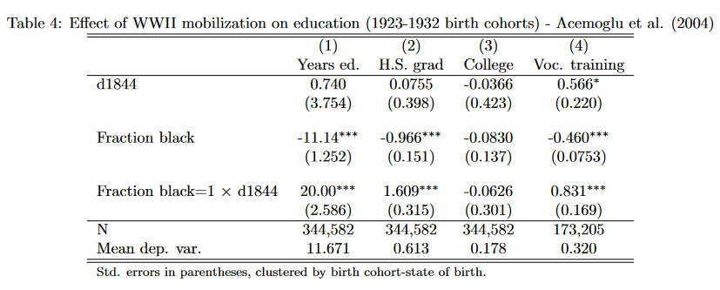
Mobilization – Acemoglu et al. (2004)
Scatter
Back
Notes:
- 41% in range have voc only; 17% coll grad

Slide 31
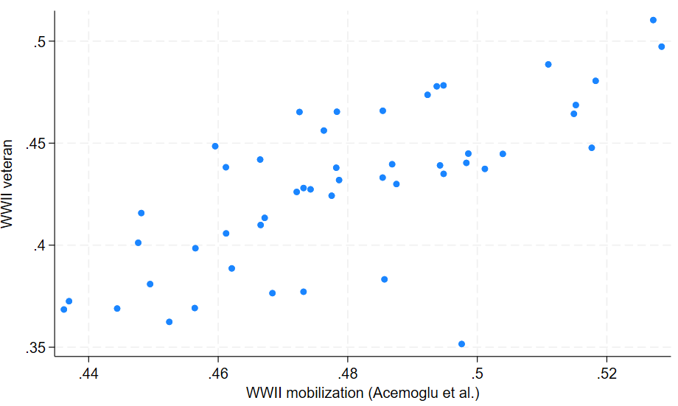
Vets in census vs. state mobilization data
Back

Slide 32
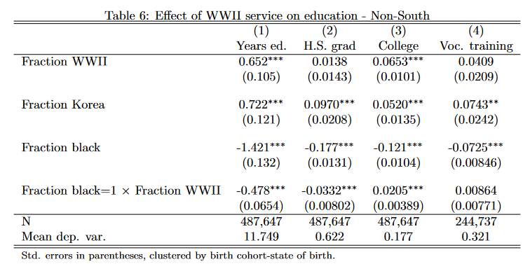
Non-South sample
Back
Notes:
- 41% in range have voc only; 17% coll grad

Slide 33
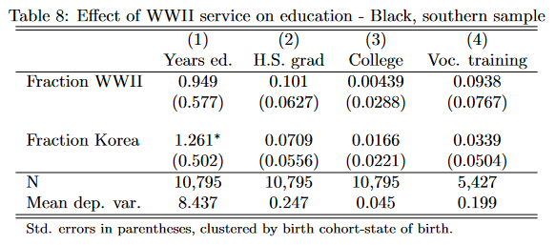
Effects by race – southern states
Back
Notes:
- 41% in range have voc only; 17% coll grad

Slide 34
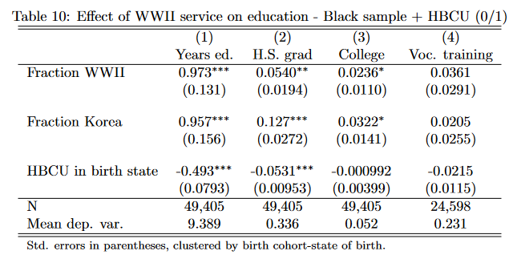
HBCU – binary measure
Back
Notes:
- 41% in range have voc only; 17% coll grad

Slide 35
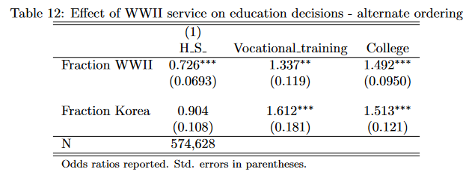
Multinomial logit – 2 yrs. college = voc. ed.
Back
Notes:
- 41% in range have voc only; 17% coll grad

Slide 36
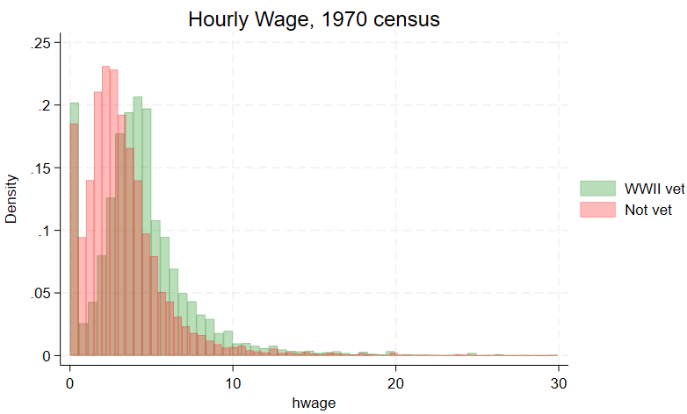
Wages by veteran status

Slide 37
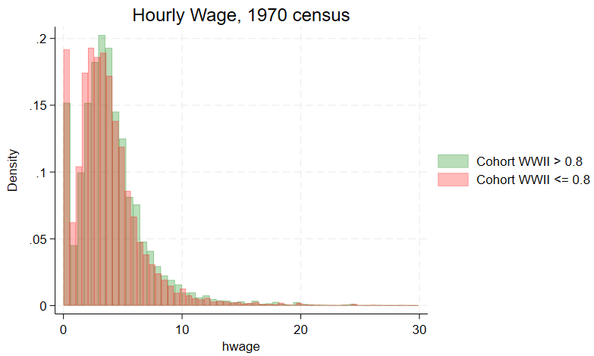
Wages by cohort WWII service

Slide 38
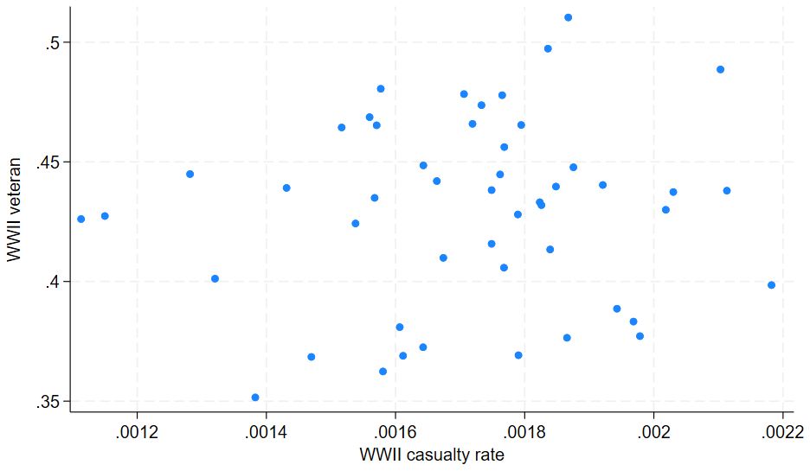
Vets in census vs. casualty data

Slide 39
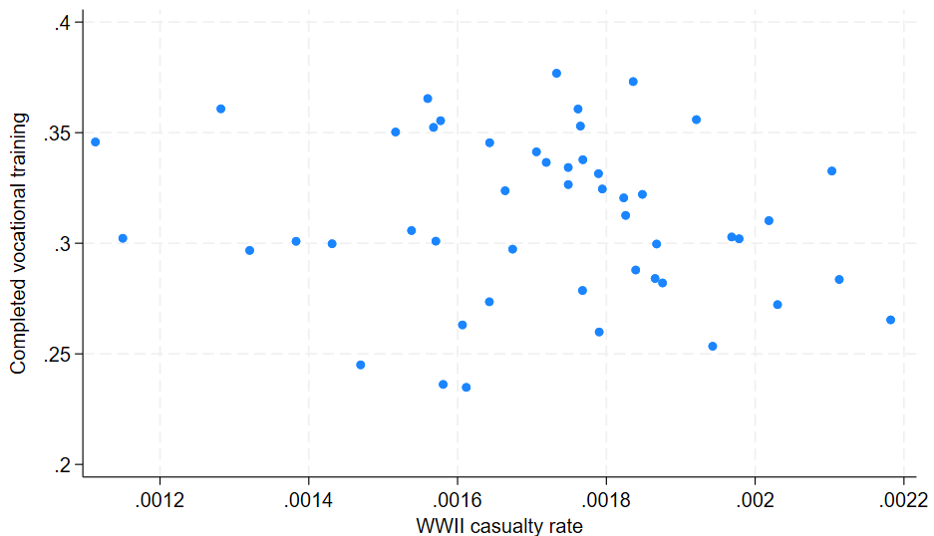
Vocation training vs. casualties by state

