Slide 1
Advancement to Candidacy Proposal: Three Essays on Vocational Education in the U.S.
Patrick Molligo
UCLA
September 25, 2023

Slide 2
Research agenda – the big picture
How and why do workers in the United States acquire skills?
Which aspects of the U.S. education and labor markets set it apart from otherwise similar countries?
Role of training/schooling (high school + postsecondary) on
Human capital investment
Employment
Occupational choice

Slide 3
Current facts on U.S. upper education
College wage premium
Increasing over time
Non-linear in education attainment
2011-2021, approx. 2/3 of high school graduates in enrolled college
2/3 in 4-year schools
1/3 in 2-year school
Drop-outs after 8 years
38% in 2-years schools
25% in 4-year schools
Source: “Digest of Education Statistics”, Table 326.27. U.S. Department of Education, National Center for Education Statistics, Integrated Postsecondary Education Data System (IPEDS)

Slide 4
Earnings by educational attainment
Source: U.S. Census Bureau (1975-2020) March Current Population Survey 2003 to 2022 Annual Social and Economic Supplement to the Current Population Survey noninstitutionalized population, excluding members of the Armed Forces living in barracks.

Slide 5
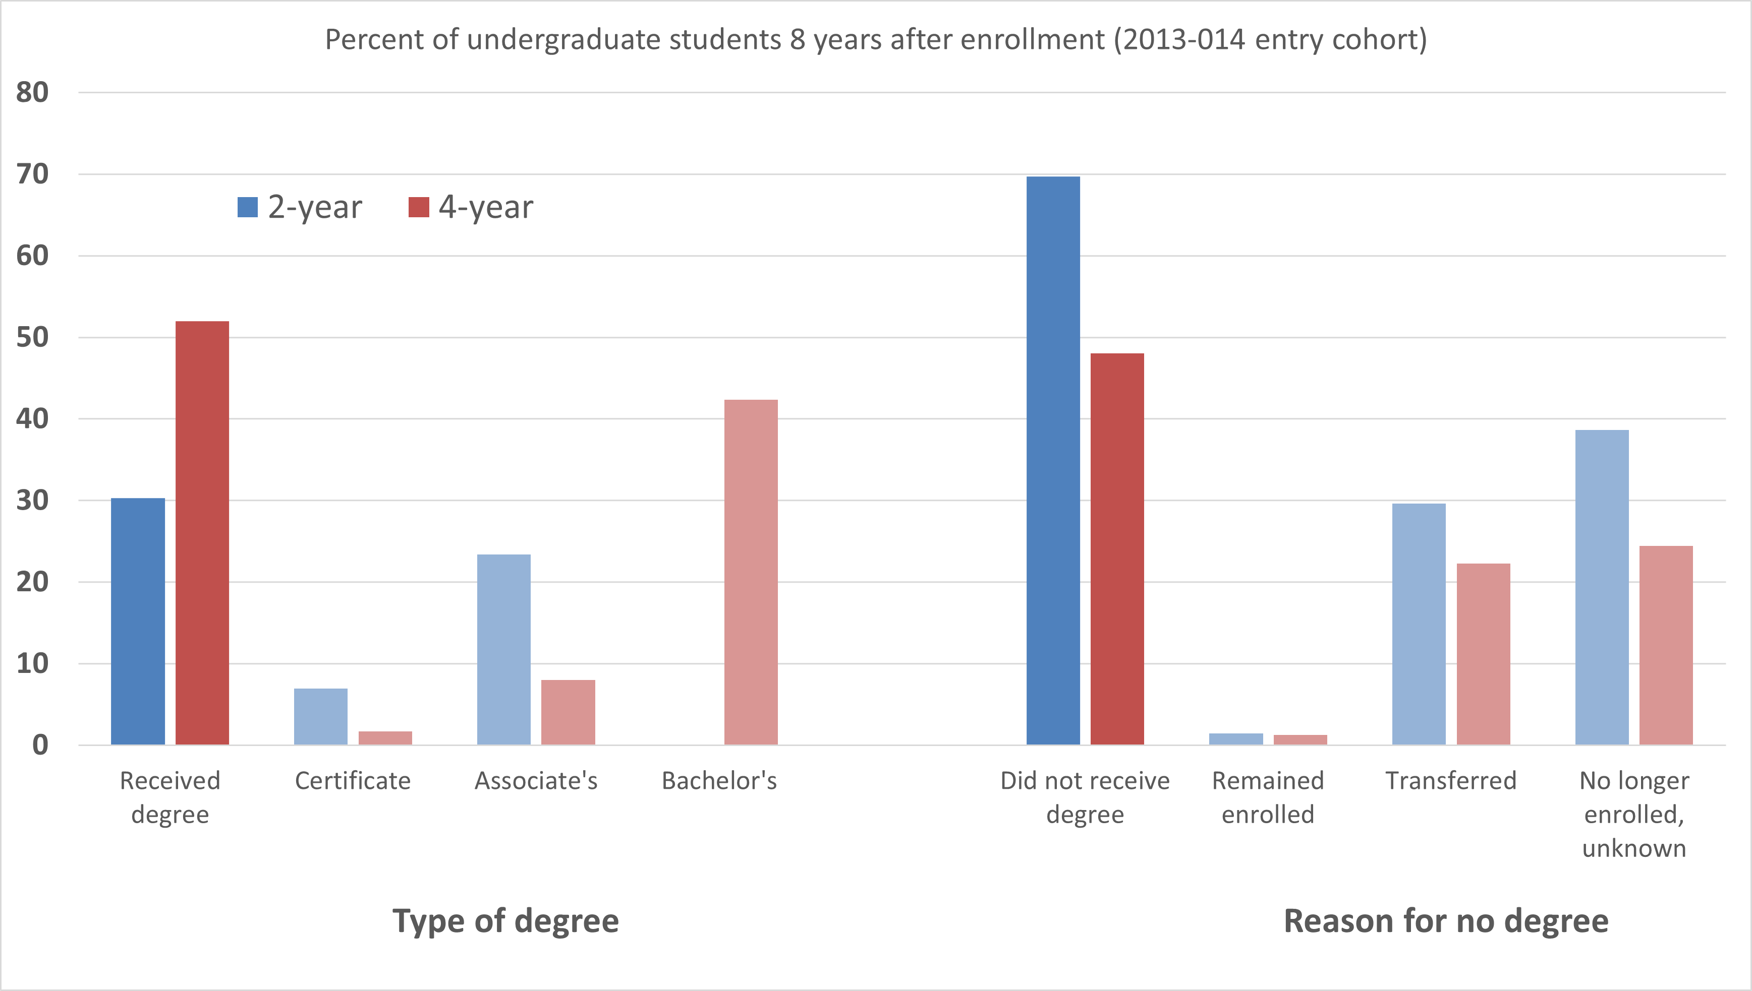
Degree completion is mixed
Source: “Digest of Education Statistics”, Table 326.27. U.S. Department of Education, National Center for Education Statistics, Integrated Postsecondary Education Data System (IPEDS)

Slide 6
Terminology
Vocational education:
“Organized educational programs offering a sequence of courses which are directly related to the preparation of individuals in paid or unpaid employment in current or emerging occupations requiring other than a baccalaureate or advanced degree.” (1990 Perkins Act)
Career and technical education:
Organized educational activities that offer a sequence of courses that provides individuals with coherent and rigorous content aligned with challenging academic standards and relevant technical knowledge and skills needed to prepare for further education and careers in current or emerging professions; provides technical skill proficiency, an industry-recognized credential, a certificate, or an associate degree. (2006 Perkins Act)
Vocational education:
“Organized educational programs offering a sequence of courses which are directly related to the preparation of individuals in paid or unpaid employment in current or emerging occupations requiring other than a baccalaureate or advanced degree.” (1990 Perkins Act)
Career and technical education:
Organized educational activities that offer a sequence of courses that provides individuals with coherent and rigorous content aligned with challenging academic standards and relevant technical knowledge and skills needed to prepare for further education and careers in current or emerging professions; provides technical skill proficiency, an industry-recognized credential, a certificate, or an associate degree. (2006 Perkins Act)

Slide 7
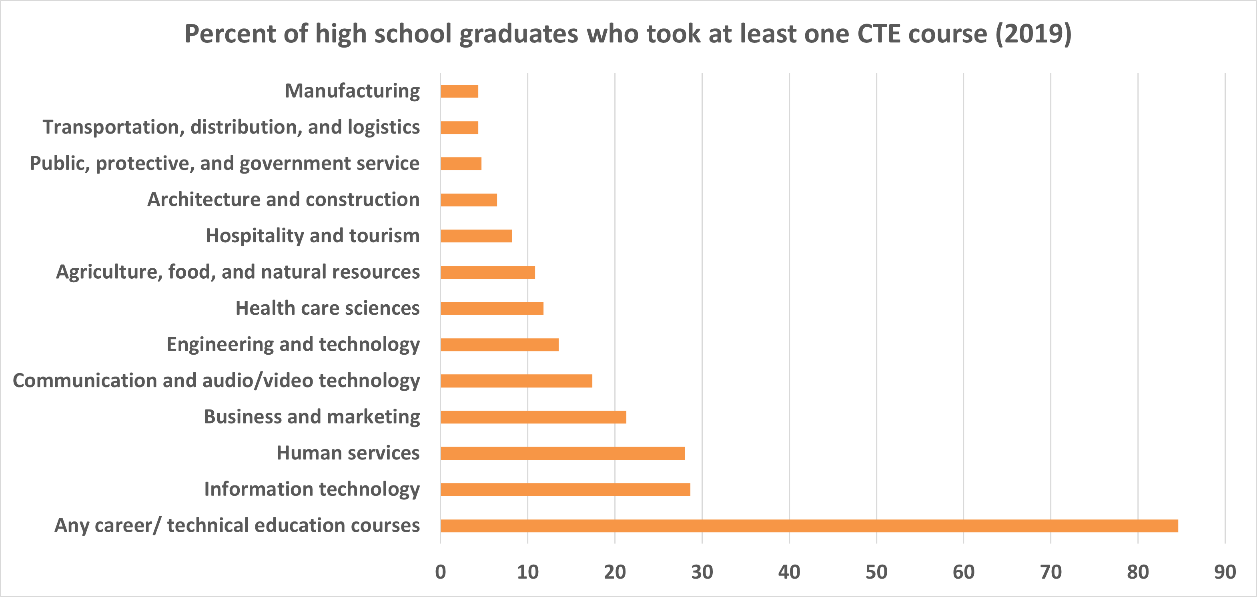
Vocational training is varied
Source: “Digest of Education Statistics”, Table 225.25. U.S. Department of Education, National Center for Education Statistics, National Assessment of Educational Progress (NAEP)

Slide 8
Dissertation chapters
How does access to vocational training influence the decisions of high school leavers?
Historical perspective
Variation: policy expansions, cross-state differences
Government policy on vocational education and the private interests that shaped it
Descriptive
Political economy
Text analysis
Health outcomes and human capital investment
Physical + mental health
IGE of labor supply

Slide 9
Related literature
Effects of public school funding
Goldin (2001), Goldin & Katz (2003)
Bound and Turner (2002)
Investment in human capital/training
Becker (1962), Spence (1973), Stiglitz (1975)
Autor et al. (2003), Autor and Dorn (2013), Acemoglu and Autor (2011)
Acemoglu & Pischke (1998), Bedard (2001), Clark & Martorell (2014)
Returns to vocational education
Hanushek et al. (2017), Malamud & Pop-Eleches (2010), Oosterbeek & Webbink (2007), Silliman & Virtanen (2022)
Country-specific: Zilic (2018), Attanasio et al. (2011), Bertrand et al. (2021), Brunello & Rocco (2017), Dionisius et al. (2009), Hartog et al. (2022)
Challenges (Muehlemann & Wolter (2020)):
Appropriate counterfactual
Selection
Outcomes depend on policy objective
External validity
References
Notes:
Goldin: virtue of early public education was localized funding, property taxes, can’t leave
First, natural experiments based on educational system reforms reveal that replacing vocational education by general training does not cause an improvement in labor market outcomes. Observable differences in labor market outcomes between students of vocational programmes and general education are, therefore, attributable to selection effects.
Second, several studies show a trade-off between early gains and later disadvantages for students of vocational programmes relative to students of general education over the life cycle. However, whether the trade-off leads to a net disadvantage for students of vocational education depends on the country and the programmes and is also a question of interpretation, as the disadvantages later in life may be driven by factors other than the form of education chosen initially.
Third, most empirical analyses show considerable heterogeneity of outcomes between women and men and between different occupations and different levels of skill requirements of vocational programmes or apprenticeships.
Last extremely time- and country specific; therefore, the external validity of findings in one context to another country or time is rather limited

Slide 10
Ch. 1: access to vocational training and occupational choice
Does the availability of multiple training pathways meaningfully impact human capital investment decisions?
What role has the U.S. government played (through its policies on vocational education) in reshaping the distribution of skills in the labor force?
Why these questions matter:
- Implications for national education and labor policy
- Role of the public education system in matching labor supply + demand

Slide 11
Smith-Hughes Act provisions
An Act to provide for the promotion of vocational education; to provide for cooperation with the States in the promotion of such education in agriculture and the trades and industries; to provide for cooperation with the States in the preparation of teachers of vocational subjects; and to appropriate money and regulate its expenditure – February 23, 1917, Ch. 114, §1, 39 Stat. 929
$7 million annually to the States
Salaries of teachers, supervisors, or directors
$3 million → agricultural subjects
$3 million → trade, home economics, & industrial subjects
Preparing teachers, supervisors, and directors
$1 million
Fund allocation rules
Agricultural → ratio of rural pop. to total U.S. rural
Trade/Home Econ/Industrial → ratio of urban pop. to total U.S. urban
Teacher training → ratio of population to total U.S.
Notes:
U.S. enters WWI 4 months after Smith-Hughes passed
Cap home economics at (20% of Section 3 funds
All 48 states submitted plans by end of (19(17
“In this whole country there are fewer trade schools than are to be found in the little German kingdom of Bavaria, with a population not much greater than that of New York City.” - From the Report of the Commission on National Aid to Vocational Education, June (1 (19(14
- Coalition of lobbies

Slide 12
Smith-Hughes Act provisions (cont.)
Established Federal Board of Vocational Education (1917-1946)
Unprecedented oversight of secondary education
State boards of vocational education
Prepare plans for fund use
Annual report to Congress work done + receipts/expenditures
Match Federal dollar amount
School requirements:
Under public supervision
Make students “fit for useful employment”
Less than college grade
Students over 14 years
Notes:
U.S. enters WWI 4 months after Smith-Hughes passed
Cap home economics at 20% of Section 3 funds
“Only national board of education responsible for any part of primary or secondary education in the United States”
Prepare plans, showing the kinds of vocational education for which funds shall be used; the kinds of schools and equipment; courses of study; methods of instruction; qualifications of teachers; plans for the training of teachers

Slide 13
Use of funds by the States
Source: Digest of annual reports of state boards for vocational education to the Office of Education, Division of Vocational and Technical Education (1962).

Slide 14
Early expansions of vocational subjects
1917 Smith-Hughes Act
Promotion of vocational education in agriculture, trade/industrial education, and home economics
Explicitly below college level
1936 George-Deen Act
Increased to $14 million
Expanded to “distributive occupations” → e.g., retail sales, store managers, purchasing agents
1956 Health Amendments Act
Expanded to “practical nurse training”
More legislation
Notes:
1862 Morrill Land Grant Act -Federally land gifts to States to open colleges for agriculture and mechanical arts;1890: expanded access for Black students
Distributive: These jobs included any positions involving the sale of a product or of a service. Some examples of these occupations are store managers, purchasing agents, and salespeople, among others
The Health Amendments Act of 1956 , Title III of which amended the Vocational Education Act of 1946 by adding Title II to extend and improve training in practical nurse and other health occupations , and authorized a sum not to exceed $ 5,000,000 annually until June 30 , 1961. This Act provided earmarked funds for training in practical nursing and other health occupations to extend the program that had been started with trade and industrial funds . (P.L. 911 , 84th Cong . , 2d Sess . ) 70 Stat . 923 , 20 U.S.C. aa -jj . Authorization extended to June 30 , 1965 ( P.L. 87-22 , 87th Cong . )

Slide 15
Timeline of legislation 1862-2018
Notes:
1929 George-Reed & 1934 George-Ellzey Acts -Increase of $1 million annually until 1934; then $3 million for three years
1946 George-Barden Act- Increased to $29 million

Slide 16
First four decades of enrollment
Source: Digest of annual reports of state boards for vocational education to the Office of Education, Division of Vocational and Technical Education (1962).

Slide 17
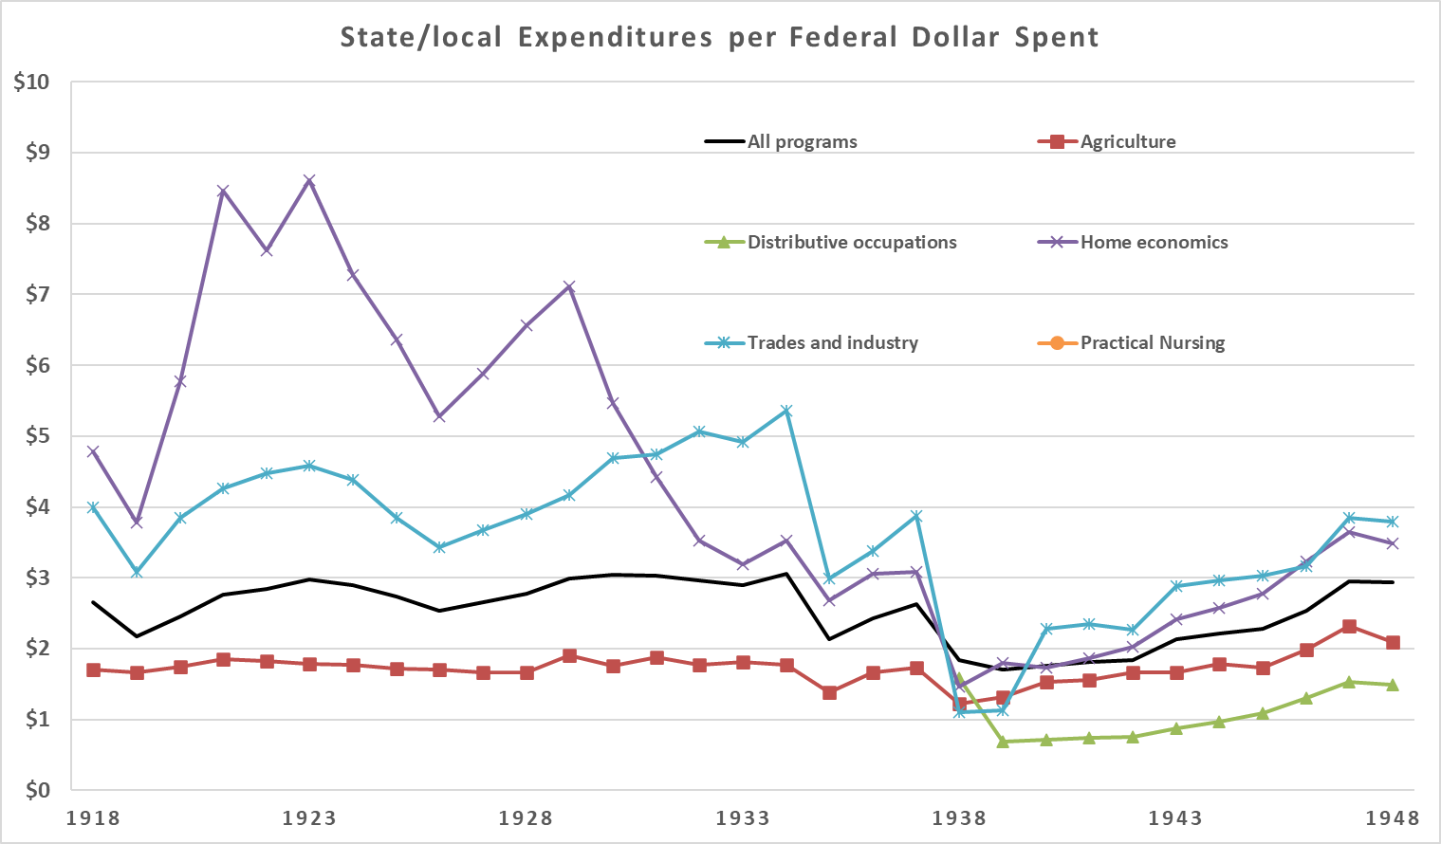
Expenditures per dollar of Federal
Source: Digest of annual reports of state boards for vocational education to the Office of Education, Division of Vocational Education (1950).

Slide 18
Public data sources
U.S. Census
1940, 1950, 1960, 1970
Key variables: Occupation codes, education, vocational training (1970 only)
Compare birth cohorts
National Sample Survey of Registered Nurses (NSSRN)
1977 (and every 4 years through 2018)
Key variables: level of nursing education
Notes:
Census:
SCHLVOC indicates whether the respondent had ever completed a vocational training program and, if so, the main field of training. Examples of vocational training programs are: special high school programs; apprenticeships; business, nursing, and trade schools; technical institutes; and armed forces schools.
No vocational trainingX2Business, office workX3Nursing, health fieldsX4Trades and craftsX5Engineering, drafting, science technicianX6Agriculture, home economicsX7Other vocational fieldX8Field not reported

Slide 19
Identifying vocational students
Use structure of Smith-Hughes Act
14-18 years old
Less than bachelor’s degree
“Exposed” cohorts
1938 → first students talking “distributive occupation” courses
1957 → first students talking “practical nursing” courses
Do workers in these cohorts have relatively more of these jobs?
Source: Digest of annual reports of state boards for vocational education to the Office of Education, Division of Vocational Education (1962).

Slide 20
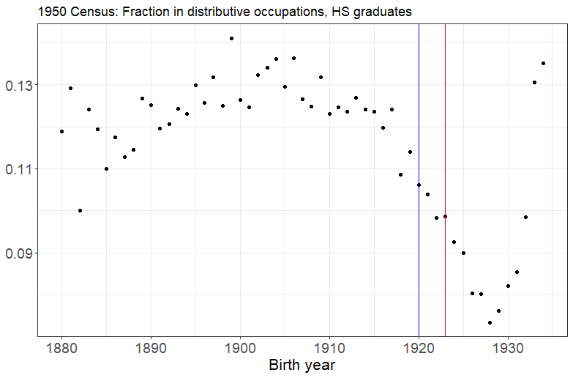
Decline followed by rise
Blue line: born 1920
Red line: born 1924
Notes:
Census:
SCHLVOC indicates whether the respondent had ever completed a vocational training program and, if so, the main field of training. Examples of vocational training programs are: special high school programs; apprenticeships; business, nursing, and trade schools; technical institutes; and armed forces schools.
No vocational trainingX2Business, office workX3Nursing, health fieldsX4Trades and craftsX5Engineering, drafting, science technicianX6Agriculture, home economicsX7Other vocational fieldX8Field not reported

Slide 21
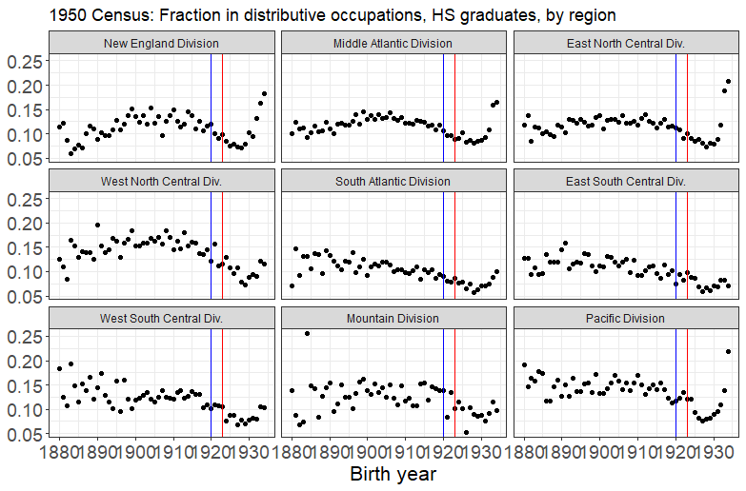
Consistent pattern across regions
Blue line: born 1920
Red line: born 1924

Slide 22
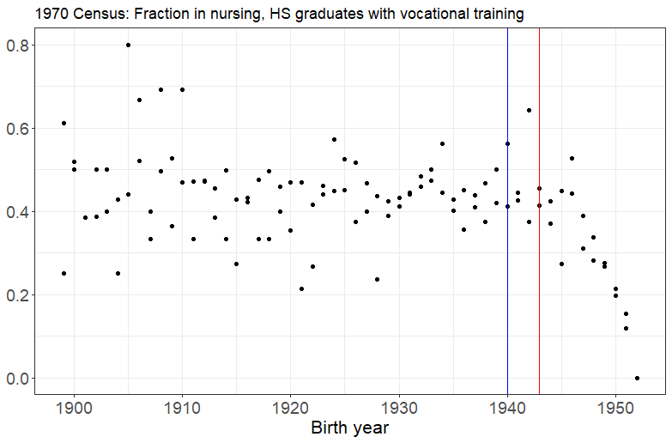
No rise among nurses
Blue line: born 1940
Red line: born 1943

Slide 23
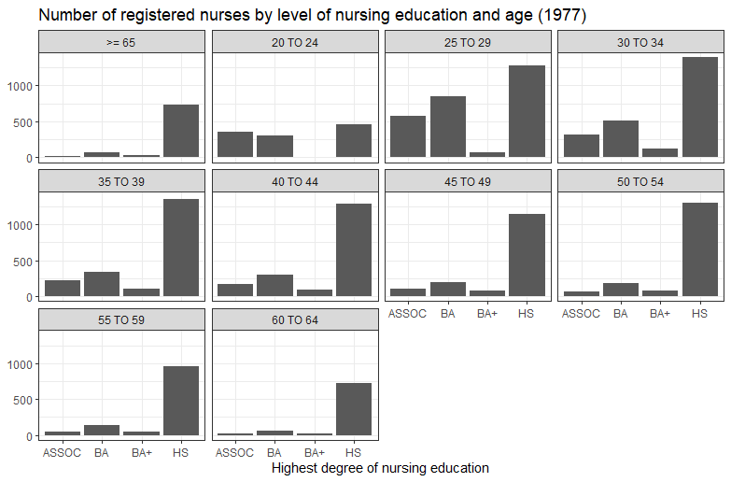
Nurse education requirements increased

Slide 24
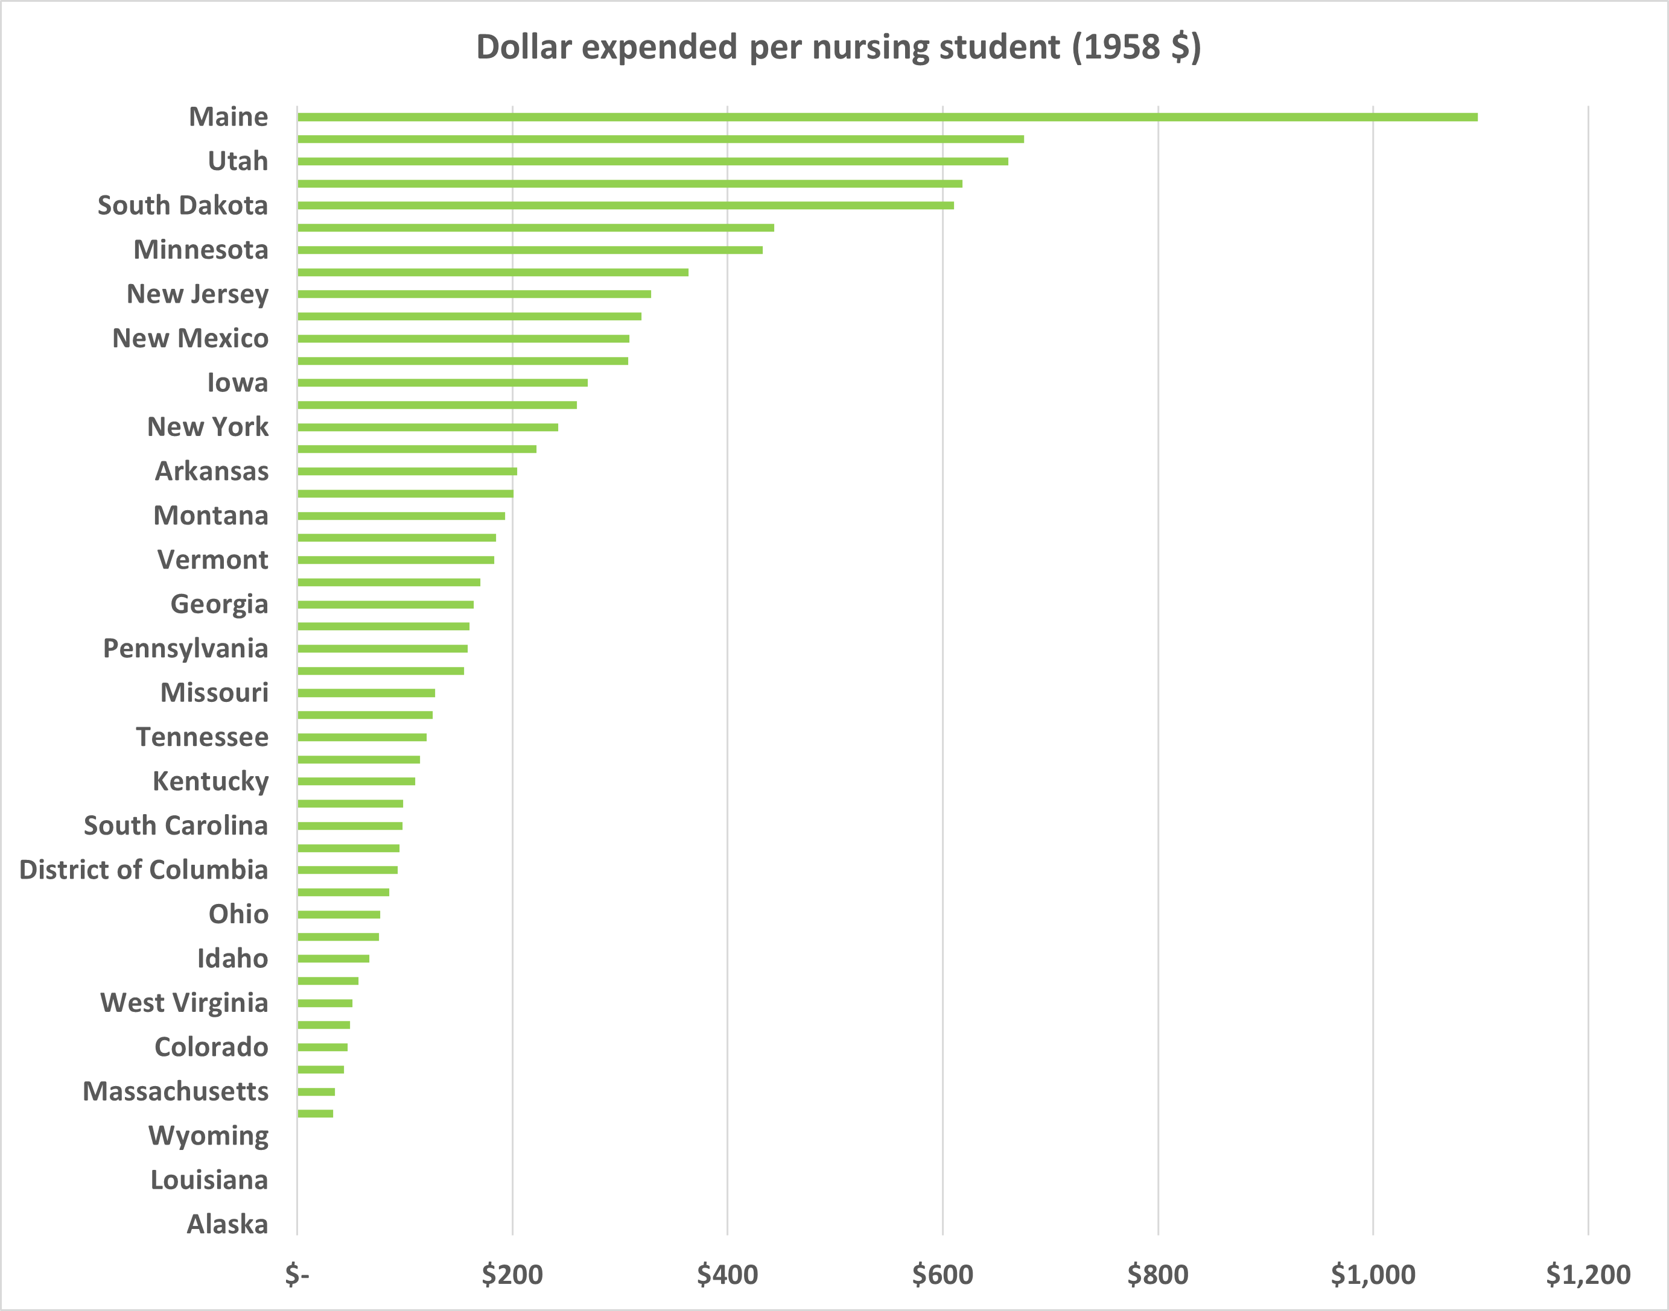
State variation in nurse training

Slide 25
Ch. 2: Political economy of U.S. vocational education policy
To what extent did Congressional policies (and the special interest groups behind them) shape
the landscape of vocational education in the United States?
Different epochs of U.S. education
Early 20th cen. → 1940s-50s → 1960s-70s → 1980s-00s
Evaluate policies in context
Must address war production
Modern legislation has deep roots

Slide 26
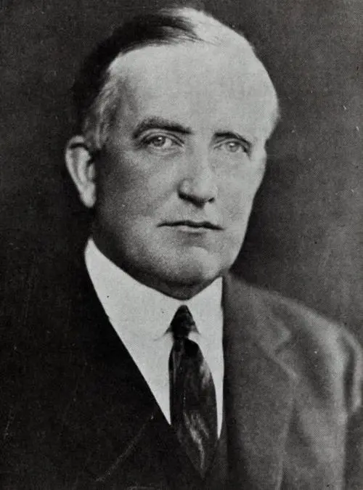
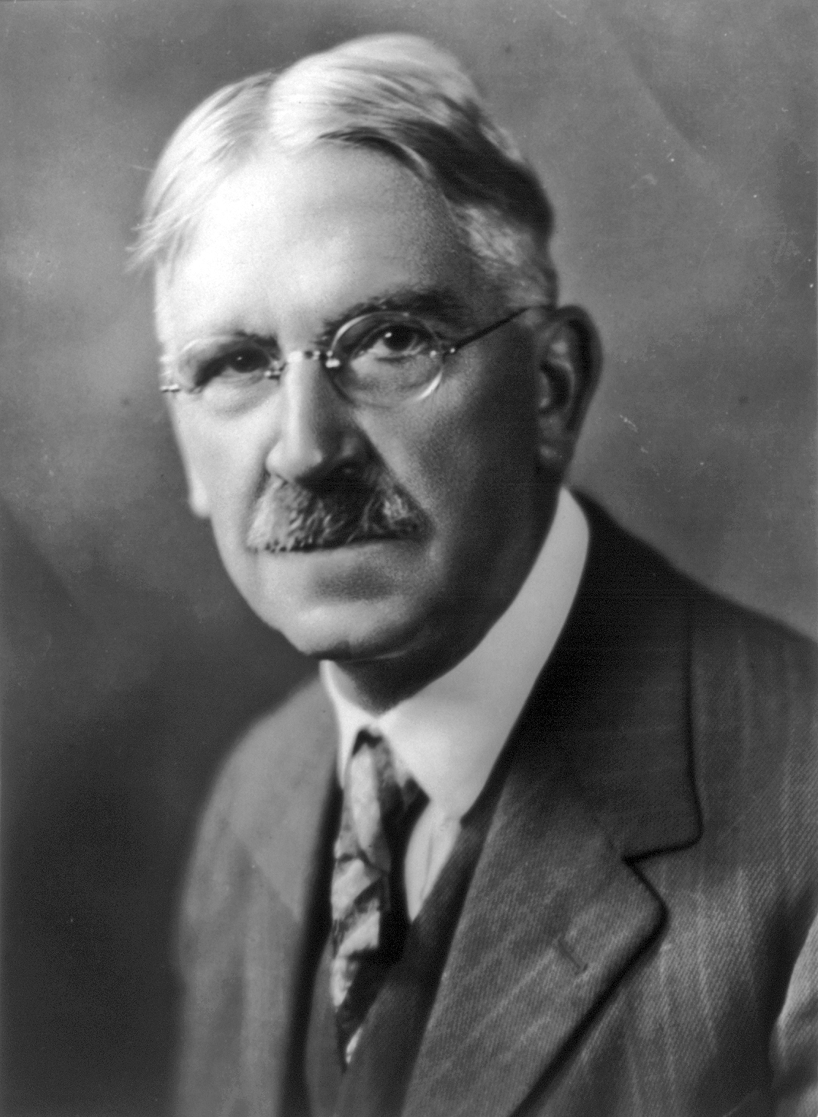
Views on vocational education
Charles Prosser (1871-1952)
“Father of Vocational Education” in U.S.
Designed Smith-Hughes Act
Supported segregated vocational track
John Dewey (1859-1952)
Co-founder, American Federation of Teachers
Democracy in education
Opposed dual track
Teach a vocation
Teach through a vocation
Notes:
John Dewey: educational reformer,
Note: Dewey decimal was Melvil Dewey in (1876
Prosser promoted the “social efficiency” or “instrumentalist” philosophy that valued a view of appropriate “fit” between certain types of students and certain types of education. The adoption of psychometric or psychological testing at the time gave rise to the idea the certain students were best suited for certain kinds of education. The academically inclined students were best suited for the classic academic curriculum while those who were not, were best suited for the vocational curriculum. Thus, vocational education was best separated from academic education, and its objective was to teach students a vocation. John Dewey promoted the philosophical stance known as Democratic Humanism that opposed dual education tracks. He argued that vocational education was needed for all students rather than for certain students, and its objective was to teach subjects through vocations rather than teach a vocation https://files.eric.ed.gov/fulltext/EJ90(13(1(1.pdf),
when was H.S. compulsory?

Slide 27
Ch. 3: health outcomes and human capital
The third chapter will study human capital as it relates to both physical and mental health.
Motivating questions
Do graduates consider the health effects of their career choices when choosing an occupation?
Do observed health outcomes of parents predict human capital decisions of their children?

Slide 28
Existing work - health outcomes + labor
Impact of childhood health on economic outcomes
Currie (1999, 2009), Case and Paxson (2008), Smith (2009), Chay, Guryan and Mazumder (2009, 2014), Currie, Hanushek, Kahn, Neidell, and Rivkin (2009)
Mental health: Currie and Stabile (2006, 2009), Cuellar and Dave (2015), Ettner (2000)
Health and productivity
Graff Zivin and Neidell (2012, 2013)
What’s missing → Does health shape occupational choice?

Slide 29
Appendix

Slide 30
Renewed interest in trade school
Notes:
Numbers represent search interest relative to the highest point on the chart for the given region and time. A value of (100 is the peak popularity for the term. A value of 50 means that the term is half as popular. A score of 0 means there was not enough data for this term.

Slide 31
Only 20% of workers need a B.A.
Source: Bureau of Labor Statistics, U.S. Department of Labor, https://www.bls.gov/opub/ted/2023/half-of-civilian-workers-required-over-1-year-of-preparation-time-to-perform-their-jobs-in-2022.htm
Notes:
The ORS provides information on the formal minimum education required to perform jobs, not the educational attainment of workers. For example: if a job requires a bachelor’s degree, but workers performing the job hold higher degrees such as a Ph.D., the estimates reflect the job requirement of a bachelor’s degree.
Bureau of Labor Statistics, U.S. Department of Labor, The Economics Daily, Half of civilian workers required over (1 year of preparation time to perform their jobs in (20(2(2 at https://www.bls.gov/opub/ted/(20(23/half-of-civilian-workers-required-over-(1-year-of-preparation-time-to-perform-their-jobs-in-(20(2(2.htm visited April 09 (20(23),.
ORS sample size?
Minimum formal education estimates only include the degree requirement and not incidental degrees. So, when a job requires a master’s degree, it is only reflected in the master’s degree requirement and not in the lower degree requirements. In (20(2(2, 30.(2 percent of civilian workers had no minimum education requirement, and a high school diploma was required for 40.0 percent.
“Of the (2.7 million people ages (16 to (24 who graduated from high school between January and October (20(2(1 (1.7 million, or 6(1.8 percent, were enrolled in colleges or universities in October (20(2(1. The college enrollment rate of recent high school graduates in October (20(2(1 was little different from the rate of 6(2.7 percent in October (20(20.”
“Among (20(2(1 high school graduates ages (16 to (24, the college enrollment rate for young women, at 69.5 percent in October (20(2(1, continued to be higher than the rate for young men 54.9 percent),. The college enrollment rate of Asians 85.9 percent), also continued to be higher than the rates for recent Black 6(1.(2 percent),, White 6(1.0 percent),, and Hispanic 58.6 percent), graduates.”

Slide 32
But 50% need at least some training
Educational attainment (ORS)
Educational attainment (CPS)
Source: Bureau of Labor Statistics, U.S. Department of Labor, https://www.bls.gov/opub/ted/2023/half-of-civilian-workers-required-over-1-year-of-preparation-time-to-perform-their-jobs-in-2022.htm
Notes:
Specific vocational preparation captures the minimum amount of time needed to develop skills for the job. Preparation time is divided into nine levels, ranging from as little as 4 hours to more than (10 years. Levels 6 through 9 indicate that over (1 year of preparation was needed

Slide 33
U.S. educational attainment, 2022
Back
Source: Bureau of Labor Statistics, U.S. Department of Labor, Occupational Requirements Survey (2022), https://www.bls.gov/ors/factsheet/minimum-formal-education.htm

Slide 34
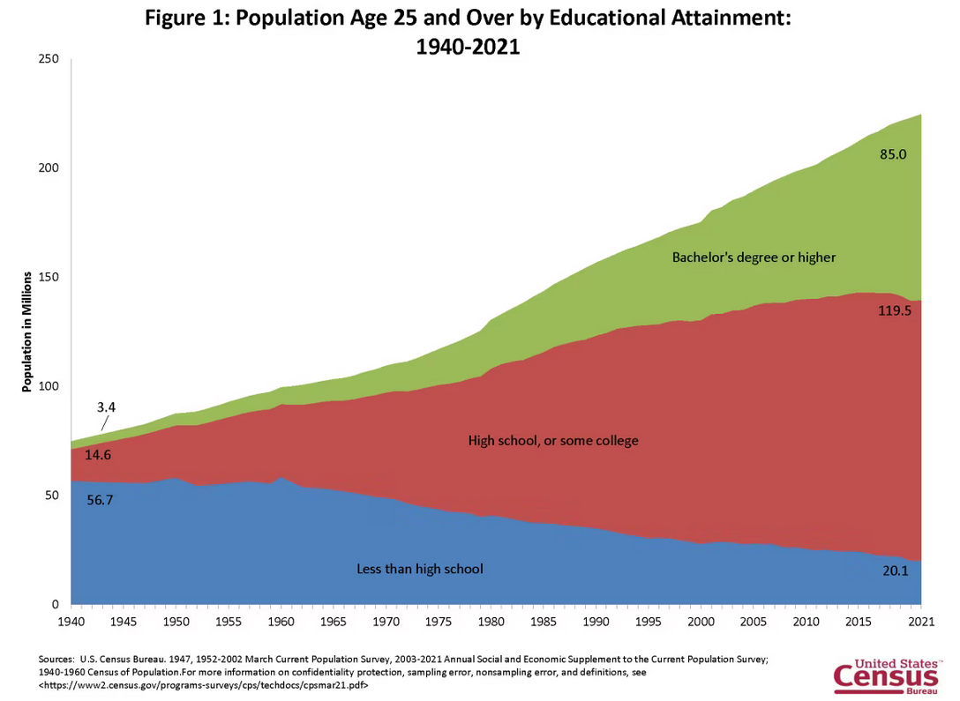
U.S. educational attainment, 1940-2021
Back

Slide 35
Timeline of legislation 1958-1984
1958 National Defense Education Act
1962 Manpower Development and Training Act
1963 Vocational Education Act
1968 Vocational Education Amendments
1976 Vocational Education Amendments
1984 Carl D. Perkins Vocational Education Act (Perkins I)
Back

Slide 36
Timeline of legislation 1990-today
1990 Carl D. Perkins Vocational and Applied Technology Act (Perkins II)
1998 Carl D. Perkins Vocational and Technical Education Act (Perkins III)
2006 Carl D. Perkins Career and Technical Education Act (Perkins IV)
2018 Strengthening Career and Technical Education for the 21st Century Act (Perkins V)
Back

Slide 37
High take up and use of funds
Source: Digest of annual reports of state boards for vocational education to the Office of Education, Division of Vocational and Technical Education (1962).

Slide 38
References
Acemoglu, D. (1999). Changes in Unemployment and Wage Inequality: An Alternative Theory and Some Evidence. American Economic Review, 89(5), 1259–1278. https://doi.org/10.1257/aer.89.5.1259
Attanasio, O., Kugler, A., & Meghir, C. (2011). Subsidizing Vocational Training for Disadvantaged Youth in Colombia: Evidence from a Randomized Trial. American Economic Journal: Applied Economics, 3(3), 188–220. https://doi.org/10.1257/app.3.3.188
Becker, G. S. (1962). Investment in Human Capital: A Theoretical Analysis. Journal of Political Economy, 70(5), 9–49.
Bedard, K. (2001). Human Capital versus Signaling Models: University Access and High School Dropouts. Journal of Political Economy, 109(4), 749–775. https://doi.org/10.1086/322089
Bertrand, M., Mogstad, M., & Mountjoy, J. (2021). Improving Educational Pathways to Social Mobility: Evidence from Norway’s Reform 94. Journal of Labor Economics, 39(4), 965–1010. https://doi.org/10.1086/713009
Brunello, G., & Rocco, L. (2017). The Labor Market Effects of Academic and Vocational Education over the Life Cycle: Evidence Based on a British Cohort. Journal of Human Capital, 11(1), 106–166. https://doi.org/10.1086/690234
Carleton, D. (2002). Landmark Congressional Laws on Education. Greenwood Publishing Group.
Clark, D., & Martorell, P. (2014). The Signaling Value of a High School Diploma. Journal of Political Economy, 122(2), 282–318. https://doi.org/10.1086/675238
Currie, Janet. 2009. “Healthy, Wealthy, and Wise: Socioeconomic Status, Poor Health in Childhood, and Human Capital Development.” Journal of Economic Literature, 47(1): 87–122.
Currie, Janet, and Brigitte C. Madrian. 1999. “Health, Health Insurance and the Labor Market.” In Handbook of Labor Economics. Vol. 3 ,ed. Orley Ashenfelter and David Card, Chapter 50, 3309–3416. Elsevier.
Dionisius, R., Muehlemann, S., Pfeifer, H., Walden, G., Wenzelmann, F., & Wolter, S. C. (2009). Costs and Benefits of Apprenticeship Training. A Comparison of Germany and Switzerland. Applied Economics Quarterly, 22 (1), 7–37. https://doi.org/10.3790/aeq.55.1.7
Back

Slide 39
References
Goldin, C. (2001). The Human-Capital Century and American Leadership: Virtues of the Past. The Journal of Economic History, 61(2), 263–292.
Goldin, C., & Katz, L. (2003). The “Virtues” of the Past: Education in the First Hundred Years of the New Republic (No. w9958; Working Paper Series, p. w9958). National Bureau of Economic Research. https://doi.org/10.3386/w9958
Hanushek, E. A., Schwerdt, G., Woessmann, L., & Zhang, L. (2017). General Education, Vocational Education, and Labor-Market Outcomes over the Lifecycle. Journal of Human Resources, 52(1), 48–87. https://doi.org/10.3368/jhr.52.1.0415-7074R
Hartog, J., Raposo, P., & Reis, H. (2022). Fluctuations in the Wage Gap between Vocational and General Secondary Education: Lessons from Portugal. Journal of Population Economics, 35(2), 643–675. https://doi.org/10.1007/s00148-021-00846-1
Malamud, O., & Pop-Eleches, C. (2010). General Education versus Vocational Training: Evidence from an Economy in Transition. The Review of Economics and Statistics, 92(1), 43–60. https://doi.org/10.1162/rest.2009.11339
Oosterbeek, H., & Webbink, D. (2007). Wage effects of an extra year of basic vocational education. Economics of Education Review, 26(4), 408–419. https://doi.org/10.1016/j.econedurev.2006.07.013
Silliman, M., & Virtanen, H. (2022). Labor Market Returns to Vocational Secondary Education. American Economic Journal: Applied Economics, 14(1), 197–224. https://doi.org/10.1257/app.20190782
Spence, M. (1973). Job Market Signaling. The Quarterly Journal of Economics, 87(3), 355–374. https://doi.org/10.2307/1882010
Stiglitz, J. E. (1975). The Theory of “Screening,” Education, and the Distribution of Income. The American Economic Review, 65(3), 283–300.
Zilic, I. (2018). General versus vocational education: Lessons from a quasi-experiment in Croatia. Economics of Education Review, 62, 1–11. https://doi.org/10.1016/j.econedurev.2017.10.009
Back

Slide 40
References
Goldin, C. (2001). The Human-Capital Century and American Leadership: Virtues of the Past. The Journal of Economic History, 61(2), 263–292.
Goldin, C., & Katz, L. (2003). The “Virtues” of the Past: Education in the First Hundred Years of the New Republic (No. w9958; Working Paper Series, p. w9958). National Bureau of Economic Research. https://doi.org/10.3386/w9958
Hanushek, E. A., Schwerdt, G., Woessmann, L., & Zhang, L. (2017). General Education, Vocational Education, and Labor-Market Outcomes over the Lifecycle. Journal of Human Resources, 52(1), 48–87. https://doi.org/10.3368/jhr.52.1.0415-7074R
Hartog, J., Raposo, P., & Reis, H. (2022). Fluctuations in the Wage Gap between Vocational and General Secondary Education: Lessons from Portugal. Journal of Population Economics, 35(2), 643–675. https://doi.org/10.1007/s00148-021-00846-1
Malamud, O., & Pop-Eleches, C. (2010). General Education versus Vocational Training: Evidence from an Economy in Transition. The Review of Economics and Statistics, 92(1), 43–60. https://doi.org/10.1162/rest.2009.11339
Oosterbeek, H., & Webbink, D. (2007). Wage effects of an extra year of basic vocational education. Economics of Education Review, 26(4), 408–419. https://doi.org/10.1016/j.econedurev.2006.07.013
Silliman, M., & Virtanen, H. (2022). Labor Market Returns to Vocational Secondary Education. American Economic Journal: Applied Economics, 14(1), 197–224. https://doi.org/10.1257/app.20190782
Spence, M. (1973). Job Market Signaling. The Quarterly Journal of Economics, 87(3), 355–374. https://doi.org/10.2307/1882010
Stiglitz, J. E. (1975). The Theory of “Screening,” Education, and the Distribution of Income. The American Economic Review, 65(3), 283–300.
Zilic, I. (2018). General versus vocational education: Lessons from a quasi-experiment in Croatia. Economics of Education Review, 62, 1–11. https://doi.org/10.1016/j.econedurev.2017.10.009
Back

