Slide 1
Federal policy and vocational school: An analysis of the 1917 Smith-Hughes Vocational Education Act
Patrick Molligo
Proseminar in Economic history | UCLA
October 31, 2023

Slide 2

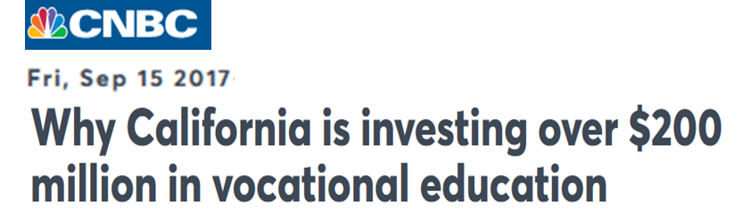
A shift in public conversation
Notes:
Renewed interest in vocational education today
Declining value of degree for certain occupations?

Slide 3
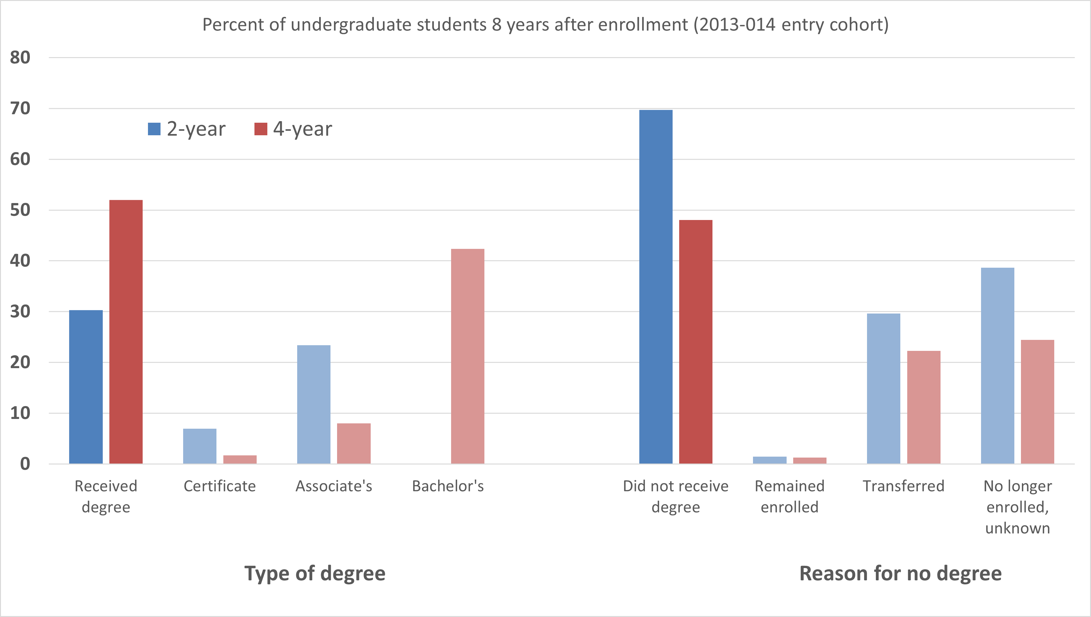
Degree completion is mixed
Source: “Digest of Education Statistics”, Table 326.27. U.S. Department of Education, National Center for Education Statistics, Integrated Postsecondary Education Data System (IPEDS)

Slide 4
Only 20% of workers need a B.A.
Earnings
Source: Bureau of Labor Statistics, U.S. Department of Labor, https://www.bls.gov/opub/ted/2023/half-of-civilian-workers-required-over-1-year-of-preparation-time-to-perform-their-jobs-in-2022.htm
Notes:
The ORS provides information on the formal minimum education required to perform jobs, not the educational attainment of workers. For example: if a job requires a bachelor’s degree, but workers performing the job hold higher degrees such as a Ph.D., the estimates reflect the job requirement of a bachelor’s degree.
Bureau of Labor Statistics, U.S. Department of Labor, The Economics Daily, Half of civilian workers required over (1 year of preparation time to perform their jobs in (20(2(2 at https://www.bls.gov/opub/ted/(20(23/half-of-civilian-workers-required-over-(1-year-of-preparation-time-to-perform-their-jobs-in-(20(2(2.htm visited April 09 (20(23),.
ORS sample size?
Minimum formal education estimates only include the degree requirement and not incidental degrees. So, when a job requires a master’s degree, it is only reflected in the master’s degree requirement and not in the lower degree requirements. In (20(2(2, 30.(2 percent of civilian workers had no minimum education requirement, and a high school diploma was required for 40.0 percent.
“Of the (2.7 million people ages (16 to (24 who graduated from high school between January and October (20(2(1 (1.7 million, or 6(1.8 percent, were enrolled in colleges or universities in October (20(2(1. The college enrollment rate of recent high school graduates in October (20(2(1 was little different from the rate of 6(2.7 percent in October (20(20.”
“Among (20(2(1 high school graduates ages (16 to (24, the college enrollment rate for young women, at 69.5 percent in October (20(2(1, continued to be higher than the rate for young men 54.9 percent),. The college enrollment rate of Asians 85.9 percent), also continued to be higher than the rates for recent Black 6(1.(2 percent),, White 6(1.0 percent),, and Hispanic 58.6 percent), graduates.”

Slide 5
This project
Who completes vocational education and what do they learn?
Can vocational training help low-skilled workers? Workers at the left tail of wag distribution?
What role has the U.S. government played?
Why these questions matter:
- Implications for national education and labor policy
- Role of the public education system in matching labor supply + demand

Slide 6
Related literature
Effects of public school funding
Goldin (2001), Goldin & Katz (2003)
Bound and Turner (2002)
Investment in human capital/training
Becker (1962), Spence (1973), Stiglitz (1975)
Autor et al. (2003), Autor and Dorn (2013), Acemoglu and Autor (2011)
Acemoglu & Pischke (1998), Bedard (2001), Clark & Martorell (2014)
Returns to vocational education
Hanushek et al. (2017), Malamud & Pop-Eleches (2010), Oosterbeek & Webbink (2007), Silliman & Virtanen (2022)
Country-specific: Zilic (2018), Attanasio et al. (2011), Bertrand et al. (2021), Brunello & Rocco (2017), Dionisius et al. (2009), Hartog et al. (2022)
Challenges (Muehlemann & Wolter (2020)):
Appropriate counterfactual
Selection
Outcomes depend on policy objective
External validity
References
Notes:
Goldin: virtue of early public education was localized funding, property taxes, can’t leave
First, natural experiments based on educational system reforms reveal that replacing vocational education by general training does not cause an improvement in labor market outcomes. Observable differences in labor market outcomes between students of vocational programmes and general education are, therefore, attributable to selection effects.
Second, several studies show a trade-off between early gains and later disadvantages for students of vocational programmes relative to students of general education over the life cycle. However, whether the trade-off leads to a net disadvantage for students of vocational education depends on the country and the programmes and is also a question of interpretation, as the disadvantages later in life may be driven by factors other than the form of education chosen initially.
Third, most empirical analyses show considerable heterogeneity of outcomes between women and men and between different occupations and different levels of skill requirements of vocational programmes or apprenticeships.
Last extremely time- and country specific; therefore, the external validity of findings in one context to another country or time is rather limited

Slide 7
Terminology
Vocational education:
“Organized educational programs offering a sequence of courses which are directly related to the preparation of individuals in paid or unpaid employment in current or emerging occupations requiring other than a baccalaureate or advanced degree.” (1990 Perkins Act)
Career and technical education:
Organized educational activities that offer a sequence of courses that provides individuals with coherent and rigorous content aligned with challenging academic standards and relevant technical knowledge and skills needed to prepare for further education and careers in current or emerging professions; provides technical skill proficiency, an industry-recognized credential, a certificate, or an associate degree. (2006 Perkins Act)
Vocational education:
“Organized educational programs offering a sequence of courses which are directly related to the preparation of individuals in paid or unpaid employment in current or emerging occupations requiring other than a baccalaureate or advanced degree.” (1990 Perkins Act)
Career and technical education:
Organized educational activities that offer a sequence of courses that provides individuals with coherent and rigorous content aligned with challenging academic standards and relevant technical knowledge and skills needed to prepare for further education and careers in current or emerging professions; provides technical skill proficiency, an industry-recognized credential, a certificate, or an associate degree. (2006 Perkins Act)

Slide 8
Timeline of legislation 1862-2018
Notes:
1929 George-Reed & 1934 George-Ellzey Acts -Increase of $1 million annually until 1934; then $3 million for three years
1946 George-Barden Act- Increased to $29 million

Slide 9
Why a historical view?
To what extent did Congressional policies (and the special interest groups behind them) shape
the landscape of vocational education in the United States?
Different epochs of U.S. education
Early 20th cen. → 1940s-50s → 1960s-70s → 1980s-00s
Evaluate policies in context
Interaction with wartime production/mobilization
Modern legislation has deep roots
Ability to study intergenerational mobility

Slide 10
Timeline of legislation 1862-1946
1862 Morrill Land Grant Act
Federally land gifts to States to open colleges for agriculture and mechanical arts
1890: expanded access for Black students
1917 Smith-Hughes Act
$7 million annual federal aid to states
Promotion of vocational education in agriculture, trade/industrial education, and home economics
Explicitly below college level
1929 George-Reed & 1934 George-Ellzey Acts
Increase of $1 million annually until 1934; then $3 million for three years
1936 George-Deen Act
Increased to $14 million
Expanded to “distributive occupations” → e.g., retail sales, store managers, purchasing agents
1946 George-Barden Act
Increased to $29 million
More legislation
Notes:
These jobs included any positions involving the sale of a product or of a service. Some examples of these occupations are store managers, purchasing agents, and salespeople, among others
The Health Amendments Act of 1956 , Title III of which amended
the Vocational Education Act of 1946 by adding Title II to extend
and improve training in practical nurse and other health occupations
, and authorized a sum not to exceed $ 5,000,000 annually
until June 30 , 1961. This Act provided earmarked funds for
training in practical nursing and other health occupations to extend
the program that had been started with trade and industrial
funds . (P.L. 911 , 84th Cong . , 2d Sess . ) 70 Stat . 923 , 20
U.S.C. aa -jj . Authorization extended to June 30 , 1965 ( P.L.
87-22 , 87th Cong . ) .

Slide 11
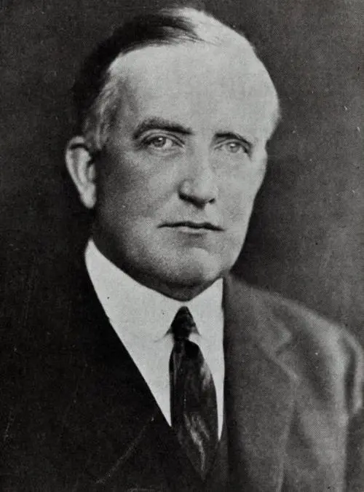
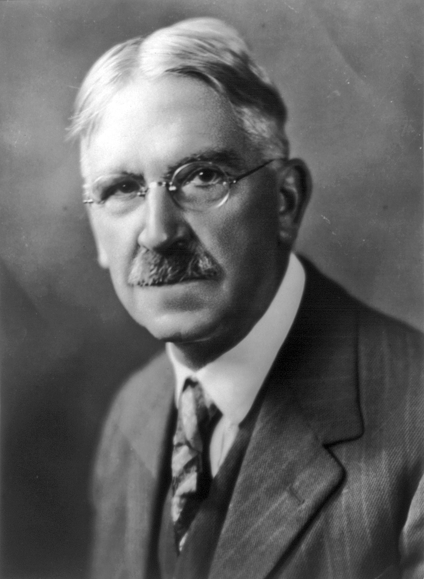
Views on vocational education
Charles Prosser (1871-1952)
“Father of Vocational Education” in U.S.
Designed Smith-Hughes Act
Supported segregated vocational track
John Dewey (1859-1952)
Co-founder, American Federation of Teachers
Democracy in education
Opposed dual track
Teach a vocation
Teach through a vocation
Notes:
John Dewey: educational reformer,
Note: Dewey decimal was Melvil Dewey in (1876
Prosser promoted the “social efficiency” or “instrumentalist” philosophy that valued a view of appropriate “fit” between certain types of students and certain types of education. The adoption of psychometric or psychological testing at the time gave rise to the idea the certain students were best suited for certain kinds of education. The academically inclined students were best suited for the classic academic curriculum while those who were not, were best suited for the vocational curriculum. Thus, vocational education was best separated from academic education, and its objective was to teach students a vocation. John Dewey promoted the philosophical stance known as Democratic Humanism that opposed dual education tracks. He argued that vocational education was needed for all students rather than for certain students, and its objective was to teach subjects through vocations rather than teach a vocation https://files.eric.ed.gov/fulltext/EJ90(13(1(1.pdf),
when was H.S. compulsory?

Slide 12
Smith-Hughes Act provisions
An Act to provide for the promotion of vocational education; to provide for cooperation with the States in the promotion of such education in agriculture and the trades and industries; to provide for cooperation with the States in the preparation of teachers of vocational subjects; and to appropriate money and regulate its expenditure – February 23, 1917, Ch. 114, §1, 39 Stat. 929
$7 million annually to the States
Salaries of teachers, supervisors, or directors
$3 million → agricultural subjects
$3 million → trade, home economics, & industrial subjects
Preparing teachers, supervisors, and directors
$1 million
Fund allocation rules
Agricultural → ratio of rural pop. to total U.S. rural
Trade/Home Econ/Industrial → ratio of urban pop. to total U.S. urban
Teacher training → ratio of population to total U.S.
Notes:
U.S. enters WWI 4 months after Smith-Hughes passed
Cap home economics at (20% of Section 3 funds
All 48 states submitted plans by end of (19(17
“In this whole country there are fewer trade schools than are to be found in the little German kingdom of Bavaria, with a population not much greater than that of New York City.” - From the Report of the Commission on National Aid to Vocational Education, June (1 (19(14
- Coalition of lobbies

Slide 13
Smith-Hughes Act provisions (cont.)
Established Federal Board of Vocational Education (1917-1946)
Unprecedented oversight of secondary education
State boards of vocational education
Prepare plans for fund use
Annual report to Congress work done + receipts/expenditures
Match Federal dollar amount
School requirements:
Under public supervision
Make students “fit for useful employment”
Less than college grade
Students over 14 years
Notes:
U.S. enters WWI 4 months after Smith-Hughes passed
Cap home economics at 20% of Section 3 funds
“Only national board of education responsible for any part of primary or secondary education in the United States”
Prepare plans, showing the kinds of vocational education for which funds shall be used; the kinds of schools and equipment; courses of study; methods of instruction; qualifications of teachers; plans for the training of teachers

Slide 14
Use of funds by the States
Source: Digest of annual reports of state boards for vocational education to the Office of Education, Division of Vocational and Technical Education (1962).

Slide 15
Early expansions of vocational subjects
1917 Smith-Hughes Act
Promotion of vocational education in agriculture, trade/industrial education, and home economics
Explicitly below college level
1936 George-Deen Act
Increased to $14 million
Expanded to “distributive occupations” → e.g., retail sales, store managers, purchasing agents
1956 Health Amendments Act
Expanded to “practical nurse training”
More legislation
Notes:
1862 Morrill Land Grant Act -Federally land gifts to States to open colleges for agriculture and mechanical arts;1890: expanded access for Black students
Distributive: These jobs included any positions involving the sale of a product or of a service. Some examples of these occupations are store managers, purchasing agents, and salespeople, among others
The Health Amendments Act of 1956 , Title III of which amended the Vocational Education Act of 1946 by adding Title II to extend and improve training in practical nurse and other health occupations , and authorized a sum not to exceed $ 5,000,000 annually until June 30 , 1961. This Act provided earmarked funds for training in practical nursing and other health occupations to extend the program that had been started with trade and industrial funds . (P.L. 911 , 84th Cong . , 2d Sess . ) 70 Stat . 923 , 20 U.S.C. aa -jj . Authorization extended to June 30 , 1965 ( P.L. 87-22 , 87th Cong . )

Slide 16
First four decades of enrollment
Source: Digest of annual reports of state boards for vocational education to the Office of Education, Division of Vocational and Technical Education (1962).

Slide 17
Relative to total H.S. enrollment
Source: Digest of annual reports of state boards for vocational education to the Office of Education, Division of Vocational and Technical Education (1962).

Slide 18
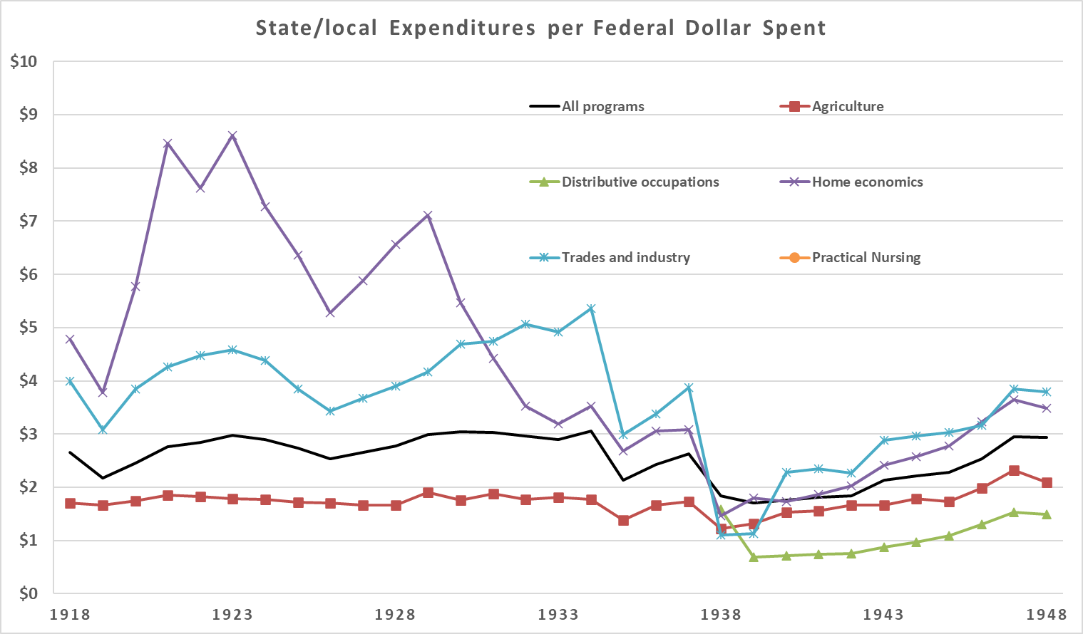
Expenditures per dollar of Federal
Source: Digest of annual reports of state boards for vocational education to the Office of Education, Division of Vocational Education (1950).

Slide 19
Public data sources
U.S. Census
1970
Key variable: vocational training (SCHLVOC)
Ever completed a vocational training program + main field of training.
Special high school programs, apprenticeships, business, nursing, and trade schools, technical institutes, and armed forces schools.
Compare birth cohorts
Notes:
Census:
SCHLVOC indicates whether the respondent had ever completed a vocational training program and, if so, the main field of training. Examples of vocational training programs are: special high school programs; apprenticeships; business, nursing, and trade schools; technical institutes; and armed forces schools.
No vocational trainingX2Business, office workX3Nursing, health fieldsX4Trades and craftsX5Engineering, drafting, science technicianX6Agriculture, home economicsX7Other vocational fieldX8Field not reported

Slide 20
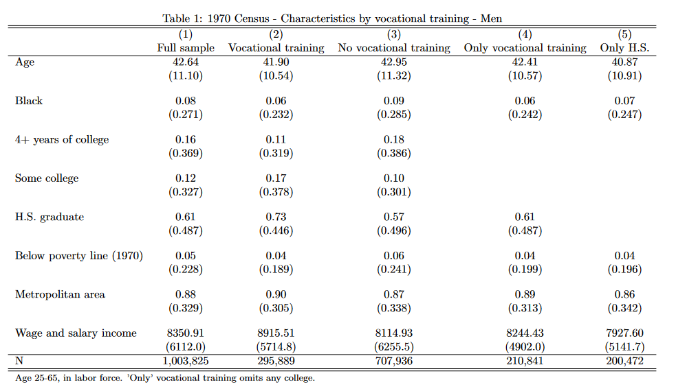

Slide 21
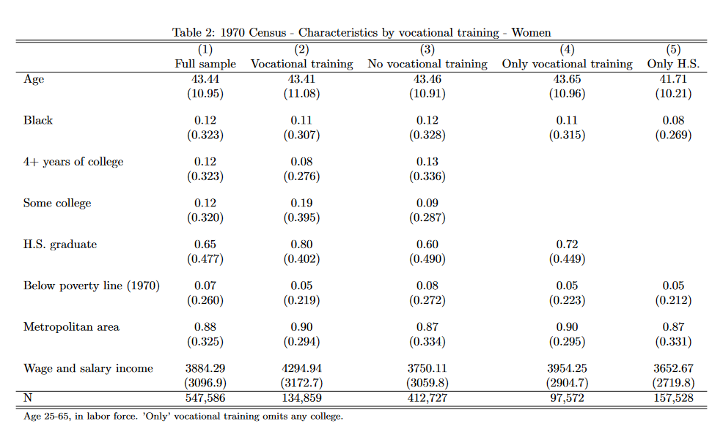

Slide 22
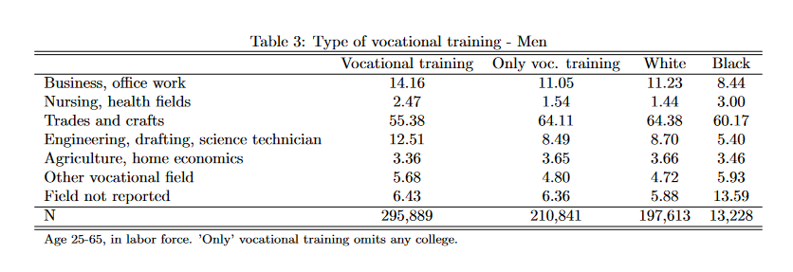
What kind of training?
Notes:
Census:
SCHLVOC indicates whether the respondent had ever completed a vocational training program and, if so, the main field of training. Examples of vocational training programs are: special high school programs; apprenticeships; business, nursing, and trade schools; technical institutes; and armed forces schools.
No vocational trainingX2Business, office workX3Nursing, health fieldsX4Trades and craftsX5Engineering, drafting, science technicianX6Agriculture, home economicsX7Other vocational fieldX8Field not reported

Slide 23
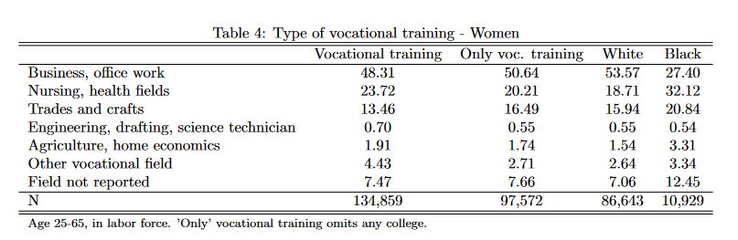
What kind of training?
Notes:
Census:
SCHLVOC indicates whether the respondent had ever completed a vocational training program and, if so, the main field of training. Examples of vocational training programs are: special high school programs; apprenticeships; business, nursing, and trade schools; technical institutes; and armed forces schools.
No vocational trainingX2Business, office workX3Nursing, health fieldsX4Trades and craftsX5Engineering, drafting, science technicianX6Agriculture, home economicsX7Other vocational fieldX8Field not reported

Slide 24
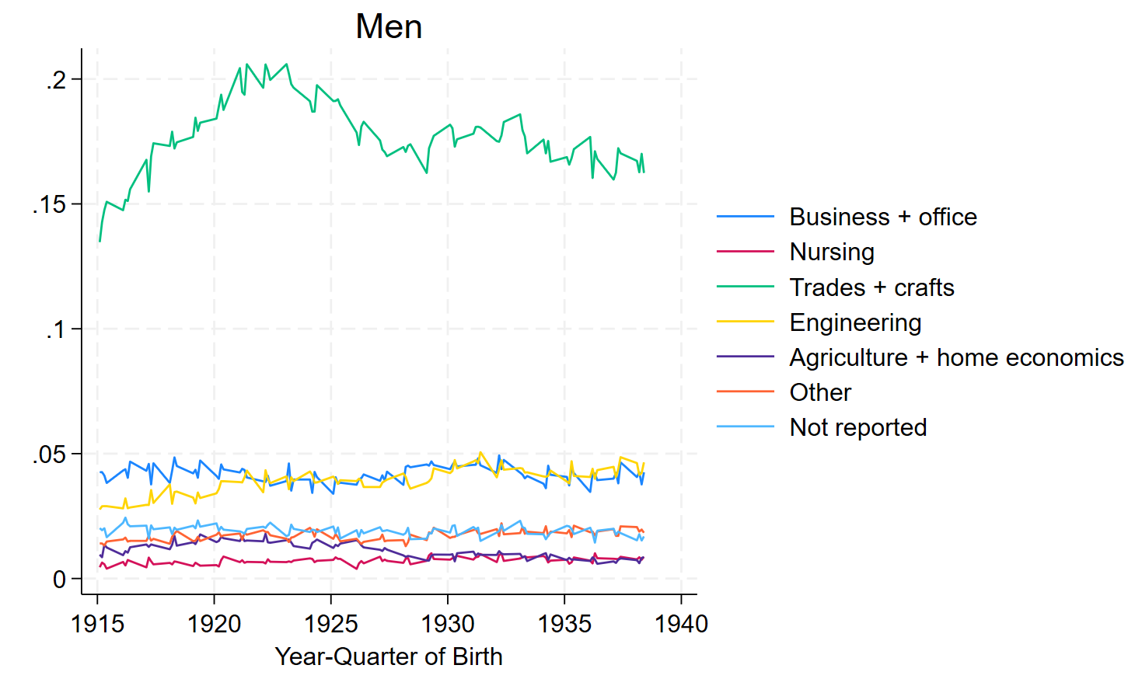
Vocational training by birth cohort
Notes:
Census:
SCHLVOC indicates whether the respondent had ever completed a vocational training program and, if so, the main field of training. Examples of vocational training programs are: special high school programs; apprenticeships; business, nursing, and trade schools; technical institutes; and armed forces schools.
No vocational trainingX2Business, office workX3Nursing, health fieldsX4Trades and craftsX5Engineering, drafting, science technicianX6Agriculture, home economicsX7Other vocational fieldX8Field not reported

Slide 25
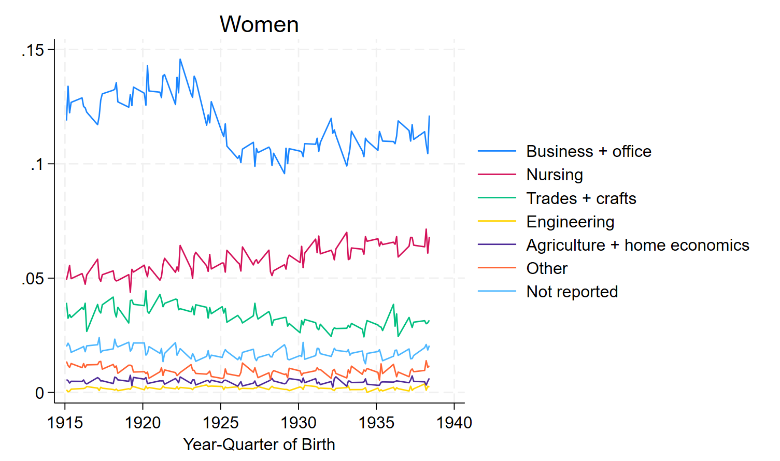
Vocational training by birth cohort
Notes:
Census:
SCHLVOC indicates whether the respondent had ever completed a vocational training program and, if so, the main field of training. Examples of vocational training programs are: special high school programs; apprenticeships; business, nursing, and trade schools; technical institutes; and armed forces schools.
No vocational trainingX2Business, office workX3Nursing, health fieldsX4Trades and craftsX5Engineering, drafting, science technicianX6Agriculture, home economicsX7Other vocational fieldX8Field not reported

Slide 26
What types of occupations?
Occupation (1950) | No vocational training | Business | Nurse | Trade | Engineer | Ag + Home Ec | Other | No report
Barbers, beauticians | 16.08 | 1.46 | 0.66 | 77.52 | 0.24 | 0.14 | 2.3 | 1.61
Practical nurses | 17.97 | 1.26 | 78.97 | 0.78 | 0.04 | 0.08 | 0.21 | 0.7
Nurses, professional | 23.2 | 1.63 | 72.63 | 0.76 | 0.24 | 0.19 | 0.33 | 1.01
Office machine-mechanic | 32.42 | 4.51 | 0.18 | 37.89 | 21.38 | 0.24 | 1.84 | 1.54
Technicians | 32.59 | 2.56 | 0.78 | 28.44 | 31.46 | 0.36 | 2.38 | 1.44
Radio and television- repair | 34.12 | 1.18 | 0.2 | 48.22 | 12.07 | 0.13 | 2.03 | 2.06
Airplane mechanics | 36.4 | 1.16 | 0.27 | 54.14 | 4.14 | 0.59 | 1.8 | 1.51
Pattern and model makers | 38.05 | 0.64 | 0 | 52.95 | 5.47 | 0.54 | 1.18 | 1.18
Electricians | 38.27 | 0.98 | 0.15 | 54.8 | 3.02 | 0.42 | 0.89 | 1.46
Airplane pilots | 39.07 | 1.05 | 0.28 | 40.9 | 4.71 | 0.98 | 9.7 | 3.3
Electrotypers and stereotypers | 39.63 | 4.27 | 0 | 51.83 | 0 | 0 | 1.22 | 3.05
Tool makers, and die-makers | 39.79 | 0.85 | 0.07 | 53.75 | 3.01 | 0.25 | 1.06 | 1.22
Funeral directors and embalmers | 42.46 | 15.29 | 17.86 | 9.95 | 1.07 | 0.21 | 8.77 | 4.39
Notes:
Census:
SCHLVOC indicates whether the respondent had ever completed a vocational training program and, if so, the main field of training. Examples of vocational training programs are: special high school programs; apprenticeships; business, nursing, and trade schools; technical institutes; and armed forces schools.
No vocational trainingX2Business, office workX3Nursing, health fieldsX4Trades and craftsX5Engineering, drafting, science technicianX6Agriculture, home economicsX7Other vocational fieldX8Field not reported

Slide 27
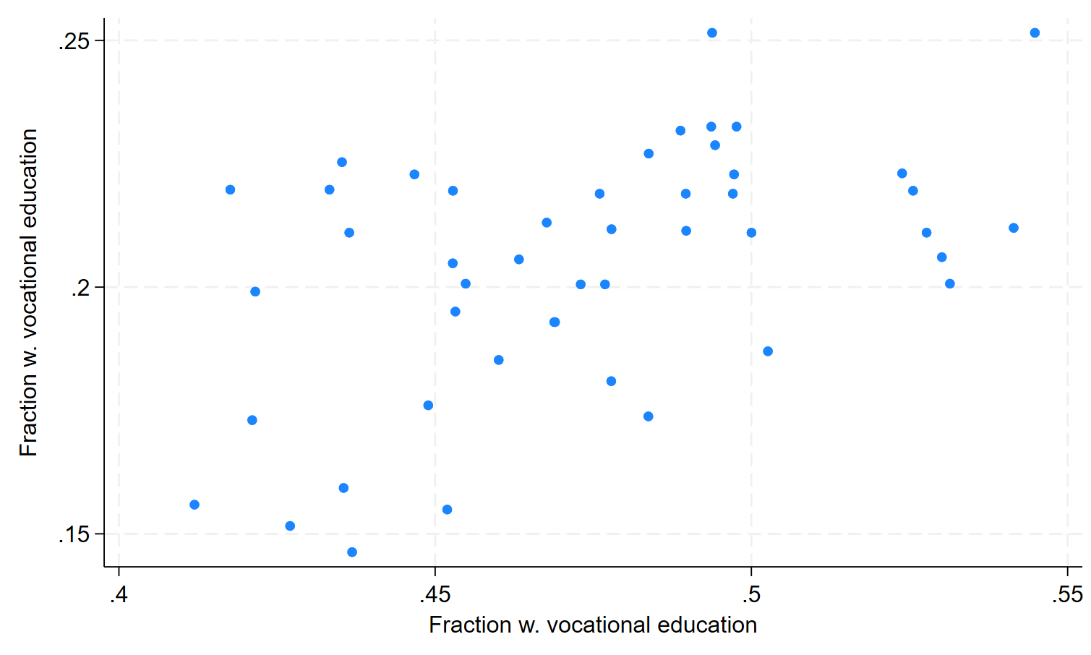
Vocational training vs. WWII mobilization

Slide 28
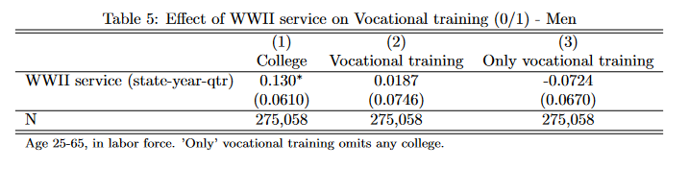
Did the GI Bill lead to vocational training?
Notes:
Census:
SCHLVOC indicates whether the respondent had ever completed a vocational training program and, if so, the main field of training. Examples of vocational training programs are: special high school programs; apprenticeships; business, nursing, and trade schools; technical institutes; and armed forces schools.
No vocational trainingX2Business, office workX3Nursing, health fieldsX4Trades and craftsX5Engineering, drafting, science technicianX6Agriculture, home economicsX7Other vocational fieldX8Field not reported

Slide 29
Appendix

Slide 30
Current facts on U.S. upper education
College wage premium
Increasing over time
Non-linear in education attainment
2011-2021, approx. 2/3 of high school graduates in enrolled college
2/3 in 4-year schools
1/3 in 2-year school
Drop-outs after 8 years
38% in 2-years schools
25% in 4-year schools
Source: “Digest of Education Statistics”, Table 326.27. U.S. Department of Education, National Center for Education Statistics, Integrated Postsecondary Education Data System (IPEDS)

Slide 31
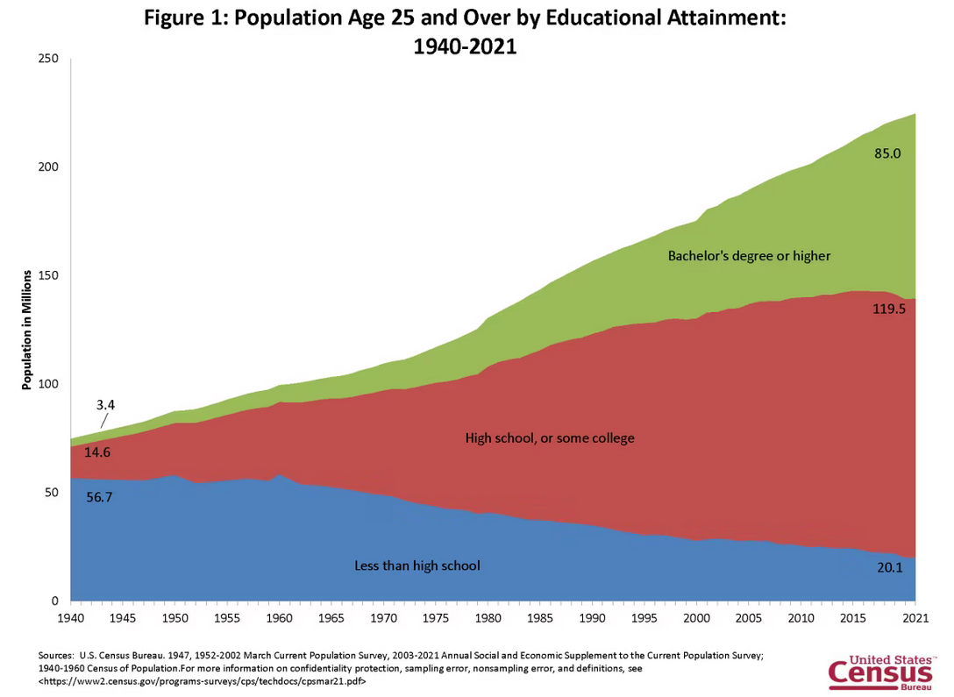
U.S. educational attainment, 1940-2021
Back

Slide 32
Earnings by educational attainment
Source: U.S. Census Bureau (1975-2020) March Current Population Survey 2003 to 2022 Annual Social and Economic Supplement to the Current Population Survey noninstitutionalized population, excluding members of the Armed Forces living in barracks.

Slide 33
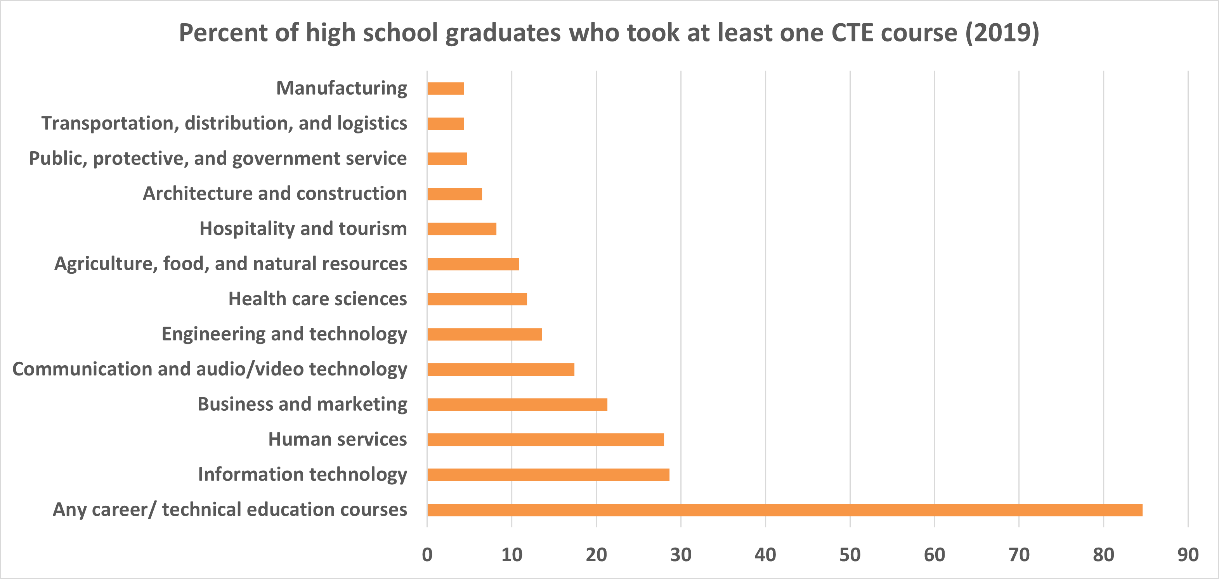
Vocational training is varied
Source: “Digest of Education Statistics”, Table 225.25. U.S. Department of Education, National Center for Education Statistics, National Assessment of Educational Progress (NAEP)

Slide 34
Renewed interest in trade school
Notes:
Numbers represent search interest relative to the highest point on the chart for the given region and time. A value of (100 is the peak popularity for the term. A value of 50 means that the term is half as popular. A score of 0 means there was not enough data for this term.

Slide 35
But 50% need at least some training
Educational attainment (ORS)
Educational attainment (CPS)
Source: Bureau of Labor Statistics, U.S. Department of Labor, https://www.bls.gov/opub/ted/2023/half-of-civilian-workers-required-over-1-year-of-preparation-time-to-perform-their-jobs-in-2022.htm
Notes:
Specific vocational preparation captures the minimum amount of time needed to develop skills for the job. Preparation time is divided into nine levels, ranging from as little as 4 hours to more than (10 years. Levels 6 through 9 indicate that over (1 year of preparation was needed

Slide 36
U.S. educational attainment, 2022
Back
Source: Bureau of Labor Statistics, U.S. Department of Labor, Occupational Requirements Survey (2022), https://www.bls.gov/ors/factsheet/minimum-formal-education.htm

Slide 37
Timeline of legislation 1958-1984
1958 National Defense Education Act
1962 Manpower Development and Training Act
1963 Vocational Education Act
1968 Vocational Education Amendments
1976 Vocational Education Amendments
1984 Carl D. Perkins Vocational Education Act (Perkins I)
Back

Slide 38
Timeline of legislation 1990-today
1990 Carl D. Perkins Vocational and Applied Technology Act (Perkins II)
1998 Carl D. Perkins Vocational and Technical Education Act (Perkins III)
2006 Carl D. Perkins Career and Technical Education Act (Perkins IV)
2018 Strengthening Career and Technical Education for the 21st Century Act (Perkins V)
Back

Slide 39
High take up and use of funds
Source: Digest of annual reports of state boards for vocational education to the Office of Education, Division of Vocational and Technical Education (1962).

