Slide 1
An economic analysis of federally funded vocational education in the early 20th-century U.S.
Patrick Molligo
Proseminar in Applied Microeconomics | UCLA
February 26, 2024

Slide 2

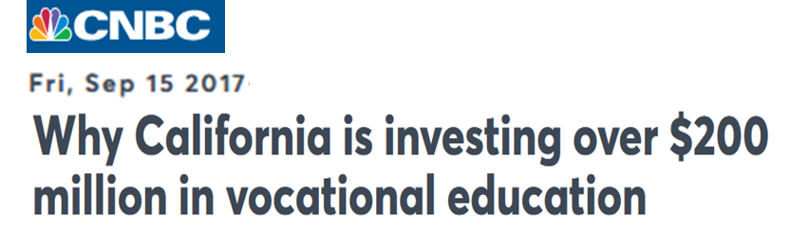
A shift in public conversation

Slide 3
History repeats itself
“Surely it is eminently in accord with the principles of our democratic life that we should furnish the highest average industrial training for ordinary skilled workmen. But it is a curious thing that in industrial training we have tended to devote our energies to producing high-grade men at the top rather than in the ranks.”
- President Theodore Roosevelt
Letter to the National Society for the Promotion of Industrial Education (May 24, 1907)

Slide 4
This project
Has federal spending increased enrollment in vocational training historically?
1944: Servicemen's Readjustment Act (G.I. Bill)
1917: Smith-Hughes Vocational Education Act
Among non-college bound students, did attending vocational school improve wages and reduce unemployment?
Why these questions matter:
- Implications for national education and labor policy
- Role of the public education system in matching labor supply + demand
Literature

Slide 5
G.I. Bill overview
An Act to provide Federal Government aid for the readjustment in civilian life of returning World War II veterans. […] This Act may be cited as the "Servicemen's Readjustment Act of 1944".
– June 22, 1944, Public Law 346
Direct cash benefits to individual veterans
$500 for tuition/books + $50-$120 monthly stipend
Served between Sept. 1940 and July 1947; at least 90 days
Min. 1 year training/eduction → up to 4 years depending on service
Similar Bill for Korean War ( served 1950-1955)

Slide 6
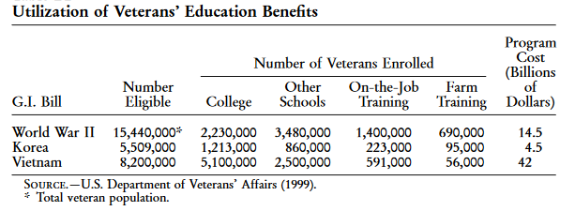
G.I. Bill take up
Source: Bound & Turner (2002), Appendix B2

Slide 7
Empirical strategy #1
Vocational school completion
Approach - Bound and Turner (2002), Thomas (2017)
Idea: WWII military service → benefit eligibility → college education
Y_{ics} = β₀ + β₁*WWII_{cs} + β₂*Korea_{cs} + β₃*State + β₃*Trend + β₄*Trend² + e_{ics}
Y_{ics}: College graduate; years of education
WWII_{cs} : fraction served in WWII (birth cohort-state)
Korea_{cs} : fraction served in Korean War (birth cohort-state)
State: State of birth dummy
Trend: birth year – 1929 + birth quarter/4
This project: use vocational school completion

Slide 8
Empirical strategy #2
Possible complication: G.I. Bill allows college, high school, or job training
Solution: multinomial logit model
Compare relative odds of choosing vocational training over, e.g., GED
Alternatives
No education
H.S. (or equivalent) but no vocational training
Vocational school
College

Slide 9
Public data sources
U.S. Census - 1970 1% samples (IPUMS)
Key variables:
Vocational training (SCHLVOC)
Ever completed a vocational training program + main field of training.
Special high school programs, apprenticeships, business, nursing, and trade schools, technical institutes, and armed forces schools
Military service (VETWWII, VETKOREA)
Notes:
Census:
SCHLVOC indicates whether the respondent had ever completed a vocational training program and, if so, the main field of training. Examples of vocational training programs are: special high school programs; apprenticeships; business, nursing, and trade schools; technical institutes; and armed forces schools.
No vocational trainingX2Business, office workX3Nursing, health fieldsX4Trades and craftsX5Engineering, drafting, science technicianX6Agriculture, home economicsX7Other vocational fieldX8Field not reported

Slide 10
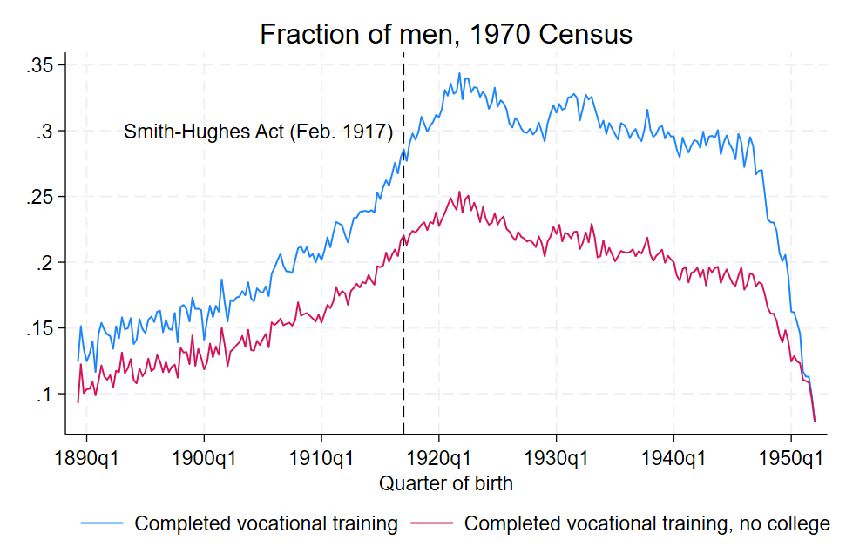
Vocational training by birth cohort

Slide 11
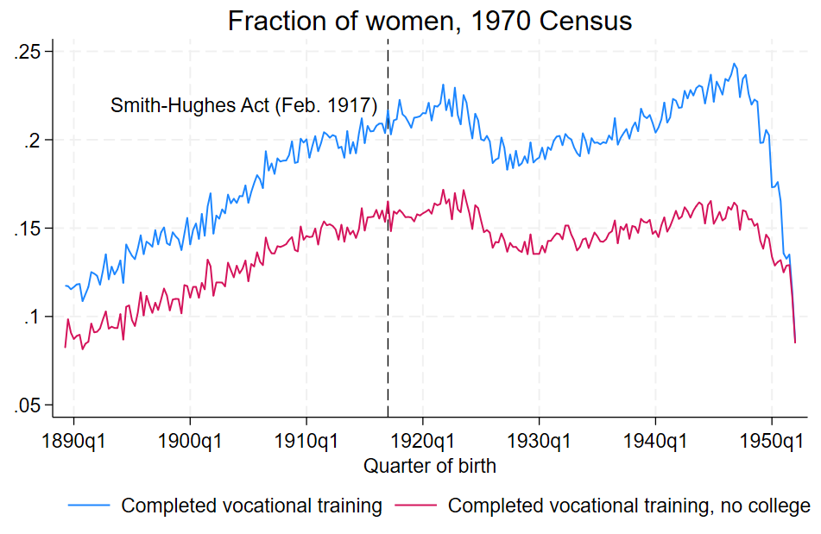
Vocational training by birth cohort

Slide 12
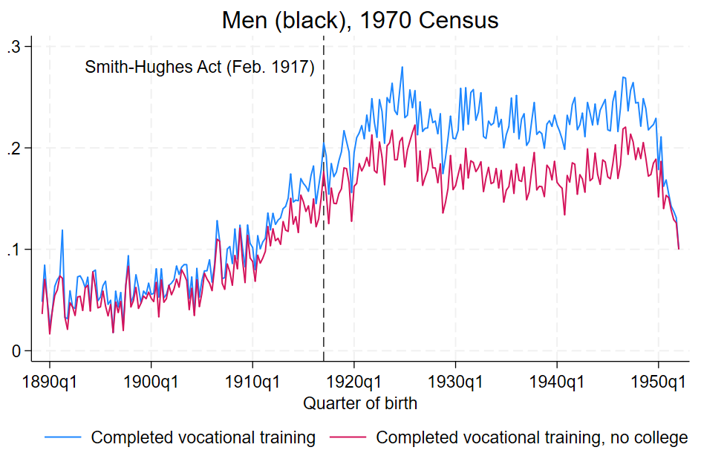
Vocational training by birth cohort

Slide 13
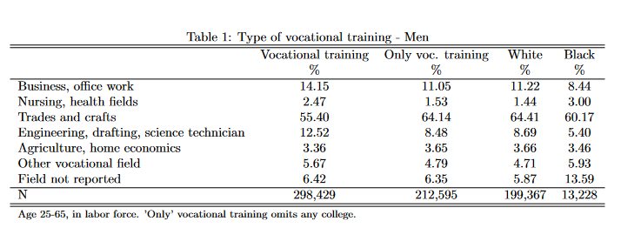
What kind of training?
Women

Slide 14
What types of occupations?
Occupation (1950) | No vocational training | Business | Nurse | Trade | Engineer | Ag + Home Ec | Other | No report
Barbers, beauticians | 16.08 | 1.46 | 0.66 | 77.52 | 0.24 | 0.14 | 2.3 | 1.61
Practical nurses | 17.97 | 1.26 | 78.97 | 0.78 | 0.04 | 0.08 | 0.21 | 0.7
Nurses, professional | 23.2 | 1.63 | 72.63 | 0.76 | 0.24 | 0.19 | 0.33 | 1.01
Office machine-mechanic | 32.42 | 4.51 | 0.18 | 37.89 | 21.38 | 0.24 | 1.84 | 1.54
Technicians | 32.59 | 2.56 | 0.78 | 28.44 | 31.46 | 0.36 | 2.38 | 1.44
Radio and television- repair | 34.12 | 1.18 | 0.2 | 48.22 | 12.07 | 0.13 | 2.03 | 2.06
Airplane mechanics | 36.4 | 1.16 | 0.27 | 54.14 | 4.14 | 0.59 | 1.8 | 1.51
Pattern and model makers | 38.05 | 0.64 | 0 | 52.95 | 5.47 | 0.54 | 1.18 | 1.18
Electricians | 38.27 | 0.98 | 0.15 | 54.8 | 3.02 | 0.42 | 0.89 | 1.46
Airplane pilots | 39.07 | 1.05 | 0.28 | 40.9 | 4.71 | 0.98 | 9.7 | 3.3
Electrotypers and stereotypers | 39.63 | 4.27 | 0 | 51.83 | 0 | 0 | 1.22 | 3.05
Tool makers, and die-makers | 39.79 | 0.85 | 0.07 | 53.75 | 3.01 | 0.25 | 1.06 | 1.22
Funeral directors and embalmers | 42.46 | 15.29 | 17.86 | 9.95 | 1.07 | 0.21 | 8.77 | 4.39

Slide 15
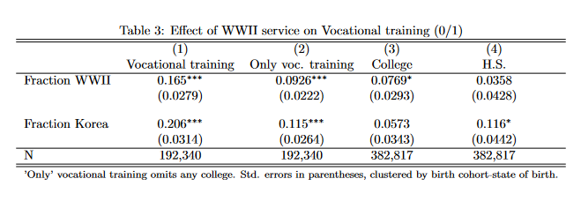
Did the GI Bill increase vocational training?
Notes:
- 41% in range have voc only; 17% coll grad

Slide 16
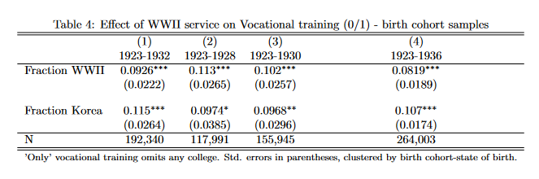
Comparison across cohort samples
Notes:
comparing educational attainment of men born during the mid-1920s, who would have been inducted into the military after finishing high school in the early 1940s and would have returned to civilian life in the late 1940s, to men born in the late 1920s, who would have finished high school at just about the same time.

Slide 17
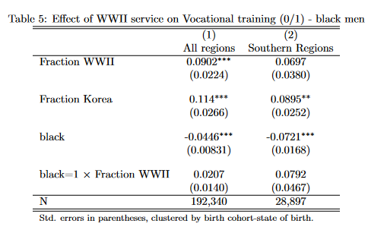
Same effects for black veterans?
Notes:
Census:
SCHLVOC indicates whether the respondent had ever completed a vocational training program and, if so, the main field of training. Examples of vocational training programs are: special high school programs; apprenticeships; business, nursing, and trade schools; technical institutes; and armed forces schools.
No vocational trainingX2Business, office workX3Nursing, health fieldsX4Trades and craftsX5Engineering, drafting, science technicianX6Agriculture, home economicsX7Other vocational fieldX8Field not reported

Slide 18
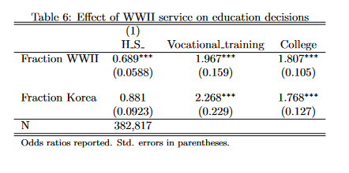
Multinomial logit – base = no training
Notes:
Census:
SCHLVOC indicates whether the respondent had ever completed a vocational training program and, if so, the main field of training. Examples of vocational training programs are: special high school programs; apprenticeships; business, nursing, and trade schools; technical institutes; and armed forces schools.
No vocational trainingX2Business, office workX3Nursing, health fieldsX4Trades and craftsX5Engineering, drafting, science technicianX6Agriculture, home economicsX7Other vocational fieldX8Field not reported

Slide 19
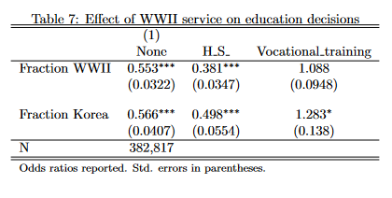
Multinomial logit – base = college
Notes:
Census:
SCHLVOC indicates whether the respondent had ever completed a vocational training program and, if so, the main field of training. Examples of vocational training programs are: special high school programs; apprenticeships; business, nursing, and trade schools; technical institutes; and armed forces schools.
No vocational trainingX2Business, office workX3Nursing, health fieldsX4Trades and craftsX5Engineering, drafting, science technicianX6Agriculture, home economicsX7Other vocational fieldX8Field not reported

Slide 20
Smith-Hughes Act provisions
An Act to provide for the promotion of vocational education; to provide for cooperation with the States in the promotion of such education in agriculture and the trades and industries; to provide for cooperation with the States in the preparation of teachers of vocational subjects; and to appropriate money and regulate its expenditure – February 23, 1917, Ch. 114, §1, 39 Stat. 929
$7 million annually to the States
Salaries of teachers, supervisors, or directors
$3 million → agricultural subjects
$3 million → trade, home economics, & industrial subjects
Preparing teachers, supervisors, and directors
$1 million
Fund allocation rules
Agricultural → ratio of rural pop. to total U.S. rural
Trade/Home Econ/Industrial → ratio of urban pop. to total U.S. urban
Teacher training → ratio of population to total U.S.
Notes:
U.S. enters WWI 4 months after Smith-Hughes passed
Cap home economics at (20% of Section 3 funds
All 48 states submitted plans by end of (19(17
“In this whole country there are fewer trade schools than are to be found in the little German kingdom of Bavaria, with a population not much greater than that of New York City.” - From the Report of the Commission on National Aid to Vocational Education, June (1 (19(14
- Coalition of lobbies

Slide 21
Smith-Hughes Act provisions (cont.)
Established Federal Board of Vocational Education (1917-1946)
Unprecedented oversight of secondary education
State boards of vocational education
Prepare plans for fund use
Annual report to Congress work done + receipts/expenditures
Match Federal dollar amount
School requirements:
Under public supervision
Make students “fit for useful employment”
Less than college grade
Students over 14 years (over 16 for evening classes)
Notes:
U.S. enters WWI 4 months after Smith-Hughes passed
Cap home economics at 20% of Section 3 funds
“Only national board of education responsible for any part of primary or secondary education in the United States”
Prepare plans, showing the kinds of vocational education for which funds shall be used; the kinds of schools and equipment; courses of study; methods of instruction; qualifications of teachers; plans for the training of teachers

Slide 22
Timeline of legislation 1862-2018
Details of legislation
Notes:
1929 George-Reed & 1934 George-Ellzey Acts -Increase of $1 million annually until 1934; then $3 million for three years
1946 George-Barden Act- Increased to $29 million

Slide 23
Use of funds by the States
Source: Digest of annual reports of state boards for vocational education to the Office of Education, Division of Vocational and Technical Education (1962).

Slide 24
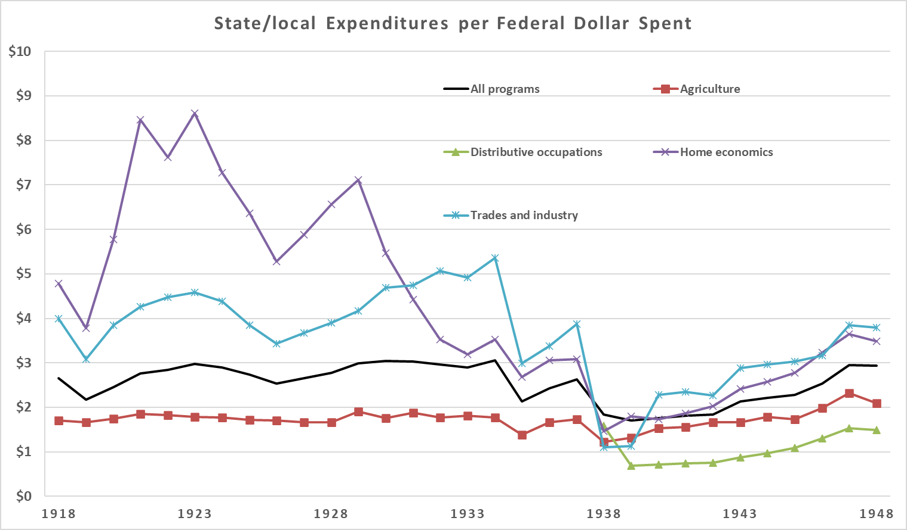
Expenditures per dollar of Federal
Source: Digest of annual reports of state boards for vocational education to the Office of Education, Division of Vocational Education (1950).

Slide 25
First four decades of enrollment
Including H.S.
Source: Digest of annual reports of state boards for vocational education to the Office of Education, Division of Vocational and Technical Education (1962).

Slide 26
Next steps
Interaction of Smith-Hughes Act with WWI labor demand
E.g., radio operators in Signal Corps.
State-specific case studies (non-federal legislation)
Compulsory schooling laws

Slide 27
Appendix

Slide 28
Timeline of legislation 1862-1946
1862 Morrill Land Grant Act
Federally land gifts to States to open colleges for agriculture and mechanical arts
1890: expanded access for Black students
1917 Smith-Hughes Act
$7 million annual federal aid to states
Promotion of vocational education in agriculture, trade/industrial education, and home economics
Explicitly below college level
1929 George-Reed & 1934 George-Ellzey Acts
Increase of $1 million annually until 1934; then $3 million for three years
1936 George-Deen Act
Increased to $14 million
Expanded to “distributive occupations” → e.g., retail sales, store managers, purchasing agents
1946 George-Barden Act
Increased to $29 million
Back
Notes:
1862 Morrill Land Grant Act -Federally land gifts to States to open colleges for agriculture and mechanical arts;1890: expanded access for Black students
Distributive: These jobs included any positions involving the sale of a product or of a service. Some examples of these occupations are store managers, purchasing agents, and salespeople, among others
The Health Amendments Act of 1956 , Title III of which amended the Vocational Education Act of 1946 by adding Title II to extend and improve training in practical nurse and other health occupations , and authorized a sum not to exceed $ 5,000,000 annually until June 30 , 1961. This Act provided earmarked funds for training in practical nursing and other health occupations to extend the program that had been started with trade and industrial funds . (P.L. 911 , 84th Cong . , 2d Sess . ) 70 Stat . 923 , 20 U.S.C. aa -jj . Authorization extended to June 30 , 1965 ( P.L. 87-22 , 87th Cong . )

Slide 29
Timeline of legislation 1958-1984
1958 National Defense Education Act
1962 Manpower Development and Training Act
1963 Vocational Education Act
1968 Vocational Education Amendments
1976 Vocational Education Amendments
1984 Carl D. Perkins Vocational Education Act (Perkins I)
Back

Slide 30
Timeline of legislation 1990-today
1990 Carl D. Perkins Vocational and Applied Technology Act (Perkins II)
1998 Carl D. Perkins Vocational and Technical Education Act (Perkins III)
2006 Carl D. Perkins Career and Technical Education Act (Perkins IV)
2018 Strengthening Career and Technical Education for the 21st Century Act (Perkins V)
Back

Slide 31
Relative to total H.S. enrollment
Back
Source: Digest of annual reports of state boards for vocational education to the Office of Education, Division of Vocational and Technical Education (1962).

Slide 32
High take up and use of funds
Source: Digest of annual reports of state boards for vocational education to the Office of Education, Division of Vocational and Technical Education (1962).

Slide 33
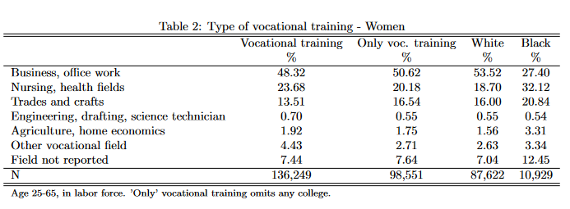
What kind of training?
Back
Notes:
Census:
SCHLVOC indicates whether the respondent had ever completed a vocational training program and, if so, the main field of training. Examples of vocational training programs are: special high school programs; apprenticeships; business, nursing, and trade schools; technical institutes; and armed forces schools.
No vocational trainingX2Business, office workX3Nursing, health fieldsX4Trades and craftsX5Engineering, drafting, science technicianX6Agriculture, home economicsX7Other vocational fieldX8Field not reported

Slide 34
Current facts on U.S. upper education
College wage premium
Increasing over time
Non-linear in education attainment
2011-2021, approx. 2/3 of high school graduates in enrolled college
2/3 in 4-year schools
1/3 in 2-year school
Drop-outs after 8 years
38% in 2-years schools
25% in 4-year schools
Source: “Digest of Education Statistics”, Table 326.27. U.S. Department of Education, National Center for Education Statistics, Integrated Postsecondary Education Data System (IPEDS)

Slide 35
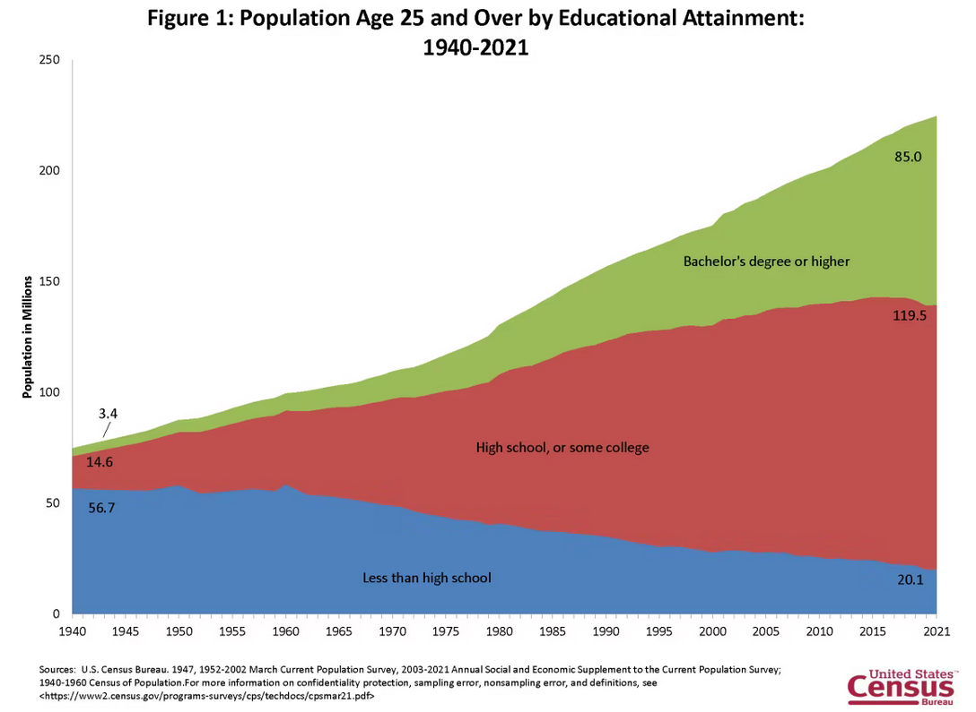
U.S. educational attainment, 1940-2021
Back

Slide 36
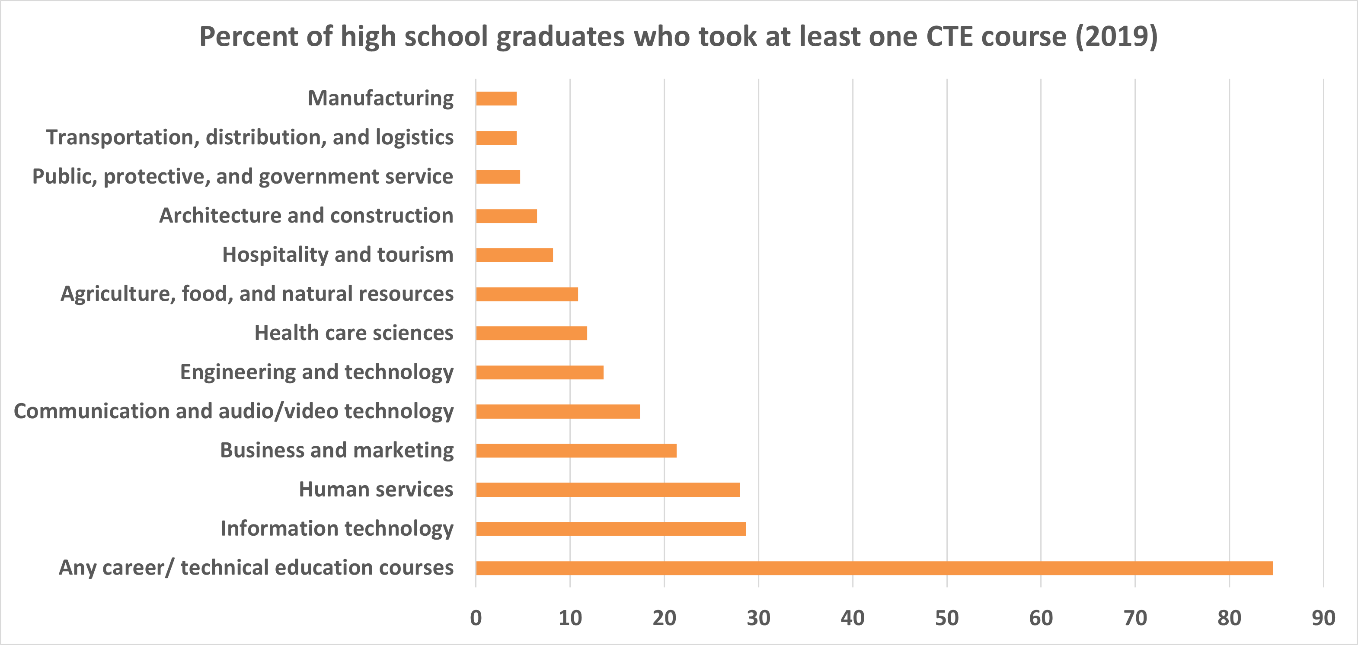
Vocational training is varied
Source: “Digest of Education Statistics”, Table 225.25. U.S. Department of Education, National Center for Education Statistics, National Assessment of Educational Progress (NAEP)

Slide 37
Degree requirements in U.S., 2022
Back
Source: Bureau of Labor Statistics, U.S. Department of Labor, Occupational Requirements Survey (2022), https://www.bls.gov/ors/factsheet/minimum-formal-education.htm

Slide 38
Earnings by educational attainment
Source: U.S. Census Bureau (1975-2020) March Current Population Survey 2003 to 2022 Annual Social and Economic Supplement to the Current Population Survey noninstitutionalized population, excluding members of the Armed Forces living in barracks.

Slide 39
Related literature
Effects of public school funding
Goldin (2001), Goldin & Katz (2003)
Bound and Turner (2002)
Investment in human capital/training
Becker (1962), Spence (1973), Stiglitz (1975)
Autor et al. (2003), Autor and Dorn (2013), Acemoglu and Autor (2011)
Acemoglu & Pischke (1998), Bedard (2001), Clark & Martorell (2014)
Returns to vocational education
Hanushek et al. (2017), Malamud & Pop-Eleches (2010), Oosterbeek & Webbink (2007), Silliman & Virtanen (2022)
Country-specific: Zilic (2018), Attanasio et al. (2011), Bertrand et al. (2021), Brunello & Rocco (2017), Dionisius et al. (2009), Hartog et al. (2022)
Challenges (Muehlemann & Wolter (2020)):
Appropriate counterfactual
Selection
Outcomes depend on policy objective
External validity
Back
Notes:
Goldin: virtue of early public education was localized funding, property taxes, can’t leave
First, natural experiments based on educational system reforms reveal that replacing vocational education by general training does not cause an improvement in labor market outcomes. Observable differences in labor market outcomes between students of vocational programmes and general education are, therefore, attributable to selection effects.
Second, several studies show a trade-off between early gains and later disadvantages for students of vocational programmes relative to students of general education over the life cycle. However, whether the trade-off leads to a net disadvantage for students of vocational education depends on the country and the programmes and is also a question of interpretation, as the disadvantages later in life may be driven by factors other than the form of education chosen initially.
Third, most empirical analyses show considerable heterogeneity of outcomes between women and men and between different occupations and different levels of skill requirements of vocational programmes or apprenticeships.
Last extremely time- and country specific; therefore, the external validity of findings in one context to another country or time is rather limited

