Slide 1
Did the G.I. Bill increase vocational training after WWII?
Patrick Molligo
Proseminar in ECONOMIC HISTORY | UCLA
November 12, 2024

Slide 2
This project
Did tuition subsidies after WWII and Korean War increase enrollment in vocational training?
1944: Servicemen's Readjustment Act (G.I. Bill) + Korean War extension (1952)
Source of randomization → eligibility cut-off by birth quarter
“Vocational Education”: “Educational programs […] directly related to the preparation of individuals in […] employment in current or emerging occupations requiring other than a baccalaureate or advanced degree.” (1990 Perkins Act)

Slide 3
Difference from previous studies
Strong evidence of increased:
College education (white)
High school attainment
Marital sorting
Home ownership
Bound and Turner (2002), Stanley (2003), Thomas (2017), Larsen et al. (2015)
Today: look at vocational (job) training as alternative use of G.I. benefits
“[…] the effects of the legislation are best conceived of as evolutionary rather than revolutionary. […] much of the effect of the WWII GI bill was probably compensatory; it maintained the prewar trend of rapid growth in higher education and moderately accelerated it.” Stanley (2003), pg. 673

Slide 4
Lead-up to G.I. Bill
“What our servicemen and women want, more than anything else, is the assurance of satisfactory employment upon their return to civil life. The first task after the war is to provide employment for them and for our demobilized workers. . . . The goal after the war should be the maximum utilization of our human and material resources.” – FDR statement to Congress, November 23, 1943

Slide 5
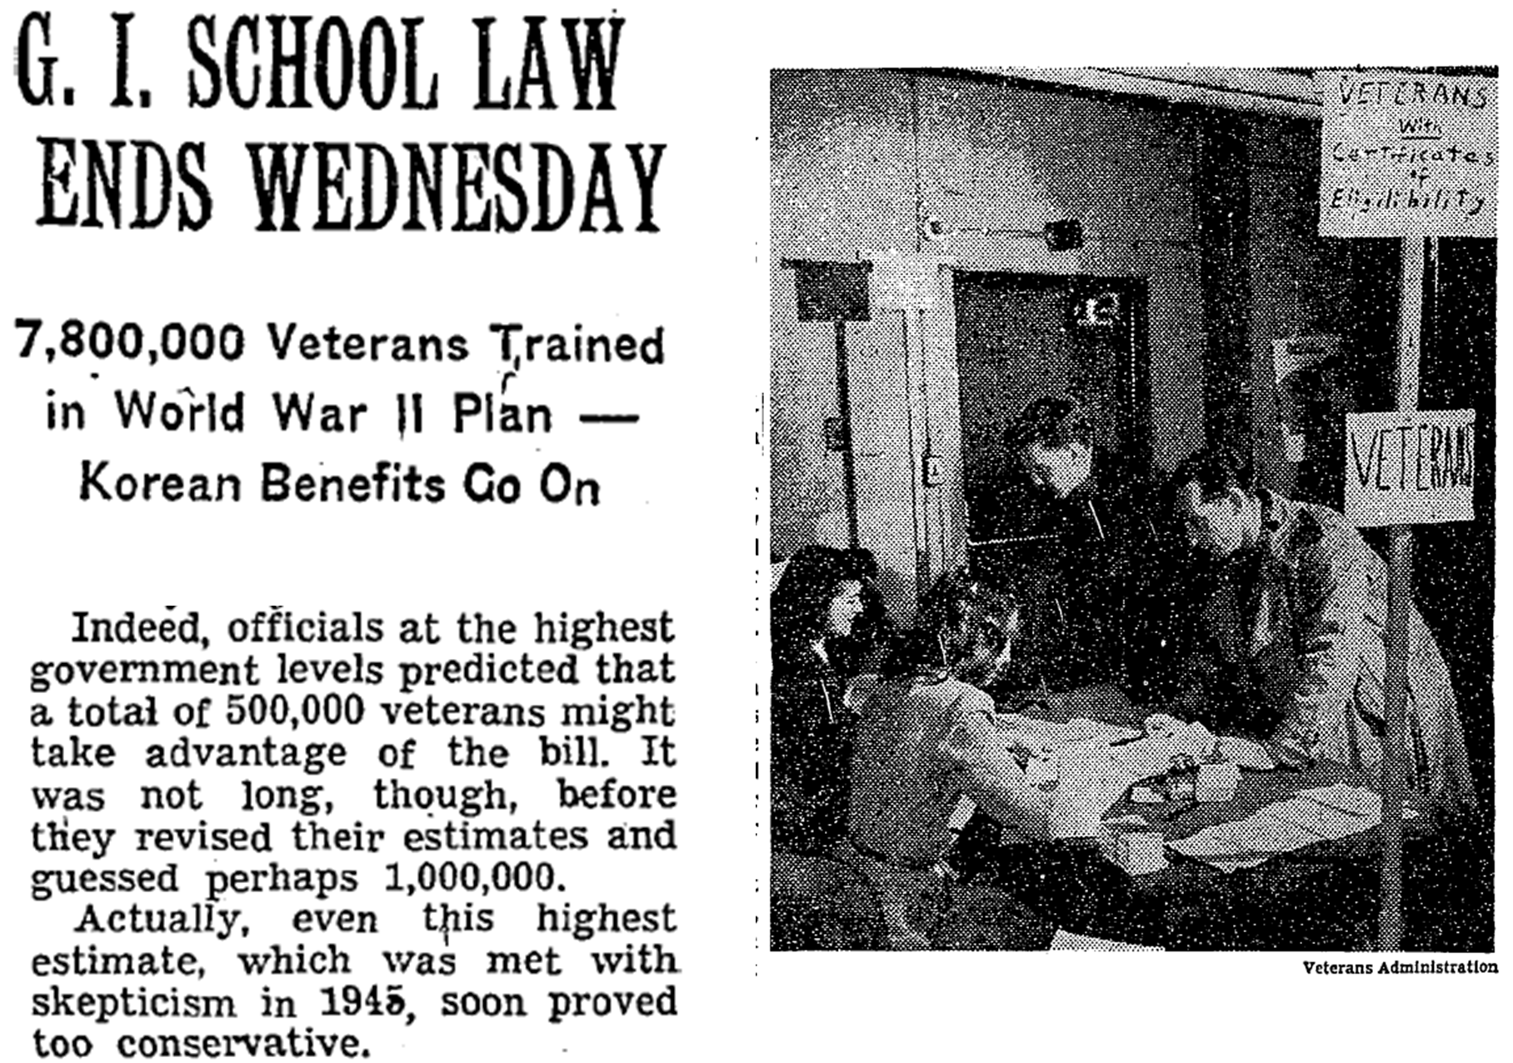
G.I. Bill aftermath – NYT July, 1956
Oldest student

Slide 6
G.I. Bill tuition subsidy overview
An Act to provide Federal Government aid for the readjustment in civilian life of returning World War II veterans. […] This Act may be cited as the "Servicemen's Readjustment Act of 1944".
– June 22, 1944, Public Law 346
Direct cash benefits to individual veterans
$500 for tuition/books + $50-$120 monthly stipend
Served between Sept. 1940 and July 1947; at least 90 days
Min. 1 year training/education → up to 4 years depending on service
Similar Bill for Korean War ( served 1950-1955)
Costs of education

Slide 7
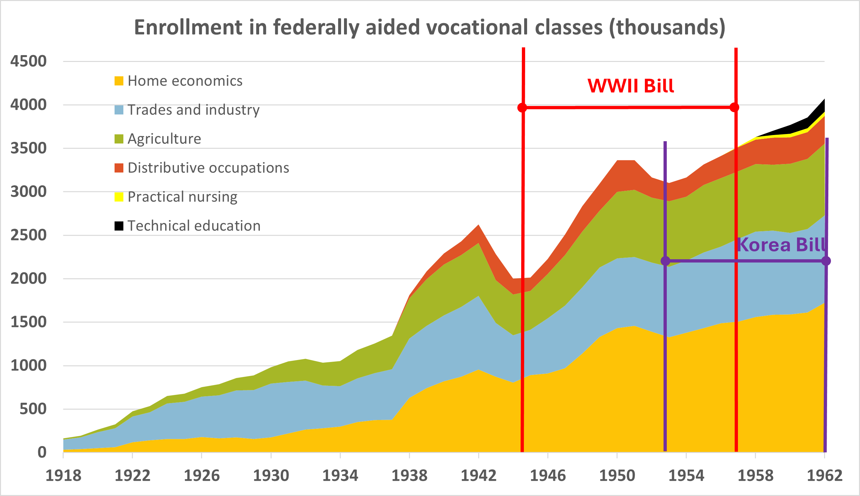
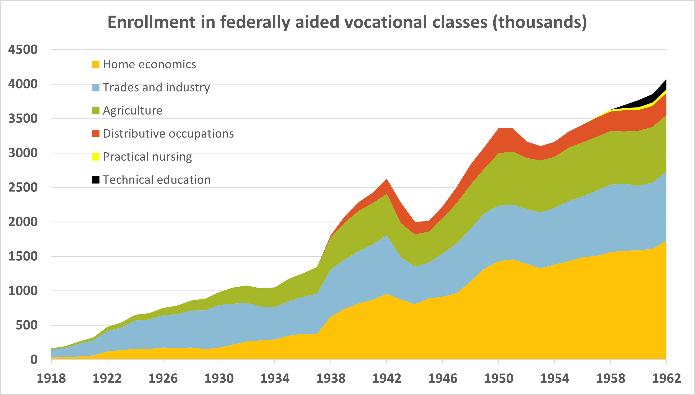
Motivation: vocational school enrollment
Source: Digest of annual reports of state boards for vocational education to the Office of Education, Division of Vocational Education, 1918-1962

Slide 8
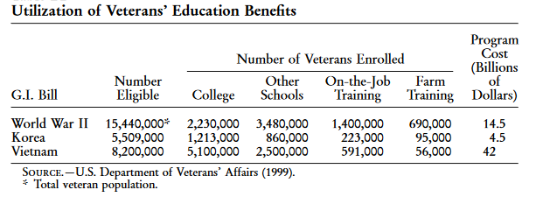
Motivation: education benefit take-up
Definition of educational institutions
Source: Bound & Turner (2002), Appendix B2

Slide 9
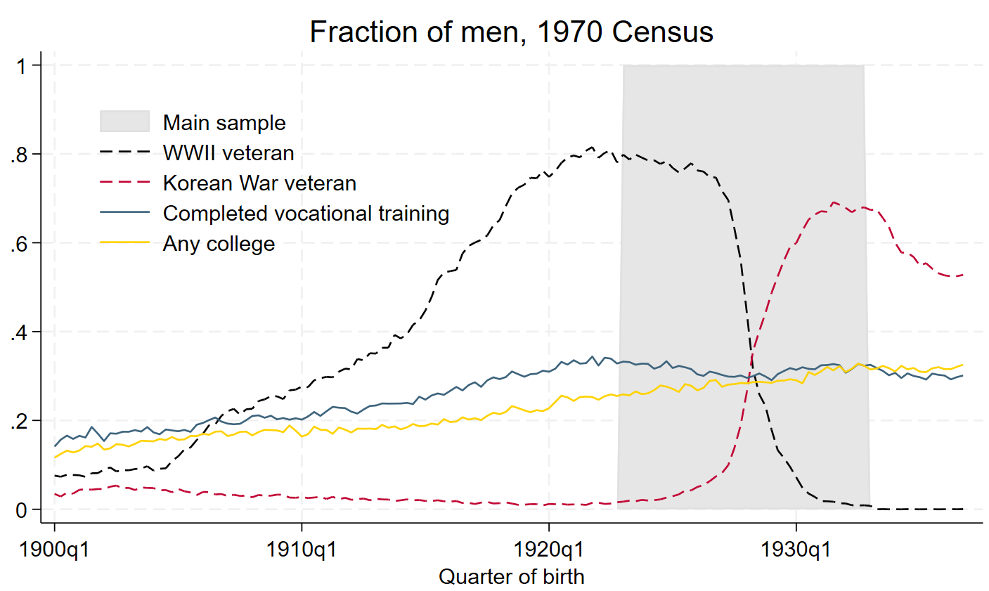
Veteran status + vocational training
Field breakdown
Vet. status + educ.

Slide 10
Empirical strategy – big picture
Goal: measure G.I. Bill effect on education/training
Challenges:
Selection into military
Don’t observe benefit utilization
Solution: Birth cohort ≈ benefit eligibility
WWII military service → benefit eligibility → vocational school take-up
Bound and Turner (2002), Larsen et al. (2015), Thomas (2017)

Slide 11
Empirical model #1
Y_{ic} = β₀ + β₁*WWII_{c} + β₂*Korea_{c} + β₃*State + β₄*Black_{i} + β₅*Trend + β₆*Trend² + e_{ic}
Y_{ic}: Education/training attainment
WWII_{c} : fraction served in WWII (birth cohort)
Korea_{c} : fraction served in Korean War (birth cohort)
State: State of birth dummy
Trend: birth year – 1929 + birth quarter/4

Slide 12
Limitations to identification
Coefficients are NOT directly identifying effect of subsidies on training take-up
“Bundled treatment”:
Tuition assistance (G.I. Bill)
Home loan guarantee (G.I. Bill)
Vocational rehabilitation for disabled vets
Experience/training in armed forces
Can we at least rule out that the G.I. Bill had no effect on vocational school completion?

Slide 13
Public data sources
U.S. Census - 1970 1% samples (IPUMS)
Key variables:
Vocational training (SCHLVOC)
Ever completed a vocational training program + main field of training.
Special high school programs, apprenticeships, business, nursing, and trade schools, technical institutes, and armed forces schools
Military service (VETWWII, VETKOREA)
Notes:
Census:
SCHLVOC indicates whether the respondent had ever completed a vocational training program and, if so, the main field of training. Examples of vocational training programs are: special high school programs; apprenticeships; business, nursing, and trade schools; technical institutes; and armed forces schools.
No vocational trainingX2Business, office workX3Nursing, health fieldsX4Trades and craftsX5Engineering, drafting, science technicianX6Agriculture, home economicsX7Other vocational fieldX8Field not reported

Slide 14
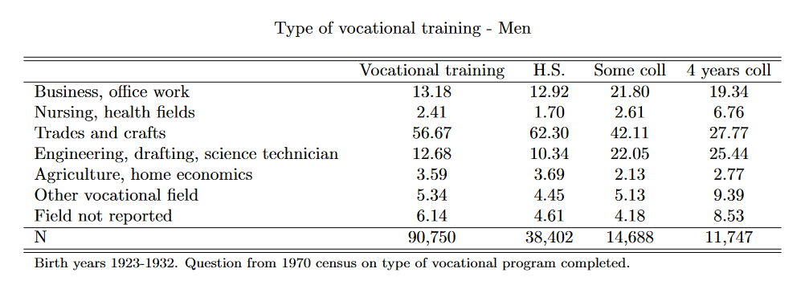
What kind of training?

Slide 15
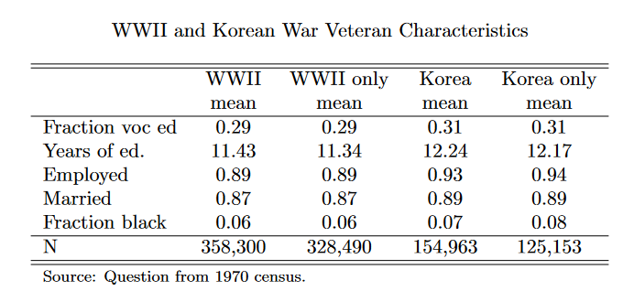
WWII vs. Korean War veterans

Slide 16
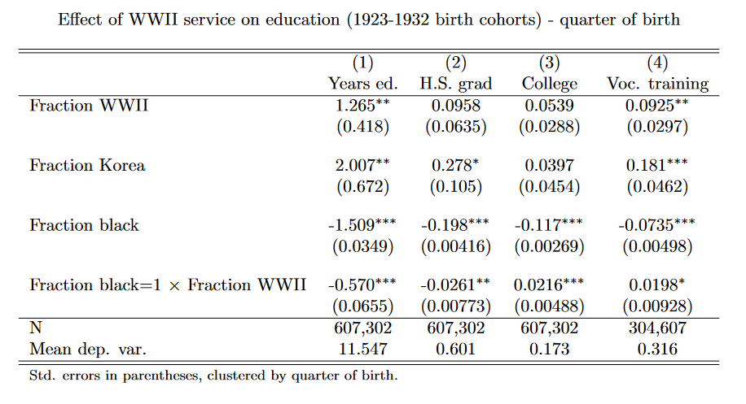
Did the GI Bill increase vocational training?
Acemoglu et al.
Notes:
- 41% in range have voc only; 17% coll grad

Slide 17
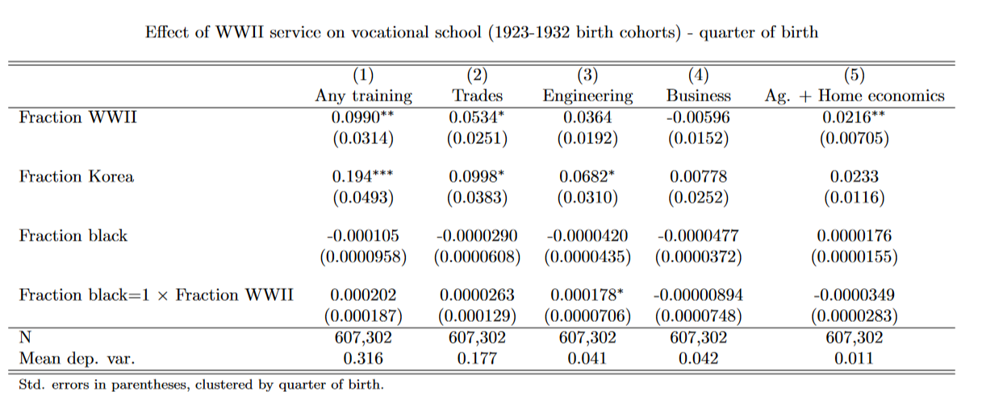
Higher take-up for trades/engineering
Notes:
- 41% in range have voc only; 17% coll grad

Slide 18
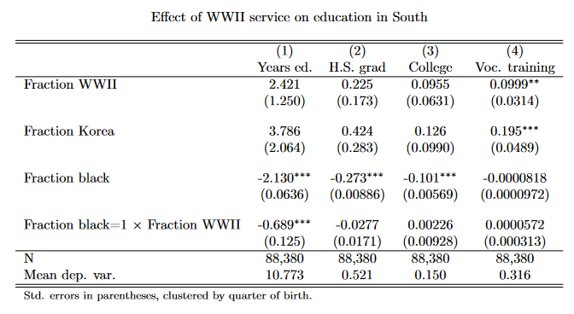
Effects in the South
Non-south
Notes:
- 41% in range have voc only; 17% coll grad

Slide 19
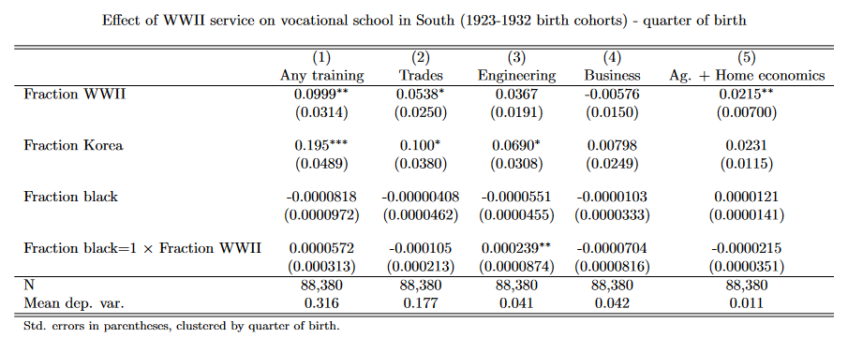
Effects in the South – different fields
Non-south
Notes:
- 41% in range have voc only; 17% coll grad

Slide 20
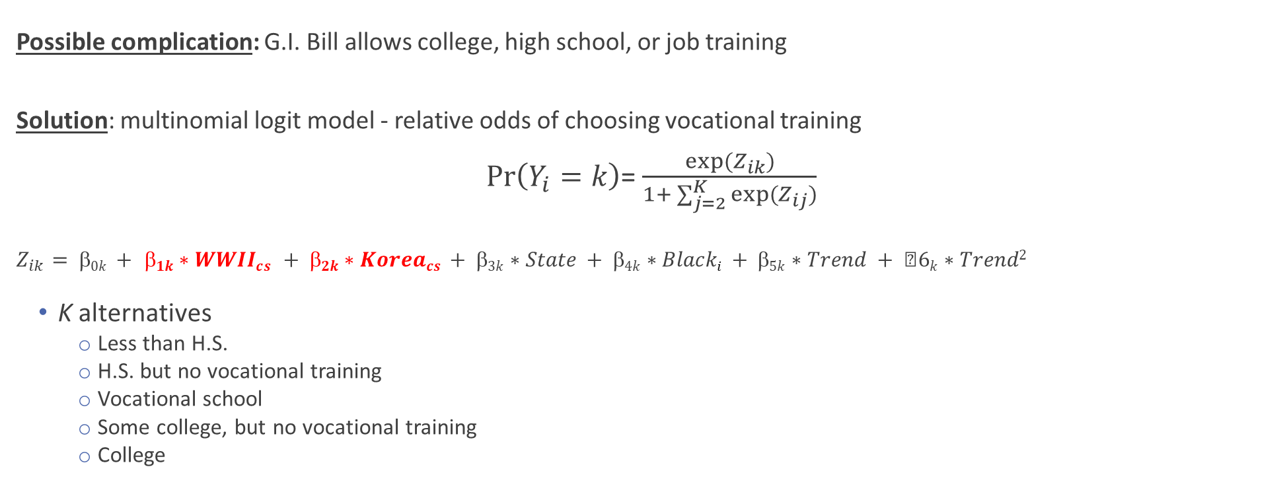
Empirical model #2
Possible complication: G.I. Bill allows college, high school, or job training
Solution: multinomial logit model - relative odds of choosing vocational training
$\operatorname{Pr}\left(Y_{i}=k\right)$= $\frac{exp⁡(Z_{ik})}{1+ \sum_{j=2}^{K}{exp⁡(Z_{ij})}}$
$$Z_{ik}= 0k + 1k∗WWIIcs + 2k∗Koreacs + 3k∗State + 4k∗Blacki + 5k∗Trend + 6k∗Trend2$$
K alternatives
Less than H.S.
H.S. but no vocational training
Vocational school
Some college, but no vocational training
College

Slide 21
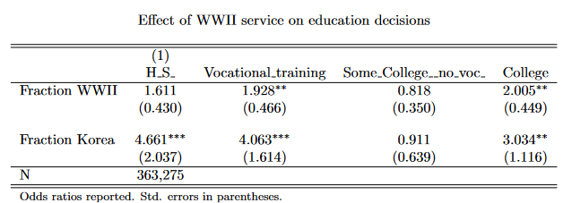
Multinomial logit – base = less than H.S.
Alternate ordering
Notes:
Census:
SCHLVOC indicates whether the respondent had ever completed a vocational training program and, if so, the main field of training. Examples of vocational training programs are: special high school programs; apprenticeships; business, nursing, and trade schools; technical institutes; and armed forces schools.
No vocational trainingX2Business, office workX3Nursing, health fieldsX4Trades and craftsX5Engineering, drafting, science technicianX6Agriculture, home economicsX7Other vocational fieldX8Field not reported

Slide 22
Empirical model #3
Regression discontinuity design: Find cut-off in military service probability
Y_{it} = β₀ + β_{1t}*1(QoB_{it}< c) + β_{2t}*1(QoB_{it} - c)*1(QoB_{it}< c)
+ β_{3t}*1(QoB_{it} - c)*1(QoB_{it}> c) + β_{4t} *Controls_{it} + e_{it}
QoB: year-quarter of birth
c: G.I. Bill eligibility cutoff

Slide 23
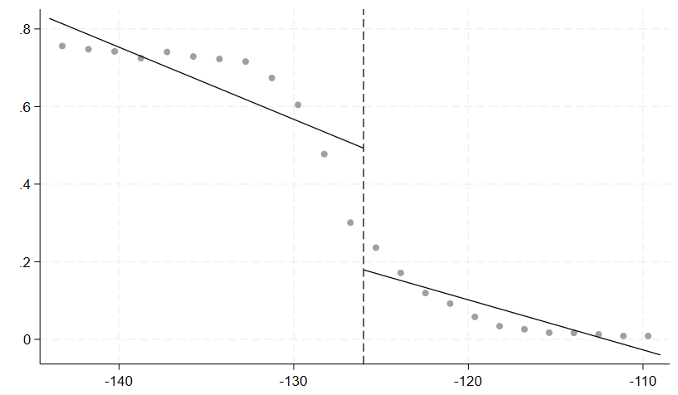
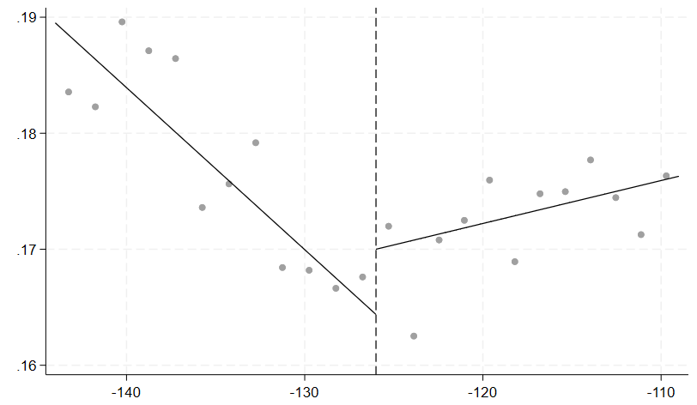
RDD preliminary results (1924-1932)
Probability of veteran status vs. birth quarter
Probability of vocational school vs. birth quarter

Slide 24
Appendix

Slide 25
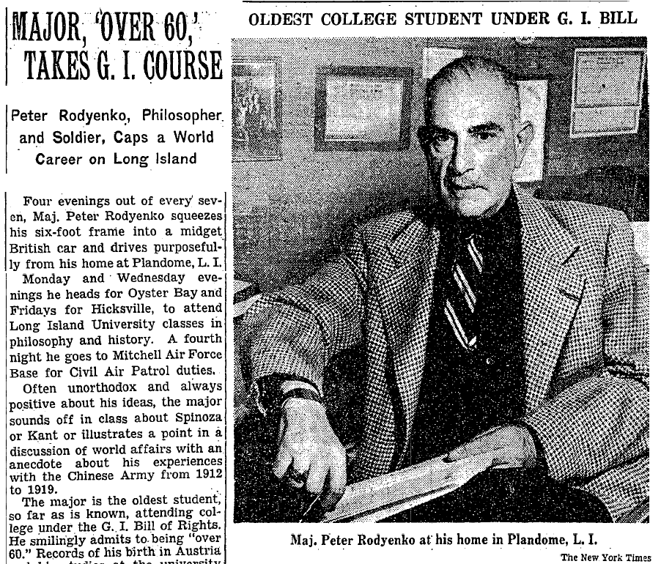
Oldest WWII beneficiary
Back

Slide 26
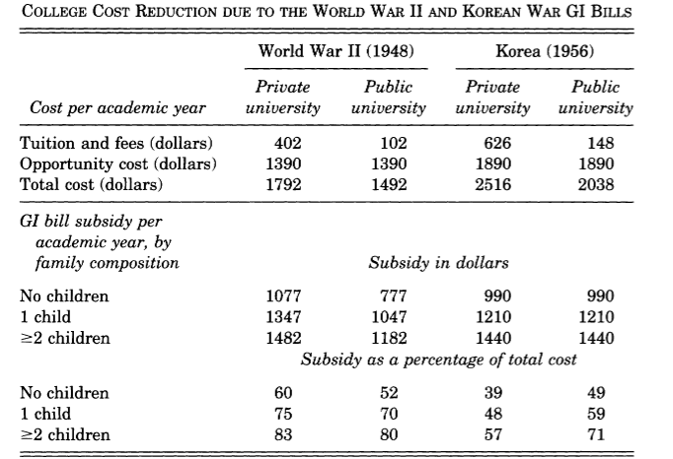
Direct + opportunity costs of college
Source: Stanley (2003), Table 1
Back

Slide 27
“Educational or training institutions”
“All public or private elementary, secondary, and other schools furnishing education for adults, business schools and colleges, scientific and technical institutions, colleges, vocational schools, junior colleges, teachers colleges, normal schools, professional schools, universities, and other educational institutions, and shall also include business or other establishments providing apprentice or other training on the job, including those under the supervision of an approved college or university or any State department of education, or any State apprenticeship agency or State board of vocational education, or any State apprenticeship council […]”
- 1944: Servicemen's Readjustment Act, Chapter 4, Education of Veterans
Back

Slide 28
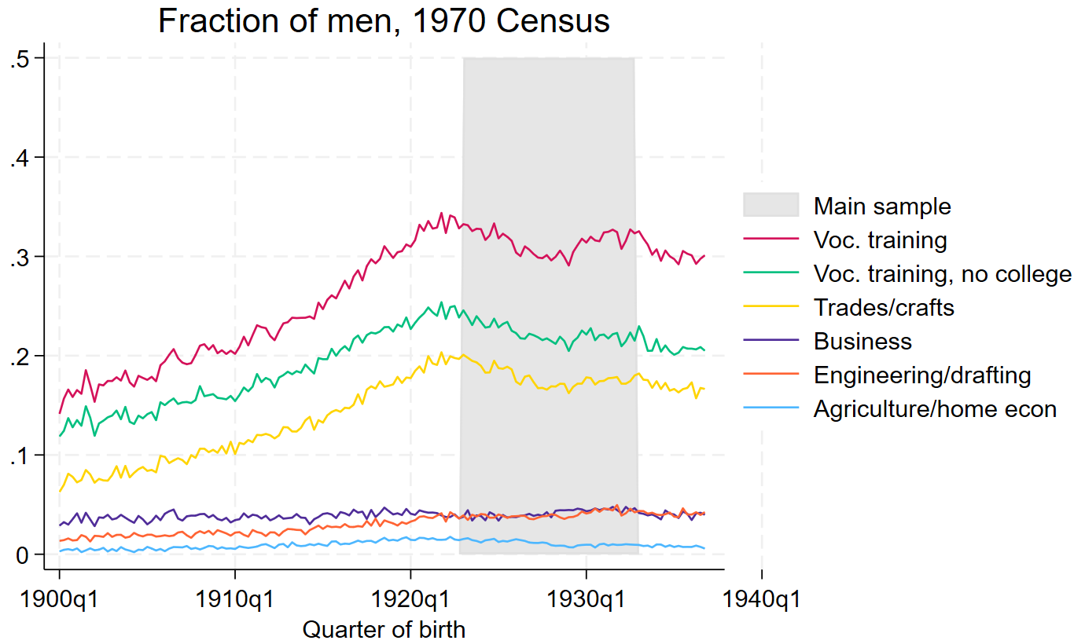
Vocational training - detailed
Back

Slide 29
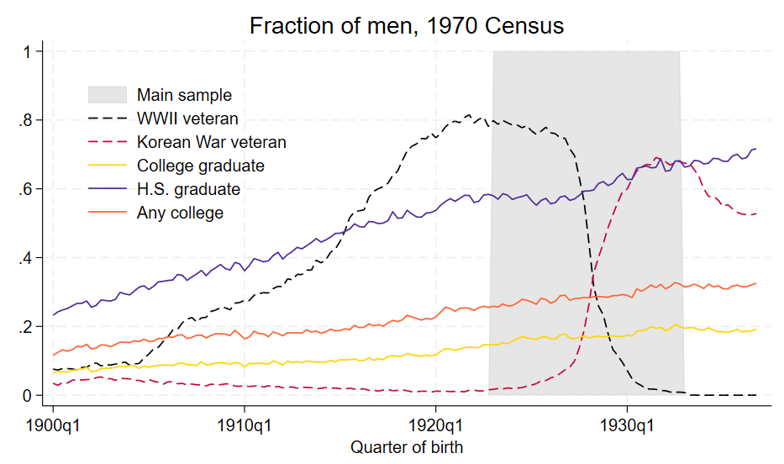
Education + veteran status
Years educ
Years college
Back

Slide 30
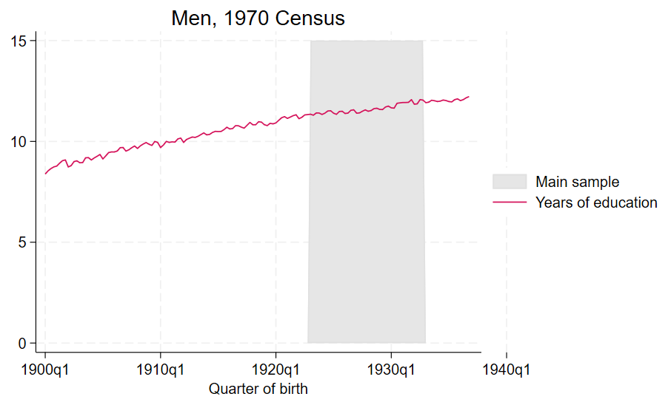
Years of education
Back

Slide 31
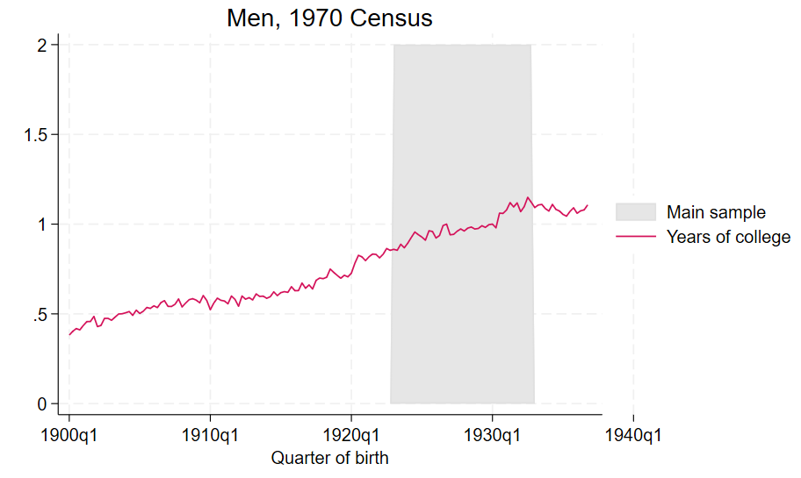
Years of college (education years
Back

Slide 32
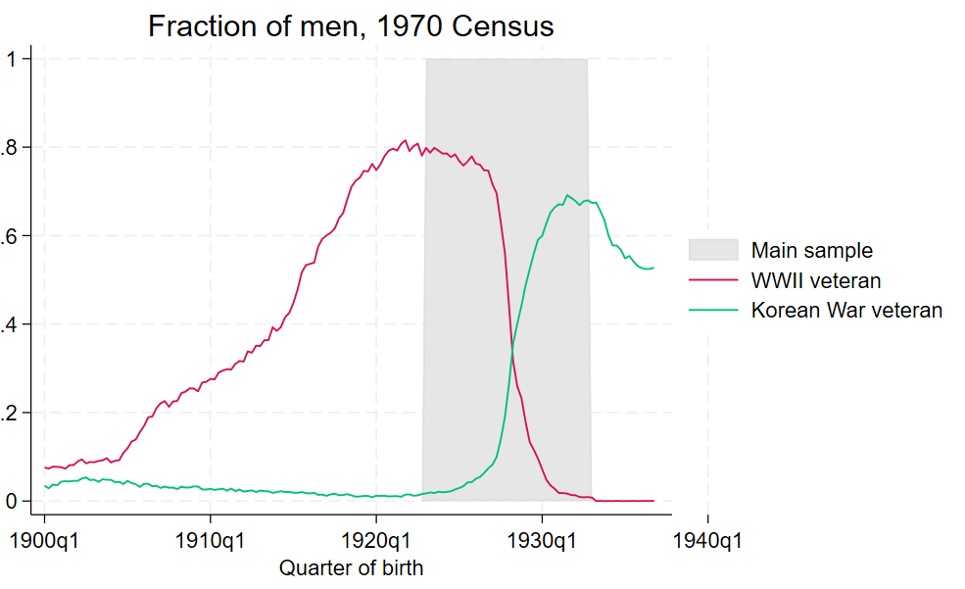
Variation in veteran status

Slide 33
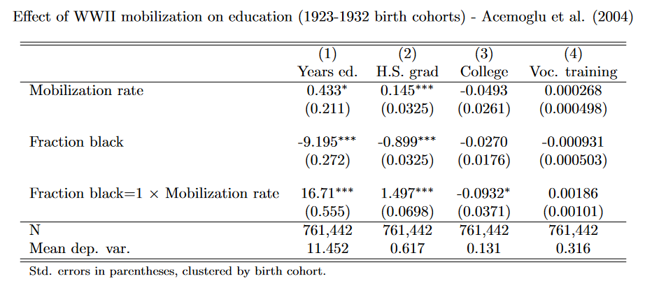
Mobilization – Acemoglu et al. (2004)
Scatter
Back
Notes:
- 41% in range have voc only; 17% coll grad

Slide 34
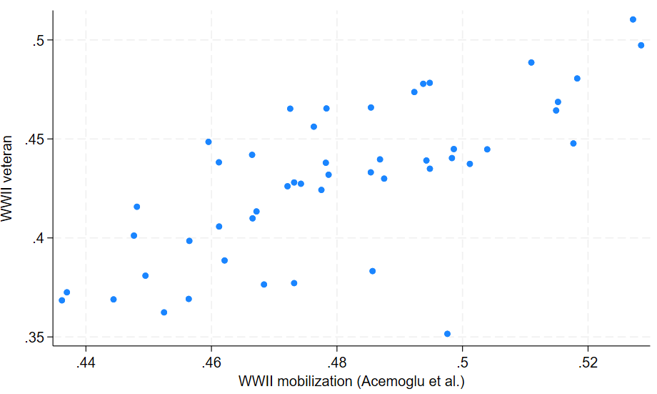
Vets in census vs. state mobilization data
Back

Slide 35
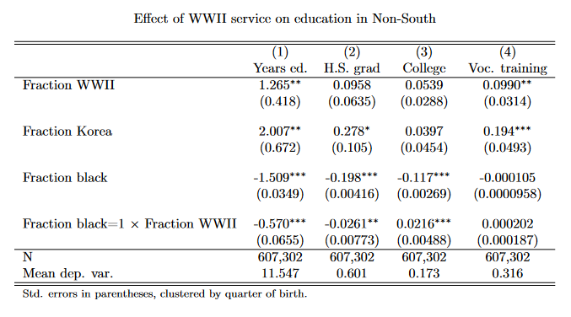
Non-South sample
Back
Notes:
- 41% in range have voc only; 17% coll grad

Slide 36
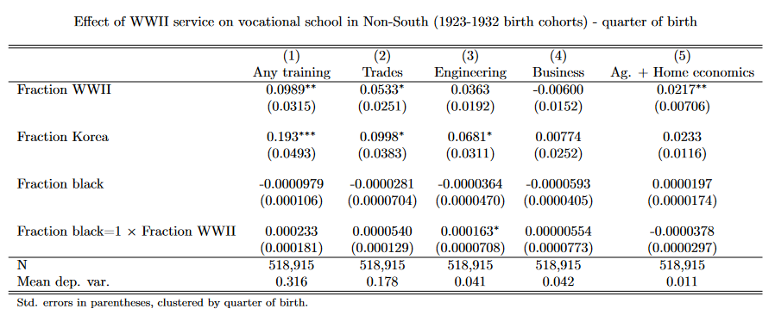
Non-South sample – different fields
Back
Notes:
- 41% in range have voc only; 17% coll grad

Slide 37
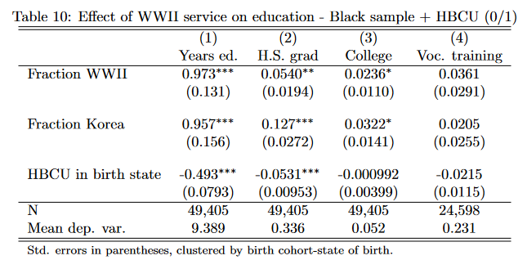
HBCU – binary measure
Back
Notes:
- 41% in range have voc only; 17% coll grad

Slide 38
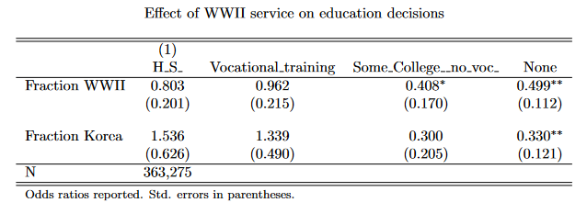
Multinomial logit – base = college
Back
Notes:
- 41% in range have voc only; 17% coll grad

Slide 39
Alternative measure of vocational school
Data limitation of 1970 vocational school measure
- Few observations; not linked to veteran questionnaire; broad measure; single Census year
Construct a more detailed measure
Group by occupation-industry-education attainment
Compute fraction with vocational training
Classify high/low intensity of voc. school

Slide 40
Variation within occupations
Occupation | Industry | Years of school | Fraction vocational training
Carpenters | Fabricated steel products | 12 | 0.51
Carpenters | Fabricated steel products | 13 | 0.76
Carpenters | Fabricated steel products | 14 | 0.82

Slide 41
Variation across industries
Occupation | Industry | Years of school | Fraction vocational training
Carpenters | Misc retail stores | 12 | 0.26
Carpenters | Misc retail stores | 13 | 0.50
Carpenters | Misc retail stores | 14 | 0.20

