Slide 1
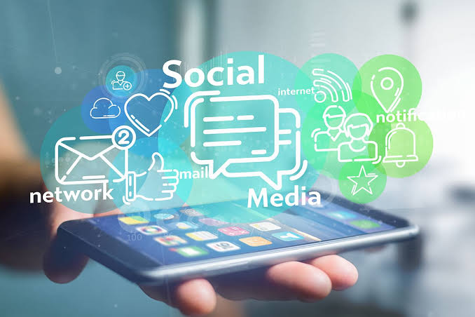
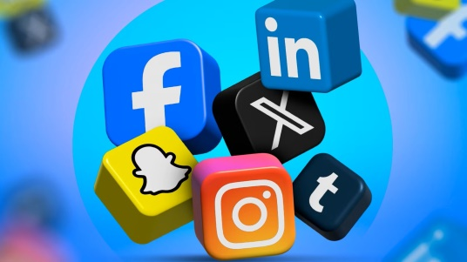
ADVANTAGE AND DISADVANTAGE
OF SOC IAL MEDIA
Papiya Mondal

Slide 2
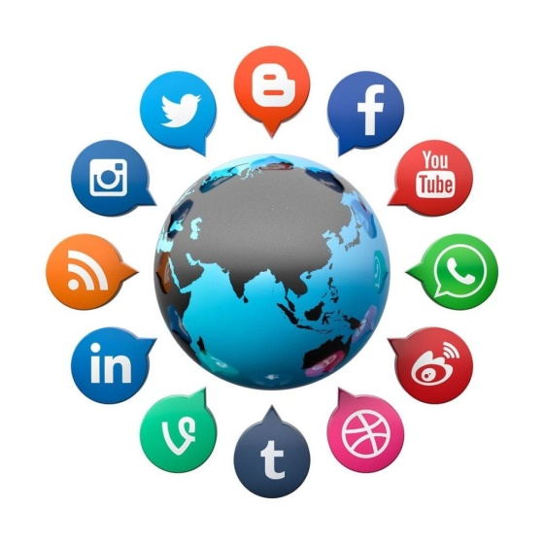
Social Networking
Social networking means creating a public profile with a particular website And making relationship between other people who are using the same website .
Examples of public websites are Instagram , Facebook , LinkedIn .
Even though social Networking can be useful , if used within preventive measures, it’s advantage overweight the disadvantage

Slide 3
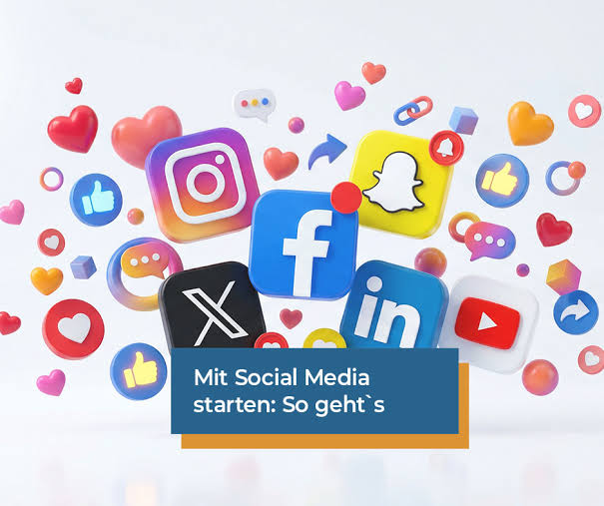
Advantage Of Social Networking
Worldwide connectivity
Real-Time Information shearing
Free Advertising

Slide 4
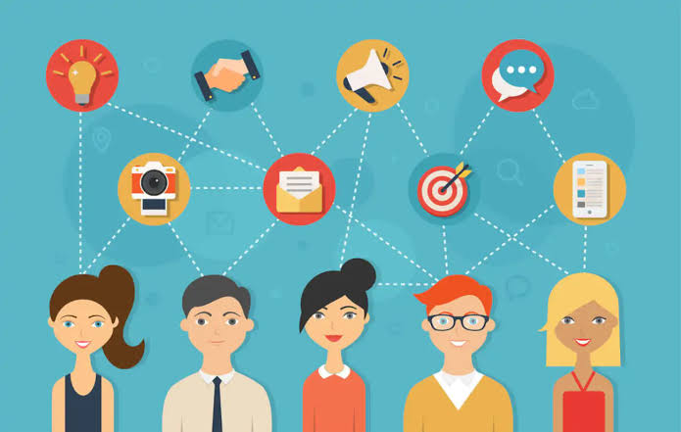
Worldwide connectivity
It is easier and faster to make new friends or business connections or extend their personal base.
There are new websites dedicated to allowing people to connect and to interact via the internet .
These connections can help one with a variety of things such as seeking job , getting product and service , etc.

Slide 5
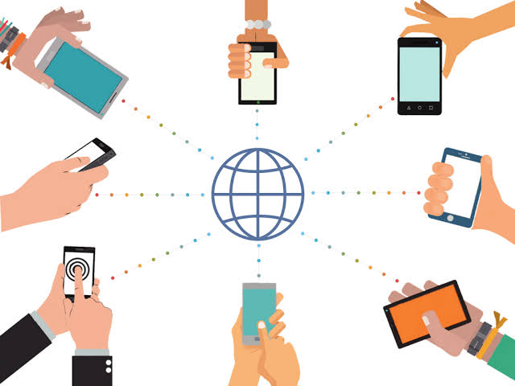
Real-Time Information sharing
With social networking site , you exchange information easily in real-time via a chat .
In addition , the internet is the ultimate online textbook.

Slide 6
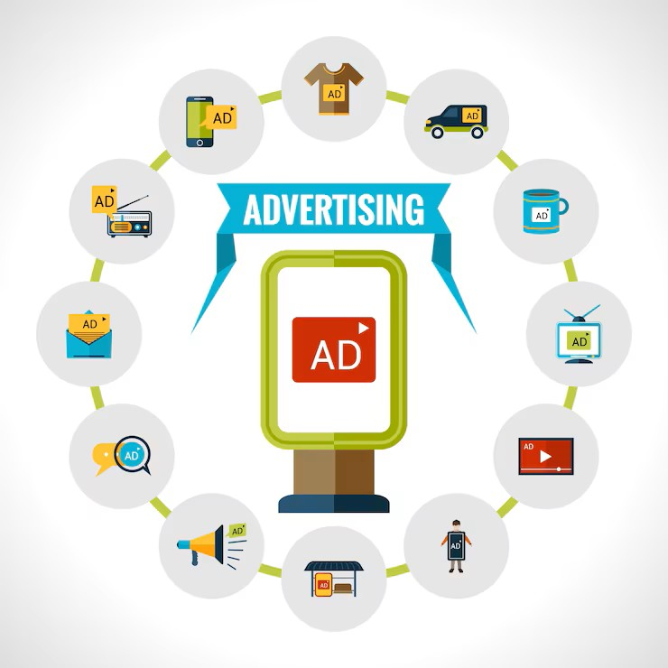
Free Advertising
Online Directories: Claim listings on Google Business Profile, Yelp, and Bing Places to boost local visibility.
Social Media: Publish regular posts, reels, and stories on Instagram, Facebook, and LinkedIn.
Content Search: Create educational videos on YouTube targeting specific questions people search for online.

Slide 7
Disadvantage Of Social Media
Cyber Bullying
Higher risk of fraud and identity
Privacy issues
Others disadvantage

Slide 8
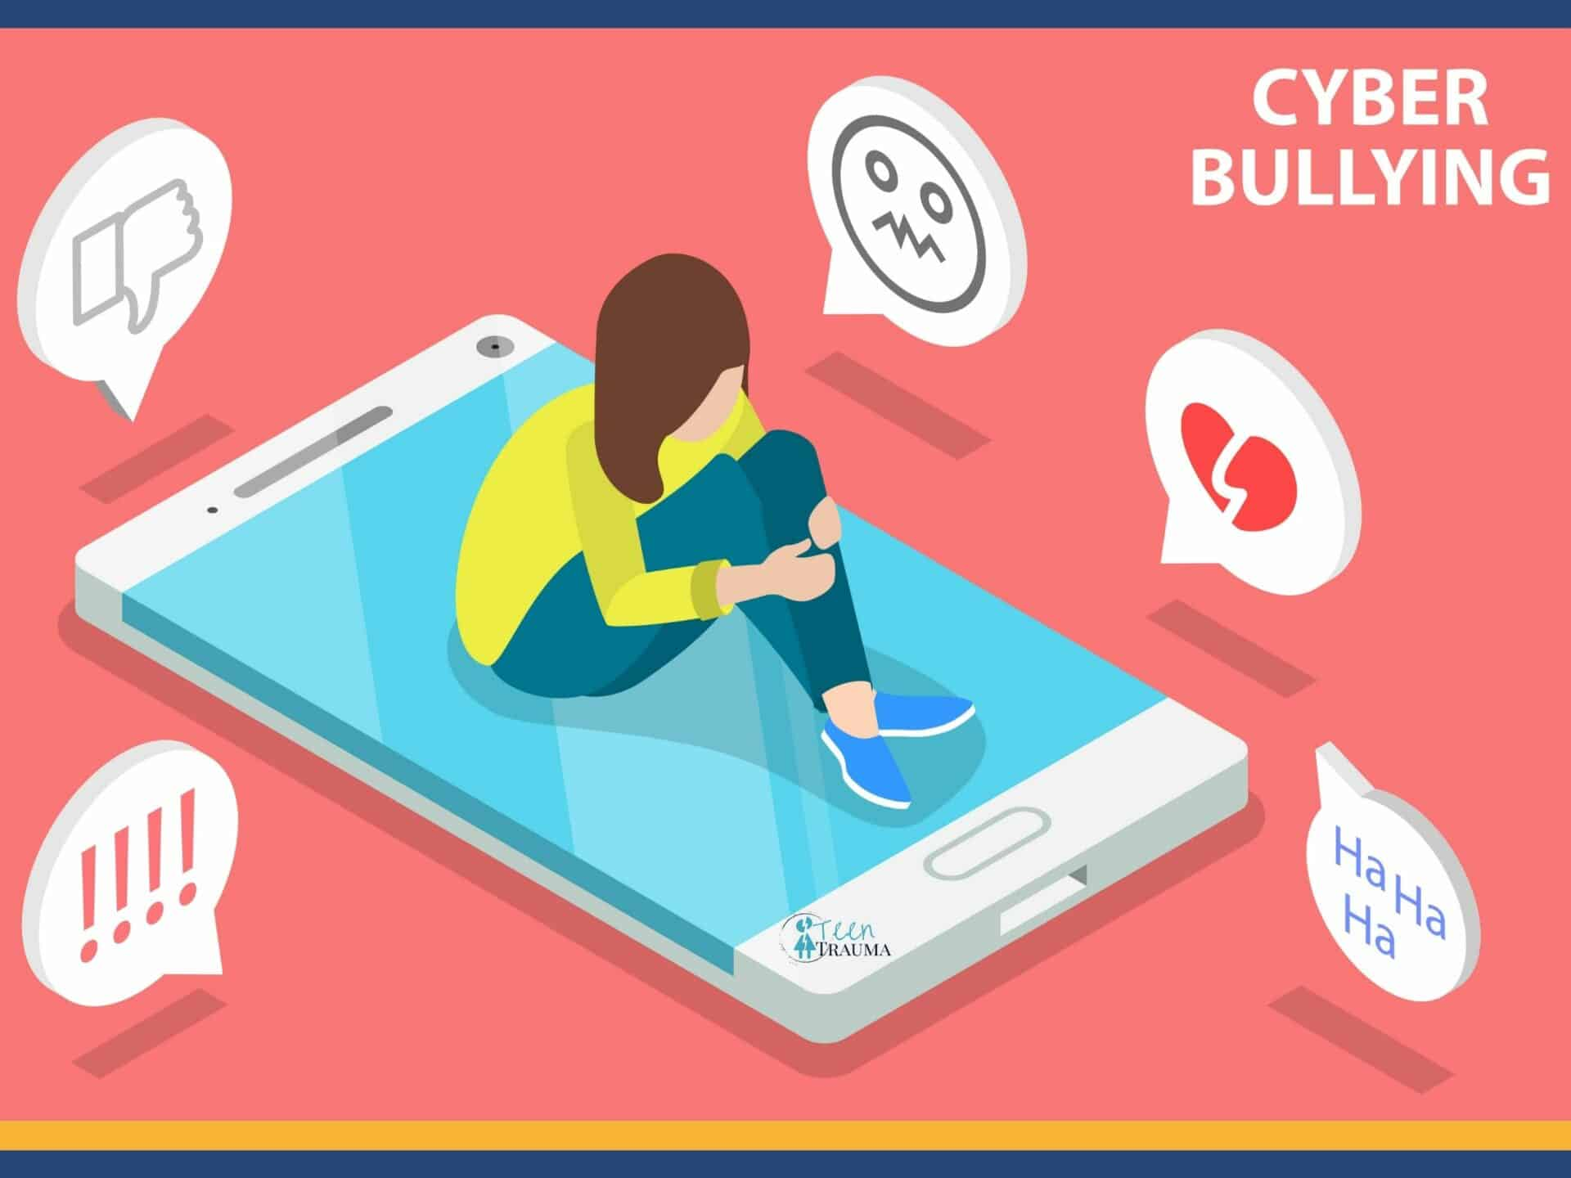
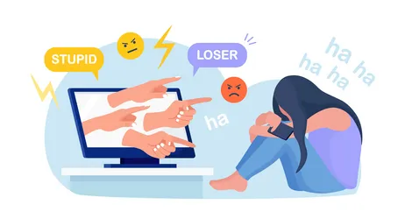
Cyber Bullying
CyberBullying is the use of digital technologies to harass, intimidate, or harm others, often repeatedly and intentionally .
Harassment: Sending threatening or insulting messages repeatedly.
Impersonation: Creating fake accounts to harm or embarrass someone.
Outing or Tricking: Sharing private information or photos without consent.
Exclusion: Deliberately leaving someone out of online groups or activities.
Spreading Rumors: Posting false or harmful information about a person online.

Slide 9
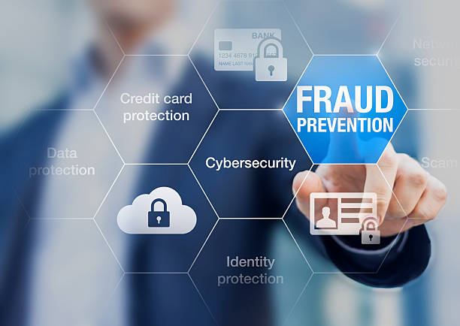
Higher risk of fraud and identity
Being part social network means understanding the security . Risk that that online user can face ; which is identity fraud.
Anyone can forge a false identity on a social network and pose as someone else . Without verification of someone’s identity , one could befriend a complete stronger and even know it .
The possibility for hackers to commit fraud and increase the risk of identity theft .

Slide 10
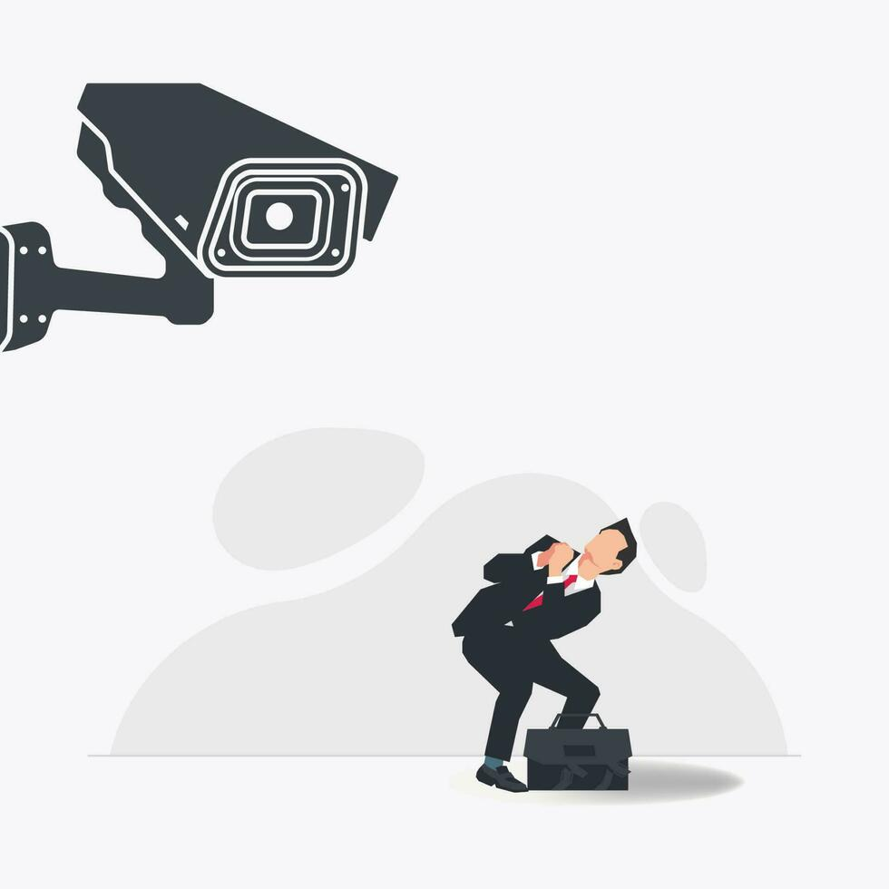
Lack Of Privacy
Lack of privacy increases vulnerability to identity theft and identity fraud, as unauthorized access to personal information enables criminals to impersonate individuals for financial or other gains
Personal data can be accessed through hacking, phishing, shredded documents, intercepted mail, unsecured online accounts, or public databases
Not all privacy breaches are due to direct malicious acts; some are due to weak architectures of data protection, leaving individuals helpless to control access to their information

Slide 11
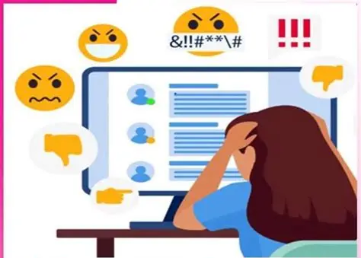
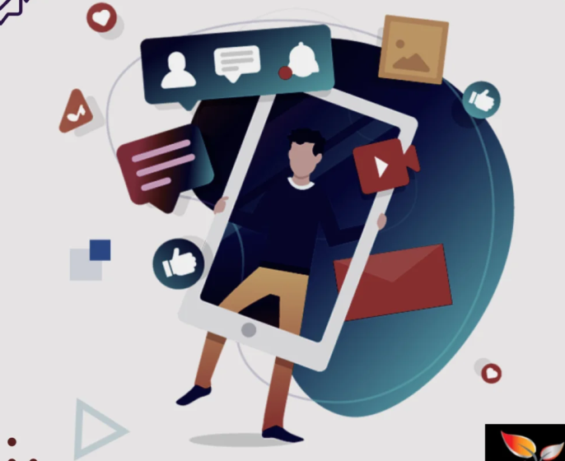
Others Disadvantages
The design of social media encourages addictive behaviors, such as endless scrolling and frequent notifications. This can lead to reduced productivity, disrupted sleep, and diminished face-to-face interactions, with users spending hours daily on platforms instead of engaging in real-life activities .
Social media can promote superficial connections rather than meaningful relationships
Social media platforms collect vast amounts of personal data, including browsing habits, location, and personal preferences. This information can be exploited by third parties, sold to advertisers, or exposed through data breaches. Users who overshare sensitive information risk identity theft, fraud, or unwanted attention

Slide 12
Conclusion
In conclusion, social media has transformed the way people communicate and access information, providing platforms for social connection, professional networking, and educational opportunities. However, excessive use can lead to negative outcomes, including addiction, exposure to misleading content, and reduced face-to-face interactions. While social media fosters engagement and broadens perspectives, users must navigate its risks responsibly, balancing the benefits with mindful usage to maintain mental well-being and protect personal privacy.

