Slide 1


Applying LLMs and semantic technologies for data extraction in literature reviews: a pilot study in LIS
Camille Demers, Ph.D student, École de Bibliothéconomie et des Sciences de l’Information (EBSI), Université de Montréal camille.demers@umontreal.ca

Slide 2
Overview
Introduction
Context & Motivation
Research objectives
Methodology
Ontology model : DoCO
Data Collection
Results
Included studies
Discussion
Conclusion
Related work
LLM-based data extraction workflow
LLMs evaluation
Limitations
Future work
Notes:
Surtout focus sur la méthodologie et les défis rencontrés davantage que sur les résultats comme ça servira à peaufiner l’approche adoptée

Slide 3




Context & Motivation
Need for automation
Drawbacks of LLMs
Publication overload
Academic tools based on LLMs

Slide 4

Semantic technologies for scientific knowledge structuration
Alternative approaches to traditional document-based scholarly dissemination
E.g. Open Research Knowledge Graph, SemOpenAlex, Semantic Publishing and Referencing Ontologies
Jiomekong et al., 2024 ; Jaradeh et al., 2019
https://www.flaticon.com/free-icon/knowledge-graph_14509922?term=graph+network&related_id=14509922

Slide 5
Research objectives
This work seeks to explore methodological frameworks to evaluate AI and semantic-based tools supporting scientific literature reviews, focusing on data extraction
This paper presents a preliminary study based on a small sample of publications included in published systematic reviews in Library and Information Science
5

Slide 6
Related work
Literature review automation
Publication overload makes the manual review process increasingly difficult
NLP and ML tools have been developed to automate various stages
Most automation efforts focus on screening / data extraction remains underexplored
Existing extraction tools are often specific to biomedical data / social sciences face challenges in transferring these tools
6
Affengruber et al., 2024 ; Bolanos et al., 2024 ; Legate et al., 2024 ; van Dinter et al., 2021 ; Wagner et al., 2022
Notes:
(Affengruber et al., 2024 ; Bolanos et al., 2024 ; Legate et al., 2024 ; van Dinter et al., 2021 ; Wagner et al., 2022)

Slide 7
Related work
Scientific information extraction
Extracting key concepts & relations in scientific texts
Traditionnal IE uses supervised ML with manually annotated datasets
Pre-LLMs state-of-the-art : BERT Language models (SciBERT, RoBERTa) with deep neural networks (CNNs, LSTMs)
LLMs now offer flexible IE without the need for annotated training data
Augenstein et al., 2017 ; Bolanos et al., 2024 ; Dagdelen et al., 2024 ; Hong et al., 2021 ; Wang et al., 2022
Notes:
Définition : extraction des concepts clés et de leurs relations dans des textes scientifiques (pas nécessairement dans le contexte d’une synthèse des connaissances – peut aussi servir à l’indexation des documents ou à la représentation des connaissances scientifiques de manière plus générale)

Slide 8
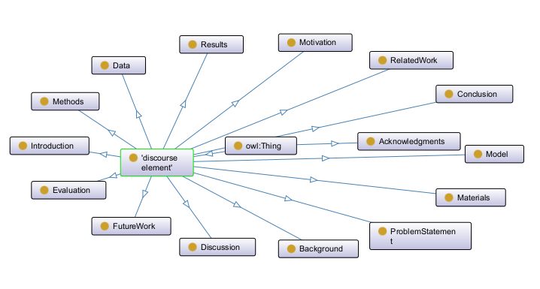

Methodology
Ontology model : DoCO (Document Components Ontology)
Constantin et al, 2016 ; Visualization in Protege (https://protege.stanford.edu/)
Notes:
la description des éléments DEO donne des indices sur les sections d’un article de recherche où se trouvent ces informations, ce qui être utile à inclure dans le prompt pour guider le modèle à focuser sur ces sections

Slide 9
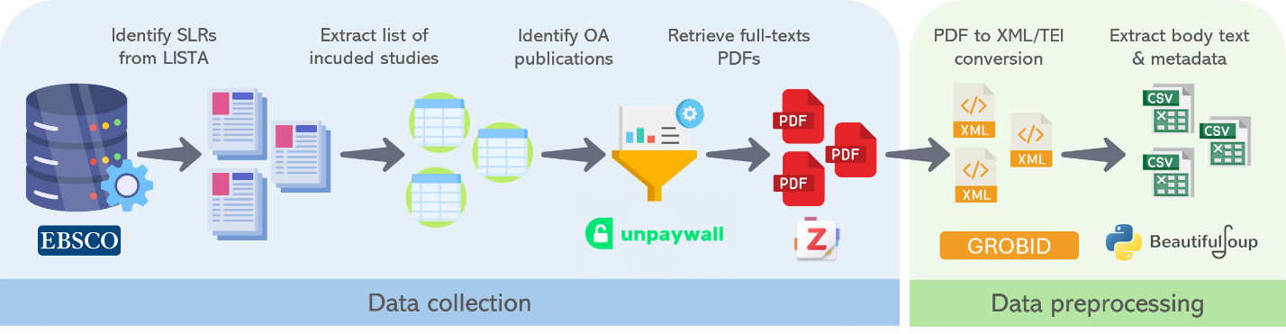
Methodology
Data collection and preprocessing
www.flaticon.com (Vectorslab, Freepik, Flat Icons, kliwir art, Smashicons, surang), https://github.com/Impactstory/unpaywall/blob/master/extension/img/icon-128.png, https://github.com/zotero/zotero/blob/main/app/linux/icons/icon128.png

Slide 10
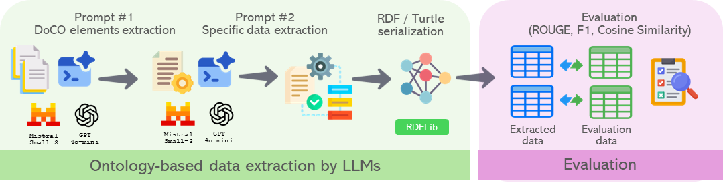
Methodology
Ontology-based data extraction by LLMs
www.flaticons.com (Freepik, fzeetechz, redempticon, Becris, Design Circle, Creatype), https://en.m.wikipedia.org/wiki/File:Mistral_AI_logo_(2025%E2%80%93).svg, https://openai.com/brand/
10

Slide 11

Methodology
Prompt development
Datta et al., 2025
Foppiano et al., 2024
Gartlehner et al., 2024
Khan et al., 2024
Schmidt et al., 2024
11

Slide 12
Methodology
Prompt development
Role assignment “You are an expert of data extraction from a given text” (Khan et al., 2025)
Data extraction task “State {given variable to extract} from the study” (Gartlehner et al., 2024)
Expected shape of the output “Return the extracted data into a JSON object of the shape provided below“ (Schmidt et al., 2024)
Expected behavior when info is not available “If you don't know the answer, just say that you don't know / just answer None” (Foppiano et al., 2024)
Avoiding rephrasing the extracted data Extract the information as it is. Do not change or modify the extracted dataset (Datta et al., 2025)
Avoiding hallucinations Do not include information outside the given text (Khan et al., 2025)
12

Slide 13
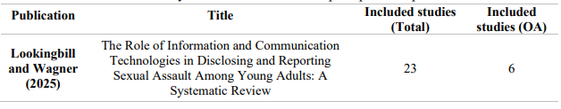
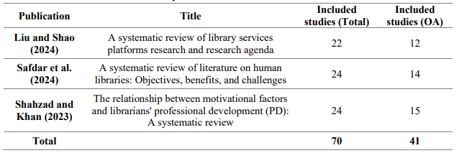
Results
Selected reviews & Included studies
Prompt development set
Test set
13

Slide 14

Results
LLMs evaluation
Variations across data elements ex. Country VS Motivational factors toward professional development
Manual evaluation is needed to nuance these results
14
Notes:
Montrer résultats métriques ROUGE et Cosine similarity en nuançant

Slide 15
Results : Mistral Small 3.1
Ground truth (Liu et Shao, 2024)
Study | Analysis method | Data sources | Participants | Participant size
Ahmad 2021 | Quantitative | Transaction log files | System users | 29 525
Bernard et al 2015 | Qualitative | Observation | System users | 19
LLM-based extraction (Mistral Small 3.1)
Study | Analysis method | Data sources | Participants | Participant size
Ahmad 2021 | Quantitative | Ebook Library (EBL) transaction log files | ECU e-book users | 8,482 (2010), 9,353 (2011), 11,690 (2012)
Bernard et al 2015 | Mixed methods | Baseline Surface Radiation Network (BSRN), PANGAEA repository | Experts from computer science, scientific digital library, usability engineering, scientists from earth and environmental sciences, digital librarians, earth observation scientists | 19
15

Slide 16
Results : GPT-4o mini
Ground truth (Liu et Shao, 2024)
Study | Analysis method | Data sources | Participants | Participant size
Ahmad 2021 | Quantitative | Transaction log files | System users | 29 525
Bernard et al 2015 | Qualitative | Observation | System users | 19
LLM-based extraction (GPT 4o-mini)
Study | Analysis method | Data sources | Participants | Participant size
Ahmad 2021 | Quantitative | Computer-generated Ebook Library (EBL) transaction log files | Unique ECU e-book users | 8,482, 9,353, and 11,690 year-wise unique users
Bernard et al 2015 | Mixed methods | PANGAEA repository, time series research data | Earth observation scientists, data collectors, data curators, digital librarians, computer scientists | 19 earth observation scientists
16

Slide 17
Discussion
Limitations
Mapping DoCO classes and data elements extracted in systematic reviews is not always possible
Heterogeneity in data presentation formats between reviews
Rigidity of automated evaluation metrics (Schmidt et al., 2024)
Possible data contamination due to the accessibility of OA studies for LLM training (Schmidt et al., 2024)
17

Slide 18
Conclusion
Data from scoping of rapid reviews might be easier to map to DoCO classes
Adding a manual evaluation workflow
Expanding to other fields of social sciences
Incorporating other LLMs
Integrating data into a triple store
Future work
18
Notes:
Matière à réflexion – mais beaucoup d’éléments à modifier ou intégrer dans de futures itérations

Slide 19



Related work
Semantic Technologies for scientific knowledge structuration
Facilitated access to scientific content
Standardization of content representation
Alignment with FAIR data principles
Ali & Gravino, 2018 ; Mitchell & Mavergames, 2019 ; Oelen et al., 2020

