Slide 1



Diamond Open Access and Open Infrastructures Have Shaped the Canadian Scholarly Journal Landscape Since the Start of the Digital Era
May 28, 2025 CAIS-ACSI, Halifax
Simon van Bellen
Senior Research Advisor
Érudit
Lucía Céspedes
Research Advisor
Érudit

Slide 2
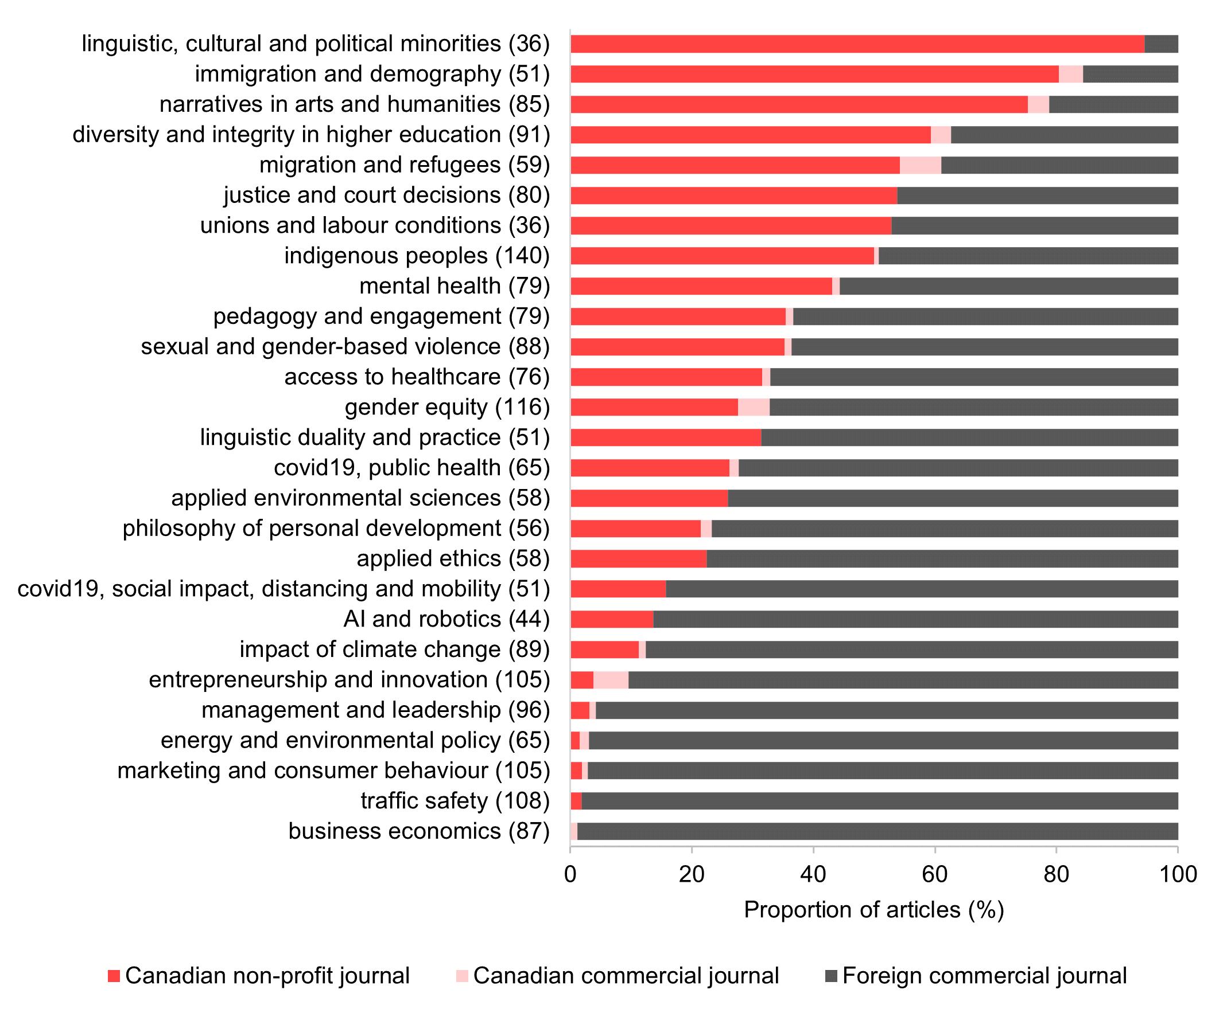
Why documenting Canadian journals?
Domestic journals allow for the publication of new knowledge within a national or local context, particularly in the Social Sciences and Humanities
Proportions of Canadian-authored articles, per journal origin and type*
Topic
*Analyses performed on article abstracts indexed by Dimensions
Notes:
Lucy

Slide 3
The roles and specificities of domestic journals
Often publishing in a national language (other than English), they contribute to the overall multilingualism of the scientific field (Kulczycki et al., 2021)
Often cover research of particular interest for local stakeholders; they attract a wider readership beyond academia, such as social organizations, policymakers, and funders
Natural channels for the creation of regionally relevant research communities and scholarly networks (Sivertsen, 2016)
E. Kulczycki, R. Guns, J. Pölönen, et al. J Assoc Inf Sci Technol 71, 1371–1385 (2020)
G. Sivertsen. Scientometrics 107, 357–368 (2016)
Notes:
Lucy

Slide 4
Aims
Provide an insight into the current state of the Canadian scholarly journals:
(Open) access
Managing organizations
Language
Role of infrastructures, various types of support
Draw an image of trends in publishing before and after the digital era
Notes:
Lucy

Slide 5
Methods
Notes:
Simon

Slide 6
An open inventory of Canadian scholarly journals
Building on previous studies which have documented active Canadian scholarly journals, such as Lange & Severson (2019) and Larivière et al. (2021)
Adding data from ISSN, OpenAlex, DOAJ, CRKN, Aurora catalogue (LAC), Public Knowledge Project and Érudit; historical data using Internet Archive’s Wayback Machine
Validating the dataset using Mir@bel and individual journal websites
J. Lange, S. Severson. J Electron Publ 24 (2021)
V. Larivière, S. Beth, S. van Bellen et al. “Les revues savantes canadiennes en sciences humaines et sociales - Portrait quantitatif et qualitatif” (2021)

Slide 7
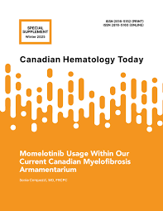

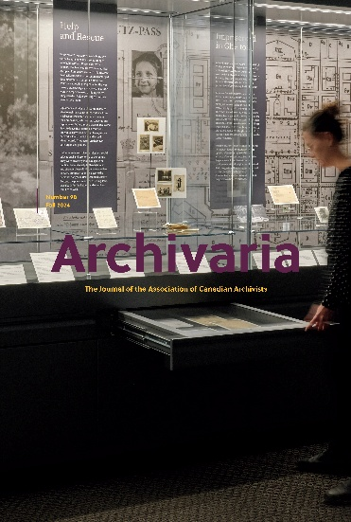
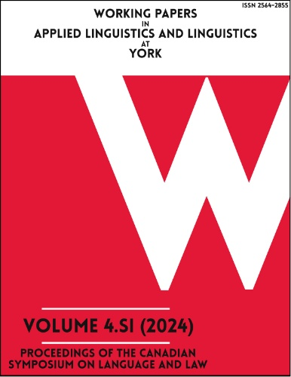
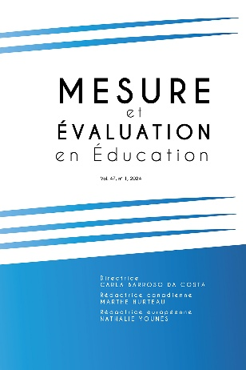
Criteria for inclusion
Scholarly, including peer- or editorial review
Mainly managed from within a Canada-based institution, association or society
Have an ISSN associated
Appear legitimate

Slide 8
What is new in this inventory?
Active and ceased journals
(Open) access and APC use, using the ‘generous’ definition of OA
Use of licences
Languages allowed for submission
SSHRC and FRQSC support status
Indexing status in Web of Science, Scopus and DOAJ
(in progress) Indexing status in JISC Open Policy Finder (former Sherpa Romeo)

Slide 9


Open access to the data
Érudit-Coalition Publica’s Borealis Dataverse, access to frequent snapshots of the inventory (CC BY): https://doi.org/10.5683/SP3/9ONCEU
Living version accessible as a Google Sheet, mainly for commenting, not recommended for research projects

Slide 10
The Canadian scholarly journal landscape

Slide 11
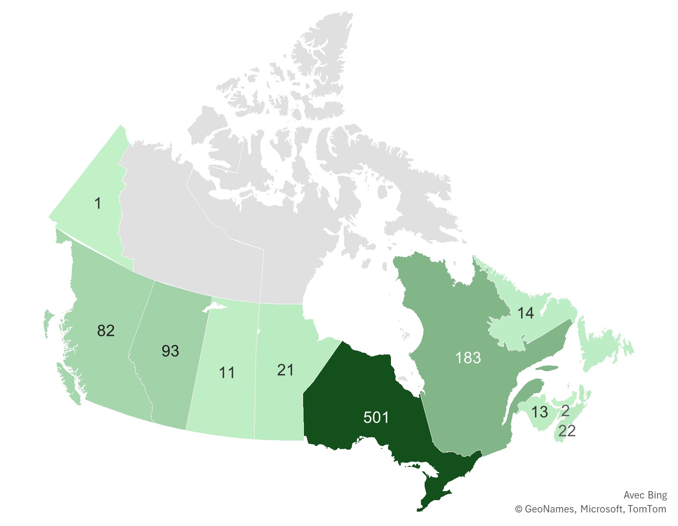
943 active journals

Slide 12
Drawing a Canadian landscape: a typology of journals*
402
Diamond OA, library-hosted, English,
Social Sciences & Professional Fields,
using OJS,
median age 15 years
148
Hybrid,
society/association, Natural Sciences, commercial publishers,
median age 53 years
118
275
Gold OA,
English, Health Sciences
independent,
median age 12 years
Subscription (but also Diamond OA),
French, Arts and Literature & Humanities
often on Érudit,
median age 37 years
*Multiple correspondence analysis and hierarchical cluster analysis
*Based on correspondence analysis and hierarchical clustering on the principal components

Slide 13
(Open) access
61% of the journals are Diamond OA; Gold OA adopted by 8%
Re-use is not guaranteed:
27% of Diamond OA journals do not have an open licence
14% of Gold OA journals do not have an open licence
16% of the journals use subscriptions (no immediate OA option), and 15% are Hybrid
Notes:
Lucy

Slide 14
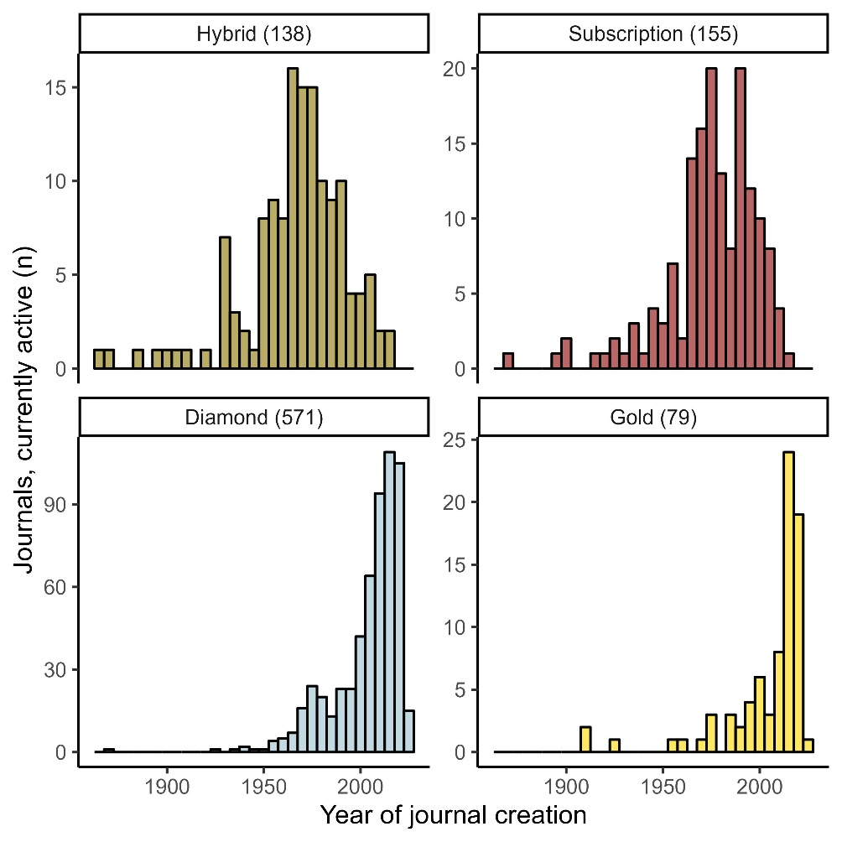
Access and age effects
Journals in Diamond and Gold OA are much younger than Subscription and Hybrid journals
84% of the journals founded since 2015 are Diamond and 16% are Gold OA
At least 25% of the current OA journals likely transitioned from a subscription model

Slide 15
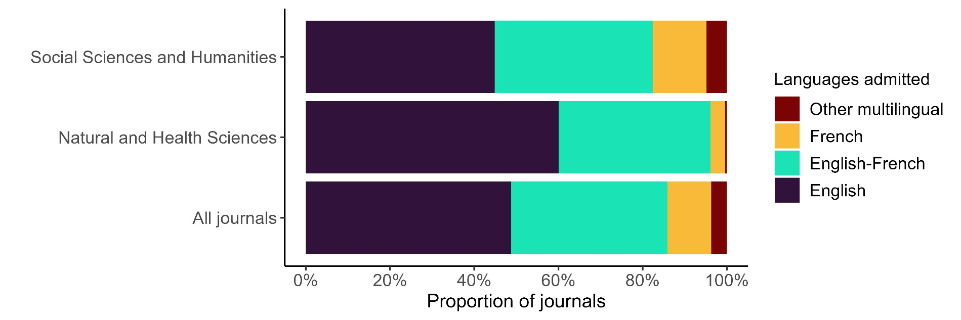
Languages
Even though close to half of the journals publish in English only, the other half declare they accept French content (in addition, or not, to other languages)

Slide 16
Open and non-profit infrastructures
A majority of journals rely on (combinations of) open and non-profit infrastructures

Slide 17
SSHRC and FRQSC support
147 journals receive support from government programs

Slide 18
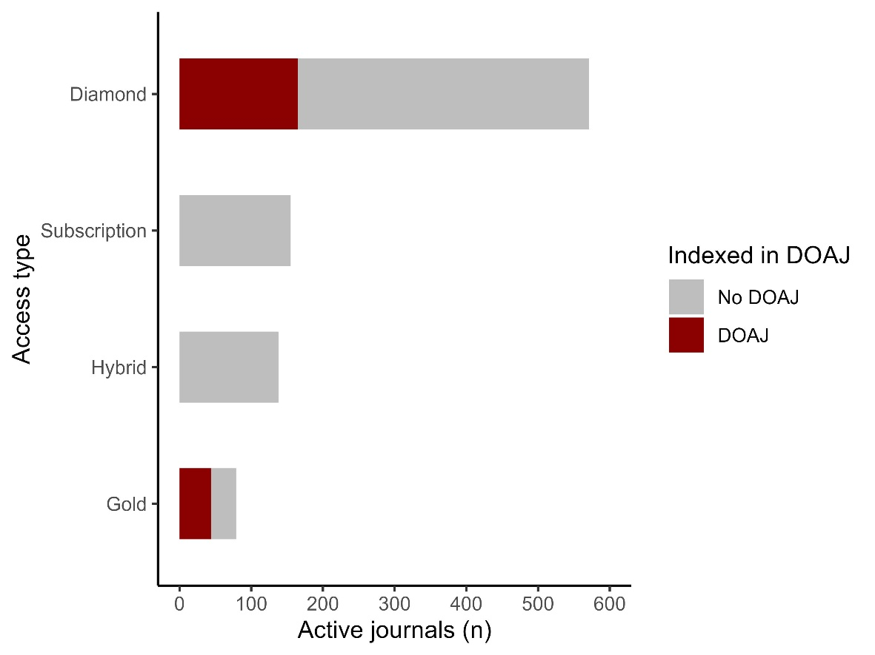
Indexing levels
Overall, only 16% of the journals are indexed in Web of Science; 36% in Scopus
While DOAJ is often perceived as a database of ‘quality’ OA journals, only 56% of the Gold OA journals and 29% of the Diamond OA journals are currently indexed

Slide 19
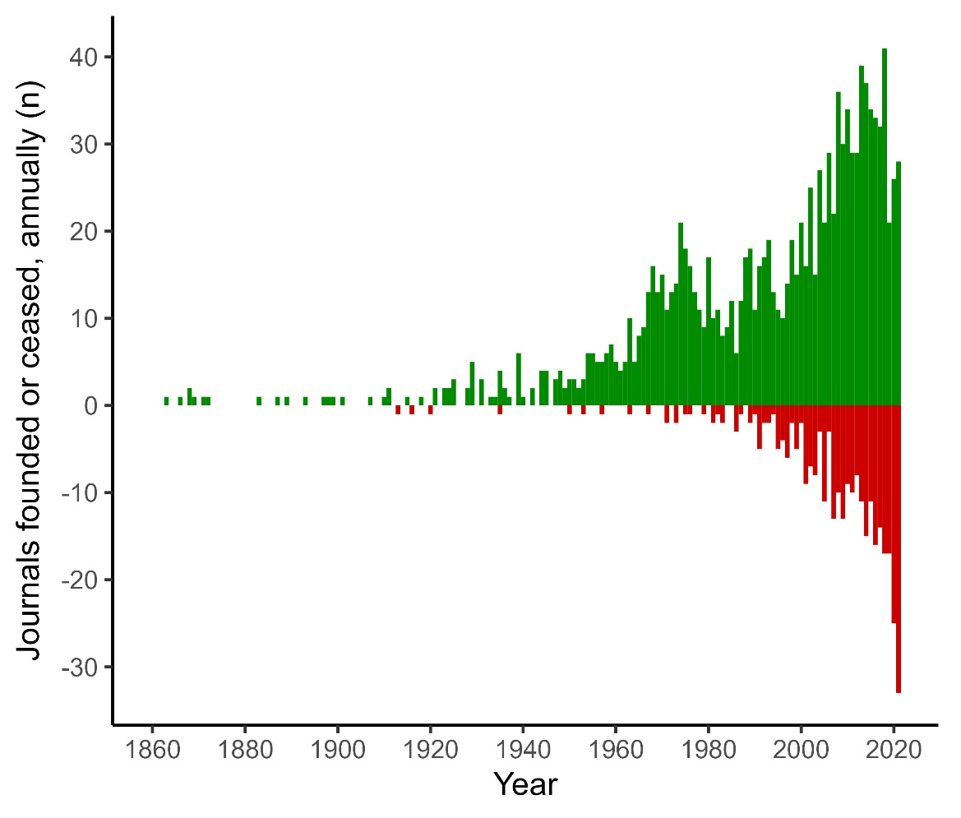
Sustainability
Since the start of the digital era, journal cessation mirrors journal creation
Out of 619 journals founded between 2000 and 2021, 145, or 23%, have ceased publication

Slide 20
Why do journals cease activity?
Current status:
Active
Analysis* of 554 journals active in 2000, taking account of:
Journal age (in 2000)
Organization governing
Student/not student
Province or territory
Language
Discipline
Ceased
*Binary logistic regression, final model created using mixed, stepwise selection, based on AIC

Slide 21
Effects of journal age and the type of governing organization
Journal viability is subject to:
A positive effect of journal age
odds of cessation decreased by 2% for each year added to the journal’s lifespan
A positive effect of societies as managing organizations
odds of cessation were two times lower than journals (primarily) managed by universities
A negative effect of being a student journal
student journals were more than three times more likely to cease activity compared to other journals
No significant effects of geographic origin, language, or discipline

Slide 22
Perspectives: journals ceasing activity
A scholarly journal closing down is a loss of (editorial) know-how and a resource for research
It may also lead to vanishing of scholarly content (Laakso et al., 2021)
It may result in a loss of options for researchers, who may increase their use of international periodicals, or even questionable ones
However, at the macro level, high journal renewal may have a benefit: innovation may be enhanced by the presence of many young entities
M. Laakso, L. Matthias, N. Jahn. J Assoc Inf Sci Technol 72, 1099–1112 (2021)

Slide 23
Research potential
To which extent a journal can be considered ‘domestic’ may depend on multiple characteristics
the composition of authorships may act as an indicator
the patterns of re-use, such as citations and consultations, may provide further insight
Future research may aim to explore further to which extent these journals are embedded in national or local research networks; analyses at the level of the articles will be essential

Slide 24
Conclusions
The different journal profiles identified in this study speak of a highly diversified landscape across Canadian provinces, OA types, managing organizations and languages
Since the start of the digital era, the development of OJS, the role of library hosting, the creation of Érudit and the support provided by SSHRC and FRQSC have likely been important in establishing this diversified landscape
However, journal viability remains an issue, as many young journals cease activity within the first decade, which may be due to a lack of staff, financial resources, or (quality) submissions
Notes:
Lucy

Slide 25
Merci, thank you, gracias, dank u, danke schön, obrigado…
The different journal profiles identified in this study speak of a highly diversified landscape across Canadian provinces, OA types, managing organizations and languages
Since the start of the digital era, the development of OJS, the role of library hosting, the creation of Érudit and the support provided by SSHRC and FRQSC have likely been important in establishing this diversified landscape
However, journal viability remains an issue, as many young journals cease activity within the first decade, which may be due to a lack of staff, financial resources, or (quality) submissions
Feedback?
simon.van.bellen@erudit.org
lucia.cespedes@erudit.org

Slide 26
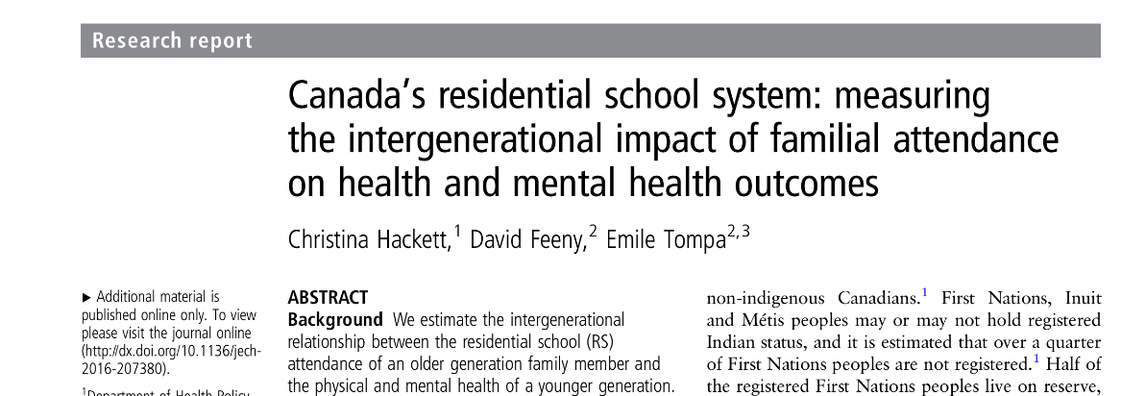
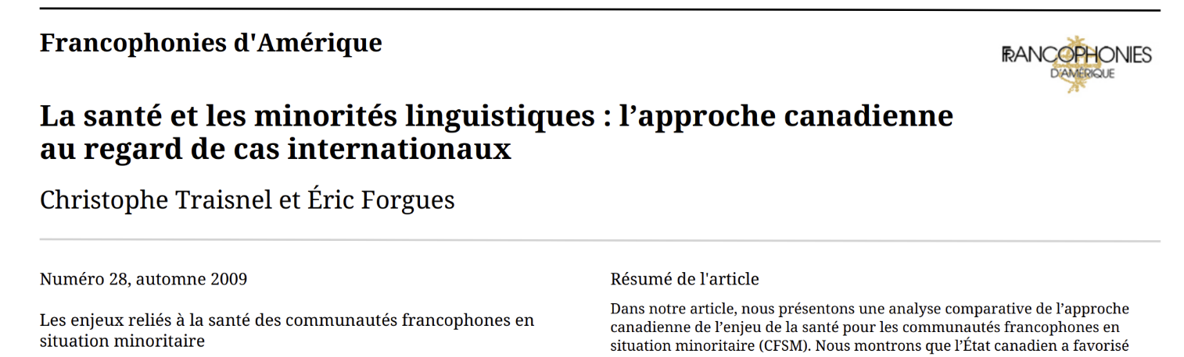
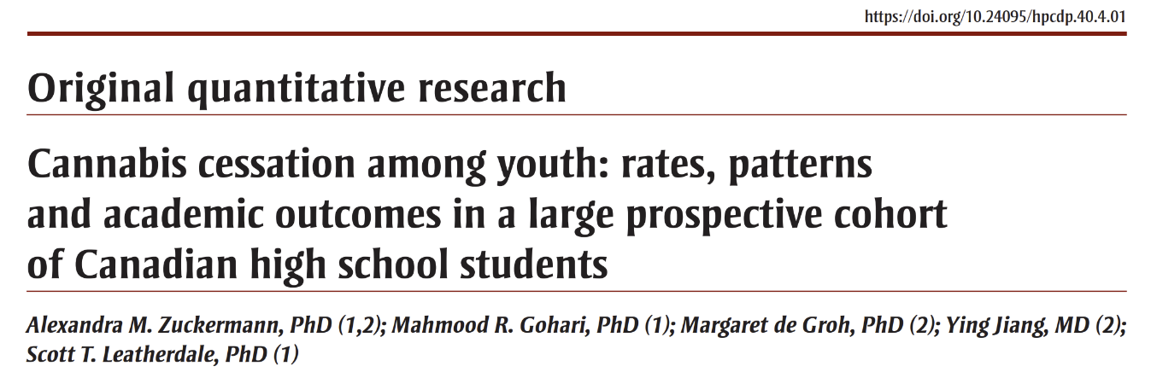
Research in SSH: a strong national and local focus
Most SSH disciplines, and interdisciplinary research, integrate a social, cultural or geographical aspect

Slide 27
Government support, per cluster
Diamond OA, library-hosted, English,
using OJS,
median age 15 years
Subscription (but also Diamond OA),
French,
often on Érudit,
median age 37 years
Hybrid,
society/association, commercial publishers,
Natural Sciences,
median age 53 years
Gold OA,
English,
independent,
Health Sciences,
median age 12 years

Slide 28

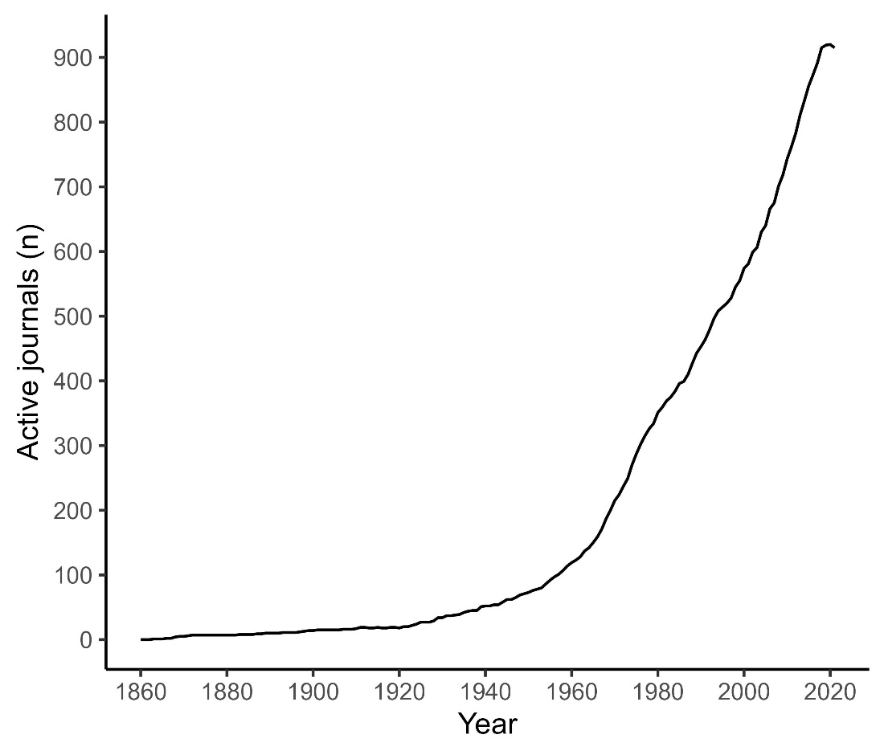
Sustainability

Slide 29
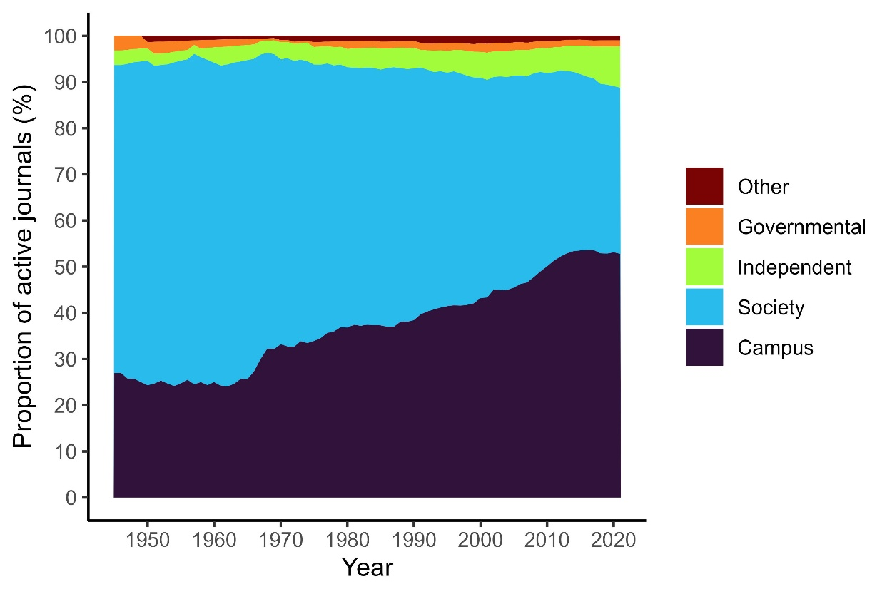
Governing organizations
Currently, 54% of the journals are primarily linked with universities and research institutes (Campus)
Societies used to dominate
Independent journals are on the rise, but remain a minority

Slide 30
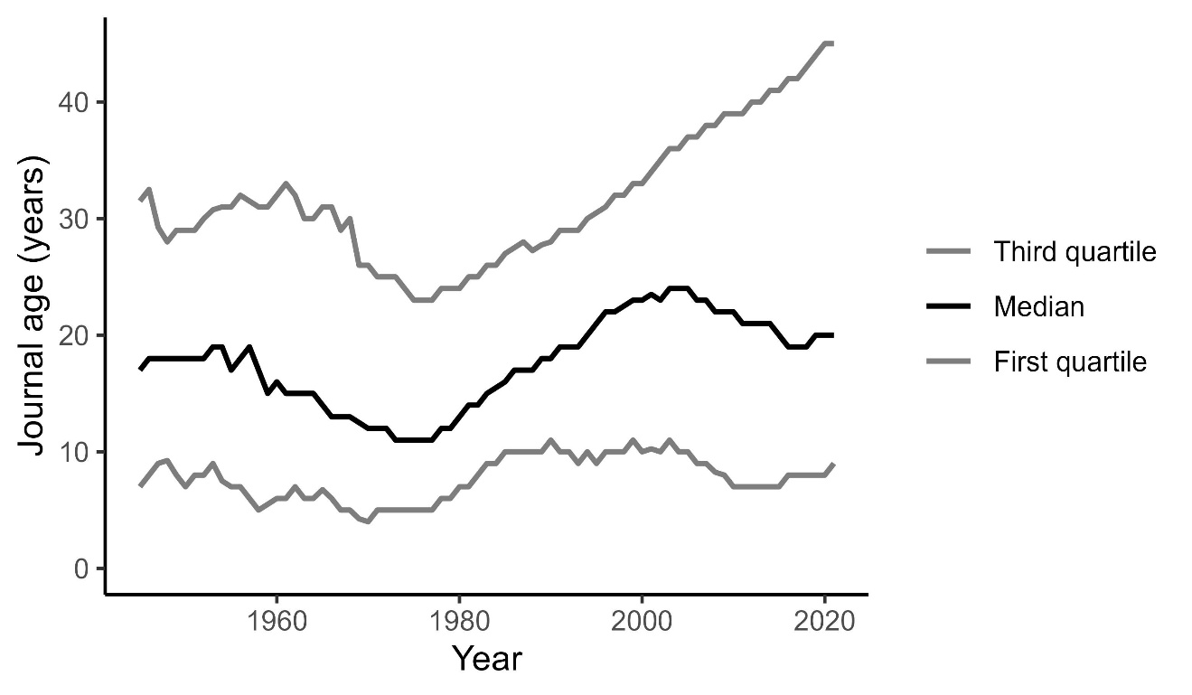
A changing journal age structure in the digital era
Increasing number of very young journals, along with an increasing number of ‘mature’ journals

Slide 31
Potential impact of the inventory
Creating a live, up-to-date inventory of Canadian scholarly journals enhances research potential, thus contributing to a better understanding of how new knowledge is circulated
It sheds light on a part of the ecosystem that is relatively poorly documented by other resources, such as the Web of Science or Scopus

