Slide 1



A bibliometric analysis of Canadian LIS scholars and practitioners’ research contributions
Jean-Sébastien Sauvé¹, Madelaine Hare², Geoff Krause³, Constance Poitras⁴, Poppy Riddle⁵, & Philippe Mongeon⁶
¹École de bibliothéconomie et des sciences de l'information, Université de Montréal, Canada, ²Digital Transformation and Innovation, University of Ottawa, Canada, ³Department of Information Science, Dalhousie University, Canada, ⁴Centre interuniversitaire de recherche sur la science et la technologie (CIRST), Université du Québec à Montréal, Canada

Slide 2
Research objectives
To map the scholarly contributions of Canadian LIS faculty and academic librarians and gain insights on their similarities and differences, as well as on the degree to which the two groups engage with each other through scholarship.
RQ1. What are the similarities and differences in publications, publication venues, and topics between Canadian LIS faculty members and academic librarians?
RQ2. To what extent do Canadian LIS faculty members and academic librarians engage with each other through collaborations and references?
Notes:
We use a comprehensive database of all Canadian LIS publications authored by faculty members and academic librarians created as part of the SSHRC-funded project “Breaking down research silos” (Sauvé et al., 2024a). This database offers the advantage of encompassing articles not typically included in traditional bibliometric surveys, such as those conducted using databases like Web of Science (WoS), Scopus, and Library and Information Science Abstracts (LISA).

Slide 3
Methods
Dataset
Open dataset by Sauvé et al. (2024a, 2024b) on Canadian LIS publications.
Includes publications by LIS academics (from ALA-accredited Canadian units) and practitioners (university librarians).
Analyzed 9,261 publications (subset indexed in OpenAlex) from the original 13,775 total.
Grouping of publications
Academic: at least one LIS academic author, no LIS practitioner (N = 6, 178).
Practitioner: at least one LIS practitioner, no LIS academic (N = 2,935).
Collaboration: at least one LIS academic and one LIS practitioner (N = 148).

Slide 4
Methods
Research activity (RQ1):
Document type
Venue
Group (academic, practitioner, collaboration)
Topic
Interactions (RQ2):
Used co-authorship data from authors_publications and authors tables.
Built a co-authorship network:
Nodes = individual authors
Edges = co-authorship ties, weighted by frequency
Node group = academic or practitioner (per Sauvé et al., 2024a)
Citation analysis:
Used OpenAlex citation links between papers.
Created a matrix of citation counts and percentages within and across groups.

Slide 5
Document types
Document type | Total |  | Academic |  | Practitioner |  | Collaboration
 | N | % | N | % | N | % | N | %
Article | 6,601 | 71.3 | 4,600 | 74.5 | 1,898 | 64.7 | 103 | 69.6
Review | 1,022 | 11.0 | 323 | 5.2 | 685 | 23.3 | 14 | 9.5
Book chapter | 667 | 7.2 | 586 | 9.5 | 73 | 2.5 | 8 | 5.4
Conference paper | 497 | 5.4 | 431 | 7.0 | 45 | 1.5 | 21 | 14.2
Book review | 191 | 2.1 | 4 | 0.1 | 187 | 6.4 | 0 | 0.0
Editorial material | 105 | 1.1 | 89 | 1.4 | 15 | 0.5 | 1 | 0.7
Note | 78 | 0.8 | 57 | 0.9 | 20 | 0.7 | 1 | 0.7
Book | 66 | 0.7 | 60 | 1.0 | 6 | 0.2 | 0 | 0.0
Letter | 34 | 0.4 | 28 | 0.5 | 6 | 0.2 | 0 | 0.0
Total | 9,261 | 100 | 6,178 | 100 | 2,935 | 100 | 148 | 100
Notes:
Table 1 reveals that of the 9,261 publications in our dataset, the majority are journal articles (71.3%), followed by reviews and book chapters. Academics tended to publish at higher rates, authoring 6,178 (66.7%) of total publications, while practitioners authored 2,935 (31.7%). Collaborations accounted for only 137 publications, or less than 2% of total output. Articles and conference papers were the most common formats in which collaboration manifested. One highlight of the results presented in Table 1 is the substantially higher proportion of reviews and book reviews performed by practitioners (23.3% and 6.4%, respectively) compared to academics (11% and 2.1%, respectively).

Slide 6
Venues
Academics
Practitioners
Collaboration
Venue | N. pubs
Proceedings of the Association for Information Science and Technology | 289
Lecture notes in computer science | 177
Proceedings of the Annual Conference of CAIS | 168
Journal of the Association for Information Science and Technology | 156
Routledge eBooks | 92
Documentation et bibliothèques | 74
Scientometrics | 69
PLoS ONE | 66
Library & Information Science Research | 65
IGI Global eBooks | 62
Journal of Documentation | 58
Education for Information | 54
Springer eBooks | 52
Cataloging & Classification Quarterly | 48
Elsevier eBooks | 43
Information Communication & Society | 41
Information Processing & Management | 38
First Monday | 33
Knowledge Organization | 32
Lecture notes in business information processing | 31
Venue | N. pubs
Evidence Based Library and Information Practice | 145
The Deakin Review of Children s Literature | 130
Partnership: The Canadian Journal of Library and Information Practice and Research | 68
BMJ Open | 63
Journal of the Canadian Health Libraries Association | 61
The Journal of Academic Librarianship | 54
College & Research Libraries | 43
Systematic Reviews | 41
Journal of the Medical Library Association | 38
PLoS ONE | 33
Cochrane library | 27
Reference Services Review | 27
CAML Review | 20
JBI Evidence Synthesis | 20
The Serials Librarian | 20
College & Research Libraries News | 19
Library Hi Tech | 19
College & Undergraduate Libraries | 16
The American Economist | 16
Proceedings of the Annual Conference of CAIS | 15
Venue | N. pubs
Proceedings of the Annual Conference of CAIS | 25
First Monday | 6
Proceedings of the Association for Information Science and Technology | 5
The Journal of Academic Librarianship | 5
Archives | 4
BMJ Open | 4
Journal of Documentation | 3
Journal of the Association for Information Science and Technology | 3
Journal of the Medical Library Association | 3
Lecture notes in computer science | 3
Library & Information Science Research | 3
Partnership: The Canadian Journal of Library and Information Practice and Research | 3
Archivaria | 2
BMC Medical Research Methodology | 2
BMC Medicine | 2
Cataloging & Classification Quarterly | 2
College & Research Libraries | 2
College & Research Libraries News | 2
Études de communication/Études de communication | 2
Implementation Science | 2
Journal of Information Policy | 2
Journal of the Canadian Health Libraries Association | 2
Knowledge Organization | 2
Online Information Review | 2
Presses de l'Université du Québec eBooks | 2
Serials Review | 2
The International Journal of Information Diversity & Inclusion (IJIDI) | 2
Notes:
The top venues of publications by academics (Table 2) show that the conference proceedings of two prominent LIS research organizations supporting both researchers and practitioners (CAIS and ASIST) are among the top five venues. The list includes several LIS-specific journals (e.g., Library & Information Science Research, Cataloging & Classification Quarterly, Information Communication & Society, etc.), but also multidisciplinary venues such as PLoS ONE and First Monday, and venues from disciplines other than LIS, some with obvious ties to the field (e.g., Lecture notes in computer science) and others for which this link is less obvious (e.g., Marine Pollution Bulletin).

Slide 7
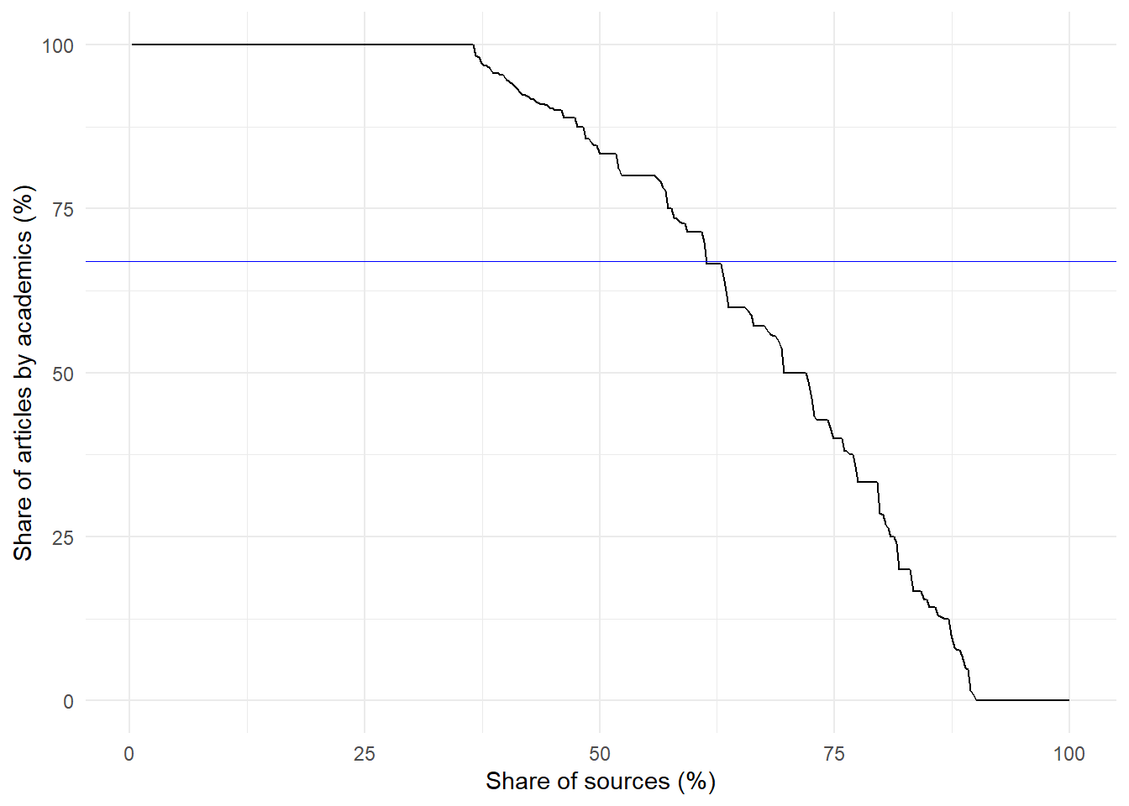
Venues
Distribution of venues by share of articles authored by academics
Notes:
Figure 1 depicts the distribution of venues by share of articles authored by academics. The blue line is the theoretical distribution in which every venue has a proportional representation of academics and practitioners. It is apparent that approximately 37.5% of venues exclusively publish academics, and about 10% of venues exclusively publish practitioners (as indicated by the 0% of academics). This shows that about half of the journals in our dataset publish exclusively works by one of the two groups.

Slide 8
topics
Topics
Academics
Practitioners
Collaboration
OpenAlex topic | N. pubs
Scientometrics and bibliometrics research | 123
Bibliometric Analysis and Research Evaluation | 98
Social Inclusion in Library Services for Newcomers | 85
Knowledge Management and Sharing | 65
Information Literacy in Higher Education | 58
The Impact of Digital Media on Public Discourse | 61
Digital Communication and Information Studies | 60
Archival Science and Digital Preservation | 58
Semantic Web and Ontologies | 55
Social Media and Politics | 53
Library Science and Information Literacy | 47
Library Science and Administration | 50
Semantic Web and Ontology Development | 50
Knowledge Sharing in Virtual Communities | 44
Information Retrieval Techniques and Evaluation | 43
Digital and Traditional Archives Management | 41
Information Retrieval and Search Behavior | 40
Innovative Human-Technology Interaction | 40
Social and Psychological Aspects of Online Gaming | 37
Digital Games and Media | 35
OpenAlex topic | N. Pubs
Information Literacy in Higher Education | 83
Library Science and Information Literacy | 82
Usage and Impact of E-Books in Academic Settings | 54
Implementation of Evidence-Based Practice in Healthcare | 48
Social Inclusion in Library Services for Newcomers | 45
Library Collection Development and Digital Resources | 42
Health and Well-being of Arctic Indigenous Peoples | 39
Health Sciences Research and Education | 36
Impact of Web 2.0 on Academic Libraries | 36
Library Science and Administration | 33
Archival Science and Digital Preservation | 31
Digital and Traditional Archives Management | 28
Bibliometric Analysis and Research Evaluation | 26
Data Sharing and Stewardship in Science | 25
Methods for Evidence Synthesis in Research | 23
Web and Library Services | 22
Research Data Management Practices | 22
Library Science and Information Systems | 19
Meta-analysis and systematic reviews | 21
Children's Literature and its Impact | 19
OpenAlex topic | N. pubs
Bibliometric Analysis and Research Evaluation | 7
Research Data Management Practices | 5
Scientometrics and bibliometrics research | 4
Digital Communication and Information Studies | 4
Semantic Web and Ontologies | 4
Health and Well-being of Arctic Indigenous Peoples | 4
Health Sciences Research and Education | 4
Data Sharing and Stewardship in Science | 4
Wikis in Education and Collaboration | 4
Knowledge Management and Sharing | 3
Knowledge Sharing in Virtual Communities | 3
Library Collection Development and Digital Resources | 3
Impact of Web 2.0 on Academic Libraries | 3
Health Policy Implementation Science | 3
Image Retrieval and Classification Techniques | 3
Information Literacy in Higher Education | 2
Library Science and Information Literacy | 2
Archival Science and Digital Preservation | 2
Library Science and Administration | 2
Information Retrieval Techniques and Evaluation | 2
Notes:
The top topics of academic-authored publications are shown in Table 5. Topics relating to Scientometrics and Bibliometrics research and analysis amount to 3.6% of publications. Several topics relating to digital media, communications, and virtual knowledge sharing (i.e., The Impact of Digital Media on Public Discourse, Digital Communication and Information Studies, Knowledge Sharing in Virtual Communities, and Digital Games and Media) appear among the top topics, making up around 3.3% of publications. We also observe the prominence of core library science topics such as information literacy, information retrieval, and information behaviour. Archives are also represented in the Archival Science and Digital Preservation (58 publications) and Digital and Traditional Archives Management (41 publications) topics. The semantic web is also a notable inclusion in the list.

Slide 9
Citations
Citing group | Cited group
 | Academic | Collaboration | Practitioner
Academic | 1,468 (89.5%) | 18 (1.1%) | 154 (9.4%)
Collaboration | 35 (63.6%) | 1 (1.8%) | 19 (34.5%)
Practitioner | 212 (36.5%) | 23 (3.9%) | 346 (59.3%)

Slide 10
Citation network
Green = Academics Pink = Practitioners

Slide 11
Dataset and associated papers
Dataset:
Sauvé, J.-S., Hare, M., Krause, G., Poitras, C., Riddle, P., & Mongeon, P. (2024). Canadian publications in Library and Information Science / Publications canadiennes en bibliothéconomie et sciences de l’information [Dataset]. Zenodo. https://doi.org/10.5281/zenodo.14302591
Data paper:
Sauvé, J.-S., Hare, M., Krause, G., Poitras, C., Riddle, P., & Mongeon, P. (2025). Canadian Publications in Library and Information Science: A Database of research by LIS academics and practitioners in Canada. Canadian Journal of Information and Library Science. https://doi.org/10.5206/cjils-rcsib.v48i1.22200
Bibliometric analysis:
Sauvé, J.-S., Hare, M., Krause, G., Poitras, C., Riddle, P., & Mongeon, P. (2025). A bibliometric analysis of Canadian LIS scholars and practitioners' research contributions. Canadian Journal of Information and Library Science. https://doi.org/10.5206/cjils-rcsib.v48i1.22439

Slide 12
References
Babb, M. N. (2017). An Exploration of Academic Librarians as Researchers within a University Setting. ERA. https://doi.org/10.7939/R3CF9JK1W
Borrego, Á., Ardanuy, J., & Urbano, C. (2018). Librarians as Research Partners: Their Contribution to the Scholarly Endeavour Beyond Library and Information Science. The Journal of Academic Librarianship, 44(5), 663–670. https://doi.org/10.1016/j.acalib.2018.07.012
Ducas, A., Michaud-Oystryk, N., & Speare, M. (2020). Reinventing Ourselves: New and Emerging Roles of Academic Librarians in Canadian Research-Intensive Universities. College and Research Libraries (Online), 81(1), 43. https://doi.org/10.5860/crl.81.1.43
Clayton, P. (1992). Bridging the Gap: Research and practice in librarianship. In P. Clayton & R. McCaskie (Eds.), Priorities for the future: Proceedings of the First National Reference and Information Service Section Conference and the University, College and Research Libraries Section Workshop on Research (pp. 73–76). D. W. Thorpe.
Finlay, S. C., Ni, C., Tsou, A., & Sugimoto, C. R. (2013). Publish or Practice? An Examination of Librarians’ Contributions to Research. Portal-Libraries and the Academy, 13(4), 403–421. https://doi.org/10.1353/pla.2013.0038
Fox, D. (2007a). A Demographic and Career Profile of Canadian Research University Librarians. The Journal of Academic Librarianship, 33(5), 540–550. https://doi.org/10.1016/j.acalib.2007.05.006
Fox, D. (2007b). Finding Time for Scholarship: A Survey of Canadian Research University Librarians. Portal : Libraries and the Academy, 7(4), 451-454,456-457,459-462. https://doi.org/10.1353/pla.2007.0041
Fox, D. (2007c). The Scholarship of Canadian Research University Librarians. Partnership : The Canadian Journal of Library and Information Practice and Research, 2(2), 15–25. https://doi.org/10.21083/partnership.v2i2.305
Genoni, P., Merrick, H., & Willson, M. A. (2006). Scholarly communities, e‐research literacy and the academic librarian. The Electronic Library, 24(6), 734–746. https://doi.org/10.1108/02640470610714189
Hall, L. W., & McBain, I. (2014). Practitioner research in an academic library: Evaluating the impact of a support group. The Australian Library Journal, 63(2), 129–143. https://doi.org/10.1080/00049670.2014.898238
Hildreth, C. R., & Aytac, S. (2007). Recent Library Practitioner Research: A Methodological Analysis and Critique. Journal of Education for Library and Information Science, 48(3), 236–258.
Hoffmann, K., Berg, S. A., Brancolini, K. R., & Kennedy, M. R. (2023). Complex and Varied: Factors Related to the Research Productivity of Academic Librarians in the United States. College and Research Libraries, 84(3), 392–427. https://doi.org/10.5860/crl.84.3.392
Jabeen, M., Yun, L., Rafiq, M., & Jabeen, M. (2015). Research productivity of library scholars. Bibliometric analysis of growth and trends of LIS publications. New Library World, 116(7/8), 433–454. https://doi.org/10.1108/NLW-11-2014-0132
Kandiuk, M., & Sonne de Torrens, H. M. (2018). Academic Freedom and Librarians’ Research and Scholarship in Canadian Universities. College & Research Libraries, 79(7), 931–947. https://doi.org/10.5860/crl.79.7.931
Mongeon, P., Gracey, C., Riddle, P., Hare, M., Simard, M.-A., & Sauvé, J.-S. (2023). Mapping information research in Canada. The Canadian Journal of Information and Library Science / La Revue Canadienne Des Sciences de l’inrmation et de Bibliothéconomie, 46(2), 1–27. https://doi.org/10.5206/cjils
-rcsib.v46i2.15568
Nguyen, L. C., & Hider, P. (2018). Narrowing the Gap Between LIS Research and Practice in Australia. Journal of the Australian Library and Information Association, 67(1), 3–19. https://doi.org/10.1080/24750158.2018.1430412
Paul-Hus, A., Mongeon, P., & Shu, F. (2016). Portraying the Landscape of Canadian Library and Information Science Research. Canadian Journal of Information and Library Science-Revue Canadienne Des Sciences De L’Information Et De Bibliothéconomie, 40(4), 332–346.
Ponti, M. (2013). Peer production for collaboration between academics and practitioners. Journal of Librarianship and Information Science, 45(1), 23–37. https://doi.org/10.1177/0961000612438430
Sugimoto, C. R., Tsou, A., Naslund, S., Hauser, A., Brandon, M., Winter, D., Behles, C., & Finlay, S. C. (2014). Beyond Gatekeepers of Knowledge: Scholarly Communication Practices of Academic Librarians and Archivists at ARL Institutions | Sugimoto | College & Research Libraries. College & Research Libraries, 75(2), 145–161. https://doi.org/10.5860/crl12-398

