Slide 1



Exploring dehumanization and infrahumanization as underlying factors in misinformation belief and spread
Andrew Weiss,
Souvick Ghosh & Frances Johnson
CSUN / SJSU / MMU
Canadian Association of Information Science (CAIS) Conference
May 27, 2025
12:00 – 12:25 PM
Notes:
Good Afternoon & good morning! It is my pleasure to speak to you about my research project today. It was unfortunate that I could not travel from my home in Los Angeles, but I am glad for this opportunity to discuss my ideas with you online today.
I am also very honored to receive this award from CAIS! Thank you very much!
My name is Andrew Weiss, a librarian (of 15 years) at California State University Northridge; I primarily focus on scholarly communications and open access publishing. I have also written four books and published several articles about misinformation and fake news during my tenure there.
In addition to working full time, I am also a part-time student with the Manchester Metropolitan and San Jose State Universities Gateway PhD program. Today I am presenting on behalf of Professors Souvick Ghosh and Frances Johnson, my faculty advisors, on the topic of “Exploring dehumanization and infrahumanization as underlying factors in misinformation belief and spread.”
As there is a lot to cover, I’ll dive right in.

Slide 2
Core Research Concerns
Overall aims of this project:
examine the role dehumanization plays in the spread of misinformation
Focusing on two things: 1) dehumanization of others [subject of today’s presentation]
2) dehumanization of oneself [cf. CHIIR 2025 conference]
higher levels of both are hypothesized to increase the belief & subsequent spread of misinformation, especially about outgroups that are the target of such dehumanization
Notes:
The overall aim of my project is to examine the role that dehumanization plays in the spread of misinformation, especially with respect to authoritarianism, either Left OR right wing, and to examine whether people who show a basic propensity for dehumanizing behaviors will be more likely to believe and thus spread certain kinds of misinformation.
The project is designed to look at two aspects:
The primary focus is on the dehumanization of others: It is hypothesized that higher levels of the dehumanization tendency would increase the belief and subsequent spread of misinformation; this is limited, though, to the misinformation spread about outgroups that are the primary targets for dehumanizing behaviors
The second focus of the project conceptualizes whether self-dehumanizing behaviors might have a link to library and information science, especially through the research theories of Elfreda Chatman, who pioneered such information behavior concepts as “Life in the round,” “information poverty,” and “normative behavior theory”; this is outside the scope of today’s paper, however.

Slide 3
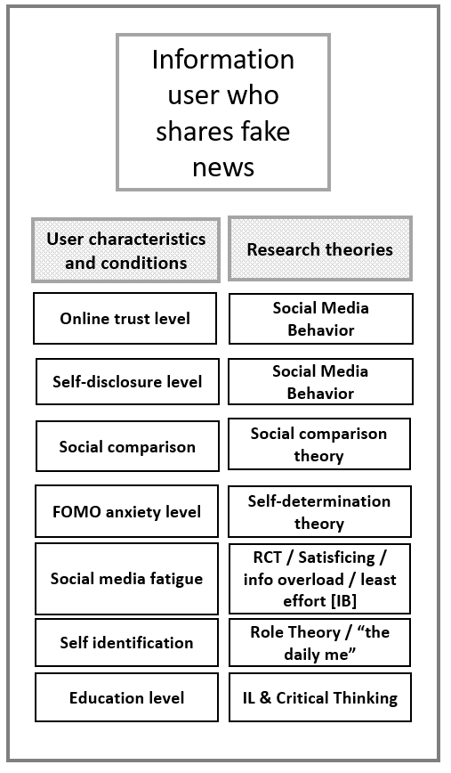
Definitions: misinformation & traits associated with its belief & spread | authoritarianism
Misinformation: “the sharing of false or misleading information with others online”
Including: fake news, false narratives, conspiracy theories, disinformation, &c.
One well-established method to study why it spreads is to look at certain characteristics of information users.
IB & IL approaches overlap with misinfo, but are just two aspects of the overall research landscape.
Authoritarianism is a trait ID’d, but not comprehensively researched for misinformation
Notes:
But first a little background on several key concepts is necessary, including misinformation, authoritarianism and dehumanization.
First, misinformation; this is generally defined in the literature by numerous researchers as “the sharing of false or misleading information with others”
This can often include subgenres and similar areas such as fake news, false narratives, conspiracy theories, disinformation, &c. A number of important research reviews cover the taxonomy of misinformation and are worth looking into due to the complexity of the problem.
There are numerous approaches to studying misinformation, but one well-established method is to look at the personality characteristics of information users; as seen in the figure to the right, this can range from things such as Online Trust, online self-disclosure levels, social comparison, Fear of Missing Out (or FOMO), Social Media Fatigue (aka information overload), Self-identification, and education levels.
The broader research theories involved in studying this behavior include social media behavior, social comparison, self-determination, satisficing, information overload & the theory of least effort, information literacy and critical thinking. Each of these factors has been shown as influential in why people share and believe fake news and misinformation with others. LIS has focused partly on information overload & information behavior as well as information literacy when it comes to examining misinformation. However, those two aspects are smaller parts of a much wider picture.
Importantly, authoritarianism is another trait identified in the spread of misinformation; this category, I would argue, overlaps with self-identification & role theory, the 6th trait listed in the figure. Such research has touched upon the way that roles in smaller groups influence how people interact with and come to accept certain types of information and reject others.

Slide 4
Definitions: Authoritarianism’s Traits
Authoritarianism: the psychological processes and situational factors that contribute to the desire for people to limit the autonomy of others (Osborne, et al. 2023).
Two types generally studied:
Right Wing Authoritarianism (RWA)
Left Wing Authoritarianism (LWA)
Shared traits of RWA/LWA include: desire for conformity, deference to authority, desire to punish those who violate norms, dehumanizing Others
Left-Wing Authoritarian (LWA)
Right-Wing Authoritarian (RWA)
Revolutionary overthrow
“by any means necessary”
Moral absolutism
re: progressive values
Protection by powerful authorities at expense of individual freedom
*Group conformity*
*Less Personal Autonomy*
*Deference to Authority*
*Desire to punish outsiders*
*Dehumanizing Others*
Obedience to
established authorities
Rigid adherence to socially conservative norms
Strong approval of punitive and coercive social control
Source: Osborne, et al, 2023
Notes:
Authoritarianism, on the other hand, explores “the factors that contribute to the desire for people to limit the autonomy of others” (Osborne, et al. 2023);
this is characterized by people obeying high-status leaders from advantaged groups that have the power to punish marginalized groups perceived as a social threat”;
Notably, researchers have looked at this primarily in terms of the political spectrum, with an emphasis on either Right Wing Authoritarianism or Left Wing Authoritarianism, each with their unique characteristics;
RWA for example, focuses much more on obedience to established authority and adherence to social-conservative norms;
While LWA may focus on revolution but also somewhat similarly advocates protection by more powerful authorities at the expense of an individual’s personal freedoms; also an adherence to moral absolutism for certain progressive values (and those values are of course, subject to change, just like conservative norms are subject to change as well)
HOWEVER, importantly both LWA & RWA contain shared traits, including overall conformity in member groups; the acceptance of less personal autonomy & the general deference to authority of their group; there appears to be a strong desire to punish the outsider that threatens group primacy or group harmony;
Importantly for this paper, both RWA & LWA also display a tendency to dehumanize others outside the member group.
I would argue that it is these shared characteristics that might provide us with a roadmap for combatting skewed perspectives and false and misleading information being shared within authoritarian circles.

Slide 5
Definitions: dehumanization & infrahumanization
Dehumanization: the way in which members of a particular in-group will blatantly deny primary human characteristics and emotions of those in outgroups;
PRIMARY EMOTIONS INCLUDE: anger, happiness, fear
harmful behavior includes: racism, classism, oppression, and genocide (Leyens, et al., 2001)(Kteily, et al, 2015) (N. A., B. Z., & Manjaly, 2020)
Infrahumanization: subtler day-to-day dehumanizing of others, simultaneously denies the secondary emotions (i.e. shame, guilt, compassion) of those in an outgroup while overestimating the same emotions for those in their group
[As an Aside:]
Self-dehumanization: deprecating one’s own self-worth and delegitimizing one’s own humanity
Those who dehumanize others are also seen to simultaneously dehumanize themselves in response to their own harmful behavior, making the effect of their behavior additionally destructive. (Bastian, et al. 2013) (Bastian and Haslam, 2010). Links to Chatman, 1990 (alienation & self-estrangement)]
Two main types:
1) animalistic (e.g. like a dog, subhuman);
2) machine-like (e.g. robotic, unfeeling, inhuman) (Leyens, et al, 2001)
Notes:
Examining the shared trait of dehumanization more closely, then, we can see that it is a powerful force influencing how people will interact and value others.
By dehumanization I am referring to the noted behavior when members of any in-group deny basic human characteristics & emotions of others in groups outside their own. This includes denying the basic human emotions such as anger, happiness, and fear.
This is the primary definition in the literature proposed by researchers as (Leyens, et al., 2001) (Kteily, et al, 2015) (N. A., & Manjaly, 2020)
A more subtle version of this is identified as “Infrahumanization,” which refers to the denial of secondary emotions in some people, including shame, guilt, or compassion. Ultimately, these emotions are less visible, and more related to morality; they are more cognitively complex, longer lasting, and more culturally variable. In some ways, this is complicated to examine, but provides a lens for its more general application across societies.
The way dehumanization generally manifests is either by comparisons of people to animals or to machines; animalistic dehumanization is meant to suggest others are beneath human or subhuman; while machine-like dehumanization is meant to suggest they are inhuman, or non-human, lacking feelings of any sort.
Self-dehumanization, on the other hand, is observed in those who deprecate their own self-worth and delegitimize their own humanity; notably, those who dehumanize others have been observed to also dehumanize themselves in response to their own harmful behavior.

Slide 6
Authoritarianism & notable effects related to information use
Authoritarianism & misinformation: notable effects found in the literature
Right Wing Authoritarianism (RWA) increases a person’s susceptibility/tolerance to misinformation (Sinclair, et al)(De keersmaecker and Roets)
higher levels of RWA associated with a stronger propensity to fall for distorted news that includes prejudicial and opinionated content.
It is clear from this research that RWA would be a strong indicator of a person’s likelihood of sharing and falling for misinformation.
RWA associated with:
lower cognitive engagement and uncritical acceptance of information (Osborne, et al, 2023)
the need for ‘epistemic certainty’ in the form of closure, closed-mindedness, & cognitive inflexibility (Van Hiel, et al, 2004)(Berggren, et al, 2019)(Cuevas, et al., 2022) (Zmigrod, et al., 2018)
greater belief in conspiracy theories, resistance to climate change, and science denial and skepticism(Dyrendal, et al, 2021)(Richey, 2017)(Choma, et al., 2024)(Stanley, et al., 2017)(Kerr & Wilson, 2021)
dehumanization of immigrants (Markowitz and Slovic, 2020 & 2021)
Notes:
Research has found some important effects when it comes to misinformation and authoritarianism:
Notably, two important studies find that higher levels of RWA are associated with a greater tendency to fall for false news stories, including prejudicial and opinionated content; overall higher RWA scores predict a greater tolerance for and susceptibility to misinformation.
Osborne and colleagues find that RWA is also associated with a lower cognitive engagement and the uncritical acceptance of information; as noted by many this occurs in tandem with the need for epistemic certainty, which is manifested in the form of closure, closed-mindedness, and a general cognitive inflexibility.
Numerous researchers also find a greater belief in conspiracy theories, resistance to climate change, and a general overall denial of and skepticism about science itself.
Most importantly for this study, two studies find that RWA is related to the dehumanization of immigrants, providing an important link to the study of misinformation that dehumanizes or antagonizes members of outgroups.

Slide 7
The Role of Authoritarianism in Misinformation Sharing
Gaps & insights found from the literature
RWA is by far the dominant approach to authoritarianism [numerous studies since the 1990s]
The Role of Left Wing Authoritarianism (LWA), however, is understudied, despite overlaps & similarities; [somewhat contested, too, as a phenomenon; esp. with relation to former Soviet subjects]
A common factor: dehumanization is common to both RWA/LWA, but not studied much in the context of misinformation
Importantly, there is the link of dehumanization to self-dehumanization: those who dehumanize others will attribute similar descriptions to themselves (Bastian, et al. 2013)
Notes:
But there are some gaps in the subject of authoritarianism.
Examining RWA is by far the most prominent approach to studying authoritarianism; this is very much at the expense of other types of extremist thinking, including Left-wing Authoritarianism (LWA).
In fact, LWA itself is both contested as an actual phenomenon by some researchers and under-studied overall, despite the overlaps and similarities in thinking styles with RWA.
Importantly, dehumanization of others appears to be an important factor common to both RWA and LWA, though the literature does not appear to spend much time examining the impact of dehumanization overall on misinformation spread. This is an important gap area that should be addressed.
Finally, as mentioned before, another important area of interest shows that the increased dehumanizing of others tended to increase the self-dehumanization of that person. In other words, a person who might dehumanize another would also be more likely to perceive THEMSELVES as less than human, or lacking in the emotional qualities found in most humans. How this links to misinformation belief and sharing is an intriguing question mark.
As seen in recent news, right and left wing political causes can drive some to violence, whether it be anti-abortion or anti-Israeli sentiment, the end result has been violence against others regardless of the political starting point; it is important to get at the common causes of violent ideologically-driven behaviors; one wonders, of course, about the role that DEHUMANIZING misinformation plays in the radicalization of young men.

Slide 8
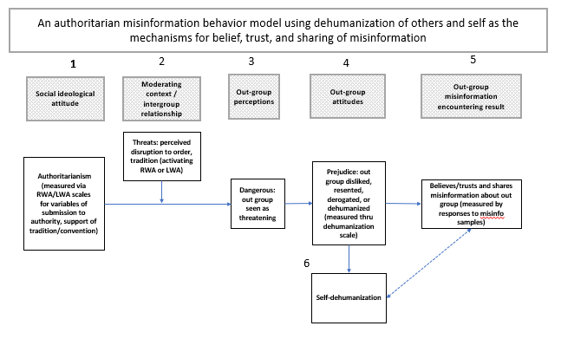
Model: authoritarianism, dehumanization, misinformation
A measure of one’s authoritarianism levels
Threats from intergroup relationships
Perceptions of outgroup threats
Prejudice & levels of dehumanization
Belief & sharing of misinformation
Level of self-dehumanization and examination of its impact on both (4) and (5)
**
** Lantos & Harris (2021)
Notes:
My project, therefore, attempts to describe the effects that dehumanizing behaviors might play in the sharing and believing of misinformation. The model attempts to show how we might describe this process, using the dehumanization of others and oneself as mechanisms for the belief, trust, and sharing of misinformation.
The process of the model would follow several steps:
First, a person’s social ideological attitude would be measured by using RWA/LWA survey scales; these look to identify the variables of submission to authority, support of tradition or convention, common to authoritarian belief systems;
Second, the moderating context would be seen through threats made identifiable by the person’s overall moderating context, meaning which group they are in and which inter-group rivalries or hatreds are most prominent for activating RWA or LWA in the person.
Third, out group perceptions are dependent upon whether a person sees the outgroup as threatening. If these first three factors are in play, it is likely that in the fourth part of the model the personal attitudes toward such outgroups will result in prejudice against them; the outgroup is thus disliked, resented, derogated and dehumanized.
Notably, this can be measured by using Lantos and Harris’ 2021 Humanization scale. It is thus hypothesized in part 5 that the greater evidence of dehumanization of others in personal attitudes about outgroups will result in greater belief, trust and sharing of misinformation about members of the outgroup; this could be measured by examining the responses to misinformation samples in an online survey.
Finally, the sixth part relates to self-dehumanization; it is likely influenced by part 4 (which shows the level of dehumanizing others) and part 5 (which shows the sharing and consuming of misinformation about the outgroup).
Part six is still an untested idea; the hope is that the root causes of some irrational information behaviors become clearer through the exploration of self-dehumanization; this will include looking into misinformation users’ feelings of and perceptions about ostracism, alienation, taboos, and other social disorders

Slide 9
Contributions to the discipline: LIS, libraries, information services
Implications to the LIS discipline
Identifies understudied mechanism (dehumanization) in how misinformation about targeted out-groups can spread
new approach to studying influence of authoritarianism for either left- or right-wing subjects:
Examines the shared characteristics of political extremists in general
Meant to be apolitical (or at least a politically balanced) approach; need not focus on RW or LW specifically
addresses curious problem about why some people don’t seek out certain kinds of information (even if it is helpful)
Conceptualization of a broader ‘misinformation need’ in info behavior
Introduces concept of an ‘information rage’ that may be a reactionary response to information that falls outside the small worlds of information users:
like “road rage;” aggressive behaviors around information and its sharing as a result of alienation, ostracism, & self-dehumanization
Notes:
Ultimately, this approach can help to emphasize an understudied mechanism in how misinformation targeting certain outgroups can spread among information users.
The new approach allows one to study the influence of authoritarian beliefs in either left or right wing subjects by examining the shared characteristics of extremism
In this sense it is meant to be more a-political, or at least more politically balanced; one need not focus on RWA or LWA specifically;
It is hoped, too, that this approach can shed light on some curious problems about why some people choose not to (or refuse to) seek out certain kinds of information – even if that information proves to be overall helpful to them or is in their better interests to address.
The implications of this approach should provide several fascinating avenues to explore in library and information science.
Another implication that arises from this approach is the realization of a broader conceptualization of information use, including a theorized “misinformation need” that describes the way erroneous information can be used to satisfy personal desires or fulfills the requirements of the world view to which a person might ascribe.
This also leads to the conceptualization of an information “rage,” similar to “road rage” that may encompass the aggressive behaviors that occur around the sharing of misinformation with others in their group or to those in an outgroup, as a result of self-alienation, ostracism, and self-dehumanization, with the purpose of antagonizing those in an outgroup.
It is an acknowledgement that information may be subject to reactionary responses especially if it falls outside the small world of the information user;

Slide 10
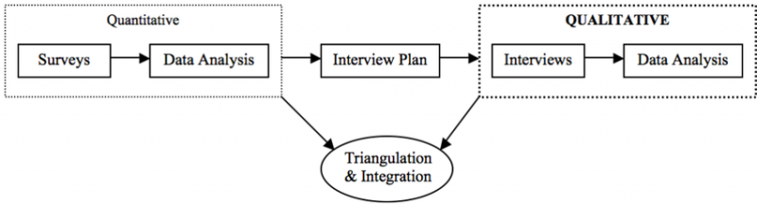
Next steps: project design & how to measure this phenomenon?
Sample Sequential explanatory mixed-methods research design
The project will be a mixed-methods experiment (in development)
With a sequential explanatory design
First stage (Quantitative): surveys: demographics & scales for dehumanization, authoritarianism; + subjects’ review of misinformation samples;
Second stage (Qualitative): Semi-structured interviews designed to explore self-dehumanization’s link to misinformation (as a result of ostracism, alienation, and the act of dehumanizing others)
Notes:
Future directions for this project will include the development of a mixed-methods experiment, likely as a sequential explanatory mixed methods design starting with a first stage quantitative study and a second-stage qualitative study.
The first stage will implement the surveys that measure demographics and education levels, provide scales for measuring dehumanization and authoritarian tendencies, and samples of misinformation stories to review;
The second stage would implement semi-structured interviews that are designed to look for patterns of self-dehumanization in those who have higher tendencies to dehumanize others. This would help to establish a link to Chatman’s work in LIS and the wider work being done in misinformation studies.
LINK to diagram: http://jeromedelisle.org/edrs_6910-mixed_methods_research_designs_issues_and_applications/designs

Slide 11
Thanks! | Questions
In sum: Dehumanization remains an understudied but important area in misinformation research
The mechanism of understanding dehumanization’s complex role in misinformation spread is a key unknown
Future research will attempt to examine these traits using mixed methods: quantitative (surveys) + qualitative (interviews)
Notes:
In conclusion, I hope this presentation provides insight into one aspect of human behavior influencing misinformation belief and spread.
While dehumanization remains somewhat understudied, and its role has yet to be definitively defined, it is a promising avenue to explore.
Thank you very much for your time & allowing me the opportunity to share my ideas and the details about my research.
I’m happy to answer any questions you might have.

Slide 12
Citations (see paper for full list)
Bastian B. and Haslam, N. (2010). Excluded from humanity: The dehumanizing effects of social ostracism. Journal of Experimental Social Psychology, 46, 107–113. https://doi.org/10.1016/j.jesp.2009.06.022
Bastian, B., Jetten, J., Chen, H., Radke, H. R. M., Harding, J. F., & Fasoli, F. (2013). Losing Our Humanity: The Self-Dehumanizing Consequences of Social Ostracism. Personality and Social Psychology Bulletin, 39(2), 156-169. https://doi.org/10.1177/0146167212471205
Berggren, M., Akrami, N., Bergh, R. & Ekehammar, B. (2019). Motivated social cognition and authoritarianism: is it all about closed-mindedness? J. Individ. Differ. 40, 204–212.
Chatman, E. A. (1990). Alienation Theory: Application of a Conceptual Framework to a Study of Information among Janitors. RQ, 29(3), 355–368.
Choma, B. L., Briazu, R. A., Asrani, V., Cojocariu, A., & Hanoch, Y. (2024). The politics of red meat consumption and climate change. Environmental Research Communications, 6(1). https://doi.org/10.1088/2515-7620/ad1c06
Cuevas, J. A., Dawson, B. L., & Grant, A. C. (2022). An analysis of the relationships between religious orientation, authoritarianism, cross‐cultural interactions, and political views. Analyses of Social Issues and Public Policy : ASAP., 22(1), 408–426. https://doi.org/10.1111/asap.12303
De keersmaecker, J. & Roets, A. Is there an ideological asymmetry in the moral approval of spreading misinformation by politicians? Personality and Individual Differences, 143, 165–169 (2019).
Dyrendal, A., Kennair, L. E. O., & Bendixen, M. (2021). Predictors of belief in conspiracy theory: The role of individual differences in schizotypal traits, paranormal beliefs, social dominance orientation, right wing authoritarianism and conspiracy mentality. Personality and Individual Differences, 173, 110645-. https://doi.org/10.1016/j.paid.2021.110645
Kerr, J.R. and Wilson, M.S. (2021). Right-wing authoritarianism and social dominance orientation predict rejection of science and scientists. Group Process. Intergroup Relat. 24, 550–567.
Kteily, N., Bruneau, E., Waytz, A., & Cotterill, S. (2015). The Ascent of Man: Theoretical and Empirical Evidence for Blatant Dehumanization. Journal of Personality and Social Psychology, 109(5), 901–931. https://doi.org/10.1037/pspp0000048
Leyens, J., Rodriguez-Perez, A., Rodriguez-Torres, R., Gaunt, R., Paladino, M., Vaes, J.,&Demoulin, S. (2001). Psychological essentialism and the differential attribution of uniquely human emotions to ingroups and outgroups. European Journal of Social Psychology, 31, 395–411. https://doi.org/10.1002/ejsp.50
Markowitz, D. M., & Slovic, P. (2020). Social, psychological, and demographic characteristics of dehumanization toward immigrants. Proceedings of the National Academy of Sciences - PNAS, 117(17), 9260–9269. https://doi.org/10.1073/pnas.1921790117
Markowitz, D. M., & Slovic, P. (2021). Why we dehumanize illegal immigrants: A US mixed-methods study. PloS One, 16(10), e0257912–e0257912. https://doi.org/10.1371/journal.pone.0257912
Moon, K. and Blackman, D. (2017). A guide to ontology, epistemology, and philosophical perspectives for interdisciplinary researchers. Integration and Implementation insights: A community blog and repository of resources… https://i2insights.org/2017/05/02/philosophy-for-interdisciplinarity/comment-page-1/
N. A., B. Z., and Manjaly, J. A. (2020). Dehumanization of Scheduled Castes and Scheduled Tribes (SC/ST): Evidence from Implicit, Moderate, and Blatant Measures. Analyses of Social Issues and Public Policy, 20(1), 563–583. https://doi.org/10.1111/asap.12214
Osborne, D., Costello, T.H., Duckitt, J. et al. (2023) The psychological causes and societal consequences of authoritarianism. Nature Reviews Psychology 2, 220–232. https://doi.org/10.1038/s44159-023-00161-4
Richey, S. A birther and a truther: the influence of the authoritarian personality on conspiracy beliefs. Politics and Policy, 45, 465–485 (2017).
Sinclair, A. H., Stanley, M. L. & Seli, P. (2020). Closed-minded cognition: right-wing authoritarianism is negatively related to belief updating following prediction error. Psychon. Bull. Rev. 27, 1348–1361.
Stanley, S. K., Wilson, M. S. & Milfont, T. L. (2017) Exploring short-term longitudinal effects of right-wing authoritarianism and social dominance orientation on environmentalism. Personal. Individ. Differ. 108, 174–177.
Van Hiel, A., Pandelaere, M. & Duriez, B. (2004). The impact of need for closure on conservative beliefs and racism: differential mediation by authoritarian submission and authoritarian dominance. Personal. Soc. Psychol. Bull. 30, 824–837.
Zmigrod, L., Rentfrow, P. J. & Robbins, T. W. (2018). Cognitive underpinnings of nationalistic ideology in the context of Brexit. Proc. Natl Acad. Sci. USA 115, E4532–E4540.
Notes:
[review & revise this]

