Slide 1
The Landscape of Contemporary Canadian Subject Access
Amber Dierking, dierkina@gvsu.edu / @king_ofthedeer
Dr. Julia Bullard, julia.bullard@ubc.ca / @julzbullard

Slide 2
Presentation Outline
Project overview - Julia
Approach and findings - Amber
Discussion & next steps - Both

Slide 3
Project Overview
Groundwork for a longer investigation into national knowledge infrastructures (more on that later)
Literature review = complete
Up next:
Ongoing empirical work on author’s impressions of these systems
Opportunities for collaborative work on individual and interrelated systems

Slide 4
Scope of the Lit Review
Broad definition of Subject Access
Limited timeframe, to focus on current & ongoing projects
Focus on Canada (with some exceptions)

Slide 5
Results

Slide 7
French only systems:
RVM (Le Répertoire de Vedettes-Matière)
RASUQAM (Répertoire des Autorités-Sujet de l’UQAM)
RAMEAU (Répertoire d‘autorité-matière encyclopédique et alphabétique unifié)
ONF (Le thésaurus de l’Office National du Film du Canada)
Le système de classification des jeux ESAR

Slide 8
Bi- & Multilingual projects

Slide 9
Indigenous Knowledge Organization
Out of the 17 IKO systems, the most robust/ well-documented include:
Digital Library North (DLN)
Brian Deer Classification System (and derivatives/adaptations particularly Xwi7xwa + FNHL SH and UBCIC)
MAIN
Inuit language cataloguing standards
Notes:
.

Slide 10
Starting to explore the patterns beyond the numbers (and their consequences)
How many come specifically from LC/LCSH
How many were Canadian and are re-forming
Not all adaptations/derivatives come from US systems
Size/usage/complexity/impact

Slide 11
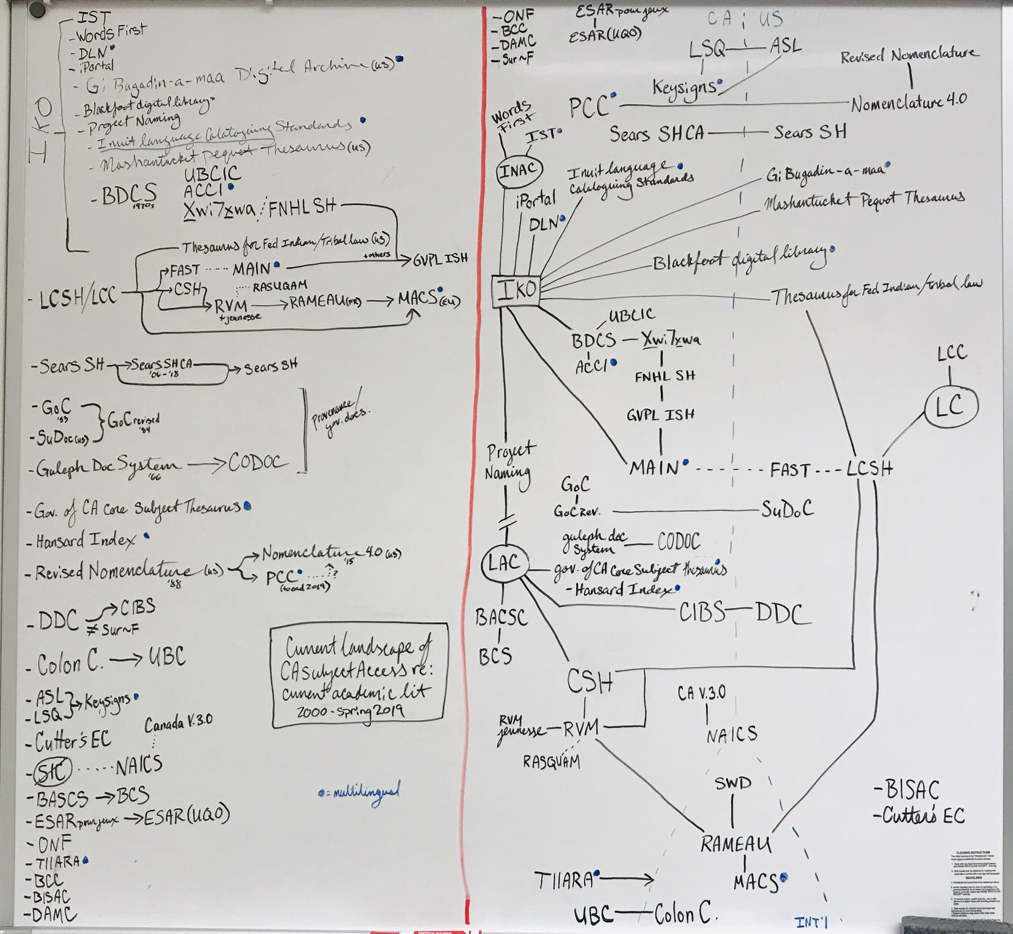

Slide 12
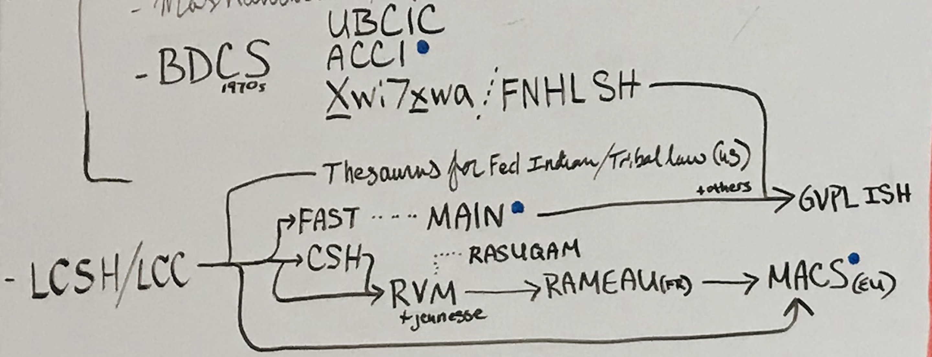
LC/LCSH adaptations/derivatives

Slide 13
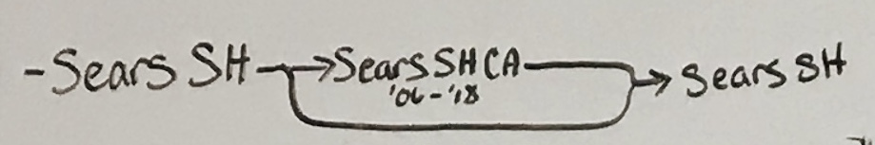
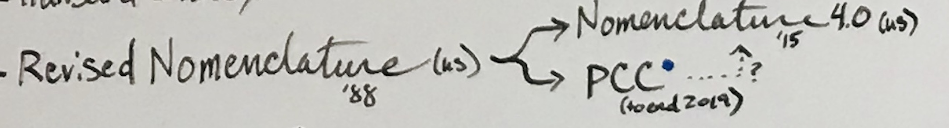
Systems being re-absorbed

Slide 14
Discussion
Tons of influence from the US
Canadian supplements with limited shelf lives
Standalone Canadian born systems either have limited scope and/or aren’t widely used
Of the active sites of original growth and research, many emphasize Indigenous knowledge organization
Gaps in the scholarship

Slide 15
Conclusion & Next Steps
Findings suggest next approaches for analysis
How are these systems into other national and cultural initiatives?
Which systems do not meet needs for Canadian and Indigenous scholarship?
Who else is working on Canada-US infrastructure?
Starting points for more detailed analysis of individual systems and their histories

Slide 16
references:
Bélair, Jo-Anne, Françoise Bourdon, and Michel Mingam. (2005). “Le répertoire de vedettes-matière et RAMEAU: Deux langages d’indexation en français: Un luxe nécessaire.” Paper presented at World Library and Information Congress: 71st IFLA General Conference and Council, Oslow, Norway, August 17. http://archive.ifla.org/IV/ifla71/papers/145f-Belair_Bourdon_Mingam.pdf.
Bone, C. (2016). Modifications to the Library of Congress Subject Headings for use by Manitoba archives (pp. 1–8). Presented at the IFLA World Library and Information Congress, Columbus, Ohio. https://doi.org/10.5203/ss_ama.main_bon.chr.2015.1
Bone, C., & Lougheed, B. (2018). Library of Congress Subject Headings Related to Indigenous Peoples: Changing LCSH for Use in a Canadian Archival Context. Cataloging & Classification Quarterly, 56(1), 83–95. https://doi.org/10.1080/01639374.2017.1382641
Cherry, A. & Mukunda, K. (2015) A Case Study in Indigenous Classification: Revisiting and Reviving the Brian Deer Scheme, Cataloging & Classification Quarterly, 53:5-6, 548-567, DOI: 10.1080/01639374.2015.1008717
Desrochers, N. (2013). Bilingual conundrums: A study of the use of subject headings pertaining to québec as a distinct Society/Équivalences énigmatiques : Représentation du québec en tant que société distincte dans les systèmes de vedettes-matière. Canadian Journal of Information and Library Science, 37(1), 1-23. doi:10.1353/ils.2013.0005
Dolbec, D. (2006). Le répertoire de vedettes-matière : Outil du XXIe siècle. Documentation Et Bibliothèques, 52(2), 99-108. doi:10.7202/1030013ar
Doyle, A. (2006). Naming and reclaiming Indigenous knowledges in public institutions: Intersections of landscape and experience. In G. Budin, C. Swertz, & K. Mitgutsch (Eds.), Advances in Knowledge Organization: Vol. 10. Knowledge Organization for a Global Learning Society: Proceedings of the Ninth International ISKO Conference, 4-7 July 2006, Vienna, Austria (pp. 435-442). Würzberg, Germany: Ergon. Retrieved from http://arizona.openrepository.com/arizona/bitstream/10150/105581/1/Naming_and_Reclaiming_Doyle06.pdf
Doyle, A. M., Lawson, K., & Dupont, S. (2015). Indigenization of knowledge organization at the Xwi7xwa library. Journal of Library and Information Studies, 13(2), 107-134. doi:10.6182/jlis.2015.13(2).107
Dunn, H. (2015). Adopting a Classification System for Collections of Cultural Objects: A comparison of Nomenclature 4.0 and the Parks Canada Classification System. Retrieved from https://www.canada.ca/en/heritage-information-network/services/collections-documentation-standards/adopting-classification-system-collections.html
Fadaie Araghi, G. (2004) A New Scheme for Library Classification, Cataloging & Classification Quarterly, 38:2, 75-98, DOI: 10.1300/J104v38n02_07
Farnel, S., Koufogiannakis, D., Laroque, S., Bigelow, I., Carr-Wiggin, A., Feisst, D., & Lar-Son, K. (2018). Rethinking representation: Indigenous peoples and contexts at the university of alberta libraries. The International Journal of Information, Diversity, & Inclusion (IJIDI), 2(3) doi:10.33137/ijidi.v2i3.32190

Slide 17
Farnel, S., Shiri, A., Campbell, S., Cockney, C., Rathi, D., & Stobbs, R. (2017). A community-driven metadata framework for describing cultural resources: The digital library north project. Cataloging & Classification Quarterly, 55(5), 289-306. doi:10.1080/01639374.2017.1312723
Filiatrault, M. & Hudon, M. (2014). De la classification et des jeux : l’expérience de l’UQO au campus de Saint-Jérôme. Documentation et bibliothèques, 60, (4), 174–188. https://doi.org/10.7202/1026486ar
Gibson, M. (2011). Innovative 21st century classification schemes for elementary school libraries. Feliciter, 57(2), 48.
Goodrum, A., Hibbard, E., Fels, D., & Woodcock, K. (2008). The Creation of Keysigns: American Sign Language Metadata. Culture and Identity in Knowledge Organization: Proceedings of the tenth international ISKO conference, 5-8 august 2008, Montréal, Canada.
Holley, R. P. (2008). Subject access tools in english for canadian topics. Library Resources & Technical Services, 52(2), 29-43. doi:10.5860/lrts.52n2.29
Lambert, F. (2011) Do Provenance-Based Classification Schemes Have a Role in Libraries and Information Centres? The Case of Classifying Government Publications, Cataloging & Classification Quarterly, 49:3, 208-222, DOI: 10.1080/01639374.2011.548053
Landry, P. (2004) Multilingual Subject Access: The Linking Approach of MACS, Cataloging & Classification Quarterly, 37:3-4, 177-191, DOI: 10.1300/J104v37n03_11
Laroque, S. (2018). Making meaningful connections and relationships in cataloguing practices: The decolonizing description project at university of alberta libraries. Evidence Based Library and Information Practice, 13(4), 2-6. doi:10.18438/eblip29440
Lincoln, T. (2003). Cultural reassertion of Alaska native languages and cultures: Libraries' responses. Cataloging & Classification Quarterly, 35(3/4), 265-290. doi:10.1300/J104v35n03_01
Littletree, S. & Metoyer, C. A. (2015) Knowledge Organization from an Indigenous Perspective: The Mashantucket Pequot Thesaurus of American Indian Terminology Project, Cataloging & Classification Quarterly, 53:5-6, 640-657, DOI:10.1080/01639374.2015.1010113
Martens, M. (2006). Creating a supplemental thesaurus to LCSH for a specialized collection: The experience of the National Indian Law Library. Law Library Journal, 98(2), 287-297. Retrieved from http://www.aallnet.org/main-menu/Publications/llj/LLJ-Archives/Vol-98/pub_llj_v98n02/2006-16.pdf
McClung, J. (2009). Herding cats: Indexing british columbia's political debates using controlled vocabulary. The Indexer, 27(2), 66-69.
Ménard, E., & Dorey, J. (2014). TIIARA: A new bilingual taxonomy for image indexing. Knowledge Organization, 41(2), 113-122. doi:10.5771/0943-7444-2014-2-113
Park, S., & Neal, D. R. (2012). A new wave of government information management: The development of a function-based classification structure in a canadian government organization. Journal of Library Metadata, 12(1), 23-38. doi:10.1080/19386389.2012.652569
Powell, T. B. (2007). A drum speaks: A partnership to create a digital archive based on traditional ojibwe systems of knowledge. RBM: A Journal of Rare Book, Manuscripts, and Cultural History, 8(2), 167-180. doi:10.5860/rbm.8.2.290
Rigby, C. (2015) Nunavut Libraries Online Establish Inuit Language Bibliographic Cataloging Standards: Promoting Indigenous Language Using a Commercial ILS, Cataloging & Classification Quarterly, 53:5-6, 615-639, DOI: 10.1080/01639374.2015.1008165
Shiri, A., & Stobbs, R. (2018). Community‐driven user evaluation of the inuvialuit cultural heritage digital library. Proceedings of the Association for Information Science and Technology, 55(1), 440-449. doi:10.1002/pra2.2018.14505501048
Swanson, R. (2015). Adapting the Brian Deer Classification System for Aanischaaukamikw Cree Cultural Institute. Cataloging & Classification Quarterly, 53(5–6), 568–579. https://doi.org/10.1080/01639374.2015.1009669
Szostak, R. (2012). Classifying relationships. Knowledge Organization, 39(3), 165-178. doi:10.5771/0943-7444-2012-3-165

Slide 18
Thank you! Questions?

