Slide 1


Knowledge Synthesis Skills in the Workplace: A Health Librarianship Perspective
January 27, 2025

Slide 2
About us
Joanne Hodder, Provincial Manager, Nova Scotia Health Library Services
Kendell Fitzgerald, Librarian Educator, Nova Scotia Health Library Services
Kristy Hancock, Evidence Synthesis Coordinator, Maritime SPOR SUPPORT Unit

Slide 3
Agenda
Introduction to knowledge synthesis
Nova Scotia Health Library Services – management view
Knowledge synthesis service development and training
Supporting systematic reviews - searching and beyond

Slide 4
Key terms
Systematic reviews:
A type of knowledge synthesis
Minimize bias by using transparent and scientific methods documented in advance with a protocol
More thorough and rigorous than a traditional literature review
Important in healthcare – making decisions based on the findings of multiple studies (the full picture) vs a single study that could be inaccurate or misleading
Knowledge synthesis:
The process of identifying and summarizing research on a topic to answer a question or describe the evidence base
An umbrella term that encompasses a range of methodologies

Slide 5
Systematic review steps
Plan (question, inclusion & exclusion criteria)
Search multiple resources, compile results
Select studies (screen results against criteria)
Assess study quality (risk of bias, validity of conclusions)
Extract relevant data from each study
Analyze and report results

Slide 6
Management View
Transformation of Service
Considerations | Status
Mission of hospital libraries | Evolving
Patron needs | Evolving
Library skills | Maturing
Librarian culture | Entrepreneurial
Budget | Problematic (always)

Slide 7
NS Library Services: Literature Search Service
Library Services currently supports non-comprehensive literature searches using databases and resources available through NS Health subscriptions (like Ovid Medline)
Requests are submitted through an online form. Each request enters the search queue with a librarian being assigned to each incoming request.
Questions can range from public health initiatives, drug comparisons, policy changes, etc.
Example research question: correlation between self harm and suicide in justice-involved youth. Things to consider:
Do I need more information from requestor to complete the request? (like a consultation)
Are there search limits from the requestor? (ex: Publication date range)
What search terms/synonyms to include? (ex: self harm; self harming; self injury; self injuries)
What databases are most appropriate to search? (ex: APA PsycINFO)
Are there example articles from the requestor?

Slide 8
Breaking down a literature search question
A tool like P.I.C.O. can help you identify the concepts within your question and what you need to include in your search strategy.
Not all questions fit P.I.C.O., but it can be helpful for more complex questions that are trying to understand the causality, correlation, or relationship between multiple concepts.
P – Patient, Population, Problem
I – Intervention
C – Comparison
O - Outcome

Slide 9
Lit Searches: rapidly changing landscape
Literature search service has grown in popularity each year, especially during the COVID-19 pandemic
From January 2024 to now, 313 requests received
Most received in a week: 13 requests
Along with more general literature search requests and consultation support needed, our team received several inquiries related to systematic review support

Slide 10


KS Service Implementation
Two librarian educators (Vinson Li, Kendell Fitzgerald) developing service since last year
Choosing a software to support multiple stages of a review project
Covidence
Developing supporting materials
Working Agreement (between lead researcher and librarian that outlines all deliverables to be done by the librarian)
Consultations (citation management, using software like Covidence, search help)
Education and training (see the above)
Subject guide
Communication pieces (blogposts, Library Services website updates)
How will researchers find and navigate these resources?

Slide 11


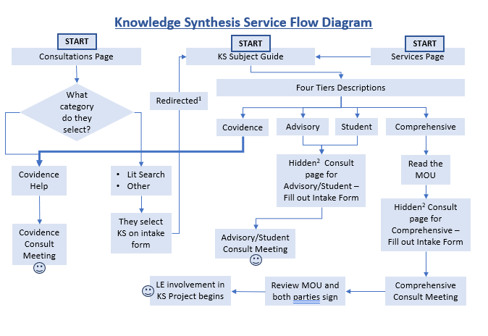
Initial Workflow

Slide 12
KS Service Tiers
We have developed two* tiers of service to support knowledge synthesis projects:
Advisory Tier: a 1 to 2 hour consultation with the lead researcher or research team to provide advice or guidance on research question development; database selection; search strategy or protocol considerations; Covidence or Zotero assistance; etc.
Comprehensive Tier: librarian meets with lead researcher or research team in a consult to over working agreement. Working agreement is signed by both. Librarian joins as a member of the research team until deliverables are finished and project is completed. Deliverables are provided in 60 days from working agreement signed.
*Initially, we considered a student tier to give some support to those who are undertaking a KS project as part of their coursework. This tier was cut to prevent confusion (and prevent the expectation that a librarian can be part of the review as a whole)

Slide 13
Supporting systematic reviews @ MSSU
Plan (question, inclusion & exclusion criteria)
Search multiple resources, compile results
Select studies (screen results against criteria)
Assess study quality (risk of bias, validity of conclusions)
Extract relevant data from each study
Analyze and report results

Slide 14
More on searching and compiling results…
The steps involved include:
Building and adapting searches across multiple databases and resources
Exporting the search results and removing duplicate records
Documenting the search methods for the manuscript
It takes weeks to develop a search approach that is:
Precise: identifies articles that meet your inclusion criteria
Comprehensive: captures all relevant results, not just some
Manageable: the team has the capacity to screen the search results from all resources (in duplicate!)

Slide 15
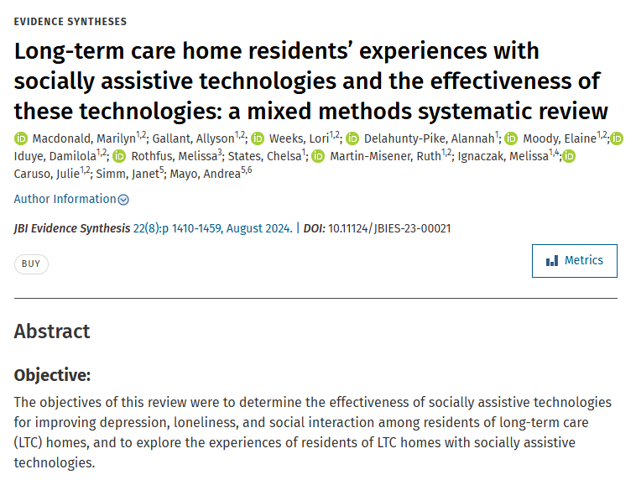
Example!

Slide 16
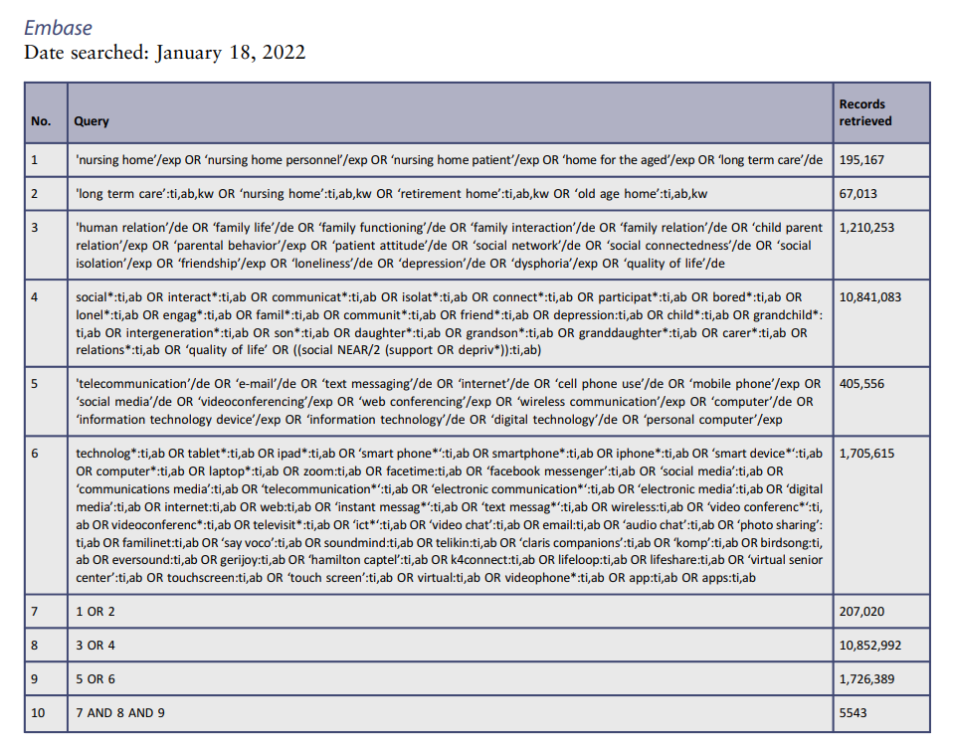
5543 results from Embase alone
Also searched Ovid MEDLINE, CINAHL, PsycInfo, Scopus, and grey literature resources

Slide 17
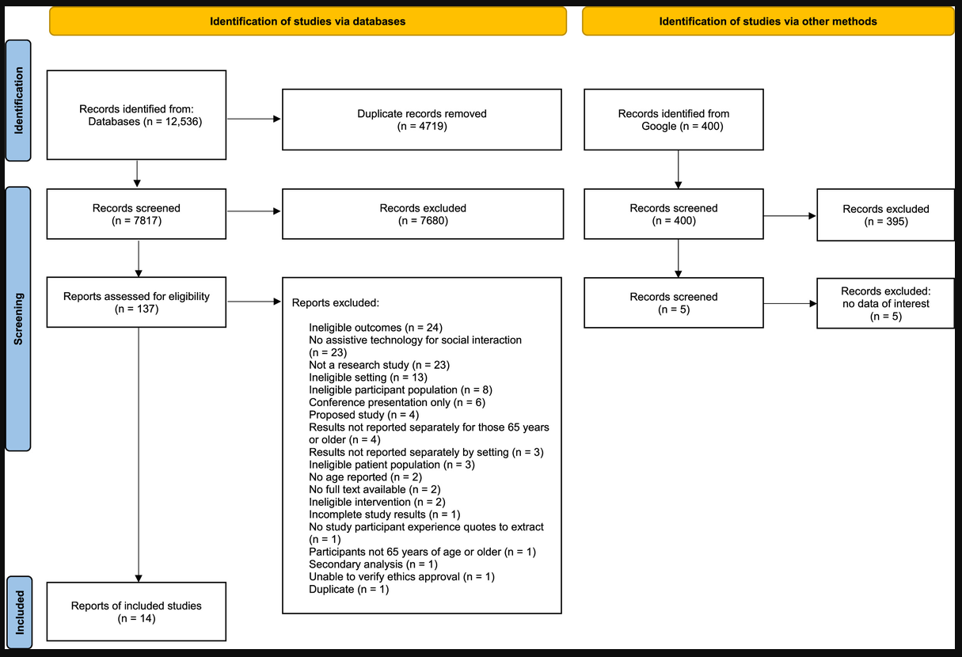

Slide 18
Importance of the librarian role
Comprehensive searching requires a unique skillset
The search = data collection
The stakes are high…missing studies will affect the findings
Additional opportunities for involvement:
Data management
Project management
Software training
Screening + extraction

Slide 19
Thank you! Questions?

