Slide 1
Code Contracts and Pex: Power Charge your Assertions and Unit Tests
VTL01
Mike Barnett, Nikolai Tillmann
Principal Research Software Design Engineers
Microsoft Research

Slide 2
What you will learn
Code Contracts
Pex
Expressing design intent
Advanced unit testing
Method contracts
Contract.Requires
Contract.Ensures
Object invariants
Contract.Invariant
Interface contracts
Tools
Runtime Checking
Static Checking
Documentation
Automated Test Generation
Parameterized Unit Testing
Stubs and Moles
Lightweight mocking
For sealed classes, static methods, interfaces

Slide 3
Objective: Implement WebService.Process
class WebService {
WebService(IWarehouse warehouse) { … }
void Process(Order order) { … }
}
class Order {
string UserName { get; … }
int ProductID { get; … }
int Quantity { get; … }
}
interface IWarehouse {
Item RemoveFromInventory(int productID);
void ShipToCustomer(string userName, int itemID);
}
class Item { … }

Slide 4
Introduction to Code Contracts, Pex
demo

Slide 5
Code Contracts – The Basics
public WebService(IWarehouse store) {
}
this.store = store;

Slide 6
Code Contracts – The Basics
public WebService(IWarehouse store) {
}
Contract.Requires(store != null);
this.store = store;
Requires: What must be true at method entry

Slide 7
Code Contracts – The Basics
public WebService(IWarehouse store) {
}
Contract.Requires(store != null);
Contract.Ensures(this.store != null);
this.store = store;
Requires: What must be true at method entry
Ensures: What must be true at method exit
One source: Many uses
Runtime Checking
Static Checking
Documentation

Slide 8
Code Contracts – The Not So Basics
[ContractInvariantMethod]
void ObjectInvariant() {
Contract.Invariant(this.store != null);
}
Invariants: internal object consistency
Conditions over (private and protected) fields
What must be true at public method exits
Can have multiple invariant methods

Slide 9
Code Contracts – Interface Contracts
Contracts for those hard-to-reach areas…
Works for abstract classes too
[ContractClass(typeof(IWarehouseContract))]
public interface IWarehouse {
…
}
[ContractClassFor(typeof(IWarehouse))]
public class IWarehouseContract : IWarehouse {
Item IWarehouse.RemoveFromInventory(int productID) {
Contract.Ensures(Contract.Result<Item>() != null);
…
}
…
}
public interface IWarehouse {
…
}

Slide 10
Code Contracts – Interface Contracts
Contracts for those hard-to-reach areas…
Works for abstract classes too
linked via attributes
[ContractClass(typeof(IWarehouseContract))]
public interface IWarehouse {
…
}
[ContractClassFor(typeof(IWarehouse))]
public class IWarehouseContract : IWarehouse {
Item IWarehouse.RemoveFromInventory(int productID) {
Contract.Ensures(Contract.Result<Item>() != null);
…
}
…
}
public interface IWarehouse {
…
}

Slide 11
Code Contracts – Interface Contracts
Contracts for those hard-to-reach areas…
Works for abstract classes too
[ContractClass(typeof(IWarehouseContract))]
public interface IWarehouse {
…
}
[ContractClassFor(typeof(IWarehouse))]
public class IWarehouseContract : IWarehouse {
Item IWarehouse.RemoveFromInventory(int productID) {
Contract.Ensures(Contract.Result<Item>() != null);
…
}
…
}
public interface IWarehouse {
…
}

Slide 12
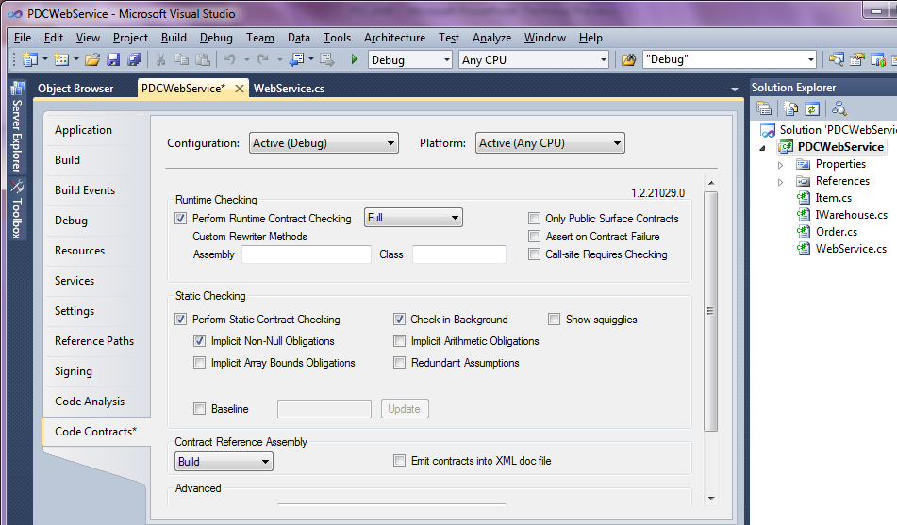
Controlling the Contracts

Slide 13

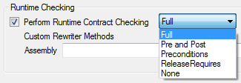
Runtime Checking — Test Build
WebService.cs
public WebService(IWarehouse store) {
}
Contract.Requires(store != null);
Contract.Ensures(this.store != null);
this.store = store;
WebService.dll
IL from requires
IL from body
csc/vbc/… + ccrewrite
IL from ensures

Slide 14
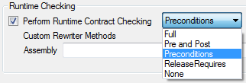
Runtime Checking — Release Build
WebService.cs
public WebService(IWarehouse store) {
}
Contract.Requires(store != null);
Contract.Ensures(this.store != null);
this.store = store;
WebService.dll
IL from requires
csc/vbc/… + ccrewrite
IL from body
For libraries with general clients

Slide 15
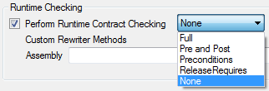
Runtime Checking — Release Build
WebService.cs
public WebService(IWarehouse store) {
}
Contract.Requires(store != null);
Contract.Ensures(this.store != null);
this.store = store;
WebService.dll
IL from body
csc/vbc/…
For trusted clients

Slide 16
Documentation
WebService.xml
XML used by Sandcastle to generate MSDN style docs
<member name="M:PDC.WebService.#ctor(PDC.IWarehouse)">
<summary>Constructs a new instance for processing orders against the specified warehouse.</summary>
<param name="store">The warehouse this instance is to use. </param>
</member>
WebService.xml
<member name="M:PDC.WebService.#ctor(PDC.IWarehouse)">
<summary>Constructs a new instance for processing orders against the specified warehouse.</summary>
<param name="store">The warehouse this instance is to use. </param>
<requires> store != null </requires>
<ensures> this.store != null </ensures>
</member>
ccdocgen
WebService.Contracts.dll
IL from requires
IL from ensures

Slide 17
Pex − Parameterized Unit Testing Beyond Unit Testing
Generated stub:
[PexMethod]
public void Process(WebService target, Order order) {
target.Process(order);
// TODO: Add assertions here
}

Slide 18
Pex − Parameterized Unit Testing Beyond Unit Testing
Attribute marks Parameterized Unit Test
Generated stub:
[PexMethod]
public void Process(WebService target, Order order) {
target.Process(order);
// TODO: Add assertions here
}

Slide 19
Pex − Parameterized Unit Testing Beyond Unit Testing
Idea: Turn values that shouldn’t matter into parameters
Pex chooses relevant values
Pex executes and analyzes code
Constraint solver determines values that trigger code paths
Result: Traditional unit tests
[PexMethod]
public void Process(WebService target, Order order) {
target.Process(order);
// TODO: Add assertions here
}

Slide 20
Pex − Choosing Relevant Values
[PexMethod]
public void Process(WebService target, Order order)
{
target.Process(order);
}

Slide 21
Pex − Choosing Relevant Values
Pex executes and monitors test
[PexMethod]
public void Process(WebService target, Order order)
{
target.Process(order);
}

Slide 22
Pex − Choosing Relevant Values
[PexMethod]
public void Process(WebService target, Order order)
{
target.Process(order);
}
Pex will generate “relevant” values
(null, new X(), …)

Slide 23
Pex − Choosing Relevant Values
[PexMethod]
public void Process(
[PexAssumeUnderTest] WebService target, Order order)
{
target.Process(order);
}
Another attribute to mark instance-under-test, may not be null.

Slide 24
Pex − Choosing Relevant Values
[PexMethod]
public void Process(
[PexAssumeUnderTest] WebService target, Order order)
{
target.Process(order);
}
Pex follows calls
public void Process(Order order) {
if (order == null) return;
for (int i = 0; i < order.Quantity; i++) {
var item = store.RemoveFromInventory(order.ProductID);
store.ShipToCustomer(order.UserName, item.ItemID);
}
}

Slide 25
Pex − Choosing Relevant Values
[PexMethod]
public void Process(
[PexAssumeUnderTest] WebService target, Order order)
{
target.Process(order);
}
public void Process(Order order) {
if (order == null) return;
for (int i = 0; i < order.Quantity; i++) {
var item = store.RemoveFromInventory(order.ProductID);
store.ShipToCustomer(order.UserName, item.ItemID);
}
}
Pex discovers non-null constraint
→ test case!

Slide 26
Pex − Choosing Relevant Values
[PexMethod]
public void Process(
[PexAssumeUnderTest] WebService target, Order order)
{
target.Process(order);
}
Pex detects loop
→ test cases for 0, 1, 2 iterations
public void Process(Order order) {
if (order == null) return;
for (int i = 0; i < order.Quantity; i++) {
var item = store.RemoveFromInventory(order.ProductID);
store.ShipToCustomer(order.UserName, item.ItemID);
}
}

Slide 27
Pex − Choosing Relevant Values
[PexMethod]
public void Process(
[PexAssumeUnderTest] WebService target, Order order)
{
target.Process(order);
}
Pex detects possible null dereference
→ test case!
public void Process(Order order) {
if (order == null) return;
for (int i = 0; i < order.Quantity; i++) {
var item = store.RemoveFromInventory(order.ProductID);
store.ShipToCustomer(order.UserName, item.ItemID);
}
}

Slide 28
Pex − Choosing Relevant Values
[PexMethod]
public void Process(
[PexAssumeUnderTest] WebService target, Order order)
{
target.Process(order);
}
Pex detects possible null dereference
→ test case!
public void Process(Order order) {
if (order == null) return;
for (int i = 0; i < order.Quantity; i++) {
var item = store.RemoveFromInventory(order.ProductID);
store.ShipToCustomer(order.UserName, item.ItemID);
}
}
[TestMethod]
public void Process03() {
var webService =
new WebService((IWarehouse)null);
var order = new Order((string)null, 0, 1);
this.Process(webService, order);
}

Slide 29
Pex − Choosing Relevant Values
[PexMethod]
public void Process(
[PexAssumeUnderTest] WebService target, Order order)
{
target.Process(order);
}
public void Process(Order order) {
if (order == null) return;
for (int i = 0; i < order.Quantity; i++) {
var item = store.RemoveFromInventory(order.ProductID);
store.ShipToCustomer(order.UserName, item.ItemID);
}
}

Slide 30
Wait a moment…
IWarehouse is an interface.
How to test code that depends on interfaces?
interface IWarehouse { … }
IWarehouse store;
public void Process(Order order) {
if (order == null) return;
for (int i = 0; i < order.Quantity; i++) {
var item = store.RemoveFromInventory(order.ProductID);
store.ShipToCustomer(order.UserName, item.ItemID);
}
}

Slide 31
Pex − Stubs for Interfaces
Generated class for every interface
interface IWarehouse { // hand-written
void ShipToCustomer(string userName, int itemID);
…
}
class SIWarehouse : IWarehouse { // generated
Action<string, int> ShipToCustomerStringInt32 { get; set; }
void IWarehouse.ShipToCustomer(string userName, int itemID)
{ return ShipToCustomerStringInt32(userName, itemID); }
…
}

Slide 32
Pex − Stubs for Interfaces
Generated class for every interface
Delegate-property for every method
interface IWarehouse { // hand-written
void ShipToCustomer(string userName, int itemID);
…
}
class SIWarehouse : IWarehouse { // generated
Action<string, int> ShipToCustomerStringInt32 { get; set; }
void IWarehouse.ShipToCustomer(string userName, int itemID)
{ return ShipToCustomerStringInt32(userName, itemID); }
…
}

Slide 33
Pex − Stubs for Interfaces
Generated class for every interface
Delegate-property for every method
interface IWarehouse { // hand-written
void ShipToCustomer(string userName, int itemID);
…
}
class SIWarehouse : IWarehouse { // generated
Action<string, int> ShipToCustomerStringInt32 { get; set; }
void IWarehouse.ShipToCustomer(string userName, int itemID)
{ return ShipToCustomerStringInt32(userName, itemID); }
…
}
Name mangling to distinguish overloads

Slide 34
Pex − Stubs for Interfaces
Generated class for every interface
Delegate-property for every method
interface IWarehouse { // hand-written
void ShipToCustomer(string userName, int itemID);
…
}
class SIWarehouse : IWarehouse { // generated
Action<string, int> ShipToCustomerStringInt32 { get; set; }
void IWarehouse.ShipToCustomer(string userName, int itemID)
{ return ShipToCustomerStringInt32(userName, itemID); }
…
}

Slide 35
Pex − Stubs for Interfaces
Generated class for every interface
Delegate-property for every method
Implementation calls delegates
interface IWarehouse { // hand-written
void ShipToCustomer(string userName, int itemID);
…
}
class SIWarehouse : IWarehouse { // generated
Action<string, int> ShipToCustomerStringInt32 { get; set; }
void IWarehouse.ShipToCustomer(string userName, int itemID)
{ return ShipToCustomerStringInt32(userName, itemID); }
…
}

Slide 36
Pex − Stubs for Interfaces
Generated class for every interface
Delegate-property for every method
Implementation calls delegates
interface IWarehouse { // hand-written
void ShipToCustomer(string userName, int itemID);
…
}
class SIWarehouse : IWarehouse { // generated
Action<string, int> ShipToCustomerStringInt32 { get; set; }
void IWarehouse.ShipToCustomer(string userName, int itemID)
{ return ShipToCustomerStringInt32(userName, itemID); }
…
}

Slide 37
Pex − Parameterized Unit Tests Putting it all together
[PexMethod]
public void ProcessOrderAndCheckQuantity(Order order) {
int count = 0;
var warehouse = new SIWarehouse() {
ShipToCustomerStringInt32 = (name, id) => count++
};
var target = new WebService(warehouse);
target.Process(order);
Contract.Assert(order.Quantity == count);
}

Slide 38
Pex − Parameterized Unit Tests Putting it all together
[PexMethod]
public void ProcessOrderAndCheckQuantity(Order order) {
int count = 0;
var warehouse = new SIWarehouse() {
ShipToCustomerStringInt32 = (name, id) => count++
};
var target = new WebService(warehouse);
target.Process(order);
Contract.Assert(order.Quantity == count);
}
This test should work for any 'Order'

Slide 39
Pex − Parameterized Unit Tests Putting it all together
[PexMethod]
public void ProcessOrderAndCheckQuantity(Order order) {
int count = 0;
var warehouse = new SIWarehouse() {
ShipToCustomerStringInt32 = (name, id) => count++
};
var target = new WebService(warehouse);
target.Process(order);
Contract.Assert(order.Quantity == count);
}
Customized stub
(here: to count invocations)

Slide 40
Pex − Parameterized Unit Tests Putting it all together
[PexMethod]
public void ProcessOrderAndCheckQuantity(Order order) {
int count = 0;
var warehouse = new SIWarehouse() {
ShipToCustomerStringInt32 = (name, id) => count++
};
var target = new WebService(warehouse);
target.Process(order);
Contract.Assert(order.Quantity == count);
}
delegate(string name, int id) {
count++;
}

Slide 41
Pex − Parameterized Unit Tests Putting it all together
[PexMethod]
public void ProcessOrderAndCheckQuantity(Order order) {
int count = 0;
var warehouse = new SIWarehouse() {
ShipToCustomerStringInt32 = (name, id) => count++
};
var target = new WebService(warehouse);
target.Process(order);
Contract.Assert(order.Quantity == count);
}
var warehouse = new SIWarehouse();
warehouse.ShipToCustomerStringInt32 = ...;

Slide 42
Pex − Parameterized Unit Tests Putting it all together
[PexMethod]
public void ProcessOrderAndCheckQuantity(Order order) {
int count = 0;
var warehouse = new SIWarehouse() {
ShipToCustomerStringInt32 = (name,id)=> count++
};
var target = new WebService(warehouse);
target.Process(order);
Contract.Assert(order.Quantity == count);
}
Executing code under test

Slide 43
Pex − Parameterized Unit Tests Putting it all together
[PexMethod]
public void ProcessOrderAndCheckQuantity(Order order) {
int count = 0;
var warehouse = new SIWarehouse() {
ShipToCustomerStringInt32 = (name, id) => count++
};
var target = new WebService(warehouse);
target.Process(order);
Contract.Assert(order.Quantity == count);
}
Asserting expected results

Slide 44
Pex − Parameterized Unit Tests Putting it all together
Assumptions in parameterized unit test
[PexMethod]
public void ProcessOrderAndCheckQuantity(Order order) {
Contract.Assume(order != null);
int count = 0;
var warehouse = new SIWarehouse() {
ShipToCustomerStringInt32 = (name, id) => count++
};
var target = new WebService(warehouse);
target.Process(order);
Contract.Assert(order.Quantity == count);
}

Slide 45
Parameterized Unit Testing
demo

Slide 46
Testability
Code becomes hard to test if it
interacts with the environments
depends on sealed classes, static methods, classes with non-public constructors, …
public void Process(Order order) {
if (order == null) return;
for (int i = 0; i < order.Quantity; i++) {
var item = store.RemoveFromInventory(order.ProductID);
if (DateTime.Now != new DateTime(2000, 1, 1))
store.ShipToCustomer(order.UserName, item.ItemID);
}
}

Slide 47
Moles – Detouring of .NET methods
What if we could replace any .NET method with a delegate?
DateTime.Now = () => new DateTime(2000, 1, 1);

Slide 48
Moles – Detouring of .NET methods
What if we could replace any .NET method with a delegate?
Possible with Moles
DateTime.Now = () => new DateTime(2000, 1, 1);
MDateTime.NowGet = () => new DateTime(2000, 1, 1);

Slide 49
Pex − Moles to Detour Untestable Code
“Mole classes” can be generated for every existing class
struct DateTime {
static DateTime Now { get; }
…
}
class MDateTime { // generated
static Func<DateTime> NowGet { set { /*magic*/ } }
…
}

Slide 50
Pex − Moles to Detour Untestable Code
“Mole classes” can be generated for every existing class
Property of delegate type for every method
struct DateTime {
static DateTime Now { get; }
…
}
class MDateTime { // generated
static Func<DateTime> NowGet { set { /*magic*/ } }
…
}

Slide 51
Pex − Moles to Detour Untestable Code
“Mole classes” can be generated for every existing class
Property of delegate type for every method
After attaching delegate, all future calls get detoured to attached delegate handler (realized by code instrumentation)
struct DateTime {
static DateTime Now { get; }
…
}
class MDateTime { // generated
static Func<DateTime> NowGet { set { /*magic*/ } }
…
}

Slide 52
Pex − Parameterized Unit Tests Putting it all together: Pex and Stubs and Moles
[PexMethod]
public void ProcessOrderAndCheckQuantityMoles(Order order,
DateTime now) {
Contract.Assume(order != null);
int count = 0;
var warehouse = new SIWarehouse() {
ShipToCustomerStringInt32 = (userName, id) => count++
};
MDateTime.NowGet = () => now;
var target = new WebService(warehouse);
target.Process(order);
Contract.Assert(order.Quantity == count);
}

Slide 53
Pex − Parameterized Unit Tests Putting it all together: Pex and Stubs and Moles
[PexMethod]
public void ProcessOrderAndCheckQuantityMoles(Order order,
DateTime now) {
Contract.Assume(order != null);
int count = 0;
var warehouse = new SIWarehouse() {
ShipToCustomerStringInt32 = (userName, id) => count++
};
MDateTime.NowGet = () => now;
var target = new WebService(warehouse);
target.Process(order);
Contract.Assert(order.Quantity == count);
}

Slide 54
Pex − Parameterized Unit Tests Putting it all together: Pex and Stubs and Moles
[PexMethod]
public void ProcessOrderAndCheckQuantityMoles(Order order,
DateTime now) {
Contract.Assume(order != null);
int count = 0;
var warehouse = new SIWarehouse() {
ShipToCustomerStringInt32 = (userName, id) => count++
};
MDateTime.NowGet = () => now;
var target = new WebService(warehouse);
target.Process(order);
Contract.Assert(order.Quantity == count);
}
We detour all calls to DateTime.Now to delegate

Slide 55
Pex − Parameterized Unit Tests Putting it all together: Pex and Stubs and Moles
[PexMethod]
public void ProcessOrderAndCheckQuantityMoles(Order order,
DateTime now) {
Contract.Assume(order != null);
int count = 0;
var warehouse = new SIWarehouse() {
ShipToCustomerStringInt32 = (userName, id) => count++
};
MDateTime.NowGet = () => now;
var target = new WebService(warehouse);
target.Process(order);
Contract.Assert(order.Quantity == count);
}
Result of DateTime.Now becomes test parameter.

Slide 56
Moles to Detour Untestable Code
demo

Slide 57
Code Contracts − Summary You have the library, get the tools now!
Contracts Library in .NET version 4
DevLabs today:
Coming soon:
VS 2010 Adornments
Pervasive contracts: use them everywhere!
Runtime Checker
Static Checker
Documentation Generator
Visual Studio Addin
Msbuild Integration
(pre-v4 contract library)

Slide 58
Pex − Summary Get it now!
Parameterized Unit Testing
Write more expressive unit tests
Automated test generation
Pex generates traditional unit tests
Result: small test suite, high coverage
Stubs and Moles
Lightweight Mocking
For interfaces, sealed classes and static methods
Replace any .NET method with your delegate

Slide 59
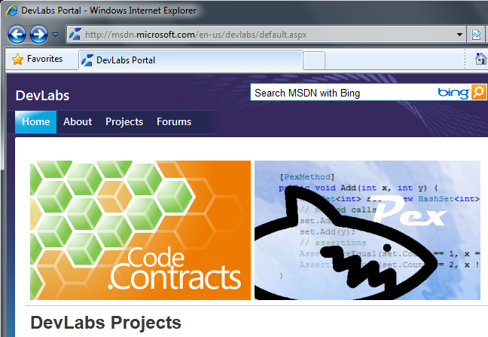
http://msdn.microsoft.com/devlabs/
Download, visit forums
Give your feedback! Shape the future.

Slide 60
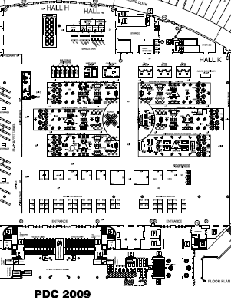
Come See Us!
Code Contracts and Pex
Big Room MP-BP03

Slide 61
YOUR FEEDBACK IS IMPORTANT TO US!
Please fill out session evaluation forms online at
MicrosoftPDC.com

Slide 62

Learn More On Channel 9
Expand your PDC experience through Channel 9
Explore videos, hands-on labs, sample code and demos through the new Channel 9 training courses
channel9.msdn.com/learn
Built by Developers for Developers….

