Slide 1


Music Transcribing program using Fourier transform
Members:
Mr. Piyawat Anantakhun M. 5/9 No. 16
Mr. Chawit Sakulyuenyong M. 5/9 No. 13
Mr. Pattarapon Moonkaen M. 5/9 No. 18
Advisor: Mr. Pichayoot Ouppaphan¹
Assc. Prof. Dr. Atiwong Suchato²
¹Department of Computer and Technology, Mahidol Wittayanusorn School, Nakhon Pathom, 73170, Thailand
²Department of Computer Engineering, Chulalongkorn University, Bangkok, 10330, Thailand

Slide 2
Problem
Some amateur musicians cannot play the music they want, and they cannot find the sheet music on the Internet.

Slide 3
Scopes of the research
Our program can work with the wave file with English name and English path.
We focused on only synthesized piano songs.

Slide 4
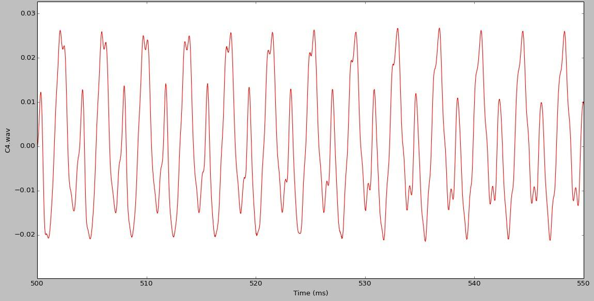
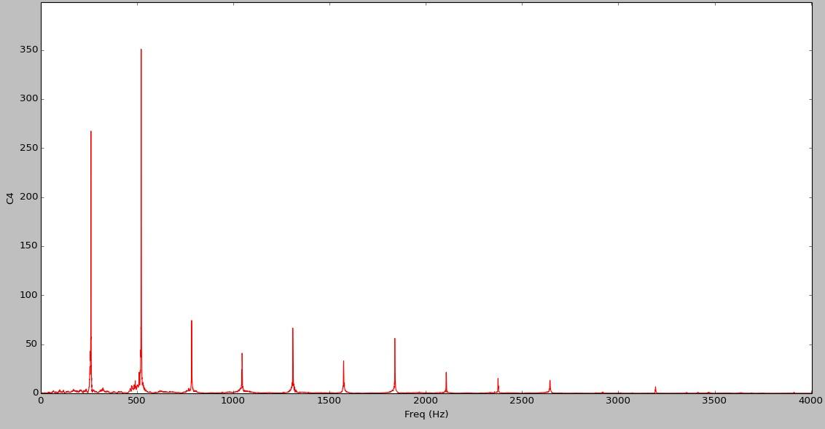
Fourier Transform
Every wave is a combination of infinitely many sinusoidal waves.
Fourier Transform is an algorithm to convert the data between time domain and frequency domain
FFT
Time Domain
Frequency Domain

Slide 5
Difference between two pitches
Each pitch has different fundamental frequency. The higher the pitch, the higher the frequency.
F_{n} = F₀ x 2^{n/12} is the fundamental frequency of n-th note, where n is the number of half steps away from the fixed note. [F(A₄) = 440.000 Hz]
C4.wav (261.626 Hz)
A4.wav (440.000 Hz)

Slide 6
C4.wav

Slide 7
261.626 Hz

Slide 8
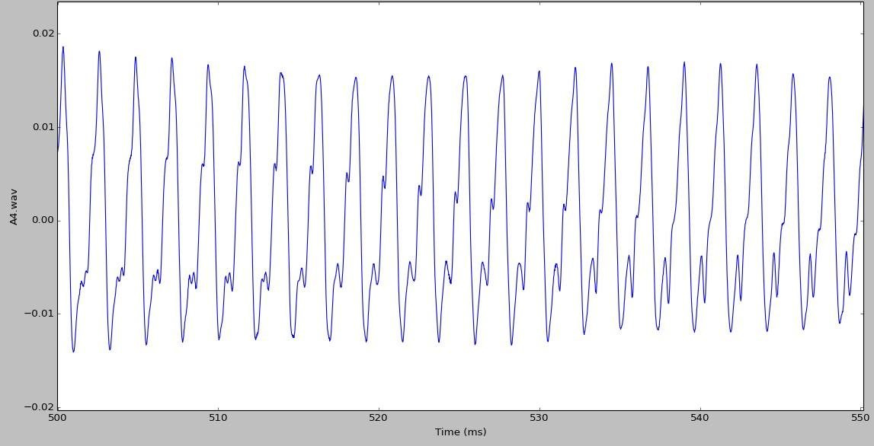
A4.wav

Slide 9
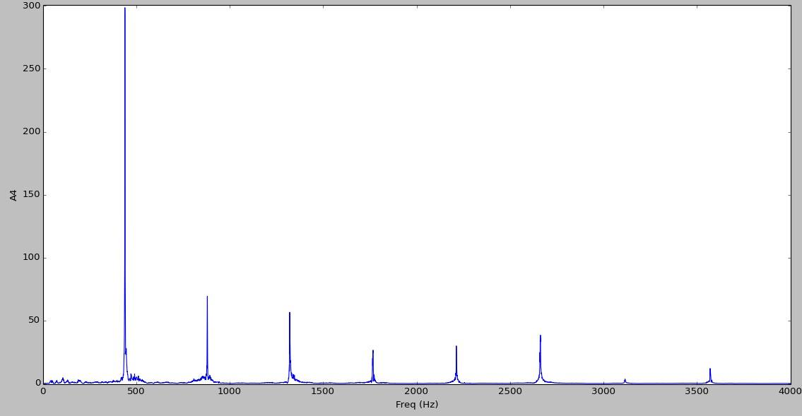
440.000 Hz

Slide 10
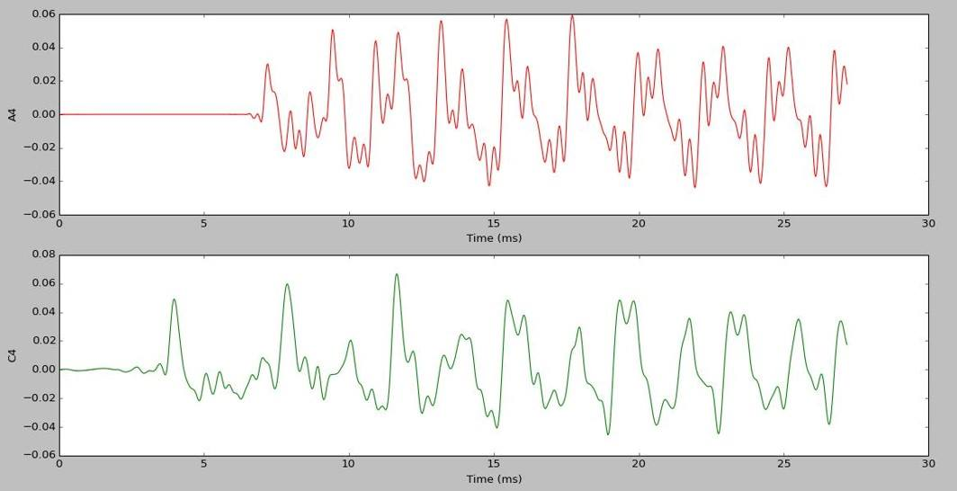
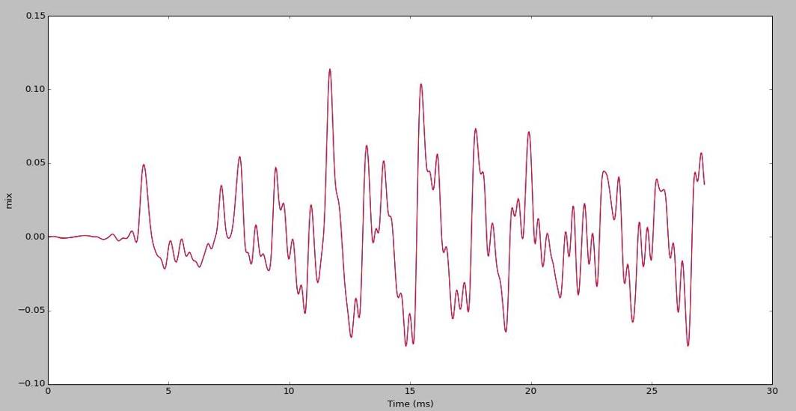
Two notes playing at a time
The result is the summation of each wave.

Slide 11
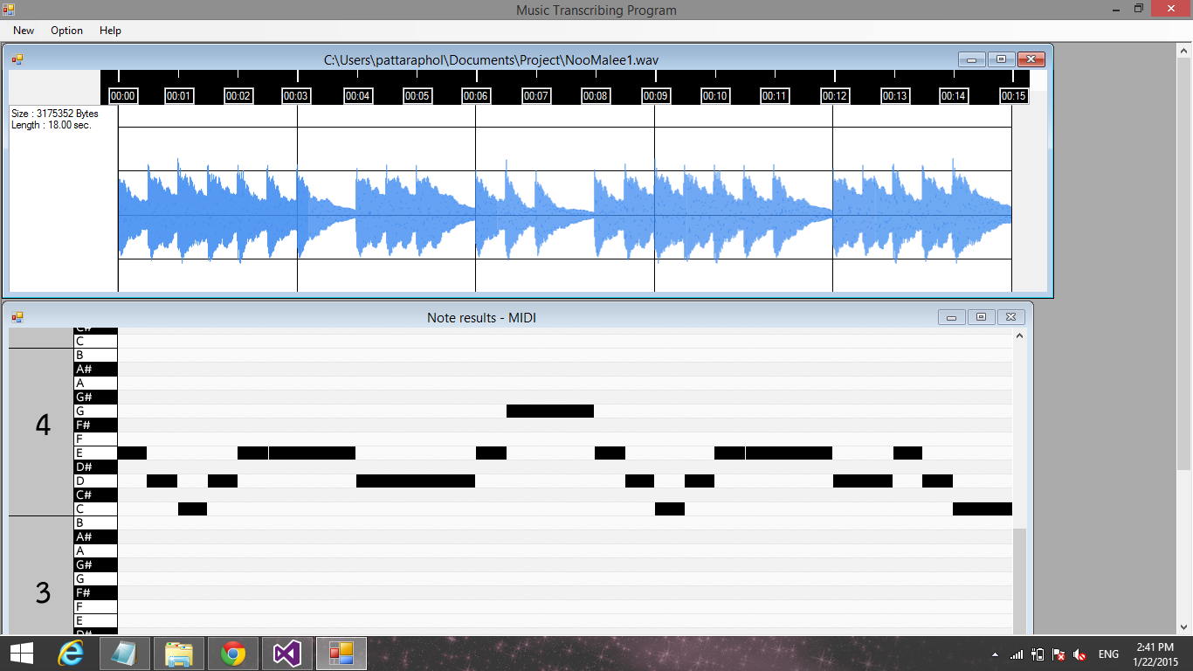
Methods
We divided our program into two main parts.
Digital Signal Processing
Graphical User Interface
- Interval Determining
- Pitch Analyzing

Slide 12
Interval Determining
1. We read the data from wave file, using C++. We would get a 1-D array of sound data in time-domain.

Slide 13
Interval Determining
2. We determined the wave data for 2,048 (or 2¹¹) samples each time and applied the Fourier Transform to them. Then, we compared them with frequency-domain in the previous interval.

Slide 14
Interval Determining
Case 1: If some new frequencies appeared in the new interval, we knew that the beginning of the note was in the new interval.

Slide 15
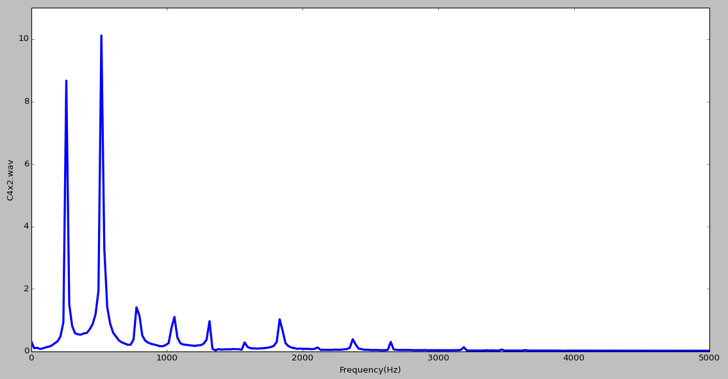
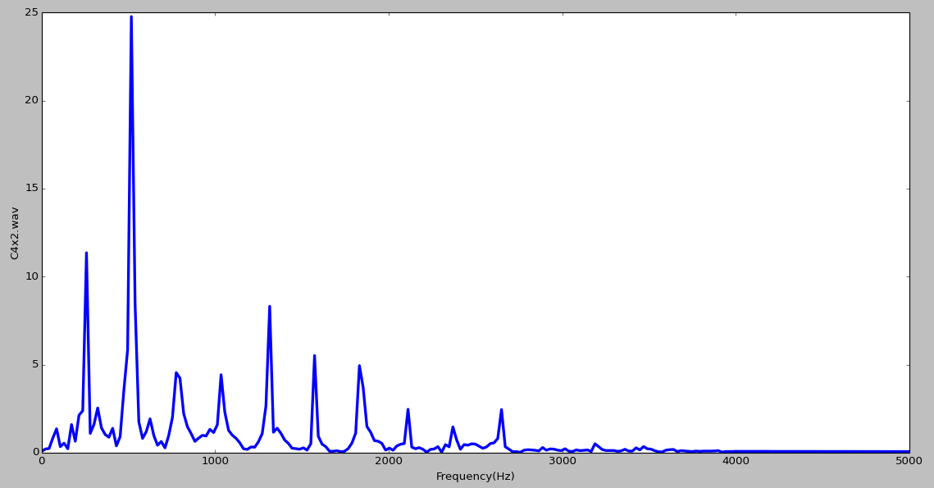
Interval Determining
Case 2: If new frequency did not appear in the new interval, we would consider the power of its harmonics. If the power was more than 1.43 times of the power in the previous interval, we knew the beginning of the note was in the new interval
10.11
24.77

Slide 16
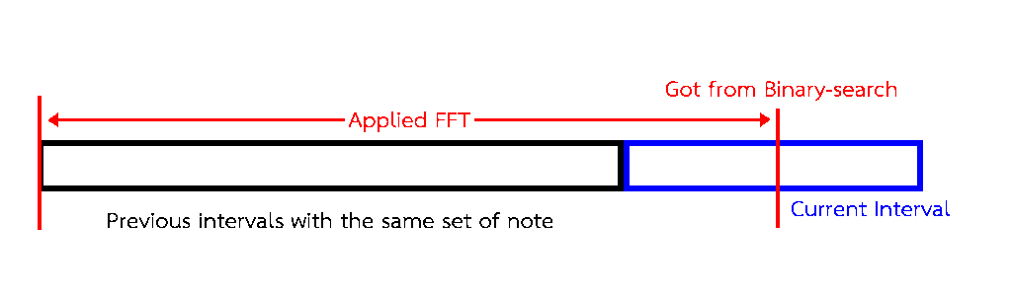
Interval Determining
We would binary-search the new interval. Each time we binary-searched, we combined them with the previous interval and applied the Fourier Transform. We binary-searched until…
Case 1: The power of new frequency was 30 percent of the maximum power,
Case 2: the power of that note was 1.43 time of the previous one.

Slide 17
Pitch Analyzing
1. We read the data in each interval from wave file, using C++. We would also get a 1-D array of sound data in time-domain.

Slide 18
Pitch Analyzing
2. We cut the data on first ten percent and last ten percent of the interval length. Then, we applied the Fast Fourier transform to get the frequency-domain data.

Slide 19
Pitch Analyzing
3. We removed the data which the power was less than 50% of the maximum power.

Slide 20
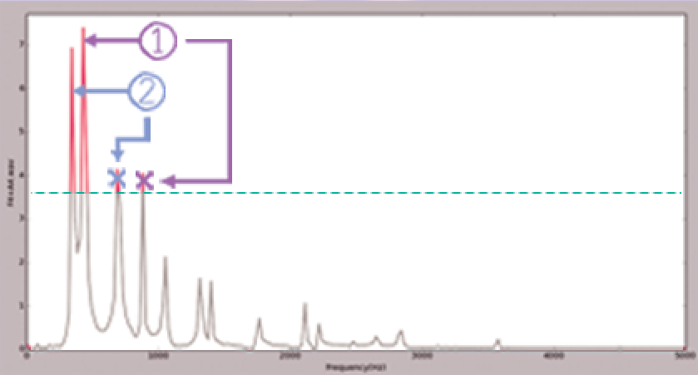
Pitch Analyzing
4. For the remaining data, we focused on the frequency that had the highest amplitude. We would mark the note with that frequency as appeared and then remove its harmonics. We repeated this step until all frequencies are removed.

Slide 21
Graphical User Interface
We implemented this part in Visual Studio 2013 Community using C#.

Slide 22
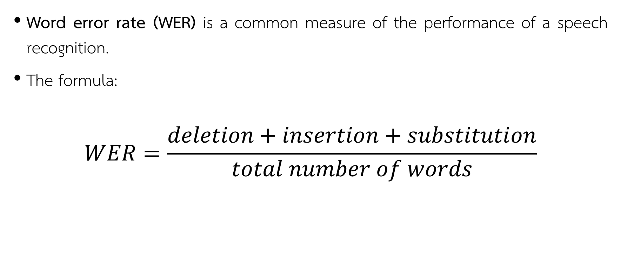
Result analyzing
Word error rate (WER) is a common measure of the performance of a speech recognition.
The formula:
$$WER=\frac{deletion+insertion+substitution}{total number of words}$$

Slide 23
Word error rate: example
Deletion: default note: C3 C4 A4
result note: C3 A4
“C4" was deleted.
Insertion: default note: C3
result note: C3 A#5
“A#5" was inserted.
Substitution: default note: C3 C4
result note: C3 A#5
“C4" was substituted by “A#5”.

Slide 24
Results
Tables of error rate of our program
Song name | % Insert | % Delete | % Substitute | % ERROR
MONOPHONIC
01 Mary Had A Little Lamb | 0.00 | 0.00 | 3.22 | 3.22
02 Yankee Doodle | 0.00 | 0.00 | 7.50 | 7.50
03 Twinkle Twinkle Little Star | 0.00 | 0.00 | 4.44 | 4.44
04 Ode To Joy | 0.00 | 0.00 | 7.09 | 7.09
05 Old MacDonald | 3.33 | 0.00 | 5.70 | 9.04
06 Joy To The World | 0.76 | 0.00 | 4.22 | 4.98
07 Jingle Bells | 7.87 | 0.00 | 9.88 | 17.75
08 London Bridge | 0.00 | 0.00 | 7.75 | 7.75
09 Happy Birthday | 0.00 | 0.00 | 9.78 | 9.78
10 We Wish You A Merry Christmas | 0.00 | 0.00 | 17.70 | 17.70
Song name | % Insert | % Delete | % Substitute | % ERROR
POLYPHONIC
01 Canon In D | 2.53 | 50.71 | 10.75 | 63.99
02 Für Elise | 6.29 | 15.47 | 23.41 | 45.17
03 Beethoven Virus | 5.36 | 35.65 | 20.71 | 61.72
04 Moonlight Sonata 2nd Movement | 14.41 | 39.84 | 10.76 | 65.00
05 Pathétique 2nd Movement | 4.00 | 40.94 | 12.74 | 57.68
06 Mozart Turkish March | 46.16 | 28.12 | 25.41 | 99.69
07 Flower Dance | 11.73 | 27.76 | 9.01 | 48.50
08 River Flows In You | 3.48 | 28.37 | 7.28 | 39.13
09 Winter 2nd movement | 5.39 | 23.82 | 23.65 | 52.86
10 New world symphony | 48.82 | 27.40 | 19.01 | 95.23
Average: 8.92%
Average: 62.90%

Slide 25
Discussion
There were 3 parts that may cause the error :
Discontinuity of data
Interval determining
Pitch analyzing

Slide 26
Discontinuity of data
The data in wave file are discrete, so our algorithm did not work well.

Slide 27
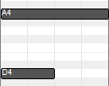

Interval determining
Our program does not support some notes with unequal length playing at the same time.
the original notes
the result from our algorithm

Slide 28
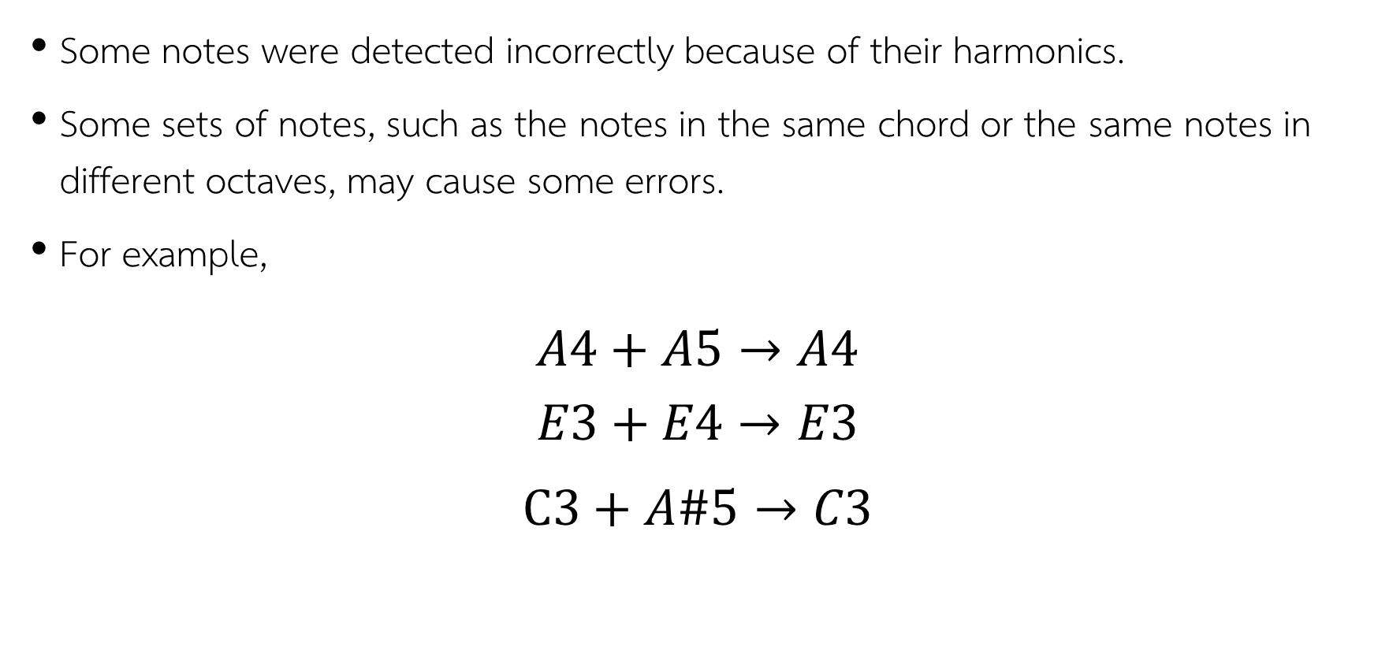
Pitch analyzing
Some notes were detected incorrectly because of their harmonics.
Some sets of notes, such as the notes in the same chord or the same notes in different octaves, may cause some errors.
For example,
$$A4+A5→A4$$
$$E3+E4→E3$$
$$C3+A\#5→C3$$

Slide 29
References
"Wave File Format" (n.d.). Retrieved January 18, 2015, from http://www.sonicspot.com/guide/wavefiles.html
Bello, J., Daudet, L., Abdallah, S., Duxbury, C., Davies, M., & Sandler, M. (2005). A tutorial on onset detection in music signals. IEEE Transactions on Speech and Audio Processing, 13(5), 1035-1047. Retrieved November 11, 2014, from http://www.nyu.edu/classes/bello/MIR_files/2005_BelloEtAl_IEEE_TSALP.pdf
Fast Fourier transform — FFT. (n.d.). Retrieved December 17, 2014, from http://www.librow.com /articles/article-10
Raphael, C. (2002). Automatic Transcription of Piano Music. Automatic Transcription of Piano Music. Retrieved June 14, 2014, from http://music.informatics.indiana.edu/~craphael/papers/ismir02_rev.pdf
Standard MIDI-File Format Spec. 1.1, updated. (n.d.). Retrieved January 22, 2015, from http://www.music.mcgill.ca/~ich/classes/mumt306/StandardMIDIfileformat.html

