Slide 1


OpenShift 3 Sneak Preview
DevOps on Kubernetes
Paul Morie
Senior Software Engineer

Slide 2
Who am I?
Github: @pmorie
Languages: Go, Java, Ruby
Working on OpenShift since 2012

Slide 3
What have you heard?
DevOps
Somehow related to Kubernetes!
Linux Containers?
PaaS? CaaS?

Slide 4
PaaS? CaaS?
PaaS
  Platform as a service
  Many vendors force you into an app model
CaaS
  Really new term (IOW: no one knows yet)
  Oriented around containerized services
  More general than PaaS

Slide 5
A Ha Moments
docker run
source -> image
image -> deployed app

Slide 6
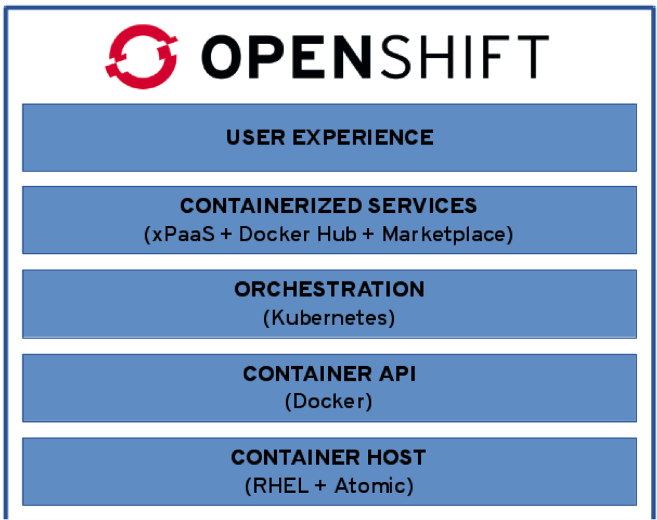
Building Blocks
Linux containers
Docker
Kubernetes
DevOps Tools
Language runtimes, middleware, databases and other services.
Container Orchestration & Management
Notes:
OpenShift 3 is a next generation, distributed application system
It is built on a core of standard & portable Linux Containers in the Docker format
It leverages powerful, web-scale container orchestration and management with Google Kubernetes
It integrates RHEL 7 and RHEL Atomic Host, optimized for running containers at scale
It provides the largest collection of supported programming languages, frameworks & services
But it’s a lot more than that! We are building a number of capabilities for developers and administrators around these core components.
This includes rich web console, CLI & IDE interfaces, multi-user collaboration features, build automation & source-to-image, integration with CI, deployment automation
It also includes a new model for container networking, support for remote storage volumes, simplified installation & administration

Slide 7
Linux Containers
Not really new
Impossible to fully explain in 3 minutes
Kernel is shared between host and container
Isolation using kernel namespaces
Resource allocation and enforcment using cGroups
Security using SELinux

Slide 8
What is Kubernetes?
Container cluster manager
Analogy: Cloud OS kernel
  Scheduling
  Resource management
  Networking
  Storage

Slide 9
OpenShift and Kube: Key Concepts
Master
Node
Kubelet
Pod
Container
Service

Slide 10
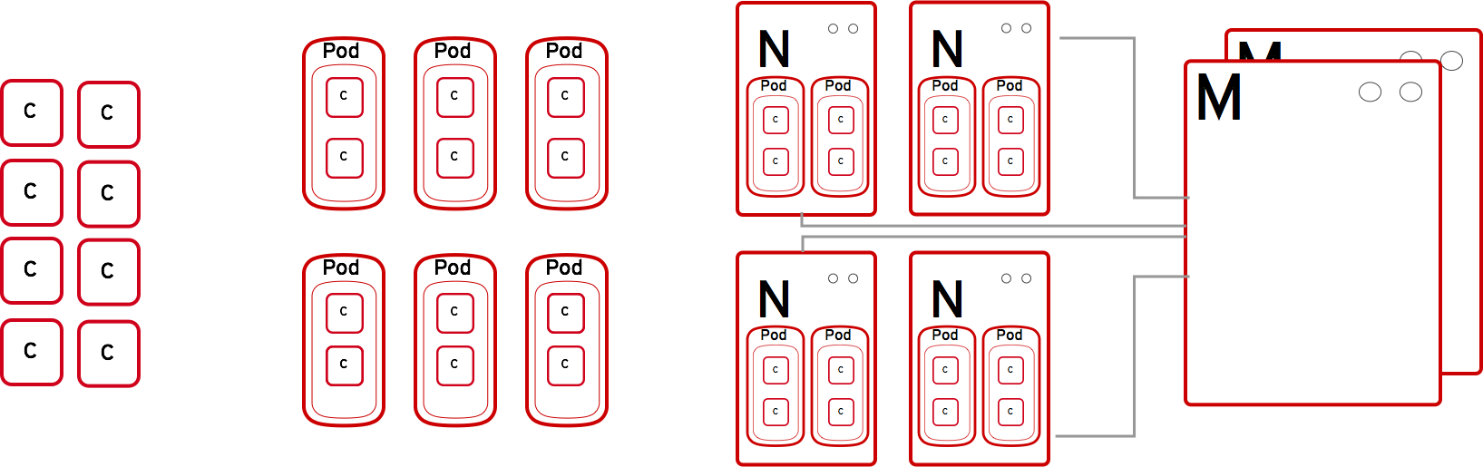
How It Works
Containers run lang/framework middleware, database & other runtimes.
Master provides API, service orchestration, scheduling/placement, maintains state and manages Pods & Services.
Pods run one or more containers as a single unit. Each pod has an IP and mapped storage volumes.
Nodes are Linux container hosts that run Pods assigned by the Master.

Slide 11
Red Hat and Kubernetes
Since July 2014
Exchange
  Improve fundamentals for everyone
  Benefit from work others do
Red Hat is second corporate contributor by commit after GOOG
11 in top 50 contributors are Red Hat employees

Slide 12
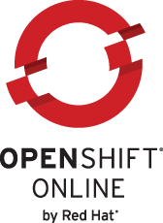
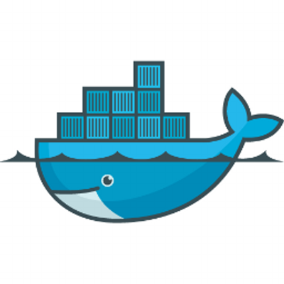

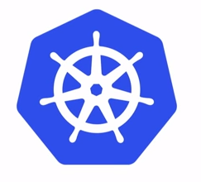
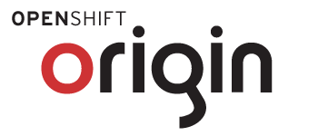


Community Powered Innovation
Community
Commercial
Notes:
OpenShift Origin is the open source community project that drives OpenShift development
But Origin combines a number of best-of-breed upstream projects including Docker, Kubernetes, Project Atomic and more.
Red Hat is a leading contributor to these these upstream projects that deliver the core infrastructure capabilities for OpenShift
OpenShift Online is our Public PaaS service offering at openshift.com
OpenShift Enterprise is our Private PaaS software solution for running your own PaaS

Slide 13
OpenShift and Kubernetes
Analogy: OS provides higher level functions that leverage the capabilities of Kubernetes, Docker, and Linux Containers to do work for you
Separate API
All-in-one binary has everything
Many possible deployment scenarios

Slide 14
OpenShift and Kubernetes - Continued
OpenShift adds:
Projects
Users
Image Streams
Builds
Deployments
Notes:
Analogy: OS provides higher level functions that leverage the capabilities of Kubernetes, Docker, and Linux Containers to do work for you
Separate API
All-in-one binary has everything
Many possible deployment scenarios

Slide 15
Key RH Contributions to Kubernetes
API / UI
Namespaces
Resource quotas
Authentication / authorization
Secret distribution
Security
Networking infra / plugins
Volumes
Scheduler
Containerization

Slide 16
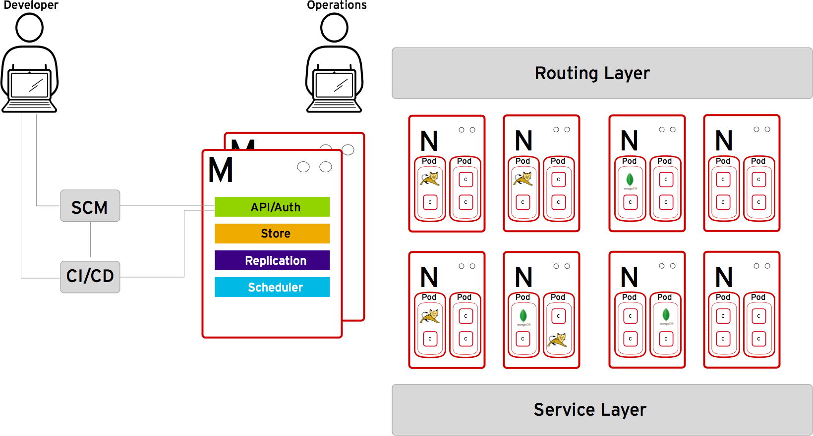
DevOps

Slide 17
DevOps: Builds
Docker images: great
Building docker images: not great
  No chain builds
  Packaging dependencies is packaging security risks
How do I:
  Keep image X up to date?
  Keep images Y and Z derived from X up to date?
  Get notified when a new version of a base image is available?

Slide 18
Source to Image (STI)
Like make for docker images
  Makefile possibly included
Decouples base images, build scripts, and source
Easily build images from existing projects

Slide 19
OpenShift: Builds
Build system provides:
Run STI or Docker builds in pods in user’s namespace
Trigger automatically when:
  New base image is available
  Git push to special repository
Push to private registry on completion

Slide 20
DevOps: Deployments
I have an image, now what?
How do I:
  Create configurations that reference a logical stream of images?
  Keep the latest version of my images deployed?
  Fix it if something goes wrong?

Slide 21
OpenShift Deployments
Deployment system provides:
Configs: drive automated deployments by the system
Triggers: drive new deployments in response to events
Strategies: make deployments live in a cluster
Rollbacks: go back to a previous deployment
Audit history: who deployed what, when

Slide 22
Thanks
Extra info at http://github.com/pmorie/codeshow15
Check us out on github:
  http://github.com/openshift/origin
  http://github.com/GoogleCloudPlatform/kubernetes
We’re here all day!
  @pmorie
  @markturansky
  @pweil-

