Slide 1
CTO REPORT | PROMPT SECURITY
7d of activity
under policy
What Prompt Security observed, what we intervened on,
and where SentinelOne takes the insight next.
Window 2026-04-15 to 2026-04-22 UTC
SentinelOne Pre-Sales Engineering
Data source dataSource.name = 'Prompt Security'
Generated 2026-04-22

Slide 2
7D SNAPSHOT
Executive summary
37,094
15,922
47.5%
40
Total events (7d)
Blocked events
Policy intervention rate
Distinct users
Three things for the CTO to act on
Block 42.9%, bypass 0.135%.
Intervention rate is 47.5%. The policy is doing heavy work. Confirm the traffic mix justifies this posture before moving anything to enforce.
One user drove 96.3% of volume.
drjones@flybynight.ru drove 96.3% of all events. Resolve this account before treating any other number as a baseline.
Bypass is the signal to watch.
Bypass is near-zero (0.13%). Users are accepting policy decisions. The cleanest possible trust signal.
SentinelOne + Prompt Security | 7d CTO review
2 / 11

Slide 3
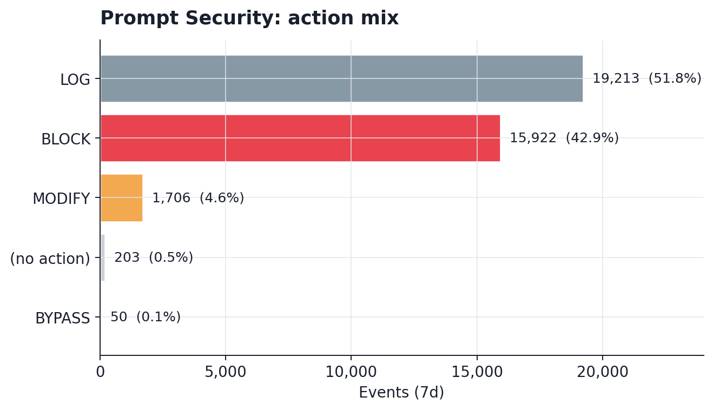
SECTION 1
Policy action mix
What to notice
■
BLOCK at 42.9%. Events the policy refused outright; exfil, compliance, jailbreak attempts live here.
■
MODIFY at 4.60%. Payload rewritten in place (eg. PII redacted) without stopping the user.
■
BYPASS at 0.135%. Users almost never override. Policy is trusted.
SentinelOne + Prompt Security | 7d CTO review
3 / 11

Slide 4
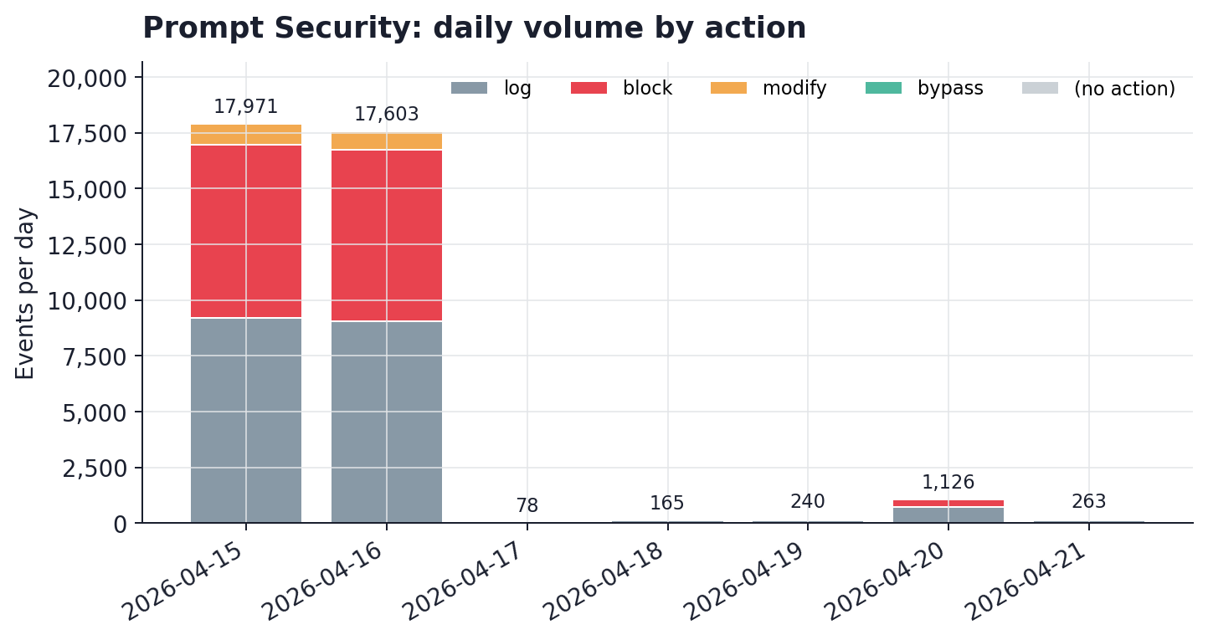
SECTION 2
Volume and timing
What to notice
■
Uneven but not pathological: busiest slice (2026-04-15) carried 48.0% of the window.
■
Dominant action across the window: 'log'. Watch the ratio to the next action as an early policy-drift signal.
■
Policy decisions are stable under load across the window. That is the precondition for promoting any log-only policy to enforce.
SentinelOne + Prompt Security | 7d CTO review
4 / 11

Slide 5
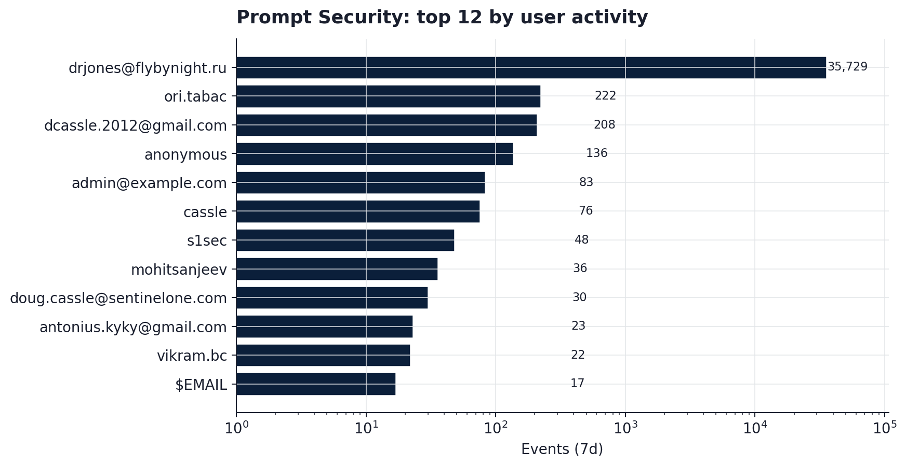
SECTION 3
Who is driving the traffic
What to notice
■
drjones@flybynight.ru = 35,729 events (96.3% of volume).
■
The rest of the cohort lives in the 1 to 222 range. That is where normal users behaviour hides.
■
Log scale used deliberately so a dominant principal does not flatten the long tail.
SentinelOne + Prompt Security | 7d CTO review
5 / 11

Slide 6
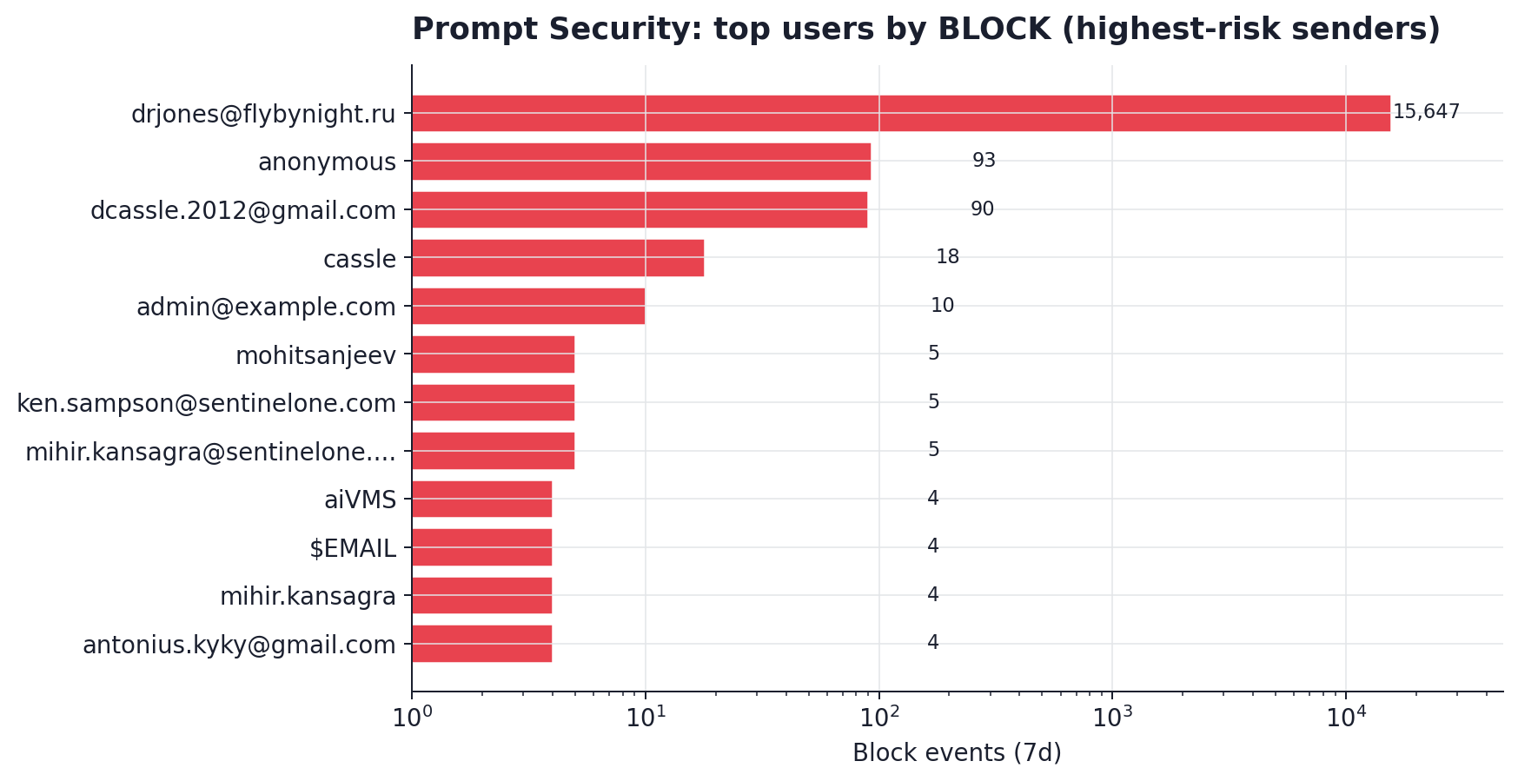
SECTION 4
Highest-risk prompt senders
What to notice
■
drjones@flybynight.ru blocks = 15,647. That is 98.3% of all blocks in the window.
■
The rest of the blocked cohort sits between 1 and 93 blocks per user. Policy tuning or 1:1 coaching has the highest ROI here.
■
Anyone labelled 'anonymous' or 'null' in the chart warrants a tagging pass so blocks can be attributed.
SentinelOne + Prompt Security | 7d CTO review
6 / 11

Slide 7
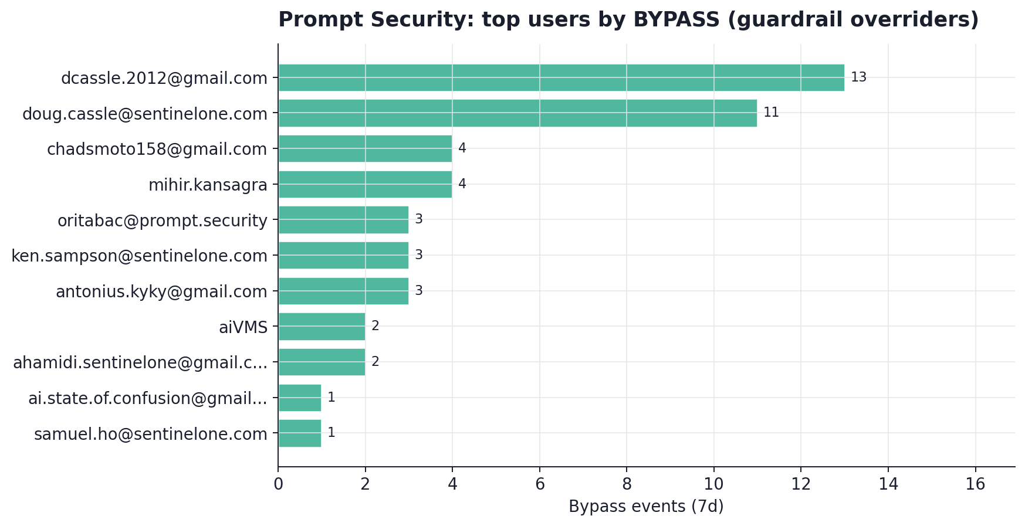
SECTION 5
Who is overriding guardrails
What to notice
■
50 bypasses across the window. Low-volume, high-signal.
■
Top overriders: dcassle.2012@gmail.com, doug.cassle@sentinelone.com. Cross-check endpoint posture for each.
■
Bypass is near-zero (0.13%). Users are accepting policy decisions. The cleanest possible trust signal.
SentinelOne + Prompt Security | 7d CTO review
7 / 11

Slide 8
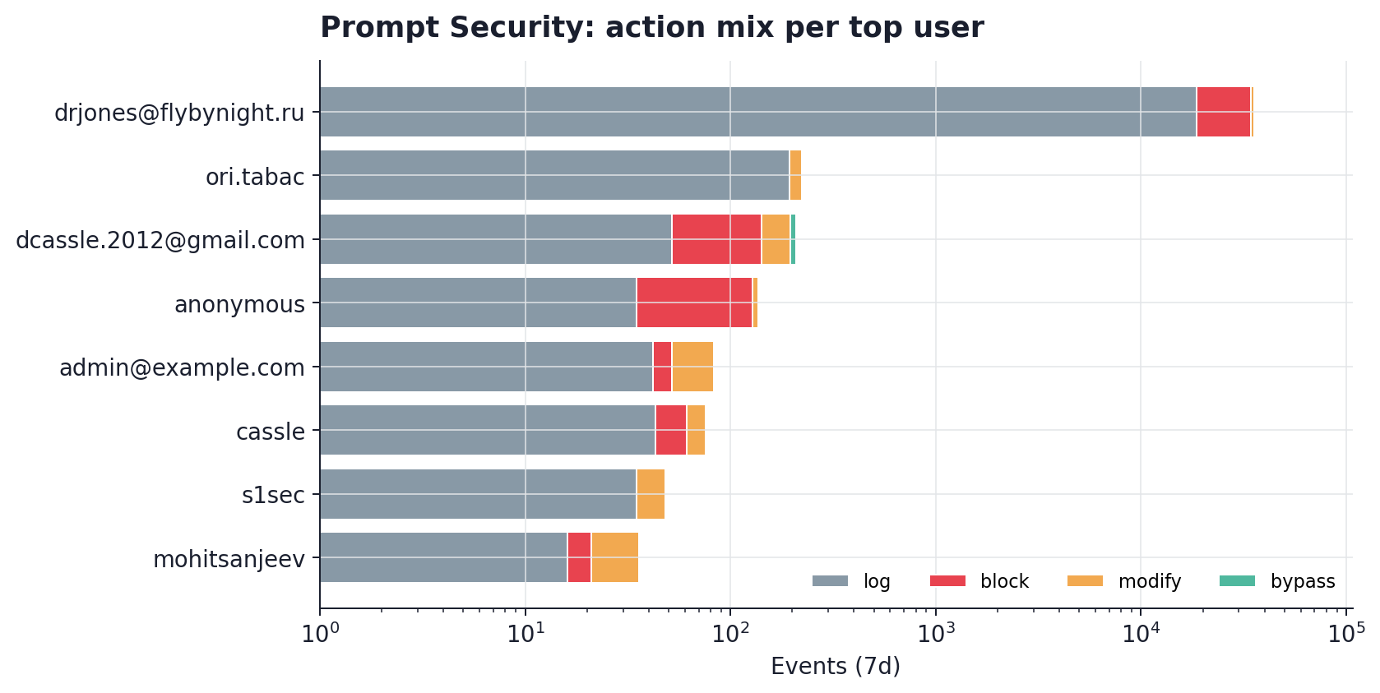
SECTION 6
Per-principal action mix
What to notice
■
Stacked action mix per top users. This is the fastest way to spot a mixed-use profile (blocked and allowed inside one session).
■
oritabac@prompt.security shows the clearest mixed-use profile (block:3, log:3, bypass:3, modify:2). Likely a real analyst probing the guardrails.
■
Use this chart to pick principals for policy feedback loops before the next re-run.
SentinelOne + Prompt Security | 7d CTO review
8 / 11

Slide 9
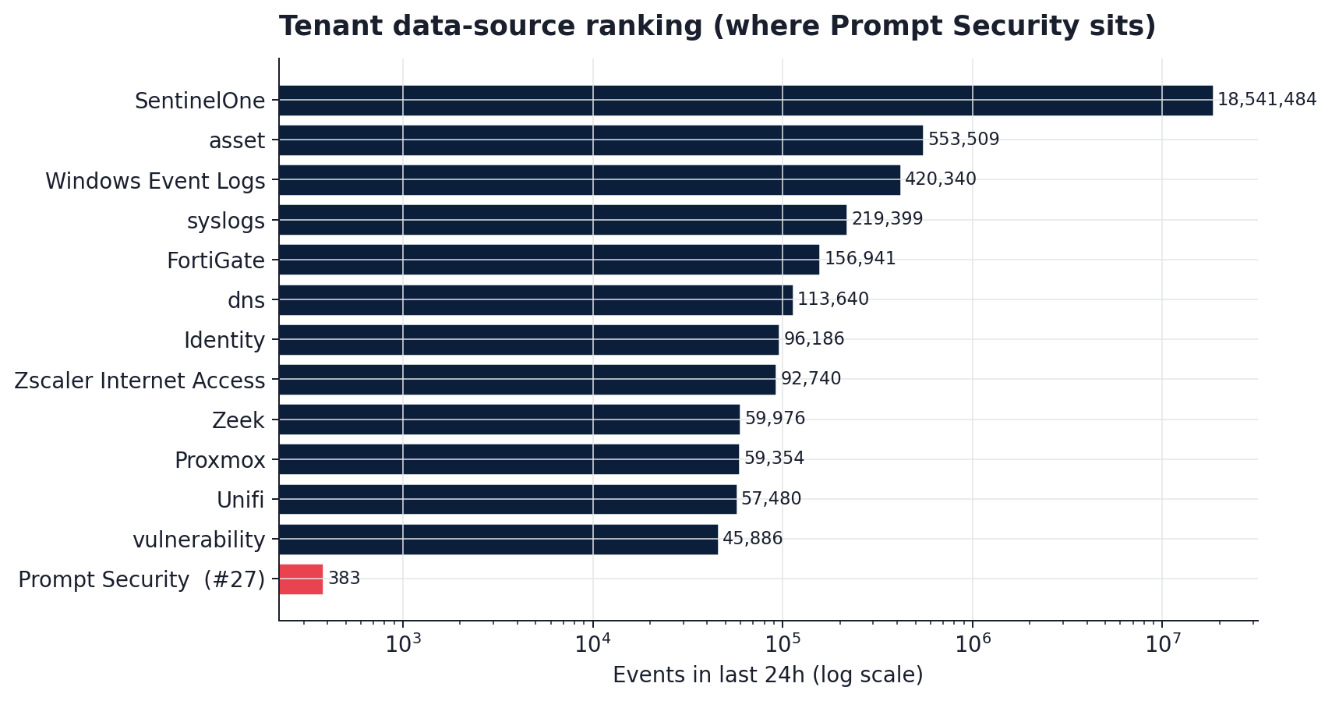
SECTION 7
Where Prompt Security sits in the broader tenant
What to notice
■
In the last 24 hours, Prompt Security ranks #27 among the data sources landing in this tenant.
■
Same data lake as SentinelOne EDR, identity, network, and cloud telemetry. Correlation is a PowerQuery join away.
■
As usage grows, Prompt Security's share of daily events climbs in rank with zero ingestion changes.
SentinelOne + Prompt Security | 7d CTO review
9 / 11

Slide 10
WHAT TO DO WITH THESE FINDINGS
Recommendations, prioritised
24 HOURS
THIS WEEK
Resolve drjones@flybynight.ru
Promote log-only policies to enforce
A single user drove 96.3% of the window. Pivot into EDR / identity from that session to establish harness vs. shared-account vs. abuse. Close the single largest risk in this report.
Block 42.9% and bypass 0.135%. That combination is as clean a trust signal as we get. Walk each log-only policy and flip the ones with zero false positives.
THIS MONTH
THIS MONTH
Correlate bypass with endpoint posture
Enrich ingestion where it is shallow
STAR rule: Prompt Security bypass THEN a SentinelOne alert of severity medium+ on the same principal within 60 minutes. One rule, two data sources, one unified alert.
Today, Prompt Security lands with a subset of fields populated. Add prompt / payload / content where possible; that unlocks content-based detections and Purple AI hunts across the same data lake.
SentinelOne + Prompt Security | 7d CTO review
10 / 11

Slide 11
NEXT STEPS
Resolve drjones@flybynight.ru, promote
log-only policy, enrich ingestion.
Everything in this deck is reproducible from a single JSON artefact.
Re-run any time the workload shifts.
Thank you. Questions?

