Slide 1
CTO REPORT | WINDOWS EVENT LOGS
24h of activity
under policy
What Windows Event Logs observed, what we intervened on,
and where SentinelOne takes the insight next.
Window 2026-04-21 to 2026-04-22 UTC
SentinelOne Pre-Sales Engineering
Data source dataSource.name = 'Windows Event Logs'
Generated 2026-04-22

Slide 2
24H SNAPSHOT
Executive summary
396,405
Windows Event Log C...
24
#3
Total events (24h)
Dominant event.type
Timeline slices
Tenant rank (24h)
Three things for the CTO to act on
Dominant event.type: 'Windows Event Log Creation'.
396,405 events (100.0% of the window). Use this as the entry point when building detections or hunts against the source.
Tenant rank #3 in the last 24h.
Windows Event Logs sits in the top tier of data sources landing in this tenant. A useful anchor for whether volume is trending or flat.
Same data lake as EDR + identity + network.
Any detection or hunt built on Windows Event Logs can join to SentinelOne endpoint context in one PowerQuery. No cross-system plumbing.
SentinelOne + Windows Event Logs | 24h CTO review
2 / 6

Slide 3
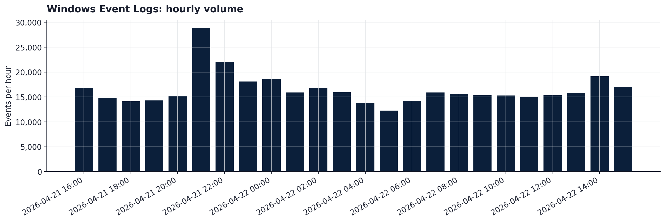
SECTION 2
Volume and timing
What to notice
■
Evenly distributed across the window. Busiest slice (2026-04-21 21:00) only 7.3% ahead of average.
■
Volume is the only lens available on Windows Event Logs today. Shape shifts in this timeline are the cleanest early warning for ingestion pipeline changes.
SentinelOne + Windows Event Logs | 24h CTO review
3 / 6

Slide 4
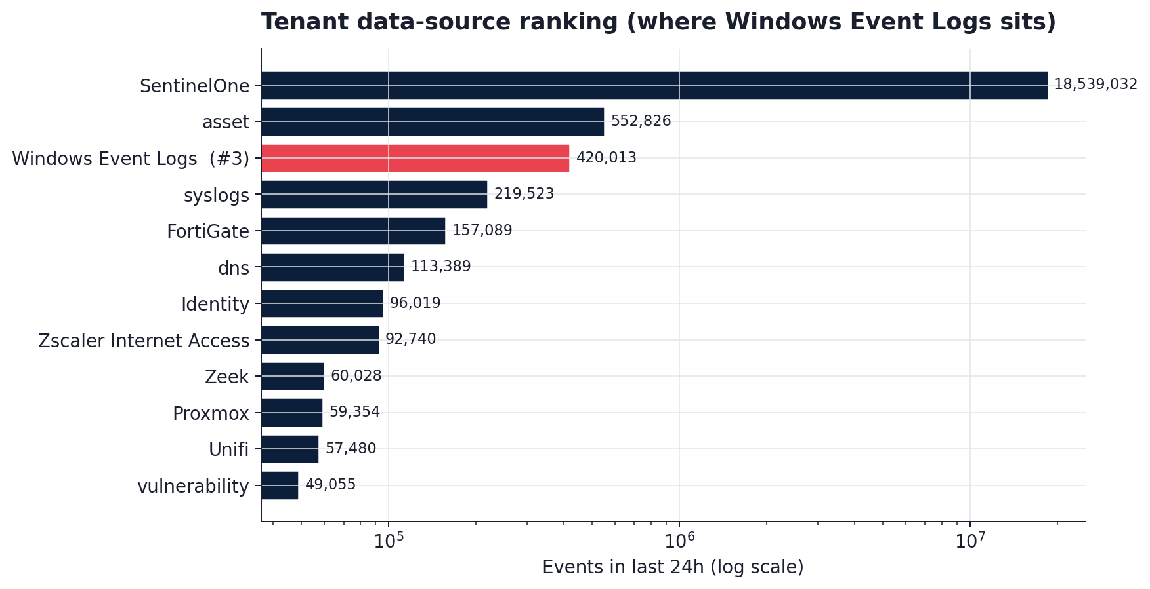
SECTION 7
Where Windows Event Logs sits in the broader tenant
What to notice
■
In the last 24 hours, Windows Event Logs ranks #3 among the data sources landing in this tenant.
■
Same data lake as SentinelOne EDR, identity, network, and cloud telemetry. Correlation is a PowerQuery join away.
■
As usage grows, Windows Event Logs's share of daily events climbs in rank with zero ingestion changes.
SentinelOne + Windows Event Logs | 24h CTO review
4 / 6

Slide 5
WHAT TO DO WITH THESE FINDINGS
Recommendations, prioritised
THIS MONTH
QUARTERLY
Enrich ingestion where it is shallow
Baseline normal
Today, Windows Event Logs lands with a subset of fields populated. Add prompt / payload / content where possible; that unlocks content-based detections and Purple AI hunts across the same data lake.
Re-run this report on a fixed cadence. Charts regenerate from a single JSON artefact, so 30- or 90-day views are a parameter flip. Anomalies feed the next round of tuning.
SentinelOne + Windows Event Logs | 24h CTO review
5 / 6

Slide 6
NEXT STEPS
Baseline Windows Event Logs, correlate with
endpoint, and re-run this report.
Everything in this deck is reproducible from a single JSON artefact.
Re-run any time the workload shifts.
Thank you. Questions?

