Slide 1
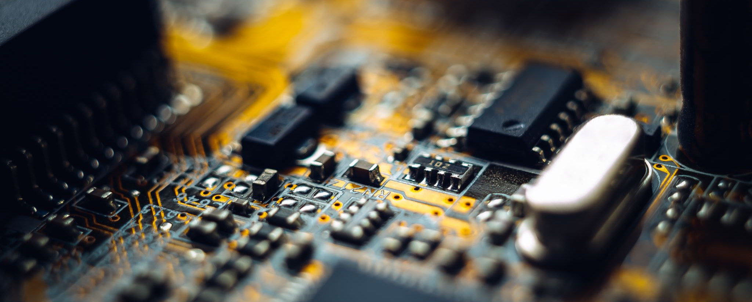
Project Bitcoin
describe the project scenario , requirements , what I understood by problem
what skill set do I need for this , what sort of resources
Give the project outline
Design explanation with various components
What I have covered and How can I Enhance this
Comments!!

Slide 2
Case Study
An Airflow Scheduler workflow to Insert Data on Mysql server
Will run every 10 minutes to Insert the data continuously on Mysql backend
A database to store the Information , In my case the database name is Bitcoin
A graphical frontend to display USD vs Bitcoin on regular Intervals
Generate alerts on task failures ( Step 1)
Secure the entire stack , containers and be ready to autoscale

Slide 3
What is Time Series DB
As the name suggests, time-series databases are designed to store data that changes with time. This can be any kind of data which was collected over time. It might be metrics collected from some systems - all trending systems are examples of the time-series data.
They can be a SQL DB or No sql , In our use case we have decided to go for Relationbal DB

Slide 4
Skill Set Required
A little understanding of how RDS DB work
Good understanding of developing and maintaining applications on Docker
Good understanding of AWS if want to scale the project and host on cloud platform
Good understanding of how data pipeline works in Airflow
Good Python Skills
Nice to have
Bash Knowledge , Admin unix skills etc .

Slide 5
Various Components
DB Server Mysql
Airflow Webserver
Production ready Python Scripts
Whole lot of Python Modules such as Matplot , numpy , requests etc
An AWS ECS stack for orchestration and advance handling of entire stack
Logging and monitoring tools if required

Slide 6
What we have covered
A timeseries DB “Bitcoin” showing continuous Data getting feed
Production ready Docker Containers running various components
A Front end Database to showcase the real time plot between USD and Bitcoin over a certain timeframe
An airflow server to schedule this in a Cron

Slide 7
How we can Enhance this
Secure the docker containers by using tools like Prometheus or Twistlock
An Advance Monitoring by using tools like Datadog etc
Advance Alerting system by using Cloud watch while launching stack on Amazon
A Production ready ECS Fargate setup running both the servers behind a AWS Elastic load balancer and Autoscaling Group for Advanced security and scaling

Slide 8
Comments!!!
They are Important Always !!

